Slide 1
Caring for Yourself While Caring for Others
Module 5: Tips for Maintaining Health and Safety
With Clients With Dementia
Presenter’s Name
Host Organization

Slide 2


Slide 3
Session Goals
Participants will be able to do the following:
Identify the health and safety risks of working with people with dementia.
Explain factors that contribute to clients with dementia becoming agitated and potentially dangerous
to themselves, workers, and others.
Discuss ways to be as safe as you can when working with clients with dementia.

Slide 4
Welcome and Introductions
Please tell us
Your name.
Your role in homecare.
How long have you been
working in homecare?
What do you know about dementia?
What do you know about its causes, symptoms, progression.
Photo
of Home
Care
Workers(s)

Slide 5
Understanding Dementia
Dementia is not a disease …
It is a set of symptoms that accompanies certain
diseases—most commonly Alzheimer’s—
or physical conditions that damage the brain.
There are more than 100 dementia-related illnesses.
Dementia can plateau, but it tends to be a progressive condition, worsening over time.

Slide 6

Symptoms of Dementia¹
Memory loss and disruption.
Challenges in planning and solving problems.
Difficulty completing familiar tasks and activities.
Confusion about time, place, and people.
Trouble understanding spatial relationships.
Photo by ®Thinkstock
¹Adapted from: 10 Early Signs and Symptoms of Alzheimer's, Alzheimer’s Association, www.alz.org

Slide 7
Symptoms of Dementia
Problems using words, speaking, or writing.
Misplacing things, losing ability to retrace steps.
Decreased or poor judgment.
Withdrawal from social or work activities.
Changes in mood and personality.

Slide 8

How Would You Feel and React?
Photo by ®Thinkstock
“They say other people will clean my house and make my meals. Those are my jobs! How can they act like I’m not capable of doing things? I hate having other people I don’t even know in my home! This is just wrong.”

Slide 9
Behaviors and Reactions That
Cause Health and Safety Risks
Clients try to do activities—such as walking, toileting, cooking, cleaning, hobbies—but they lack the balance, memory, or coordination to do them successfully. This puts people with dementia at greater risk of falls, burns, cuts, and other dangers.
Clients become agitated or angry at their own frustrations and confusions.
Clients may reject offered assistance they need.

Slide 10
Behaviors and Reactions That
Cause Health and Safety Risks
Clients may lash out—doing things such as hitting, kicking, biting, slapping, pushing, or shoving.
They may act out of poor impulse control, delusions,
or confusion—and they may make intimate or sexual overtures.
Clients may perseverate with ideas and questions— asking the same things over and over and over.

Slide 11

Responses That Can Increase Health and Safety Risks
Workers can provoke a response by:
Showing anger or frustration.
Trying to argue logically with
the person with dementia.
Speaking or yelling with an
angry tone.
Rushing a person with dementia.
Grabbing, slapping, or other physical actions.
Photo by ®Thinkstock

Slide 12
Worker Health and Safety Risks
With People With Dementia
Home emergencies due to risky behavior of clients.
Physical assault.
Stress, frustration, and hurt in response to irrational behavior and speech.
Grief, stress, and other powerful emotions in response to the “loss” of the person as known before the dementia progressed.

Slide 13
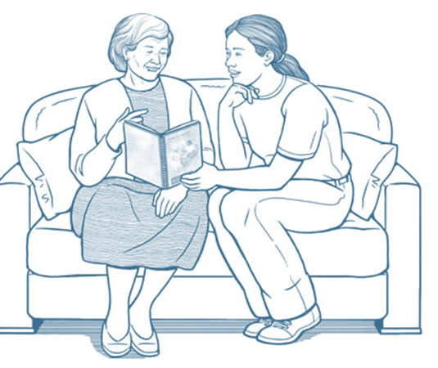
Areas to Focus on to Reduce
Health and Safety Risks
Keeping the physical environment and activities as safe as possible.
Physically interacting with people with dementia in ways most likely to keep them calm.
Promoting calm and positive verbal interactions.
Illustration by ®Mary Ann Zapalac

Slide 14
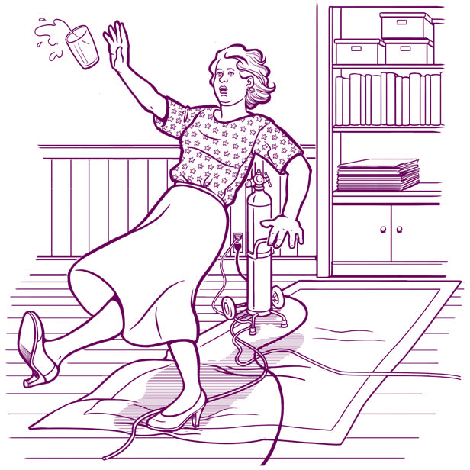
Keep the Physical
Environment as Safe as Possible
Reduce the risk of falls, trips,
and slips.
Reduce access to dangerous objects and activities.
Create a comfortable and soothing environment.
Illustration by ®Mary Ann Zapalac

Slide 15
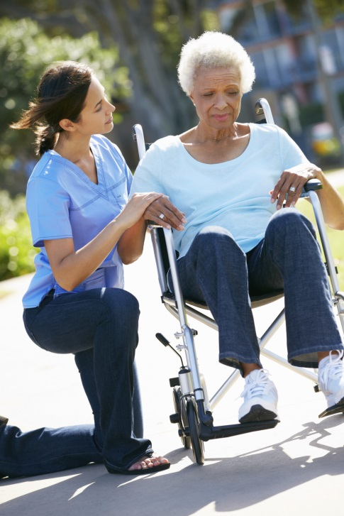
Keep Activities as Safe as Possible
Take it slow, at client’s pace.
Take one step at a time.
Speak simply and concretely.
Stay warm and encouraging.
Shift gears if client becomes fatigued or stressed.
Photo by ®Thinkstock

Slide 16

Physically Interacting to Help People With Dementia Be Calm
Slowly approach from the front.
Bend so you are eye-to-eye.
Look into people’s faces, make eye contact.
Call people by the names you learn they prefer.
Move to the side, give space.
Let them take your offered hand.
Be careful about touching.
Photo by ®Thinkstock
http://www.ready.gov/seniors

Slide 17
Promoting Calm and Positive Verbal Interactions
The “3Rs Strategy”
Respond—Assess and respond to emotions. Give a direct answer that won’t increase distress.
Reassure—Name the emotions or concerns they express. Show your own warmth and concern.
Redirect—Draw attention to activities or subjects that you know may be pleasantly distracting,
such as food, music, storytelling, or hobbies.

Slide 18

Positive Interactions
Using the 3Rs Strategy
In your small group, use
the 3Rs Strategy to respond
to your assigned scenario:
How would you Respond, Reassure, and Redirect?
What might a client say
in response?
Photo by ®Thinkstock
Prepare to present or role play your answers!
Notes:
18
Instructions: Review these techniques. When people get angry and agitated, it can be important to pay attention to the body in different ways. Explain that the goal is to meet the needs of the client while remaining safe as a caregiver.
Standing to the side of the other person: This protects the caregiver from a direct hit if the client is aggressive.
Standing with feet 18 inches apart: This offers the caregiver a balanced stance in case the client becomes aggressive.
Keeping a distance of 6 feet: Ask participants how they feel when someone suddenly invades “their space.” How close can a person, who for example does not know them well, get to them without making them feel uncomfortable? And, does this space need to be even farther apart when feeling threatened or emotional? Generally six feet is a safe distance, for our comfort as well as others.
Remove objects that could harm: When you remove the object at which the other person is directing emotions, you calm that person.
Keep client safe: Offer examples of “keeping the client safe,” which includes observing without touching and accompanying the client if he/she tries to leave, if you can, redirecting him/her away from dangerous areas, and calling on co-workers or the client’s friends/family, for help.

Slide 19
People With Dementia May
Become Physically Aggressive
This can happen for many reasons:
Pain or discomfort from physical conditions.
Stress in the environment, such as the level of noise, activity, other stimuli, or temperature.
Stressful interactions with others.
Delusions, paranoia, or other impacts of their dementia.
Notes:
19
Instructions: Review these techniques. When people get angry and agitated, it can be important to pay attention to the body in different ways. Explain that the goal is to meet the needs of the client while remaining safe as a caregiver.
Standing to the side of the other person: This protects the caregiver from a direct hit if the client is aggressive.
Standing with feet 18 inches apart: This offers the caregiver a balanced stance in case the client becomes aggressive.
Keeping a distance of 6 feet: Ask participants how they feel when someone suddenly invades “their space.” How close can a person, who for example does not know them well, get to them without making them feel uncomfortable? And, does this space need to be even farther apart when feeling threatened or emotional? Generally six feet is a safe distance, for our comfort as well as others.
Remove objects that could harm: When you remove the object at which the other person is directing emotions, you calm that person.
Keep client safe: Offer examples of “keeping the client safe,” which includes observing without touching and accompanying the client if he/she tries to leave, if you can, redirecting him/her away from dangerous areas, and calling on co-workers or the client’s friends/family, for help.

Slide 20
Responding When Clients
Pose a Health and Safety Threat
Stand safely—with feet 18 inches apart.
  Stand to the side of the client.
  Keep a distance of 6 feet, if possible.
Keep client as safe as possible.
  Remove objects that could harm the client.
  Accompany the client—without touching.
Call for help.
Notes:
20
Instructions: Review these techniques. When people get angry and agitated, it can be important to pay attention to the body in different ways. Explain that the goal is to meet the needs of the client while remaining safe as a caregiver.
Standing to the side of the other person: This protects the caregiver from a direct hit if the client is aggressive.
Standing with feet 18 inches apart: This offers the caregiver a balanced stance in case the client becomes aggressive.
Keeping a distance of 6 feet: Ask participants how they feel when someone suddenly invades “their space.” How close can a person, who for example does not know them well, get to them without making them feel uncomfortable? And, does this space need to be even farther apart when feeling threatened or emotional? Generally six feet is a safe distance, for our comfort as well as others.
Remove objects that could harm: When you remove the object at which the other person is directing emotions, you calm that person.
Keep client safe: Offer examples of “keeping the client safe,” which includes observing without touching and accompanying the client if he/she tries to leave, if you can, redirecting him/her away from dangerous areas, and calling on co-workers or the client’s friends/family, for help.

Slide 21
Thanks for participating!
Additional Resources:
Alzheimer’s Association’s “Dementia Care Practice Recommendations for Professionals Working in a Home Setting, Phase 4.” http://www.alz.org/national/documents/phase_4_home_care_recs.pdf

Slide 22
Credits
[Insert trainer and/or training organization’s name(s), and contact information here.]

