Slide 1

Indices of ED crowding
Stephen Pitts MD, MPH
Emory University
Department of Emergency Medicine

Slide 2

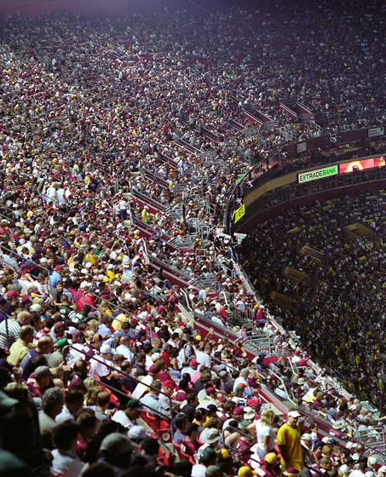

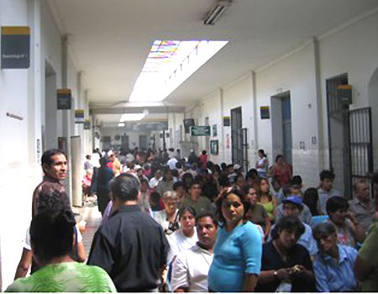
Crowding: items per m²

Slide 3
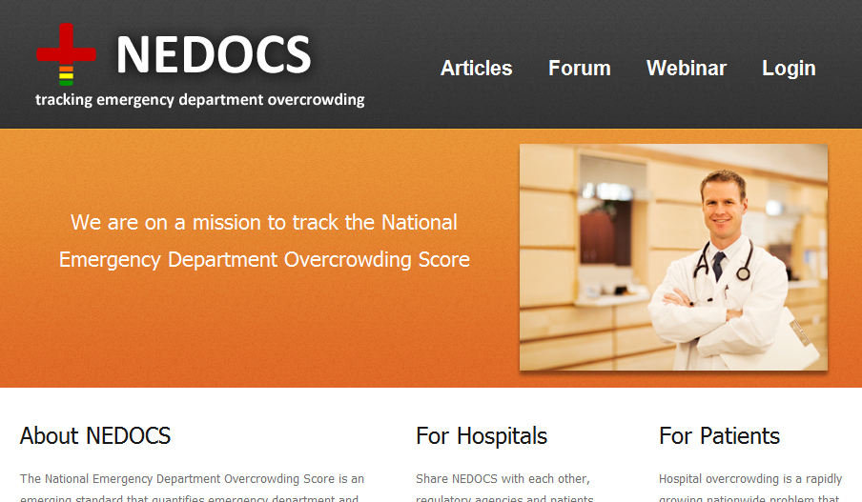
Why measure crowding?
Prevent adverse outcomes in real time
  Adverse outcomes: delays, morbidity, mortality
    Proxy outcomes:
      Waiting time
      Ambulance diversion
      LWBS rate (Left without being seen)
  Alarm bell function: call in backup
  Crowding indices that use realtime ED flow tracking
    EDWIN: ED work index
    READI
    NEDOCS: proprietary system
    ED work score

Slide 4
Why measure crowding nationally?
Measure system performance
  Evaluate temporal trend
    EDs are “canary in coalmine” for healthcare system
  Compare EDs (benchmarking)
    Practice variation = inequity in cost, quality
    Marketing = product differentiation

Slide 5
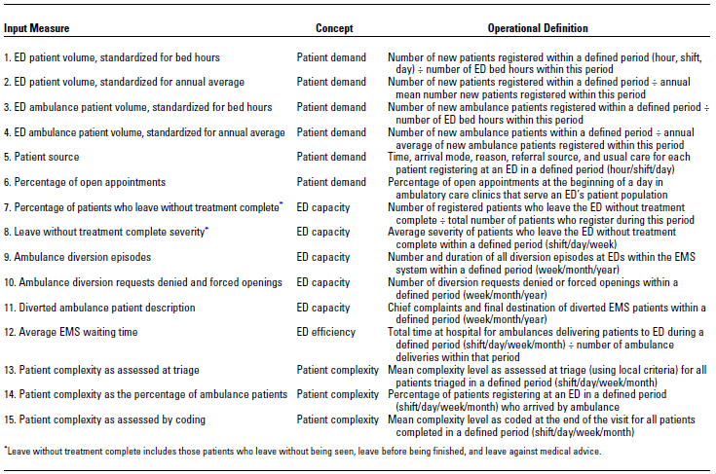
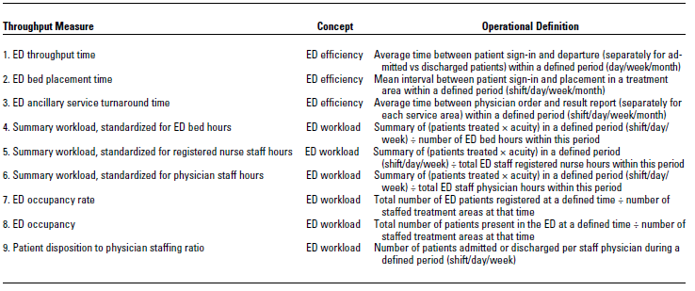
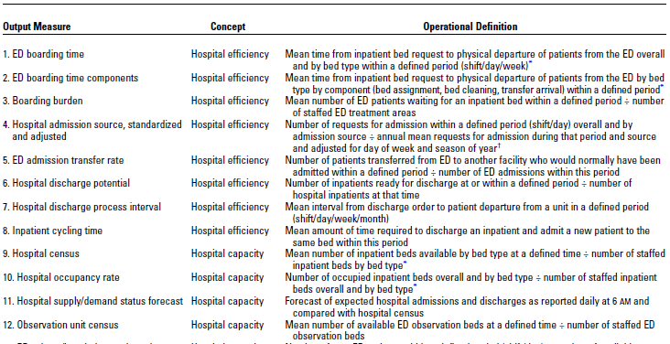
Many other potential indices
Ann Emerg Med. 2003;42:824-834

Slide 6
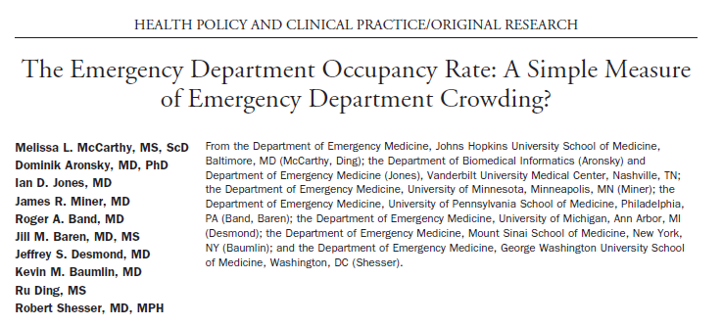

ED occupancy rate:
As good as the ED work index (EDWIN)

Slide 7
Calculating occupancy in NHAMCS-ED public use data
Not available:
  Staffing levels
  ED bed availability
  Hospital bed availability
  Date of visit (only month, day of week)
Available since 2001:
  Time of arrival
  Length of visit in minutes

Slide 8
National ED arrivals vs. occupancy
(2001-2007 NHAMCS-ED surveys combined)
Error bars are 95% confidence intervals

Slide 9
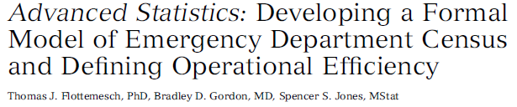
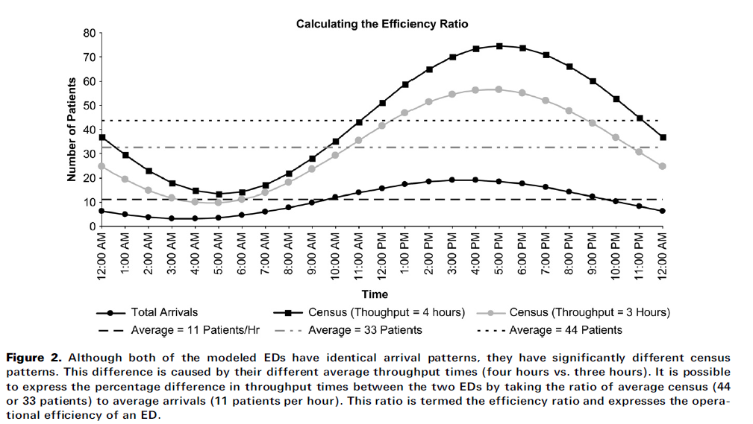
occupancy

Slide 10
National ED arrivals vs. occupancy
(2001-2007 NHAMCS-ED surveys combined)
Mean occupancy
Efficiency ratio =
12/38 = 0.32
Mean arrivals
Error bars are 95% confidence intervals

Slide 12
Problems with occupancy
No national denominator (# of treatment spaces)
  # of spaces probably decreased nationally 2001-2007
  Underestimates crowding trend
Time of discharge = problematic item
  Actual ED departure harder to get than time of admission
  Underestimates boarding, crowding
Occupancy is an ED-level characteristic
  NHAMCS-ED surveys 350+ EDs
  ED identity and characteristics are masked
  Avg 100 surveys per ED annually
    Too few for ED-specific occupancy/efficiency estimate
Solution: proxy for crowding = length of visit
  Patient-level analysis

