Slide 1
Surveillance Data for Heart Disease And Stroke Prevention: A Clinician Educator’s Perspective
Charles K. Francis, MD, MACP, FACC

Slide 2
Age-adjusted death rates for CHD, stroke, lung and breast for white and black females (United States: 2006). Source: NCHS.

Slide 3
CVD disease mortality trends for males and females (United States: 1979-2006). Source: NCHS and NHLBI.

Slide 4
Percentage breakdown of deaths from cardiovascular diseases (United States: 2006) * - Not a true underlying cause. Source: NCHS.

Slide 5
Hospital discharges for coronary heart disease by sex
(United States: 1970-2006). Source: NHDS/NCHS.
Note: Hospital discharges include people discharged alive, dead, and status unknown.

Slide 6
Annual rate of first heart attack by age, sex and race. (ARIC Surveillance:1987-2004). Source: NHLBI.

Slide 7
Trends in Cardiovascular Operations and Procedures (United States: 1979-2006). Source: NCHS and NHLBI.
Note: In-hospital procedures only.

Slide 8
A B C D E F
Systolic BP* 95-105 130-148 130-148 130-148 130-148 130-148
Diabetes No No Yes Yes Yes Yes
Cigarettes No No No Yes Yes Yes
Prior Atrial Fib. No No No No Yes Yes
Prior CVD No No No No No Yes
*Closest ranges for women are: 95-104 and 115-124.
Estimated 10-year stroke risk in 55-year-old adults according to levels of various risk factors (FHS). Source: Wolf et al., Stroke.1991;22:312-318.

Slide 9
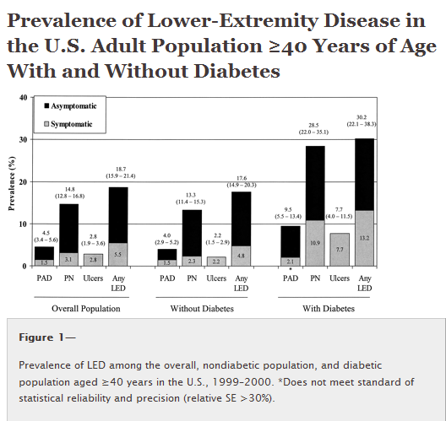

Slide 10
Prevalence of Physician Diagnosed Type 2 diabetes in Adults age 20+ by Race/Ethnicity, and Years of Education (NHANES: 2003-2006). Source: NCHS and NHLBI. NH – non-Hispanic.

Slide 11
Diabetes Awareness, Treatment and Control (NHANES: 2003-2006). Source: NHLBI.

Slide 12
Age-adjusted prevalence trends for high blood pressure in Adults age 20 and older by race/ethnicity, sex and survey (NHANES: 1988-94, 1999-02 and 2003-06). Source: NCHS and NHLBI. NH- non-Hispanic.

Slide 13
Extent of Awareness, Treatment and Control of High Blood Pressure by Race/Ethnicity and Sex (NHANES: 1999-2006). Source: NCHS and NHLBI.

Slide 14
Trends in mean total serum cholesterol among adolescents ages 12-17 by race, sex, and survey (NHANES: 1976-80, 1988-94, 1999-02, 2003-04, and 2005-06). Source: NCHS and NHLBI.

Slide 15
Age-adjusted prevalence of obesity in Adults ages 20-74 by sex and survey. (NHES, 1960-62; NHANES, 1971-74, 1976-80, 1988-94 and 2003-2006). Source: Health, United States, 2008. NCHS.
Note: Obesity is defined as a BMI of 30.0 or higher.

Slide 16
Prevalence of regular leisure-time physical activity among adults age 18 and older by race/ethnicity, and sex. (BRFSS: 2001 and 2005). Source: MMWR, 2007;56:No. 46. NH – non-Hispanic.

Slide 17
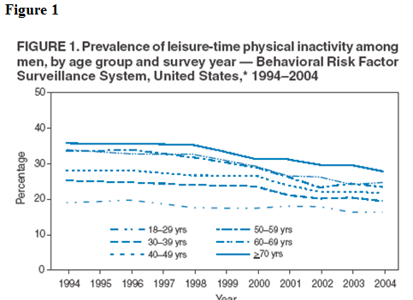

Slide 18
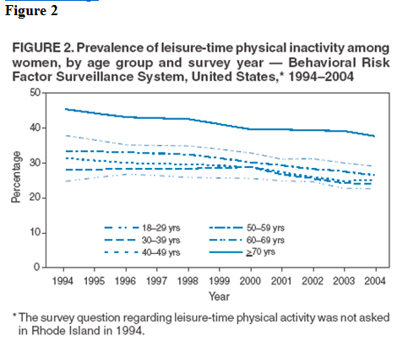

Slide 19
Issues In Cardiovascular Health
Race/ethnic admixture
Acculturation
Birthplace,
Built environment
Diet (salt, DASH diet)
Insurance coverage
Language
Geography: urban-rural, neighborhood, city, state
Legal and regulatory policies
Education
Income
Religion
Health beliefs and attitudes
Medication non-adherence
Pharmacogenomics

Slide 20
Socioeconomic Issues
Lower socioeconomic ranks
Lower quality schools
Poorer paying jobs
Mortgage lending denials
Employment and housing discrimination
Prior beliefs (clinical uncertainty relating to age, gender, socioeconomic status, and race or ethnicity)
Bias against certain groups (e.g. immigrants)
Beliefs (Stereotypes) held by the provider and patients
Patient mistrust and resistance

Slide 21
Cardiovascular Surveillance
Longitudinal data:
Impact of educational programs
Attainment of risk factor targets
Assessment of diagnostic technology
Performance indicators of quality
Clinical outcomes of therapeutic interventions
Adoption of electronic health record (EHR)
Changes in prevalence and incidence of CVD
Standard definitions of data
Linkage of national, state and local data
Feed back to clinicians
Feedback to patients

Slide 22
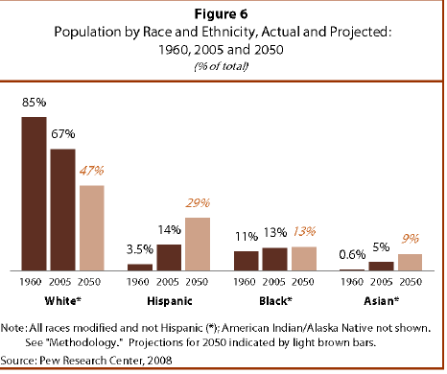

Slide 23
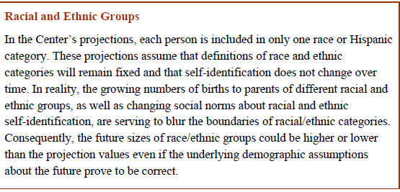
US Population Projections: 2005-2050. Jeffrey S. Passel, D’Vera Cohn
Pew Research Center. Social and Demographic Trends. February 2008

Slide 24
The Association Between Birthplace and Mortality From Cardio-vascular Disease Among Black and White Residents of NYC* (1)
Methods: Mortality data for blacks born in the U.S. South, the Northeast and the Caribbean were compared with those for whites born in the Northeast.
Results: (1) Overall rates of mortality from CVD: blacks>white; (2) Persons born in the Northeast: CVD death rates similar for white men versus black men and white women versus black women. (3) Southern-born black men and women had higher mortality rates than their black counterparts born in the Northeast. (4) Caribbean-born blacks had mortality rates lower than their black counterparts born in the Northeast.
*Fang J, Madhavan S, Alderman MH. N Engl J Med, 1996 Nov 21;335(21):1545-51

Slide 25
The Association Between Birthplace and Mortality From Cardio-vascular Disease Among Black and White Residents of NYC*(2)
Results (continued)
Black men born in the South had death rates 30 percent higher than Northeastern-born blacks and four times that of Caribbean-born blacks of the same sex and age.
Higher rates of CVD mortality among blacks compared to whites masks substantial variation among blacks based on birthplace.
*Fang J, Madhavan S, Alderman MH. N Engl J Med, 1996 Nov 21;335(21):1545-51

Slide 26
2010 Census Questionnaire
Hispanic Identity:
Is this person of Hispanic, Latino or Spanish origin?
No, not of Hispanic, Latino or Spanish origin
Yes, Mexican, Mexican Am. Chicano
Yes, Puerto Rican
Yes, Cuban
Yes, another Hispanic, Latino, or Spanish origin
*Population Reference Bureau: http/www.prb.org/Articles/2009/2009/questionnaire.aspx

Slide 27
2010 Census Questionnaire
-What is the person’s race?: White, Black, African Am or Negro, American Indian or Alaska Native
-Asian Indian, Chinese, Filipino, Japanese, Korean, Vietnamese, Native Hawaiian, Guamanian or Chamorro, Samoan, Other Pacific Islander
-Other Asian: (print race: e.g. Hmong, Laotian, Thai, Pakistani, Cambodian and so on.
-Some Other Race (print race)
*Population Reference Bureau: http/www.prb.org/Articles/2009/2009/questionnaire.aspx

Slide 28
Heterogeneity Within Racial and Ethnic Groups
The Asthma Example:
Prevalence and mortality of asthma is highest in Puerto Ricans, African Americans, Filipinos and Hawaiians.
Prevalence is lowest in Mexicans and Koreans
Albuterol response lower in Puerto Ricans vs. Af Am.
Genetic Admixture and Ancestry
African American ancestry is on the average 20% European and 80% African.
Latino populations are descendents of European, Native American and African ancestors. The average proportion of these ancestral populations varies between Latino subgroups and among individuals within the same group
*Drake KA, Galanter JM, Burchard EG. Race, ethnicity and social class and the complex etiologies of asthma. Pharmacogenomics 2008. 9(4);453-462

Slide 29
Berkman LF. Social epidemiology: social determinants of health in the United States: are we losing ground? Annu Rev Public Health. 2009 Apr 29;30:27-41.
Clinical Adaptation: We conclude that more attention needs to be devoted to (a) identifying the correct etiologic period within a life-course perspective and (b) understanding the dynamic interplay between preventive, diagnostic and therapeutic interventions and outcomes and the genetic, clinical, social, economic, and environmental contexts in which interventions are delivered

Slide 30
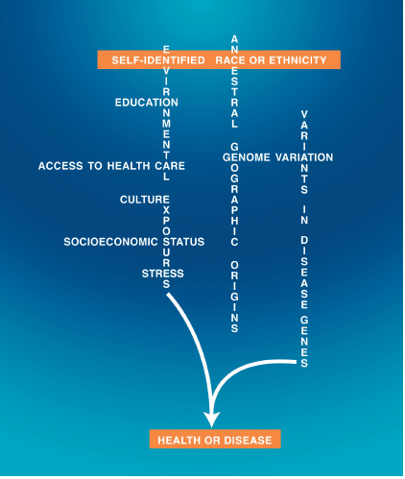

Slide 31
Thank you for your attention

