Slide 1
Health, United States Academic and Policy Perspectives
Judith A. Shinogle, PhD
University of Maryland, Baltimore County
August 18, 2010

Slide 2
Where I am going…
Academic Perspective:
Courses
Students
Grants, Research and Papers
Policy Perspective
Issue Briefs
Estimates
Issues Identification

Slide 3
Academics Course Preparation
Introduction to Health Care System
Health Economics
Health Policy
Statistics
Health Behavior/Psychology
Pharmacy Administration
Epidemiology

Slide 4
Academics Course Preparation
Why?
Saves time!!
Love excel links and charts
Trends
Issues
examples

Slide 6
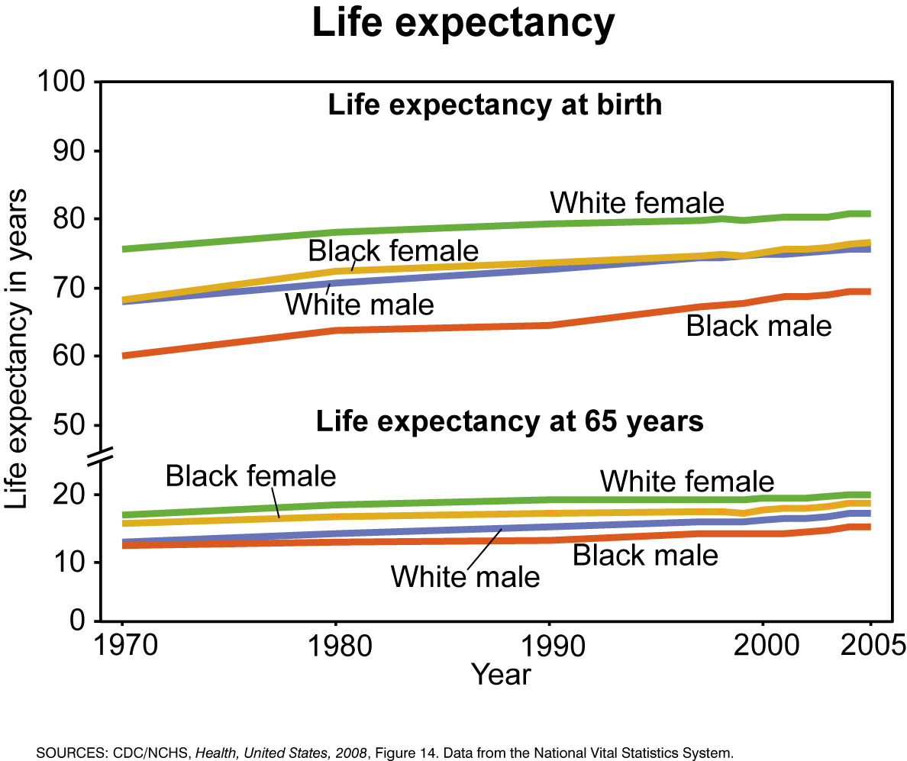
Notes:
Male female differences largely attributed to men’s early adoption of smoking -> deaths due to heart disease and lung cancer. Black-white -> heart disease, cancer, homicide. Health disparities between blacks and the general population have been attributed to less access to health care and to health-care coverage.

Slide 7
Academics Student Projects
Thesis ideas and preparation
Discussion modules
Statistics
Leadership – develop a health care system

Slide 8
Academics Grant Preparation/Papers/Research
Basic statistics
Overview of issue
Potential areas of research

Slide 9
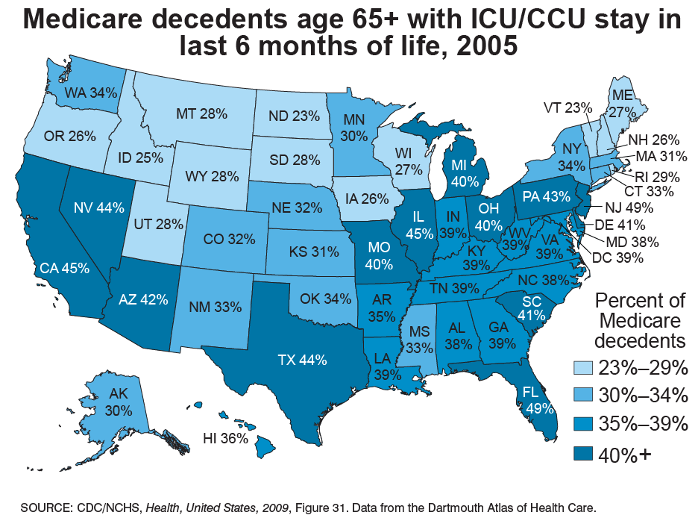

Slide 10
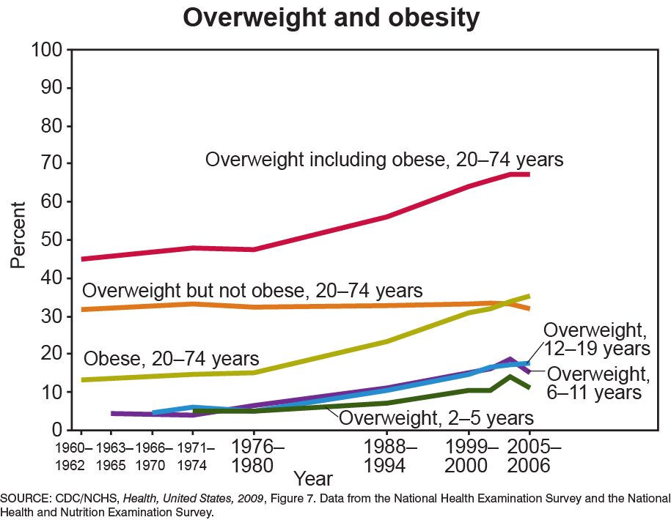

Slide 11
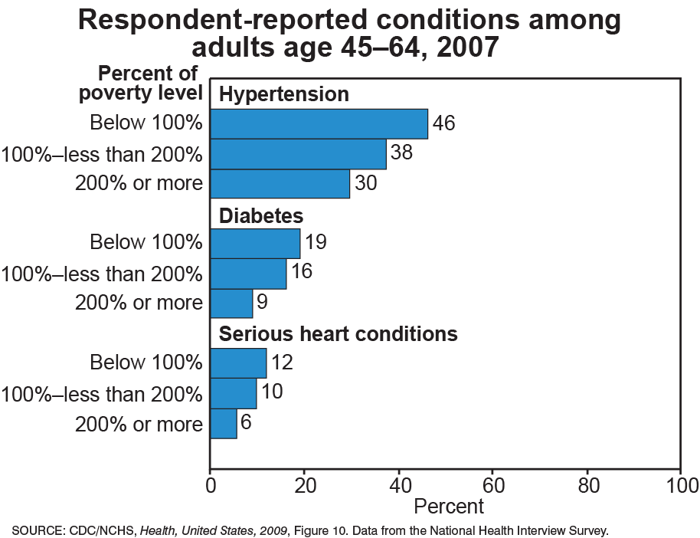

Slide 12
Policy
Issue Briefs- background
Estimation
Potential Issues

Slide 13
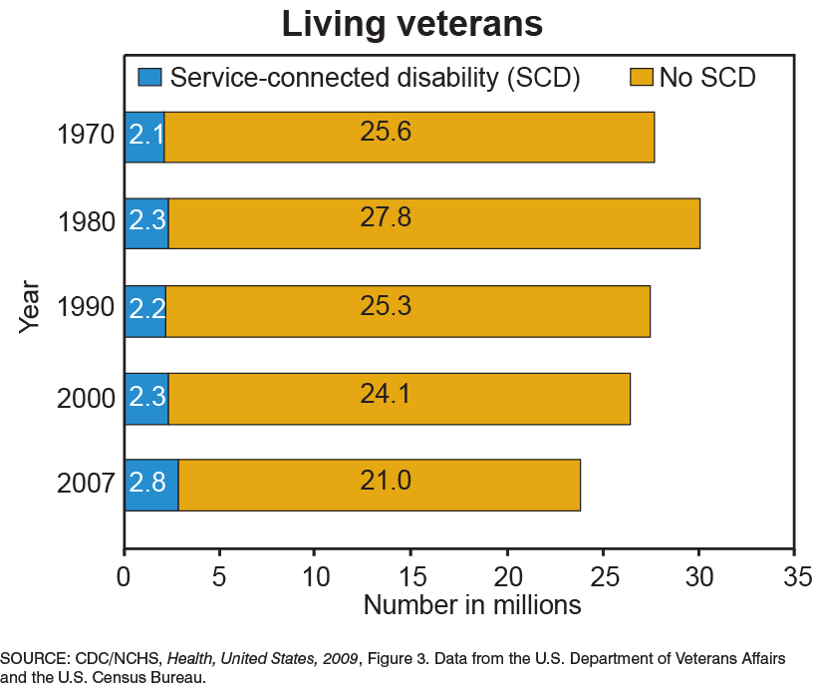

Slide 14
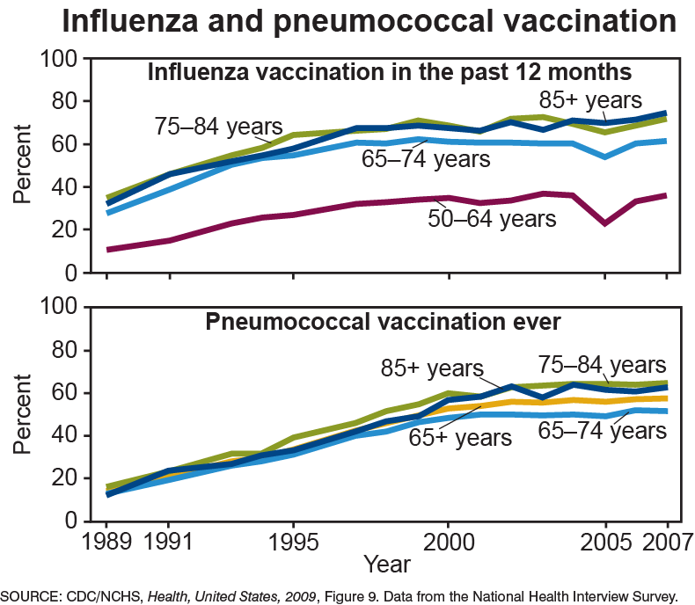

Slide 16
Positives
Online version
Excel spreadsheets
Charts
Trends
Older products available
Special Issues

Slide 17
What Could be Improved?
Hard to search, locate
State information or comparators
Trend changes
Data or is it Real?
Appendix gets lost
Special Issues
Hard to find?
Can they rotate?
Collapse together?

Slide 18
What Could be Improved?
Marketing of the information to:
Academics:
Links in professional journals or association newsletters
Special listserve or emails to educators
Modules on issues
Policy:
Push information through formats – Press Briefs, Facebook, Twitter
Target information services – CRS, GAO, CBO
Listserve?
Small bits of information – In Brief is a good start

