Slide 1

Use of Federal Surveys for
State Policy Analysis
National Conference of Health Statistics
August 16, 2010
Washington, DC
Lynn A. Blewett, PhD
State Health Access Data Assistance Center (SHADAC)
University of Minnesota, School of Public Health
Funded by a grant from the Robert Wood Johnson Foundation

Slide 2
Overview of presentation
Making the case: Need for state-level estimates
Data requirements for state estimates
ACS vs. CPS vs. IHIS for insurance coverage
Comments on today’s presentations
Conclusion

Slide 3
Making the care: State Data Need

Slide 4
State need for data (1)
Implementation of access provisions in health reform
  Medicaid expansion
  State insurance exchange and regulation
  Possible public plan implementation at the state level
  Implementation of insurance regulations including young adult dependent coverage
CHIP reporting requirements
  Annual state reports to CMS on progress in reducing number of uninsured children

Slide 5
State need for data (2)
Effectively target outreach,enrollment,and safety net strategies
  Insurance status, age, location, income, race/ethnicity
Budget and forecasting activities
  Inputs to forecasting models based on expansion or contraction activities
  Distribution formulas for state funds to localities
Evaluation/Monitoring of Affordable Care Act

Slide 6
State data requirements
State representative sample;
Large enough sample and sample coverage that provides for reliable estimates for subpopulations including; low-income children, race/ethnic groups and geographic areas such as county or local region;
Timely release of data including tabulated estimates of released within one year of data collection; and
Access to micro-data through readily available public- use files with state identifiers to allow states do conduct their own analysis and policy simulations.
Source: (Blewett et al, JHPPL 2004)

Slide 7
State Health Insurance Survey Activity
2001-Present
*Alabama, ‘03
Alaska, ‘04, ’05, ‘06-’07, ‘08
Arkansas ‘01, ‘04
California ’01, ’03, ‘05, ’07, ‘09
*Colorado ‘01, ‘08-’09
*Connecticut ’01, ‘04, ’05, ‘06
Florida ‘03, ‘04
*Georgia ‘02
Hawaii ’03
Idaho ‘05
Illinois ‘01
*Indiana ‘03
Iowa ’01, ‘05, ‘07
Kansas ‘01, ‘06
Kentucky ‘05
Louisiana ’03, ’05, ’07, ‘09
*Maine ‘01, ‘02, ‘05, ‘06
Maryland ’01, ‘04
*Massachusetts ‘02, ‘04, ‘06-07, ‘07, ‘08
Michigan ’05
*Minnesota ‘01, ‘04, ‘07, ‘09
*Missouri ’04, ’07
Mississippi ’03-’04
*Montana ‘03, ‘07
*Nebraska ‘04, ‘07
New Hampshire, ‘01
New Jersey ‘01, ‘02, ‘03, ’04-’09
New Mexico ‘02, ’04
*North Dakota ‘04, ‘07
Ohio ‘03-’04, ‘08
*Oklahoma ’03, ’04, ‘08
Oregon ‘01, ‘02, ‘04, ‘06
*Pennsylvania ‘04, ‘08, HMPC (‘00-’08)
Rhode Island ‘01, ‘04
*South Carolina ’03
South Dakota, ‘01, ‘04, ‘07
*Tennessee ‘05
Texas ‘01, ‘02
Utah ‘01, ‘03, ‘04, ‘05, ‘07, ‘08
Vermont ‘05, ‘08
*Virginia ‘01, ‘04
Washington ’00, ‘02, ‘04, ‘06, ‘08
*West Virginia ‘01, ’03, ‘07
Wisconsin ’01, 02, ‘03, ‘04,
‘05, ‘06, ‘07, ’08, ‘09
*Wyoming ’02
NONE:
Arizona
Delaware
Nevada
New York (enrollment surveys)
North Carolina
17 states with ongoing surveys
* 19 states used the CSCS
Source: http://www.shadac.org/content/state-survey-research-activity

Slide 8
A few points on state surveys
Most are RDD telephone surveys but lead states are moving to Dual Frame with cell-phone samples
  24.5% of HH were cell-phone only (‘09)
  Cell phone-only households are significantly more likely to lack health insurance compared to HH with landline telephone service
Most states account for coverage error due for HH without phone service through a weighting adjustment
  Similar adjustments for cell-phone HH have yielded mixed results
Concern about declining response rates on RDD surveys
State surveys have 24% fewer uninsured than CPS
Source: Call et al, Health Affairs, 2007

Slide 9
Comparisons of key federal surveys and state surveys

Slide 10
Methods – federal survey comparisons
2008 ACS and 2009 CPS data come from publically available micro-data files provided by the Census Bureau
2008 NHIS data come from published tabular data
Uninsurance is defined in all surveys as lacking any public or private coverage in CY 2008
The ACS and NHIS use a point-in-time measure and the CPS uses an all-year measure
Standard errors in ACS and CPS were created using the replicate weight methodology suggested by Census.

Slide 11
Sample size comparisons
 | All Ages
State (Survey Year) | ACS |  | CPS |  | State Survey
CA (07)† | 339,381 |  | 19,836 |  | 64,599
CO (08-09)† | 47,803 |  | 4,402 |  | 10,090
NJ | 85,393 |  | 4,629 |  | 7,336
MA (08)† | 63,688 |  | 3,173 |  | 12,235
MN (09)† | 52,144 |  | 4,666 |  | 12,031
OH‡ | 114,426 |  | 5,417 |  | 50,944
OK (08) | 36,704 |  | 2,974 |  | 5,729
PA (08) | 122,337 |  | 6,151 |  | 49,345
VT | 5,924 |  | 2,717 |  | 9,237
WI (07) | 57,157 |  | 3,913 |  | 6,857
†: Sample based on dual-frame.
Notes:
ACS mostly dominates – accept for some states… VT state sample of 9.237 trumps ACS and CPS for all ages and kids…..

Slide 12
ACS vs CPS state perspective
Positive:
-Large sample size, geographic coverage, annual estimates, public-use files
-Imputation done in each state independently
-Point-in-time coverage questions
-Ask coverage about each person in HH
Negative:
-Lack of state add-in names
-Different estimates and unfamiliar from the CPS and state surveys
-No additional health status or access questions
Notes:
The ACS also uses an area probability design and captures data through a mail survey, with telephone followed by and in-person surveys for non-respondents.

Slide 13
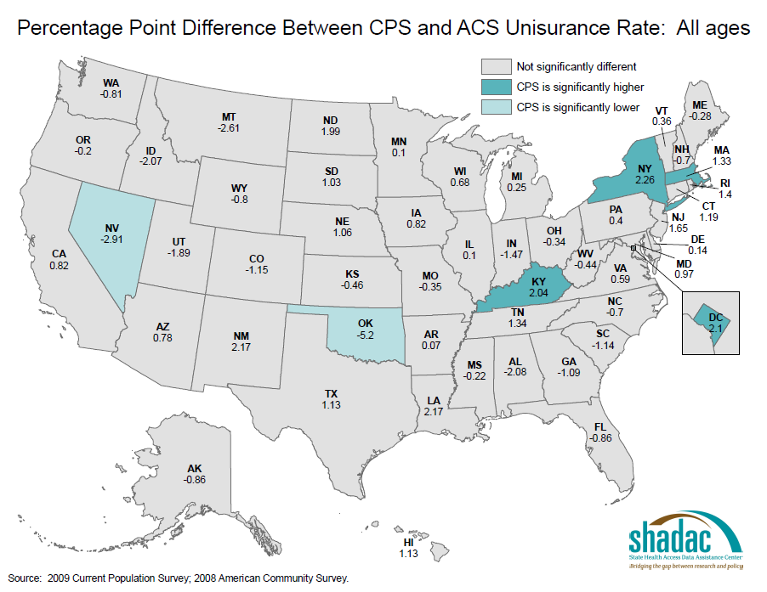
Notes:
Three states CPS is significantly higher – NY, RI, KY
Two states CPS is significantly lower – OK, NV

Slide 14
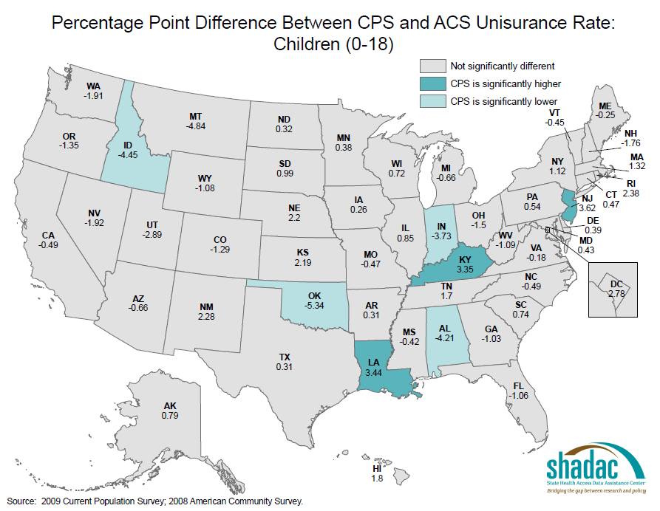
Notes:
3 states significantly higher (KY, NJ, LA)
4 states significantly lower (ID, OK, AL, IN)

Slide 15
National Health Interview Survey
The NHIS publishes health insurance coverage estimates for 20 selected states each year
  AZ, CA, FL, GA, IL, IN, MD, MA, MI, MO, NJ, NY, NC, OH, PA, TN, TX, VA, WA, WI.
Smallest geographic identifier available on public-use micro-data is the census region
  Limits state-level or subpopulation analysis
Data users wanting state-level analysis must obtain access to state identifiers in NCHS RDCs
  Only those with enough sample and sample coverage as determined by NCHS
Rich health-related data source, good point-in-time health insurance question,

Slide 16
Integrated Health Interview Survey (IHIS)
NICHD-funded project to harmonize 30 years of the NHIS
13,000 harmonized variables, recent August 2010 release of 5,000 integrated and documented variables; 7,000 in November
Ability to link IHIS to state identifiers in NCHS RDCs…SHADAC developing data resource for states
http://www.ihis.us/ihis/

Slide 17
Comparison of Estimates of Uninsurance by
Federal Survey Source, All Ages (sorted by ACS)
Five lowest
states
Source: 2009 CPS-ASEC and 2008 ACS data are from public use data. NHIS data collected from published reports.

Slide 18
Comparison of Relative Standard Errors for Estimates of Uninsurance by Federal Survey Source, All Ages
Source: 2009 CPS-ASEC and 2008 ACS data are from public use data. NHIS data collected from published reports. Relative standard errors defined as the standard error divided by its mean.
Notes:
Range of relative standard errors – not always the smallest states with the smallest standard errirsp NHIS has highest standard errors, ACS has lowest

Slide 19
Comparison of Relative Standard Errors for Estimates of Uninsurance by Federal Survey Source, Children (0-17)
Source: 2009 CPS-ASEC and 2008 ACS data are from public use data. NHIS data collected from published reports. Data is missing in MA for NHIS due to small sample sizes. Relative standard errors defined as the standard error divided by its mean.

Slide 20
Comments on presentations

Slide 21
Creative use of federal survey data (1)
MEPS pooled state sample in the RDC (Cunningham) – OOP Costs
  Potential use of pooled data files or pooled estimates created annually on key variables
  Difficult for state analysts to do on their own
  Difficult to detect significant change over time
Two-stage estimation (Graven) – Chronic Conditions
  Relative comparisons across states interesting
  Difficult to track trends over time
  Methodologically cumbersome

Slide 22
Creative use of federal survey data (2)
NHIS: Analysis of larger states with enough sample size and sample coverage (Long) health insurance coverage
  Important comparative analysis of different policy strategies
  Only applicable for larger states with enough sample
  Limited understanding of trends in large states with small populations

Slide 23
Conclusion

Slide 24
Federal survey capacity
Each federal survey has unique purpose and provides important national estimates of key policy variables
States cannot afford the ability to field multiple surveys to meet all of their needs
Researchers demonstrated creative methods to develop and compare state estimates of key policy variables
  Not done routinely nor consistently
Still difficult to know what is working and where

Slide 25
Two potential options…….
Expand sample size and sample coverage for key federal surveys to produce reliable state-estimates of policy variables of interest
  - NHIS for coverage, health status, health conditions, MEPS for cost and utilization
Build a state-level data collection infrastructure to inform national monitoring of the affordable care act
  Could be a sub-group of states building off existing state surveys
  Early indicators of reform success and challenges

Slide 26

Contact information
Lynn A. Blewett, PhD
Professor, Health Policy and Management
Director, State Health Access Data Assistance Center
University of Minnesota, Minneapolis, MN
www.shadac.org
blewe001@umn.edu
612-624-4802
©2002-2009 Regents of the University of Minnesota. All rights reserved.
The University of Minnesota is an Equal Opportunity Employer

