Slide 1
ONC’s Programs & Policies To Achieve Widespread and Meaningful Use of Health Information Technology
Melinda Beeuwkes Buntin, Ph.D.
for
Yael Harris, Ph.D., M.H.S.
Office of the National Coordinator
for Health Information Technology (ONC)
August 17, 2010

Slide 2
Meaningful Use:
Key features specified in ARRA
Health IT policy committee
Public rule making process
Notes:
ARRA requirements:
Use of a certified EHR
Information exchange
Quality Reporting

Slide 3

Pillars of Meaningful Use
Patient & Family Engagement
Coordinated Care
Quality, Safety & Efficiency
Improved Public & Population Health
Privacy & Security
3
Notes:
Based on 2008 priorities to focus performance improvement efforts, developed by National Priorities Partnership, convened by National Quality Forum

Slide 4
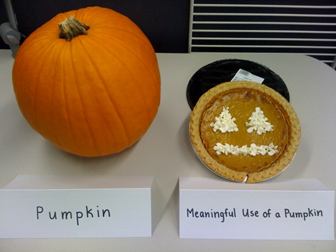

Slide 5
HIT – Enabled Health Reform
Achieving Meaningful Use
Capture / share data
Advanced care processes with decision support
Improved Outcomes
2015
2013
2011

Slide 6
Key Features of 2011 Definition
Core Set
Clinical documentation
Menu Set
Medication reconciliation
Provider order entry
Quality measures
E-prescribing
Patient access to their information
Incorporation of test results into EHR
Drug interaction checks

Slide 7
Full Sets of 2011 Definition
Core Set
Clinical Provider Order Entry (CPOE)
Menu Set
Drug Formulary Checks
Drug-Drug and Drug-Allergy Checks
E-Prescribing
Demographics
Problem List
Medication List
Medication Allergy List
Vital Signs
Smoking Status
Clinical Decision Support
Calculate and Transmit CMS
Electronic Copy of Health Information
Electronic Copy of Discharge Instructions
Clinical Summaries
Exchange Key Critical Information
Privacy/Security
Advance Directives
Lab Results into HER
Patient List
Patient Reminders
Timely Electronic Access to HIT
Patient Specific Education
Medication Reconciliation
Summary of Care
Immunization Registries
Submit Lab Results to Public Health Agencies
Syndromic Surveillance

Slide 8

Process to Achieve Meaningful Use
Regional Extension Centers
Adoption of EHR’s
Workforce
Training
Improved Individual and Population Health Outcomes
Increased Transparency and Efficiency
Improved Ability to Study an Improve Care Delivery
Medicare and Medicaid Incentives and Penalties
Meaningful Use of EHR’s
State Grants for Health Information Exchange
Standards and Certification Framework
Exchange of Health Information
Privacy and Security Framework
Research to Enhance Health IT
Beacon Community Program

Slide 9

Regional Extension Centers (RECs)
60 Centers covering 98% of U.S. providers
Focus on small, primary care practices and critical access hospitals
Register and support 100,000 providers to help them achieve meaningful use
Provide direct, individualized, onsite technical assistance
9
Notes:
Product selection
Implementation
Upgrade
Workflow redesign
Connection with local information exchanges
Sharing of best practices

Slide 10
State Health Information Exchange Program
Facilitate secure, electronic movement and use of health information
Federal & state collaboration to achieve interoperability
Statewide Policy, Governance, Technical Infrastructure and Business Practices
Notes:
Facilitate and expand the secure, electronic movement of health information using nationally recognized standards
long-term goal of nationwide HIE and interoperability
Cooperative agreements focus on
developing the statewide policy,
governance,
technical infrastructure and
business practices needed to support the delivery of HIE services

Slide 11
Health IT Workforce Development
$84M to support training of 50,000+ new health IT professionals
$84M in Funding
University-based
Training Programs
Community Colleges
Curriculum
Development
Competency
Exam
Notes:
70 community colleges- 103 sites- ADD EXPECTED # of GRADS
UBT- expected # of grads

Slide 12
Beacon Communities
Vision:
Guide the way to a transformed health care system through demonstration communities showing how health IT-enabled quality and cost improvements are achievable, sustainable, and replicable all across the country.
Goals:
Use health IT to bring together core health care stakeholders at the community level
Show how health IT can support breakthrough advancements in health care quality, efficiency, and in population health

Slide 13



Beacon Communities
Notes:
$220 M awarded to 15 communities in May 2010
2 More awards expected in late 2010

Slide 14
Health IT is Foundational for Health Reform
Sustainable
quality & efficiency improvements
Care delivery innovations
Measurement & Provider Feedback
Payment Reform
Decision support
Rx management
Care coordination
Discharge planning
Quality
Efficiency
Pop. health
Reforms to make improvements in efficiency/quality sustainable
Foundation of Health IT
Electronic Health Records and Information Exchange
14

Slide 15
Thank you!
Melinda.Buntin@hhs.gov
healthit.hhs.gov

