Slide 1
Comparing State and National Injury Statistics Examples from Colorado
Holly Hedegaard, MD, MSPH
EMS and Trauma Data Program
Emergency Medical and Trauma Services Section
8/17/10

Slide 2
Injury Deaths and Hospitalizations
Deaths
National Vital Statistics System
www.cdc.gov/nchs/nvss.htm
WONDER, WISQARS
Hospitalizations
National Hospital Discharge Survey
www.cdc.gov/nchs/nhds.htm
AHRQ HCUPNet (Nationwide Inpatient Sample, NIS)
hcupnet.ahrq.gov/

Slide 3
Purpose of the Study
Compare NHDS and HCUPNet for national estimates of injury hospitalizations
Compare Colorado to national estimates

Slide 4
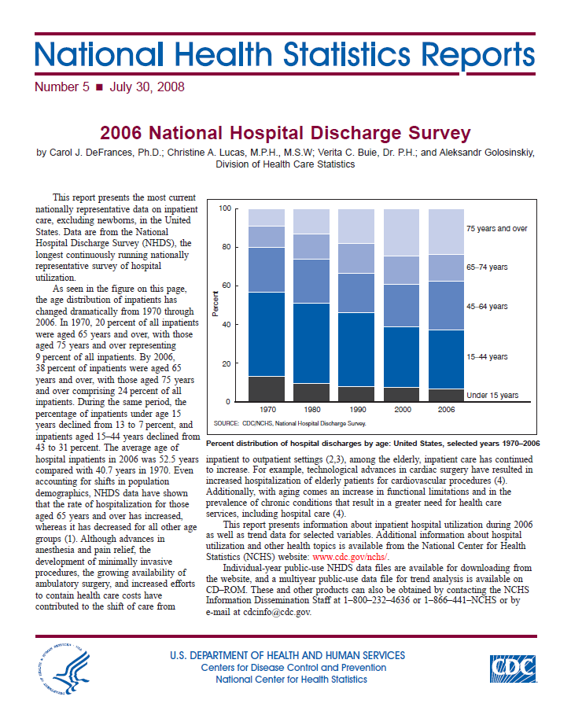
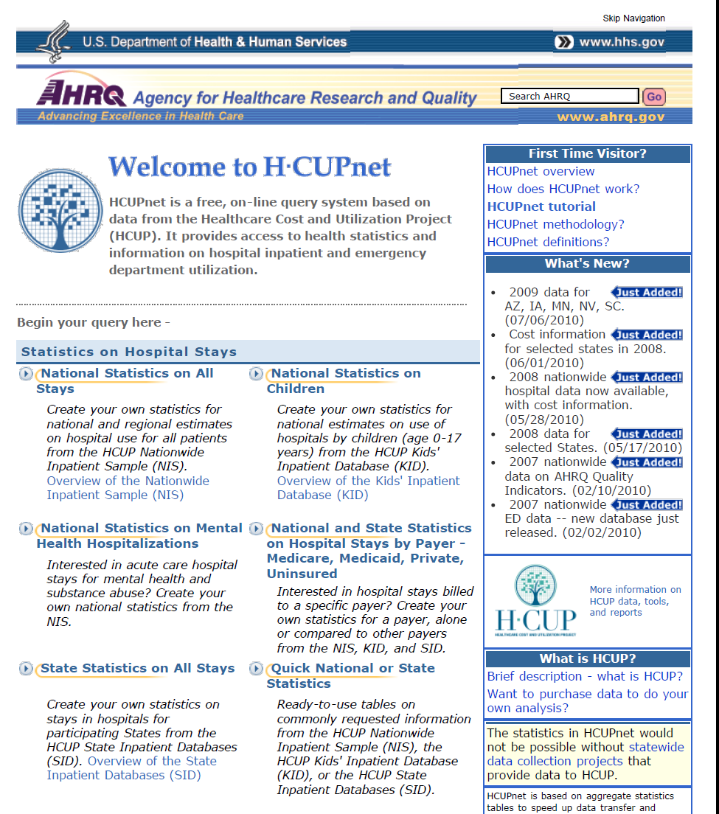
National Estimates for Injury Hospitalizations

Slide 5
ICD-9-CM Diagnosis Codes
 | ICD-9-CM
All Injury and Poisoning | 800-999
Injury | 800-959, 990-995
Poisoning | 960-989
Complications of med/surg care | 996-999
Fractures, all sites | 800-829
Fracture, neck of femur | 820
First listed diagnosis only

Slide 6
Comparison of National Estimates Injury Discharges in 2006
 | NHDS (Number in Thousands) | HCUPNet* (Number in Thousands)
All Injury and Poisoning | 2,968 | 2,873
Injury | 1,785 | 1,632
Poisoning | 271 | 270
Complications of med/surg care | 912 | 970
Fractures, all sites | 1,074 | 1,032
Fracture, neck of femur | 330 | 304
First listed diagnosis only

Slide 7
Percent of All Hospital Discharges for Injury and Poisoning in 2006

Slide 8
Percent of All Hospital Discharges for Injury and Poisoning in 2006

Slide 9
Hospital Discharges for Poisoning Rate per 10,000 population by Age Group

Slide 10
Hospital Discharges for Femoral Neck Fracture, Patients Age 65+ Rate per 10,000 population

Slide 11
Average Hospital Length of Stay (days) for Femoral Neck Fracture, Patients Age 65+

Slide 12
These results suggest that
Similar estimates for injury and poisoning hospital discharges can be obtained from NHDS and the HCUP National Inpatient Sample
States can use these tools to compare their injury hospitalization rates with national estimates

Slide 13
Thank You!
Holly Hedegaard, MD, MSPH
EMS and Trauma Data Program
Colorado Department of Public Health & Environment
holly.hedegaard@state.co.us
(303) 692-3005

