Slide 1



Working with injury data
Margaret Warner, PhD
Office of Analysis and Epidemiology
National Conference on Health Statistics
Washington, DC August 2010
U.S. DEPARTMENT OF HEALTH AND HUMAN SERVICES
Centers for Disease Control and Prevention
National Center for Health Statistics

Slide 2
Introduction
Overview of Working with Injury Data session
Injury-related NCHS publications
  Injury Data and Resources website

Slide 3
Session Overview
Comparisons of injury estimates from a
population-based survey and provider based surveys
Li Hui Chen MS PhD, Office of Analysis and Epidemiology, NCHS
Comparing state and national injury statistics:
Examples from Colorado
Holly Hedegaard MD MSPH, Colorado Department of Public Health and Environment
International injury comparisons
using ICE developed injury indicators
Margaret Warner PhD, Office of Analysis and Epidemiology, NCHS
Utilizing severity to interpret changing trends
of hospitalized injury rates
Claudia A. Steiner MD, MPH, AHRQ
Identifying Accidental Passenger Vehicle Non-transport Incidents
in the NVSS
Seymour D. Stern, National Center for Statistics and Analysis, NHTSA

Slide 4

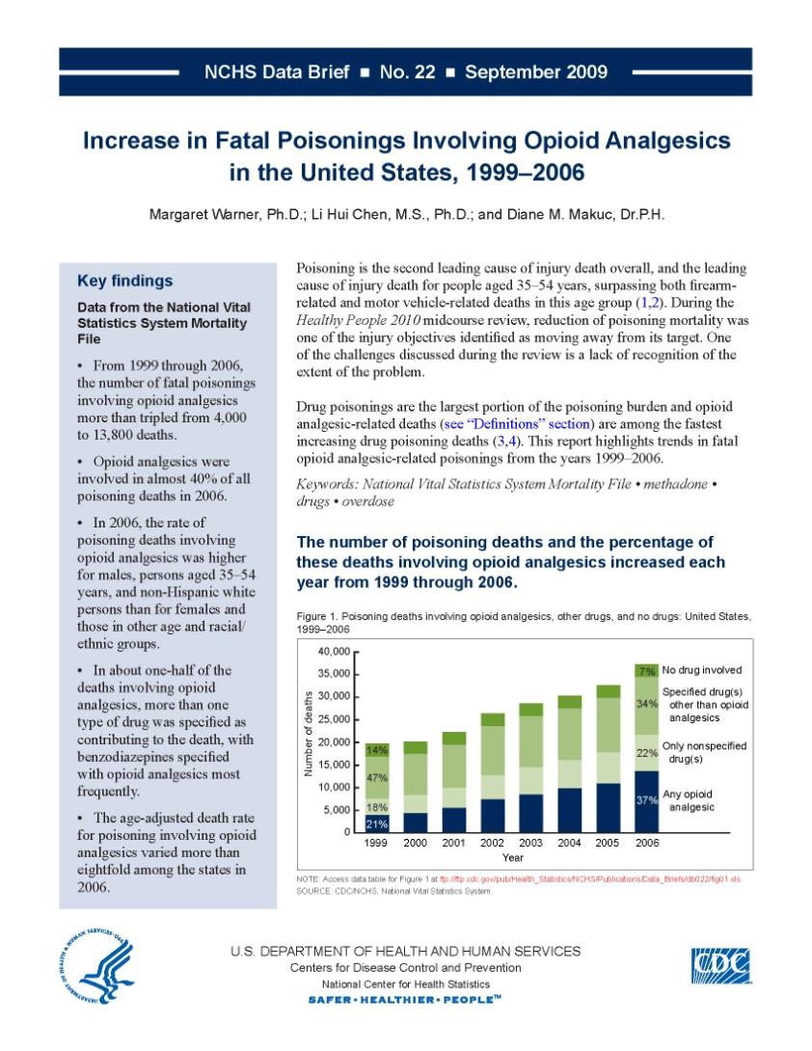

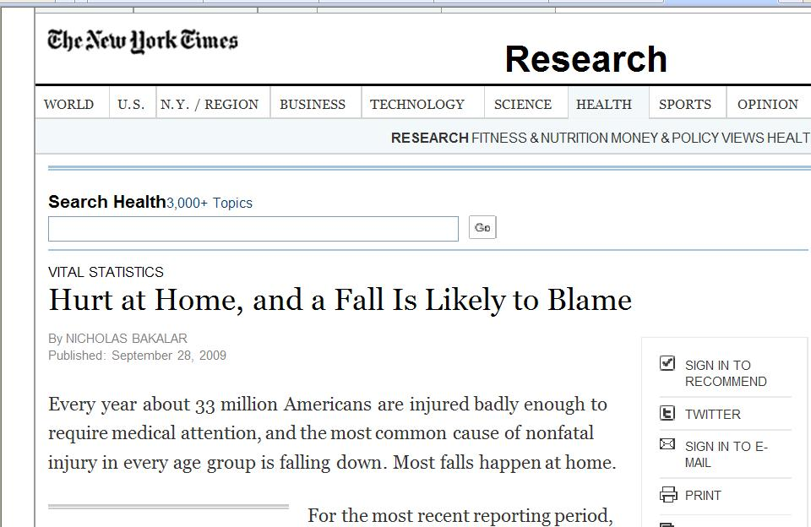
Injury-related NCHS publications
Annual NCHS publications
Special reports
NCHS Data Brief
Series reports
Fact sheets

Slide 5
On the web
On-line tools to access NCHS injury data
Injury Data and Resources Website
  NCHS Databases
  ICE on Injury Statistics
  Tools and Frameworks
  Data Access and Resources

Slide 6
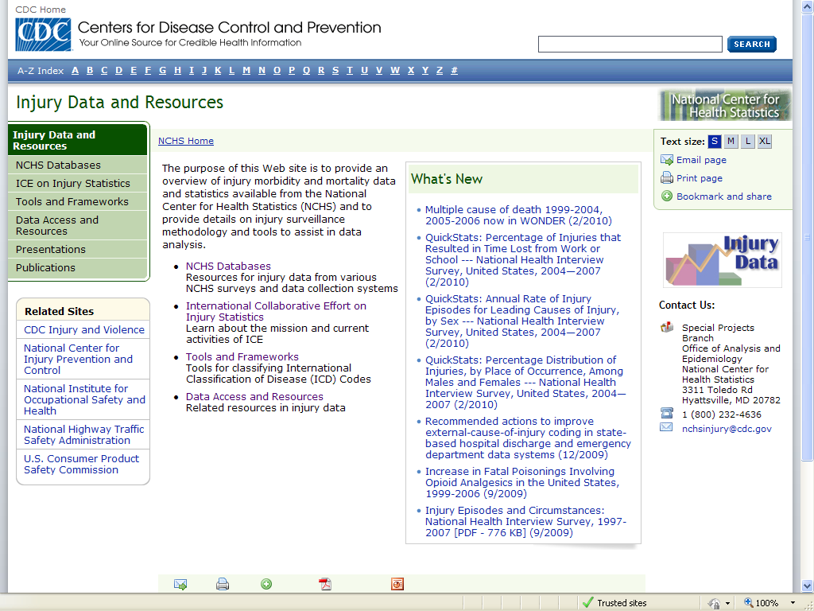
http://www.CDC.gov/NCHS/injury.htm

Slide 7
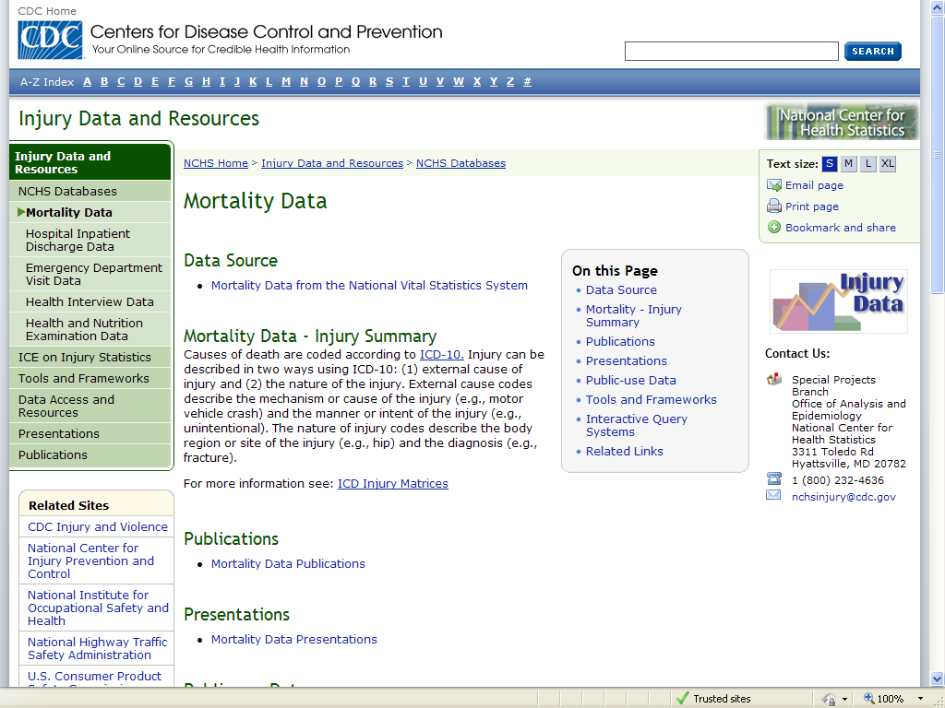
Similar pages for …
National Hospital Discharge Survey
National Hospital Ambulatory Medical Care Survey
National Health Interview Survey

Slide 8
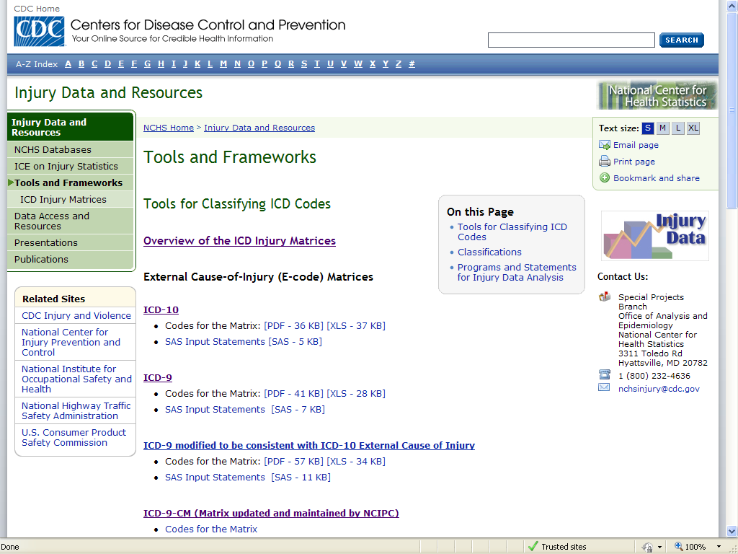

Slide 9
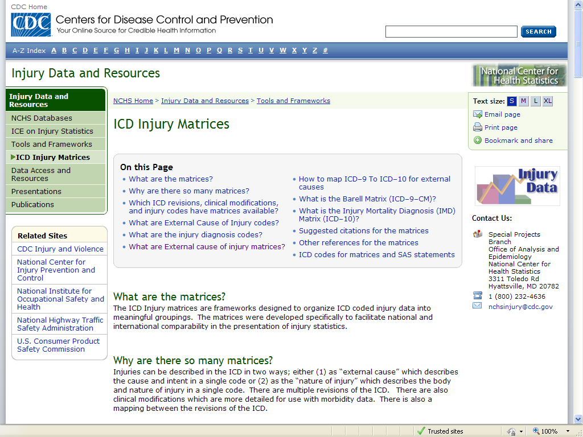

Slide 10
ICD Injury matrices
External cause matrix categorizes ICD codes by cause & intent.
Nature of injury matrix categorizes ICD codes by nature & body region.
ICD Revisions & modifications | External cause of injury | Nature of injury
ICD–9 | Matrix
ICD–9–CM | Matrix | Barell Matrix
ICD–10 | Matrix | Injury Mortality Diagnosis Matrix
For codes and SAS programs see http://www.cdc.gov/nchs/injury/injury_tools.htm

Slide 11
For more information, see: www.cdc.gov/nchs/injury.htm

