Slide 1
Crossing the “medical void”: health transition in young adults with special health care needs
Kathleen S. O’Connor, M.P.H.*
Centers for Disease Control and Prevention
National Center for Health Statistics
Washington, DC
August 16, 2010
*This presentation, analyses, discussion & conclusions do not necessarily
represent the official views of CDC/NCHS or the survey funding agency, HRSA/MCHB

Slide 2
Agenda
Tell a tale of two surveys
  define “children with special health care needs” & “health care transition”
  describe main & follow-back surveys
    2001 National Survey of Children with Special Health Care Needs (NSCSHCN)
    2007 Survey of Adult Transition and Health (SATH)
How can these follow-back SATH data be used?
  Describe select bivariate findings
  Describe exploratory longitudinal analyses
How to access SATH data & documentation

Slide 3
What do “health care transition” & “children with special health care needs” mean?

Slide 4
Definition of Children with Special Health Care Needs (CSHCN)
Maternal & Child Health Bureau (MCHB) definition
Children aged 0-17 who:
(1) have or are at increased risk for a chronic physical, developmental, behavioral, or emotional condition
AND
(2) also require health and related services of a type or amount beyond that required by children generally
Notes:
Published in Pediatrics, 1998 McPherson et al.

Slide 5
Definition & goals of health care transition
Moving from health care providers who only treat children to those that only treat adults (vs general transition to adulthood)
Patient-centered
Flexible
Responsive
Continuous
Comprehensive
Coordinated
    *American Academy of Pediatrics, American Academy of Family Physicians, American College of Physicians – American Society of Internal Medicine. A consensus statement on health care transitions for young adults with special health care needs. Pediatrics 2002;110:1304-1306
Notes:
This joint statement explicitly states that goals of health care transition are to
“…maximize lifelong functioning & potential through the provision of high-quality, developmentally appropriate health care services that continue uninterrupted..” from adolescence to adulthood

Slide 6
“Young adults often fall into a medical void after they leave their pediatrician and don’t have a primary care doctor until their 30s or 40s, which worries many health care experts”.
Melinda Beck, “Can’t part with the pediatrician”, Wall Street Journal, August 10, 2010, health journal section
Notes:
Within the last week-and-a-half, several articles have appeared in the popular press to discuss this health care transition. To frame this issue, I’ve included some quotes from one WSJ article, where I’ve added bold font for emphasis. It discussed both children with and without special health care needs, and several known barriers to health care transition.

Slide 7
“We’ve now realized that young adults are a special group, just as we realized with adolescents 30 or 40 years ago…”.
Charles Wibbelsman, MD, chief of adolescent medicine, Kaiser Permanente
Notes:
PAUSE

Slide 8
An emerging & interesting trend to follow
“The growing medical specialty known as med-peds (for doctors certified in both internal medicine and pediatrics) also helps provide more continuity as patients outgrow their pediatricians – particularly those who have special needs”.

Slide 9
A tale of two surveys
Notes:
Earlier you heard a few characteristics and goals of a successful medical transition. To put this into context, I’ll discuss two surveys where we looked at medical transition and medical home among CSHCN. I’ll refer to the target group as “young adults” instead of “YASHCN” for ease of use & comprehension.

Slide 10
A tale of two surveys: key design differences
Design feature | 2001 NS-CSCHN | 2007 SATH
Population target | CSHCN aged 0 - 17 years at the time of the interview | Young adults (YA) aged 19-23 years who were subjects of the 2001 interview & from English-speaking households (HH)
Survey design | List-assisted Random-Digit-Dial (RDD) sample of landline telephone households | Follow-back survey targeting YASHCN who were 14 - 17 years old in 2001
Respondent | Most knowledgeable parent or guardian | Young adult
Sample size (person-level public use file) | 38,866 completed CSHCN interviews | 1,865 completed interviews out of 10,933 total eligible SATH cases, of which we located 2001 R for 3,524 cases (32% of overall eligible) Very high YA cooperation rate
Notes:
You’ve already heard about the 2001 survey in some detail, so I won’t repeat that information. To facilitate comparison, I’m showing relevant design features of the 2001 and 2007 surveys side-by-side.
What are the most salient features of the SATH design that you should remember? FOLLOW-BACK, YA RESPONDENT SELF-REPORT
The primary goal of fielding the SATH survey was to assess the impact of medical home and receipt of transition services in adolescence on selected adult health and well-being outcomes. It also provided new national data that could be linked to the 2001 survey data, which enhanced the analytic utility. A secondary reason to conduct the SATH was for methodological research. The survey design and fielding periods were used to identify and resolve unique respondent locating challenges, and to test the feasibility of using similar procedures in future follow-back surveys.

Slide 11
SATH: select bivariate findings

Slide 12
Primary outcome variable
“About 6 years ago, your parent or guardian told us about your health. Compared with 6 years ago, would you say your health now is better, worse, or about the same?”
Notes:
Self-reported data on the change in health status over time of the young adult are based on data collection for one variable in 2007, shown on this slide. READ QUESTION TEXT.

Slide 13
YA’s self-reported change in health status over time, 2007
Change in health status six years later | Sample size | % (SE)
Improved | 561 | 29.1 (1.7)
Same | 1,101 | 59.9 (1.8)
Worse | 197 | 11.1 (1.2)
Total | 1,859 | 100.0
DATA SOURCE: CDC/NCHS, SLAITS Survey of Adult Transition and Health, 2007 public use file.
Notes:
As a reference point, I’ve listed the frequency distribution of the self-reported change in health status over time variable. About 60% of YA reported their health did not from 2001 to 2007. Just over 1 in 10 reported their health declined over time, and for approximately 1 in 3 young adults, their health improved.

Slide 14
Association between meeting conditions of MCHB Core Outcome 1 in 2001 with self-reported change in health status, 2007*
Change in health status six years later | CSHCNs’ families WERE satisfied with services & care received, partnered in decision-making, 2001 n = 470 % (SE) | CSHCNs’ families WERE NOT satisfied with services & care received, partnered in decision-making, 2001 n=328 % (SE)
Health status Improved | 31.2 (3.3) | 24.5 (3.6)
Same | 56.7 (3.5) | 68.8 (3.8)
Worse | 12.2 (2.4) | 6.8 (1.6)
Total | 100.0 | 100.0
DATA SOURCE: CDC/NCHS, SLAITS Survey of Adult Transition and Health, 2007 public use file.
*Differences are significant at the 0.05 level.
Notes:
Among those CSHCN whose families in 2001 were satisfied with the care received, the vast majority (87.9%) reported their health status improved over time or at least stayed the same. Just over 1 in 10 reported worse health over time.

Slide 15
Association between meeting conditions of MCHB Core Outcome 2 in 2001 with self-reported change in health status, 2007*
Change in health status six years later | CSHCN received coordinated ongoing comprehensive care within a medical home, 2001 n=1,006 % (SE) | CSHCN DID NOT receive coordinated ongoing comprehensive care within a medical home, 2001 n=753 % (SE)
Health status Improved | 29.9 (2.3) | 28.8 (2.6)
Same | 61.7 (2.4) | 57.3 (2.9)
Worse | 8.4 (1.4) | 13.9 (2.1)
Total | 100.0 | 100.0
DATA SOURCE: CDC/NCHS, SLAITS Survey of Adult Transition and Health, 2007 public use file.
*Differences are significant at the 0.10 level.
Notes:
Only 8% of the CSHCN who in 2001 received care in a medical home reported worse health over 6 years, which suggests an impact of provision of medical home in pediatric care over time. Again, this is just an association due to the cross-sectional nature of the design, and cannot be construed as causation.

Slide 16
Association between health care provider discussion with self-reported change in health status, 2007*
Change in health status six years later | YAs’ doctors discussed how YA health care needs might change as he/she aged n=1,016 % (SE) | YAs’ doctors DID NOT discuss how YA health care needs might change as he/she aged n=829 % (SE)
Health status Improved | 32.8 (2.4) | 24.1 (2.3)
Same | 57.7 (2.5) | 62.8 (2.7)
Worse | 9.5 (1.4) | 13.1 (2.1)
Total | 100.0 | 100.0
DATA SOURCE: CDC/NCHS, SLAITS Survey of Adult Transition and Health, 2007 public use file.
*Differences are significant at the 0.05 level.
Notes:
Overall, about 45% of YA reported their doctor did not discuss how their health care needs might change as they aged. Of the young adults who did have this conversation, 1 in 3 YA reported improved health status over time. Over 1 in 10 YA who did not have this conversation reported their health had declined over time.

Slide 17
Association between health care provider discussion with self-reported change in health status, 2007*
Change in health status six years later | YAs’ doctors discussed w/YA - eventually see doctors who treat adults n=243 % (SE) | YAs’ doctors DID NOT discuss w/YA - eventually see doctors who treat adults n=178 % (SE)
Health status Improved | 36.2 (5.1) | 20.9 (3.8)
Same | 56.2 (5.1) | 61.4 (5.3)
Worse | ** | 17.7 (4.2)
Total | 100.0 | 100.0
DATA SOURCE: CDC/NCHS, SLAITS Survey of Adult Transition and Health, 2007 public use file.
*Differences are significant at the 0.05 level.
**Figure does not meet NCHS standards for reliability or precision and cannot be reported.
Notes:
Overall, 57.7% YA providers discussed with them the need to eventually see HCP who treat adults. YA whose health improved over time were more likely to have this conversation than those whose health did not improve. YA whose health stayed the same were less likely to have this conversation.

Slide 18
YAs - any of their doctors/HCP only treat children, teens, or young adults, 2007
Any of YAs’ MD/HCP only treat children, teens, YA | Sample size | % (SE)
Yes | 430 | 26.7 (1.7)
No | 1,397 | 73.3 (1.7)
Total | 1,827 | 100.0
DATA SOURCE: CDC/NCHS, SLAITS Survey of Adult Transition and Health, 2007 public use file.
Notes:
Just under 27% of YA reported that at least one of their doctors or other health care providers only treated children, teens, or young adults in 2007.

Slide 19
YAs - any of their doctors/HCP only treat children, teens, or young adults by age, 2007
YA age in years | Yes n=430 % (SE) | No n=1,397 % (SE)
20 | 33.0 (3.5) | 23.1 (1.8)
21 | 32.9 (3.7) | 26.2 (1.9)
22 | 21.3 (2.9) | 28.3 (2.0)
23 | 12.9 (2.4) | 17.3 (3.2)
Total | 100% | 100%
DATA SOURCE: CDC/NCHS, SLAITS Survey of Adult Transition and Health, 2007 public use file.
*Differences are significant at the 0.05 level.
Notes:
As the YA aged, the % that had at least one doctor or HCP who only treated children, teens, or adults declined, but even so, over 1 in 10 YA at 23 years of age still saw some type of pediatric care provider. Although this is speculation on my part, note that the percentage drops for YA with at least one pediatric provider between the ages of 21 and 23, which may reflect two issues for a portion of this sample. This may reflect health insurance policies that stop dependent coverage at age 21, or this represents a chunk of YA who graduate from college who are then removed their parents’ plan upon graduation and/or securing their own plan at a new job.

Slide 20
Select preliminary longitudinal finding(s)

Slide 21
Methods
Identified identical constructs & variables available in both data files (2001 & 2007)
Created four groups to assess change in these variables over time
Preliminary analyses
Notes:
will continue with pairwise comparisons & other outcomes

Slide 22
Summary of 4 groups created to assess change over time
X = health event, status, outcome, or characteristic that is desirable to have or experience
Features | Group 1 | Group 2 | Group 3 | Group 4
In 2001 | Did not have X | Had X | Did not have X | Had X
In 2007 | Did not have X | Did not have X | Had X | Had X
Description SC/YA | Bad 2001 Bad 2007 | Good 2001 Bad 2007 | Bad 2001 Good 2007 | Good 2001 Good 2007
WORST (Gr 1) CONTINUUM BEST (Gr 4)

Slide 23
Association of changes in usual source of care (USC) over time with changes in health status: 2001, 2007*
Change in health status six years later | 2001 no USC 2007 no USC % (SE) n=40 | 2001 had USC 2007 no USC % (SE) n=322 | 2001 no USC 2007 had USC % (SE) n=103 | 2001 had USC 2007 had USC % (SE) n=1,386
Health status Improved | ** | 31.2 (4.3) | ** | 29.4 (1.9)
Same | 38.8 (10.9) | 53.5 (4.7) | 66.8 (7.3) | 61.8 (2.1)
Worse | ** | 15.3 (3.4) | ** | 8.9 (1.2)
Total | 100.0% | 100.0% | 100.0% | 100.0%
DATA SOURCE: CDC/NCHS, SLAITS Survey of Adult Transition and Health, 2007 public use file.
*Differences are significant at the 0.05 level (based on p-value of a single chi square test of association).
**Figure does not meet NCHS standards for reliability or precision and cannot be reported.
Notes:
Unfortunately have to suppress much of this table due to unstable estimates, driven by small sample sizes. The majority of those who had USC in 2001 and 2007 reported that their health care status stayed the same, and just under 30% reported their health had improved. Among those who did not have USC at 2001 and 2003, almost 40% reported their health stayed the same, so the health of a majority of this group either improved or declined (not shown).

Slide 24
Association of changes in getting timely care with changes in health status: 2001, 2007*
(e.g., care was not delayed or foregone)
Change in health status six years later | 2001 no timely care 2007 no timely care % (SE) n=61 | 2001 had timely care 2007 no timely care % (SE) n=441 | 2001 no timely care 2007 had timely care % (SE) n=75 | 2001 had timely care 2007 had timely care % (SE) n=1,271
Health status Improved | ** | 34.4 (3.7) | 37.2 (9.2) | 27.8 (1.9)
Same | 53.8 (10.4) | 46.7 (3.8) | 50.1 (9.3) | 65.6 (2.0)
Worse | ** | 18.9 (3.1) | ** | 6.7 (0.9)
Total | 100.0% | 100.0% | 100.0% | 100.0%
DATA SOURCE: CDC/NCHS, SLAITS Survey of Adult Transition and Health, 2007 public use file.
*Differences are significant at the 0.05 level (based on p-value of a single chi square test of association).
**Figure does not meet NCHS standards for reliability or precision and cannot be reported.
Notes:
YA who received timely care at both time points reported much lower rates of health status decline, and higher rates of steady health status.

Slide 25
How to access SATH data

Slide 26
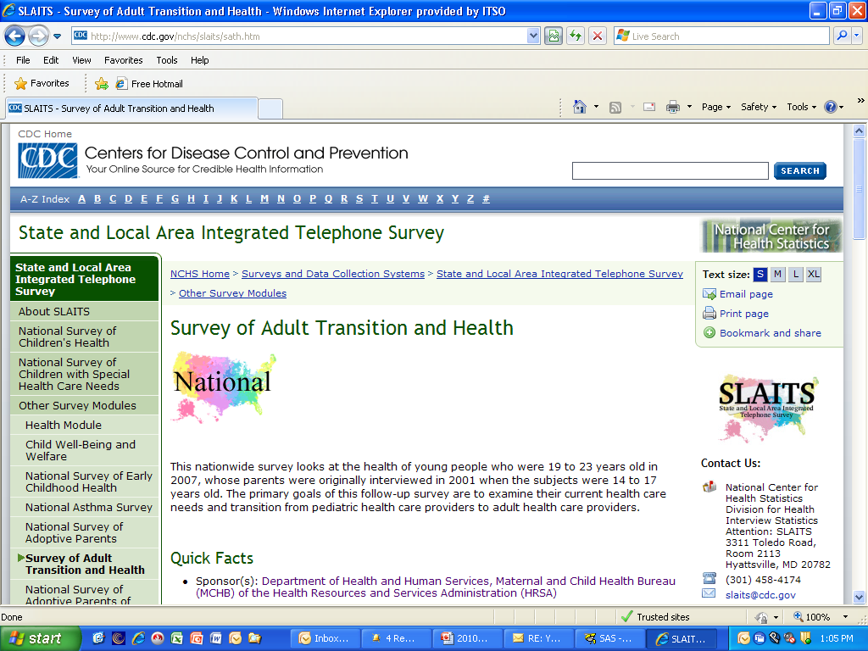

Slide 27
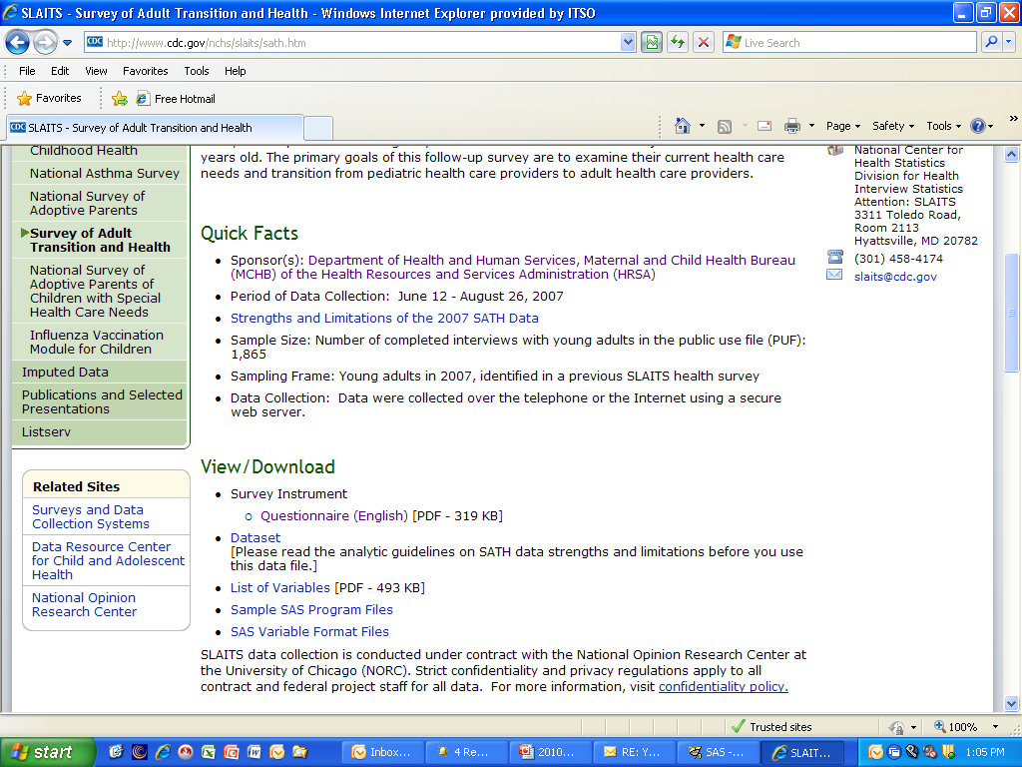

Slide 28
Conclusions
IN THIS SAMPLE OF YASHCN:
pairwise comparisons, modeling (to extent possible give sample sizes)
Change in health status over time is associated with provision of timely care & having a usual source of care
Over 1 in 10 YA at 23 YO still saw at least one type of pediatric care provider; continue to focus on actual transition for these youth
identified areas of improvement for health care provider discussion with YA:
  need to eventually see HCP treat adults
  health changes over time

Slide 29
For more information
E-mail: slaits@cdc.gov
Kathy O’Connor, CDC/NCHS
301.458.4181 (Eastern time zone)
Hyattsville, MD
www.cdc.gov/nchs/slaits.htm

