Slide 1
The HHS Gateway to Data and Statistics
Overview and Hands-On Demo of the
Gateway to Data and Statistics to the:
16 Aug 2010
Fulfilled as part of the DHHS contract:
“Maintenance, Enhancements and Improvements to the HHS Data Council's Integrated Electronic Gateway to Data and Statistics” for the
Office of the Assistant Secretary for Policy and Evaluation

Slide 2
Agenda
Demonstration and Hands-on Session to the NCHS
What is the HHS Gateway?
Background
How can it serve you in your organization?
Mission or goal specific focus
Standard and customized screens/reports
What can you do to enhance the Gateway?
Increasing the quality and quantity of records
Improving the user interface and result listings
Providing feedback on the material
Demo
Exercise in using the Gateway
Follow-up Scavenger hunt for information

Slide 3
What is the HHS Gateway?
The Gateway to Data and Statistics [http://hhs-stat.net] is a portal for health data, information and statistical resources that:
Catalogs websites that feature federal, state and local government created or sponsored health statistics and reports into a single, web portal, accessible worldwide to the public free of charge
Is sponsored by the HHS Data Council and the Office of the Assistant Secretary for Planning and Evaluation
Users include:
Policy-makers
Researchers
Administrators
General public

Slide 4
Purpose
The HHS Gateway to Data and Statistics is designed to help users find the websites with data and statistical results that they can use to gain a better understanding of health and human services conditions and the services that respond to them.
It provides access to an online catalog of these resources. The catalog is organized like a catalog of a library except that it refers to websites rather than books.

Slide 5
Coverage
Coverage
The HHS Gateway covers all types of Health and Human Services Statistics.
It catalogs internet-based resources including:
Internet sites
Internet-published reports
Tables on the internet
Geographically-referenced materials
Sites where searchers can configure their own tables
It also links to relevant websites including those sponsored by:
The HHS Data Council
The National Committee on Vital and Health Statistics
Agencies within HHS as well as other federal agencies that present related data
The Office of Minority Health
The Office of Women’s Health and
Sites that present data collected by relevant State and local government agencies

Slide 6
Scope
Scope
The HHS Gateway database includes internet resources that meet the following criteria:
The resource reports on statistical data or methods related to health or human services
The resources was created or sponsored by a Federal, state, or local government agency or organization.
Non-government resources are included if are funded by a government agency, but otherwise the site does not cover them.

Slide 7
Features
The Gateway
Serves as a window to access Health Data and Statistics and:
Catalogs web based resources.
Allows users to search with Boolean (think “Google” search) logic strings
Offers a guided search feature
Other key features of the Gateway are:
Use of standard terminology to catalog material.
Equivalence tables that direct users to terms related to those they use.
Information on studies, organizations and agencies.
Tagging of geographically referenced materials—to integrate the application with the geodata.gov initiative.
Notes:
Word catalogs is larger font in 1.

Slide 8
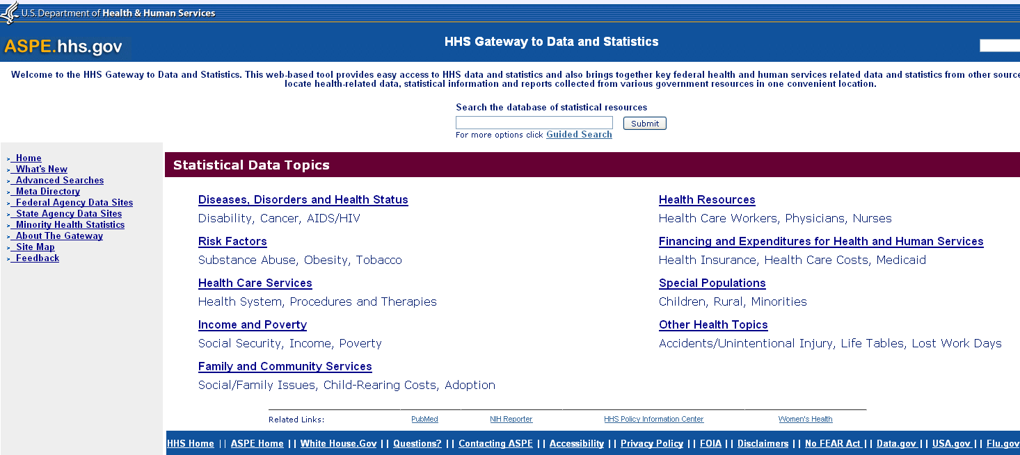
The HHS Gateway Process
Gateway Operational Model
1. Users access the HHS Gateway
2. The Gateway pulls information using a tagged database
Search Organizer Database
3. The appropriate website URL, agency, study, topic and other features are accessed via the database.
Website A
Website B
…..
Website n

Slide 9
The Gateway Home Page

Slide 10
HHS Gateway to Data and Statistics: Hands On Exercise
The exercise will cover some of the ways to use the Gateway
There will be a quiz (scavenger hunt) afterwards

Slide 11
HHS Gateway to Data and Statistics: Hands On Session
This session will demonstrate four features of the HHS Gateway site
3
4
2
1
The site offers several ways to search for sites--by Boolean logic, using topics, through the guided search and using the meta directory of HHS data resources

Slide 12
HHS Gateway to Data and Statistics Hands On Session
1: Risk Factors
1
An example using the topics to find information

Slide 13
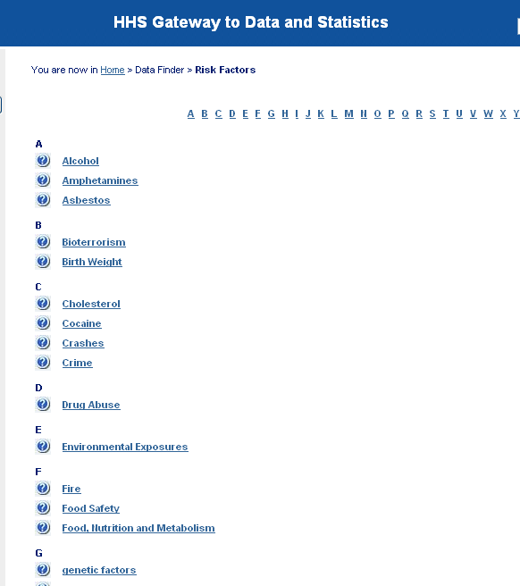
HHS Gateway to Data and Statistics Hands On Session
1: Risk Factors: Food Safety

Slide 14
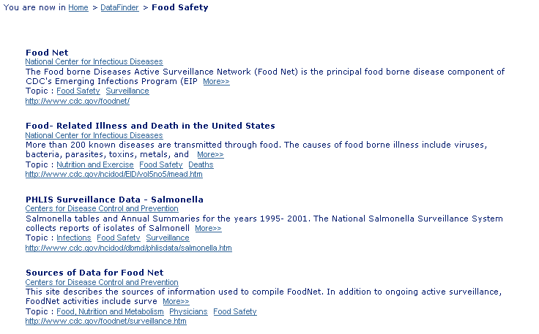
HHS Gateway to Data and Statistics Hands On Session
1: Risk Factors: Food Safety

Slide 15
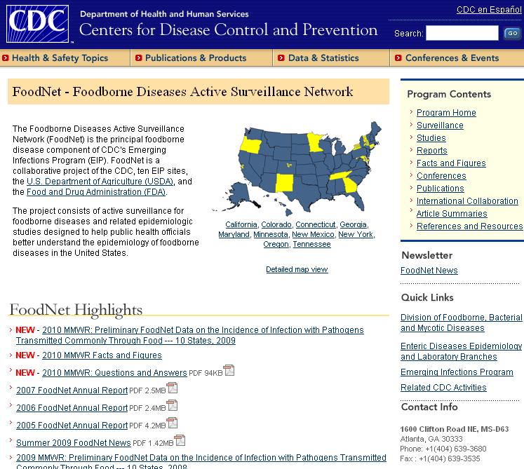
HHS Gateway to Data and Statistics Hands On Session
1: Risk Factors: Food Safety: CDC Report on Foodborne Diseases

Slide 16
HHS Gateway to Data and Statistics Hands On Session
2: Health Resources
2
Another example using the topics to find information

Slide 17
HHS Gateway to Data and Statistics Hands On Session
2: Health Resources: Nurses

Slide 18
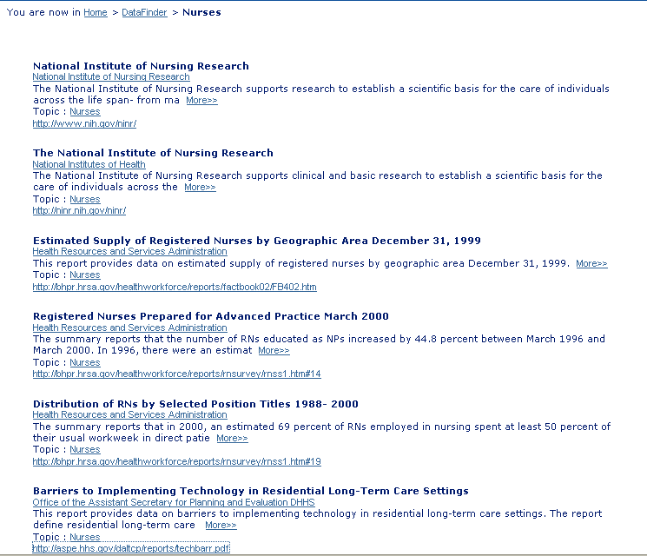
HHS Gateway to Data and Statistics Hands On Session
2: Health Resources: Nurses

Slide 19
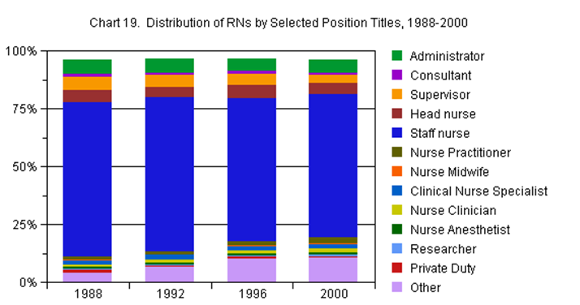
HHS Gateway to Data and Statistics Hands On Session
2: Health Resources: Nurses: RNs by Position Titles

Slide 20
HHS Gateway to Data and Statistics Hands On Session
3: Guided Search
3
An example using the Guided Search to find information

Slide 21
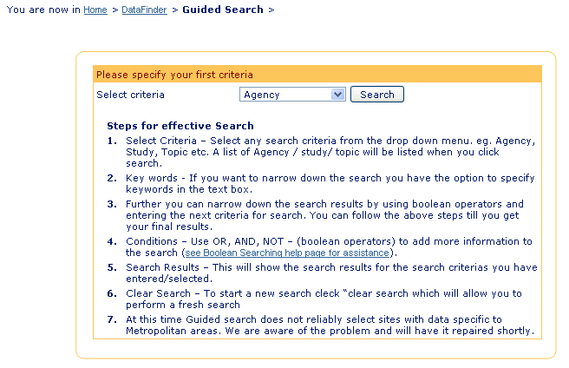
HHS Gateway to Data and Statistics Exercise
3: Guided Search
Guided Search Categories are:
Agency
Geographic Area
Study
Topic
Type of Site
URL Type

Slide 22
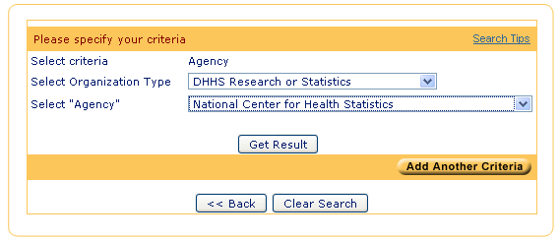
HHS Gateway to Data and Statistics Exercise
3: Guided Search

Slide 23
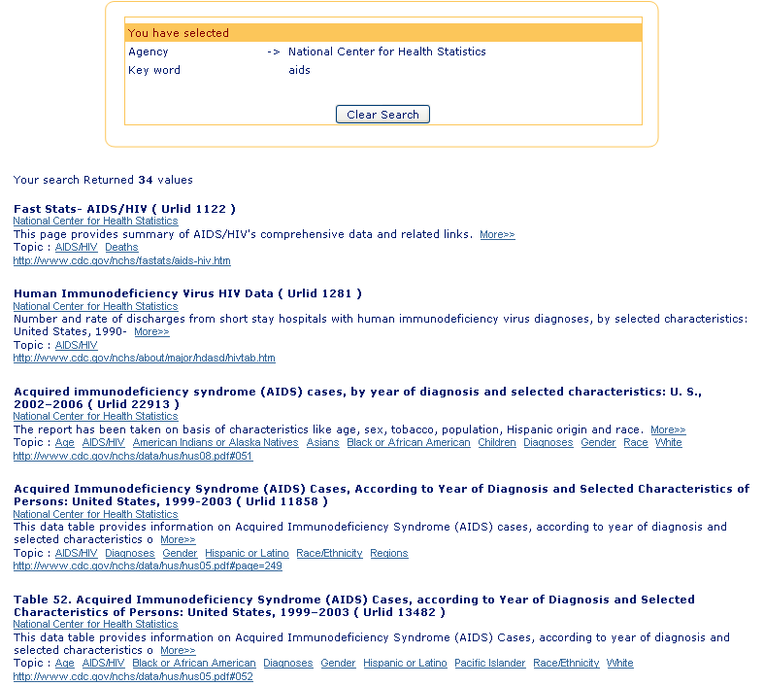
HHS Gateway to Data and Statistics Exercise
3: Guided Search
Type in Aids for a search on Aids-related information and statistics

Slide 24
HHS Gateway to Data and Statistics: Hands On Session
4: MetaDirectory of HHS Data Resources
4
An example showing the MetaDirectory to access meta-links

Slide 25
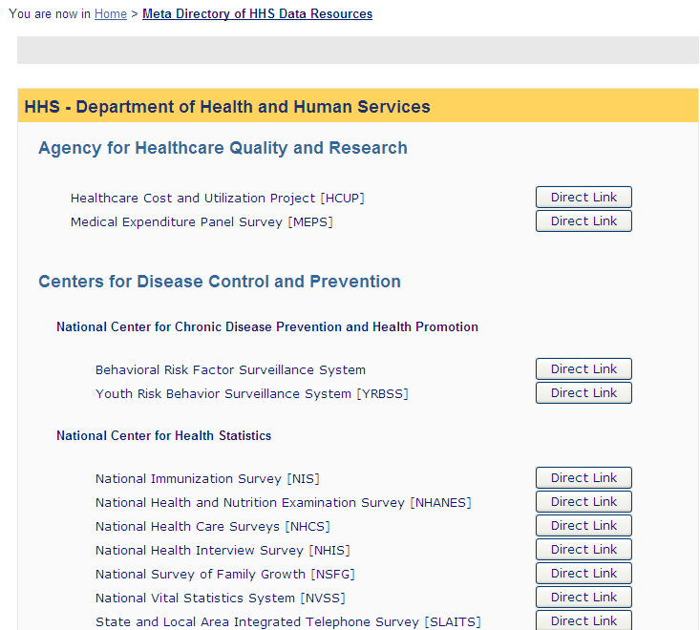
HHS Gateway to Data and Statistics: Hands On Session
4: MetaDirectory of HHS Data Resources

Slide 26
Return to the Home page

Slide 27
HHS Gateway to Data and Statistics Exercise
Scavenger Hunt
Check on skills for using the HHS Gateway to locate information
Notes:
Item #1: Answer is: $2,816/consumer unit; 5.7% of income. References:1) http://www.census.gov/compendia/statab/cats/arts_recreation_travel.html 2) http://www.census.gov/compendia/statab/2010/tables/10s1195.pdf

Slide 28
HHS Gateway to Data and Statistics Exercise
Scavenger Hunt Item #1
Using Guided Search, find the study that shows the number of people who died from the West Nile Virus in Alabama from Jan 1 to Nov 17, 2007.
Notes:
Item #1: Answer is: 3 people. References:1)http://www.cdc.gov/mmwr/preview/mmwrhtml/mm5645a4.htm

Slide 29
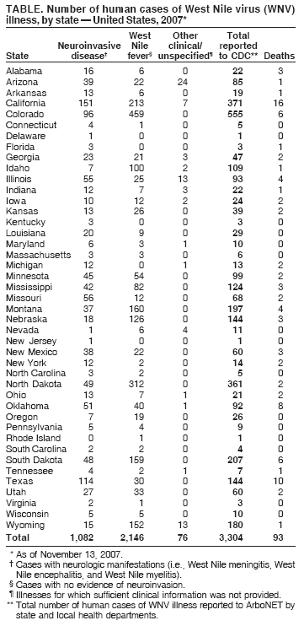
Item #1
Answer to Scavenger hunt question #1. Timeframe is from Jan 1 – Nov 13, 2007.
West Nile Virus Update --- United States, January 1--November 13, 2007 Centers for Disease Control and Prevention This report summarizes 2007 West Nile virus (WNV) surveillance data reported to CDC through ArboNET, November 13, 2007. A total of 43 states had reports More>> Topic : Deaths http://www.cdc.gov/mmwr/preview/mmwrhtml/mm5645a4.htm

Slide 30
HHS Gateway to Data and Statistics Exercise
Scavenger Hunt Item #2
Using Meta Directory of HHS Data Resources, find the brochure about the National Health Interview Survey
You should see the report that looks like this one. Notify proctor when you have found it.
Notes:
Item #2: Answer is: . References:1) http://www.cdc.gov/nchs/data/nhis/brochure2010January.pdf

Slide 31
Wrap-up of the HHS Gateway Hands On Session and Scavenger Hunt
Trifolds contain all of the HHS Gateway information
To enhance the site by increasing the quality and quantity of records we will be:
Interested in obtaining your feedback and ideas on topics and areas of interest, user interface and design
Researching for automated tools that easily crawl and search the web for new material
Adding in alerts to notify us when information has changed
http://hhs-stat.net/

