Slide 1
Survey Content Highlights from the
National Heath And Nutrition Examination Survey (NHANES)
2007- 2010
Natalie E. Dupree M.S.,
National Center for Health Statistics

Slide 2
NHANES Website Links
NHANES Homepage
http://www.cdc.gov/nchs/nhanes.htm
Survey Content Brochure
http://www.cdc.gov/nchs/data/nhanes/survey_content_99_10.pdf
NHANES Tutorials
http://www.cdc.gov/nchs/tutorials/

Slide 3
Presentation Objectives
Overview:
  Selected content NHANES 2007-08
  Selected content NHANES 2009-10
  New NHANES Web Tutorials
    Environmental Chemicals
    Dietary

Slide 4
  Selected Content NHANES
  2007-08

Slide 5
Respiratory Health
(2007-12)
Objectives
  Estimate prevalence of obstructive airway disease
  determine the proportion of reversible airway disease among those with obstructive patterns
  Determine distribution of airway inflammation based on exhaled nitric oxide levels.

Slide 6
Respiratory Health
(2007-2012)
  Mobile Exam Center
  Ages 6-79 years
  Spirometry with bronchodilator
    Provides 1st national estimates of reversible airway disease among those with obstructive patterns at baseline
  Exhaled nitric oxide
    Provides first national data on airway inflammation among US residents
  First public release expected early 2011

Slide 7
Asthma Medications (2007-10)
Household Interview
  Prescription medications - birth+
  Special emphasis placed on asthma medications in the prescription medication section
  When asthma medication identified, ask for use in past 30 days
  Goal of identifying high use
  Data released April 2010
Notes:
RXQ section
Dietary Supplements and Prescription medication interview asked of everyone – birth+

Slide 8
Air Pollution Alert Behavior
(2007-10)
Household Interview
Participants 16 years & older
Outdoor air pollution is an important asthma trigger
Identify behaviors in response to air pollution
Compare behaviors between those affected by asthma and those not affected by asthma
Data released September 2009
Notes:
PAQ section
Household Interview
During the past 12 months, when you thought or were informed air quality was bad, did you do anything differently?
Which of these did you do differently?

Slide 9
Dietary Supplements
Reasons for Use (2007-present)
Household Interview
  Ages from birth+
  Reason(s) for taking each dietary supplement reported in the past 30 days
  Answer categories based on responses during pilot study conducted in NHANES 2006
  2007-2008 data just released - August 2010

Slide 10
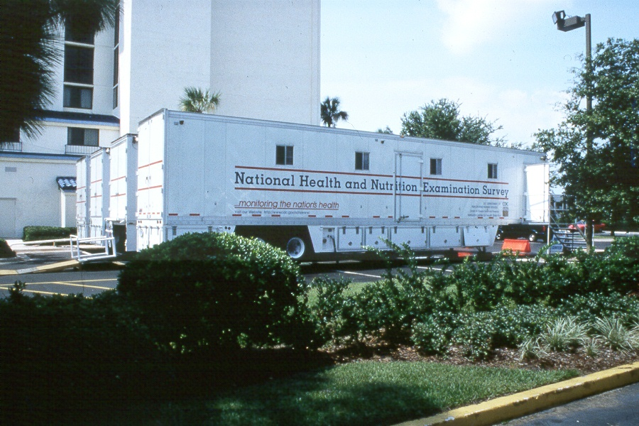
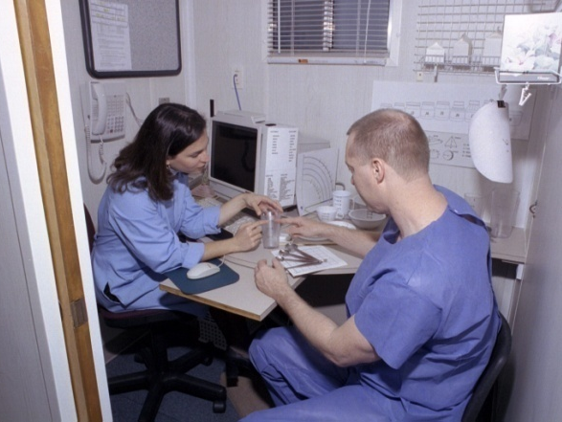
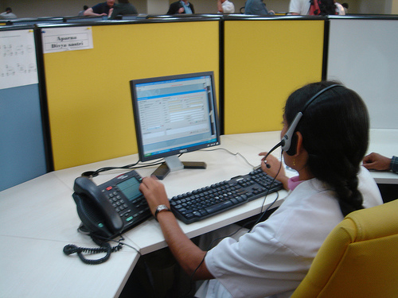
Supplements Added (2007-present) –
24-Hour Dietary Recall Interviews
ALL NHANES examinees (from birth+) are eligible for TWO 24-hour dietary recall interviews.
  Day 1: in-person in MEC
  Day 2: telephone
Notes:
Beginning in 2007, data is now collected on the usage of all vitamins, minerals, herbals and other dietary supplements as well as non-prescription antacids, as part of the dietary interviews.

Slide 11
Dietary Supplements Added –
Dietary Interviews (2007-present)
New design allows:
  researchers to combine food & beverage data with dietary supplement data
  researchers to improve total nutrient intake estimations & examine associations by nutrient source, such as from foods versus supplements.
  2007-08 data just released - August 2010
Notes:
The improved nutrient estimates will increase researchers’ ability to examine nutrient-disease or nutrient-health associations and to estimate percentages of the population with intakes over or under various nutrient standards.

Slide 12
Omega-3 Fatty Acids (2007- present)
Laboratory
  Participants 3 years & older
  public health agencies advise eating more fish, despite associated health risks of methylmercury
    Provide reference ranges by age, gender, race-ethnicity
    Relate biomarker data with dietary intake data
    Evaluate omega-fatty acids vs. methylmercury
    Evaluate omega-fatty acids vs. trans-fat
Notes:
NCEH – National Center for Environmental Health

Slide 13
Flexible Consumer Behavior Survey (FCBS) Module (2007-10)
Core module (household interview)
  family level questions
  participant level questions for 1 years & older
  2007-2008 data released on May 2010
Examples of family level topics
  time spent on food shopping & cooking
  meals eaten together in the family
Examples of participant level topics
  self-assessed dietary quality
  use of convenience foods
Notes:
The FCBS module comprises two elements: 1) a core set of questions designed to be repeated in each two-year cycle of NHANES; and 2) a supplementary module with specific focuses that is intended to be cycled periodically during two-year NHANES cycles.
FCBS Core Module
Topics included in family level questions:
family member’s use of special diet
availability of certain type of foods in the family
food expenditures
time spent on food shopping and cooking
meals eating together in the family
Topics for participants 1 years and older :
self-assessed dietary quality
frequency of getting meals prepared away from home
frequency of meals got from fast-food or pizza places
use of convenience foods
self-perceived vegetarian status
food allergy
food assistance program participation

Slide 14
Flexible Consumer Behavior Survey (FCBS) Module (2007-10)
Supplemental module (phone follow-up interview)
  NHANES participants age 16 years & older
  One adult in children participants’ (1-15 years old) family
  2007-2008 data to be released in 2010
Examples of topics included in 2007-08:
    Awareness of dietary recommendations
    Factors influencing grocery shopping
    Use of food labels
    Use of organic foods
Notes:
The FCBS module comprises two elements: 1) a core set of questions designed to be repeated in each two-year cycle of NHANES; and 2) a supplementary module with specific focuses that is intended to be cycled periodically during two-year NHANES cycles.
FCBS Supplementary Module
Topics included in 2007-2008:
attitudes toward to foods away from home
awareness of dietary recommendations
factors Influence grocery shopping
diet and body weight related believes and attitudes
use of food label
use of organic foods

Slide 15
Selected Content NHANES
2009-10

Slide 16
Inflammatory Back Pain (IBP) & Spondyloarthritis (2009-10)
Participants 20-69 years
Household Questionnaire - history of Inflammatory Back Pain
Exam - Arthritis-Related Body Measures
Laboratory - HLA-B27 & High-Sensitivity C-reactive protein
(Note: HLA-B27 - 1 year RDC data set)
Notes:
Ankylosing spondylitis (AS) refers to inflammation of the joints in the spine.
Expected release August 2011

Slide 17
Inflammatory Back Pain (IBP) & Spondyloarthritis (2009-10)
Goal - U.S. national prevalence data
  1st estimate for Inflammatory Back Pain (IBP) related to arthritis
  Provisional estimate for Spondyloarthritis (SpA)
  1st study of HLA-B27 arthritis biomarker prevalence, population distribution & associations
  Collect genetic testing database for future IBP & SpA research
Notes:
Provide the 1st U.S. National Prevalence Estimate for Inflammatory Back Pain (IBP) Related to Arthritis
Provide a Provisional U.S. National Prevalence Estimate for Spondyloarthritis (SpA). This is the 3rd Most Common Form of Arthritis in U.S. Adults
1st U.S. National Study of HLA-B27 Arthritis Biomarker Prevalence, Population Distribution & Associations. HLA-B27 may be Associated with Arthritis Risk
Collect an Unbiased Population-Based Genetic Testing Study Database for Future IBP and SpA Research

Slide 18
Audiometry (hearing) (2009-10)
Mobile Exam Center (MEC)
  Participants 70+ added back to survey
  Audiometry last done in this age group in NHANES in 2006

Slide 19
Human Papillomavirus (HPV) –
Oral Rinse (2009-present)
Mobile Exam Center (MEC)
  Participants 14 – 69 years
  perform the first population-based study of oral HPV infection
  determine the prevalence & type distribution of infection
  investigate the demographic & behavioral factors associated with infection

Slide 20
Celiac Disease (2009-present)
  Intolerance to dietary glutens
  U.S. prevalence not known
  Participants 6 years & older
  Questions
    history of having been diagnosed with celiac disease
    history of following a gluten free diet
  Laboratory blood tests
(Note: low prevalence expected; will be on NHANES 4 to 6 years)
Notes:
TTG-EMA - Anti-transglutaminase (tTG) and Anti-endomysium (EMA)
We propose to estimate the prevalence of celiac disease in the United States population.. Celiac disease is an intolerance to dietary glutens that has protean manifestations. In population surveys in other countries, it is found in about 0.5 to 1 percent of the population. It may well be as common in the United States, but has not been adequately examined. Advances in diagnostic testing now allow accurate disease prevalence estimates using two step serological testing. To provide reliable population estimates, four to six years of data collection are required.
A major recommendation of the 2004 NIH Celiac Disease Consensus Development Conference was to determine the overall prevalence of celiac disease in the United States and its ethnic distribution.(32) As NHANES provides the only representative samples of the U.S. population that includes collection of serum, it represents the best and perhaps only way to accomplish this goal. An accurate prevalence determination would be the benchmark for future recommendations regarding testing. Food labeling for common allergens including wheat has been of considerable aid to patients with celiac disease. But because the autoimmune process may be triggered by trace amounts of gluten, it usually must be eliminated entirely from the diets. Many processed foods may contain trace amounts of gluten due to contamination. An accurate prevalence determination could bring greater attention to this issue.

Slide 21
Home Urine Collection
(2009-present)
  Participants 6 & older
  26 million American adults have Chronic Kidney Disease (CKD)
  Early detection can help prevent progression to kidney failure
  Multiple high risk groups
    Diabetes, hypertension, family history of kidney disease, African Americans, Hispanics, Pacific Islanders, Native Americans & older persons
  NHANES provides national estimates of the prevalence of CKD in the US
Notes:
26 million American adults have CKD and millions of others are at increased risk (National Kidney Foundation statement)
Early detection can help prevent the progression of kidney disease to kidney failure.
High risk--diabetes, hypertension and family history of kidney disease
African Americans, Hispanics, Pacific Islanders, Native Americans and older persons are at increased risk

Slide 22
Urine Flow Rate (2009-present)
  Participants 6 years & older, who provide urine samples
  Urine specimen volume, date and time of collection
  Many NHANES environmental toxicants measured in urine
  Difficult to quantify exposures levels because concentrations vary by amount of urine produced
  estimates of urine flow rate allow for better quantification of exposures

Slide 23
Dietary Screener Module (2009-10)
Food frequency questionnaire without measurement of quantity
Useful to assess specific food components or nutrients
Questionnaire
  Participants 2-11 years old by proxy in the Household Interview
  Participants 12 years and older during the MEC Interview
Notes:
The Dietary Screener Module consists of 26 questions assessing participants’ intake of fruits and vegetables, fiber, added sugar, dairy/calcium, whole grains, red meat and processed meat. These were chosen because they are implicated in chronic disease etiology, targets of dietary guidance, potential or current targets for nutrition interventions, and/or current or potential targets for policy changes.

Slide 24



Dietary components of interest
(2009-10)
Fruits and Vegetables
Whole grains
Dairy and Calcium
Fruit
Fruit juice
Salad
Potatoes
Dried beans
Tomato sauce
Salsa
Cereal
Bread
Popcorn
Brown Rice
Milk
Cheese
Ice cream
Notes:
The Dietary Screener Module consists of 26 questions assessing participants’ intake of fruits and vegetables, fiber, added sugar, dairy/calcium, whole grains, red meat and processed meat. These were chosen because they are implicated in chronic disease etiology, targets of dietary guidance, potential or current targets for nutrition interventions, and/or current or potential targets for policy changes.

Slide 25
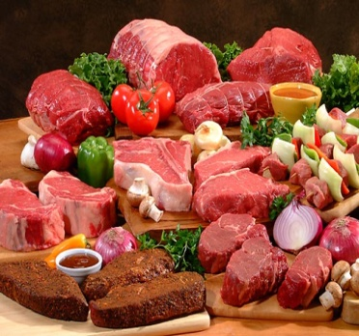
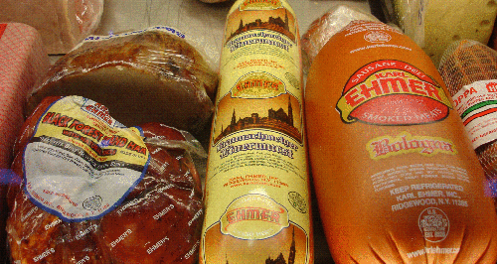

Dietary components of interest
(2009-10)
Red meat
Processed Meat
Added Sugar
Beef
Pork
Lamb
Red Meat
Chicken
Turkey
Soda
Fruit drinks
Cookies Cake
Pie
Doughnuts
Ice cream
Notes:
The Dietary Screener Module consists of 26 questions assessing participants’ intake of fruits and vegetables, fiber, added sugar, dairy/calcium, whole grains, red meat and processed meat. These were chosen because they are implicated in chronic disease etiology, targets of dietary guidance, potential or current targets for nutrition interventions, and/or current or potential targets for policy changes.

Slide 26
Flexible Consumer Behavior Survey (FCBS) Supplemental Module (2007-10)
  Core module the same through 2010
  Supplemental module modified in 2009-10
Additional topics :
    why people use or don’t use food labels
    use of organic foods among different food categories
    awareness of regulations related to organic foods
Notes:
NHANES participants age 16 years & older
One adult in children participants’ (1-15 years old) family

Slide 27
New NHANES Tutorials

Slide 28
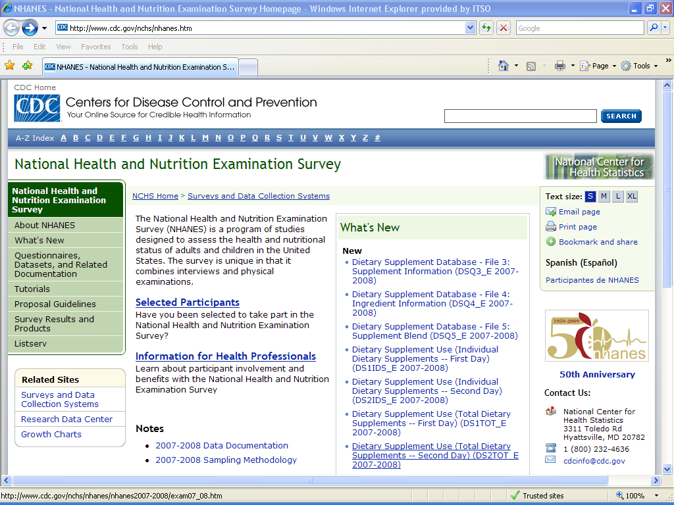
http://www.cdc.gov/nchs/nhanes.htm

Slide 29
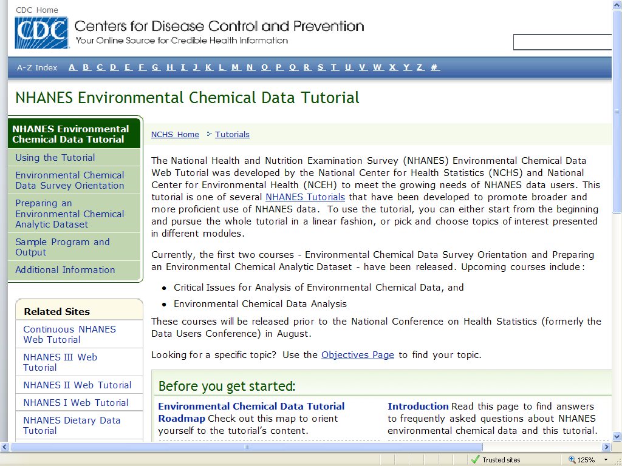
http://www.cdc.gov/nchs/tutorials/environmental/index.htm
NHANES Environmental Chemical Data Tutorial

Slide 30
  NHANES
  Environmental Chemical Tutorial
Rationale
  Meet the growing demands of NHANES environmental chemical data users
  Promote broader and more proficient use of this NHANES data

Slide 31
Example topics - NHANES Environmental Chemical Tutorial
  Understanding subsample designs & weighting of environmental specimens
  Creating an environmental data set for analysis (sample programs provided)
  Managing limit of detection & non-normality of environmental chemicals
  Use of lipid & creatinine adjustments when analyzing environmental data
Notes:
Before preceding, we wish to stress the three most important take home messages from today’s workshop.
Read the data documentation! Read the data documentation! Read the data documentation!
Doing this before starting any data analysis is crucial. While it takes a little time, it will save a lot more time and reduce your level of frustration during an analysis.
The NHANES tutorials rely extensively on the written NHANES data documentation. The tutorials do not contain all the exquisite details that NHANES has to offer. And trust me, the details are important.

Slide 32
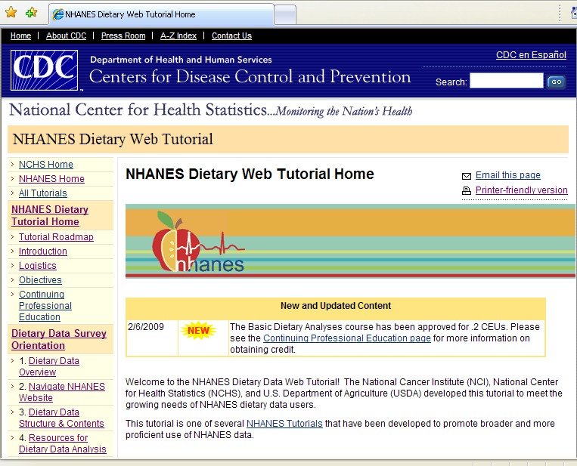
Dietary Tutorial – Advanced Modules

Slide 33
Advanced Dietary Tutorial Modules
Module 17 - Estimate prevalence and examine relationships using supplement data
Module 18 - Model usual intake using dietary recall data
Module 19 - Evaluate the effects of covariates on usual dietary intakes
Notes:
The FCBS module comprises two elements: 1) a core set of questions designed to be repeated in each two-year cycle of NHANES; and 2) a supplementary module with specific focuses that is intended to be cycled periodically during two-year NHANES cycles.

Slide 34
Advanced Dietary Tutorial Modules
Module 20 - Estimate population-level distributions of usual dietary intake
Module 21 - Examine the relationship between usual dietary intake and some outcome measure
Module 22 - Examining usual total nutrient intake from supplements and diet
Notes:
The FCBS module comprises two elements: 1) a core set of questions designed to be repeated in each two-year cycle of NHANES; and 2) a supplementary module with specific focuses that is intended to be cycled periodically during two-year NHANES cycles.

Slide 35
Thank You
NHANES Homepage
http://www.cdc.gov/nchs/nhanes.htm
Survey Content Brochure
http://www.cdc.gov/nchs/data/nhanes/survey_content_99_10.pdf
NHANES Tutorials
http://www.cdc.gov/nchs/tutorials/

