Slide 1
Overview of the
National Ambulatory Medical Care Survey and the
National Hospital Ambulatory Medical Care Survey
Farida Bhuiya M.P.H.,
National Center for Health Statistics

Slide 2
Overview
Background
Uses of data
Survey methodology
Data collection procedures
Accessing data
  Data on the web
  NCHS Research Data Center
  Analytical considerations
Notes:
This slide gives an overview of the topics I will talk about today. I will cover the background of the surveys, uses of survey data, methodology, and data collection procedures of NAMCS and NHAMCS. I will also discuss ways to access the survey data and some things to keep in mind when analyzing data.

Slide 3
BACKGROUND

Slide 4
National Ambulatory Medical Care Survey (NAMCS)
National probability sample survey
Patient visits to non-federal office-based physicians and community health centers (CHCs)
History
  Survey fielded 1973-1981, 1985, and 1989 – present
  Sample expanded in 2006 to include 104 community health centers (CHCs)
Notes:
The NAMCS is a nationally representative survey of visits to non-federal office-based physicians.
NAMCS has been in the field for almost 40 years. A sample of community health centers was added in 2006 to improve the reliability of CHC provider and visit estimates. While NAMCS traditionally surveys physicians, in the expansion to CHCs, NAMCS began to sample visits to nurse practitioners, physician assistants, and nurse midwives in addition to physicians within the CHC.

Slide 5
National Hospital Ambulatory Medical Care Survey (NHAMCS)
National probability sample survey
Patient visits to emergency departments (EDs), outpatient departments (OPDs), and ambulatory surgery centers (ASCs)
  History
  Survey fielded 1992 – present
  Two major modifications in scope:
    2009, added hospital-based ambulatory surgery centers
    2010, added freestanding ambulatory surgery centers
Notes:
The NHAMCS is the NAMCS counterpart in hospitals. The NHAMCS is a nationally representative survey of visits to emergency departments (EDs) and outpatient departments (OPDs) in non-federal short-stay or general hospitals.
A significant amount of ambulatory care is provided in hospitals, and planning for the NHAMCS began as early as 1976. The survey was finally fielded in 1992 and has been collecting data annually since then. The scope of the NHAMCS was expanded in 2009 to include hospital-based ambulatory surgery and in 2010 to include freestanding ambulatory surgery centers. Ambulatory surgery center data was previously captured in the National Survey for Ambulatory Surgery, which was discontinued due to lack of funding. Incorporating ASCs into NHAMCS allows us to get a greater picture of ambulatory care.

Slide 6
USES OF DATA

Slide 7
NAMCS/NHAMCS Survey Goals
National statistics on ambulatory care utilization
Provide data for health policy formulation
Provide comparative data for medical practice management
Notes:
The original goals of the two surveys were to provide nationally representative estimates of ambulatory care utilization in physician offices and hospitals, to provide data for health policy formulation, and comparative data for medical practice management.

Slide 8
Data Users
Health professional associations
State and federal policy makers
Health services researchers
Epidemiologists
Universities and medical schools
Broadcast and print media
Notes:
NAMCS and NHAMCS data have been widely used many researchers, including professional associations, state and federal policy makers, health services researchers, and by the media.

Slide 9
How are NAMCS and NHAMCS Data Used?
Changes in utilization and practice
  diagnoses, tests/procedures, prescribing
Quality of care
  Impact of performance measures and educational campaigns
  Healthy People 2010 objectives
Health disparities
Adoption of new technologies
  Electronic health records
Notes:
Researchers using the NAMCS and NHAMCS have analyzed changes in ambulatory care utilization and in physician practice patterns. The data has been used to produce quality measures for ambulatory care, identify health disparities, and monitor adoption of new technologies such as electronic health records.

Slide 10
NAMCS AND NHAMCS METHODOLOGY
Notes:
Next I will describe the NAMCS and NHAMCS methodology.

Slide 11
NAMCS Scope
In-scope providers:
  Traditional physicians
    Primarily engaged in office-based patient care
    Not Federally employed
    Not in anesthesiology, radiology, or pathology
  Community Health Centers (CHCs)
    Physicians and non-physician clinicians
    Federally qualified health centers
    Urban Indian Health Service outpatient clinics
Sample of 30 visits per provider over one week period
Notes:
NAMCS collects patient visit information from physician offices and community health centers. In-scope physicians are primarily engaged in office-based patient care as classified by the AMA or AOA, non-federally employed, and are not anesthesiologists, radiologists or pathologists. Within community health centers, we sample physicians as well as non-physician clinicians, including nurse practitioner, physician assistants, and nurse midwives.
We look at a sample of 30 visits per provider over a one week period.

Slide 12
NAMCS Sample Design
Community Health Center (CHC)
CHC Provider
CHC Provider
CHC Provider
~30 Patient Visits
~30 Patient Visits
~30 Patient Visits
~30 Patient Visits
Primary Sampling Unit (PSU)
Physician
Notes:
NAMCS has a multi-stage sample design involving a sample of geographically-defined primary sampling units (PSUs), a sample of physicians within PSUs, and a sample of visits within physician practices. The majority of the NAMCS sample is selected from the masterfiles of the American Medical Association (AMA) and American Osteopathic Association (AOA).

Slide 13
NAMCS Scope (cont.)
In-scope visits:
  Must occur in physician or CHC office
  Must be for medical purposes
Out of scope visits:
  Administrative visits
  House calls, emails, phone calls
2007 data
  3,450 doctors sampled
  104 CHCs sampled
  32,778 total visits
Notes:
The basic sampling unit for NAMCS is the physician office visit in which medical services are provided. Out of scope visits include administrative visits such as visits to pay a bill or leave a specimen, phone calls, email consults, house calls, or visits to hospitals.
In 2007, 3,450 physicians and 104 CHCs were sampled. The 2007 public use file includes 32,778 patient visit records.

Slide 14
NHAMCS Scope
In-scope hospitals
  Non-institutional general and short-stay
  Not Federal, military, or Veterans Administration facilities
Sample patient visits during a 4-week reporting period
2007 Data
  482 hospitals sampled
    35,490 ED visits
    34,473 OPD visits
Notes:
The NHAMCS survey collects patient visits to hospitals. The hospitals sampled in NHAMCS are non-institutional general and short-stay hospitals that are not Federal, military, or Veterans Administration facilities.
Within hospitals, we look at visits to the emergency department, outpatient department, and ambulatory surgery center. We sample patient visits for a 4-week period. In 2007, we sampled 482 hospitals and collected approximately 35,000 visits each from the ED and OPD.

Slide 15
2007 NHAMCS Sample Design
Emergency Department
Hospital
Outpatient Department
Emergency Service Area
Clinic 1
Clinic 2
Clinic 3
~100 ED Visits
OPD Visits
OPD Visits
OPD Visits
Primary Sampling Unit (PSU)
Clinic 4
Clinic 5
OPD Visits
OPD Visits
Sample ~200 visits across sampled clinics
Notes:
NHAMCS has a multi-stage sample design involving a sample of 112 PSUs, hospitals within those PSUs, Emergency service areas (ESAs) within EDs and clinics within OPDs. We then take a sample of 100 visits across ESAs and 200 visits across OPD clinics. Visits are sampled proportionally to the size of the clinic.

Slide 16
NAMCS AND NHAMCS
DATA COLLECTION

Slide 17
Data Collection
Induction interview
  Determine eligibility
  Obtain data on facility characteristics
  Train facility staff on data abstraction
Office/hospital staff abstracts Patient Record forms (PRFs)
Induction forms and PRFs are keyed and coded by a contractor
Entered data are edited and analyzed at NCHS
Notes:
The NAMCS and NHAMCS surveys are entirely paper-based. We start with the induction interview to determine whether the physician office or hospital is eligible for our surveys. We gather data on facility characteristics and then train the office staff to abstract data using our patient record forms.
After the assigned reporting period, which for NAMCS is one week and NHAMCS is 4 weeks, we collect the completed forms. A contractor keys and codes the survey data, and the data are sent to NCHS for editing and analysis.

Slide 18
Common Patient Record Form Items
Patient demographic information
Triage/Vital signs
Reason for visit
Injury/Poisoning/ Adverse effects
Provider’s diagnosis
Diagnostic and screening services
Treatment/procedures
Medications
Visit disposition
Providers seen
Notes:
The patient record forms are slightly different for each ambulatory care setting, but collect similar data items. These items include patient information, vital signs, reason for visit, diagnosis, medications, and visit disposition. The patient record forms for NAMCS visits and NHAMCS outpatient department visits are designed similarly to allow users to compare data from each setting.

Slide 19
Coding Systems Used
A Reason for Visit Classification (NCHS)
ICD-9-CM
  diagnoses
  external causes of injury
  procedures
Multum drug classification system
Notes:
As I mentioned before, the patient record forms are keyed and coded by a contractor. The following coding systems are used. For reason for visit, we use the NCHS classification system. For provider’s diagnosis, causes of injury, and procedures performed, we used the ICD-9-CM system. For coding medications, we use the Multum drug classification system.

Slide 20
Drug Classification System
1985-2005, FDA’s National Drug Code therapeutic classification was used
  Discontinued by FDA
  Only one level of sub-classification
2006-present, Multum Lexicon
  Two levels of sub-classification
  Regular updates

Slide 21
Accessing
NAMCS/NHAMCS
Data

Slide 22
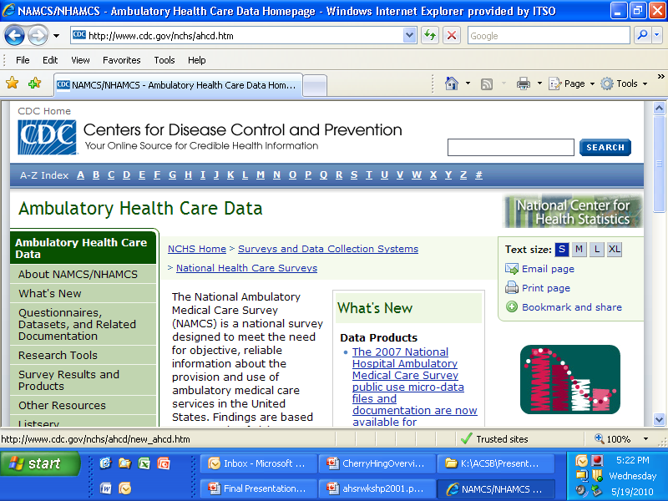
On the Internet at: http://www.cdc.gov/nchs/ahcd.htm

Slide 23
Microdata Files
Downloadable flat ASCII files
    NAMCS, 1973-2007
    NHAMCS, 1992-2007
CD-ROMs
    NAMCS, 1990-2005
    NHAMCS, 1992-2005
Notes:
On the web, you can find downloadable ASCII files. You can also request CD-ROMs of our data or pick up copies at our booth.

Slide 24
Anticipated Data Releases in Year 2010
2008 NAMCS public use file
2008 NHAMCS public use file
Combined 2006-2008 NAMCS community health center (CHC) visit file
  2006 and 2007 NAMCS file only included CHC physician visits
  Combined file will include all 2006-2008 CHC visits (physicians, physician assistants, nurse practitioners, and nurse midwives)

Slide 25
NCHS
RESEARCH DATA CENTER (RDC)

Slide 26
Advantages of the RDC
Gain access to information not available on public use files
  Patient: ZIP code linked income, education, etc.
  Provider: sex and age, teaching hospital
  Geographic: FIPS state and county codes
  Full list of variables on website
Data from NAMCS/NHAMCS supplements

Slide 27
NAMCS/NHAMCS Supplements
  Emergency Pediatric Services and Equipment Supplement (EPSES) - 2002-2003, 2006
  Pandemic and Emergency Response Preparedness Supplement – 2008
  Upcoming: Cervical Cancer Screening Supplement - 2006-2010

Slide 28
USER CONSIDERATIONS

Slide 29
NAMCS/NHAMCS Strengths
Amount of utilization
Health care users
Treatment patterns
Trends over time
Springboard for future research
Notes:
The strengths of NAMCS and NHAMCS data are that they measure actual utilization of ambulatory care, as recorded in the patients’ medical records. Characteristics measured include patient and provider characteristics, and the content of the medical encounter, including reasons for the visit, diagnoses made, tests or procedures ordered or provided, and medications prescribed. These data can be used to examine specific treatment patterns, as well as trends over time. Each year over 100 journal articles are published based on secondary analysis of the NAMCS or NHAMCS. Another strength of the surveys is the continuous improvements made to the surveys including the NAMCS and NHAMCS expansions in scope.

Slide 30
NAMCS/NHAMCS Limitations
Few outcome measures
Lacks longitudinal view
Documents single episode of illness
Rare event estimation is difficult
Notes:
The NAMCS and NHAMCS data are subject to certain limitations. First, the surveys have few outcome measures. We record tests ordered or provided, but we don’t measure the lab values of the tests. Second, since visits are the sample unit, we cannot identify individual patients. This in turn prevents us from following patients longitudinally or trying to capture episodes of care across providers. Finally, although our sample of visits is fairly large, rare events may lack sufficient cases for analysis.

Slide 31
Reminders
NAMCS / NHAMCS sample visits, not patients
No estimates of incidence or prevalence
No state-level estimates
Except for CHCs, we do not sample by setting or by non-physician providers
Notes:
Here are some reminders as you analyze our data. NAMCS / NHAMCS sample visits, not patients and there are no estimates of incidence or prevalence. At this time, we do not have sufficient data for state-level estimates. Except for CHCs, we do not sample by setting or by non-physician providers. Our data may capture different types of care for solo vs. group practice physicians

Slide 32
Sample Weight
Sample data MUST be weighted to produce national estimates
Estimation process
  Adjusts for survey and item nonresponse
  Makes several ratio adjustments within and across physician specialties and hospitals
Notes:
Another important thing to keep in mind is the importance of applying sample weights. When you are analyzing the data, you must apply sample weights to produce national estimates. The estimates adjust for nonresponse and make ratio adjustments within and across specialties and hospitals.

Slide 33
Where to Get More Information
Website - http://www.cdc.gov/nchs/ahcd.htm
Ambulatory Care Listserv (ACLIST) - http://www.cdc.gov/nchs/ahcd/ahcd_listserv.htm
Call Ambulatory and Hospital Care Statistics Branch at (301) 458-4600
Public Use Documentation

Slide 34
Thank You
Farida Bhuiya Chun-Ju Hsiao
fbhuiya@cdc.gov jhsiao1@cdc.gov
Notes:
Be sure to visit our booth for survey content booklets, survey results, and other materials.

