Slide 1
Explore, customize, download: pre-tabulated national health statistics

Slide 2
Objectives
By the end of today’s workshop, you should:
Know how to navigate to and through the Health Data Interactive website
Understand the website’s general benefits and limitations
Be able to locate tables of interest
Be able to customize and retrieve data in a useful form

Slide 3
What is Health Data Interactive (HDI)?
HDI is a collection of online, interactive tables on the health and well-being of the US population
HDI provides pre-tabulated statistics for several covariates:
Age
Race and ethnicity
Gender
Year
Geographic location (when available)
Income (when available)
Urbanicity (when available)

Slide 4
Data sources fall into 3 categories
Data systems with total counts of events
Births and Deaths from the National Vital Statistics System
Population surveys
National Health Interview Survey
National Health and Nutrition Examination Survey
Administrative data
National Hospital Ambulatory Medical Care Survey
National Hospital Discharge Survey
Medicare Current Beneficiary Survey

Slide 5
Before demonstrating how to use HDI, we’ll show two examples of HDI data in use
Exploring patterns in injury death rates
Leading causes of emergency department visits by age group

Slide 6
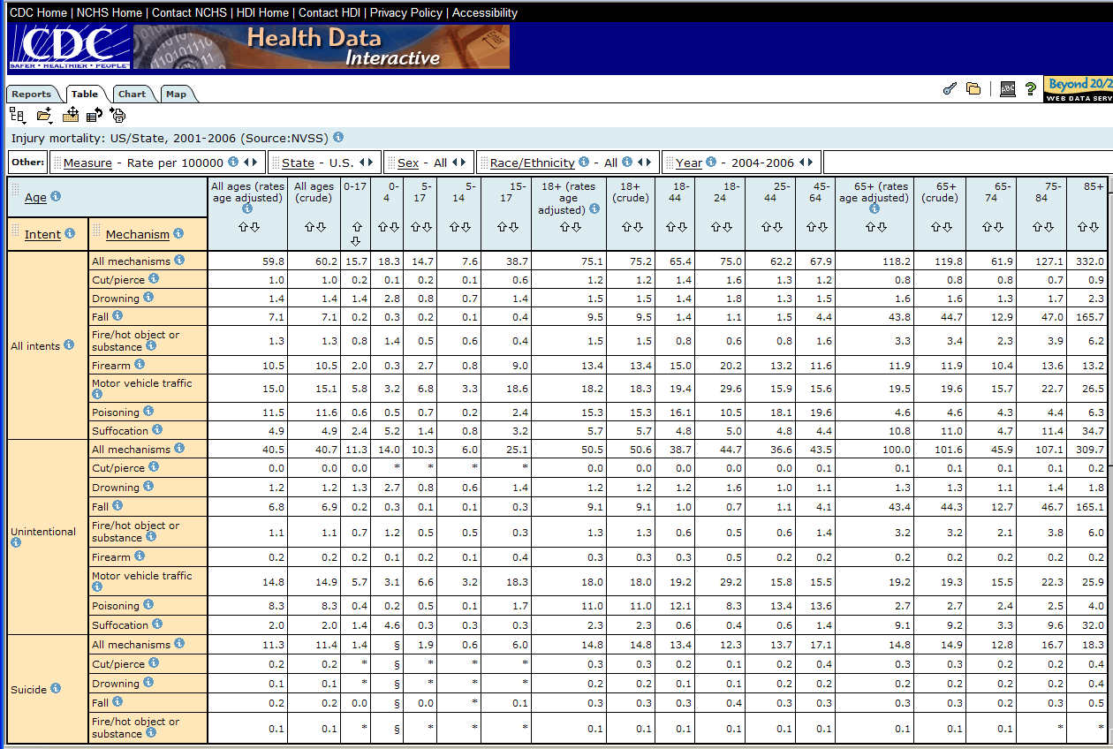
Pretabulated data on injury mortality

Slide 7
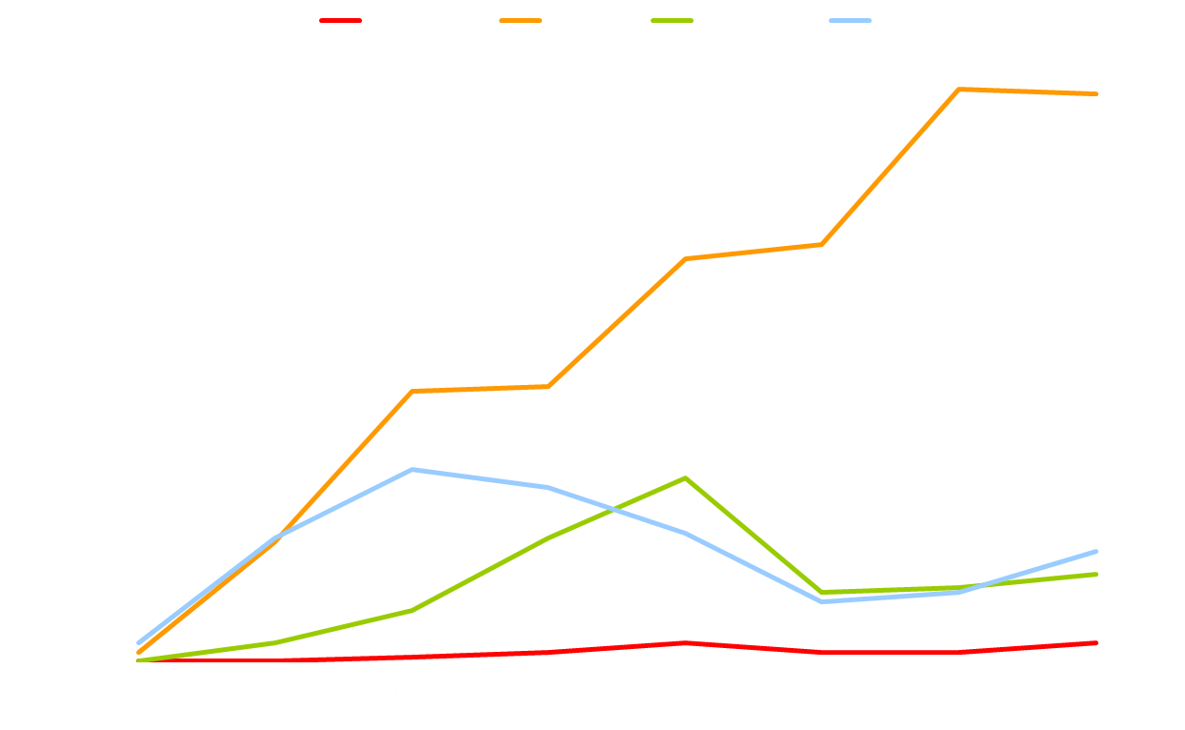
A custom-made chart from the injury mortality HDI table: Suicide per 100,000, by age group and mechanism--United States, 2004-2006

Slide 8
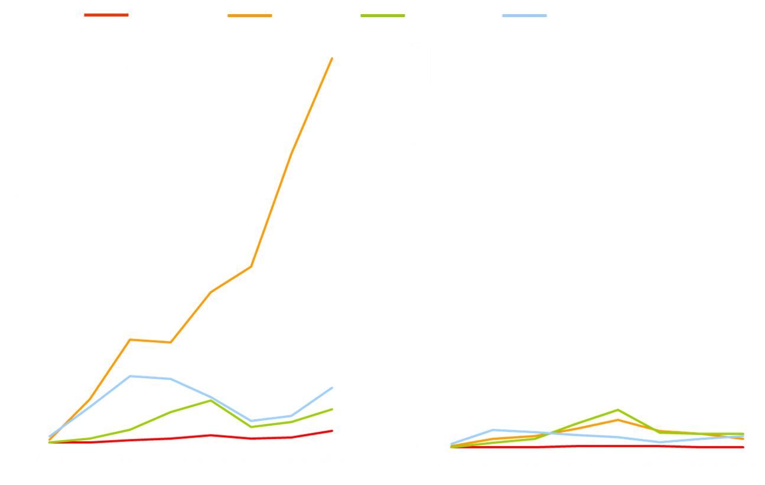
Looking more in depth at patterns by sex: Suicide per 100,000, by sex, age group and mechanism--United States, 2004-2006

Slide 9
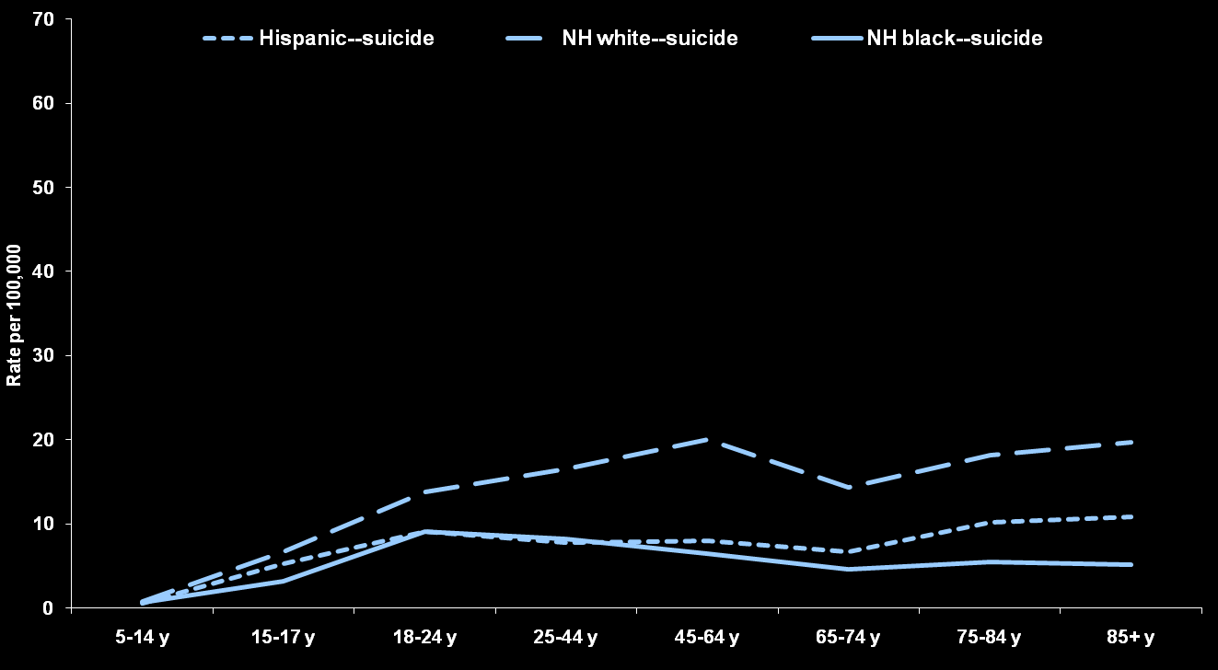
Another example of subgroup patterns: Suicide per 100,000, by race/ethnicity and age group--United States, 2004-2006

Slide 10
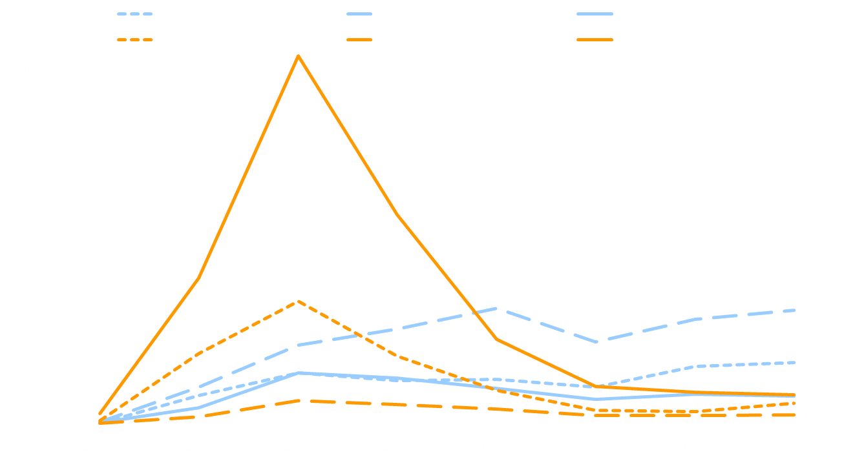
Comparing injury death intents: Suicide and homicide per 100,000, by race/ethnicity and age group--United States, 2004-2006

Slide 11
Looking at geographic detail: Suicide by firearm per 100,000 by state — 2004-2006

Slide 12
Another geographic perspective:
Suicide by firearm per 100,000 by state — 2004-2006

Slide 13
Switching to examining emergency department use: Top 10 causes of emergency department visits, by age, 2005-2007

Slide 14
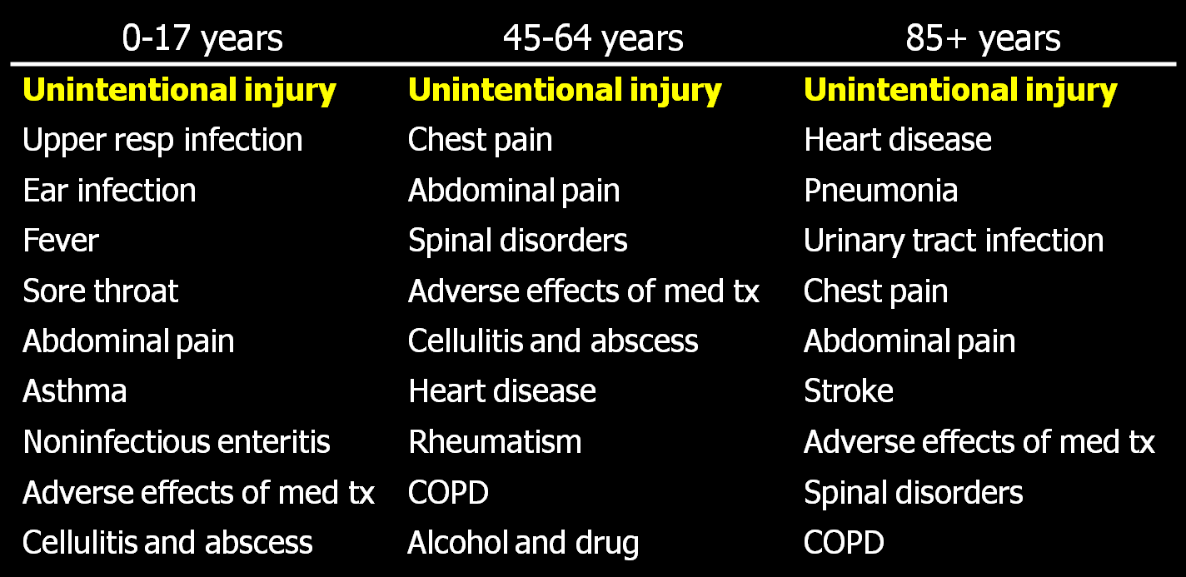
Top 10 causes of emergency department visits, by age, 2005-2007

Slide 15
Top 10 causes of emergency department visits, by age, 2005-2007

Slide 16
Top 10 causes of emergency department visits, by age, 2005-2007

Slide 17
Top 10 causes of emergency department visits, by age, 2005-2007

Slide 18
Some overall considerations before showing the nuts and bolts of HDI
Estimates may be single year or multiple-year, depending on the topic
Examples in the previous slides used three-year annual estimates
Pooled years yield greater precision (e.g., statistics on children)
Pooled years give the ability to show estimates for smaller population sub-groups
Trend vs. detail
Some tables will have time trends, but less detailed covariates (and vice versa)
Data suppression
Estimates with a relative standard error>30% are suppressed (relative standard error=standard error ÷ estimate)
Estimates based on insufficient sample sizes are suppressed (depends on data source)

Slide 19
We will show how to…
Find tables
Manipulate interactive tables
Scroll through variables
Select variable categories to view
Sort
Move variables around and reset
Read the metadata
Create charts
Create maps
Print
Export
Download

Slide 20
We will show how to…
Find tables
Manipulate interactive tables
Scroll through variables
Select variable categories to view
Sort
Move variables around and reset
Read the metadata
Create charts
Create maps
Print
Export
Download

Slide 21
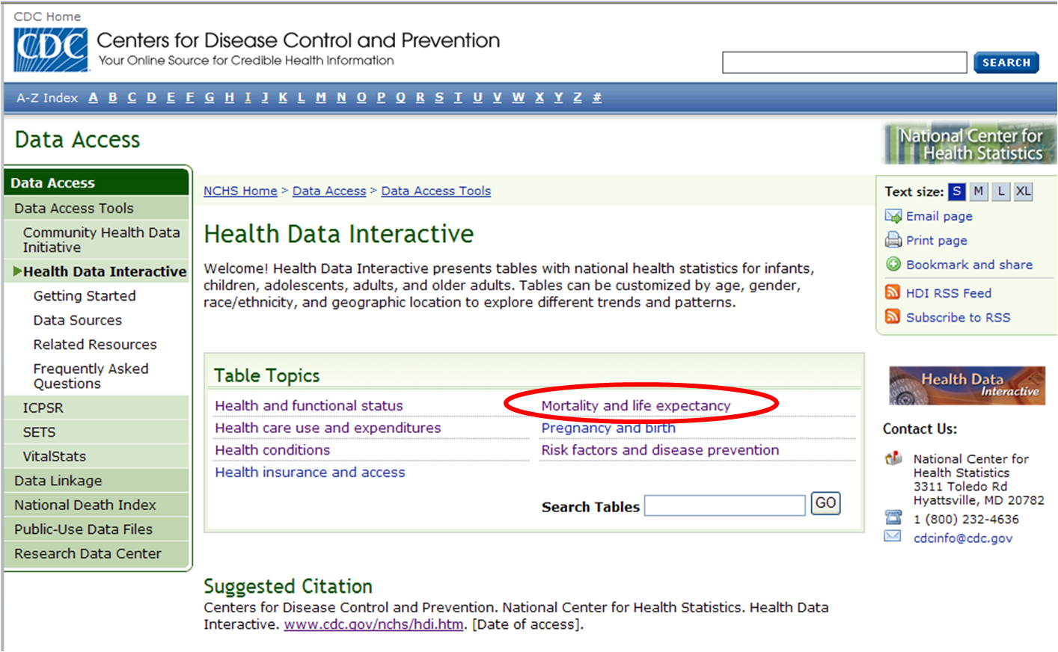
HDI homepage: www.cdc.gov/nchs/hdi.htm

Slide 22
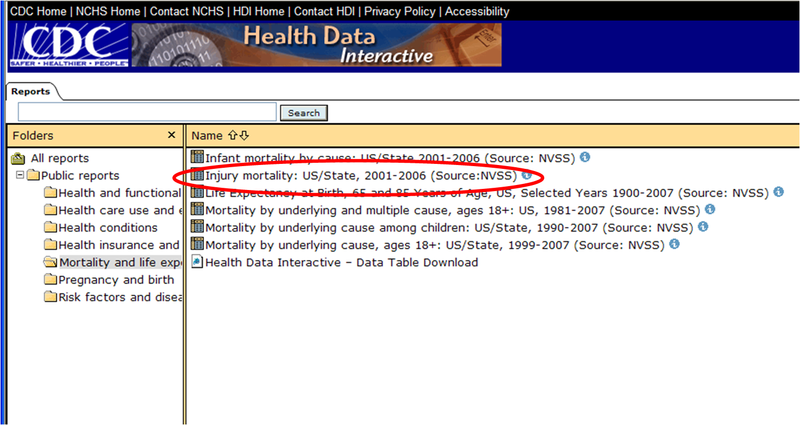

Slide 23
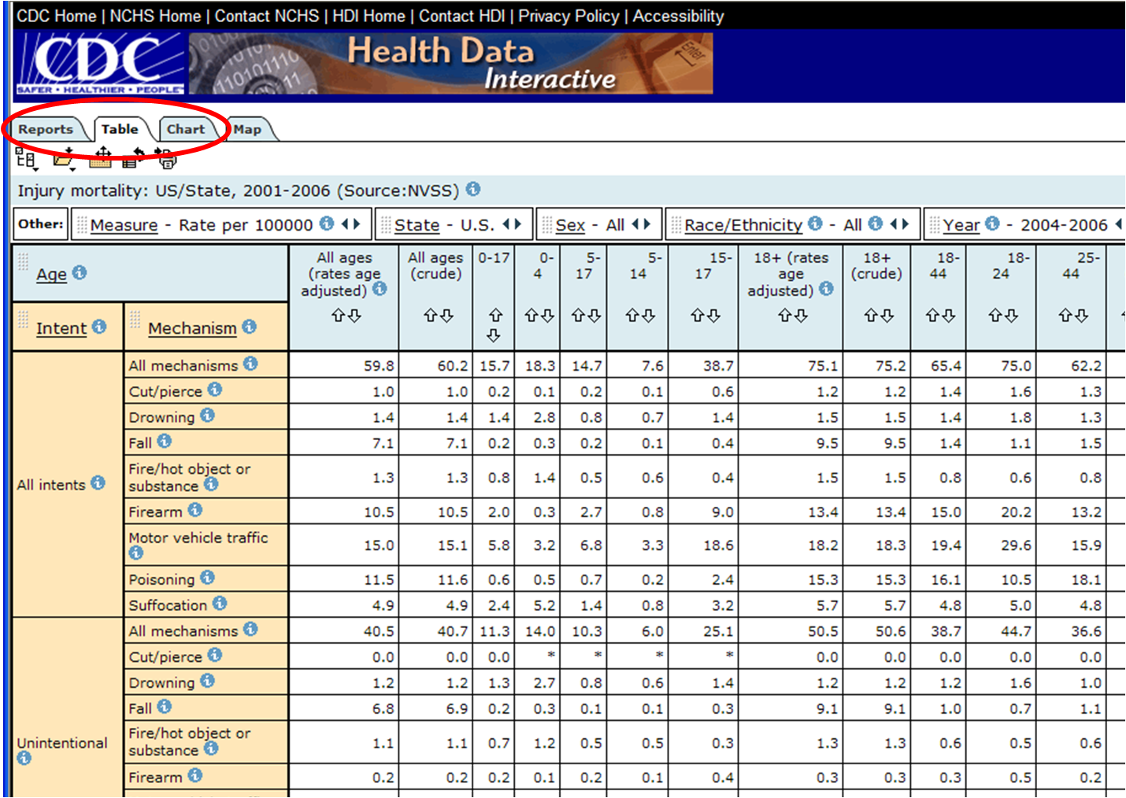

Slide 24
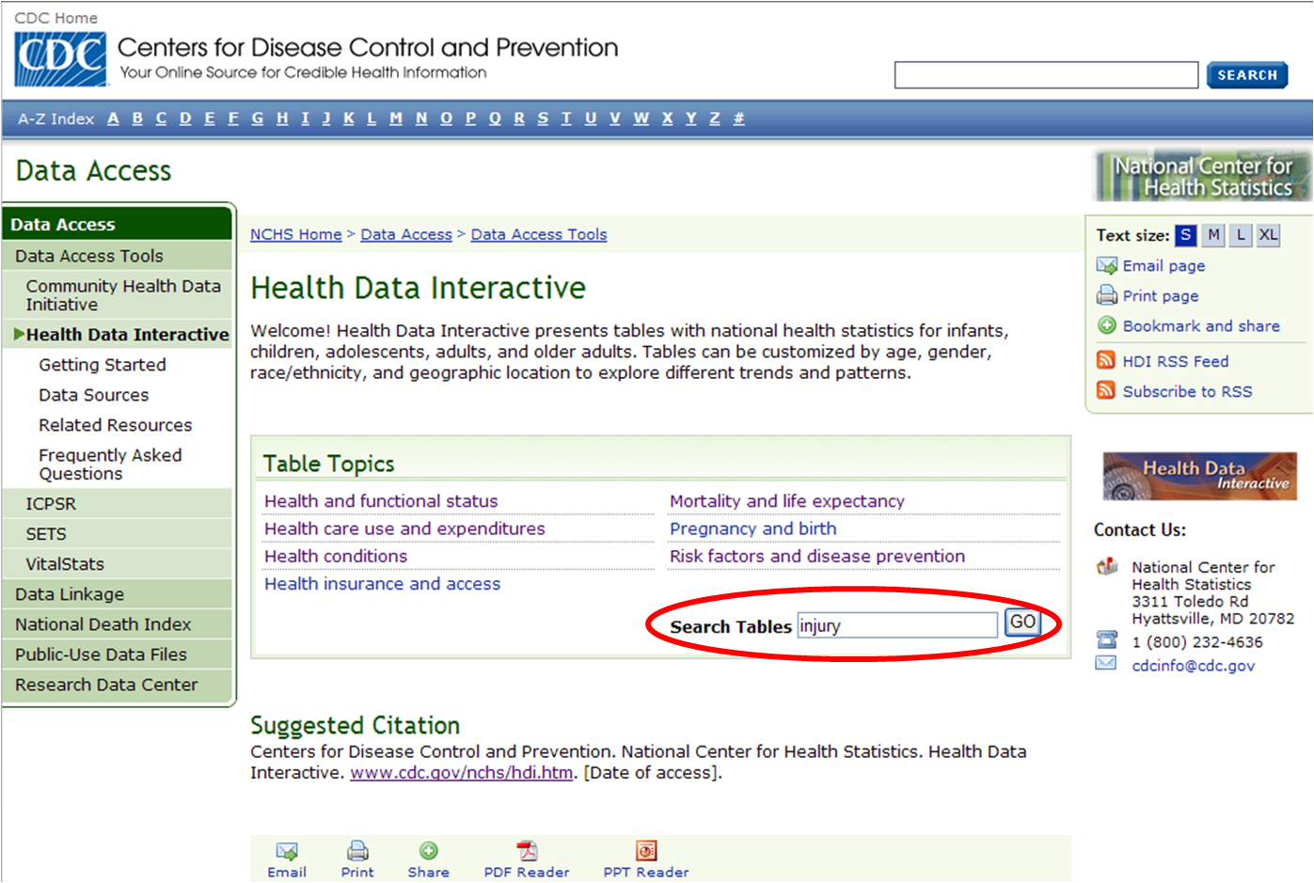

Slide 25
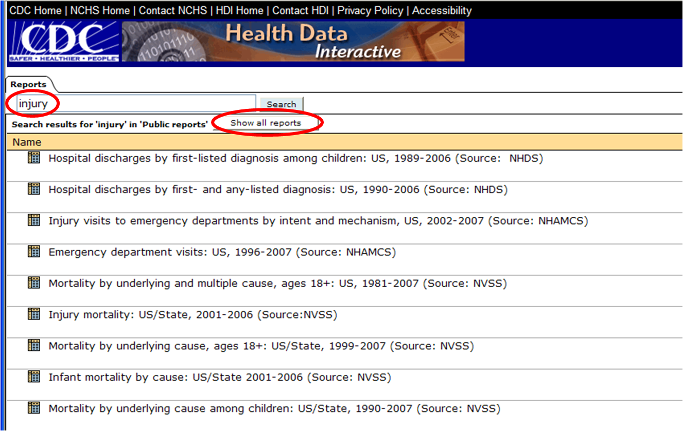

Slide 27
We will show how to…
Find tables
Manipulate interactive tables
Scroll through variables
Select variable categories to view
Sort
Move variables around and reset
Read the metadata
Create charts
Create maps
Print
Export
Download

Slide 29
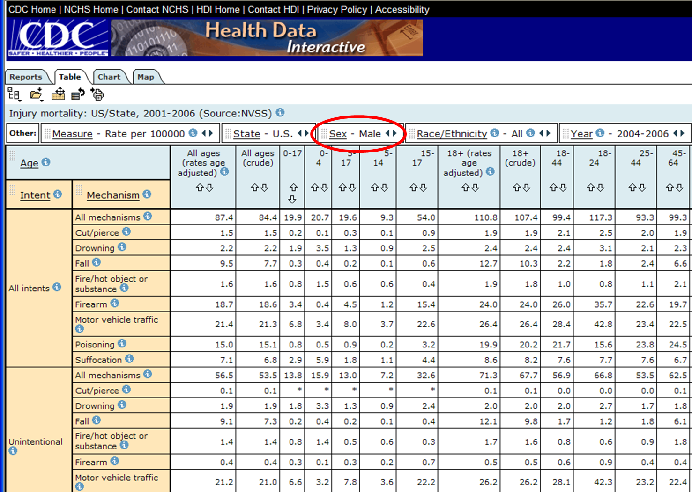

Slide 30
We will show how to…
Navigate to the site
Find tables
Manipulate interactive tables
Scroll through variables
Select variable categories to view or
Sort
Move variables around and reset
Read the metadata
Create charts
Create maps
Print
Export
Download

Slide 31
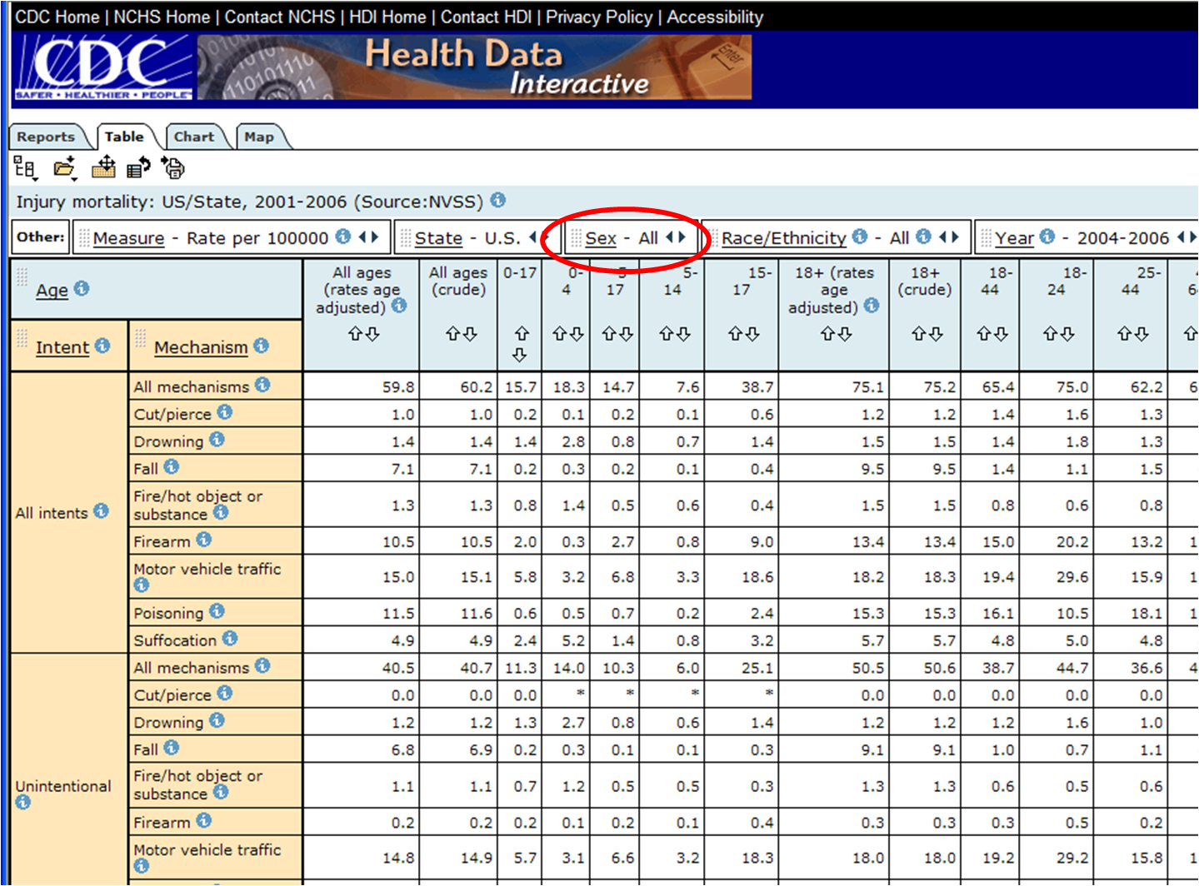

Slide 32
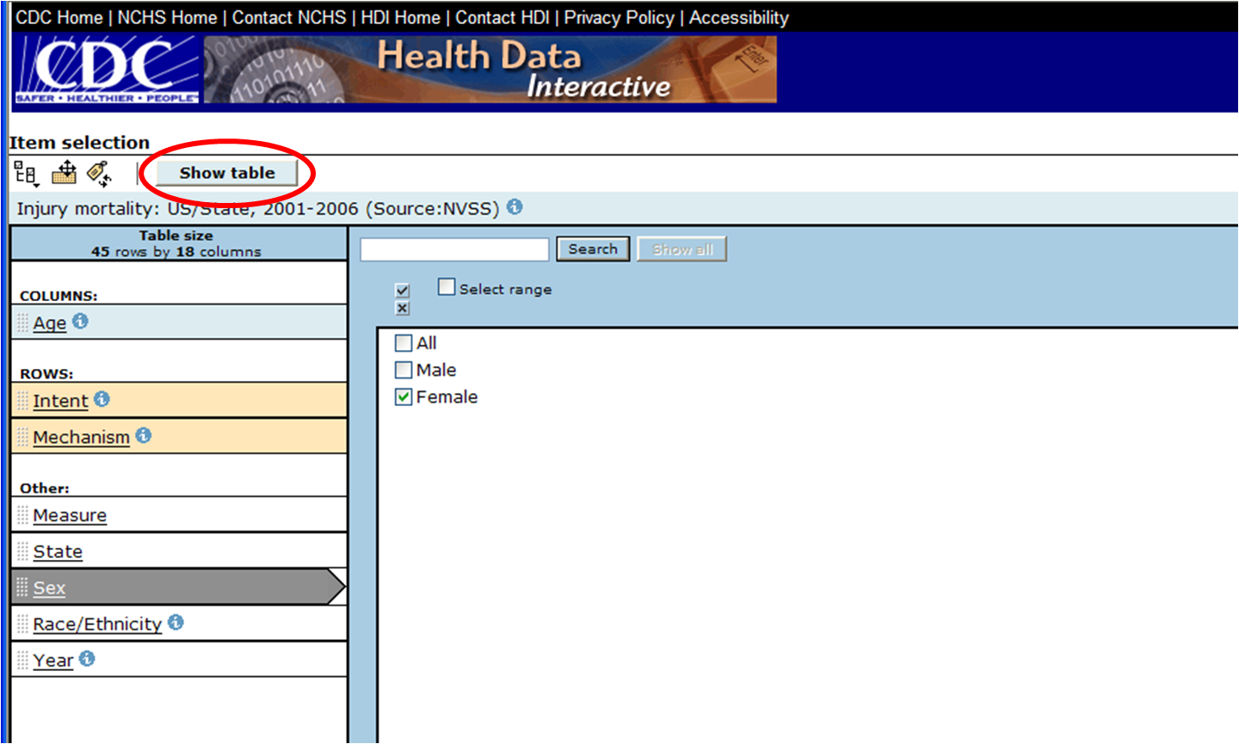

Slide 33
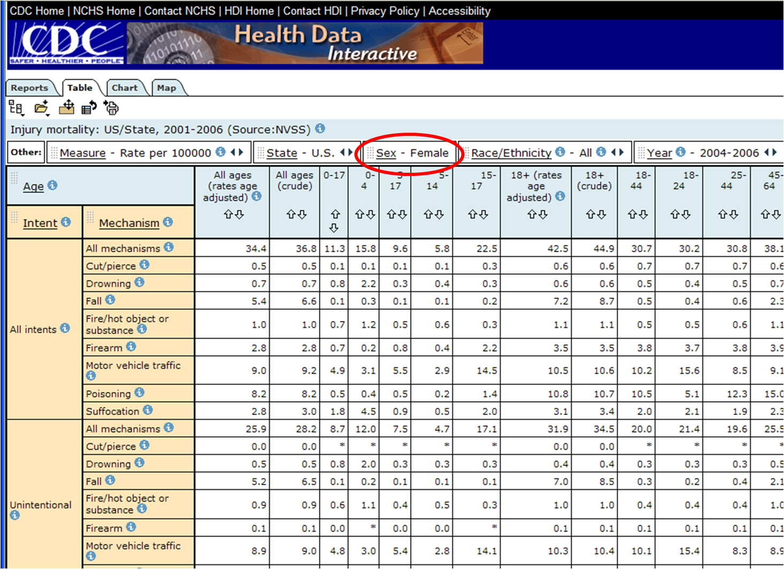

Slide 34
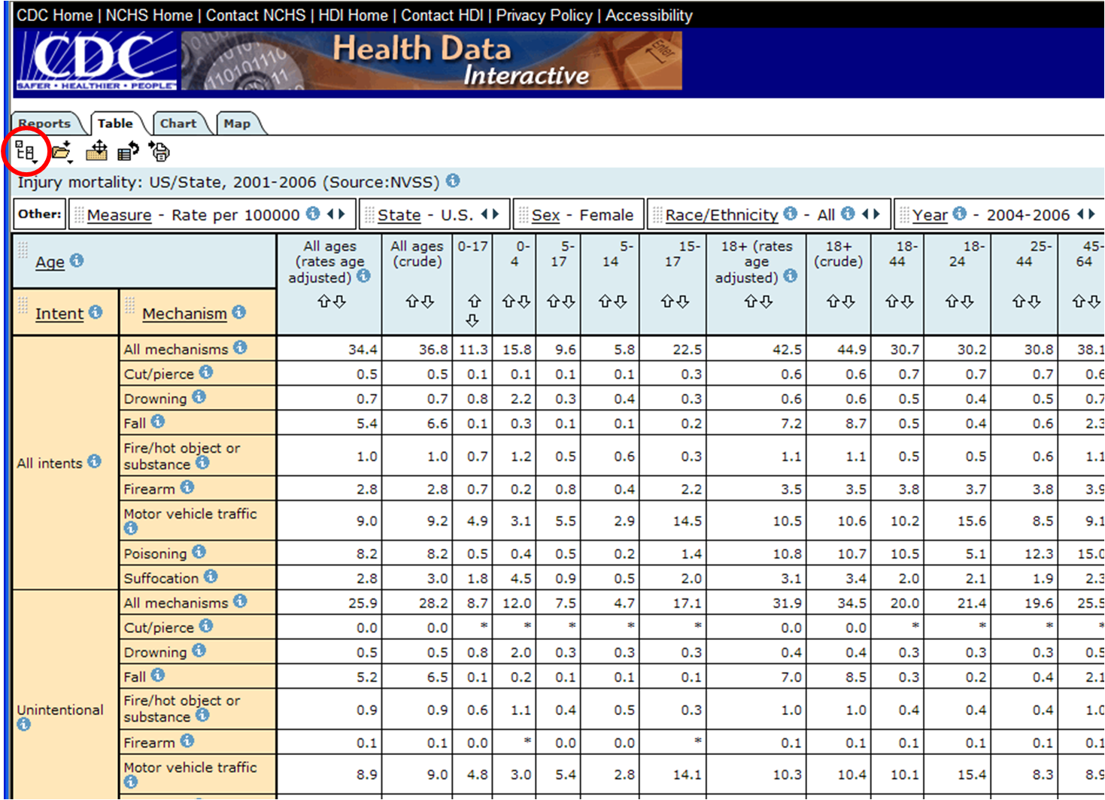

Slide 37
We will show how to…
Navigate to the site
Find tables
Manipulate interactive tables
Scroll through variables
Select variable categories to view
Sort
Move variables around and reset
Read the metadata
Create charts
Create maps
Print
Export
Download

Slide 38
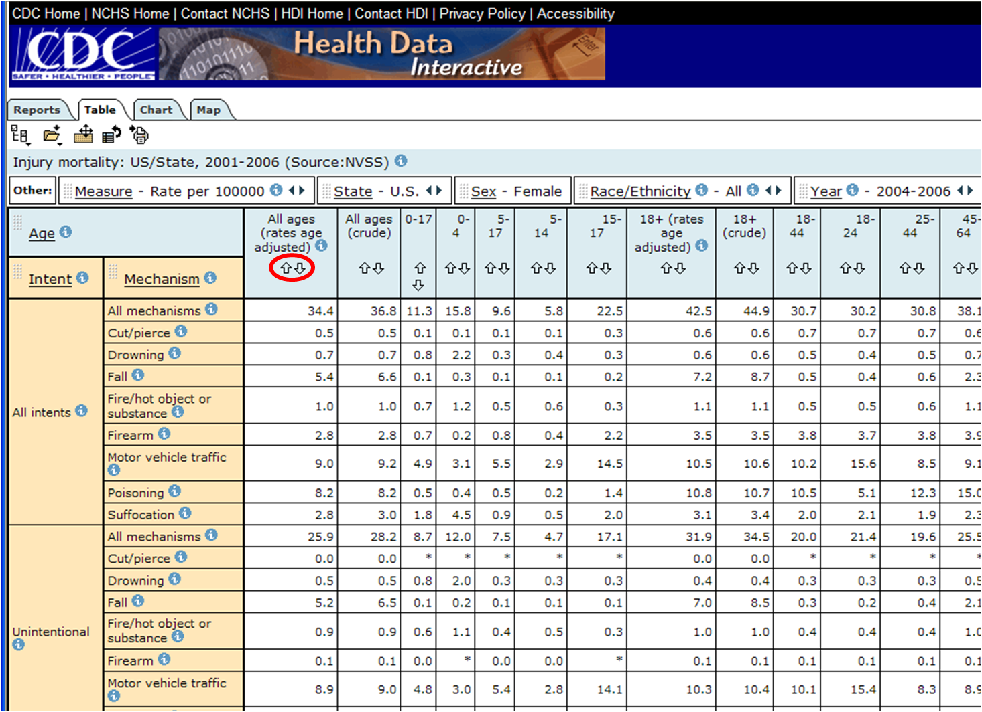

Slide 39
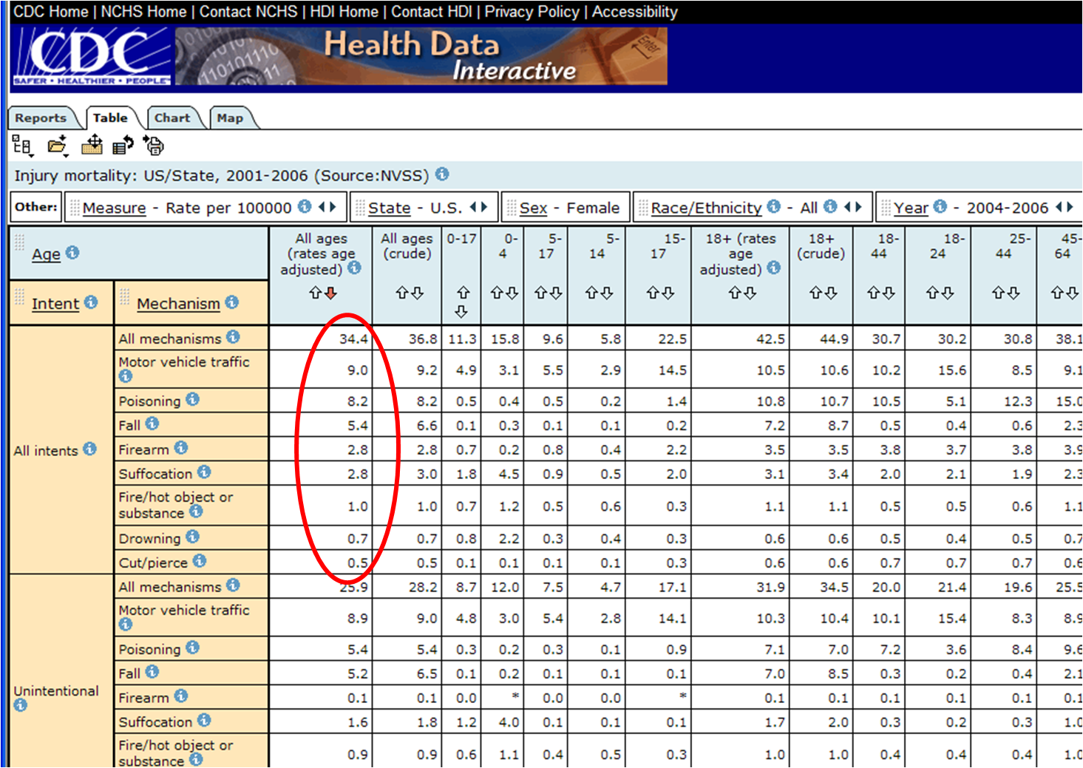

Slide 40
We will show how to…
Find tables
Manipulate interactive tables
Scroll through variables
Select variable categories to view
Sort
Move variables around and reset
Read the metadata
Create charts
Create maps
Print
Export
Download

Slide 41
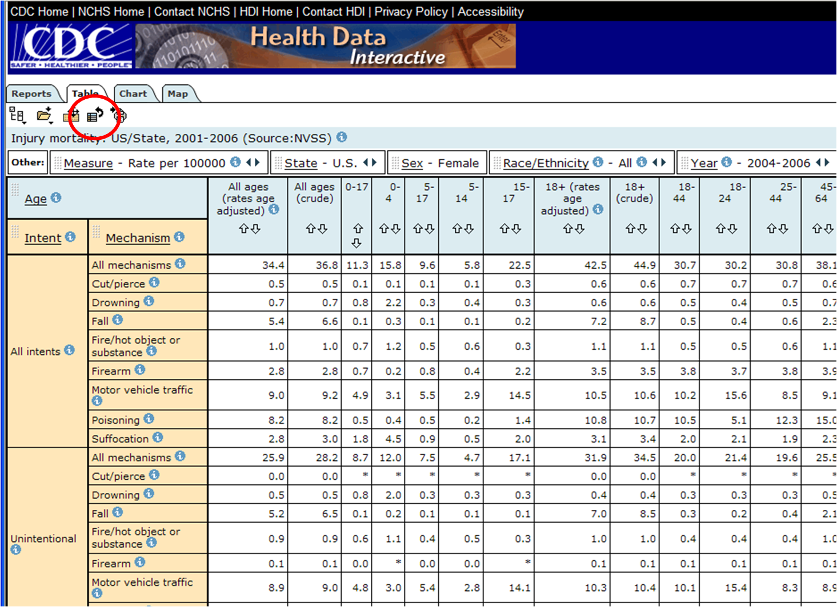

Slide 43
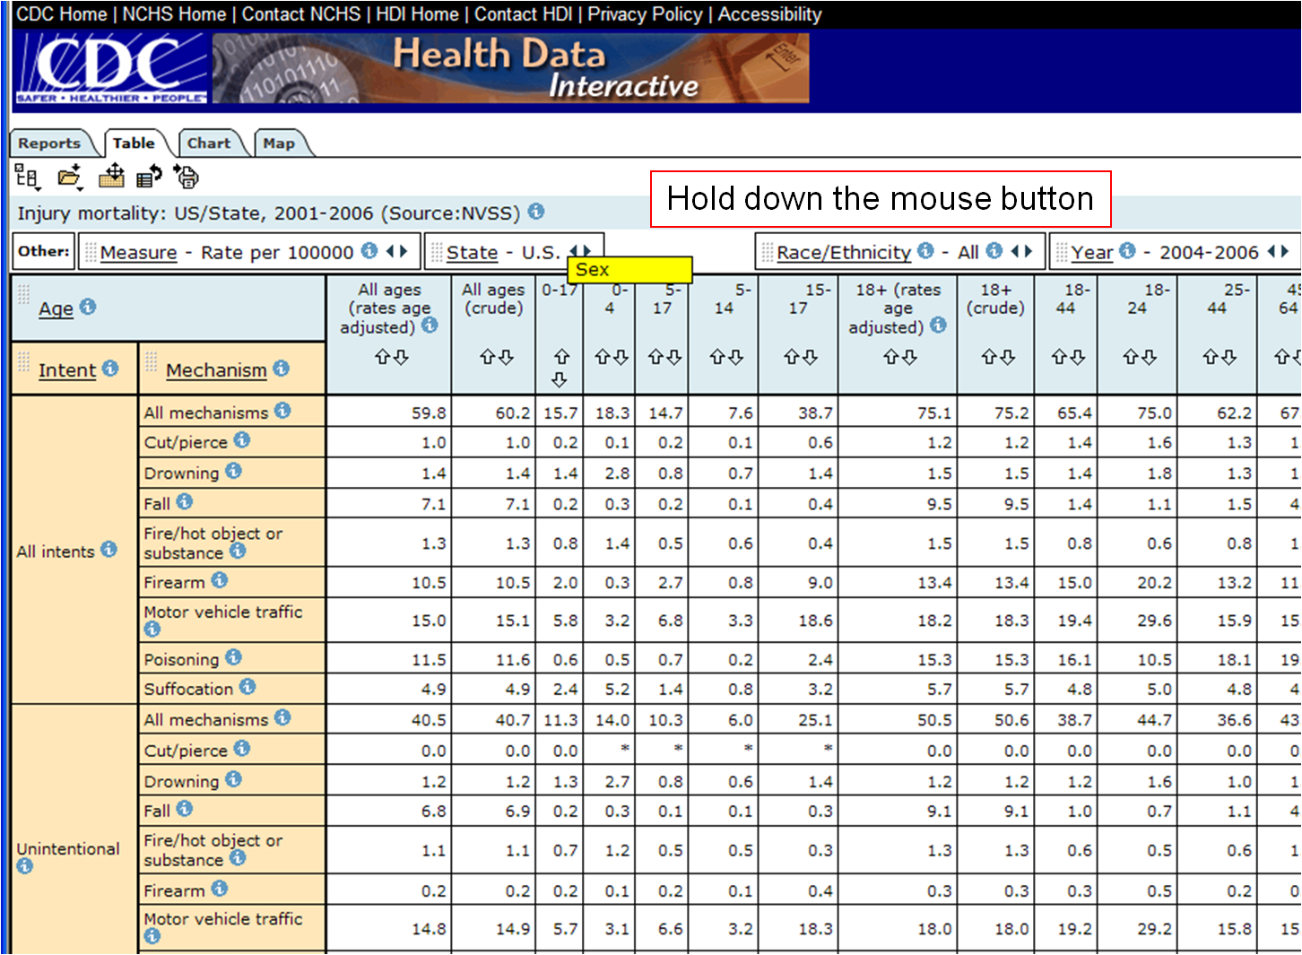

Slide 45
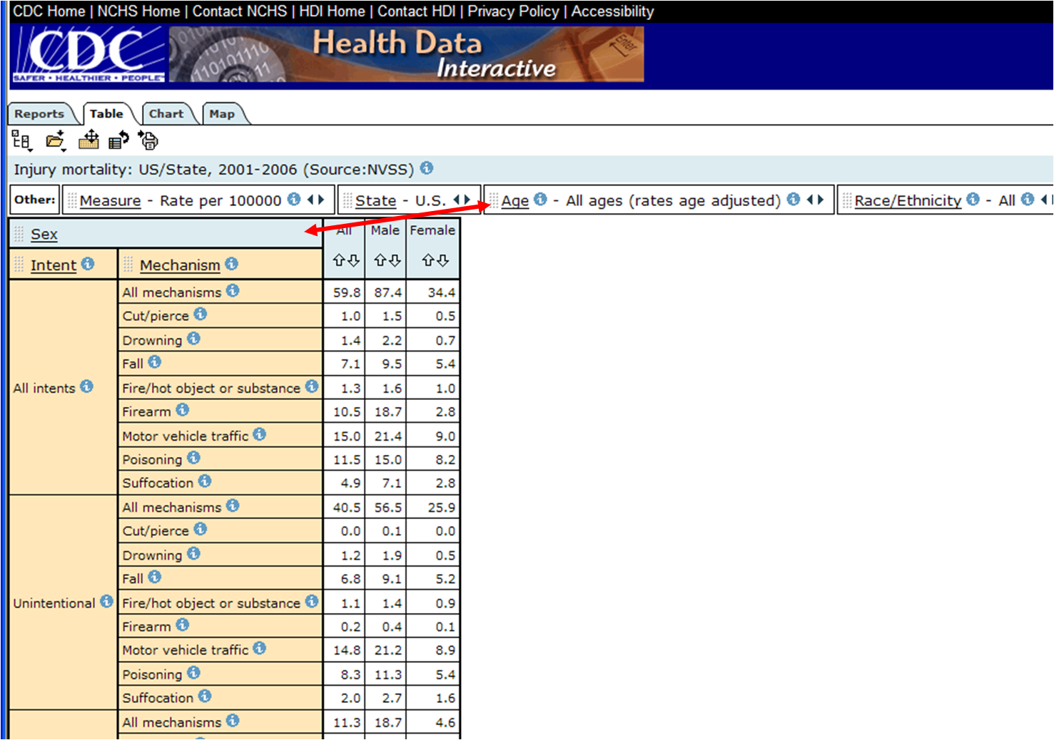

Slide 48
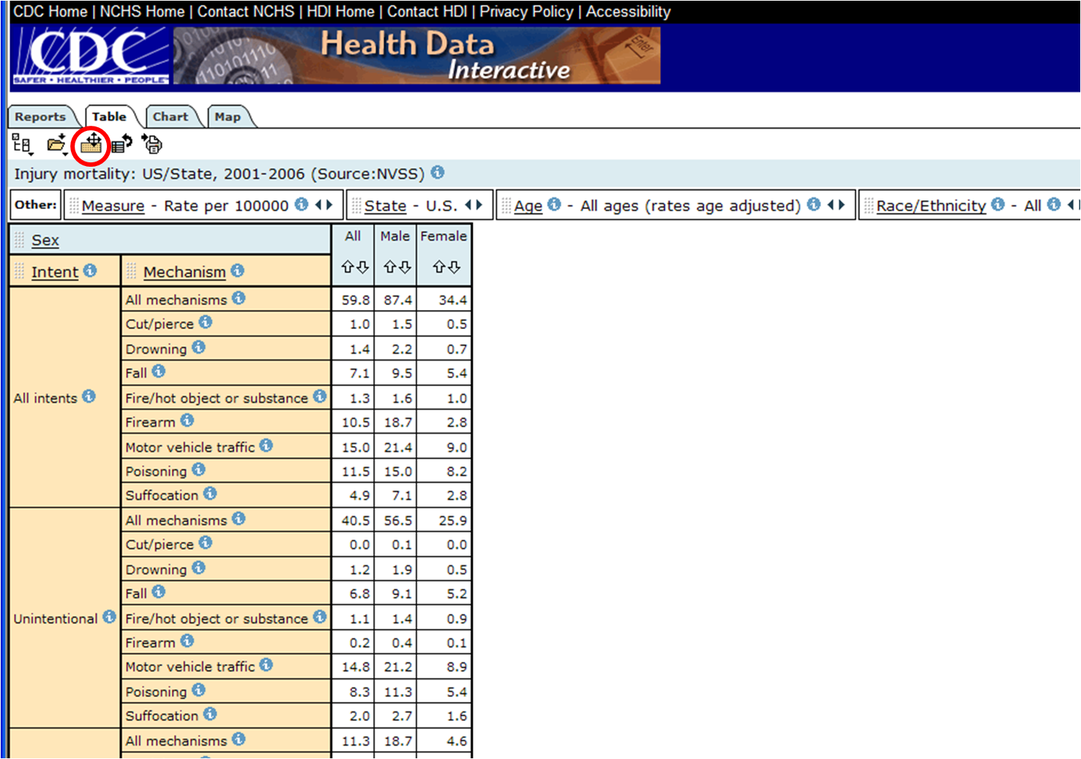

Slide 49
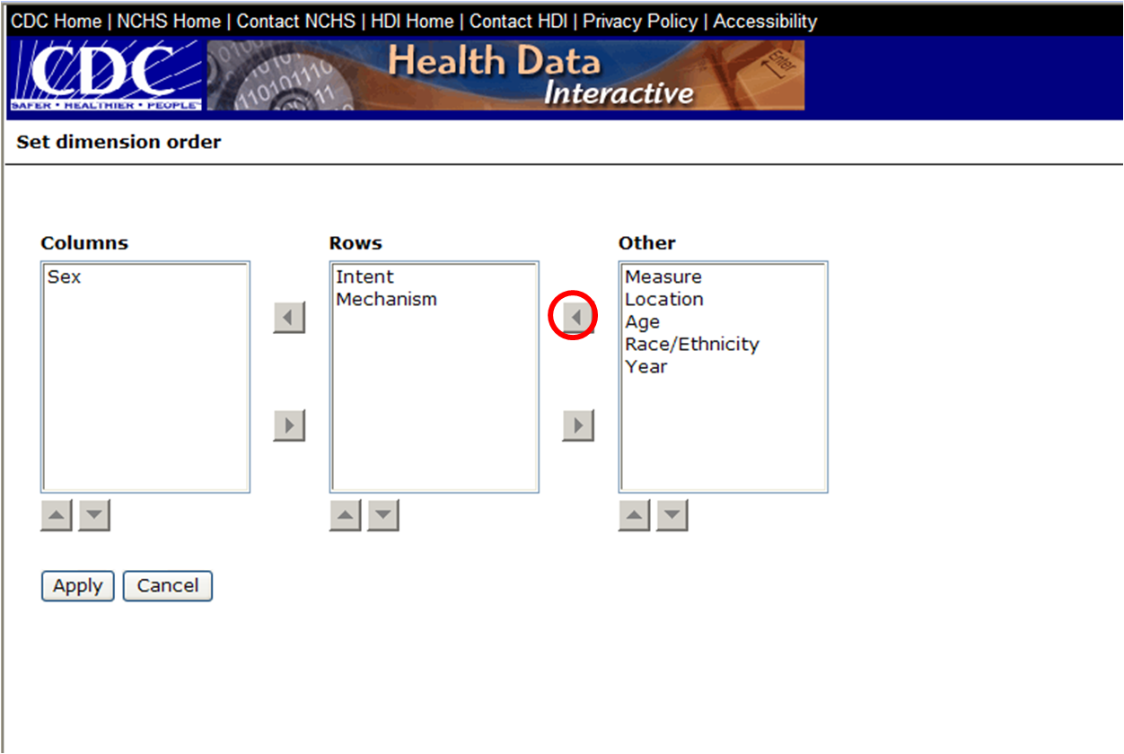

Slide 51
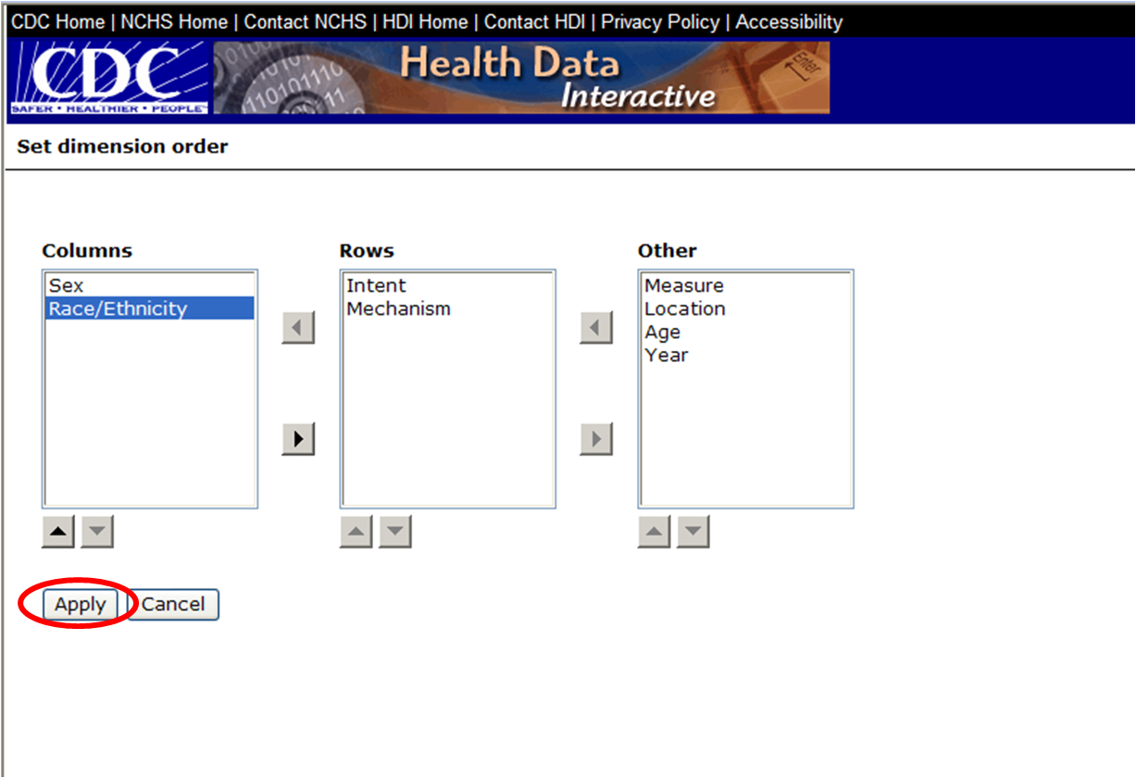

Slide 52
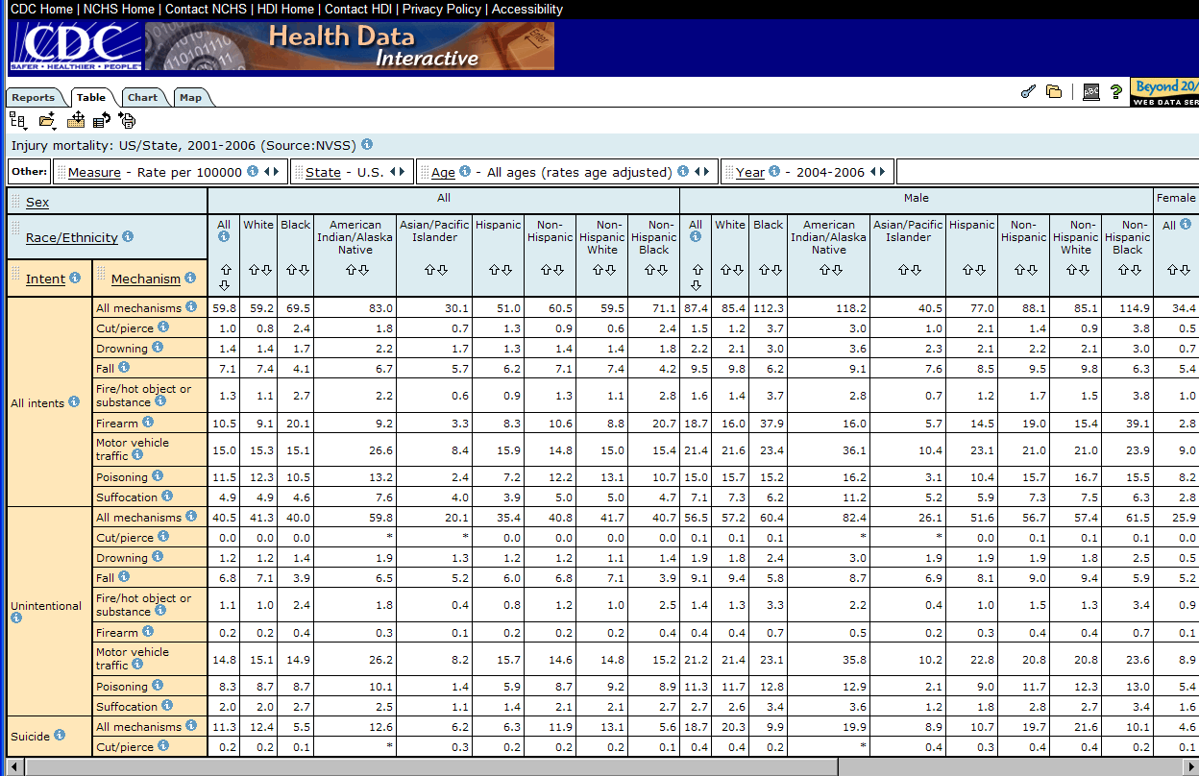

Slide 53
We will show how to…
Navigate to the site
Find tables
Manipulate interactive tables
Scroll through variables
Select variable categories to view
Sort
Move variables around and reset
Read the metadata
Create charts
Create maps
Print
Export
Download

Slide 54
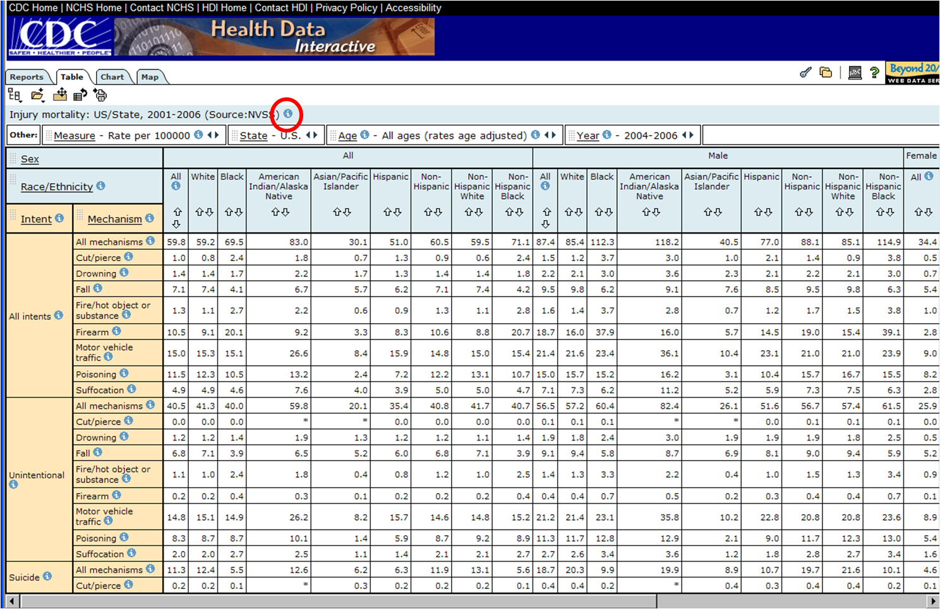

Slide 55
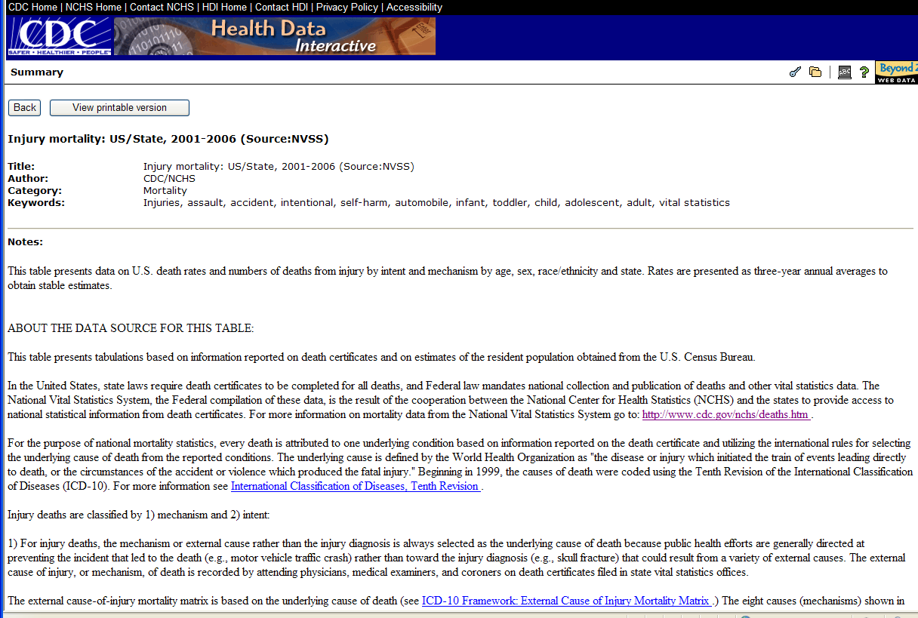

Slide 56
We will show how to…
Navigate to the site
Find tables
Manipulate interactive tables
Scroll through variables
Select variable categories to view
Sort
Move variables around and reset
Read the metadata
Create charts
Create maps
Print
Export
Download

Slide 57
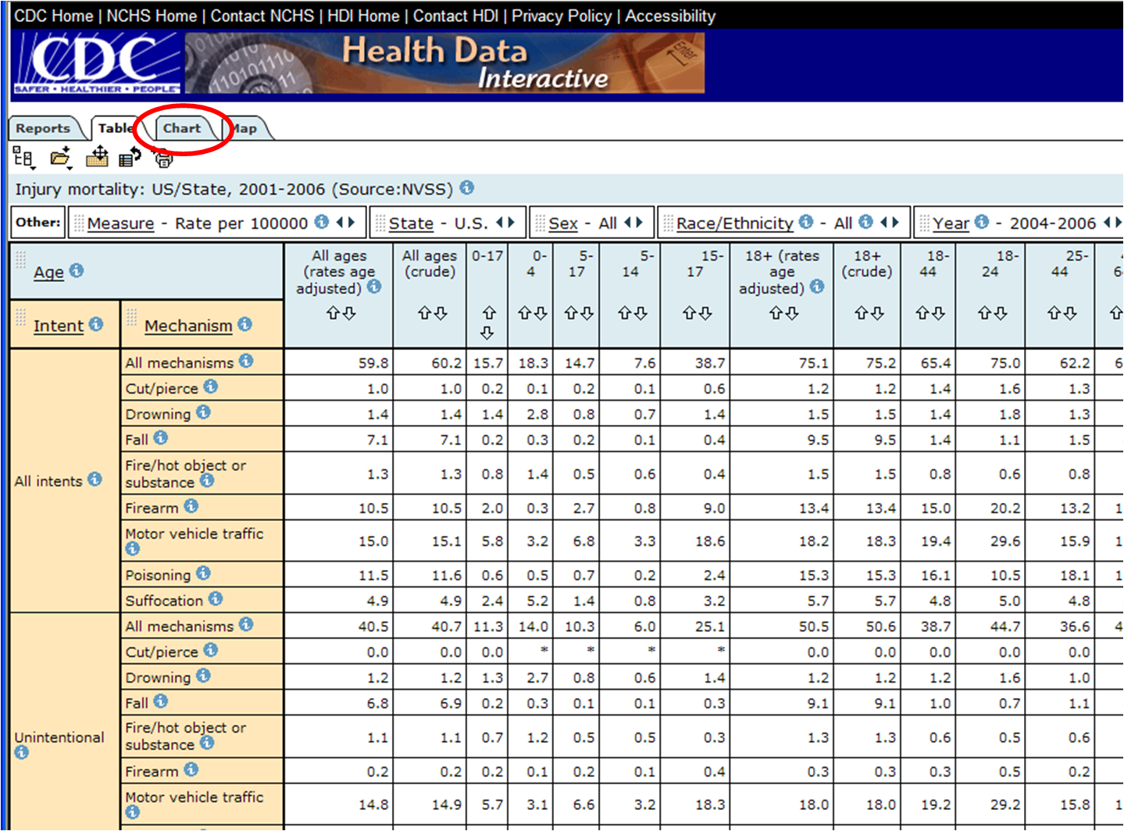

Slide 58
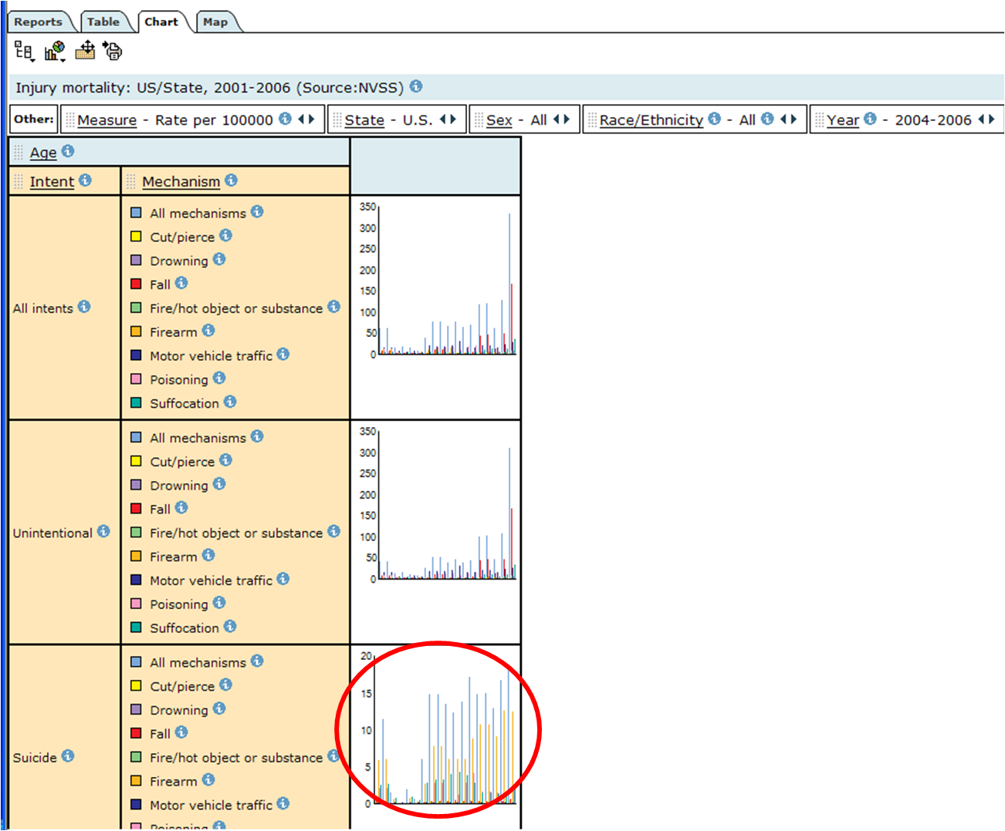

Slide 59
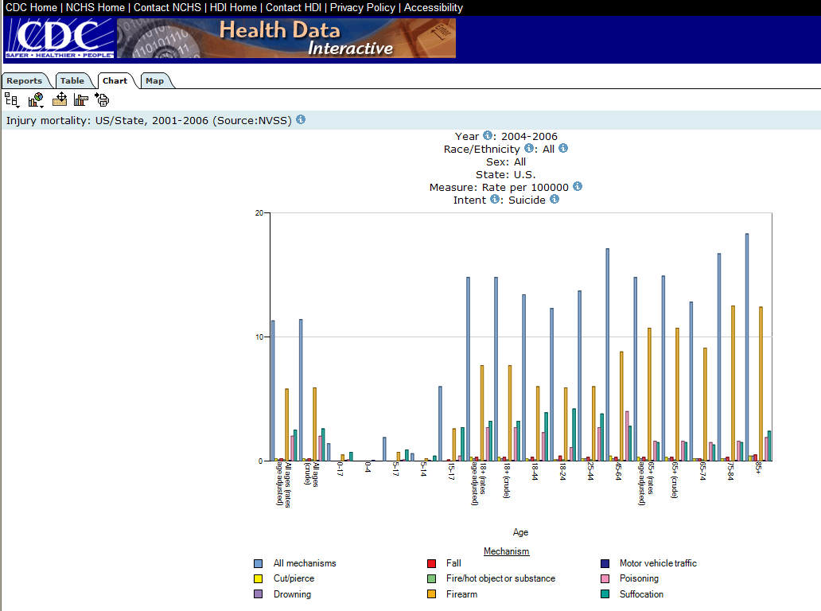

Slide 60
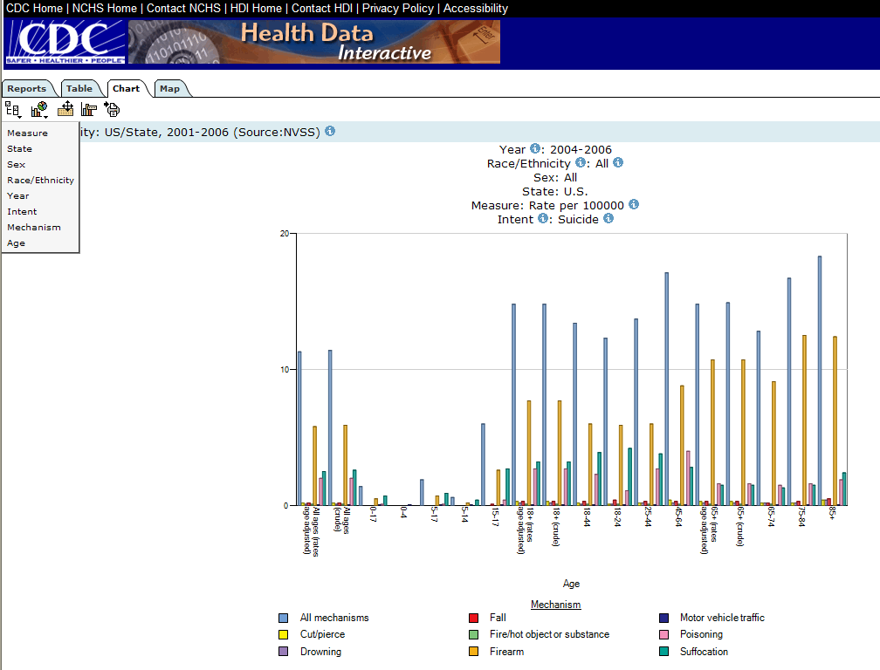

Slide 62
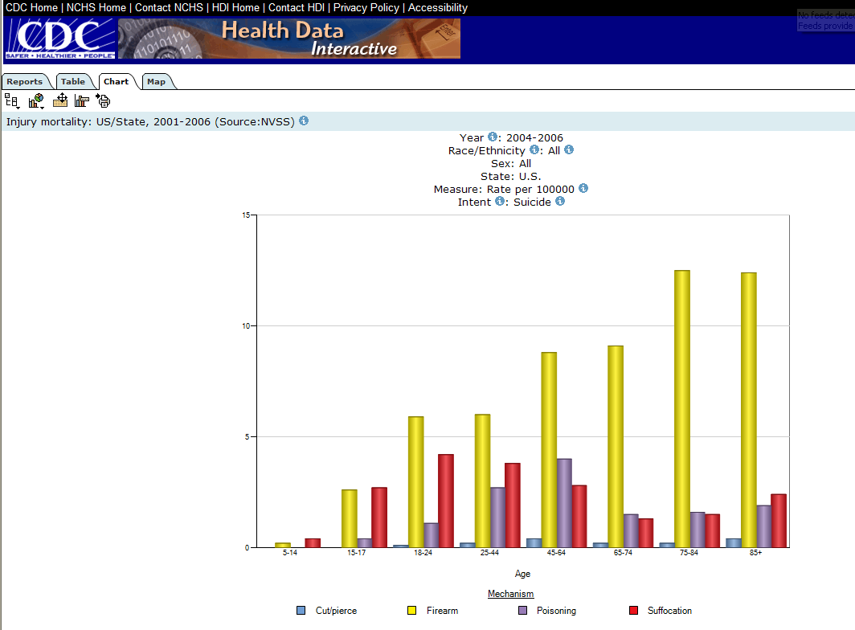

Slide 63
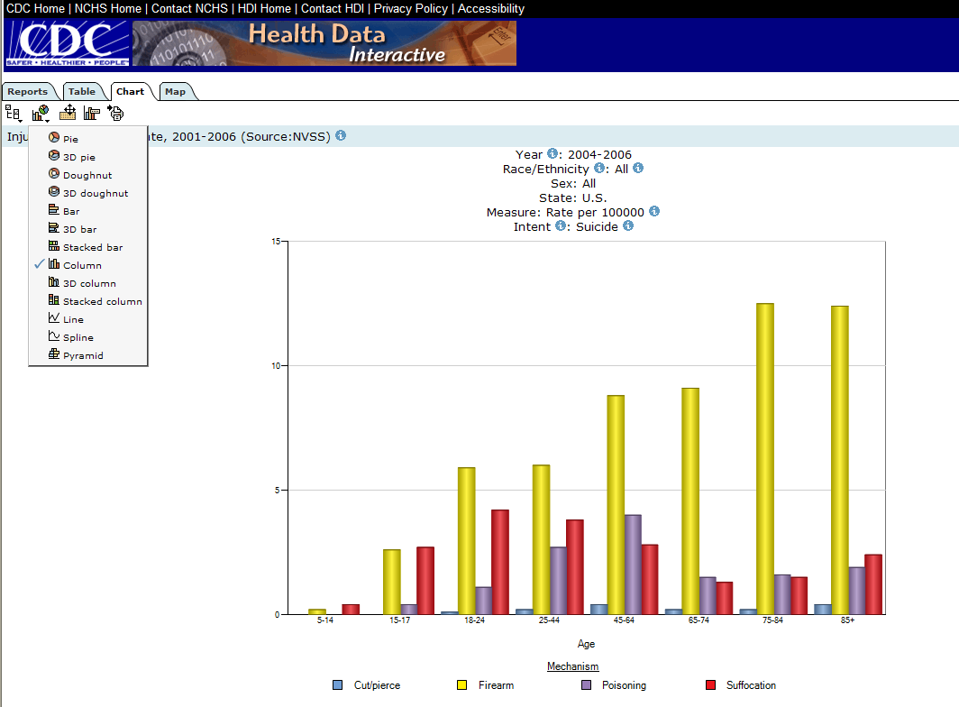

Slide 64
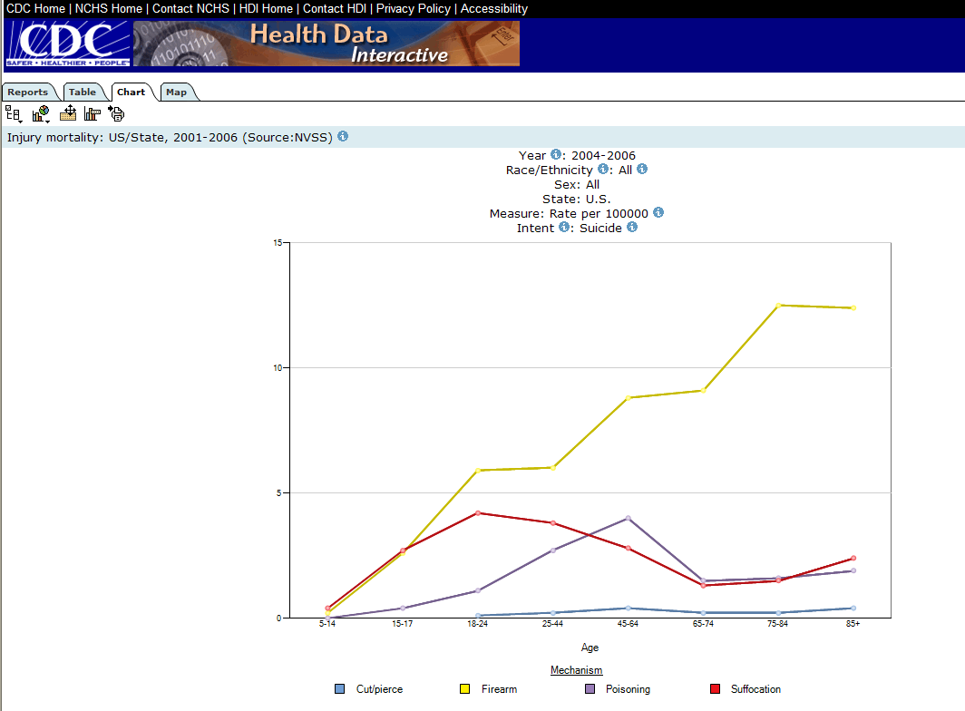

Slide 65
How to …
Find tables
Manipulate interactive tables
Scroll through variables
Select variable categories to view
Sort
Move variables around and reset
Read the metadata
Create charts
Create maps
Print:
Export
Download

Slide 66
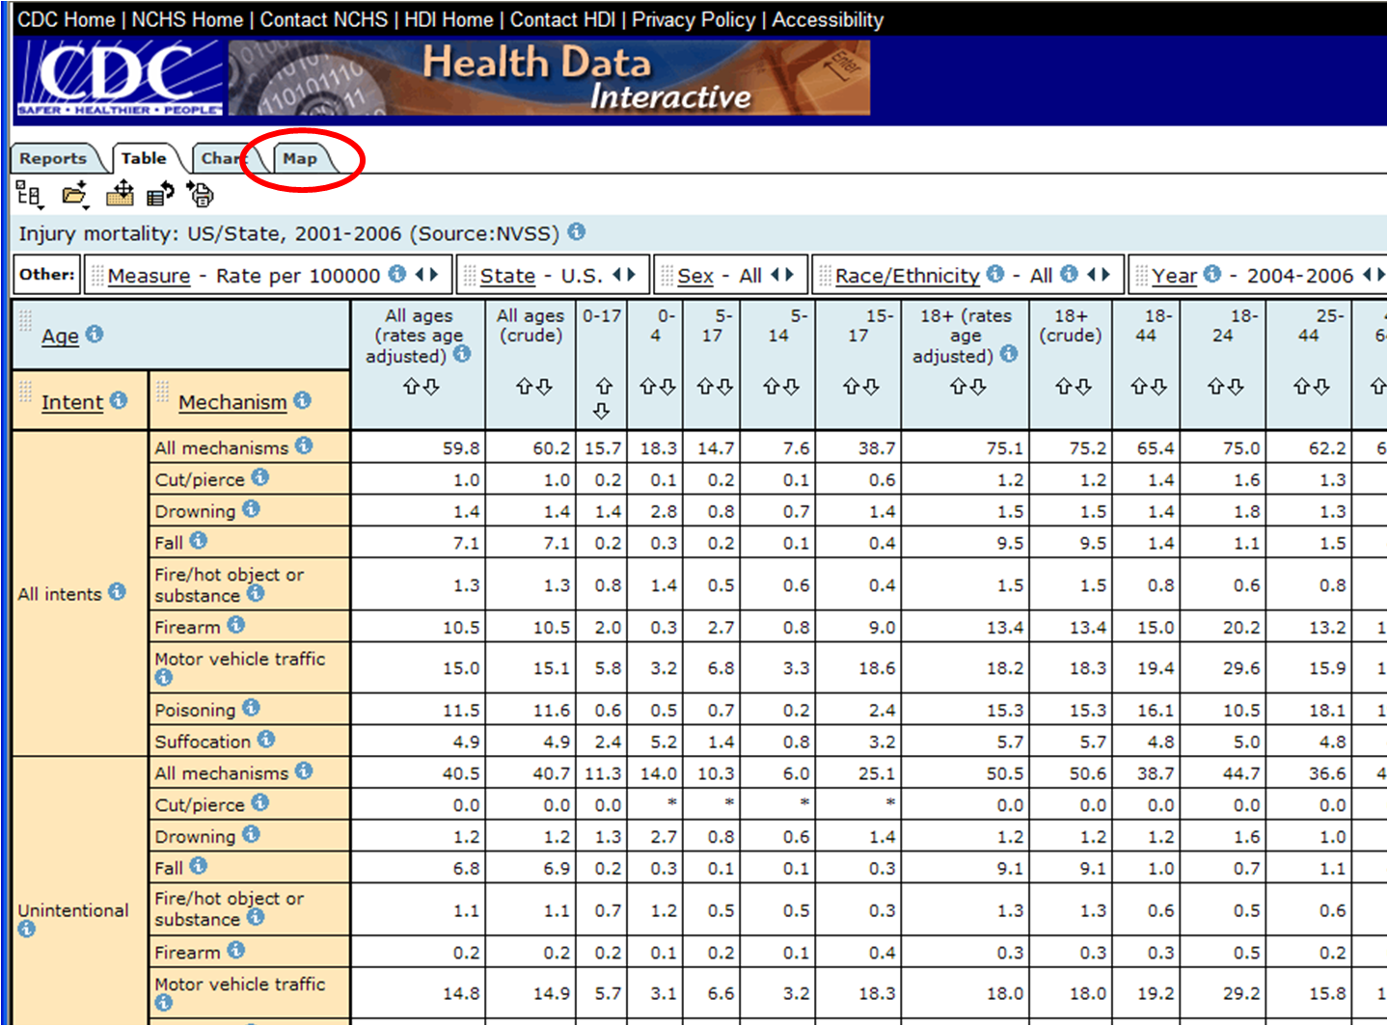

Slide 67
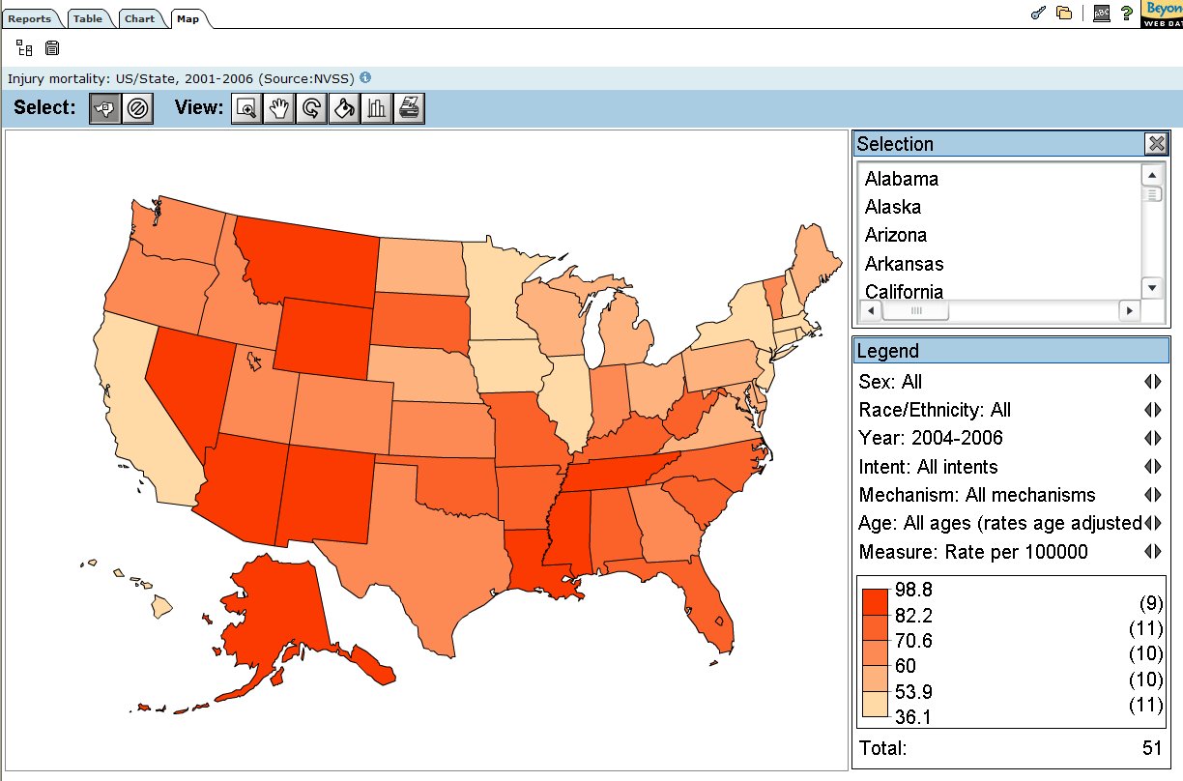

Slide 68
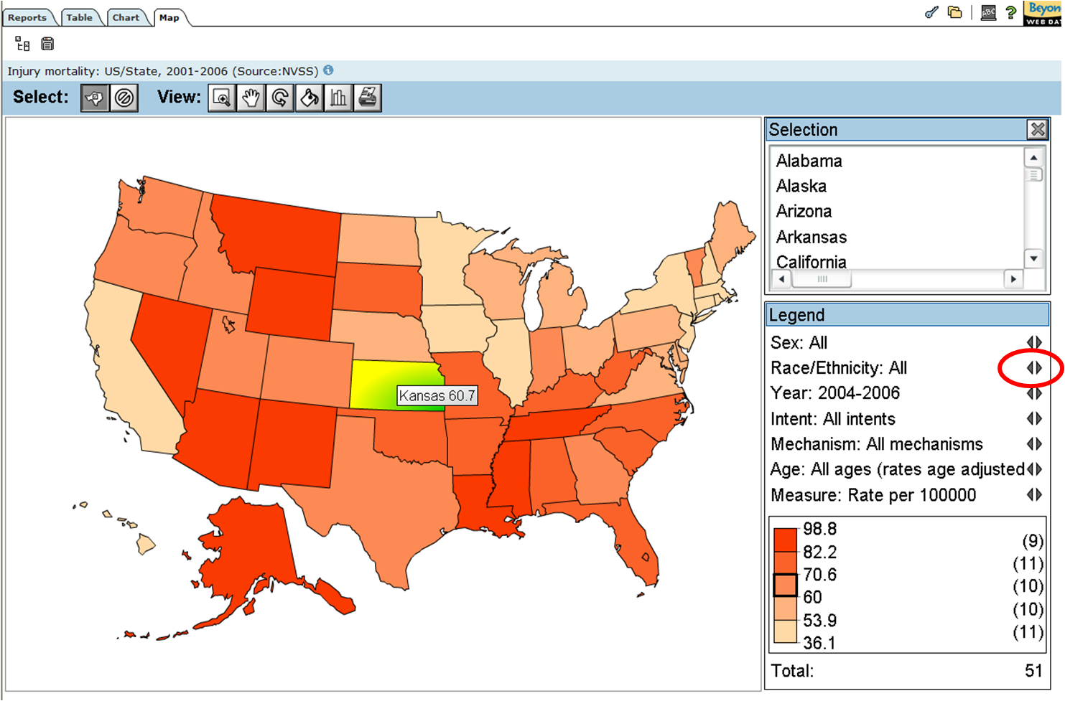

Slide 69
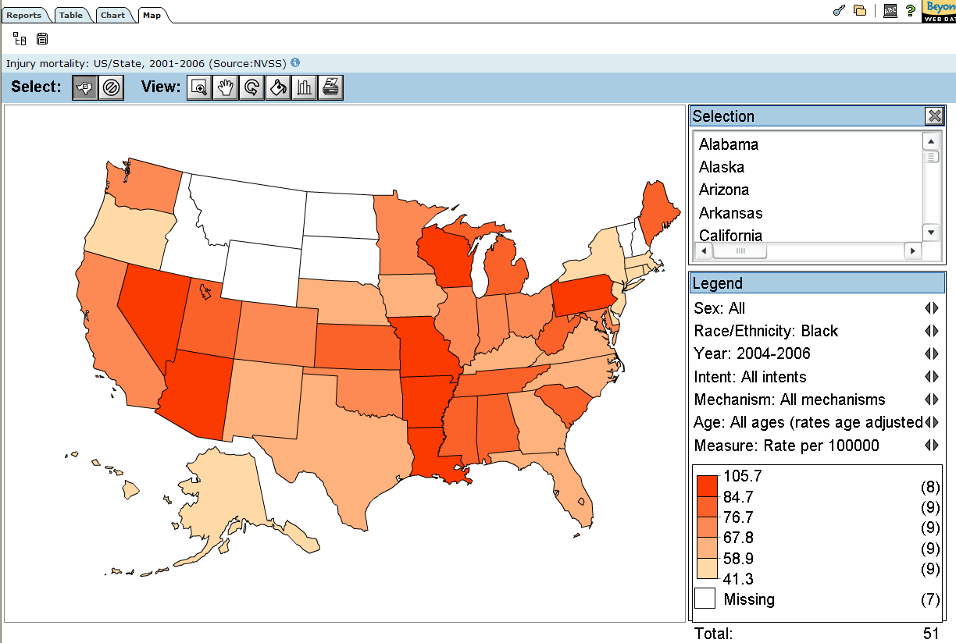

Slide 70
How to …
Navigate to the site
Find tables
Manipulate interactive tables
Scroll through variables
Select variable categories to view
Sort
Move variables around and reset
Read the metadata
Create charts
Create maps
Print:
Export
Download

Slide 71
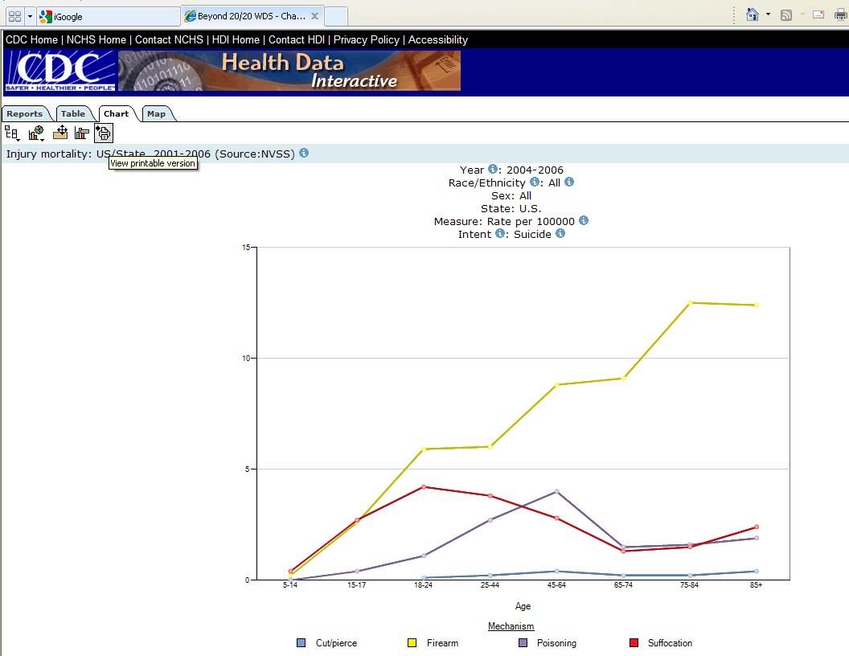

Slide 72
How to …
Navigate to the site
Find tables
Manipulate interactive tables
Scroll through variables
Select variable categories to view
Sort
Move variables around and reset
Read the metadata
Create charts
Create maps
Print
Export
Download

Slide 74
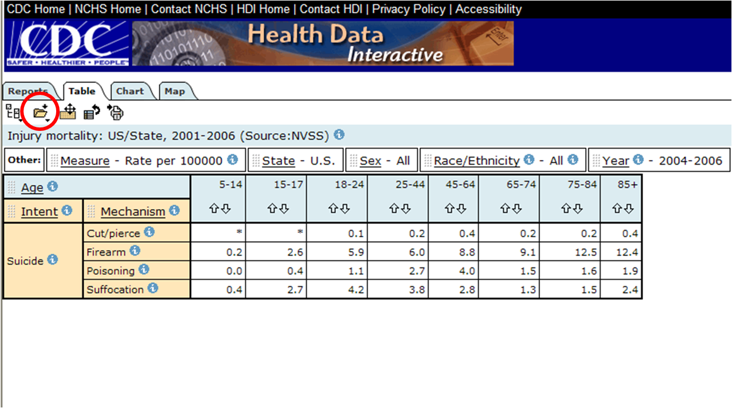

Slide 75
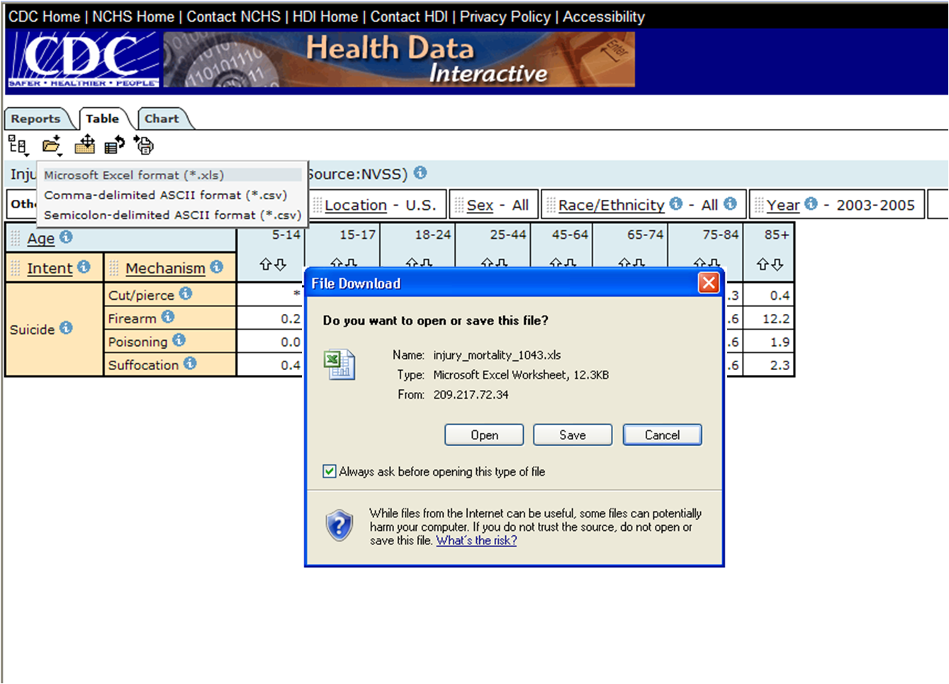

Slide 77
How to …
Navigate to the site
Find tables
Manipulate interactive tables
Scroll through variables
Select variable categories to view
Sort
Move variables around and reset
Read the metadata
Create charts
Create maps
Print
Export
Download

Slide 79
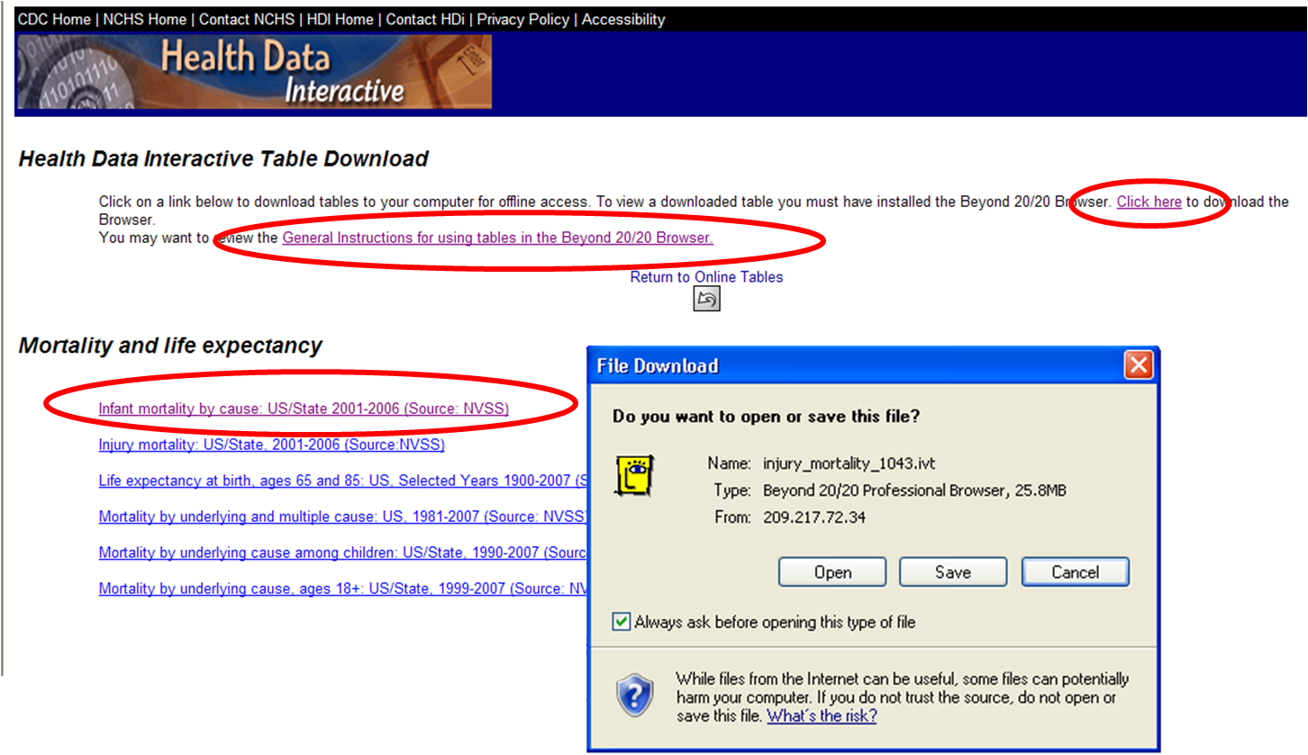

Slide 80
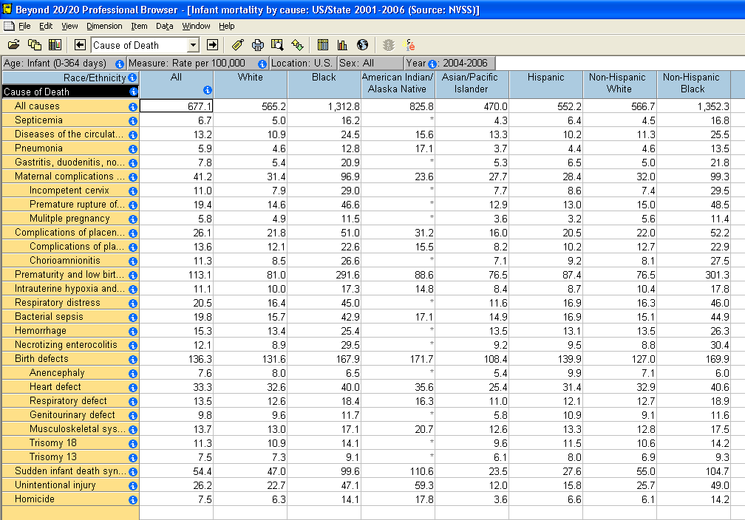

Slide 81
Exporting and downloading points
Exporting to Excel (for example)
What you see is what you get (allows you to manipulate a small data table in Excel)
Only displayed information is downloaded
To export the entire table, you must nest all the variable tiles in the table
Not all the metadata are exported
Downloading
You must first download the “Browser” software
Downloading to your computer includes the whole table, not just what you see in the table view
Downloaded tables include metadata and mapping features

Slide 82
Help / Contact Us
To receive technical support with Beyond 20/20 software and the tables
e-mail: hdi@cdc.gov

