Slide 1
Sleeping, Breathing, and Quality of Life:
A Healthy People 2020 Progress Review
December 5, 2013

Slide 2
Howard K. Koh, MD, MPH
Assistant Secretary for Health
U.S. Department of Health and Human Services

Slide 3
Overview and Presenters
Chair
Howard K. Koh, MD, MPH, Assistant Secretary for Health
U.S. Department of Health and Human Services
Data Presentation
Irma Arispe, PhD, Associate Director
National Center for Health Statistics
Centers for Disease Control and Prevention
Research and Program presentation
Gary Gibbons, MD, Director National Heart, Lung and Blood Institute, NIH
Vikas Kapil, DO, MPH, FACOEM, Acting Deputy Director
Chief Medical Officer, National Center for Environmental Health
  Agency for Toxic Substances and Disease Registry, CDC
Community Highlight
Karen Meyerson, FNP-C, AE-C
Manager, Asthma Network of West Michigan

Slide 4
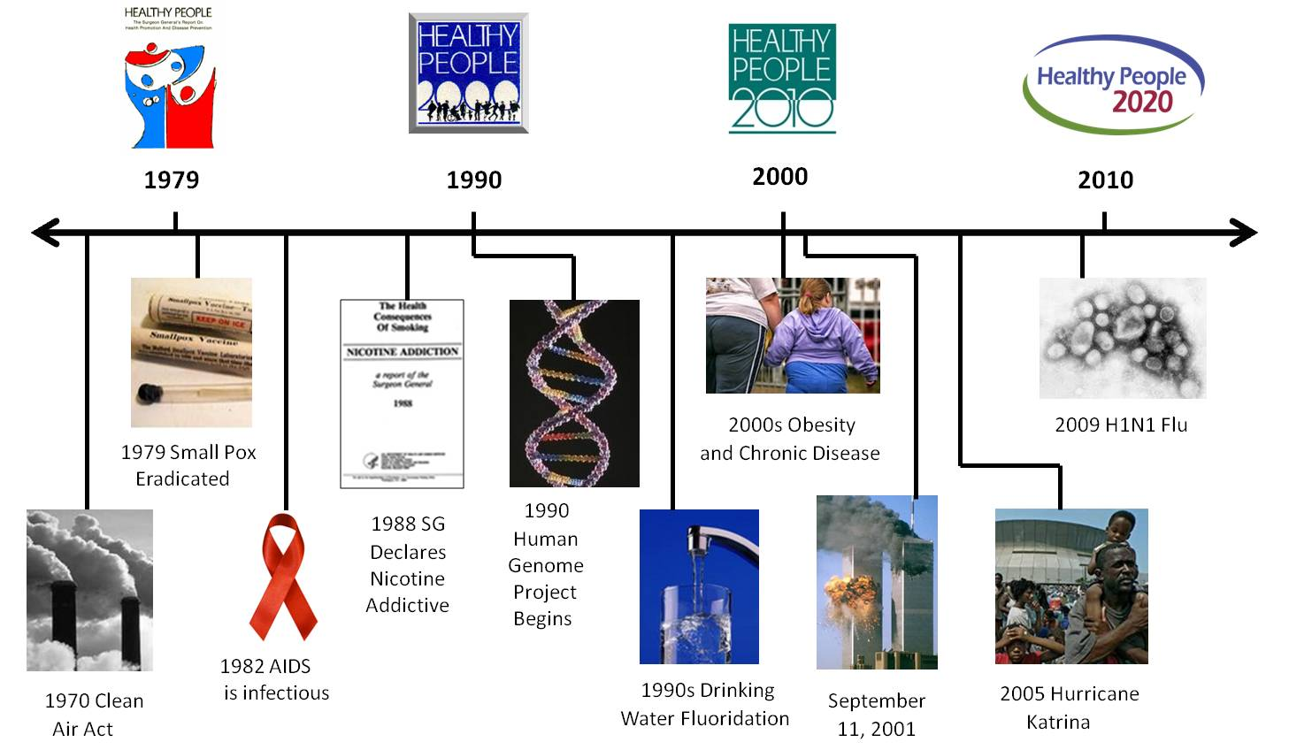
Healthy People 2020 Evolves
1979 Smallpox Eradicated
1982 AIDS is Infectious

Slide 5
Overview: Respiratory Diseases
Chronic Lower Respiratory Disease (CLRD) is the third leading cause of death
  Asthma - $53.42 billion (2011)
    Prevalence: 25.6 million people or 8.3% (2012)
      6.8 million children (9.3%)
      18.7 million adults (8.0%)
  Chronic Obstructive Pulmonary Disease (COPD) - $49.9 billion (2010)
    Prevalence: 11.3 million adults or 4.8 % (2012)
      Includes emphysema and chronic bronchitis, older adults
SOURCE: National Health Interview Survey (NHIS), CDC/NCHS.

Slide 6
Overview: Respiratory Diseases
Asthma was responsible for (2010):
  14.2 million physician office visits
  1.8 million emergency department visits
  439,000 hospitalizations
  3,404 deaths
COPD was responsible for (2010):
  1.2 million physician office visits
  1.8 million emergency department visits
  700,480 hospitalizations
  133,660 deaths
SOURCES: National Vital Statistics System—Mortality (NVSS-M), National Hospital Discharge Survey (NHDS), National Hospital Ambulatory Medical Care Survey (NHAMCS), National Ambulatory Medical Care Survey (NAMCS)

Slide 7
Overview: Sleep Health
Sleep Deficiency and Causes:
  Lifestyle factors
  Occupational factors
  Sleep disorders
  Insufficient sleep and sleep disorders are associated with:
  Risk, management, and outcome of chronic disease
    Cardiovascular disease
    Diabetes
    Obesity
    Depression
  Motor vehicle crashes and machinery-related errors

Slide 8
Healthy People 2020 Progress Review: Sleeping, Breathing, and Quality of Life
December 5, 2013

Slide 9
Irma Arispe, PhD
Associate Director, National Center for Health Statistics
Centers for Disease Control and Prevention

Slide 10
Presentation Outline
Respiratory Diseases
  Asthma
  Chronic Obstructive Pulmonary Disease (COPD)
  Sleep Health
10

Slide 11
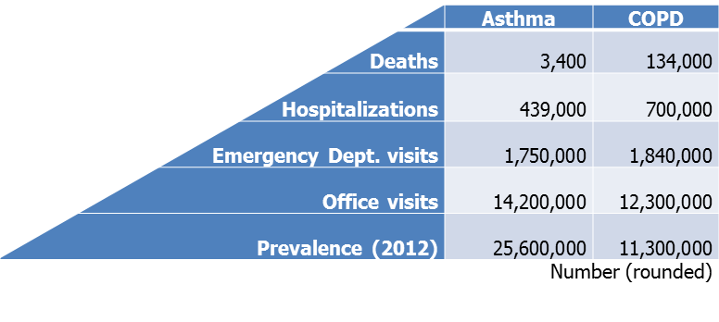
Burden of Respiratory Diseases, 2010
NOTES: Data are for all ages except for COPD prevalence which is among adults aged 18 years and over. Deaths are based on an underlying cause of asthma (ICD-10 codes J45–J46) or COPD (ICD-10 codes J40–J44). Hospital discharges, emergency department visits, and office visits are based on a principal diagnosis of asthma (ICD-9-CM code 493) or COPD (ICD-9-CM code 490-492, 496). Asthma prevalence is defined as the proportion of persons with current asthma. COPD prevalence is defined as proportion of adults who have ever been diagnosed with emphysema or who were diagnosed with chronic bronchitis in the last 12 months.
SOURCES: National Vital Statistics System—Mortality (NVSS-M), National Hospital Discharge Survey (NHDS), National Hospital Ambulatory Medical Care Survey (NHAMCS), National Ambulatory Medical Care Survey (NAMCS), and National Health Interview Survey (NHIS), CDC/NCHS.

Slide 12
Asthma Prevalence, 1980–2012
1997 NHIS Redesign
Current asthma prevalence
Asthma 12-month period prevalence
NOTES: Asthma period prevalence is the proportion of persons with asthma in the previous 12 months; current asthma prevalence is the proportion of persons with asthma at the time of interview. After the redesign, a medical diagnosis of asthma was required and proxy reporting for adults was eliminated.
SOURCE: National Health Interview Survey (NHIS), CDC/NCHS.

Slide 13
Current Asthma Prevalence, 2012
Percent
Total
Black
White
Hispanic
Children <18 years
Adults 18+ years
NOTES: I = 95% confidence interval. Respondents were asked to select one or more races. The race categories black and white are for persons who reported only one racial group and exclude persons of Hispanic origin. Persons identified as Hispanic can be of any race.
SOURCE: National Health Interview Survey (NHIS), CDC/NCHS.

Slide 14
Current Asthma Prevalence, 2010–2012
Nonpoor
Near Poor
Poor
NOTES: I = 95% confidence interval. Data are age adjusted to the 2000 standard population. Income groups are defined based on the ratio of family income to poverty threshold: nonpoor 200%+, near poor 100-199%, poor <100%. Respondents were asked to select one or more races. The categories black and white are for persons who reported only one racial group and exclude persons of Hispanic origin. Persons identified as Mexican or Puerto Rican may be of any race.
SOURCE: National Health Interview Survey (NHIS), CDC/NCHS.

Slide 15
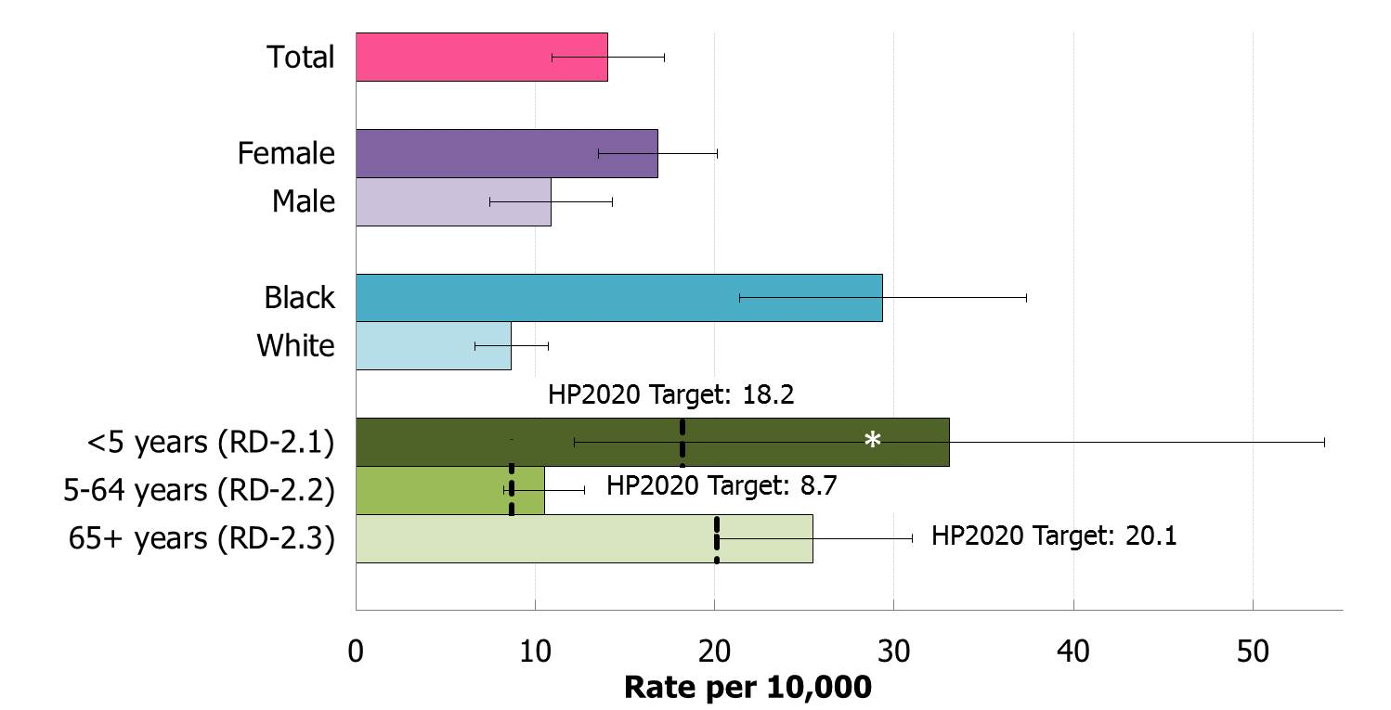
Asthma Hospitalizations, 2010
NOTES: I = 95% confidence interval. Data are for hospital discharges with a principal diagnosis of asthma (ICD-9-CM code 493). Data, except those for children under age 5 years, are age adjusted to the 2000 standard population. Healthy People 2020 objectives RD-2.1, 2.2, and 2.3 track asthma hospitalizations separately for ages <5, 5-64, and 65+, respectively, while the data displayed here by sex and race are for all ages. The race categories black and white include persons of Hispanic or non-Hispanic origin for whom only one racial group was recorded. * Data are unreliable.
Objs. RD-2.1, 2.2, 2.3
Decrease desired
SOURCE: National Hospital Discharge Survey (NHDS), CDC/NCHS.

Slide 16
Asthma Deaths, 1999–2010
Rate per million
65+ years
HP2020 Target: 21.5
35-64 years
<35 years
HP2020 Target: 4.9
No HP2020 Target
NOTES: Data are for deaths with an underlying cause of asthma (ICD-10 codes J45–J46).
Obj. RD-1.1, 1.2, 1.3 Decrease desired
SOURCE: National Vital Statistics System—Mortality (NVSS-M), CDC/NCHS.

Slide 17
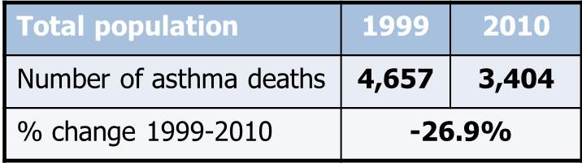
Asthma Deaths
1999
2010
NOTES: I = 95% confidence interval. Data are for deaths with an underlying cause of asthma (ICD-10 codes J45–J46). HP2020 objectives RD-1.1, 1.2, and 1.3 track asthma deaths separately for ages <35, 35-64, and 65+, respectively, while the data displayed here for the total and by sex and race are for all ages. Prior to 2003, only one race could be recorded; recording more than one race was not an option. Beginning in 2003 multiple-race data were reported by some states; multiple-race data were bridged to the single-race categories for comparability. Persons of Hispanic origin may be of any race.
SOURCE: National Vital Statistics System—Mortality (NVSS-M), CDC/NCHS.

Slide 18
Appropriate Asthma Care, 2008
Told how to use inhaler
No overuse of rescue inhaler
Taught to recognize and respond to symptoms
Advice re: exposure to environmental triggers
Received written asthma plan
Told if asthma is work-related (2010)
No HP2020 Target
HP2020 Target: 90.2%
HP2020 Target: 68.5%
HP2020 Target: 54.6%
HP2020 Target: 36.8%
HP2020 Target: 17.9%
NOTES: I = 95% confidence interval. Data are for persons with current asthma who received the specified care from a health care provider, and are age adjusted to the 2000 standard population.
Objs. RD-7.1 through 7.5, 7.8
Increase desired
SOURCE: National Health Interview Survey (NHIS), CDC/NCHS.

Slide 19
Activity Limitations due to Asthma
Adults 18+ Years, 2008–2012
2008
2012
HP2020 Target: 10.3%
*
Family Income (Percent Poverty Threshold)
NOTES: I = 95% confidence interval. Data are for adults aged 18 years and over with current asthma who experienced activity limitations due to lung or breathing problems, and are age adjusted to the 2000 standard population. * Data are unreliable.
Obj. RD-4
Decrease desired
SOURCE: National Health Interview Survey (NHIS), CDC/NCHS

Slide 20
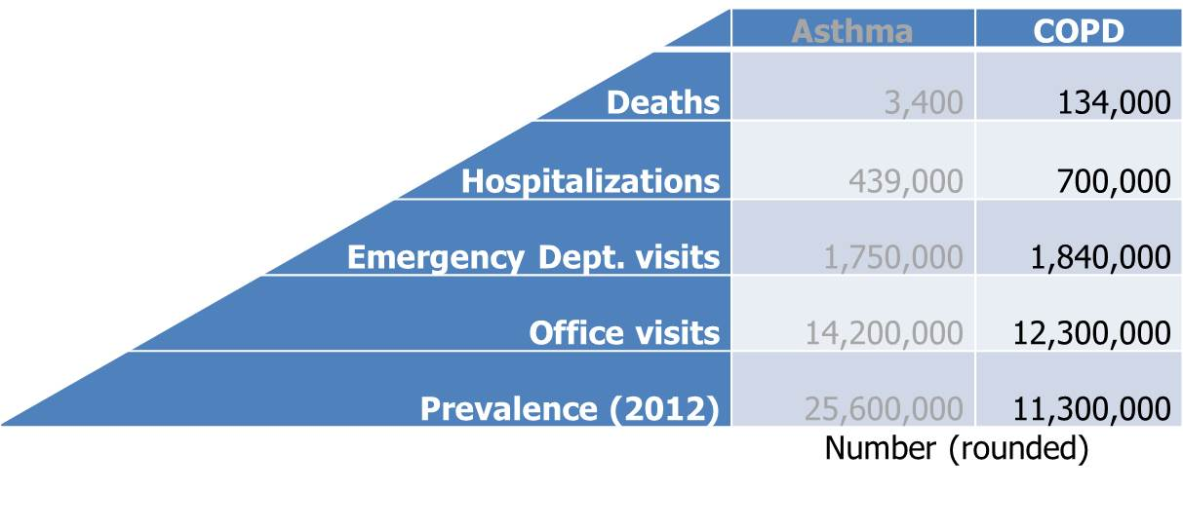
Burden of Respiratory Diseases, 2010
NOTES: Data are for all ages except for COPD prevalence which is among adults aged 18 and over. Deaths are based on an underlying cause of asthma (ICD-10 codes J45–J46) or COPD (ICD-10 codes J40–J44). Hospital discharges, emergency department visits, and office visits are based on a principal diagnosis of asthma (ICD-9-CM code 493) or COPD (ICD-9-CM code 490-492, 496). Asthma prevalence is defined as the proportion of persons with current asthma. COPD prevalence is defined as proportion of adults who have ever been diagnosed with emphysema or who were diagnosed with chronic bronchitis in the last 12 months.
SOURCES: National Vital Statistics System—Mortality (NVSS-M), National Hospital Discharge Survey (NHDS), National Hospital Ambulatory Medical Care Survey (NHAMCS), National Ambulatory Medical Care Survey (NAMCS), and National Health Interview Survey (NHIS), CDC/NCHS.

Slide 21
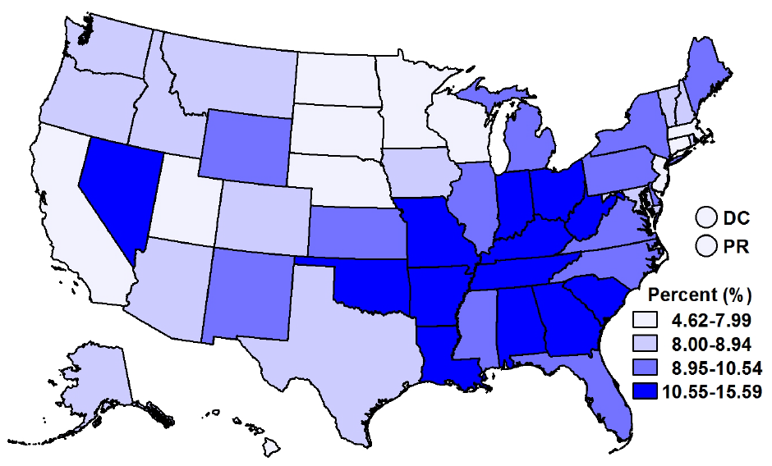
COPD Prevalence, Adults 45+ Years, 2012
NOTES: Data are for adults aged 45 years and over who have ever been diagnosed with COPD, emphysema, or chronic bronchitis, and are age adjusted to the 2000 standard population. State data from the BRFSS may not be comparable to the national data from the NHIS.
SOURCE: Behavioral Risk Factor Surveillance System (BRFSS), CDC/PHSPO.

Slide 22
COPD Prevalence, 1997–2012
Percent
65+ years
45-64 years
18-44 years
NOTES: Data are for adults who have ever been diagnosed with emphysema or who were diagnosed with chronic bronchitis in the last 12 months.
SOURCE: National Health Interview Survey (NHIS), CDC/NCHS.

Slide 23
COPD Prevalence, Adults 45+ Years, 2010–2012
NOTES: I = 95% confidence interval. Data are for adults aged 45 years and over who have ever been diagnosed with emphysema or who were diagnosed with chronic bronchitis in the last 12 months, and are age adjusted to the 2000 standard population. Income groups are defined based on the ratio of family income to poverty threshold: nonpoor 200%+, near poor 100-199%, poor <100%. Respondents were asked to select one or more races. The categories black and white are for persons who reported only one racial group and exclude persons of Hispanic origin. Persons identified as Mexican or Puerto Rican may be of any race.
SOURCE: National Health Interview Survey (NHIS), CDC/NCHS.

Slide 24
COPD Hospitalizations, Adults 45+ Years, 2010
HP2020 Target: 50.1%
NOTES: I = 95% confidence interval. Data are for hospital discharges with a principal diagnosis of COPD (ICD-9-CM code 490-492, 496) among adults aged 45 years and over. Data, except those by age, are age adjusted to the 2000 standard population. The race categories black and white include persons of Hispanic or non-Hispanic origin for whom only one racial group was recorded.
Obj. RD-11
Decrease desired
SOURCE: National Hospital Discharge Survey (NHDS), CDC/NCHS.

Slide 25
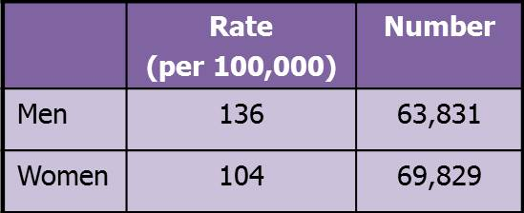
COPD Deaths, Adults 45+ Years, 2010
HP2020 Target: 102.6
NOTES: I = 95% confidence interval. Data are for deaths with an underlying cause of COPD (ICD-10 codes J40–J44) among adults aged 45 years and over and are age adjusted to the 2000 standard population. Data by age are not age adjusted, and, therefore, the target does not apply to data by age. Multiple-race data were reported by some states; multiple-race data were bridged to the single-race categories for comparability. Persons of Hispanic origin may be of any race.
Obj. RD-10
Decrease desired
SOURCE: National Vital Statistics System—Mortality (NVSS-M), CDC/NCHS.

Slide 26
Activity Limitations due to COPD
Adults 45+ Years, 2012
Percent
HP2020 Target: 18.7%
*
NOTES: I = 95% confidence interval. Data are for adults aged 45 years and over with COPD who experienced activity limitations due to lung or breathing problems, and are age adjusted to the 2000 standard population. * Data are unreliable.
Obj. RD-9
Decrease desired
SOURCE: National Health Interview Survey (NHIS), CDC/NCHS.

Slide 27
Presentation Outline
Respiratory Diseases
  Asthma
  Chronic Obstructive Pulmonary Disease (COPD)
  Sleep Health
27

Slide 28
Sleep Health: Public Health Impact
  50–70 million people experience chronic sleep and wakefulness disorders.
  Sleep disorders account for approximately $16 billion dollars in annual medical costs, in addition to costs for lost productivity.
Physician office visits (2010):
  Sleep apnea* – 2.7 million
  Insomnia – 5.8 million
NOTES: * Sleep apnea is a disorder with one or more pauses in breathing or shallow breaths during sleep.
SOURCES: Institute of Medicine. Sleep disorders and sleep deprivation: an unmet public health problem. Washington, DC: The National Academies Press; 2006. National Ambulatory Medical Care Survey (NAMCS), CDC/NCHS.
28

Slide 29
Persons With Sleep Apnea Symptoms who
Seek Medical Care, Adults 20+, 2005–2008
HP2020 Target: 28%
NOTES: I = 95% confidence interval. Data are for adults aged 20 years and over who (snore 5 or more nights per week) OR (snort, gasp, or stop breathing 5 or more nights per week) OR (feel excessively sleepy during the day 16-30 times per month AND usually sleep 7 or more hours per night) who have told a health professional that they have trouble sleeping. Data are age adjusted to the 2000 standard population. Data by age are not age adjusted, and, therefore, the target does not apply to data by age. Respondents were asked to select one or more race categories. The categories black and white are for persons who reported only one racial group and exclude persons of Hispanic origin. Persons of Mexican origin may be any race.
Obj. SH-1
Increase desired
SOURCE: National Health and Nutrition Examination Survey (NHANES), CDC/NCHS.

Slide 30
Crashes Involving Drowsy Drivers, 2005–2011
Rate per 100 million vehicle miles traveled
HP2020 Baseline
HP2020 Target: 2.1
NOTES: Data are for vehicular crashes per 100 million miles traveled due to drowsy driving. General Estimates System data are from a nationally representative sample of police-reported motor vehicle crashes. To be included, the crash must involve a motor vehicle traveling on a traffic way and result in property damage, injury, or death.
Obj. SH-2
Decrease desired
SOURCE: General Estimates System (GES), DOT/NHTSA.

Slide 31
Sufficient Sleep, Adults, 2012
HP2020 Target: 70.9%
NOTES: I = 95% confidence interval. Data are for adults aged 18 years and over who get sufficient sleep (defined as ≥ 8 hours for those aged 18 to 21 years and ≥ 7 hours for those aged 22 years and over) on average during a 24-hour period. Respondents were asked to select one or more races. Data for the single race categories are for persons who reported only one racial group. Persons of Hispanic origin may be any race.
Obj. SH-4
Increase desired
SOURCE: National Health Interview Survey (NHIS), CDC/NCHS.

Slide 32
Sufficient Sleep, High School Students, 2011
HP2020 Target: 33.2%
NOTES: I = 95% confidence interval. Data are for students in grades 9–12 who report getting 8 or more hours of sleep on an average school night. Respondents were asked to select one or more races. The single race categories listed include persons who reported only one racial group. Persons of Hispanic origin may be of any race.
Obj. SH-3
Increase desired
SOURCE: Youth Risk Behavior Surveillance System (YRBSS), CDC/NCHHSTP.

Slide 33
Key Takeaways
Asthma
  Despite increasing prevalence, deaths have declined while ED visits and hospitalizations have remained stable.
  Age, sex, race and income disparities persist.
  COPD
  Prevalence is higher for older age groups and lower income groups.
  Disparities persist in hospitalizations and deaths by age and race.
  Death rates are highest among the non-Hispanic white population.
  Sleep Health
  Disparities exist by sex, race, and age.
  Most students in grades 11 and 12 do not get sufficient sleep.
33

Slide 34
Appendix
Note: The information contained within these slides provides additional details to supplement the webinar material.
34

Slide 35
Objective Status: Respiratory Diseases
Target met Improving Little/No change Getting worse Baseline only Developmental
  RD-1.1 Asthma deaths: <35 years
  RD-1.2 Asthma deaths: 35–64 years
  RD-1.3 Asthma deaths: 65+ years
  RD–2.1 Asthma hospitalizations: <5 years
  RD-2.2 Asthma hospitalizations: 5-64 years
  RD-2.3 Asthma hospitalizations: 65+ years
  RD-3.1 Asthma emergency department visits: <5 years
  RD-3.2 Asthma emergency department visits: 5-64 years
  RD-3.3 Asthma emergency department visits: 65+ years
  RD-4 Activity limitations among persons with asthma
  RD-5.1 Children with asthma who miss school days
  RD-5.2 Adults with asthma who miss work days
  RD-6 Patient education among persons with asthma
  RD-7.1 Persons with asthma receiving written asthma plans from health care providers
  RD-7.2 Persons with asthma receiving proper use instructions with prescribed inhalers
  RD-7.3 Persons with asthma receiving education on early signs, symptoms, and responses to asthma episodes
  RD-7.4 Persons with asthma who do not use more than 1 beta agonist inhalation canister per month
  RD-7.5 Persons with asthma receiving advice from health professionals in reducing exposure to environmental risk factors
  RD-7.6 Persons with asthma who have had at least one routine follow-up visit in the past year
  RD-7.7 Persons with asthma whose doctor assessed their asthma control in the past year
  RD-7.8 Persons with asthma whose doctor assessed whether their asthma was work related
  RD-8 State comprehensive asthma surveillance systems
  RD-9 Activity limitations among persons with COPD
  RD-10 COPD deaths
  RD-11 COPD hospitalizations
  RD-12 COPD emergency department visits
  RD-13 COPD diagnosis among adults with underlying obstructive lung disease
35
Notes:
Definitions
Target met: Target met or exceeded
Improving – Change is toward the target:
Change in objective is statistically significant*, OR
Objective has achieved 10% or more of the targeted change
Little/No change:
Objective has achieved less than 10% of the targeted change (and is not statistically significant*), OR
Objective has a deficit of less than 10% relative to its baseline which it needs to regain before starting to move toward the target (and is not statistically significant*), OR
No change between baseline and most recent data point
Getting worse – Change is away from the target:
Change in objective is statistically significant*, OR
Objective has a deficit of 10% or more (relative to its baseline), which it needs to regain before starting to move toward the target
Baseline only: Baseline data only; progress cannot be assessed
Developmental: Objective is developmental (does not have baseline data)
Informational: Objective is informational (does not have a target)
Notes
*Statistical significance is only assessed when estimates of variability are available
Percent of targeted change achieved = 100 × (Most recent value – Baseline value) / (HP2020 target – Baseline value)
Percent in deficit = 100 × |Most recent value – Baseline value| / (Baseline value)

Slide 36
Current HP2020 Objective Status:
Respiratory Diseases
Total number of objectives: 27
Target met
Improving
Little/No change
Getting worse
Baseline only
Developmental
Notes:
Definitions
Target met: Target met or exceeded
Improving – Change is toward the target:
Change in objective is statistically significant*, OR
Objective has achieved 10% or more of the targeted change
Little/No change:
Objective has achieved less than 10% of the targeted change (and is not statistically significant*), OR
Objective has a deficit of less than 10% relative to its baseline which it needs to regain before starting to move toward the target (and is not statistically significant*), OR
No change between baseline and most recent data point
Getting worse – Change is away from the target:
Change in objective is statistically significant*, OR
Objective has a deficit of 10% or more (relative to its baseline), which it needs to regain before starting to move toward the target
Baseline only: Baseline data only; progress cannot be assessed
Developmental: Objective is developmental (does not have baseline data)
Informational: Objective is informational (does not have a target)
Notes
*Statistical significance is only assessed when estimates of variability are available
Percent of targeted change achieved = 100 × (Most recent value – Baseline value) / (HP2020 target – Baseline value)
Percent in deficit = 100 × |Most recent value – Baseline value| / (Baseline value)

Slide 37
Objective Status: Sleep Health
SH-1 Adults with symptoms of obstructive
sleep apnea
SH-2 Motor vehicle crashes involving drowsy
driving
SH-3 Students getting sufficient sleep on
school nights
SH-4 Adults getting sufficient sleep per night
Target met Improving Little/No change Getting worse Baseline only
37
Notes:
Definitions
Target met: Target met or exceeded
Improving – Change is toward the target:
Change in objective is statistically significant*, OR
Objective has achieved 10% or more of the targeted change
Little/No change:
Objective has achieved less than 10% of the targeted change (and is not statistically significant*), OR
Objective has a deficit of less than 10% relative to its baseline which it needs to regain before starting to move toward the target (and is not statistically significant*), OR
No change between baseline and most recent data point
Getting worse – Change is away from the target:
Change in objective is statistically significant*, OR
Objective has a deficit of 10% or more (relative to its baseline), which it needs to regain before starting to move toward the target
Baseline only: Baseline data only; progress cannot be assessed
Developmental: Objective is developmental (does not have baseline data)
Informational: Objective is informational (does not have a target)
Notes
*Statistical significance is only assessed when estimates of variability are available
Percent of targeted change achieved = 100 × (Most recent value – Baseline value) / (HP2020 target – Baseline value)
Percent in deficit = 100 × |Most recent value – Baseline value| / (Baseline value)

Slide 38
Asthma Health Care Encounter Rates 2001–2009
NOTES: Data are for health care encounters with a principal diagnosis of asthma (ICD-9-CM code 493).
SOURCE: National Ambulatory Medical Care Survey, National Hospital Ambulatory Medical Care Survey, National Hospital Discharge Survey, CDC/NCHS

Slide 39
Asthma Emergency Department Visits
Number of Asthma ED Visits, 2008-10
1995-97
2008-10
HP2020 Target: 95.6
HP2020 Target: 49.7
HP2020 Target: 15.8
NOTES: I = 95% confidence interval. Data are for visits to an emergency department with a first-listed diagnosis of asthma (ICD-9-CM code 493).
SOURCE: National Hospital Ambulatory Medical Care Survey (NHAMCS), CDC/NCHS.
Obj. RD-3.1, 3.2, 3.3
Decrease desired

Slide 40
Asthma Hospitalizations by Age
Number of Asthma Hospitalizations, 2010
HP2020 Target: 8.6
HP2020 Target: 20.3
HP2020 Target: 18.1
NOTES: I = 95% confidence interval. Data are for hospital discharges with a principal diagnosis of asthma (ICD-9-CM code 493). Data, except those among children aged under 5 years, are age adjusted to the 2000 standard population.
Obj. RD-2.1, 2.2, 2.3
Decrease desired
SOURCE: National Hospital Discharge Survey (NHDS), CDC/NCHS.

Slide 41
Asthma Patient Education
Percent
HP2020 Target: 14.5%
NOTES: I = 95% confidence interval. Data are for the proportion of persons with current asthma who have ever taken a course or class on how to manage their asthma, and are age adjusted to the 2000 standard population. Respondents were asked to select one or more races. The categories black and white include persons who reported only one racial group. Persons of Hispanic origin may be of any race.
Obj. RD-6
Increase desired
SOURCE: National Health Interview Survey (NHIS), CDC/NCHS.

Slide 42
COPD Physician Office Visits, 2008-2010
2008
2009
2010
NOTES: Data are for physician office visits with a principal diagnosis of COPD (ICD-9-CM code 490-492, 496).
SOURCE: National Ambulatory Medical Care Survey (NAMCS), CDC/NCHS.

Slide 43
COPD Physician Office Visits, 2008-2010
2008
2009
2010
NOTES: Data are for physician office visits made by patients with COPD based on the chronic conditions checkbox or any-listed diagnosis of COPD (ICD-9-CM code 490-492, 496).
SOURCE: National Ambulatory Medical Care Survey (NAMCS), CDC/NCHS.

Slide 44
Sleeping, Breathing, and Quality of Life:
Perspectives from:
National Heart, Lung, and Blood Institute
National Institute of Allergy and Infectious Diseases
National Institute of Environmental Health Sciences
Gary H. Gibbons, MD, Director
National Heart, Lung, and Blood Institute
December 5, 2013

Slide 45
Today’s Research for Tomorrow’s Care:
NHLBI Enduring Principles
Investigator-initiated discovery science.
Balanced, cross-disciplinary research portfolio.
Train a diverse new generation of leaders in science.
Implementation science for public health impact that empowers patients and enables partners.
Evidenced-based elimination of health disparities.
Basic
Research
Clinical
Trials
Translational
Research
Implementation
Science

Slide 46
Chronic Obstructive Pulmonary Disease (COPD) Research
  COPDGene
  Developing innovative imaging tools to detect COPD prior to the onset of symptoms.
  Discovering genetic factors that predispose to COPD as a guide to new therapies.
  SPIROMICS
  Collaborative teams developing next-generation diagnostic tests and treatments for COPD.
  COPD Clinical Research Network
  Testing new treatment strategies to reduce hospitalizations in COPD patients.
    Macrolide Antibiotic (Azithromycin) Trial
  Long-term Oxygen Treatment Trial (with CMS)

Slide 47

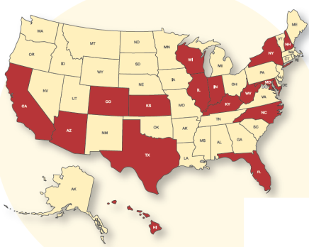
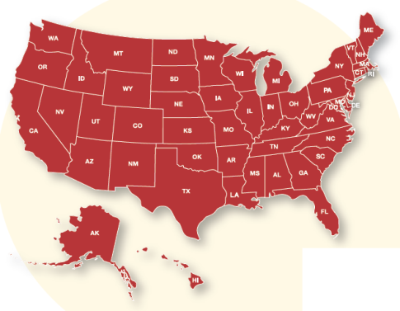

Public Awareness of COPD
Learn More Breathe Better
Public Health Challenge
  Estimated 24 million Americans with COPD; yet nearly 50% are undiagnosed and unaware.
NHLBI Public Awareness Campaign (2007)
  At-Risk Group: Adults 45+ with a history of smoking
  Objectives
    To increase awareness and understanding of COPD
    Empower patients to move from awareness-to-action
  Outcomes
    Growing 80+ partner network (local/national) in 50 states
    Breathe Better Network members conduct COPD education and outreach in their communities
2009
2013

Slide 48
Improving Asthma Outcomes by
Adherence to Evidence-Based Care
NAEPP Guidelines
Systematically review latest evidence and identify gaps
Provide recommendations
for clinical practice
Healthy People Practice Communities
Implement guidelines in clinic and community settings
Define lessons learned, knowledge gaps & future research priorities
Clinical Research
Test new treatment strategies
Provide new evidence base
for updating guidelines

Slide 49



Clinical Research Addresses Critical Questions to Improve Asthma Care
Do preschoolers with recurrent wheeze need inhaled corticosteroids (ICS) every day?
  Clinical Trial Evidence: Compared to daily ICS treatment, intermittent therapy (taken only as needed) uses much less (1/3) medicine for similar benefit
Current Trials Examine New Potential Approaches to Asthma Control:
  Is asthma control improved by Vitamin D supplementation?
  Does treatment with a macrolide antibiotic improve wheezing in pre-schoolers?

Slide 50



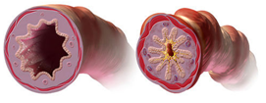





Developing Novel Therapies for Asthma:
A Broad, Balanced, Cross-Disciplinary Portfolio
National Heart, Lung, and Blood Institute
  Epidemiology key risk factors
  Genetics consortium personalized medicine
  Basic science cellular, molecular targets
  Centers to Advance Experimental Therapies
  Origins of Asthma Projects prevention
National Institute of Allergy and Infectious Diseases
  Allergen Epitope Research and Validation Centers
  Asthma and Allergic Diseases Cooperative Research Centers role of allergy
  Inner City Asthma Consortium immune based therapies
National Institute of Environmental Health Sciences
  Research (basic science, epidemiology, clinical) understanding environmental exposures and genetic susceptibility for prevention and intervention
  Well Being Project understanding respiratory health among children to identify environmental asthma triggers
  Broader knowledge of asthma establishing relationship between genes, social factors, and environment
Genetics
STRESS
Social Determinants
Inflammation
Exposures

Slide 51



Implementation Science Accelerates Adoption of Evidence-Based Care
Recently funded studies show adherence can be improved with novel approaches:
  Supervised therapy at school by school nurses
  Computer assisted learning in urban high schools
  Voice recognition - automated telecommunication
Current studies examine:
  Cultural competency training for primary care physicians
  Asthma management in Head Start
  Peer telephone counseling for women of color

Slide 52


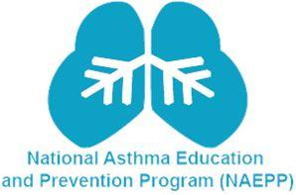
The National Asthma Education and Prevention Program (NAEPP): From Expert Panel Report-3 to Six Key Actions
Six Key Actions to Control Asthma
Use inhaled corticosteroids for control of persistent asthma
Use written asthma action plans
Assess asthma severity
Assess and monitor asthma control
Schedule follow-up visits
Control environmental exposures
The NAEPP works with over 40 organizations and partners:
Major medical associations
Voluntary health organization
Federal partners
The NAEPP’s Expert Panel Report 3–Guidelines for Diagnosing and Managing Asthma (2007) is based on the best available science
The NAEPP’s Guidelines Implementation Panel (GIP) Report (2008) prioritized six key actions
www.nhlbi.nih.gov/guidelines/asthma

Slide 53
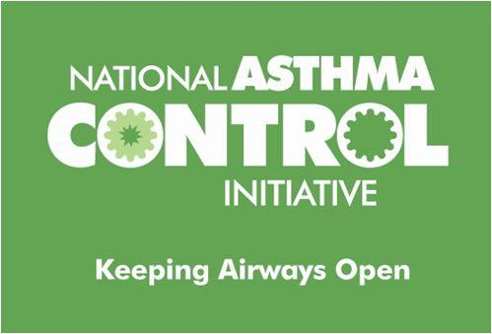
Mobilizing Partners to Put Guidelines Into Action for Improved Asthma Control
National Asthma Control Initiative (NACI)
Purpose: To improve asthma care and control, particularly in hard-hit communities, by promoting awareness and use of the NAEPP clinical practice guidelines
Time Period: 2009-2012
Audiences:
  Health Care Providers and Organizations
  Patients, Families, and Caregivers
  Schools and Childcare Settings
  States, Communities, and Coalitions

Slide 54

Reducing Disparities: Coordinated
Federal Action Plan
The Federal Action Plan was developed
to avoid redundancies & increase impact through interagency collaborations to:
  Reduce barriers to asthma care;
  Enhance local capacity to deliver care; (e.g., health care teams, healthy homes).
  Improve ability to identify children most in need;
  Accelerate research efforts to prevent the onset of asthma

Slide 55
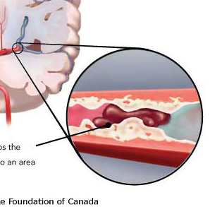
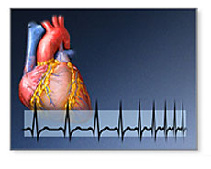

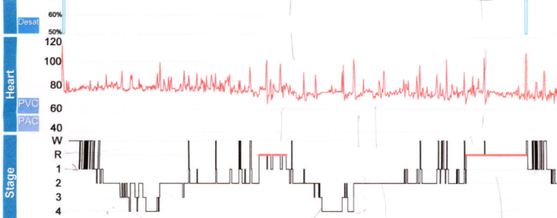
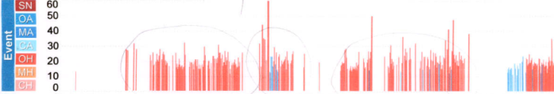

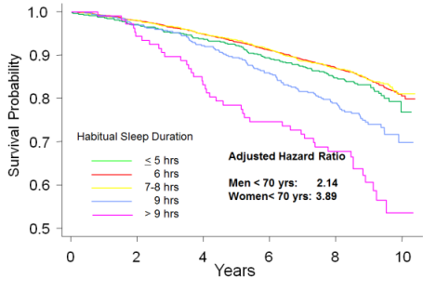
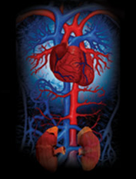
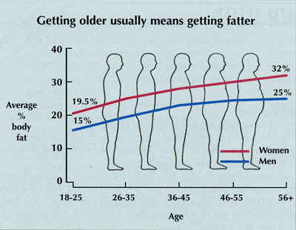
Sleep and Health Outcomes
Stroke risk 
Sleep Deficiency
Sleep Disorder
CVD risk 
PSG
Hypertension risk 
Obesity risk 
Mortality
Notes:
55

Slide 56
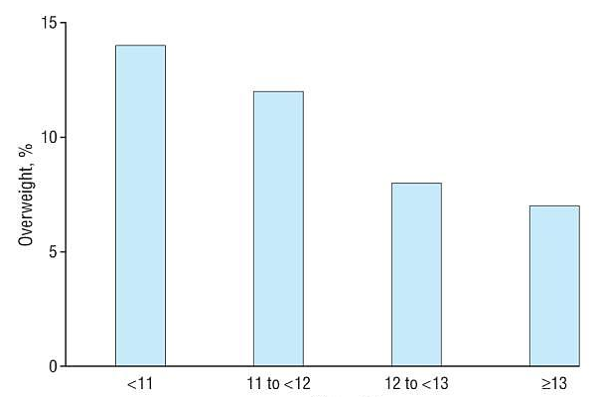
Sleep and Weight Gain in Children:
Racial Disparities
Sleep Duration During Infancy
Sleep (hours/day)
Short Sleep Duration in Infancy and Risk of Childhood Overweight
Taveras et al, Arch Pediatr Adolesc Med. 2008 April; 162(4): 305–311.

Slide 57

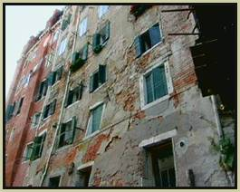
Sleep and CVD Disparities:
Social Context and Systems Science
Racism
Segregation
Socioeconomic Status
Housing Density
Crime
Noise
Shift Work
Stress
Depression
Poor Sleep Quality
CVD/STROKE

Slide 58
Key Takeaways
NHLBI maintains a broad portfolio of research to effectively elucidate factors influencing COPD, asthma and sleep.
Collaborations among NIH Institutes (NHLBI, NIAID, NIEHS) allows us to maximally leverage resources and broaden the NIH scope
We work with our stakeholders to generate evidence, translate the science, increase awareness, and promote partnerships for respiratory and sleep health and attainment of HP 2020 goals.

Slide 59
Vikas Kapil, DO, MPH, FACOEM
Acting Deputy Director and Chief Medical Officer
National Center for Environmental Health and
Agency for Toxic Substances and Disease Registry
Centers for Disease Control and Prevention

Slide 60
CDC
Sleep and Respiratory Diseases
  National Center for Environmental Health (NCEH)
    Asthma
  National Center for Chronic Disease Prevention and Health Promotion (NCCDPHP)
    Asthma, COPD and Sleep
  National Institute for Occupational Safety and Health (NIOSH)
    Asthma, COPD and Sleep

Slide 61
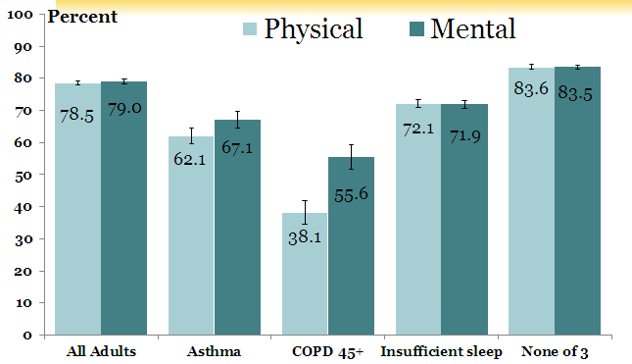
Adults Reporting Good or Better Physical and Mental Health* United States, 2010
* Global PROMIS scale I Confidence Interval
National Health Interview Survey: United States, 2010

Slide 62

NCEH: America Breathing Easier Since 1999
CDC’s National Asthma Control Program

Slide 63

NCEH: Reducing the Burden from Asthma
CDC’s National Asthma Control Program
A Public Health Approach Since 1999:
Surveillance
  National and state level data
  Asthma Call-back Survey
Partnerships
  34 states, Washington D.C., and Puerto Rico
  Non-governmental organizations
  Federal agencies
Interventions and Evaluation
  Self-management education
  Health care provider education
  Environmental management
  School-based programs

Slide 64
NCEH: National Asthma Surveillance
Prevalence
Mortality
Hospitalization
Outpatient visits
ED visits
Physician office visits

Slide 65
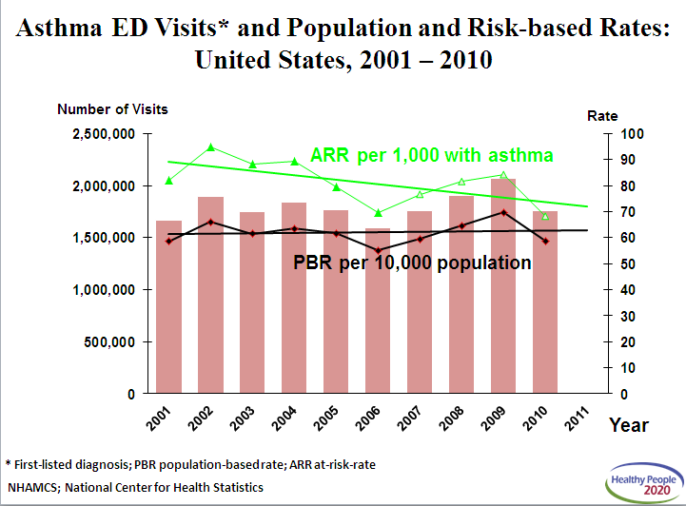
Asthma ED visits and population and risk-based Rates.

Slide 66
NCEH: State Surveillance: Data Profiles
Prevalence
Mortality
Hospitalization
Patient education
Medication use

Slide 67
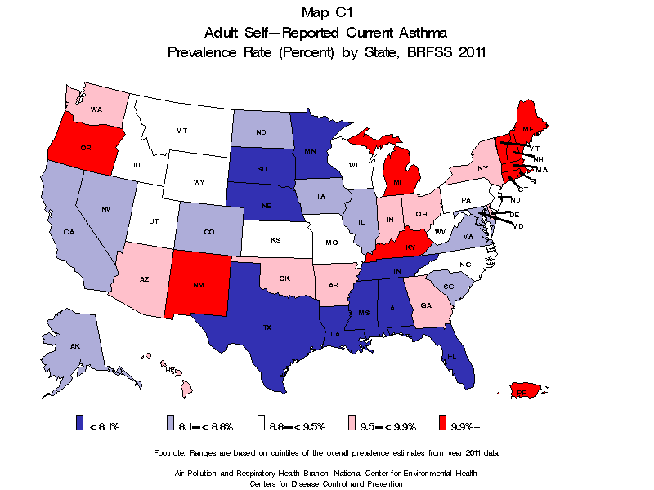
Current Asthma Prevalence, Adults 18+ years
NOTES: Data are for adults aged 18 years and over who have ever been diagnosed with asthma and still have asthma, State data from the BRFSS may not be comparable to the national data from the NHIS.
SOURCE: Behavioral Risk Factor Surveillance System (BRFSS), CDC/PHSPO

Slide 68
NCEH: Education for a Partnership in Asthma Care
Establish and Maintain a Partnership
  jointly develop treatment goals
  health literacy (read, count, measure, time, schedule)
  cultural sensitivity/ ethnic considerations
Provider Education
  implementing guidelines
  communication techniques
  clinical decision support
  systems-based interventions
Expert Panel Report 3: Guidelines for the Diagnosis and Management of Asthma
http://www.nhlbi.nih.gov/guidelines/asthma/asthgdln.htm p93-164

Slide 69
NCEH: Education for a Partnership in Asthma Care
Asthma Self-Management Education at Multiple Points of Care
  clinic/office-based education
  emergency department/ hospital-based education
  education by pharmacists
  education in school settings
  community-based interventions
  home-based interventions
Tools for Asthma Self-Management
  asthma action plans
  peak flow meters
Expert Panel Report 3: Guidelines for the Diagnosis and Management of Asthma
http://www.nhlbi.nih.gov/guidelines/asthma/asthgdln.htm p93-164

Slide 70
NCCDPHP: COPD Efforts
Develop a strategic framework to tackle COPD as a public health issue
Improve COPD surveillance
Increase COPD awareness

Slide 71

NCCDPHP: Strategic Framework - COPD
Public Health Strategic Framework for COPD Prevention

Slide 72
NCCDPHP: Improve COPD Surveillance
National Health and Nutrition Examination Survey
  Adult Medical Condition Questionnaire
  Respiratory Health and Disease Questionnaire
  Spirometry

Slide 73
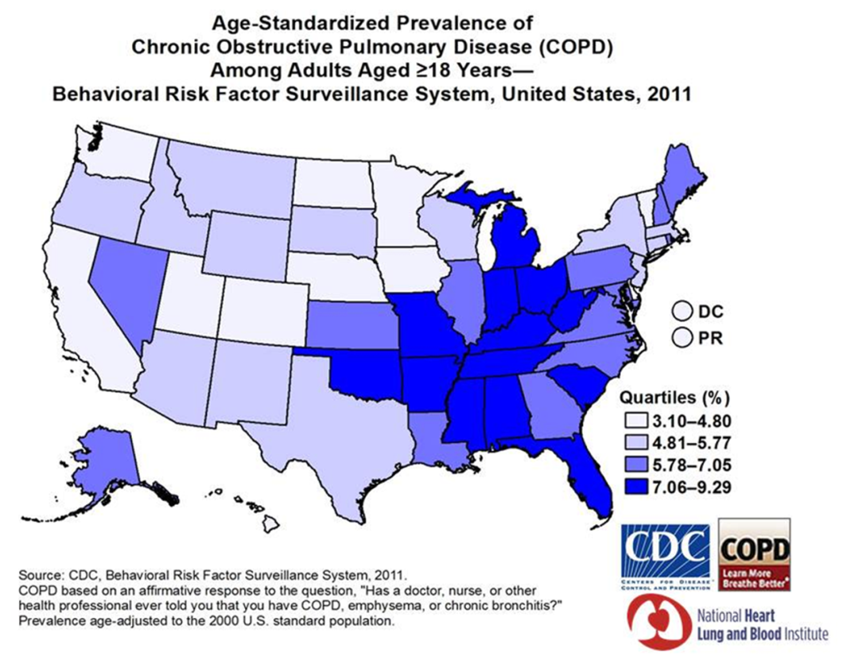
NCCDPHP: Improve COPD Surveillance
Behavioral Risk Factor Surveillance System
  Core question: (Ever told) you have COPD (chronic obstructive pulmonary disease), emphysema or chronic bronchitis?
  COPD module questions asked of individuals with COPD in 20 states, DC, and Puerto Rico (2011)

Slide 74
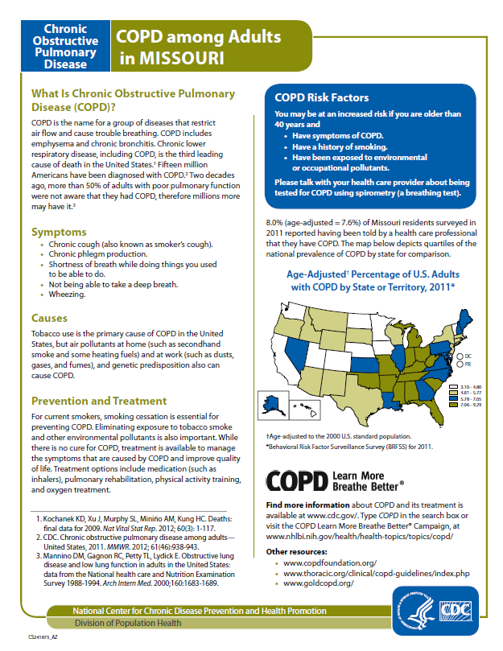
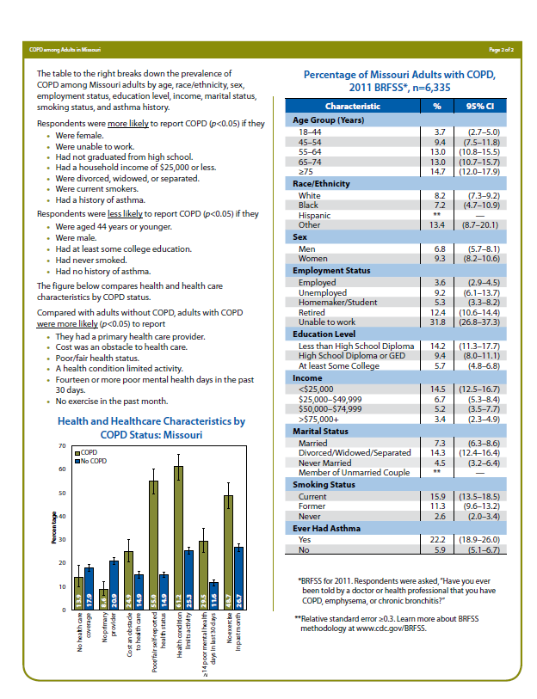
NCCDPHP: Increase COPD Awareness

Slide 75
NCCDPHP: Sleep Activities
Improve sleep-related content of national and state surveillance systems
Increase public awareness of the importance of healthy sleep
Support research
Promote sleep-healthy policies

Slide 76
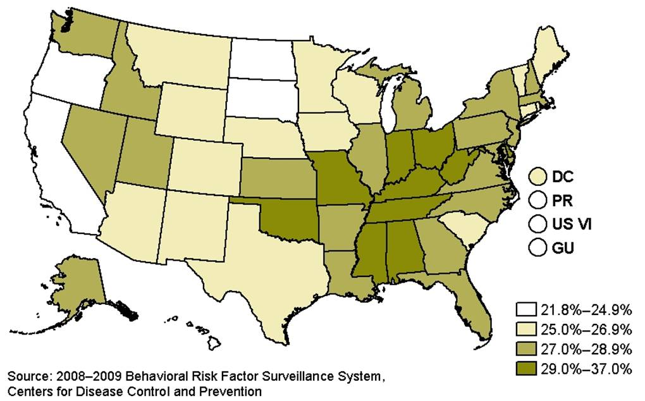
NCCDPHP: Improved Surveillance for Sleep Issues
Behavioral Risk Factor Surveillance System:
Days of perceived insufficient rest or sleep question
Percentage of adult population that reported ≥14 days of insufficient rest or sleep in the past 30 days, 2008-2009

Slide 77
NCCDPHP: Improved Surveillance for Sleep Issues
National Health and Nutrition Examination Survey
  Sleep Disorders Questionnaire
    In 2005-2008 (extensive)
    In 2009-2010 (limited):
  Actigraphy
Youth Risk Behavior Survey
  Sleep duration on school nights
School Health Policies and Practices Study
  School start time

Slide 78
NCCDPHP: Improved Surveillance for Sleep Issues
Insufficient Sleep State Fact Sheets

Slide 79
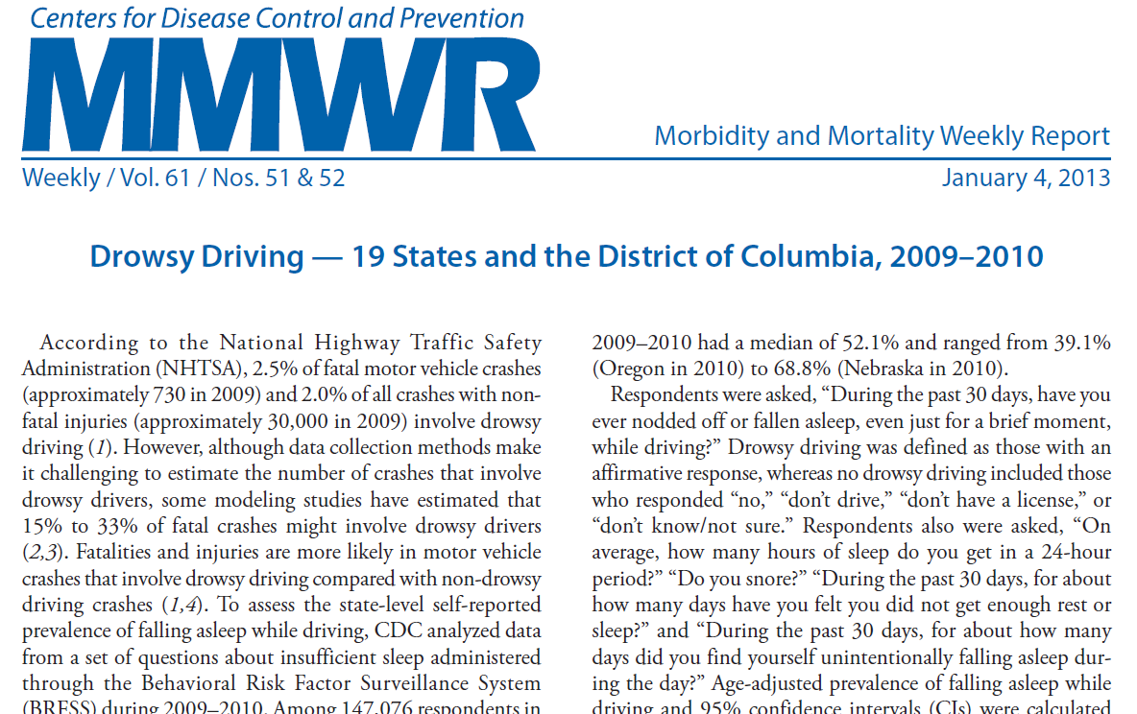
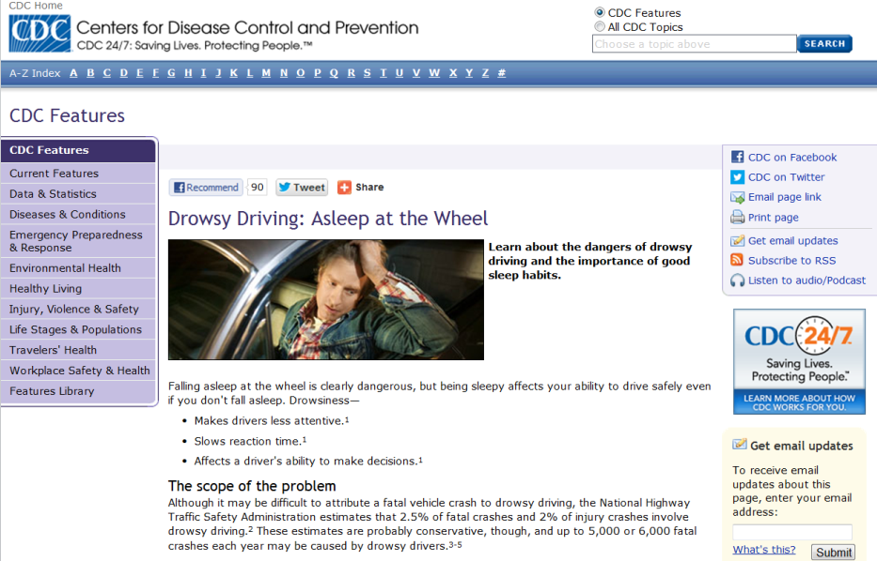
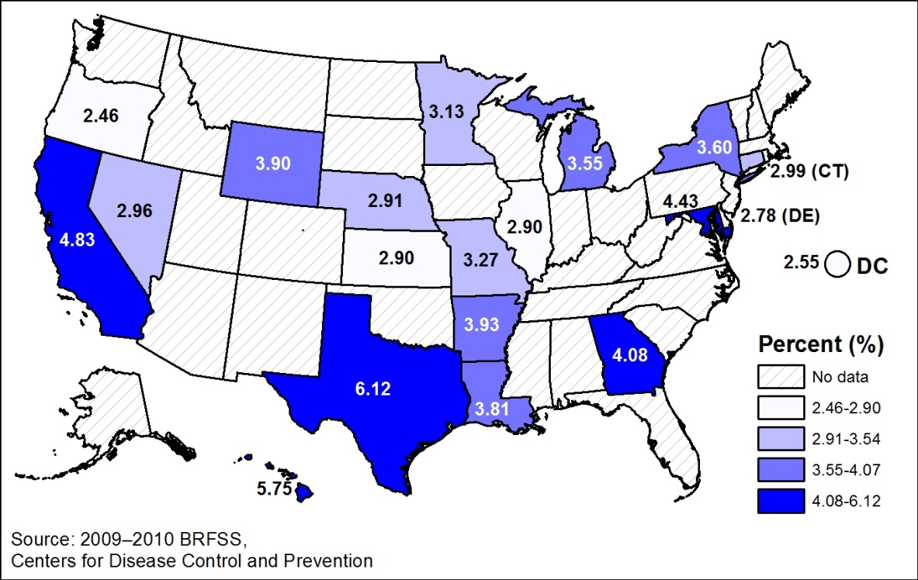
NCCDPHP: Improved Surveillance for Sleep Issues
Adults ≥ 18 Years Who Fell Asleep While Driving in Preceding 30 Days: 2009, 2010

Slide 80
NCCDPHP: Improved Surveillance for Sleep Issues
CDC extramural research support
BRFSS Sleep Question Validation Study by the University of Rochester
  Wrist Actigraphy
  Sleep Journals
Delayed School Start Times Study by the University of Minnesota
  Academic performance
  Student health

Slide 81
NIOSH: Work-Related Asthma (WRA)
Burden:
About 15% of adult asthma attributable to work
About 23% of adults with asthma experience work-related asthma exacerbations
Examples of NIOSH Efforts:
Surveillance (collaboration with national studies, state-based)
Isocyanates (widely used chemicals that cause asthma)
Indoor dampness and mold
Healthcare (cleaners & disinfectants)
Appropriate recognition and treatment of WRA
Participation in authoritative groups – Cochrane, American Thoracic Society, European Respiratory Society, NIH-NAEPP

Slide 82
NIOSH: Work- Related COPD
Burden – COPD prevalence, 12 million people; about 15% attributable to work
COPD mortality in 2010: 135,000
Collaboration with population based-studies is an important source of information
  National Health and Nutrition Examination Survey (NHANES); NIOSH assisted in providing spirometry
  Multi-Ethnic Study of Atherosclerosis (MESA); included spirometry and chest CT; NIOSH is analyzing relationships between occupation, industry, and COPD
Studies evaluating specific at-risk populations: coal mine dust, agriculture, construction, WTC dust, etc.

Slide 83
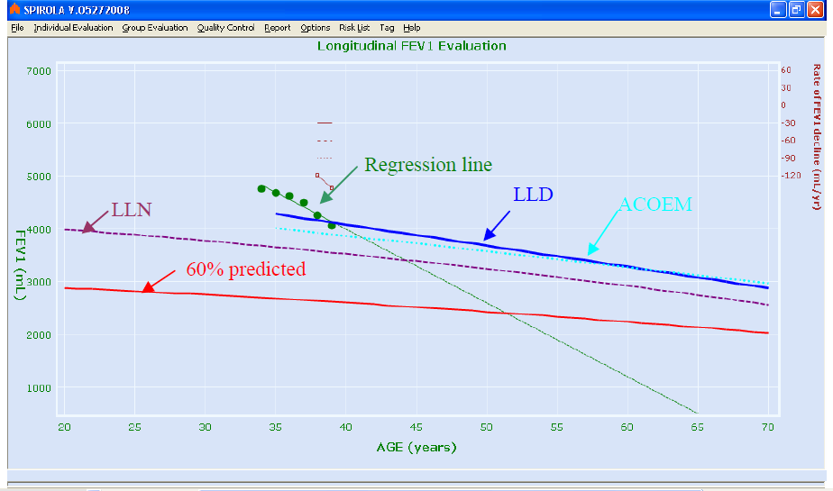
NIOSH: Early Detection of Work-Related COPD
Efforts to improve the quality of spirometry: technician training, educational materials
Longitudinal spirometry software: monitors spirometry program quality, aids in evaluating individual data, useful for health protection and promotion

Slide 84
NIOSH: Sleep & Work Schedule Research
Burden: Sleep disruption by factors such as rotating shifts is a health hazard. For example, the International Agency for Research on Cancer (IARC) designates shiftwork that involves circadian disruption as probably carcinogenic to humans (Group 2A).
Sleepiness is also a safety issue for those who drive or operate heavy equipment.
NIOSH Efforts
developing & testing tailored work schedule & sleep training for managers & workers in aviation, manufacturing, mining, nursing, retail, & trucking
large national survey of long-haul truck drivers includes measures of sleep, fatigue, work hours, health conditions & crashes.
surveillance of the prevalence of insufficient sleep by industry sector
impact of shift work on women’s reproductive outcomes
adverse health outcomes associated with insufficient sleep & shift work in police officers
Series of long work hour studies examining insufficient sleep, depression, injury, immune measures
quantitative risk assessment of work hours related to occupational illnesses & injury
See NIOSH Blog http://blogs.cdc.gov/niosh-science-blog/2012/03/09/sleep/

Slide 85
EPA’s Asthma Program
  Aimed at reducing racial and ethnic asthma disparities
    Training 5,000+ health care professionals annually to help families manage environmental triggers
    Raising awareness and action via the Asthma Media Campaign and www.noattacks.org.
    Disseminating best practices and successful strategies through:
    www.AsthmaCommunityNetwork.org
    National Environmental Leadership Award in Asthma Management

Slide 86
CDC Program Summary
  Healthy People objectives related to asthma, COPD, and sleep disorders are addressed by three organizational units at CDC.
  CDC has established programs dedicated to improving the quality of life for those affected by respiratory disease and sleep disorders.
  The CDC programs work closely with other federal agencies, non-governmental organizations, and state health departments to achieve these objectives.

Slide 87
Appendix
Note: The information contained within these slides provides additional details to supplement the webinar material.

Slide 88
NCEH: Advancing knowledge on asthma interventions

Slide 89
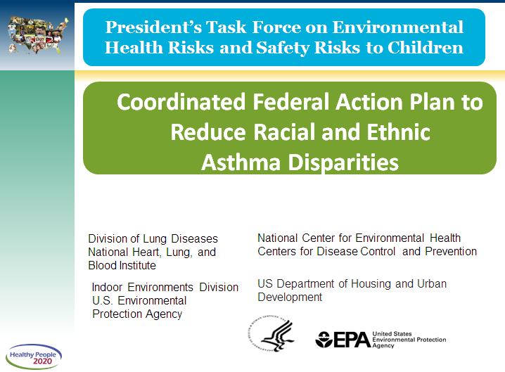
President’s task force on Environmental Health risks and afety risks to children.
Coordinated Federal Action Plan to Reduce Racial and Ethnic
Asthma Disparities
Coordinated Federal Action Plan to Reduce Racial and Ethnic
Asthma Disparities

Slide 90
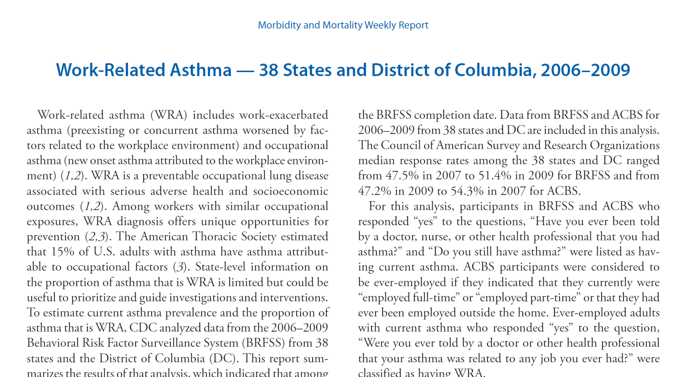
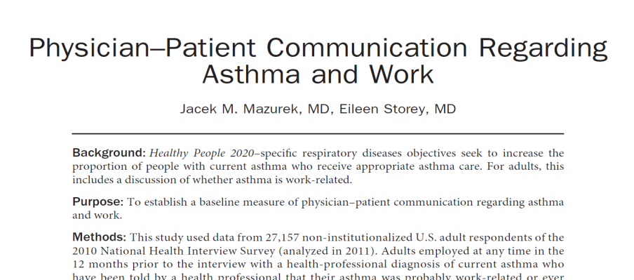

NIOSH: Improve WRA Awareness
MMWR
Scientific Publications
Twitter

Slide 91
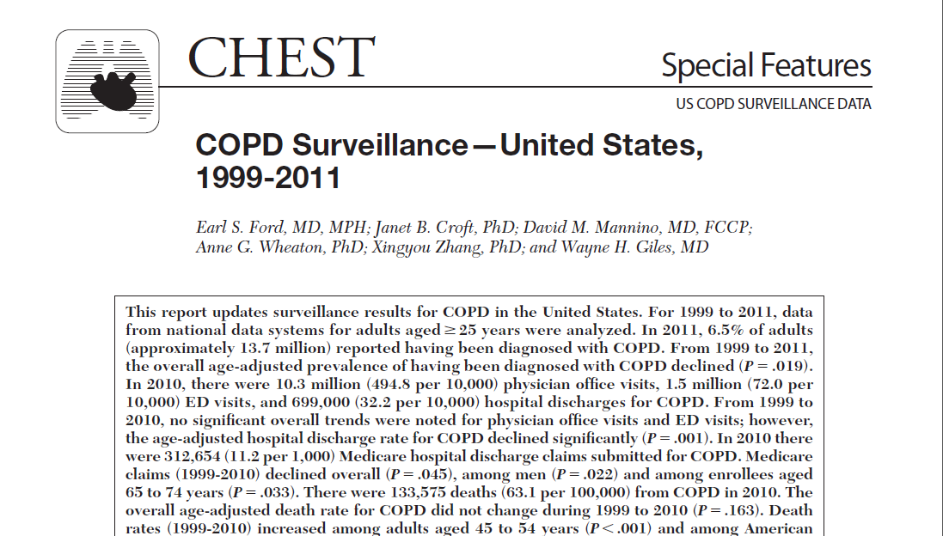
NCCDPHP: Improve COPD Surveillance

Slide 92
NCCDPHP: Improve COPD Surveillance
National Health Interview Survey
  Emphysema
  Chronic bronchitis
  *Chronic obstructive pulmonary disease (COPD)

Slide 93
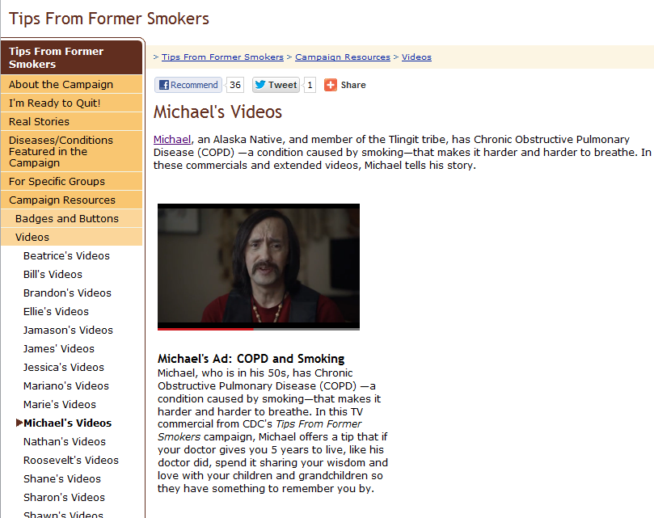
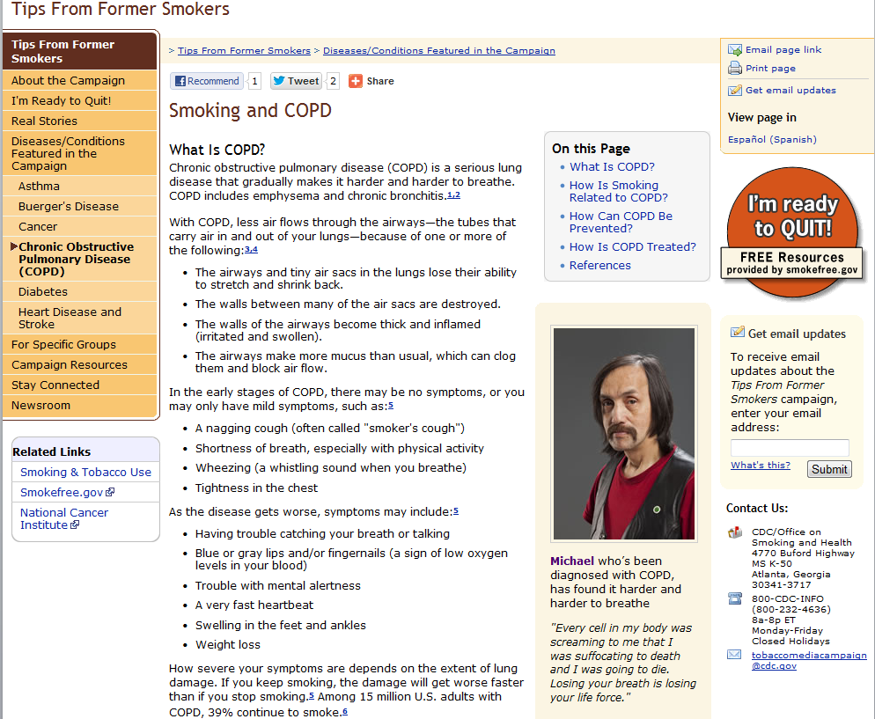
NCCDPHP: Increase COPD Awareness
Tips From Former Smokers Campaign

Slide 94
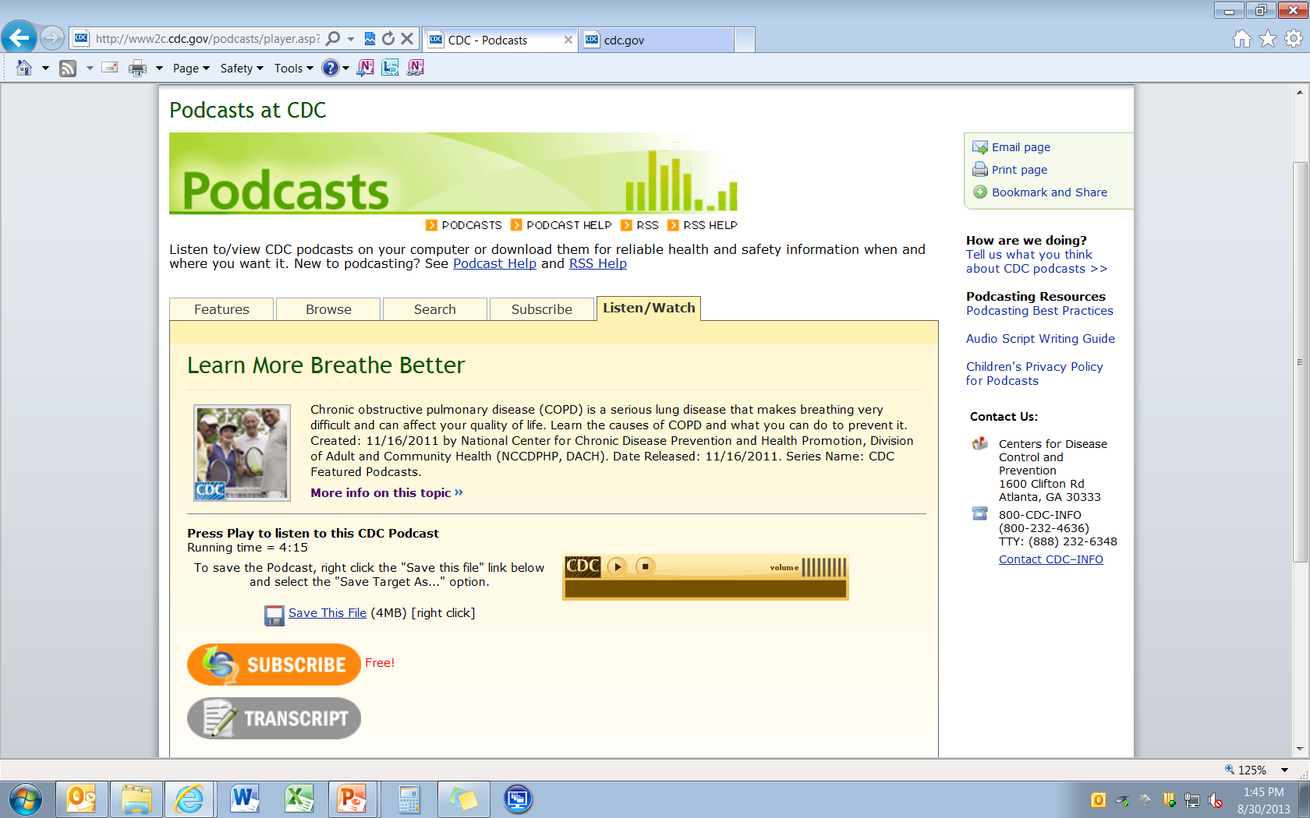
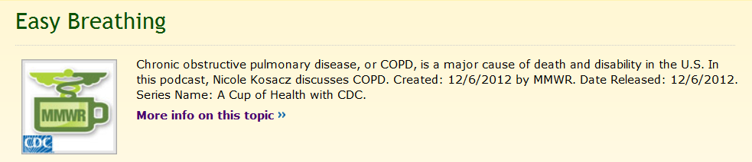
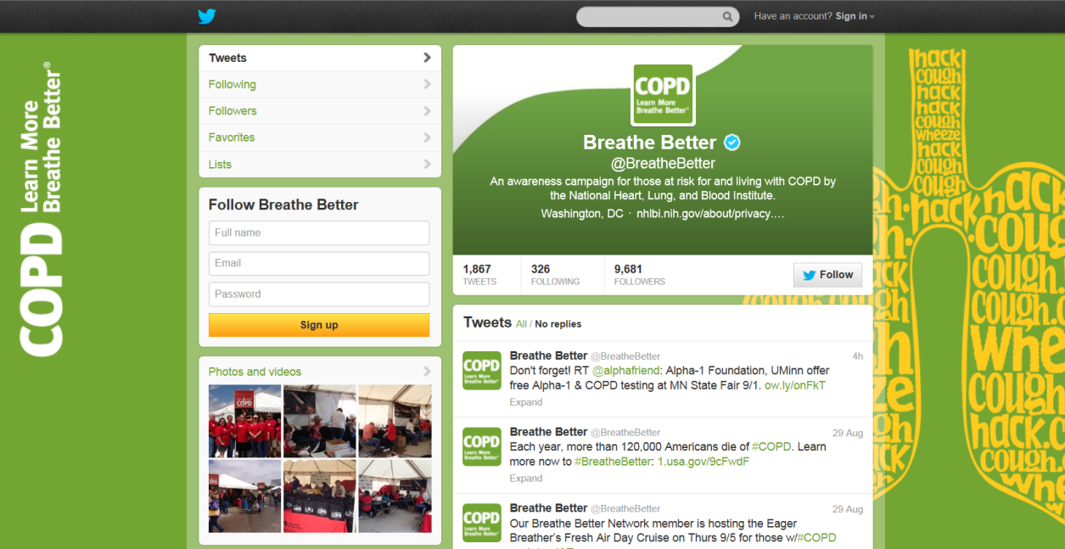
NCCDPHP: Increase COPD Awareness
Podcasts
Twitter Chat

Slide 95
NCCDPHP: Improved Surveillance
Behavioral Risk Factor Surveillance System
  Days of perceived insufficient rest or sleep question
  Insufficient Sleep module:
    Usual sleep duration
    Snoring
    Excessive daytime sleepiness
    Falling asleep at the wheel

Slide 96
NCCDPHP: Improved Surveillance
National Health and Nutrition Examination Survey
  Sleep Disorders Questionnaire
    In 2005-2008 (extensive):
      General sleep– sleep duration, sleep latency
      Sleep disorders/symptoms – OSA, insomnia, RLS
      Sleep-related difficulties
    In 2009-2010 (limited):
      How much sleep do you usually get at night on weekdays or workdays?
      Have you ever told a doctor or other health professional that you have trouble sleeping?
      Have you ever been told by a doctor or other health professional that you have a sleep disorder?
  Actigraphy

Slide 97
NCCDPHP: Improved Surveillance
School Health
Youth Risk Behavior Survey
  Sleep duration on school nights
School Health Policies and Practices Study
  School start time

Slide 98
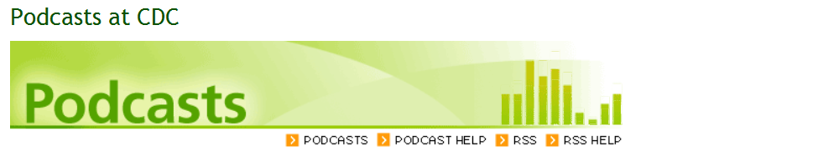
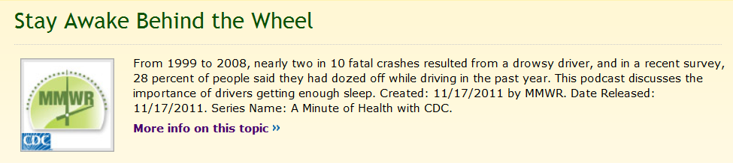
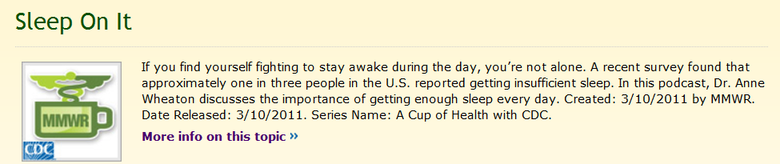
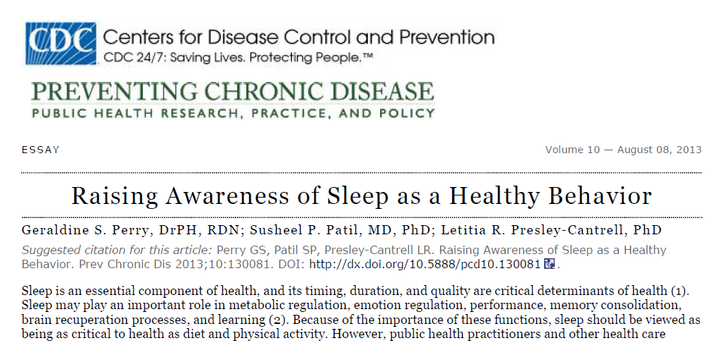
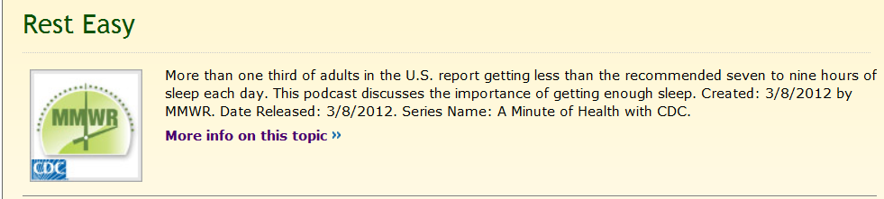
NCCDPHP: Increase Awareness
Podcasts
Scientific Publications
Sleep Essay

Slide 99
NCCDPHP: National Sleep Awareness Roundtable (NSART)
Goals
To increase public awareness about sleep, sleep disorders, and the consequences of sleep deprivation
To promote science-based public policies
To advance basic, clinical, applied, and population-based research
To promote recognition of and access to care for all individuals with sleep disorders.

Slide 100

Home-Based Case
Management for Asthma
Healthy People 2020 Progress Review
December 5, 2013
Karen Meyerson, MSN, APRN, FNP-C, AE-C

Slide 101
Who We Are
Community Asthma Coalition established in 1994
Location: Grand Rapids, Michigan
Population: 82,933 people with asthma in 3 counties
Target population: children (<18 years) with uncontrolled asthma from low-income families
Backgrounds served: 33% African American, 32% Hispanic/Latino, 15% Caucasian
    78% covered by Medicaid, 20% uninsured/under-insured
Original funding: Foundations, local hospitals

Slide 102
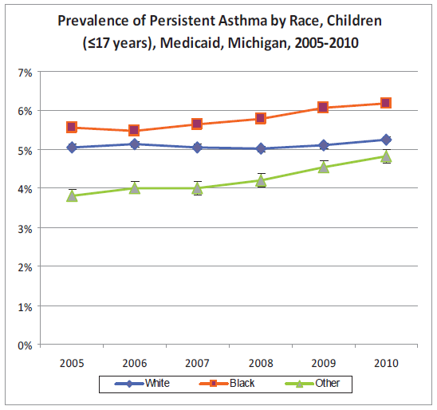
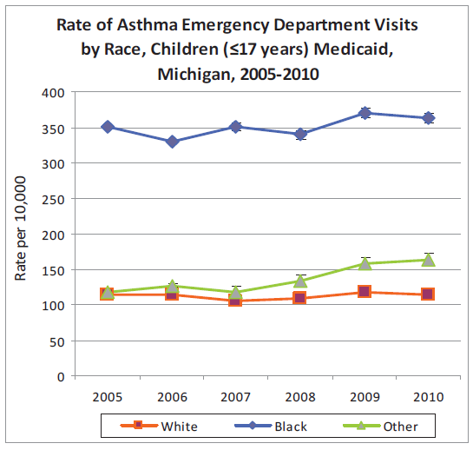
Asthma Burden for Children with Medicaid - Michigan
Garcia, E and Lyon-Callo S. “Asthma Burden for Children in Medicaid.” Epidemiology of Asthma in Michigan. Bureau of Epidemiology,
Michigan Department of Community Health, 2012.

Slide 103
What We Do
Why we are essential to the delivery of quality asthma care in our community:
Provide asthma education and case management support in homes
Utilize holistic approach to asthma management
  Work with patients, caregivers, families, school staff, health care providers
Serve as the “eyes and ears” of providers in the homes

Slide 104
Tailored Environmental Interventions:
Case Management
  Staff: Case managers, social worker, community health workers
Home-Based Case Management:
  Home visits
  Medical home visit(s)
  School/daycare visit(s)
  Up to 18 visits authorized per patient, per year
Community outreach:
  Speakers’ Bureau

Slide 105
Our Impact
The results we’re most proud of:
Design and implement a sustainable, comprehensive home-based asthma case management model
First asthma coalition in the nation to partner with a health plan and obtain reimbursement for services
Long-term partnership with health plans who report cost savings and positive return on investment (ROI)
60% decrease in hospitalizations
40% decrease in ED visits
Two national U.S. EPA awards:
  “National Model Asthma Program” (2006)
  National Environmental Leadership Award in Asthma Management (2008)

Slide 106
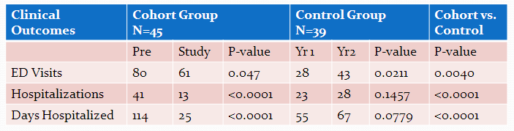
Getting Early Results: Evaluating the System
Kirk GM, et al. Abstract presented to the American Thoracic Society International Conference in San Francisco - May 2001

Slide 107
MATCH Study: Utilization

Slide 108



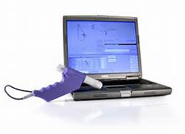
“This is the woman who saved my life”

Slide 109
Key Takeaways
Building and Fueling the System
  Diversify your funding base
  Don’t reinvent the wheel
  Plan for focused growth, but ensure financial stability at every step
Build strong community partnerships
  “Leave your badges at the door”
Evaluating & Tracking Results
  Measure everything and share outcomes with potential funders
The Asthma Network of West Michigan is striving daily to bring asthma under control in our community. Individuals with asthma should expect nothing less.

Slide 110

For more information, please contact:
Karen Meyerson, MSN, APRN, NP-C, AE-C
  E-mail: meyersok@mercyhealth.com
  Websites: www.asthmanetworkwm.org
  www.GetAsthmaHelp.org

Slide 111
Roundtable Discussion
Please take a moment to fill out our brief survey

Slide 112

LHI Infographic Gallery http://www.healthypeople.gov/2020/LHI/infographicGallery.aspx

Slide 113


Healthy People 2020 Progress Review Webinar
Prevention of Foodborne Illness and Medical Product Adverse Events
Wednesday, January 8 | 12:00 PM EST
  Please join us as we review select
  Healthy People 2020 objectives in the
  Food Safety and Medical Products Safety Topic Areas.
  Hear from a community-based organization that is partnering to share evidence-based science with consumers to prevent illness.
  To register, visit:
  www.healthypeople.gov

Slide 114



Stay Connected
Web healthypeople.gov
Email hp2020@hhs.gov
Twitter @gohealthypeople
LinkedIn Healthy People 2020
YouTube ODPHP (search “healthy people”)
Join the Healthy People Listserv & Consortium
Notes:
114

Slide 115

Healthy People 2020
Oral Health LHI Webinar
Join us on January 23rd for a
Who’s Leading the Leading Health Indicators?
Webinar to learn how one group is working to address the importance of oral health.
Register soon!
www.healthypeople.gov

Slide 116

Healthy People 2020
Sharing Library
A library of stories highlighting ways organizations across the country are implementing Healthy People 2020
Healthy People in Action - Sharing Library http://healthypeople.gov/2020/implement/MapSharingLibrary.aspx

Slide 117
Healthy People 2020
Progress Review Planning Group
  Jeanne Moorman, CDC/NCEH
  Joylene John-Sowah, NIH/NHLBI
  Bill Jirles, NIH/NIEHS
  Peter Gergen, NIH/NIAID
  Michael Twery, NIH/NHLBI
  Antonello Punturieri, NIH/NHLBI
  Rachael Tracy, NIH/NHLBI
  Stan Lehman, CDC/NCHHSTP
  Denise Stredrick NIH/OD
  Rebecca Hines, CDC/NCHS
  Leda Gurley, CDC/NCHS
  Kimberly Hurvitz CDC/NCHS
  Carter Blakey, HHS/ODPHP
  Emmeline Ochiai, HHS/ODPHP
  Ellis Davis, HHS/ODPHP
  Yen Luong, HHS/ODPHP

