Slide 1
Optimal Aging for Older Adults: Promoting Health and Addressing Dementias Including Alzheimer’s Disease
June 19, 2014

Slide 2
Don Wright, MD, MPH Deputy Assistant Secretary for Health U.S. Department of Health and Human Services

Slide 3
Overview and Presenters
Chair
Don Wright, MD, MPH, Deputy Assistant Secretary for Health
U.S. Department of Health and Human Services
Presentations
Irma Arispe, PhD, Associate Director, National Center for Health Statistics
Marie A. Bernard, MD, Deputy Director, National Institute on Aging, National Institutes of Health
Edwin Walker, JD, Deputy Assistant Secretary for Aging, Administration on Aging, Administration for Community Living
Wayne H. Giles, MD, MS, Director, Division of Population Health, National Center for Chronic Disease Prevention and Health Promotion, Centers for Disease Control and Prevention
Community Highlight
Susan Snyder, MS, Director, Project Enhance, Senior Services, Seattle Washington
Nichole Shepard, MPH, Health Educator, Salt Lake County Aging and Adult Services

Slide 4
Healthy People 2020 Evolves

Slide 5
Adults Aged 65+ Years 1900─2010 with Projections to 2050
Millions
NOTES: Projections are based on Census 2000. Number of people aged 65 and 85 years and over based on the residential population.
SOURCE: Federal Interagency Forum on Aging-Related Statistics. Older Americans 2012: Key Indicators of Well-Being. Federal Interagency Forum on Aging-Related Statistics. Washington, DC: US Government Printing Office. June 2012.; U.S. Census Bureau, U.S. Department of Commerce.
5

Slide 6
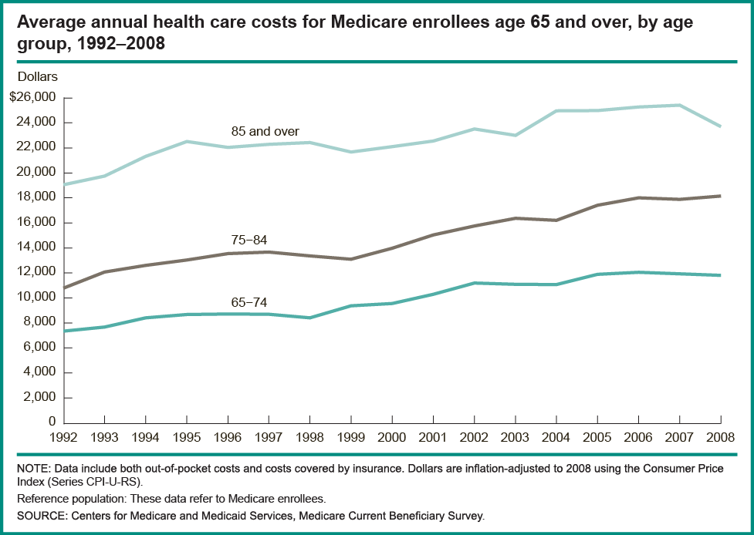
Health Care Expenditures of Medicare Beneficiaries
6

Slide 7
Irma Arispe, PhD Associate Director, National Center for Health Statistics Centers for Disease Control and Prevention

Slide 8
Presentation Overview
Tracking the Nation’s Progress
Public Health Impact: Older Adults and Dementias Including Alzheimer’s
Older Adults Topic Area
Access to selected Medicare benefits
Core preventive services
Functional limitations
Physical activity
Injury-falls
Dementias Including Alzheimer’s Topic Area
Awareness of diagnosis
Preventable hospitalizations
8

Slide 9
Tracking the Nation’s Progress
15 HP2020 Measurable Older Adults Objectives:
6 Targets met
0 Improving
0 Little or No detectible change
8 Getting worse
1 Baseline data only
2 HP2020 Measurable Dementias Including Alzheimer’s Objectives:
2 Baseline data only
NOTES: The Older Adults Topic Area contains 4 Developmental objectives. Measurable objectives are defined as having at least one data point currently available, or a baseline, and anticipate additional data points throughout the decade to track progress. Developmental objectives lack baseline data and targets.
9

Slide 10
Adults Aged 65+ Years 1900─2010 with Projections to 2050
Millions
NOTES: Projections are based on Census 2000. Number of people aged 65 and 85 years and over based on the residential population.
SOURCE: Federal Interagency Forum on Aging-Related Statistics. Older Americans 2012: Key Indicators of Well-Being. Federal Interagency Forum on Aging-Related Statistics. Washington, DC: US Government Printing Office. June 2012.; U.S. Census Bureau, U.S. Department of Commerce.
10

Slide 11
Medicare Beneficiaries Receiving Services or Treatment for Multiple Chronic Conditions, Adults 65+ Years, 2012
Percent
Number of Chronic Conditions
NOTES: The 17 chronic conditions were identified through Medicare administrative claims. A Medicare beneficiary is considered to have a chronic condition if the CMS administrative data have a claim indicating that the beneficiary received a service or treatment for the specific condition. Beneficiaries may have more than one of the chronic conditions. To classify multiple chronic conditions for each Medicare beneficiary, these conditions are counted and grouped into four categories (0-1, 2-3, 4-5 and 6 or more). In addition, all values have been rounded to the nearest integer. Therefore percentages may not add to 100%.
SOURCE: Chronic Conditions Warehouse, CMS, retrieved from http://www.ccwdata.org/chronic-conditions/index.htm.

Slide 12
Distribution of Spending for Medicare Beneficiaries by Number of Chronic Conditions, 2010
Percent of Beneficiaries with Multiple Chronic Conditions
Percent of Total Medicare Spending
NOTES: The 17 chronic conditions were identified through Medicare administrative claims. A Medicare beneficiary is considered to have a chronic condition if the CMS administrative data have a claim indicating that the beneficiary received a service or treatment for the specific condition. Beneficiaries may have more than one of the chronic conditions. To classify multiple chronic conditions for each Medicare beneficiary, these conditions are counted and grouped into four categories (0-1, 2-3, 4-5 and 6 or more). In addition, all values have been rounded to the nearest integer. Therefore percentages may not add to 100%.
SOURCE: Chronic Conditions Warehouse (CCW), CMS, retrieved at http://www.ccwdata.org/chronic-conditions/index.htm.

Slide 13
Leading Causes of Death, Adults 65+ Years, 2010
Rank | Cause of Death
1 | Heart disease
2 | Cancer
3 | Chronic lower respiratory diseases
4 | Stroke
5 | Alzheimer’s disease
6 | Diabetes
7 | Influenza and pneumonia
8 | Kidney disease
9 | Accidents (unintentional injuries)
10 | Septicemia
SOURCE: Heron M. Deaths: Leading causes for 2010. National vital statistics reports; vol 62 no 6. Hyattsville, MD: National Center for Health Statistics. 2013
13

Slide 14
Percent Change in Age-Adjusted Death Rates Between 2000 and 2010
Percent
NOTES: Data are for all ages and are age-adjusted.
SOURCE: Tejada-Vera B. Mortality from Alzheimer’s disease in the United States: Data for 2000 and 2010. NCHS data brief, no 116. Hyattsville, MD: National Center for Health Statistics. 2013.
14

Slide 15
Projected Prevalence of Alzheimer’s Disease, 2010—2050
Number of persons (millions)
SOURCE: Herbert LE. Alzheimer disease in the United States (2010-2050) estimated using the 2010 census. Neurology 2013; 80(19): 1778-83; Chicago Health and Aging Project (CHAP).
15

Slide 16
Estimated Monetary Costs of Dementia, 2010 and 2040
Dollars (Billions)
NOTES: Costs are calculated in 2010 dollars. * 2040 estimates are projections calculated in 2010 dollars. The minimum informal care cost is calculated based on the foregone wages for the informal caregivers. The maximum informal care cost is calculated based on the cost to replace the informal caregiver with professional staff. Direct cost is the cost for care purchased in the market place, and is equal to the sum of the estimated cost associated with dementia for out-of-pocket, Medicare, nursing home, and in-home care spending.
SOURCE: Hurd MD, Martorell P, Delavande A, Mullen KJ, Langa KM. (2013) Monetary costs of dementia in the United States. NEJM 368(14):1326-34.
16

Slide 17
Presentation Overview
Tracking the Nation’s Progress
Public Health Impact: Older Adults and Dementias Including Alzheimer’s
Older Adults Topic Area
Access to selected Medicare benefits
Core preventive services
Functional limitations
Physical activity
Injury-falls
Dementias Topic Area
Awareness of diagnosis
Preventable hospitalizations
17

Slide 18
Use of the Welcome to Medicare Benefit by New Enrollees, Adults 65+ Years, 2008—2011
Percent
HP2020 Target: 7.0 %
NOTES: The “Welcome to Medicare” benefit is a preventive visit for Medicare enrollees under Medicare Part B. *Data are not available for the year 2009. Estimates of variability are not available.
Obj. OA-1
Increase desired
SOURCE: Medicare Administrative Data, CMS.
18

Slide 19
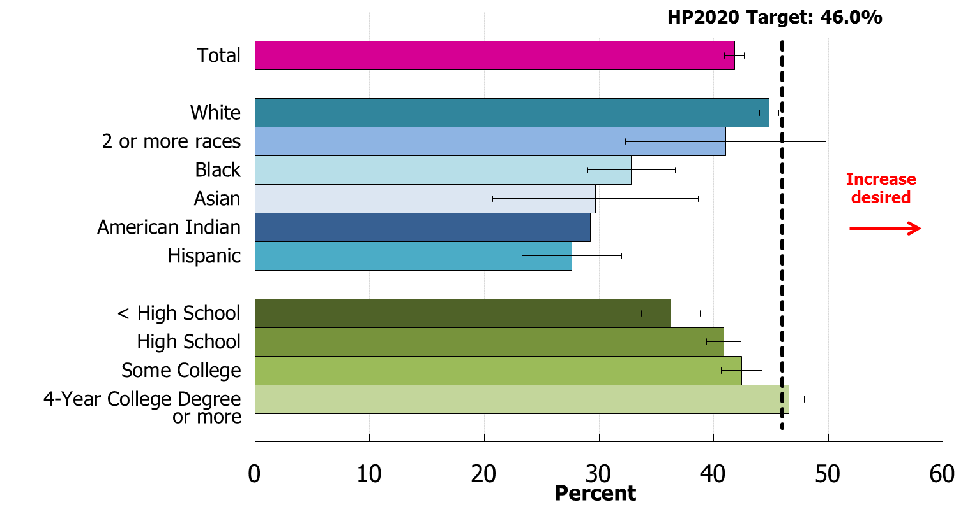
Up-to-Date Core Preventive Services, Males 65+ Years, 2012
NOTES: = 95% confidence interval. Data are for men aged 65 years and over who received a flu vaccination in the last year, pneumococcal vaccination ever, and colorectal cancer screening based on colonoscopy or sigmoidoscopy in the last 10 years or fecal occult blood test in the past year. American Indian includes Alaska Native. Asian includes Pacific Islander. The categories black and white exclude persons of Hispanic origin. Persons of Hispanic origin
may be any race. Respondents were asked to select one or more races. Data for the single race categories shown are for persons
who reported only one racial group.
I
Obj. OA-2.1
19
SOURCE: Behavioral Risk Factor Surveillance System (BRFSS) , CDC/ PHSPO.

Slide 20
Up-to-Date Core Preventive Services, Females 65+ Years, 2012
HP2020 Target: 43.1%
Increase desired
or more
Percent
NOTES: = 95% confidence interval. Data are for women aged 65 years and over who received a flu vaccination in the last year, pneumococcal vaccination ever, and colorectal cancer screening based on colonoscopy or sigmoidoscopy in the last 10 years or fecal occult blood test in the past year, and mammogram in the last 2 years. A mammogram is only required for women aged 65-74 years. American Indian includes Alaska Native. Asian includes Pacific Islander. The categories black and white exclude persons of Hispanic origin. Persons of Hispanic origin may be any race. Respondents
were asked to select one or more races. Data for the single race categories shown are for persons who reported only one racial group.
I
Obj. OA-2.2
20
SOURCE: Behavioral Risk Factor Surveillance System (BRFSS), CDC/ PHSPO.

Slide 21
Receipt of Diabetes Self-Management Benefits, Adults 65+ Years, 2008—2012
Percent
HP2020 Target: 2.2%
NOTES: Data are for Medicare beneficiaries who have been diagnosed with diabetes for whom there is a Medicare claim for diabetes self-management training services. *Data are not available for the year 2009. Estimates of variability are not available.
Obj. OA-4
Increase desired
21
SOURCE: Medicare Administrative Data, CMS.

Slide 22
Moderate to Severe Functional Limitations, Adults 65+ Years
HP2020 Target: 26.4%
Decrease desired
Percent
NOTES: = 95% confidence interval. Data are for adults age 65 years and over with one or more limitations in activities of daily living or living in a long term care facility. The categories black and white exclude persons of Hispanic origin. Persons of Hispanic origin may be any race.
I
Obj. OA-5
22
SOURCE: Medicare Current Beneficiary Survey (MCBS), CMS.

Slide 23
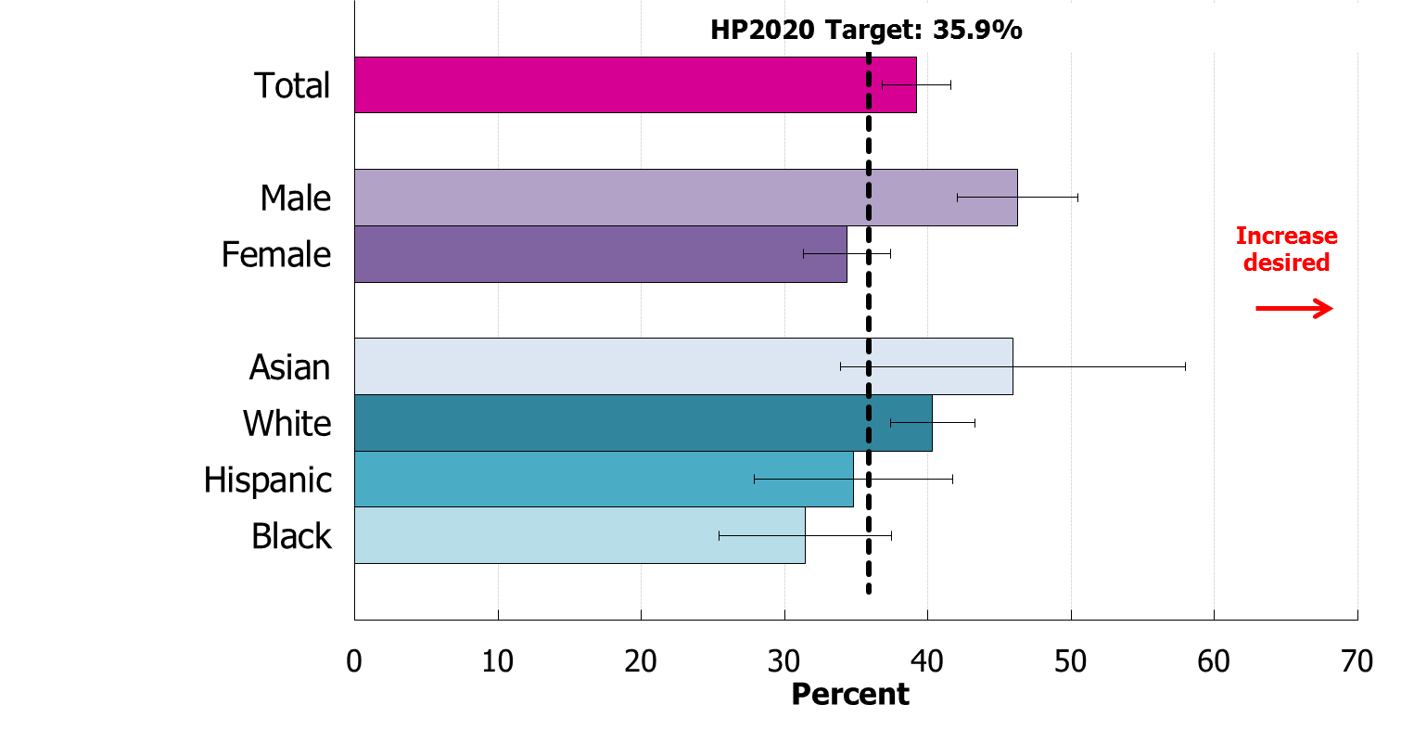
Physical Activity, Adults 65+ Years with Reduced Physical or Cognitive Function, 2012
NOTES: = 95% confidence interval. Data are for adults age 65 years and over with reduced physical or cognitive function who engage in light, moderate, or vigorous leisure time physical activity for at least 10 minutes per week. The categories black and white exclude persons of Hispanic origin. Persons of Hispanic origin may be any race. Respondents were asked to select one or more races. Data for the single race categories are for persons who reported only one racial group. Data for American Indian or
Alaska Native, Native Hawaiian or Other Pacific Islander, and 2 or more races are statistically unreliable and are suppressed.
I
Obj. OA-6
23
SOURCE: National Health Interview Survey (NHIS), CDC/NCHS.

Slide 24
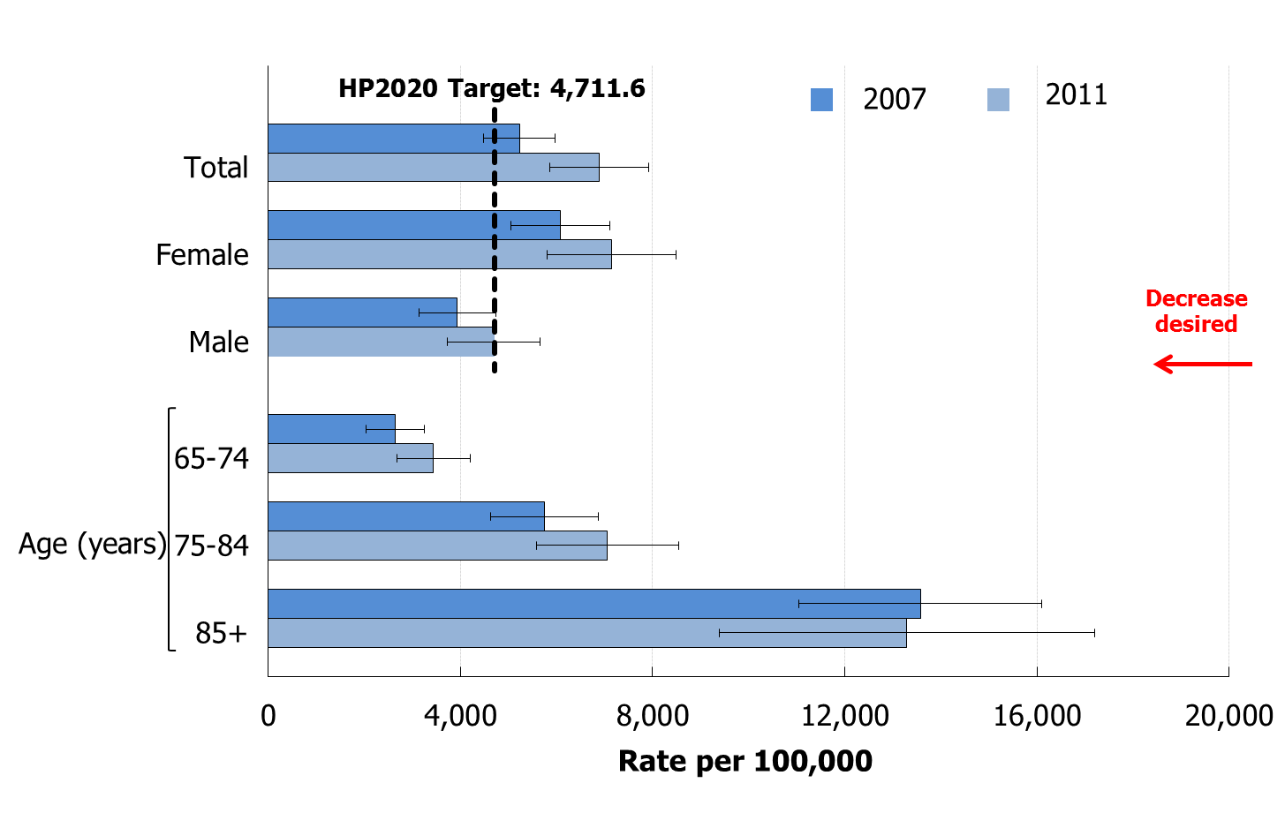
Emergency Department Visits for Falls, Adults 65+ Years
NOTES: = 95% confidence interval. Data are for initial emergency department visits for falls (first listed ICD-9-CM codes E880-E886, E888, E957, E968.1, E987) among people age 65 and over. Data are age adjusted to the 2000 standard population.
I
Obj. OA-11
24
SOURCE: National Hospital Ambulatory Medical Care Survey (NHAMCS), CDC/NCHS.

Slide 25
Presentation Overview
Tracking the Nation’s Progress
Public Health Impact: Older Adults and Dementias Including Alzheimer’s
Older Adults Topic Area
Access to selected Medicare benefits
Core preventive services
Functional limitations
Physical activity
Injury-falls
Dementias Including Alzheimer’s Topic Area
Awareness of diagnosis
Preventable hospitalizations
25

Slide 26
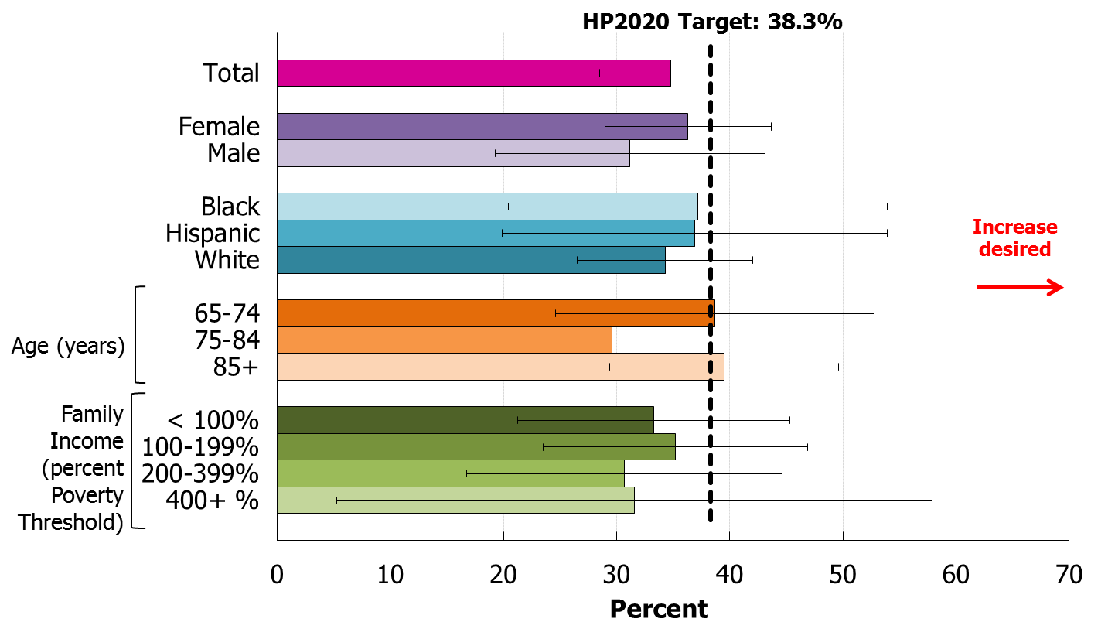
Awareness of Dementia Diagnosis, Adults 65+ Years, 2007—2009
NOTES: = 95% confidence interval. Data are for persons diagnosed with or receiving treatment for Alzheimer’s disease or other type of dementia, or their caregiver, who are aware of the diagnosis. The categories black and white exclude persons of Hispanic origin. Persons of Hispanic origin may be any race.
I
Obj. DIA-1
26
SOURCE: Medicare Current Beneficiary Survey (MCBS), CMS.

Slide 27
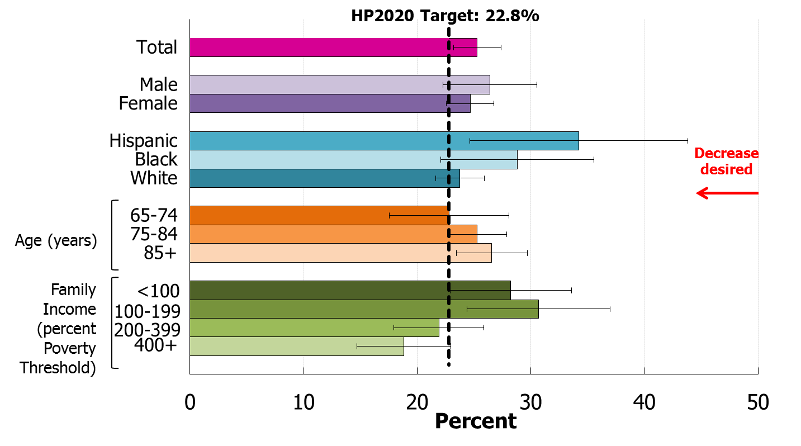
Preventable Hospitalizations for Adults 65+ with Diagnosed Dementias, 2006—2008
NOTES: = 95% confidence interval. Data are for persons with Alzheimer’s disease and other dementia’s with preventable ambulatory care sensitive hospitalizations for conditions such as diabetes, hypertension, dehydration, and urinary tract infections. The categories black and white exclude persons of Hispanic origin. Persons of Hispanic origin may be any race.
I
Obj. DIA-2
27
SOURCE: Health and Retirement Survey (HRS) linked with Medicare Claims Data, CMS.

Slide 28
Key Takeaways—Older Adults
Both the number and proportion of the population age 65 and over are increasing.
Average annual health care costs are increasing.
Medicare spending is highest for those with 4 or more chronic conditions.
37.6% of adults have 4 or more chronic conditions (2012).
Nearly 1/3 of older adults have moderate to severe functional limitations.
28

Slide 29
Key Takeaways—Older Adults
Emergency Department visits for falls in older adults are increasing over time.
Less than half (40%) of older adults received core preventive services.
Certain Medicare benefits are under-used, such as diabetes self-management and the Welcome to Medicare benefit.
29

Slide 30
Key Takeaways—Dementias Including Alzheimer’s Disease (DIA)
Alzheimer’s Disease is the 5th leading cause of death among adults aged 65 years and over.
Approximately 1 in 3 older adults are aware of their dementia diagnosis.
Approximately 1 in 4 persons with dementia experience potentially preventable hospitalizations.
30

Slide 31
Optimal Aging for Older Adults: Promoting Health and Addressing Dementias, including Alzheimer’s Disease Marie A. Bernard, M.D. Deputy Director National Institute on Aging

Slide 32
NIA Research Updates

Slide 33
Does Moving to a Lower Poverty Neighborhood Improve Health and Well-Being?
Three groups assigned by lottery; key intervention: housing assistance provided but moves limited to low-poverty Census tracts
Results of the low-poverty move:
The effect on glucose control for adults that was comparable to that of metformin.
Improvements in subjective well-being = $13,000 increase in an annual income.
Related to HP 2020 Obj. OA-3 & 8
Ludwig, J et al. (2011) NEJM 365: 1509-1519.

Slide 34
Does Medicaid Improve the Health and Well-Being of the Poor?
An opportunity in Oregon
Medicaid closed to new enrollment in 2004
CMS-approved lottery for enrollment, when additional funds were identified
Some findings from the Medicaid group
Increased use of primary and preventive care
Lower out-of-pocket medical expenditures/debt
Better self-reported physical and mental health
Increased diagnosis and management of diabetes
Related to HP 2020 Obj. OA-2, 2.1, 2.2, 3, 4, 5, & 8
Baicker, K and Finkelstein, A. (2011) NEJM 365(8):683-5.

Slide 35
LIFE Study
The ability to walk without assistance is critical for older people to live in a community and function well.
The study showed that a regular, balanced and moderate exercise program followed for an average of 2.6 years reduced the risk of major mobility disability by 18 percent in an elderly, vulnerable population.
Exercises included walking, and strength, flexibility, and balance training activities.
Pahor, M et al. (2014) JAMA 2014 May 27 [Epub ahead of print].
Related to HP 2020 Obj. OA-5, 6, 8, & 11

Slide 36
Advanced Cognitive Training for Independent and Vital Elderly (ACTIVE)
The study looked at the effects of cognitive training on cognitive abilities and everyday function.
Benefits at ten years were seen in reasoning and speed, but not memory.
~60% of participants maintained or improved Instrumental Activities of Daily Living (IADLs).
Related to HP 2020 Obj. OA-5 & 8
Rebok, GW et al. (2014) J Am Geriatr Soc Jan 13 [Epub ahead of print].

Slide 37
NIA & Patient Centered Outcomes Research Institute (PCORI) Collaboration
RFA on Falls-Injury Prevention Issued in July 2013
Falls are a common but serious problem among the elderly
The best prevention strategy is not known
The goal of the collaboration is to fund a single large clinical trial on prevention of fall-related injuries in non-institutionalized older adults
Meaningful involvement of patients and stakeholders as partners with researchers is included throughout the research process
$30 million, 5-year study supported with funds from PCORI and led by NIA and team of investigators: “Randomized Trial of a Multifactorial Fall Injury Prevention Strategy”
The research team involves investigators at Brigham and Women’s/Harvard, the Yale School of Medicine, and the School of Medicine at UCLA
Award announced June 4th
Related to HP 2020 Obj. OA-5, 6, 8, 11 & DIA-2

Slide 38
Assessing the Progression of Alzheimer’s Disease
Cognitive and other functional impairments were initial measures used to monitor AD progression.
Later, changes in brain volume and metabolism were detected before cognitive changes occur.
More recently, imaging of beta-amyloid build-up can enable us to detect AD-related changes in the living brain, earlier than ever before.
The benefit of these early markers is a newfound ability to intervene in very early stages of disease and monitor the impact of these interventions.
Related to HP 2020 Obj. DIA-1 & 2
Aisen, PS et al. (2010) Alzheimers Dement 6:239-246.
Notes:
38

Slide 39
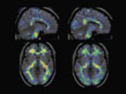
Intervening in Presymptomatic Early-Onset Alzheimer’s Disease
Study of a Colombia family that develops AD early has made research on very early interventions possible
Studies are underway currently to test an anti-amyloid treatment
Non-Carriers, late 30’s
Gene Carriers, late 30’s
Beta-amyloid, late 20’s
Related to HP 2020 Obj. OA-3, 5, 6, 8, 11, & DIA-2
Fleisher, AS et al. (2012) Lancet Neurology 11(12):1057-65.

Slide 40
Treatment for Agitation in Alzheimer’s
The CitAd trial compared the antidepressant citalopram to placebo in participants with probable AD and clinically significant agitation
Citalopram offered significant improvement in agitation symptoms compared to controls.
Citalopram volunteers also showed some decline in cognition and heart function; however antipsychotic treatments may have greater risks.
Citalopram – especially in lower doses – was concluded to be a more effective and safer alternative.
Related to HP 2020 Obj. OA-5, 8, & DIA-2
Porsteinsson, AP et al. (2014) JAMA 311(7):682-691.

Slide 41
Go4Life
Go4Life is an exercise and physical activity campaign from the NIA, designed to encourage older adults to become more active.
http://www.nia.nih.gov/Go4Life

Slide 42
National Plan to Address Alzheimer’s Disease
Goal 1: Prevent and Effectively Treat Alzheimer’s Disease by 2025
Goal 2: Enhance Care Quality and Efficiency
Goal 3: Expand Supports for People with Alzheimer’s Disease and Their Families
Goal 4: Enhance Public Awareness and Engagement
Goal 5: Improve Data to Track Progress
Updates on milestones are available at: http://aspe.hhs.gov/daltcp/napa/milestones/milestones-p.pdf

Slide 43
Edwin Walker Deputy Assistant Secretary for Aging U.S. Department of Health and Human Services Administration for Community Living

Slide 44
Administration for Community Living (ACL): Purpose and Structure
Created in 2012, ACL develops policies and improves supports for older adults and persons with disabilities of all ages
Combines the Administration on Aging (AoA), Office on Disability, and Administration for Intellectual and Developmental Disabilities
AoA leads the National Aging Network:
56 State Units on Aging
400+ tribes and tribal organizations
620 Area Agencies on Aging (AAAs)
20,000+ local service providers

Slide 45
Aging Network Services
Services available address most of the objectives related to Older Adults (OA) and Dementias, Including Alzheimer’s Disease (DIA):
Access services
In-home, community, and supportive services
Caregiver services
Elder rights services
Health-related services
Nutrition services

Slide 46
Increase self confidence in managing chronic conditions(OA-3)
Chronic disease self management education is an evidence-based approach that helps older adults learn how to manage their health conditions more effectively
Aging and public health networks and their partners are delivering these programs across the US
Chronic disease self management programs have shown the following outcomes:
Better health (self-reported health, pain, fatigue, depression)
Better care (patient-physician communication, medication compliance, confidence completing medical forms)
Less use of services (fewer emergency room visits and hospitalizations)

Slide 47
Increase self confidence in managing chronic conditions(OA-3)
ACL/AoA Role in Chronic Disease Self-Management Education
History:
2003-2012 Evidence-Based Grants: 24 states
2010-2013 American Recovery and Reinvestment Act (ARRA) Grants: 47 states, DC & PR
2012-2015 Prevention and Public Health Fund (PPHF) Grants: 22 states

Slide 48
Increase use of Diabetes Self-Management Benefits (OA-4)
Diabetes Self-Management Program (DSMP)
Through ARRA and current PPHF grants, 39 states provide DSMP
ACL provides technical assistance resources on how to obtain ADA/AADE accreditation and Medicare reimbursement
Resources include a toolkit, tip sheets, webinars

Slide 49
Reduce emergency department visits due to falls (OA-11)
Falls Management & Prevention Programs
Prior evidence-based grants and Older Americans Act Title III-D funding has established program infrastructure in 38 states
2014-2016 PPHF Evidence-Based Falls Prevention grants to states and tribal organizations
Start date ~ September 1, 2014
Funding: About $4 million for 8-10 states and 5 tribes

Slide 50
Reduce unmet need for long-term services and supports (OA-8)
ACL’s Supportive Services – Older Americans Act (OAA)
Supportive services
Nutrition services
Services protecting vulnerable older adults
Services for tribes and tribal organizations
About $1 billion serving 10 million older adults
Serve 1 in 5 adults aged 60+

Slide 51
Reduce unmet need for caregiver support services (OA-9)
National Family Caregiver Support Program (NFCSP)
2000 OAA reauthorization – 1st Federal grant program specifically for meeting the needs of unpaid family caregivers
Authorizes 5 categories of services: information; assistance in accessing services; caregiver counseling, support groups & training; respite; supplemental services
Outcomes: 2013 AoA National Survey data show:
78% of caregivers served say NFCSP enabled them to provide care longer
93% of caregivers served rated services as good to excellent

Slide 52
Reduce preventable hospitalizations in those with dementias (DIA-2)
Alzheimer’s Disease Supportive Services Program (ADSSP)
Began in 1992 as the first Federal demonstration program to target services to people with the disease
In 2008, the program shifted to funding services that are evidence-based.
Translated interventions have:
Decreased caregiver depression & burden
Increased caregiver knowledge, confidence & coping
New Alzheimer’s program with funding from PPHF - $10.5 million

Slide 53
Administration for Community Living: Program Takeaways
ACL/AoA’s programs relate to many OA and DIA objectives and offer older adults direct benefits from evidence-based programs. For more information on the programs:
Chronic disease self management education: http://www.aoa.gov/AoARoot/AoA_Programs/HPW/ARRA/PPHF.aspx
Diabetes self management benefits: http://www.ncoa.org/dsmt
National Family Caregiver Support Program: http://www.aoa.gov/aoa_programs/hcltc/caregiver/index.aspx
Alzheimer’s Disease Supportive Services program: http://www.aoa.gov/AoARoot/AoA_Programs/HPW/Alz_Grants/index.aspx

Slide 54
Wayne H. Giles, MD MS Director, Division of Population Health National Center for Chronic Disease Prevention and Health Promotion Centers for Disease Control and Prevention

Slide 55
CDC Strategic Directions

Slide 56
CDC Healthy Aging Program and Healthy Brain Initiative (HBI)
DIA-1&2
CDC Healthy Aging Program
Focal point for older adult health at CDC
CDC Healthy Brain Initiative (HBI)
HBI Road Map for States and Communities
Actions recommended in 4 domains
Monitor and evaluate
Educate and empower the nation
Develop policy/mobilize partnerships
Assure a competent workforce
Used by states as a model for their own state plans (e.g., GA, HI)

Slide 57
CDC Healthy Brain Initiative
DIA-1&2
2014 - CDC support* to 5 states and 1 territory for Road Map activities, e.g.,
Arizona – Community health worker training on Alzheimer’s disease (“assure a competent workforce”)
Hawaii – Public awareness materials to reduce stigma (“educate/empower the nation”)
Wisconsin – Models to promote and develop dementia-friendly communities, e.g., toolkits (“develop policy/partnerships”)
Puerto Rico – First Alzheimer’s disease plan in Puerto Rico to guide program and service development (“develop policy/partnerships”)
* In partnership with the National Association of Chronic Disease Directors

Slide 58
Increasing the Use of Clinical Preventive Services
OA-2
From article: “Clinical and Community Delivery Systems for Preventive Care: An Integration Framework”,
Am Journal of Preventive Medicine, October 2013, Alex Krist et al.

Slide 59
Increasing the Use of Clinical Preventive Services
OA-2
Data for action in states and communities
Focus on adults aged 65 or over – developed with AOA (now ACL), AHRQ, and CMS
Focus on older adult health indicators – now available as searchable, internet-based resource: CDC’s Healthy Aging Data Portfolio
Focus on adults ages 50-64 – developed with AARP and AMA

Slide 60
Increasing the Use of Clinical Preventive Services
OA-2
Vote & Vax Program
Flu vaccines available at polling sites and nearby community settings during national elections
Nearly 1,600 Vote & Vax sites* delivered ≈ 10,000 vaccinations during 2012 election
Local level partners – examples:
Health departments – Pharmacies
Aging network agencies – Election officials
Health care providers – Fire departments
Immunization coalitions – Universities
* In 49 states, 2 territories, and District of Columbia

Slide 61
Increasing the Use of Clinical Preventive Services
OA-2
CDC Colorectal Cancer Control Program - supports 25 states and 4 tribes
Pennsylvania: Regularly track screening using EMR and issue progress reports to providers on screening goals; stock every exam room with educational materials
Provider with 17,000 patients has increased screening from low 60% range to nearly 75% over 15 months
New Hampshire: Use patient navigation to ensure low “no-show” rate and good screening preparation; work with providers to track screening rates and share effective strategies (e.g., client reminder systems)
Hospital achieved increase in screening rates from 69.8% in 2008 to 75.6% in 2012

Slide 62
Broadening Access to Chronic Disease Self-Management
OA-4
Assistance to employers/worksites
Diabetesatwork.org – Web portal through which employers can access packaged educational and motivational materials and toolkits on diabetes
Support to states for diabetes self- management (Year 1 of 5-year funding)
In all states, to increase number of:
Accredited/certified diabetes self-management programs
Individuals who receive diabetes self-management education
Link with aging network counterparts to increase older adult participation in diabetes self-education course (11 states)

Slide 63
Promoting Physical Activity
OA-5,6,11
Work with national partners and states
U.S. Forest Service to promote park trails for older adults and those with disabilities
Nat’l Recreation and Park Association, YMCA, and Arthritis Foundation to implement physical activity programs for people with arthritis
Over 1,350 people have participated in 29 locations since August 2013
CDC Arthritis Program supports 12 states to increase participation in physical activity programs, e.g., EnhanceFitness, Walk with Ease
Over 75,000 individuals participated 2008-2012

Slide 64
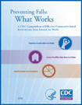
Preventing Injuries from Falls
Support variety of key partners:
Public health/aging services workforce:
CDC Compendium of Effective Fall Interventions: What Works for Community-Dwelling Old Adults
States and communities: 3 states funded for
Stepping On program for older adults at higher risk for falls - shown to result in 31% reduction in falls among those 70+
Otago Exercise Program
Tai Chi: Moving for Better Balance
Health care providers:
STEADI Toolkit (STopping Elderly Accidents, Death, and Injuries) - to incorporate fall prevention into clinical practice

Slide 65
Key References
CDC Healthy Aging Program
www.cdc.gov/aging
CDC’s Healthy Aging Data Portfolio
www.nccd.cdc.gov/DPH_Aging/default.aspx
CDC – Clinical Preventive Services for Older Adults
www.cdc.gov/aging/services/index.htm
CDC Healthy Brain Initiative
www.cdc.gov/aging/healthybrain
National Alzheimer’s Project Act (NAPA)
www.aspe.hhs.gov/daltcp/napa/
National Plan to Address Alzheimer’s Disease
www.aspe.hhs.gov/daltcp/napa/natlplan2013.shtml

Slide 67
Senior Services of Seattle King County

Slide 68
Senior Services Seattle Wa

Slide 69
Enhance Fitness

Slide 83
Roundtable Discussion Please take a moment to fill out our brief survey

Slide 84
Healthy People 2020 Sharing Library

Slide 85
Healthy People 2020 Spotlight on Health Webinar
Join us on September 30, 2014, from 12:30 pm to 2:00 pm ET
Free Educational Webinar
Featured Topic will be “Moving from Disease and Illness to Living Well: Promoting and Tracking Well-Being and Quality of Life”
Notes:
85

Slide 86
LHI Infographic gallery

Slide 87
Healthy People 2020 Substance Abuse LHI Webinar

Slide 88
Stay Connected
Web healthypeople.gov
Email hp2020@hhs.gov
Twitter @gohealthypeople
LinkedIn Healthy People 2020
YouTube ODPHP (search “healthy people”)
Join the Healthy People Listserv & Consortium
Notes:
88

Slide 89
Healthy People 2020 Progress Review Planning Group
Denise Stredrick (NIH/OD)
Marie Bernard (NIH/NIA)
Melinda Kelley (NIH/NIA)
Vicky Cahan (NIH/NIA)
Dallas Anderson (NIH/NIA)
Stan Lehman (CDC/OD)
Lynda Anderson (CDC/ONDIEH)
Dree Harris (CDC/ONDIEH)
Angela Deokar (CDC/ONDIEH)
Jane Tilly (ACL/AOA)
Rosaly Correa-de-Araujo (ACL/AOA)
Deb Potter (OASH/ASPE)
Helen Lamont (HHS/ASPE)
Shari Ling (CMS/CCSQ)
Rebecca Hines (CDC/NCHS)
Leda Gurley (CDC/NCHS)
Ellen Kramarow (CDC/NCHS)
Julie Weeks (CDC/NCHS)
Bruce Jonas (CDC/NCHS)
Christina Dragon (CDC/NCHS)
Carter Blakey (HHS/ODPHP)
Deb Nichols (HHS/ODPHP)
Theresa Devine (HHS/ODPHP)
Yen Luong (HHS/ODPHP)

