Slide 1
Healthy Places, Healthy People: A Progress Review on Nutrition and Weight Status, & Physical Activity
May 9, 2014

Slide 2
Howard K. Koh, MD, MPH Assistant Secretary for Health U.S. Department of Health and Human Services

Slide 3
Overview and Presenters
Chair
Howard K. Koh, MD, MPH, Assistant Secretary for Health
U.S. Department of Health and Human Services
Presentations
Irma Arispe, PhD, Associate Director, National Center for Health Statistics
David Murray, PhD, Associate Director for Prevention Director, Office of Disease Prevention, National Institutes of Health
Michael Landa, JD, Director, Center for Food Safety and Applied Nutrition Food and Drug Administration
Janet Collins, PhD, Director, Division of Nutrition, Physical Activity, and Obesity National Center for Chronic Disease Prevention and Promotion Centers for Disease Control and Prevention
Community Highlight
James Krieger, MD, MPH, Chief Chronic Disease and Injury Prevention Section Public Health – Seattle King County

Slide 4
Healthy People 2020 Evolves

Slide 5
Public Health and Economic Impact
Regular physical activity and healthy eating can reduce the risk of:
▪ Heart disease ▪ Type 2 Diabetes
▪ Stroke ▪ Osteoporosis
▪ Hypertension ▪ Some cancers
▪ Obesity
$147 billion/year: medical cost of obesity (2008 U.S. dollars)
▪ $1,429/year: additional cost for
obese vs. normal weight individuals
SOURCES: NIH, NHLBI Obesity Education Initiative. Clinical Guidelines on the Identification, Evaluation, and Treatment of Overweight and Obesity in Adults. Available online: http://www.nhlbi.nih.gov/guidelines/obesity/ob_gdlns.pdf . Finkelstein, EA, Trogdon, JG, Cohen, JW, and Dietz, W. Annual medical spending attributable to obesity: Payer- and service-specific estimates. Health Affairs 2009; 28(5): w822-w831.
Physical Activity Guidelines Advisory Committee. Physical Activity Guidelines Advisory Committee Report, 2008. Washington, DC: U.S. Department of Health and Human Services, 2008.

Slide 6
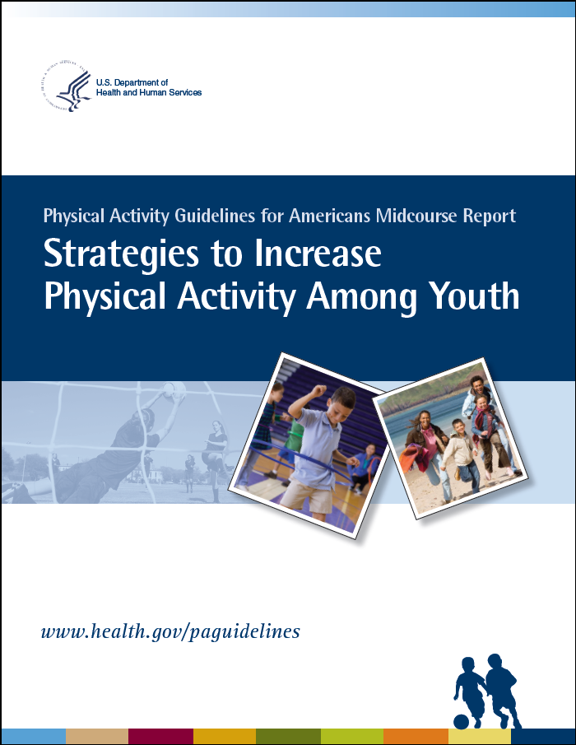
Federal Guidelines
Dietary Guidelines for Americans, 2010 www.dietaryguidelines.gov
Physical Activity Guidelines for Americans, 2008 www.health.gov/paguidelines
Physical Activity Guidelines for Americans Midcourse Report: Strategies to Increase Physical Activity Among Youth, 2013
http://www.health.gov/paguidelines/midcourse/

Slide 7
Irma Arispe, PhD Associate Director, National Center for Health Statistics Centers for Disease Control and Prevention

Slide 8
Presentation Overview
Nutrition and Weight Status
Weight Status
Food Insecurity
Food and Nutrient Consumption
Healthier Food Access
Physical Activity
2008 Physical Activity Guidelines
Physical Activity Education in Schools
Screen Time
Physical Activity Access and Environment
8

Slide 9
Tracking the Nation’s Progress
31 HP2020 Measurable Nutrition and Weight Status Objectives:
25 HP2020 Measurable Physical Activity Objectives:
1 | Target met
7 | Improving
14 | Little or No detectable change
0 | Getting worse
9 | Baseline data only
5 | Targets met
1 | Improving
6 | Little or No detectable change
1 | Getting worse
12 | Baseline data only
NOTES: The NWS Topic Area contains 7 Developmental objectives. The PA Topic Area contains 1 Informational objective and 10 Developmental objectives. Measurable objectives defined as having at least one data point currently available, or a baseline, and anticipate additional data points throughout the decade to track progress. Informational objectives are also measurable objectives, however, they do not have a target associated with their data. Developmental objectives lack baseline data and targets.
9

Slide 10
Healthy Weight, Adults, 2009–2012
HP2020 Target: 33.9%
Female
Increase desired
Male
Family Income (percent poverty threshold)
NOTES: = 95% confidence interval. Data are for the proportion of adults 20 years and over who are at a healthy weight, defined as a BMI≥ 18.5 and <25.0 kg/m². BMI is calculated based on measured height and weight. Data are age adjusted to the 2000 standard population. Respondents were asked to select one or more races. The categories black and white include persons who reported only one racial group and exclude persons of Hispanic origin. Persons of Hispanic origin may be of any race.
I
SOURCE: National Health and Nutrition Examination Survey (NHANES), CDC/NCHS.
Obj. NWS-8

Slide 11
Obesity, Adults, 2009–2012
HP2020 Target: 30.5%
Female
Decrease desired
Male
Family Income (percent poverty threshold)
NOTES: = 95% confidence interval. Data are for the proportion of adults 20 years and over who are obese, defined as a BMI≥30.0 kg/m². BMI is calculated based on measured height and weight. Data are age adjusted to the 2000 standard population. Respondents were asked to select one or more races. The categories black and white include persons who reported only one racial group and exclude persons of Hispanic origin. Persons of Hispanic origin may be of any race.
I
SOURCE: National Health and Nutrition Examination Survey (NHANES), CDC/NCHS.
Obj. NWS-9

Slide 12
Self-Reported Obesity, Adults, 2012
US* (2009–2012 NHANES): 35.3%
US (2012 BRFSS): 24.4%
Percent
17.1 - 23.7
23.7 - 28.3
28.3 - 34.3
NOTES: Data are for the proportion of adults 20 years and over who are obese, defined as a BMI≥30 kg/m², and are age adjusted to the 2000 standard population. Rates are displayed by Jenks classification for US states.
*National data for the objective are based on measured height and weight from the National Health and Nutrition Examination Survey (NHANES) and are the basis for setting the target. State data from the BRFSS are based on self-reported weight and height and may not be comparable to the national data from the NHANES.
Obj. NWS-9
Decrease desired
SOURCE: Behavioral Risk Factor Surveillance System (BRFSS), CDC/PHSPO.

Slide 13
Obesity, Children/Adolescents and Adults 1988–1994 through 2011–2012
Percent
Women (20+ years)
HP2020 Target: 30.5%
Men (20+ years)
Boys (2-19 years)
Girls (2-19 years)
HP2020 Target: 14.5%
1988-1994
1999-2000
2001-
2002
2003-
2004
2005-
2006
2007-
2008
2009-
2010
2011-
2012
NOTES: Obesity defined as BMI≥30 kg/m² for adults and BMI-for-age≥95th percentile on the sex specific 2000 CDC Growth Charts for 2-19 years. Data for adults are age adjusted to the 2000 standard population.
SOURCE: National Health and Nutrition Examination Surveys (NHANES), CDC/NCHS.
Objs. NWS-9, 10.4
Decrease desired

Slide 14
Obesity, Children and Adolescents, 2009–2012
HP2020 Target: 14.5%
Decrease desired
Male
Female
Family Income (percent poverty threshold)
Age (years)
I
NOTES: = 95% confidence interval. Data are for children and adolescents aged 2-19 years who are obese, defined as a BMI-for-age≥95th percentile on the sex specific 2000 CDC Growth Charts. BMI is calculated based on measured height and weight. Respondents were asked to select one or more races. The categories black and white include persons who reported only one racial group and exclude persons of Hispanic origin. Persons of Hispanic origin may be of any race. Target does not apply to age groups.
SOURCE: National Health and Nutrition Examination Survey (NHANES), CDC/NCHS.
Objs. NWS-10.1 through 10.4

Slide 15
Food Insecurity, US Households, 1995–2012
HP2020 Target: 6.0%
2012
NOTE: Data are for the proportion of U.S. households that reported experiencing food insecurity at least some time in the past 12 months based on providing an affirmative answer to at least 3 of 18 core questions regarding food inadequacy and insufficiency that result from inadequate household resources.
SOURCE: Food Security Supplement to the Current Population Survey (CPS), Census and DOL/BLS.
Obj. NWS-13
Decrease desired

Slide 16
Total Vegetable Consumption, 2007–2010
HP2020 Target: 1.1
Increase desired
Family Income (percent poverty threshold)
Age (years)
I
NOTES: = 95% confidence interval. *Baseline year: 2001–2004. Data are for mean daily intake of cup equivalents of total vegetables per 1,000 calories by persons aged 2 years and older based on a single 24-hour dietary recall. Cup equivalents were calculated using the Food Patterns Equivalents Database (FPED), USDA/ARS. Except for age specific groups, data are age adjusted to the 2000 standard population. The categories black and white include persons who reported only one racial group and exclude persons of Hispanic origin. Persons of Hispanic origin may be of any race.
SOURCE: National Health and Nutrition Examination Survey (NHANES), CDC/NCHS.
Obj. NWS-15.1

Slide 17
Added Sugars Consumption, 2007–2010
HP2020 Target: 10.8
Decrease desired
Family Income (percent poverty threshold)
Age (years)
I
NOTES: = 95% confidence interval. *Baseline year: 2001–2004. Data are for the proportion of total daily calorie intake from added sugars by persons aged 2 years and over based on a single 24-hour dietary recall. Estimates were calculated using the Food Patterns Equivalents Database (FPED). Except for age specific groups, data are age adjusted to the 2000 standard population. Respondents were asked to select one or more races. The categories black and white include persons who reported only one racial group and exclude persons of Hispanic origin. Persons of Hispanic origin may be of any race.
SOURCE: National Health and Nutrition Examination Survey (NHANES), CDC/NCHS.
Obj. NWS-17.2

Slide 18
Sodium Consumption, 2009–2010
HP2020 Target: 2300
Decrease desired
Family Income (percent poverty threshold)
Age (years)
I
NOTES: = 95% confidence interval. Data are for mean total daily sodium intake (in mg) from food, detary supplements, tap water, and salt use at the table by persons aged 2 years and older based on a single 24-hour dietary recall. Except for age specific groups, data are age adjusted to the 2000 standard population. Respondents were asked to select one or more races. The categories black and white include persons who reported only one racial group and exclude persons of Hispanic origin. Persons of Hispanic origin may be of any race.
SOURCE: National Health and Nutrition Examination Survey (NHANES), CDC/NCHS.
Obj. NWS-19

Slide 19
Healthier Food Access for Children and Adolescents
In 2006, 24 states had nutrition standards for foods and beverages provided to preschool-aged children in child care.
In 2006, 9.3% of schools did not sell or offer calorically sweetened beverages to students.
In 2012, 9.6% of school districts required schools to make fruits or vegetables available whenever other food is offered or sold.
SOURCES: National Resource Center for Health and Safety in Child Care and Early Education, School Health Policies and Practices Study (SHPPS), CDC/NCHHSTP
Objs. NWS-1, 2.1, 2.2
Increase desired
19

Slide 20
Incentive Policies for Food Retail Outlets to Provide Foods Encouraged by the Dietary Guidelines, 2011
2011: 10 States
HP2020 Target: 18 States
District of
Columbia
States with state-level policies
NOTES: States with retail policies (legislation or executive action) had to support at least one of the following goals: (1) the building and/or placement of new food retail outlets; (2) renovation and equipment upgrades of existing food retail outlets; (3) increases in, and promotion of, foods encouraged by the Dietary Guidelines for Americans stocked or available at food retail outlets.
SOURCE: State Indicator Report on Fruits and Vegetables, CDC.
Obj. NWS-3
Increase desired
20

Slide 21
Presentation Overview
Nutrition and Weight Status
Weight Status
Food Insecurity
Food and Nutrient Consumption
Healthier Food Access
Physical Activity
2008 Physical Activity Guidelines
Physical Activity Education in Schools
Screen Time
Physical Activity Access and Environment
21

Slide 22
Physical Activity Benefits
Decreases risk of early death, obesity, and chronic diseases, including osteoporosis
Reduces risks of depression and improves mental well-being
Improves control of body weight, blood pressure, blood glucose, and cholesterol
Improves quality of sleep and functional health
Enhances independent living among older adults
Prevents falls and reduces risk of hip fracture
Reduces risk of cognitive decline
SOURCES: Physical Activity Guidelines Advisory Committee. Physical Activity Guidelines Advisory Committee Report, 2008. Washington, DC: U.S. Department of Health and Human Services, 2008.

Slide 23
Leisure-Time Physical Activity (PA), Adults
Percent
2008
2012
Decrease desired
Increase desired
HP2020 Target: 47.9%
HP2020 Target: 32.6%
HP2020 Target: 31.3%
HP 2020 Target: 24.1%
HP2020 Target: 20.1%
No PA
Aerobic PA
≥150 min
Aerobic PA
≥ 300 min
Muscle-
strengthening PA
Aerobic & Muscle-strengthening PA
NOTES: I = 95% confidence interval. Data are for adults 18 years and over who report no leisure-time aerobic PA; aerobic PA: ≥150 min of moderate
or ≥75 min of vigorous PA per week or an equivalent combination of moderate and vigorous-intensity activity; for additional health benefits: ≥300 min
of moderate or ≥150 min of vigorous PA per week or an equivalent combination of moderate and vigorous-intensity activity. Muscle-strengthening PA -
exercise at least twice per week. Aerobic & muscle-strengthening PA includes ≥150 min of moderate or ≥75 min of vigorous PA
per week or an equivalent combination of moderate and vigorous-intensity PA and muscle-strengthening PA at least twice a week.
Data are age adjusted to the 2000 standard population.
SOURCE: National Health Interview Survey (NHIS), CDC/NCHS.
Objs. PA-1, PA-2.1 through 2.4
23

Slide 24
No Leisure-Time Physical Activity, Adults
1997
2012
Percent
HP2020 Target: 32.6%
HP2020 Target
Decrease desired
Age (Years)
NOTES: = 95% confidence interval. Data are for adults ages 18 years and over who were engaged in no leisure-time aerobic physical activity. Except for age-specific estimates data are age adjusted to the 2000 standard population.
SOURCE: National Health Interview Survey (NHIS), CDC/NCHS.
I
Obj. PA-1
24

Slide 25
No Leisure-Time Physical Activity,
Adults, 2012
HP2020 Target: 32.6%
Decrease desired
NOTES: = 95% confidence interval. Data are for adults 18 years and over; except for education-level data that are for adults 25 years and over. Data are age adjusted to the 2000 standard population. American Indian includes Alaska Native. The categories black and white exclude persons of Hispanic origin. Persons of Hispanic origin may be any race. Respondents were asked to select one or more races. Data for the single race categories are for persons who reported only one racial group.
SOURCE: National Health Interview Survey (NHIS), CDC/NCHS.
I
Obj. PA-1
25

Slide 26
Meeting the Aerobic and Muscle- Strengthening PA Guidelines, Adults, 2012
HP2020 Target: 20.1%
Increase desired
NOTES: = 95% confidence interval. Data are for adults 18 years and over, except for education-level data that are for adults 25 years and over, who report light or moderate leisure time PA for at least 150 minutes per week or vigorous PA 75 minutes per week or an equivalent combination of moderate and vigorous-intensity activity and report doing PA specifically designed to strengthen muscles at least twice per week. Data are age adjusted to the 2000 standard population. American Indian includes Alaska Native. Black and white exclude persons of Hispanic origin. Persons of Hispanic
origin may be any race. Data for the single race categories are for persons who reported only one racial group.
SOURCE: National Health Interview Survey (NHIS), CDC/NCHS.
I
Obj. PA-2.4
26

Slide 27
Meeting the Aerobic PA Guidelines, High School Students, 2011
HP2020 Target: 31.6%
Increase desired
NOTES: = 95% confidence interval. Data are for students in grades 9–12 who report being involved in PA for at least 60 minutes per day in the past week. American Indian includes Alaska Native. The categories black and white exclude persons of Hispanic origin. Persons of Hispanic origin may be any race. Persons were asked to select one or more races. Data for the single race categories are for persons who reported only one racial group.
SOURCE: Youth Risk Behavior Surveillance System (YRBSS), CDC/NCHHSTP.
I
Obj. PA-3.1
27

Slide 28
Participation in Daily School Physical Education, High School Students
Percent
HP2020 Target: 36.6%
Grade
NOTES: I = 95% confidence interval. Data are for students in grades 9 through 12 who participate in physical education classes
on five or more days in an average week. The categories black and white exclude persons of Hispanic origin. Persons of Hispanic
origin may be any race.
SOURCE: Youth Risk Behavior Surveillance System (YRBSS), CDC/NCHHSTP.
Obj. PA-5
Increase desired
28

Slide 29
Computer Use for Non-School Work for Two or Fewer Hours a School Day, High School Students
Percent
HP2020 Target: 82.6%
Increase
desired
Grade
NOTES: I = 95% confidence interval. Data are for students in grades 9 through 12 who reported playing video or computer games
or using computer for non-school work (including Xbox, PlayStation, an iPod, an iPad or other tablet, a smartphone, YouTube,
Facebook, and the Internet) for no more than 2 hours on an average school day. The categories black and white exclude persons of
Hispanic origin. Persons of Hispanic origin may be any race.
SOURCE: Youth Risk Behavior Surveillance System, CDC/NCHHSTP.
Obj. PA-8.3.3
29

Slide 30
PA Access and Environment
25 states required activity programs provided to preschool-aged children in child care (2006).
28.8% of schools provided access to their physical activity spaces and facilities outside of normal school hours (2006).
Among children, 30.8% of trips to school of 1 mile or less were made by walking (2009).
Among adults, 31.2% of trips of 1 mile or less were made by walking (2009).
Data for objectives PA-13.1 and 13.2 are preliminary.
SOURCE: National Resource Center for Health and Safety in Child Care and Early Education; National Household Travel Survey (NHTS), DOT/FHWA
Objs. PA 9.1, 10, 13.1, 13.2
Increase desired
30

Slide 31
Key Takeaways – NWS
Weight status data for children, adolescents and adults show little or no change.
While total vegetable consumption shows little or no change, there is a significant decrease in the consumption of added sugars.
Disparities persist in:
Weight status by age, race and income.
Food and nutrient consumption by age, sex, race and income.
Obesity prevalence is higher among the non-Hispanic black and Hispanic populations and lower income groups.
31

Slide 32
Key Takeaways – PA
Between 2008 and 2012, more adults engaged in leisure time aerobic activity.
In 2012, 20.6% of adults met the PA guidelines for aerobic and muscle-strengthening physical activity.
In 2011, 28.7% of high school students met the guidelines for aerobic physical activity.
Computer use for non-school work for 2 or fewer hours among high school students has declined, moving away from the target.
Although there have been some improvements in PA, disparities still persist by age, sex, race, and education.
32

Slide 33
David M. Murray, Ph.D. Associate Director for Prevention Director, Office of Disease Prevention

Slide 34
National Institutes of Health
The NIH seeks fundamental knowledge about the nature and behavior of living systems and the application of that knowledge to enhance health, lengthen life, and reduce illness and disability.

Slide 35
NIH Investments in Nutrition, Weight Status, and Physical Activity
Investments
$2.3 billion for 5,961 projects in FY2012¹
$2.2 billion for 5,810 projects in FY2013¹
Research Foci
Basic Science
Prevention
Treatment
¹Investment figures are not based on official NIH Research, Condition, and Disease Categorization (RCDC) categories. Statistics reflect use of custom sub-setting criteria to select relevant projects from two official RCDC categories’ project lists (Nutrition and Obesity) and from the unofficial Physical Activity research area where redundant projects in the combined pool of selected projects were eliminated.

Slide 36
Examples of Research on Nutrition and Weight Status - Adults
The Diabetes Prevention Program (DPP), NEJM, 2002
Lifestyle modification (increased physical activity, along with reduced fat and caloric intake) lowered risk by 58%
Metformin medication lowered risk by 31%
Effects persisted over 10 years of follow-up, Lancet, 2009
Percent Reduction in Diabetes Incidence Compared to Placebo
3,234 individuals at risk for Type 2 diabetes
Objective(s):
NWS-9, NWS-18, PA-2

Slide 37
Examples of Research on Nutrition and Weight Status - Adults
Similar results via group-delivered intervention by YMCA Staff (Am J Prev Med, 2008)
Objective(s):
NWS-9, NWS-18, PA-2

Slide 38
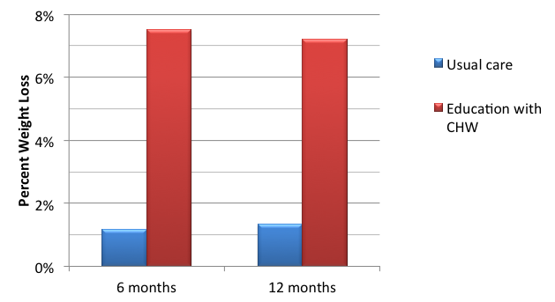
Examples of Research on Nutrition and Weight Status - Adults
Similar results via group-delivered intervention through American Diabetes Association (Diab Care, 2011)
Objective(s):
NWS-9, NWS-18, PA-2

Slide 39
Examples of Research on Nutrition and Weight Status - Youth
The HEALTHY Study
A school-based study to reduce risk factors for type 2 diabetes targeting food service, physical education, and behavior change
Followed 4600 students from 6th – 8th grade, in 42 middle schools, >50% minority, >50% overweight or obese, low SES
21% lower prevalence of obesity and lower BMI z-score, waist circumference, and fasting insulin levels in intervention schools
No effect on the combined rate of overweight and obesity, which fell by 4% in both arms (NEJM, 2010)
Objective(s):
NWS-10, NWS-14, NWS-15
www.healthystudy.org

Slide 40
Examples of Research on Nutrition and Weight Status
Obesity Related Behavioral Intervention Trials (ORBIT)
Translate findings from basic behavioral research into more effective interventions
Early Adult Reduction of weight through LifestYle intervention (EARLY) Trials
Test innovative behavioral approaches for weight control in young adults
Childhood Obesity Prevention and Treatment Research (COPTR)
Test innovative behavioral approaches for weight gain prevention in children and youth
Status: ongoing
Objective(s):
NWS-8, NWS-9, NWS-10, NWS-11, NWS-14, NWS-15, NWS-16, NWS-17, NWS-18
http://www.nhlbi.nih.gov/resources/obesity/clinicaltrials.htm

Slide 41
Examples of Research on Nutrition and Weight Status - Youth
The Healthy Communities Study: How Communities Shape Children’s Health
A five-year, nationwide study to identify characteristics of existing community programs and policies that may help reduce childhood obesity and improve dietary and physical activity behaviors.
Collect retrospective and prospective data
Document programs/policies in 120 US communities
Measure BMI, diet, and physical activity in ~5,000 elementary and middle school children
Partners: NHLBI, NCI, NIDDK, NICHD, OBSSR, CDC, RWJ
Status: ongoing
http://www.nhlbi.nih.gov/resources/obesity/pop-studies/hcs.htm

Slide 42
Examples of Research on Nutrition and Weight Status - Adults
R01-HL060712; Dietary Patterns and Risk of Cardiovascular Disease; Frank Hu, Harvard University
Test the hypothesis that higher diet quality is inversely associated with long-term weight gain
Diet quality measured by Healthy Eating Index, Mediterranean Diet, Dietary Approaches to Stop Hypertension [DASH], Food Quality Score (FQS).
Explore biological pathways that mediate the effects of diet quality on weight change and the long-term relationships between change in diet quality and changes in biomarkers.
Status: ongoing
http://projectreporter.nih.gov/reporter.cfm

Slide 43
Examples of Physical Activity Research
Population-Focused Research
R01-HL114283; Promoting Physical Activity in High Poverty Neighborhoods; Deborah Cohen, PhD, RAND Corporation
Aim: To determine whether the provision of opportunities for physical activity in parks in low income neighborhoods can increase park use and park-based physical activity
Status: Ongoing
Objective(s):
PA-1, PA-2
http://projectreporter.nih.gov/reporter.cfm

Slide 44
Examples of Physical Activity Research
Methods- and Measurement-Focused Research
R01-HL111195; Physical Activity Patterns via New Dimension-Informative Cluster Models; Ken Cheung, PhD, Columbia University
Aim: To develop new methods and identify patterns of physical activity that can be used as predictors of health outcomes.
Status: Ongoing
http://projectreporter.nih.gov/reporter.cfm

Slide 45
Examples of Physical Activity Research - Adults
Individual-Focused Research
R01-HL109429; Prosocial Behavior and Volunteerism to Promote Physical Activity in Older Adults; Capri Foy, PhD, Wake Forest University
Aim: To determine whether prosocial behavior, defined as voluntary behavior that benefits others, can be used to help older adults begin and continue a regular physical activity program.
Results: Ongoing
Objective(s):
PA-2
http://projectreporter.nih.gov/reporter.cfm

Slide 46
Examples of Data Resources and Surveys for NWS and PA
Support for NHANES physical activity, sleep and strength components http://appliedresearch.cancer.gov/nhanes
NHIS Cancer Control Supplement http://appliedresearch.cancer.gov/nhis
HINTS Health Promotion Module: Monitors public understanding of recommendations for physical activity, nutrition, and weight http://hints.cancer.gov
Family Life, Activity, Sun, Health and Eating (FLASHE) Study http://nccor.org/projects/flashe.php
Classification of Laws Associated with School Students (CLASS) http://class.cancer.gov

Slide 47
Examples of Tools for Investigators in NWS and PA
Automated Self-Administered 24-Hour Dietary Recall (ASA24) http://appliedresearch.cancer.gov/asa24/
Web-based tool that enables automated and self-administered 24-hour dietary recalls
Measures of the Food Environment (MFE) Website https://riskfactor.cancer.gov/mfe
Compilation of articles about and measures of the food environment
Portable eTechnology Diet and Physical Activity Tools for Consumers (SBIR Contract) [in development]
Web-based system to perform real-time energy balance assessment and intervention

Slide 48
title
Examples of resources found at http://nccor.org:
Measures Registry
Searchable online registry of over 1,000 diet and physical activity measures used in childhood obesity research
Catalogue of Surveillance Systems
Review, sort and compare more than 105 publicly available datasets relevant to childhood obesity research

Slide 49
title
New Activities
Pursuing work to address economics research in childhood obesity.
2014 Summer Workshop with USDA and RWJ on incentivizing healthful purchases for Supplemental Nutrition Assistance Program (SNAP) Participants
An NCCOR workgroup is examining food data systems, monitoring, and related areas.

Slide 50
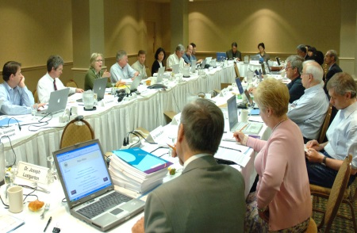
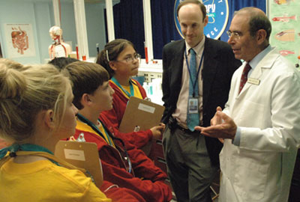
Summary of NIH Research that Supports Healthy People 2020
Addresses virtually all of the Nutrition & Weight Status (NWS) and Physical Activity (PA) objectives
Identifies factors influencing health and health disparities in the US population
Evaluates promising strategies for prevention and treatment diverse communities
Harnesses technology and tools to advance prevention and treatment
Seeks expert input on research gaps
Trains the next generation of scientists
Fosters collaborations to maximize translation and dissemination
50

Slide 51
Michael M. Landa Director FDA/Center for Food Safety and Applied Nutrition

Slide 52
FDA is a Regulatory and Public Health Agency
Center for Food Safety and Applied Nutrition
80% of U.S. food supply is regulated by FDA
Nutrition-related activities focus on
Food labeling
Food ingredients
52

Slide 53
FDA’s Contributions to Nutrition & Weight Status Objectives
Nutrition and Weight Status (NWS) objectives are consistent with 2010 Dietary Guidelines for Americans
Increase fruits, vegetables, and whole grains (NWS-14, 15.1, 15.2, 16)
Reduce solid fats, added sugars, saturated fat, and sodium (NWS-17.1, 17.2, 18, 19)
Increase calcium (NWS-20)
53

Slide 54
FDA Nutrition Activities Related to Healthy People 2020
Proposed regulations
Updating Nutrition Facts labels
Changes in regulations affecting serving sizes
Menu labeling and vending machine labeling
GRAS (“generally recognized as safe”) status of partially hydrogenated oils
Draft voluntary sodium reduction targets
Health claims
54

Slide 55
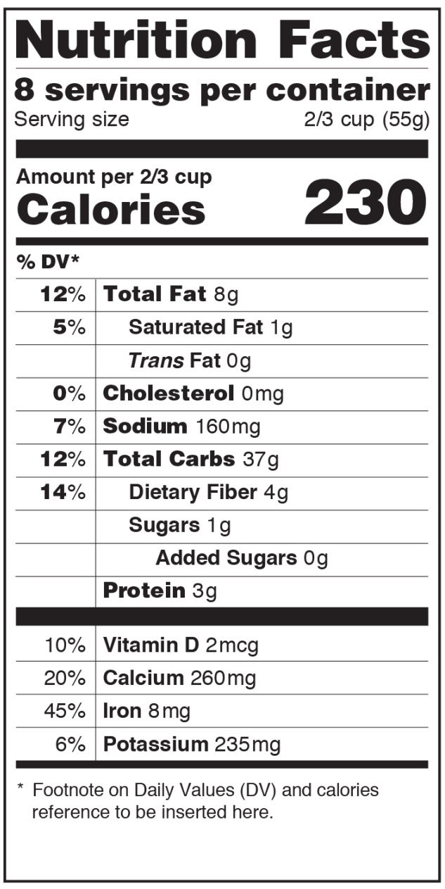
Proposed Regulation: Nutrition Facts Label
Proposed label will help consumers achieve HP2020 objectives to:
Reduce consumption of saturated fat (NWS-18)
Reduce consumption of sodium (NWS-19)
Reduce consumption of calories from
Solid fats (NWS-17.1)
Added sugars (NWS-17.2)
Solid fats and added sugars (NWS-17.3)
Increase consumption of calcium (NWS-20)
55

Slide 56
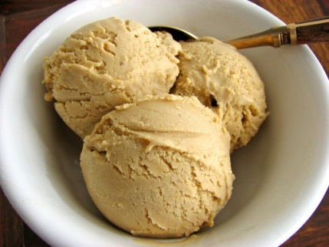
Proposed Regulation: Updating Serving Sizes and RACCs
Reference amounts customarily consumed (RACCs)
Based on recent national food intake data
Used to establish product serving sizes
NOT a recommended amount to eat
Serving sizes will be more realistic to reflect how much people typically eat at one time
Example: Ice cream
Current RACC: ½ cup
Proposed RACC: 1 cup
Example: Soda
Both 12- and 20-ounce bottles of soda would equal 1 serving, since people typically drink either of these sizes in one sitting
Regulation would improve Nutrition Facts label by
Helping consumers see how many calories they are actually eating
Assisting consumers in managing their overall caloric intake and eating healthier diets
56

Slide 57
Proposed Regulations: Menu and Vending Machines Labeling
Nutrition Labeling of Standard Menu Items in Restaurants and Similar Retail Food Establishments
Patient Protection and Affordable Care Act (ACA) of 2010
Requires restaurants and similar retail establishments, with 20 or more locations, to list calorie content for standard menu items
Other nutrient information would be available upon request
ACA also requires vending machine operators who own or operate 20 or more vending machines to disclose calorie content for certain items
Published April 6, 2011 (76 FR 19192)
Calorie Labeling of Articles of Food in Vending Machines
Published April 6, 2011 (76 FR 19238)
7

Slide 58
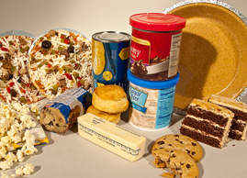
Partially Hydrogenated Oils and GRAS Status
GRAS: Generally Recognized As Safe
FDA requested comments on tentative conclusion that partially hydrogenated oils, the primary dietary source of industrially produced trans fat in processed foods, are not GRAS
If GRAS status revoked, PHOs would be considered food additives and require premarket review/approval by FDA, absent a subsequent determination of GRAS status for a particular use
Addresses objective to reduce consumption of calories from solid fats (NWS-17.1)
Trans Fat required on label since 2006
2003 intake: 4.6 grams/person/day
2012 intake: 1.0 gram/person/day
58

Slide 59
Sodium Reduction: FDA Considers Voluntary Targets
Sodium consumption in U.S. remains much higher than recommended levels
NWS-19: Reduce sodium intake in the population
Decreasing sodium intake expected to lower morbidity & mortality and have large cost savings
Most sodium comes from salt added to processed foods during manufacturing
Public health approach: Reduce sodium in overall food supply
FDA and USDA requested comments, data, and evidence on sodium intake (76 FR 57050) including:
How industry promotes sodium reduction
Consumer understanding of sodium’s role in chronic disease risk
Motivation and barriers in reducing sodium intake
Joint Public Meeting on Approaches to Reduce Sodium Consumption (held on Nov. 10, 2011) http://www.fda.gov/Food/NewsEvents/WorkshopsMeetingsConferences/ucm279012.htm
INSTITUTE OF MEDICINE
OF THE NATIONAL ACADEMIES
59

Slide 60
FDA Authorized Health Claims Addressing HP2020 Objectives
Model Health Claim Examples | Objectives & Issues Addressed
Diets low in saturated fat and cholesterol and rich in fruits, vegetables, and grain products that contain some types of dietary fiber, particularly soluble fiber, may reduce the risk of heart disease, a disease associated with many factors. (21 CFR 101.77) | NWS-14. Increase fruits NWS-15. Increase variety and amount of vegetables NWS-18. Reduce saturated fat
Diets low in sodium may reduce the risk of high blood pressure, a disease associated with many factors. (21 CFR 101.74) | NWS-19. Reduce sodium
Adequate calcium throughout life , as part of a well-balanced diet, may reduce the risk of osteoporosis. (21 CFR 101.72) | NWS-20. Increase calcium

Slide 61
Summary
FDA is helping to achieve HP2020 targets through
Proposed regulations to improve nutrition labeling
Initiatives aimed at reducing trans fat and sodium in the food supply
Health claims that may encourage consumers to choose healthier products
For most NWS objectives that FDA is involved in, data show improvements towards meeting the HP 2020 targets
NWS Objective
Improving: 6 objectives | 14 16 17.1 17.2 17.3 18
Little or no change: 3 objectives | 15.1 15.2 20
Baseline data only: 1 objective | 19

Slide 62
Thank You!
U.S. Food and Drug Administration
Protecting and Promoting Public Health

Slide 63
Janet Collins, PhD Director, Division of Nutrition, Physical Activity, and Obesity Centers for Disease Control and Prevention
Supporting Healthy People Through Healthy Places, 2014

Slide 64
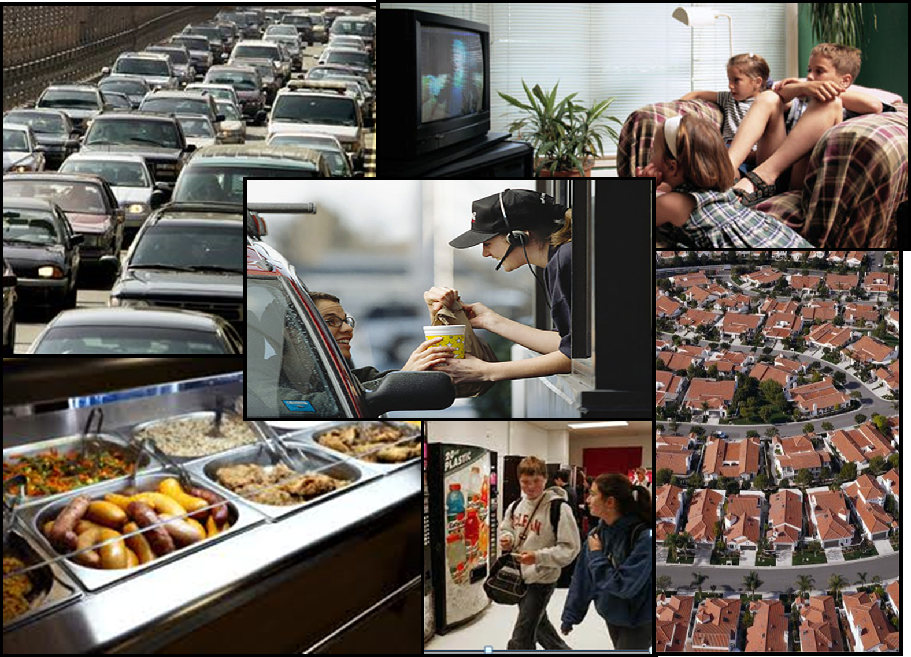
title

Slide 65
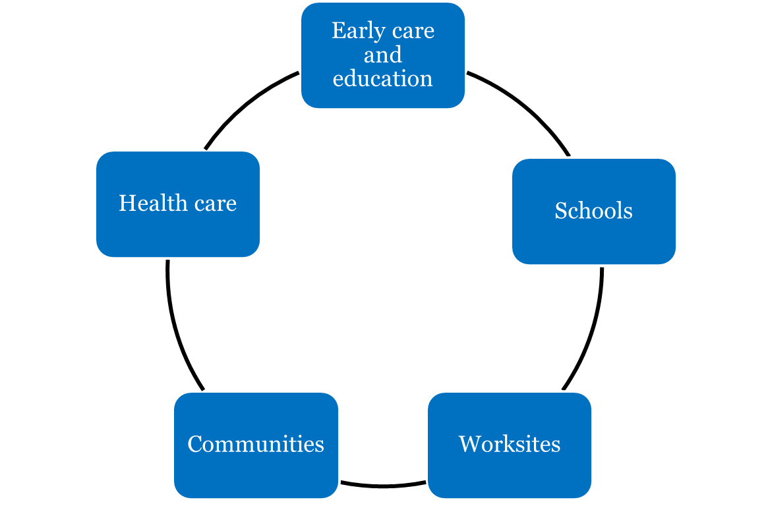
Supporting Healthy People Through Healthy Places

Slide 66
The Role of CDC in Healthy Places

Slide 67
HP2020 Selected Healthy Places Objectives
Child Care
Nutrition standards for preschool-aged children in child care. (NWS-1)
Licensing regulations for physical activity provided in child care (PA-9)
K-12 School Settings
Nutritious foods and beverages outside of school meals (NWS-2)
Daily physical education for all students (PA-4)

Slide 68
HP2020 Selected Healthy Places Objectives
Worksites
Worksites that offer nutrition or weight management classes or counseling (NSW-7 D)
Access to employer-based exercise programs (PA-12D)
Communities
Access to healthy food retail outlets (NWS-3 and 4D)
Built environment supports for physical activity (PA-15 D)
Health Care
Physicians routinely measure BMI (NWS-5) and provide counseling for nutrition, weight (NWS-6) and physical activity (PA-11)

Slide 69
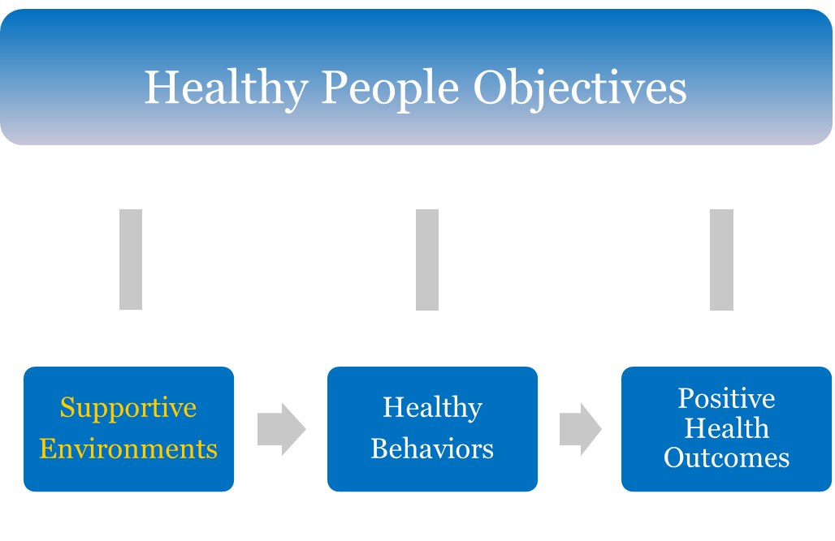
Supporting Health People Through Healthy Places

Slide 70
Early Care and Education (ECE)
Why?
6.7 million children, aged 0-4 years, are in regular child care arrangements with non-relatives
Early introduction to healthful behaviors
Examples
Let’s Move! Child Care
ECE Learning Collaboratives

Slide 71
Schools
Why?
More than 50 million children are in K-12 school settings
Healthy, active children learn better
Critical time to establish lifelong healthy habits
Examples
Comprehensive school physical activity programs
Local education wellness polices

Slide 72
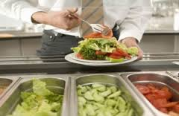
Worksites
Why?
43 million adults work 30 hours or more per week
Healthy workers have:
-Lower health care costs
-Lower absenteeism
-Higher productivity
Examples
Health and Sustainability Guidelines for Federal Concessions and Vending Operations (HHS and GSA)
Worksite incentives for physical activity

Slide 73
Communities
Why?
Physical environments influence healthy behaviors
Social support/social norms influence healthy behaviors
Examples
Racial and Ethnic Approaches to Community Healthy Programs (REACH)
Sodium Reduction in
Communities Program

Slide 74
Health Care
Why?
Approximately 80% percent of adults and 90% of children see a health care professional each year
Physicians and other health professionals are important influencers of healthy behaviors
Examples
Electronic Health Records
Community-clinical linkages

Slide 75
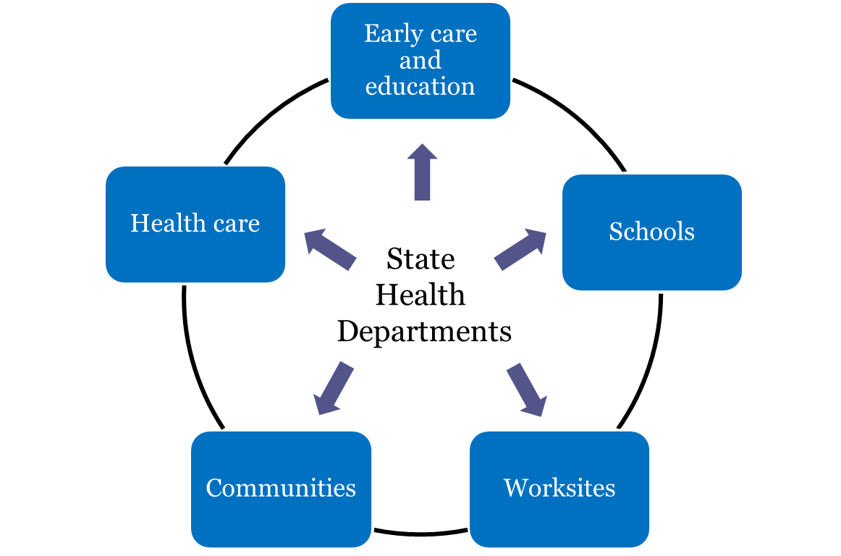
State Health Actions: A Comprehensive Approach

Slide 76
Summary
Together we are working:
at the tribal, local, state, and Federal Levels…..
across sectors…..
To create environments that support healthy dietary and physical activity choices, particularly for high risk groups, and to address Healthy People 2020 objectives.

Slide 77
Communities Putting Prevention to Work – Seattle King County
Notes:
77

Slide 78
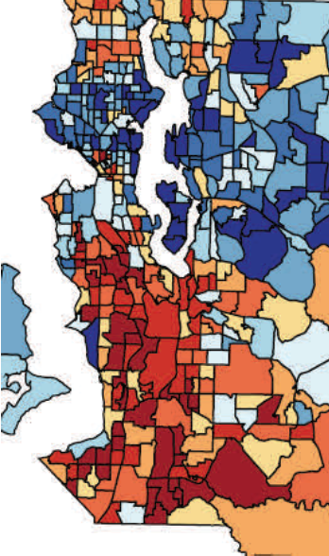
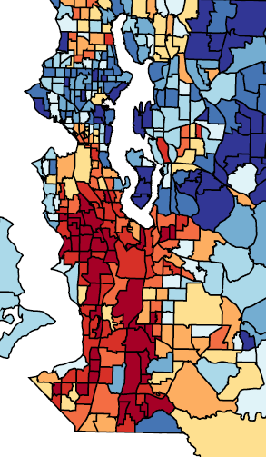
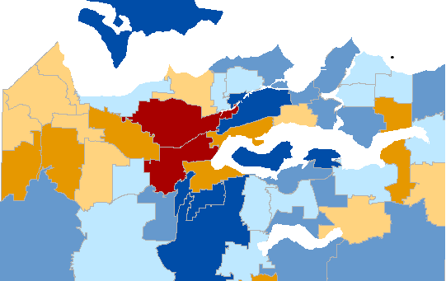
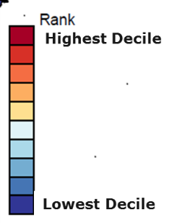
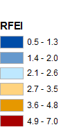
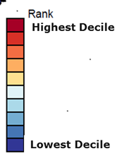
An Opportunity to Address Health Inequity
Obesity
Food Environment
No Physical Activity

Slide 79
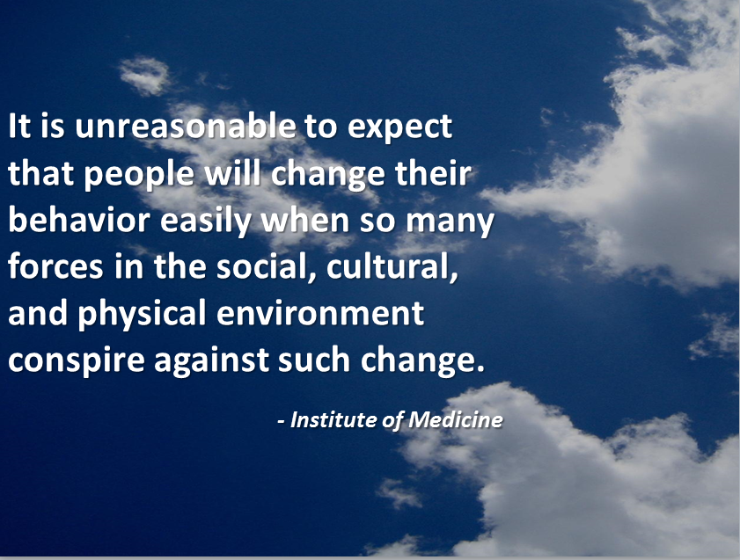
Quote from the Institute of Medicine (IOM).
Notes:
79

Slide 80
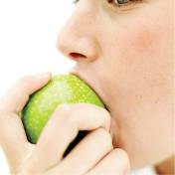
CPPW Overview - 1
Goals:
Decrease obesity through healthy eating and active living (HP 2020 goal)
Decrease health inequities (HP 2020 goal)
Federal stimulus funds to reduce chronic diseases related to obesity and tobacco in 55 sites across US
$15.5M (April 2010 – March 2013) in King County for obesity

Slide 81
CPPW Overview - 2
Change policies, organizations and systems to change environments to make the healthy choice the default choice and remove exposure to unhealthy options
Individual behavior
Work with community partners
$10 million in grants to 55 partners
Leadership team
Coalition of >200 members
Reach people where they live, work, learn, play

Slide 82
Promoting Healthy Eating and Active Living
Increase access to healthy food
(NWS-2, 4)
Healthier Eating
(NWS- 14, 15, 16, 17, 18)
Lower rates of obesity and other chronic diseases
(NWS-1, D-1)
Change social norms
Decrease access to unhealthy food
More Physical Activity
(PA 1, 2, 3, 13, 14)
Increase access for physical activity
(PA 4, 5, 6, 7, 10, 15)
Notes:
82

Slide 83
Increase Access to physical activity
Notes:
83

Slide 84
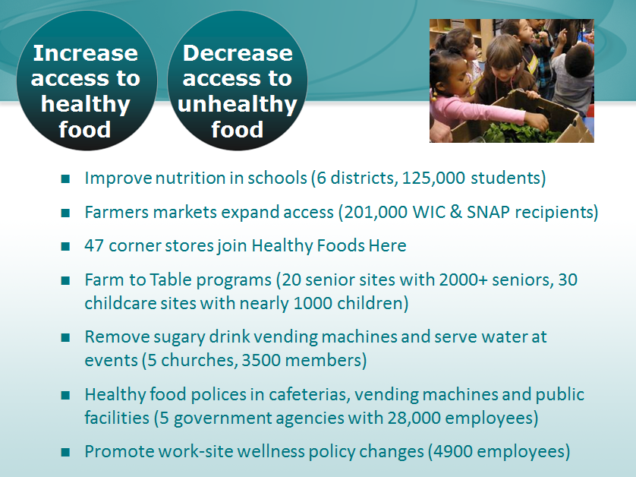
Decrease access to unhealthy food.
Notes:
84

Slide 85
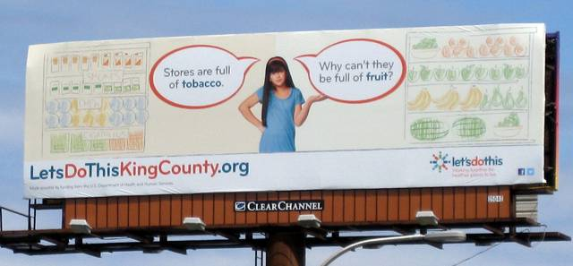
Let’s Do This!
Change social norms

Slide 86
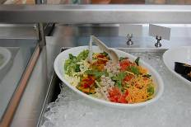
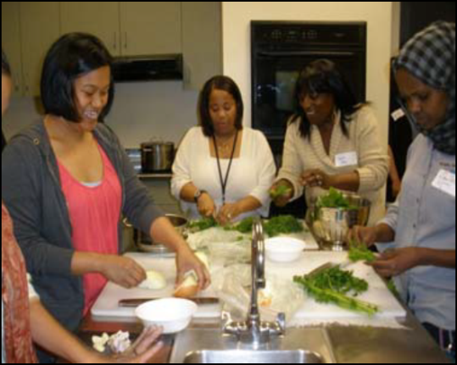
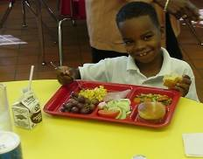
Schools
Healthier school food
Trained 500+ food service staff
New recipes by celebrity chefs
Salad bars
Restricting unhealthy foods
Event guidelines
Farm-to-School
School gardens
Student-led healthy eating marketing campaigns
High quality PE
New curricula
PE staff training
Tools and equipment
Joint Use Agreements
Safe Routes to Schools
Notes:
86

Slide 87
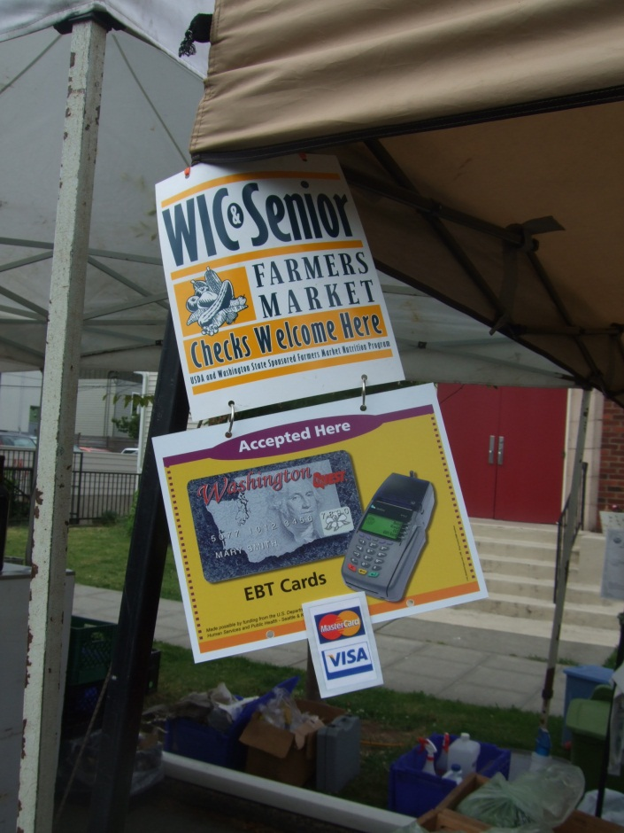
Farmers Market Access Project
Increased access for SNAP and WIC at 9 markets
Technology and training:
EBT machines
Mobile benefits processing
Train WIC staff
Community outreach

Slide 88
Youth obesity declines In school districts where we invested in CPPW.
Notes:
Talking points: Will continue to track over time to assess over time since one data point – next data in early 2015
88

Slide 89
Success Factors -1
Policy, systems and organizational change to promote healthy environments and determinants of health
Lasting relationships with partners from multiple sectors to support PSE change
Schools, childcare, hospitals, local government, farmers, churches, and more
Technical Assistance
Funding (re-granting)

Slide 90
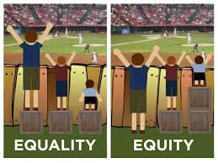
Success Factors - 2
Community engagement
Funding directly at local level
Strong backbone organization to convene and manage
Health equity lens
Sufficient per capita funding to accelerate change

Slide 91
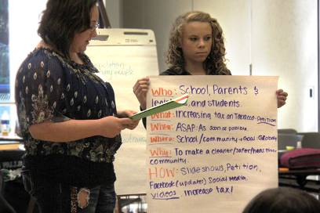
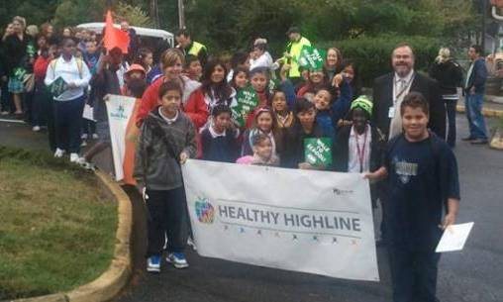
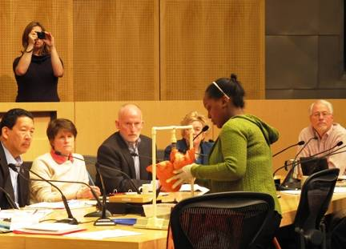
Community Engagement

Slide 92
Challenges
Time frame: it takes 5-10 years (for community transformation)
Need to show early wins
Capacity for facilitating PSE change
Lack of data to identify gaps in PSE and monitor progress
Insufficient intensity of evaluation
Siloed funding streams hamper integration of local work
Differences in funder and local priorities
Staying focused – so much to do
Notes:
92

Slide 93
Sustain the work
Notes:
93

Slide 94
The End…Thanks
kingcounty.gov/health/cppw
Notes:
94

Slide 95
Roundtable Discussion Please take a moment to fill out our brief survey

Slide 96
LHI Infographic gallery

Slide 97
Healthy People 2020: Clinical Preventive Services LHI Webinar
Join us on May 22nd for a
Who’s Leading the Leading Health Indicators? Webinar
Learn how one group is working to address the importance of immunizations for children.
Register soon!
www.healthypeople.gov

Slide 98
Stay Connected
Web healthypeople.gov
Email hp2020@hhs.gov
Twitter @gohealthypeople
LinkedIn Healthy People 2020
YouTube ODPHP (search “healthy people”)
Join the Healthy People Listserv & Consortium
Notes:
98

Slide 99
Healthy People 2020 Sharing Library

Slide 100
Healthy People 2020 Progress Review Planning Group
Denise Stredrick (NIH/OD)
Kara Morgan (FDA/OC)
Camelia Thompson (FDA/OC)
Stan Lehman (CDC/OD)
Van Hubbard (NIH/NIDDK)
Crystal McDade-Ngutter (NIH/NIDDK)
Sheila Fleishhacker (NIH/NIDDK)
Mark Kantor (FDA/CFSAN)
Wenyen Juan (FDA/CFSAN)
Janet Fulton (CDC/ONDIEH)
Deb Galuska (CDC/ONDIEH)
Kathleen Watson (CDC/ONDIEH)
Rebecca Hines (CDC/NCHS)
Leda Gurley (CDC/NCHS)
Asel Ryskulova (CDC/NCHS)
Kimberly Hurvitz (CDC/NCHS)
Carter Blakey (HHS/ODPHP)
Katrina Piercy (HHS/ODPHP)
Stephanie Goodwin (HHS/ODPHP)
Yen Luong (HHS/ODPHP)

