Slide 1
Reducing Exposure: A Healthy People 2020 Progress Review of Environmental Health and Tobacco Use
December 5, 2014

Slide 2
Karen DeSalvo, MD, MPH, MSc Acting Assistant Secretary for Health U.S. Department of Health and Human Services

Slide 3
Overview and Presenters
Chair
Karen DeSalvo, MD, MPH, MSc, Acting Assistant Secretary for Health, U.S. Department of Health and Human Services
Presentations
Irma Arispe, PhD, Associate Director, National Center for Health Statistics
Linda Birnbaum, PhD, Director, National Institute of Environmental Health Sciences, NIH
Tim McAfee, MD, MPH, Director, Office on Smoking and Health, CDC
Community Highlight
Kara Skahen, MSW, MPP, Program Director, Live Smoke Free, St. Paul, Minnesota

Slide 4
Healthy People 2020 Evolves

Slide 5
Our Environment, Our Health
Limiting exposure to hazardous substances in air, water, soil, food improves quality of life
Natural environment (e.g., ambient air, beaches and drinking water, and soil)
Built environment (e.g., radon, lead paint, and other indoor allergens)
Poor environmental quality has its greatest impact on people whose health status is already at risk
5

Slide 6
Impact and Burden of Environmental Factors
Globally, 13 million deaths annually are attributable to preventable environmental causes
Environmental factors contribute over 80% of the diseases regularly reported by the World Health Organization
Clean Air Act, in 2010 helped prevent:
160,000 premature deaths
130,000 heart attacks
86,000 hospital admissions
6

Slide 7
Burden of Tobacco Use
Patterns of tobacco use are changing:
cigarette use is declining
use of other tobacco products is increasing
According to the 2014 Surgeon General Report*:
Cigarettes are leading cause of preventable death
480,000 smoking-attributable deaths each year (2005-2009, annual average)
16 million persons have smoking-attributable conditions
Note: *Data are for cigarette use.
Source: U.S. Department of Health and Human Services. The Health Consequences of Smoking—50 Years of Progress: A Report of the Surgeon General. Atlanta: U.S. Department of Health and Human Services, Centers for Disease Control and Prevention, National Center for Chronic Disease Prevention and Health Promotion, Office on Smoking and Health, 2014
7

Slide 8
Cigarette Use — Economic Costs
The estimated economic costs attributable to cigarette smoking (2009 – 2012) now approach $300 billion annually including:
At least $130 billion in direct medical care costs
More than $150 billion for lost productivity
Source: U.S. Department of Health and Human Services. The Health Consequences of Smoking—50 Years of Progress: A Report of the Surgeon General. Atlanta: U.S. Department of Health and Human Services, Centers for Disease Control and Prevention, National Center for Chronic Disease Prevention and Health Promotion, Office on Smoking and Health, 2014
8

Slide 9
Irma Arispe, PhD Associate Director, National Center for Health Statistics Centers for Disease Control and Prevention

Slide 10
Presentation Overview
Tracking the Nation’s Progress
Environmental Health
Background of Environmental Health Exposures
Burden of Toxic Air Pollution
Exposure to Hazardous Substances
Summary of Environmental Health Findings
Tobacco Use
Burden
Prevalence of Cigarette Use
Initiation of Cigarette Use
Exposure to Tobacco Marketing
Smoke-free Indoor Air Laws
Secondhand Smoke Exposure
10

Slide 11
Tracking the Nation’s Progress
64 HP2020 Measurable Environmental Health Objectives
66 HP2020 Measurable Tobacco Use Objectives:
7 | Targets met
11 | Improving
7 | Little or no detectable change
7 | Getting worse
32 | Baseline data only
6 | Targets met
22 | Improving
27 | Little or no detectable change
4 | Getting worse
7 | Baseline data only
NOTES: The Tobacco Use topic area also has 10 developmental objectives. Measurable objectives are defined as having at least one data point currently available, and anticipate additional data points throughout the decade to track progress. Developmental objectives lack baseline data and targets.
11

Slide 12
Our Environment, Our Health
Environmental health consists of preventing or controlling disease, injury, and disability related to the interactions between people and their environment.
The Healthy People 2020 Environmental Health objectives focus on 6 themes, each of which highlights an element of environmental health:
Outdoor air quality
Surface and ground water quality
Toxic substances and hazardous wastes
Homes and communities
Infrastructure and surveillance
Global environmental health
12

Slide 13
Outdoor Air Quality
Globally:
Poor environmental quality accounts for one in eight deaths¹
$3.5 trillion cost in premature mortality and health care in 34 OECD countries including the US, plus China and India (2010)²
In the United States:
200,000 premature deaths (2013)³
130,000 particulate matter-related deaths and 4,700 ozone-related deaths (2012)⁴
$76.6 billion spent on diseases of environmental origin in children (2008)⁵
NOTE: Particulate matter is fine particulate matter (< 2.5 micrometers per cubic meter of air).
SOURCES: ¹ Quantifying environmental health impacts. [online]. 2012. Available from: http://www.who.int/quantifying_ehimpacts/global/en/; ² Regional, rural and urban development: The cost of air pollution: Health impacts of road transport. [online]. 2010. Available from: http://www.oecd.org/regional/cost-of-air-pollution.htm; ³ Caiazzo F, Ashok A, Waitz IA, Yim SHL, Barrett SRH. Air pollution and early deaths in the United States. Part I: Quantifying the impact of major sectors in 2005. Atmos Environ 2013;79:198-208.; ⁴ Fann N, Lamson AD, Anenberg SC, Wesson K, Risley D, Hubbell BJ. Estimating the nationnal public health burden associated with exposure to ambient PM_{2.5} and ozone. Risk Analysis 2012; 32(1):81-95.; ⁵ Trasande L, The economic costs of environmental health impacts [online]. 2014. Available from : http://www.niehs.nih.gov/news/newsletter/2014/7/science-economic/
13

Slide 14
Number of Days the Air Quality Index (AQI) Exceeds 100, Weighted by Population and AQI
AQI-weighted people days (billions)
HP2020 Target: 1.98 billion
0
NOTES: AQI days are weighted by severity of air quality (e.g. an AQI of 130 counts as 1.3 days, an AQI of 250 counts as 2.5 days, etc.). The objective tracks concentrations of ozone and particulate matter, which account for over 95% of AQI action days. Tests of significance are not available.
Obj. EH-1
Decrease desired
SOURCE: Air Quality System (AQS), EPA.
14

Slide 15
Toxic Pollutants Released into the Environment
Tons
HP2020 Target: 1,750,000
NOTES: Mobile sources emissions, which account for approximately 50% of all air toxics, as well as smaller sources such as gas stations and dry cleaners are not included in TRI.
Obj. EH-11
Decrease desired
SOURCE: Toxics Release Inventory (TRI), EPA.
15

Slide 16
Homes with an Operating Radon Mitigation System
Percent
HP2020 Target: 30%
NOTE: Proportion of homes with an operating radon mitigation system for persons living in homes at risk for radon exposure.
Obj. EH-14
Increase desired
SOURCE: Homes with Radon Mitigation Systems, Radon Vent Fan Manufacturers.
16

Slide 17
High-End* Arsenic Exposure by Age
µg/g creatinine
2003-2004
2009-2010
HP2020 Target: 35.28
Total
12-19 years
20 years and over
NOTES: I = 95% confidence interval. The measure tracks the top 5% (highest concentration) of arsenic in the population. *In the literature this is referred to as the 95th percentile. The measure is micrograms per gram in urine, and is creatinine-adjusted to account for in person-to-person and time of day differences in urine dilution.
Obj. EH-20.1
Decrease desired
SOURCE: Fourth National Report on Human Exposure to Environmental Chemicals, Updated Tables, August, 2014; National Health and Nutrition Examination Survey (NHANES), CDC/NCHS.
17

Slide 18
High-End* Lead Exposure by Race/Ethnicity and Sex
µg/dL
1999-2000
2003-2004†
2011-2012
HP2020 Target: 2.94
Total
Mexican
American
Black
White
Male
Female
NOTES: I = 95% confidence interval. † Indicates Healthy People 2020 baseline year for this measure. Respondents were asked to select one or more races. The categories black and white include persons who reported only one racial group and exclude persons of Hispanic origin. Persons of Hispanic origin may be of any race. The measure tracks the top 5% (highest concentration) of lead in the population. *In the literature this is referred to as the 95th percentile. The measure is micrograms per deciliter of blood.
Obj. EH-20.3
Decrease desired
SOURCE: Fourth National Report on Human Exposure to Environmental Chemicals, Updated Tables, August, 2014; National Health and Nutrition Examination Survey (NHANES), CDC/NCHS.
18

Slide 19
High-End* Lead Exposure by Age
µg/dL
1999-2000
2003-2004†
2011-2012
1-5 years
6-11 years
12-19 years
20 years and over
NOTES: I = 95% confidence interval. † Indicates Healthy People 2020 baseline year for this measure. The measure tracks the top 5% (highest concentration) of lead in the population. In the literature this is referred to as the 95th percentile*. The measure is micrograms per deciliter of blood.
Obj. EH-20.3
Decrease desired
SOURCE: Fourth National Report on Human Exposure to Environmental Chemicals, Updated Tables, August, 2014; National Health and Nutrition Examination Survey (NHANES), CDC/NCHS.
19

Slide 20
High-End* Mercury Exposure in Children, Ages 1 to 5 Years
µg/L
HP2020 Target: 1.26
NOTES: The measure tracks the top 5% (highest concentration) of mercury in the population. In the literature this is referred to as the 95th percentile*. The measure is micrograms per liter of blood. The most unhealthy form is methyl mercury.
Obj. EH-20.4
Decrease desired
SOURCE: Fourth National Report on Human Exposure to Environmental Chemicals, Updated Tables, August, 2014; National Health and Nutrition Examination Survey (NHANES), CDC/NCHS.
20

Slide 21
High-End* Bisphenol A Exposure in Persons Ages 6 Years and Over
µg/g creatinine
HP2020 Target: 7.84
NOTES: The measure tracks the top 5% (highest concentration) of bisphenol A in the population. In the literature this is referred to as the 95th percentile*. The measure is micrograms per gram of urine, and is creatinine-adjusted to account for in person-to-person and time of day differences in urine dilution.
.
Obj. EH-20.15
Decrease desired
SOURCE: Fourth National Report on Human Exposure to Environmental Chemicals, Updated Tables, August, 2014; National Health and Nutrition Examination Survey (NHANES), CDC/NCHS.
21

Slide 22
High-End* Phthalate Exposure in Persons Ages 6 Years and Over
µg/g creatinine
HP2020 Target: 64.12
NOTES: Mono-n-butyl phthalate is tracked in Healthy People and is representative of the phthalate class of chemicals. The measure tracks the top 5% (highest concentration) of phthalate in the population. In the literature this is referred to as the 95th percentile*. The measure is micrograms per gram of urine, and is creatinine-adjusted to account for in person-to-person and time of day differences in urine dilution.
Obj. EH-20.17
Decrease desired
SOURCE: Fourth National Report on Human Exposure to Environmental Chemicals, Updated Tables, August, 2014; National Health and Nutrition Examination Survey (NHANES), CDC/NCHS.
22

Slide 23
Presentation Overview
Tracking the Nation’s Progress
Environmental Health
Background of Environmental Health Exposures
Burden of Toxic Air Pollution
Burden of Pesticide Use
Exposure to hazardous substances
Summary of Environmental Health Findings
Tobacco Use
Burden
Prevalence of Cigarette Use
Initiation of Cigarette Use
Exposure to Tobacco Marketing
Smoke-free Indoor Air Laws
Secondhand Smoke Exposure
23

Slide 24
Burden of Cigarette Use
According to the 2014 Surgeon General’s Report:
Leading cause of preventable death
480,000 smoking-attributable deaths each year (2005 – 2009, annual average)
16 million persons have smoking-attributable conditions
SOURCE: U.S. Department of Health and Human Services. The Health Consequences of Smoking—50 Years of Progress: A Report of the Surgeon General. Atlanta, GA: U.S. Department of Health and Human Services, Centers for Disease Control and Prevention, National Center for Chronic Disease Prevention and Health Promotion, Office on Smoking and Health, 2014.
24

Slide 25
Secondhand Smoke
Contains over 70 known carcinogens
At least 40,000 deaths attributed to secondhand smoke each year
A known cause of:
Infants: Low birth weight and Sudden Infant Death Syndrome (SIDS)
Children: Lung problems, asthma, and ear infections
Adults: Heart disease, stroke, and lung cancer
NOTE: Data are for non-smokers.
SOURCE: U.S. Department of Health and Human Services. The Health Consequences of Smoking—50 Years of Progress: A Report of the Surgeon General. Atlanta, GA: U.S. Department of Health and Human Services, Centers for Disease Control and Prevention, National Center for Chronic Disease Prevention and Health Promotion, Office on Smoking and Health, 2014.
25

Slide 26
Current Cigarette Smoking, Adults Ages 18 Years and Over
Percent
HP2020 Target: 12.0%
NOTES: Data are for adults 18+ who have smoked at least 100 cigarettes in their lifetime and currently report smoking every day or some days. Data are age adjusted to the 2000 standard population. Data prior to 1997 are not strictly comparable with data for later years due to the 1997 questionnaire redesign.
Obj. TU-1.1
Decrease desired
SOURCE: National Health Interview Survey (NHIS), CDC/NCHS.
26

Slide 27
Current Cigarette Smoking, Adults Ages 18 Years and Over, 2013
HP2020 Target: 12.0%
Decrease desired
Educational Attainment (Ages 25+)
I
NOTES: = 95% confidence interval. *2008 data – HP2020 baseline. Data are for persons who have smoked at least 100 cigarettes in lifetime and currently report smoking every day or some days. Black and White exclude persons of Hispanic origin. Persons of Hispanic origin may be any race. American Indian includes Alaska Native. Native Hawaiian includes other Pacific Islander. Respondents were asked to select one or more races. Data for the single race categories shown are for persons who reported only one racial group. Data are age adjusted to the 2000 standard population.
SOURCE: National Health Interview Survey (NHIS), CDC/NCHS.
Obj. TU-1.1

Slide 28
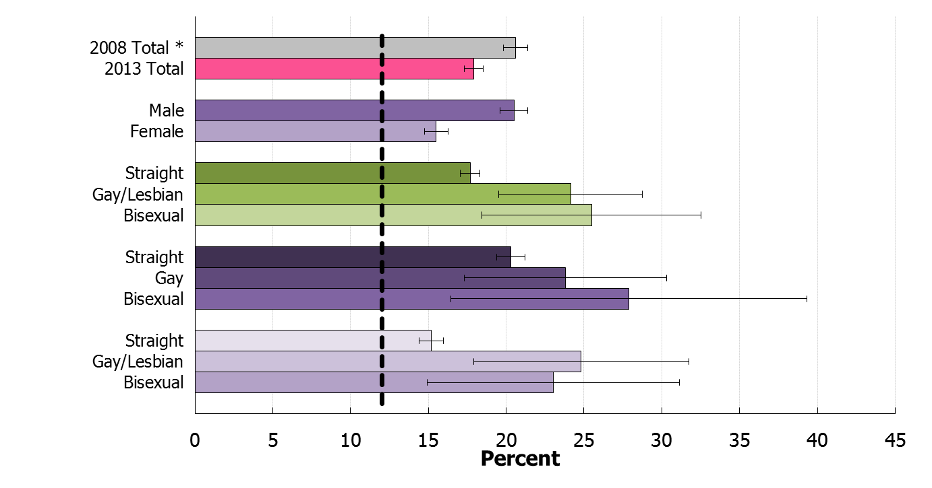
Current Cigarette Smoking, Adults Ages 18 Years and Over, 2013
HP2020 Target: 12.0%
Decrease desired
Both Sexes
Male
Female
I
NOTES: = 95% confidence interval. *2008 data – HP2020 baseline. Data are for persons who have smoked at least 100 cigarettes in lifetime and currently report smoking every day or some days. Data are age adjusted to the 2000 standard population. For data on sexual orientation, men were asked, “Which of the following best represents how you think of yourself? : Gay; Straight, that is, not gay; Bisexual; Something else; I don’t know the answer.” Women were asked, “Which of the following best represents how you think of yourself?: Lesbian or gay; Straight, that is, not lesbian or gay; Bisexual; Something else; I don’t know the answer.”
SOURCE: National Health Interview Survey (NHIS), CDC/NCHS.
Obj. TU-1.1

Slide 29
Tobacco Use in Past Month Among Students in Grades 9–12, 1991–2013
Percent
Cigarettes
Any Tobacco Product
HP2020 Target: 21.0%
Cigars
HP2020 Target: 16.0%
HP2020 Target: 8.0%
Smokeless
HP2020 Target: 6.9%
NOTES: Data are for the proportion of students in grades 9–12 who used any of the following tobacco products on 1 or more of the 30 days preceding the survey: cigarettes, cigars (including cigarillos or little cigars) and smokeless tobacco (i.e., chewing tobacco, snuff, or dip).
Objs. TU-2.1–2.4
Decrease desired
SOURCE: Youth Risk Behavior Surveillance System (YRBSS), CDC/NCCDPHP.
29

Slide 30
Cigarette Initiation, Adolescents and Young Adults
Percent
18-25 years
HP2020 Target: 6.4%
12-17 years
HP2020 Target: 4.3%
NOTE: Data are for the percent of never smoking adolescents (ages 12-17 years) or young adults (ages 18-25 years) who initiated cigarette use in the 12 months prior to the interview.
Objs. TU-3.2 and TU-3.6
Decrease desired
SOURCE: National Survey on Drug Use and Health (NSDUH), SAMHSA.
30

Slide 31
Exposure to Tobacco Marketing, Students in Grades 6–12
Percent
2013
HP2020 Target: 77.1%
HP2020 Target: 69.8%
HP2020 Target: 19.3%
HP2020 Target: 33.1%
Internet
Magazines and Newspapers
Movies and TV
Point of Purchase
NOTES: I= 95% confidence interval. *2009 is HP2020 baseline.
Students are considered to be exposed to Internet tobacco advertising if they answered ‘always’ 'most of the time' or 'some of the time‘ as applicable to seeing marketing or promotion of cigarettes or tobacco products. The question wording and answer categories are periodically revised for this survey, which may affect the interpretation of the trend.
Obj. TU-18.1 – 18.4
Decrease desired
SOURCE: National Youth Tobacco Survey (NYTS), CDC/NCCDPHP/OSH.

Slide 32
Smoke-Free Indoor Air Laws
Number of States and DC
HP2020 Targets: 51 (states and DC)
Private Workplaces
Restaurants
Bars
NOTES: *Data for 2014 are as of September 30, 2014. These data will be updated through December 31, 2014 when available. Data for 1998-2013 are as of December 31 of that year. Target applies to all three objectives shown. Data are for the number of states and D.C. with comprehensive laws enacted that banned smoking in private workplaces (TU-13.1), restaurants (TU-13.3), and bars (TU-13.4).
Objs. TU-13.1, TU-13.3,
and TU-13.4
Increase desired
SOURCE: State Tobacco Activities Tracking and Evaluation System (STATE), CDC/NCCDPHP.
32

Slide 33
Exposure of Non-Smokers to Secondhand Smoke
Percent
HP2020 Target: 47.0%
HP2020 Target: 41.0%
HP2020 Target: 33.8%
3-11 years
12-17 years
18 years and over
NOTES: I= 95% confidence interval. Children ages 3-11 years are considered to be non-smokers if they have a serum cotinine level of less than or equal to 10 ng/ml. Adolescents and adults ages 12 years and over are considered to be non-smokers if they reported that they did not use any product containing nicotine in the past 5 days and if their serum cotinine level is less than or equal to 10ng/ml. Persons of all age groups shown are considered to be exposed to secondhand smoke if they have a serum cotinine level of greater than or equal to 0.05 ng/ml and less than or equal to 10 ng/ml. Data for adults ages 18 years and older are age adjusted to the 2000 standard population.
SOURCE: National Health and Nutrition Examination Survey (NHANES), CDC/NCHS.
Obj. TU-11.1-11.3
Decrease desired

Slide 34
Exposure of Non-Smokers to Secondhand Smoke, Children Ages 3–11 Years, 2009–2012
Percent
HP2020 Target: 47.0%
Race/Ethnicity
Family Income (percent poverty threshold)
NOTES: I= 95% confidence interval. Children ages 3-11 years are considered to be non-smokers if they had a serum cotinine level of less than or equal to 10 ng/ml. Children are considered to be exposed to secondhand smoke if they had a cotinine level greater than or equal to 0.05ng/ml and less than or equal to 10 ng/ml. Black and White exclude persons of Hispanic origin. Persons of Hispanic origin may be any race. Respondents
were asked to select one or more races. Single race categories are for persons who reported only one racial group.
SOURCE: National Health and Nutrition Examination Survey (NHANES), CDC/NCHS.
Obj. TU-11.1
Decrease desired

Slide 35
Key Takeaways – Tobacco Use
Mixed results for Tobacco Use thus far in the decade.
28 objectives have improved or met their target.
Tobacco use among adults has continued to decline gradually.
Cigarette use among adolescents has decreased considerably, exceeding the Healthy People 2020 target.
Initiation of cigarette/tobacco use has decreased.
Number of states with smoke free indoor air laws has increased substantially since 1998, but less progress is seen in Healthy People 2020 tracking period.
Exposure to secondhand tobacco smoke has decreased, although disparities remain.
27 Objectives have seen little or no change so far this decade.
4 objectives are getting worse.
Exposure to tobacco marketing has increased among students.
35

Slide 36
Key Takeaways – Environmental Health
Data show mixed results for Environmental Health thus far in the decade.
Overall arsenic exposure has gotten worse since the baseline.
The use of in-home radon mitigation and reduction features has improved.
Since 1999-2000 lead concentrations have improved significantly for all population groups tracked.
Similarly, concentrations of Bisphenol and Phthalate have decreased, with levels meeting or exceeding the target.
Ambient air quality as measured by ozone and particulate matter has met the Healthy People target and continues to improve.

Slide 37
Linda S. Birnbaum, Ph.D., D.A.B.T., A.T.S. Director, National Institute of Environmental Health Sciences (NIEHS)
December 5, 2014

Slide 38
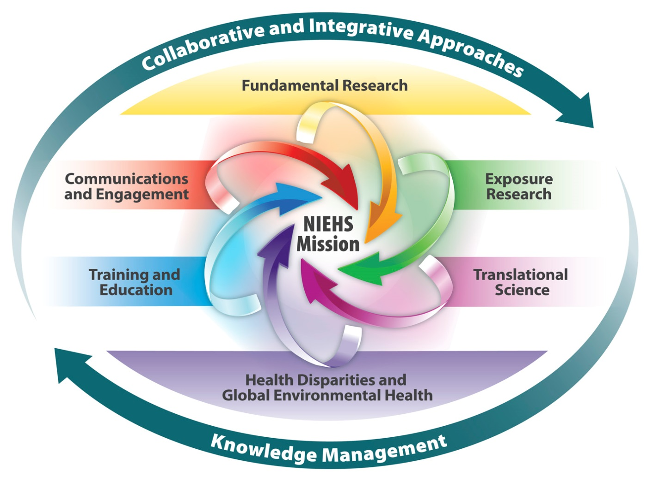
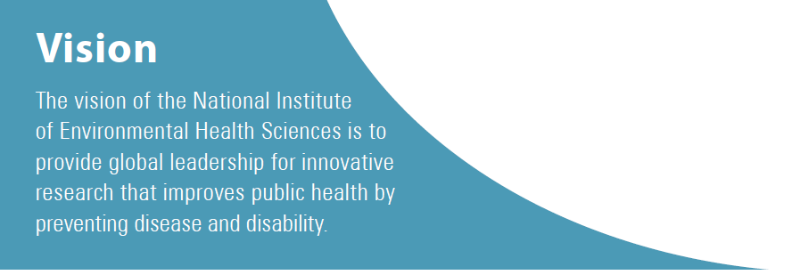
National Institute of Environmental Health Sciences (NIEHS)

Slide 39
NIEHS and Healthy People 2020
HP 2020 Environmental Health Goal: “Promote health for all through a healthy environment” is similar to the NIEHS mission.
The NIEHS conducts or funds research that relates to a number of objectives in Healthy People 2020

Slide 40
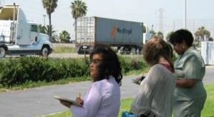
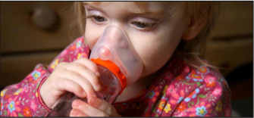
AIR Pollution
Living within 75m of a major roadway associated with increased risk of asthma. This is particularly the case for children without a family history of asthma.
Genetic variations may offer protection or make a child more susceptible to asthma and autism. Genetic differences vary between ethnic groups, could contribute to health disparities.
Mothers exposed to urban air pollutants, known as polycyclic aromatic hydrocarbons (PAHs), had children with lower IQ’s
Objectives – EH 1 & 3

Slide 41
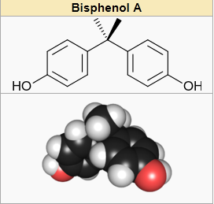
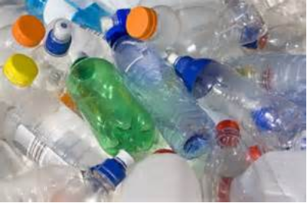
Bisphenol A
Ubiquitous in the environment and many possible exposures
Animal and human research has associated BPA with many health problems including infertility, weight gain, behavioral changes, early-onset puberty, prostate and mammary gland cancers, cardiovascular effects, and diabetes.
CLARITY BPA Program: Consortium-based science - the NIEHS's multipronged, collaborative approach to assessing the health effects of bisphenol A.
Recent NIEHS funded research: Association of BPA exposure during fetal development may adversely impact cardiovascular fitness.
Objective – EH 20.15

Slide 42
Heavy Metals
Real-world Exposures to Metals Often at Low Doses
Very low levels of Arsenic exposure (5-10ug/L) in drinking water are associated with lower IQ Wasserman et al., Environ Health (2014)
Exposure to Manganese is associated with poorer memory and attention in children, even at low levels commonly encountered in North America. Oulhote et al., EHP (2014)
Very low levels of lead exposure (mean 6.4 mg/dl)) are associated with increased risk of behavioral and emotional problems, such as being anxious, depressed, or aggressive. (Liu et al., JAMA Pediatr 2014)
Children exposed to Mercury show decreased visuospatial processing and memory. Grandjean et al., Neurotoxicol Teratol (2014)
Objectives – EH 8, 16.7, 18, 20.1, 20.3-5

Slide 43
Phthalates
NIEHS funded researchers at Columbia University found an association between childhood asthma and prenatal exposure to two phthalates used in a diverse array of household products.
Objective – EH 20.17

Slide 44
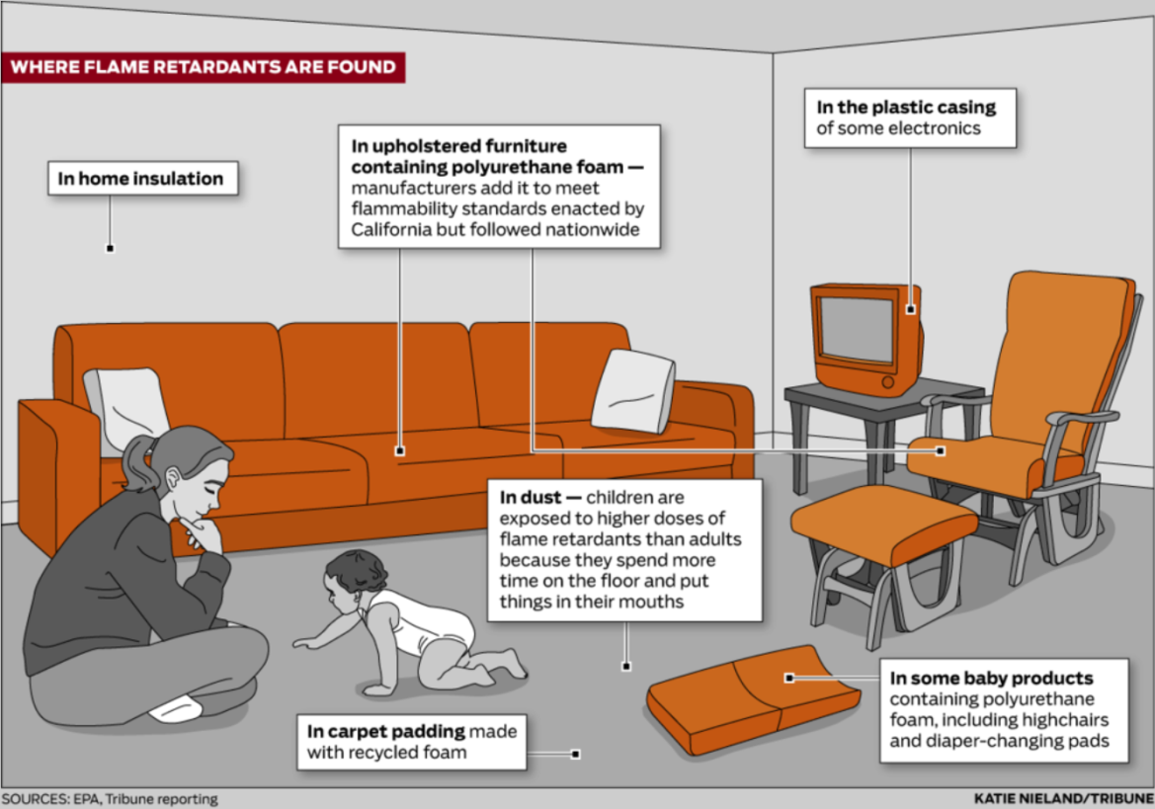
Flame Retardants
NIEHS funded researchers at the University of Cincinnati found that prenatal exposure to Polybrominated Diphenyl Ether (PBDE) was associated with lower IQ and higher hyperactivity scores in children.
Objective– EH 20.18

Slide 45
Disease Prevention and Health Promotion
HP 2020 has 4 “Overarching Goals” that relate to disease prevention and health promotion
An integral part of the NIEHS research mission
Prevention is 30% (> $230 million) of the NIEHS budget
Educate and train the next generation of prevention scientists
Educate the public and health professionals

Slide 46
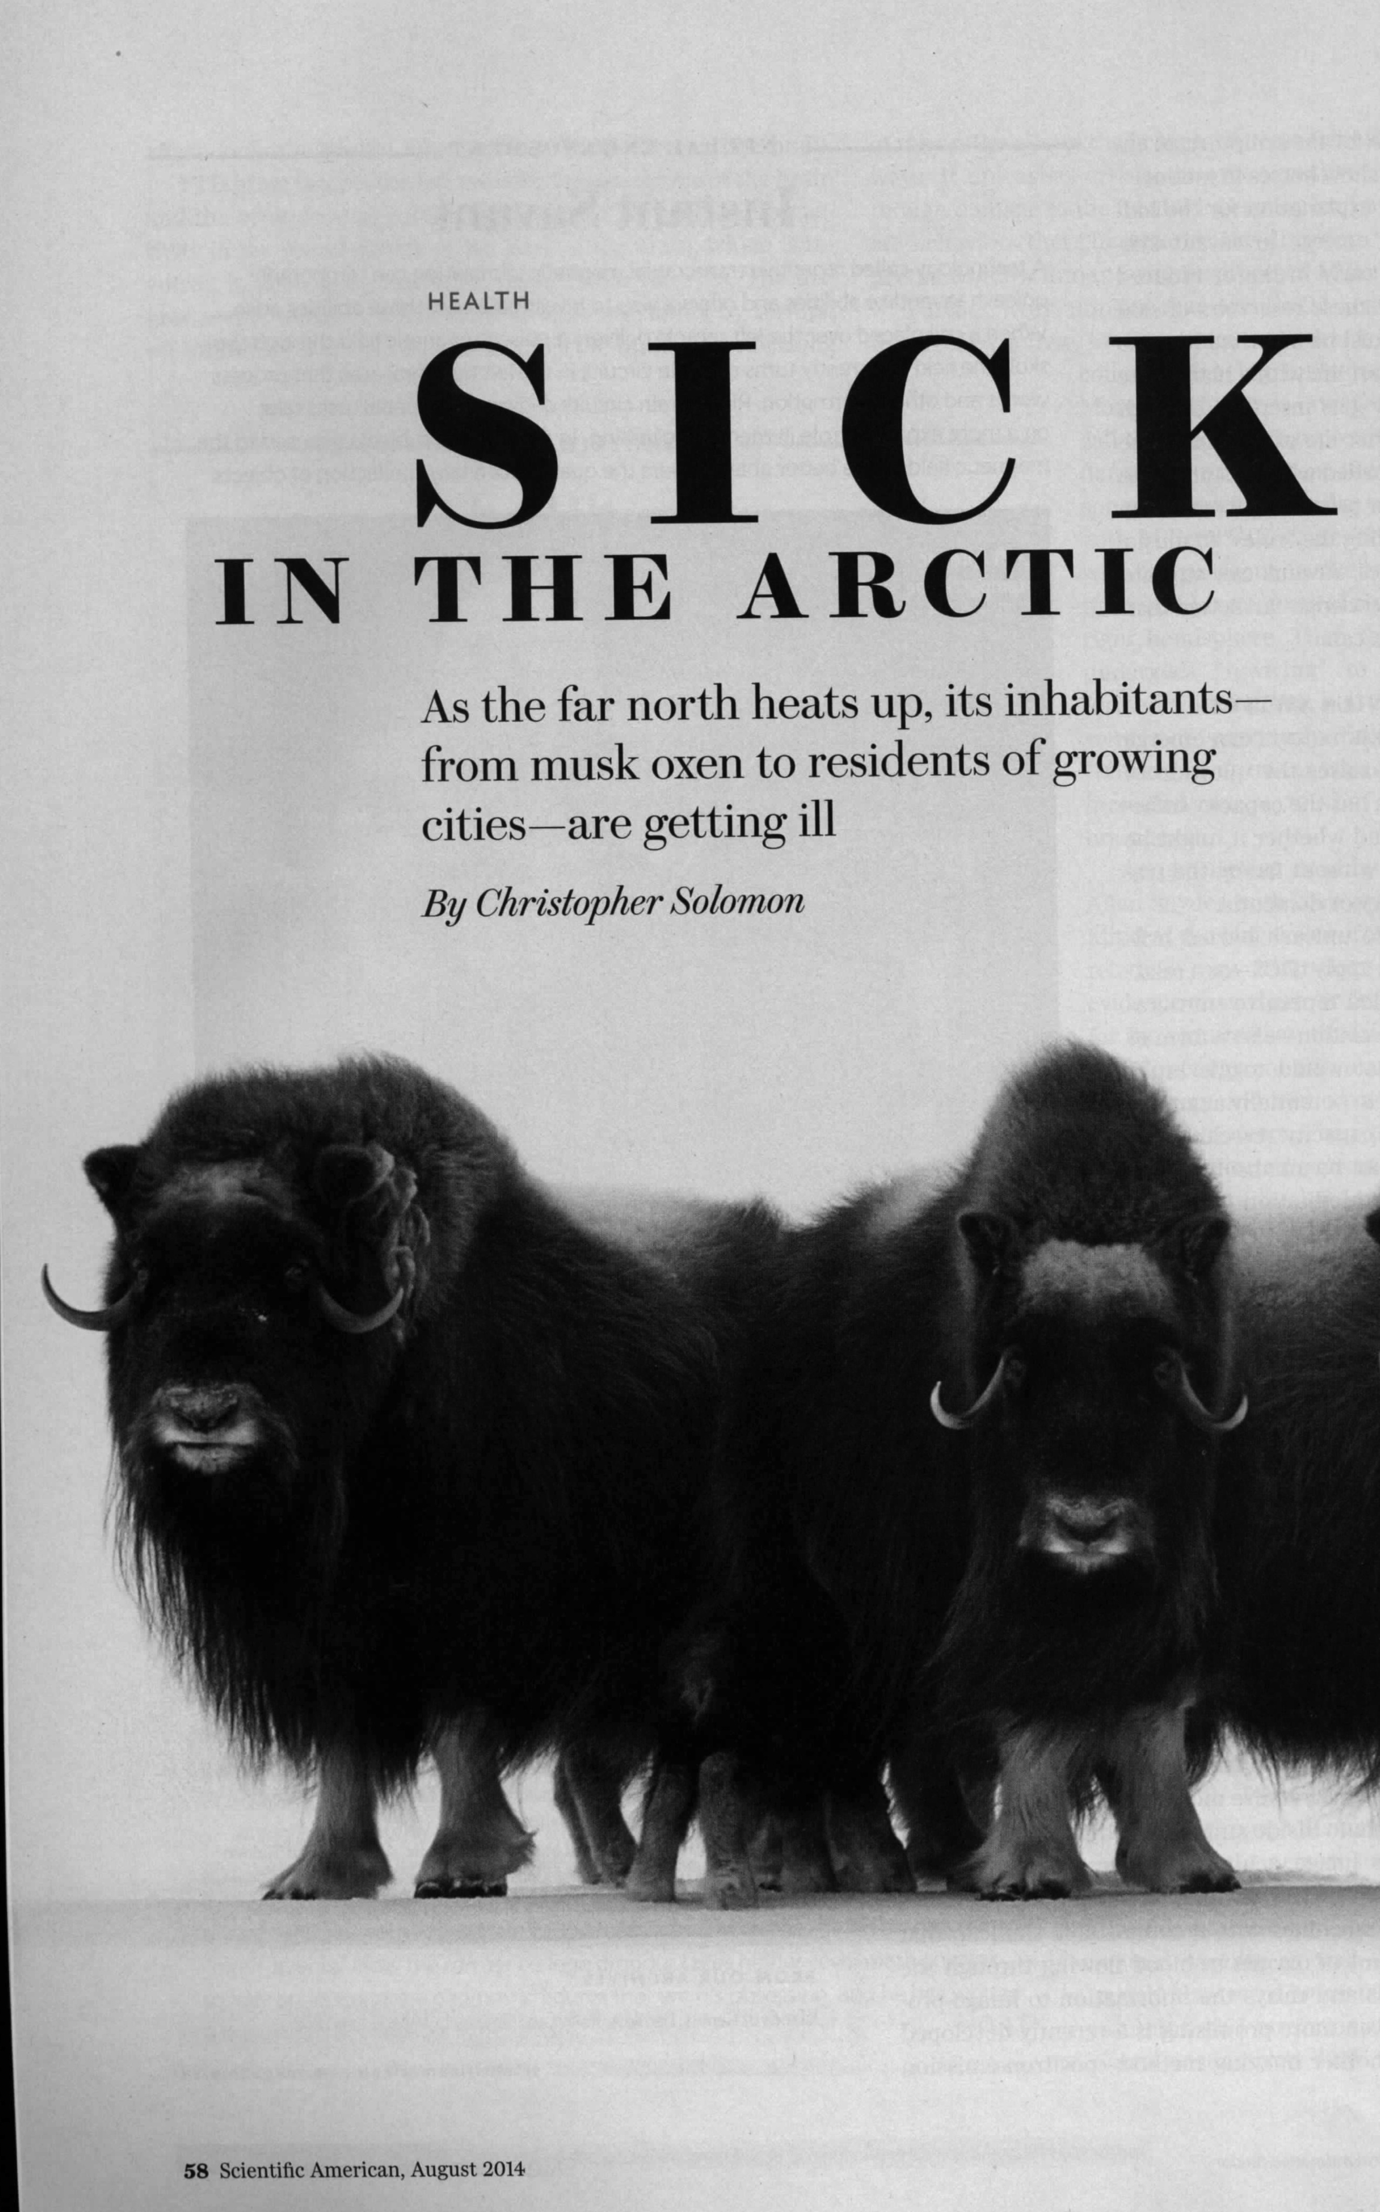
Health Disparities
Sister Study
Women exposed to solvents before the birth of their 1st child may have an increased risk of breast cancer
Agricultural Health Study
Genetic susceptibilities that increase risk of Parkinson disease when exposed to pesticides
Superfund Worker Training Program
National network of over 100 non-profit safety and health training organizations that trained nearly 1,200 Native Americans in FY 2014
Alaska Community Forums
St. Lawrence Island, Chickaloon Village
Hazardous Waste Risk and Remediation in the Southwest
Training modules for Promotores (Mexican women health advocates) are available online in Spanish and English for arsenic, pesticides, and environmental toxicology

Slide 47
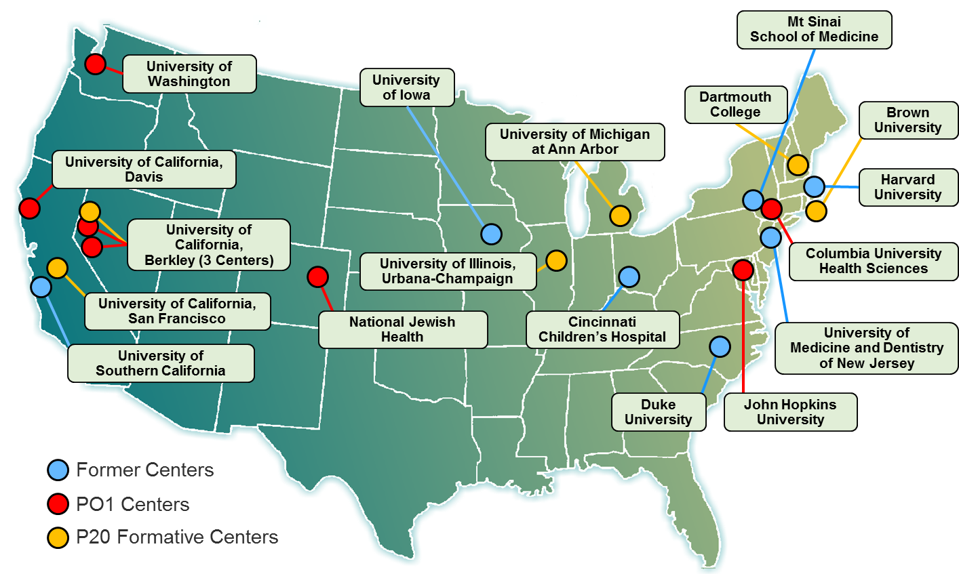
Early Exposures
Developmental Origins of Health and Disease (DOHaD)
NIEHS/EPA Children’s Environmental Health and Disease Prevention Research Centers
Markers of Autism Risk in Babies – Learning Early Signs
Breast Cancer and the Environment Research Program (BCERP)

Slide 48
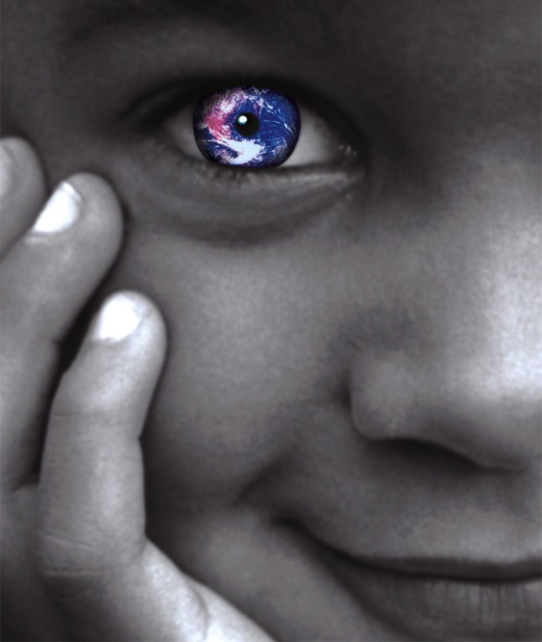
Future Direction
NIEHS has made great strides in identifying and understanding the role of environment in health and disease.
NIEHS will continue to invest in research that has a significant, measurable public health impact.
NIEHS brings new understanding through stakeholder and community engagement in 21st century environmental health challenges.

Slide 49
Dr. Tim McAfee, MD, MPH Director, Office of Smoking and Health Centers for Disease Control and Prevention

Slide 50
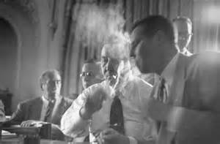
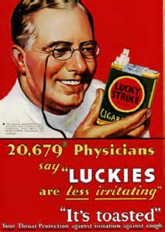
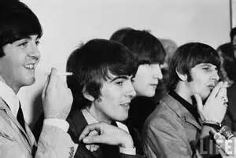
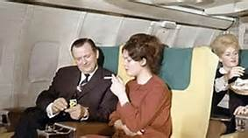
50 Years Ago

Slide 51
Progress with Leading Health Indicators
Bulleted Text

Slide 52
Adult Per Capita Cigarette Consumption and Major Smoking-and-Health Events—United States, 1900-2013
1st Surgeon
General’s Report
On smoking and health
Nicotine medications available
over-the-counter
U.S. entry
Into WW II
Fairness Doctrine
Messages on TV
and Radio
Master
Settlement
Agreement
Confluence of evidence linking smoking and cancer
Federal
cigarette
tax doubles
Family Smoking Prevention and Tobacco Control Act
1986 Surgeon
General’s report on
secondhand smoke
U.S. entry
Into WWI
2006 Surgeon General’s report on secondhand smoke
Great Depression
begins
Sources: Adapted from Warner 1985 with permission from Massachusetts Medical Society, ©1985; U.S. Department of Health and Human Services 1989; Creek et al. 1994; U.S. Department of Agriculture 2000; U.S. Census Bureau 2013; U.S. Department of the Treasury 2013. *Adults ≥18 years of age as reported annually by the Census Bureau.

Slide 53
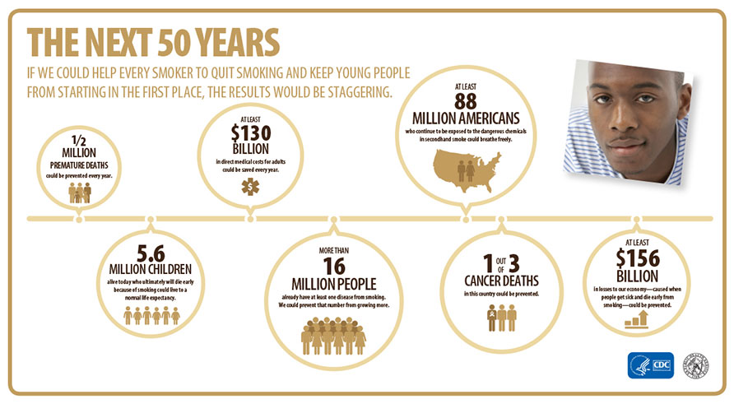
Smoking costs lives and money
Bulleted Text
CURRENT SITUATION
Source: The health consequences of smoking – 50 years of progress: a report of the Surgeon General. – Atlanta, GA. : U.S. Department of Health and Human Services, Centers for Disease Control and Prevention, National Center for Chronic Disease Prevention and Health Promotion, Office on Smoking and Health, 2014.

Slide 54
Current cigarette smoking* among adults aged ≥ 18 years, by state—U.S., 2013
WA
VT
MT
ND
ME
OR
MN
NH
ID
SD
WI
NY
MA
WY
MI
RI
IA
PA
NJ
CT
NV
NE
IL
OH
UT
IN
DE
CA
CO
KS
MO
WV
VA
MD
KY
D.C.
Smoking Prevalence (percent)
TN
NC
AZ
OK
AR
SC
10.6 – 12.9
NM
MS
AL
GA
13.0 – 15.9
LA
TX
16.0 – 18.9
FL
AK
19.0 – 21.9
HI
22.0 – 24.9
25.0 – 27.3
* Persons who have smoked at least 100 cigarettes in lifetime and currently report smoking every day or some days.
Source: Behavioral Risk Factor Surveillance System (BRFSS)
HP2020 TU-1.1 Reduce cigarette smoking by adults

Slide 55
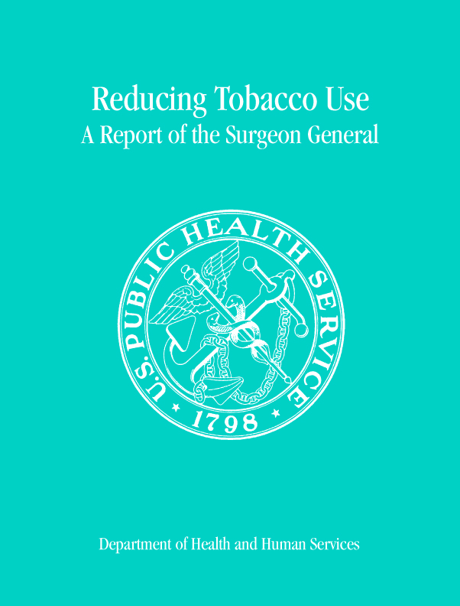
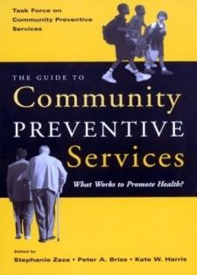
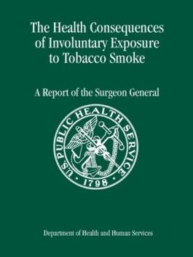
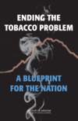
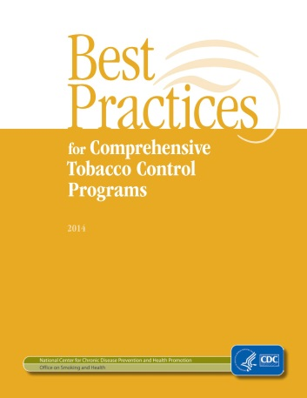
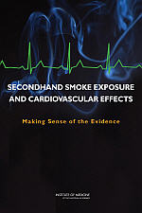
We Know What Works: Evidence-Based Interventions
Sustained funding of comprehensive programs
100% smoke-free policies
Tobacco price increases
Hard-hitting media campaigns
Cessation access

Slide 56
Tobacco Industry is Outspending Prevention Efforts 18:1
State Tobacco
Revenue
(FY 2014 CTFK Report)
Federal
Cigarette
Tax Revenues
(2012 Tax Burden on Tobacco)
$25 billion
Percent
Tobacco Industry Marketing & Promotion
Spending (2011 FTC estimates)
$8.8 billion
$15.6
billion
Total CDC-Recommended Spending Level (2014)
State Tobacco Program Budgets
2014
$481.2 million
Cigarettes
And
Smokeless
$3.3 billion
Campaign for Tobacco Free Kids, Federal Trade Commission, 2012 Tax Burden on Tobacco Report, CDC's Best Practices for Comprehensive Tobacco Control Programs.

Slide 57
State Smoke-Free Air Laws Effective September 30, 2014
WA
MT
VT
ME
ND
OR
MN
ID
WI
NH
WY
SD
NY
MA
MI
RI
NV
NE
IA
PA
CT
IL
IN
OH
NJ
UT
DE
CA
CO
WV
VA
KS
MO
KY
MD
TN
NC
D.C.
AZ
NM
OK
SC
AR
MS
AL
GA
LA
Comprehensive (prohibited in workplaces, restaurants, and bars) (n=27)
TX
AK
FL
Prohibited in two locations (n=5)
HI
Prohibited in one location (n=5)
Less stringent or no restrictions (n=14)
Centers for Disease Control and Prevention’s State Tobacco Activities Tracking and Evaluation (STATE) System. Available at: http://apps.nccd.cdc.gov/statesystem/Default/Default.aspx . Washington, DC is included in states.
HP2020 TU-13.1, 13.3, & 13.4 Establish laws in States, District of Columbia, Territories, and Tribes on smoke-free indoor air that prohibit smoking in Private Worksites, Restaurants, and Bars.
Notes:
57
57

Slide 58
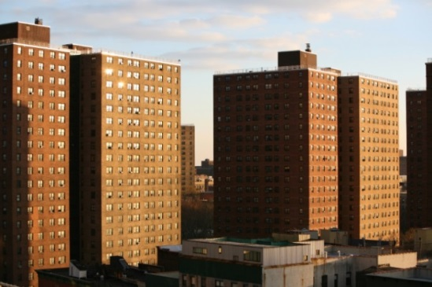
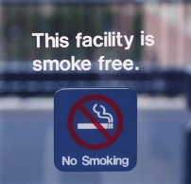
Exposure in Multi-unit Housing and on Campus
Despite considerable success in reducing exposure of nonsmokers to secondhand smoke; half of the population remains unprotected by comprehensive smoke-free laws
At least 250 public housing authorities have implemented 100% smoke-free policies, including all those in Maine. *
As of October 2014 there were 1,478 smoke-free campuses. About 976 (2/3rds) were fully tobacco free**
Sources:
*Americans for Nonsmokers’ Rights (ANR)
**Tobacco Free College Campus Initiative

Slide 59
State Cigarette Excise Tax Rates Effective September 30, 2014
WA
MT
VT
ME
ND
OR
MN
ID
WI
Chicago $6.16
NH
WY
SD
NY
MA
MI
RI
NV
NE
IA
PA
CT
IL
IN
OH
NJ
NYC
$5.85
UT
DE
CA
CO
WV
VA
KS
MO
KY
MD
TN
NC
D.C.
AZ
NM
OK
SC
AR
MS
AL
GA
≥ $3.00 per pack (n=6)
LA
$2.00–$2.99 per pack (n=10)
TX
AK
$1.50–$1.99 per pack (n=8)
FL
$1.00–$1.49 per pack (n=7)
HI
50–99 cents per pack (n=13)
<50 cents per pack (n=7)
Centers for Disease Control and Prevention’s State Tobacco Activities Tracking and Evaluation (STATE) System. Available at: http://apps.nccd.cdc.gov/statesystem/Default/Default.aspx. Local taxes from Campaign for Tobacco-Free Kids, December 2013.
HP2020 TU-17.1 Increase the Federal and State tax on Cigarettes
Notes:
59
59

Slide 60
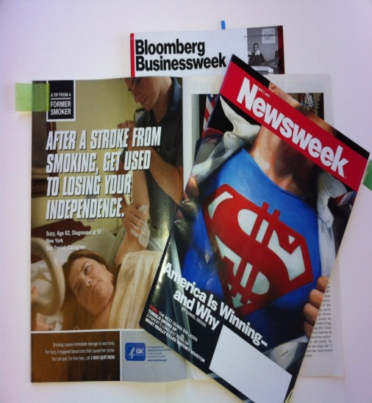
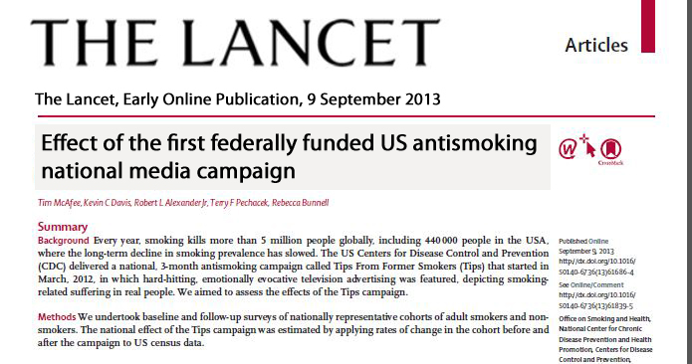
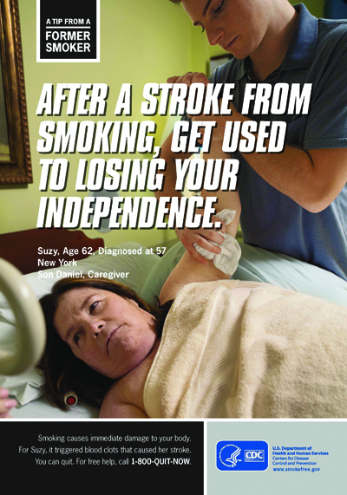
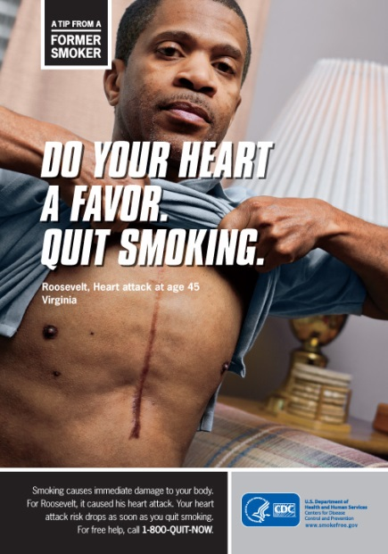
Tips From Former Smokers Campaign

Slide 61
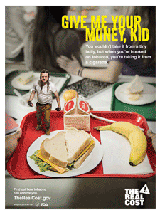
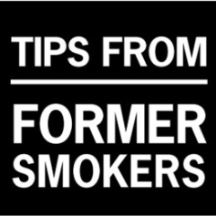
Tips, Truth, The Real Cost
Bulleted Text

Slide 62
New Opportunities to Increase Cessation
Affordable Care Act
Health Systems Change

Slide 63
“A defective and unreasonably dangerous product”
Major Conclusion
“The burden of death and disease from tobacco use in the United States is overwhelmingly caused by cigarettes and other combusted tobacco products; rapid elimination of their use will dramatically reduce this burden.”
End Game scenarios for the U.S. include:
FDA regulation
Sales restrictions
Sources:
The health consequences of smoking – 50 years of progress: a report of the Surgeon General. – Atlanta, GA. : U.S. Department of Health and Human Services, Centers for Disease Control and Prevention, National Center for Chronic Disease Prevention and Health Promotion, Office on Smoking and Health, 2014.
Proctor RN. Why ban the sale of cigarettes? The case for abolition. Tobacco Control 2013;22:i27-i30

Slide 64
Past 30 day use of e-cigarettes among U.S. adults – HealthStyles, 2010/2011 and 2012/2013
Source: Source: Brian A. King, Roshni Patel, Kimberly Nguyen, and Shanta R. Dube. Trends in Awareness and Use of Electronic Cigarettes among U.S. Adults, 2010-2013 Nicotine Tob Res ntu191 first published online September 19, 2014 doi:10.1093/ntr/ntu191

Slide 65
Current e-cigarette use among students more than doubled between 2011 and 2012
554,000
Students
* Current use is defined as use on one or more days in the last 30 days
Centers for Disease Control and Prevention (2013). "Notes from the Field: Electronic Cigarette Use Among Middle and High School Students — United States, 2011–2012." Morbidity and Mortality Weekly Report 62(35): 729-730.

Slide 66
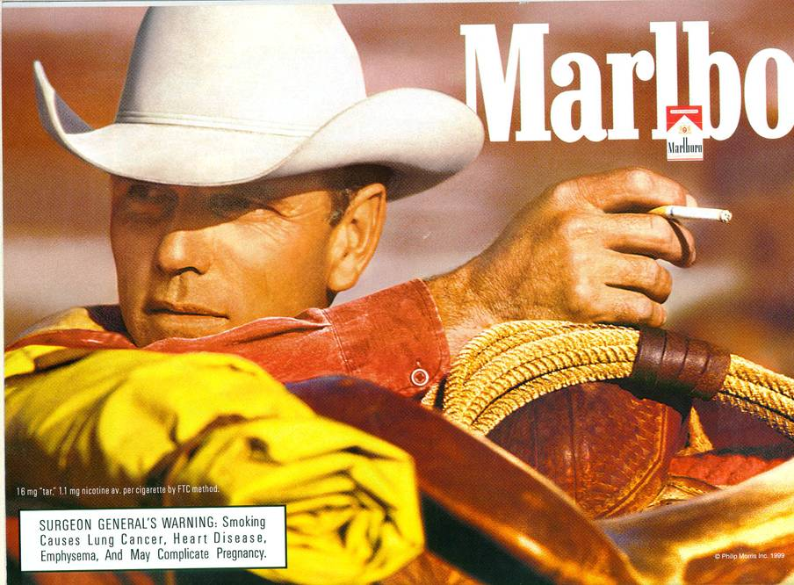
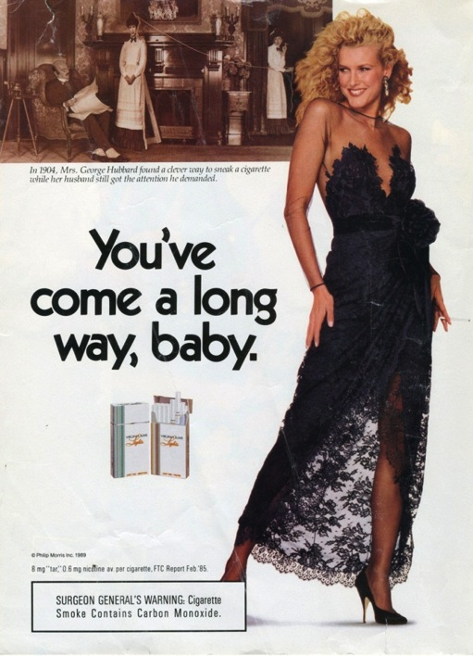
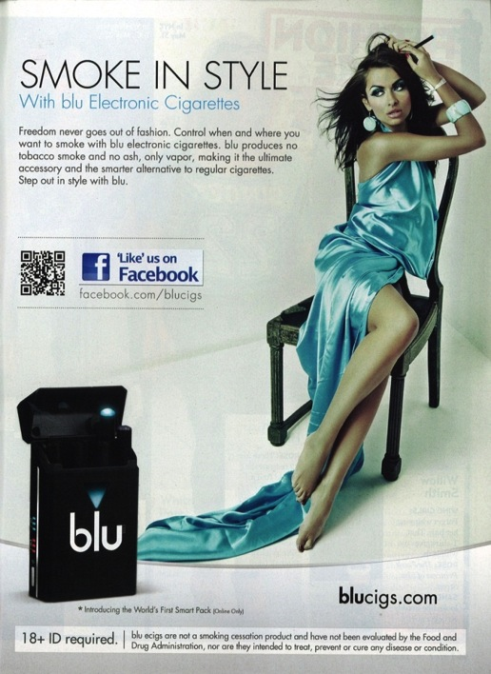
Industry Advertising
Bulleted Text

Slide 67
We Know What Works: Evidence-Based Interventions
Sustained funding of comprehensive programs
100% smoke-free policies
Tobacco price increases
Hard-hitting media campaigns
Cessation access

Slide 68
Live Smoke Free: Healthier Buildings, Happier Residents, a Smart Investment
December 5, 2014
Kara Skahen MSW, MPP
Program Director
Notes:
68

Slide 69
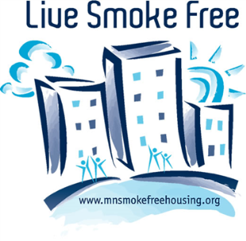
Why Smoke-Free Housing?
Minnesotans living in multi-unit housing:
21.5%
504,648 units (US Census, 2010)
Residents of multi-unit housing are disproportionately:
Low-Wage Workers, People of Color, the Elderly, and the Young (under 18).
Struggle with poverty, chronic disease, mental illness, and chemical dependency.
Exposed to secondhand smoke at high rates.
Members of these special populations often have:
Limited housing options, resources to move, and access to health care.
Members of these special populations cannot prevent exposure:
Due to secondhand smoke drift, residents cannot 100% control the air in their unit.
Everyone deserves to have a healthy, safe place to call home.

Slide 70
Societal Benefits
Smoke-Free Housing policies:
Protect priority populations from second and thirdhand smoke exposure.
Encourage people who smoke to reduce their consumption or quit.
Help to reduce cigarette-caused fires.
Protect housing investments.
Save money for residents, property owners, and taxpayers.
Smoke-free subsidized housing would save $521 million a year.
(Centers for Disease Control and Prevention, 2013)

Slide 71
Healthy People 2020
Live Smoke Free directly addresses the following
Healthy People 2020 objectives:
TU-11 Reduce the proportion of nonsmokers exposed to secondhand smoke
TU-11.1 Reduce the proportion of children aged 3 to 11 years exposed to secondhand smoke
TU-11.2 Reduce the proportion of adolescents aged 12 to 17 years exposed to secondhand smoke
TU-11.3 Reduce the proportion of adults aged 18 years and older exposed to secondhand smoke
TU-14 Increase the proportion of smoke-free homes

Slide 72
The Association for Nonsmokers Minnesota (ANSR)
Non-profit, member-based organization.
Located in St. Paul, Minnesota.
Dedicated to reducing the human and economic costs of tobacco use.
In 1975, ANSR helped pass the nation's first comprehensive state clean indoor air legislation.

Slide 73
Live Smoke Free Program
1990s: Started receiving phone calls from concerned renters.
Early 2000s:“Initiative for Smoke-free Apartments”
2007: Full time funding; “Live Smoke Free”
Currently:
5 full time staff
Funding:
Grants from
Minnesota Department of Health (MDH)
Subcontracts from local public health departments
ANSR Member Donations & Fundraising Efforts

Slide 74
Program Evolution
2000-2003: Research Phase
Statewide studies on air movement, legal questions, survey of renters and managers.
2003-2006: Smoke-Free Policy Work Phase I
Direct policy work begins part time.
2007-2012: Smoke-Free Policy Work Phase II & Technical Assistance
Direct policy work begins full time.
Technical assistance to statewide grantees begins.
2011-2012: Communities Putting Prevention to Work (CPPW)
Recipient of a CPPW Mentoring Supplement from the MDH to mentor U.S. communities
2012-Current: Smoke-Free Policy Work Phase III & Technical Assistance
Direct policy work continues, emphasis on affordable and supportive housing.
Technical Assistance to statewide grantees.
Notes:
74

Slide 75
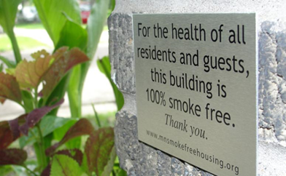
Policy Approach
Voluntary policy approach
Beginning to adopt alternative policy options such as housing tax credits
Work on all housing types: subsidized, market rate, public, private, common interest communities, etc.
Partner with a number of public and private groups statewide
Public Health Law Center at William Mitchell College of Law

Slide 76
What Makes for a Good Policy?
Written in a lease or house rules.
Defines “smoke free” and what areas of the property are covered.
Consequences for violations are clearly defined; violations may result in eviction.
No grandfathering.
100% of indoors are covered (outdoor areas are a plus!)

Slide 77
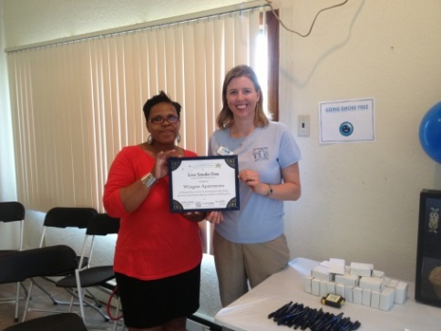
Scope of Work: Direct Policy Assistance
Policy adoption support to Minnesota-based property owners, managers, developers, and residents.
Resources Live Smoke Free can offer:
Consultations.
Promotions (Press Releases, Signage, Listing in a Statewide Housing Directory).
Implementation Tools (Surveys, Notification letters, Lease addendums, Translated documents).
Educational Resources (Tailored for Management, Staff, and Residents).
Presentations to Staff and Residents.
Cessation Referrals.

Slide 78
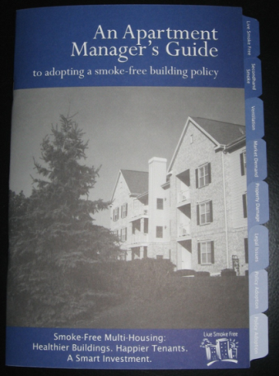
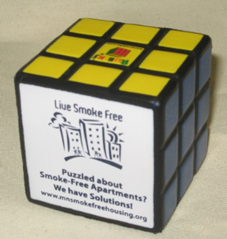
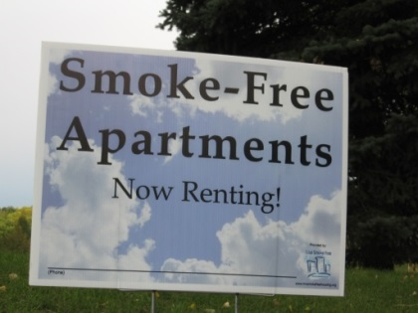
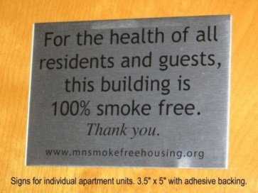
Resources for Property Managers
3-Part “How To” Module Series
Educational Resources and Trinkets
Smoke-Free Signage

Slide 79
Minnesota’s Statewide Smoke-Free Housing Directory

Slide 80
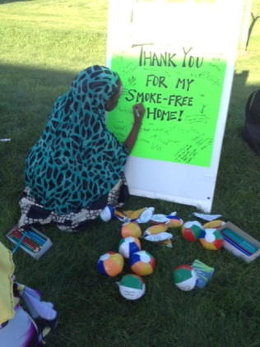
Scope of Work: Training & Technical Assistance
Statewide and National Technical Assistance
Resources Live Smoke Free can offer:
Individual consultations (including site visits), strategy development, and educational materials.
Sample Implementation Tools
Smoke-Free lease addendums in multiple languages.
Training Resources for Staff
Educational Resources to provide to Property Managers
Photo Credit: Kelly Corbin, Olmsted County Public Health Services

Slide 81
Stages of Smoke-Free Multi-Housing Program Development

Slide 82
Outcomes
Smoke-Free Apartments in Minnesota:
2007: 50 properties
2014: 1,500+ properties
Over half of Public Housing Authorities
Smoke-Free Apartment in Minnesota Since 2011:
523 new or expanded policies (1086 buildings and 35,300 units)
Subsidized properties
171 new or expanded policies (161 buildings, 10,930 units)
Senior properties
104 new or expanded policies (34 buildings and 6,373 units)
Thousands of Minnesotans protected from secondhand smoke
Exposure to Secondhand Smoke at Home:
2003: 16.9%, 2007: 12.0%, 2010: 9.5% (Minnesota Adult Tobacco Survey, 2010)

Slide 83
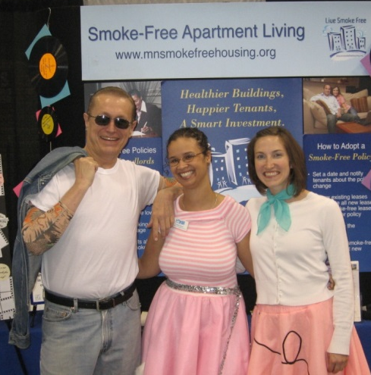
Lessons Learned
Communicate and partner with other local grants.
Track your progress, keep in touch with managers that have already gone smoke free.
No need to reinvent the wheel.
Utilize appropriate messaging.
Maintain a strong web presence.
Have fun!

Slide 84
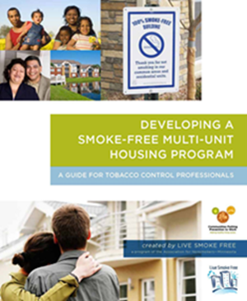
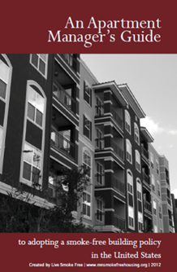
Resources for Public Health Professionals
“Developing a Smoke-Free Multi-Unit Housing Program”
Training Manual
“An Apartment Manager’s Guide to Adopting a
Smoke-Free Building Policy in the United States”
Booklet for Property Managers

Slide 85
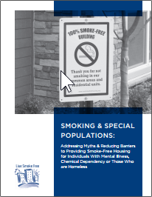
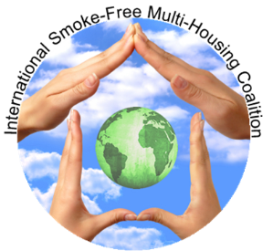
Resources for Public Health Professionals
“Smoking & Special Populations” Booklet
Addressing Myths & Reducing Barriers to Providing Smoke-Free
Housing for Individuals with Mental Illness, Chemical Dependency
or Those who are Homeless
Global Directory of Smoke-Free Multi-Housing Programs:
http://www.mnsmokefreehousing.org/organizations/Resources
Model Smoke Free Lease Addendum
Available in English, Spanish, Hmong, Oromo, Somali, Vietnamese
http://www.mnsmokefreehousing.org/materials

Slide 86
Webinar Series
Based on the Smoke-Free Multi-Unit Housing Program Continuum:
The Case for Smoke-Free Housing
Getting to Know the Multi-Housing Industry
Building Your Smoke-Free Housing Program
Understanding Legal Issues
Strategies to Reach the Housing Industry
Working with Property Owners/Managers to Adopt a Smoke-Free Policy
Providing Cessation in Smoke-Free Buildings
Working with Renters Exposed to Secondhand Smoke
Program Sustainability
View archives and recorded webinars at: http://www.mnsmokefreehousing.org/organizations/archivedweb

Slide 87
Contact Information
Kara Skahen, MSW, MPP
Program Director
Live Smoke Free: Smoke-Free Multi-Housing
Association for Nonsmokers-MN
2395 University Avenue West, Suite 310
Saint Paul, MN 55114
kara@ansrmn.org
Phone: 651.646.3005 x301
Fax: 651-646-0142
www.mnsmokefreehousing.org

Slide 88
Roundtable Discussion Please take a moment to fill out our brief survey

Slide 89
FDA’s Public Health ACTIONS to date
Prohibited
Sales to people younger than 18; requires proof of age for purchase if < 27 years of age
Sales of cigarette packs with less than 20 cigarettes
Distribution of free samples of cigarettes; restricts the distribution of free samples of smokeless tobacco products
Brand name sponsorship of athletic, musical, or other social events, teams
Hats and tee shirts, etc., with brand names or logos
Sales in vending machines, self-service displays except in adult-only facilities
Enforced the ban on cigarettes not have characterizing flavors (except tobacco or menthol).
Prohibited misleading descriptors (light, low, mild) on regulated tobacco products

Slide 90
FDA’s Public Health ACTIONS to date
Required larger smokeless tobacco warnings on packs and ads
Required graphic health warnings on cigarettes (overturned by the courts)
Ongoing monitoring of online websites for violation of Federal tobacco promotion and advertising restrictions such as marketing or selling flavored cigarettes, having modified risk claims, or selling to a minor.
Conducted over 356,000 retailer inspections covering 54 states and territories
Issued more than 20,300 warning letters for violations
Issued more than 2,100 civil money penalties for violations
Educated at risk teens on the dangers of smoking (the “Real Cost” campaign)

Slide 91
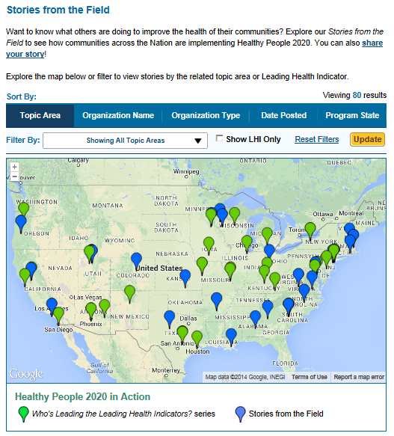
Healthy People 2020 Stories from the Field
A library of stories highlighting ways organizations across the country are implementing Healthy People 2020
Healthy People in Action
http://www.healthypeople.gov/2020/healthy-people-in-action/Stories-from-the-Field

Slide 92
Stay Connected
Web healthypeople.gov
Email hp2020@hhs.gov
Twitter @gohealthypeople
LinkedIn Healthy People 2020
YouTube ODPHP (search “healthy people”)
Join the Healthy People Listserv & Consortium
Notes:
92

Slide 93
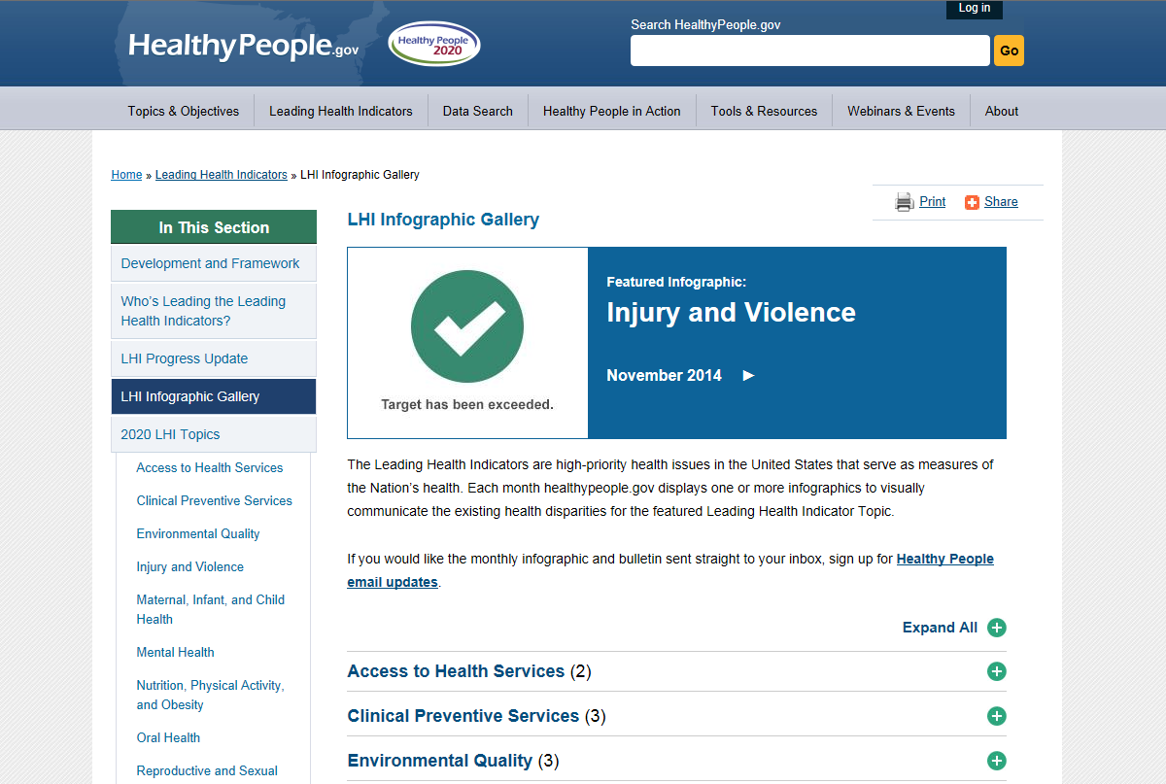
LHI Infographic gallery
www.healthypeople.gov/2020/leading-health-indicators/LHI-Infographic-Gallery
Notes:
[ Scroll through for Q&A ]

Slide 94
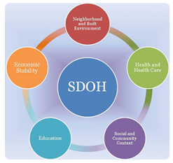
Healthy People 2020 Progress Review Webinar
Please join us as we review select
Healthy People 2020 objectives in the Social Determinants of Health and Lesbian, Gay, Bisexual and Transgender Health topic areas.
February 2015
Hear from a community-based organization that is working to improve outcomes in the community.
To register, visit: www.healthypeople.gov
Notes:
[ Scroll through for Q&A ]

Slide 95
Healthy People 2020 Progress Review Planning Group
Bill Jirles (NIH/NIEHS)
Chinaro Kennedy (CDC/NCEH)
Allison MacNeil (CDC/OSH)
Brandon Kenemer (CDC/OSH)
Pam Lemos (CDC/OSH)
Stan Lehman (CDC/OD)
Minh Wendt (HHS/OMH)
Rebecca Hines (CDC/NCHS)
Leda Gurley (CDC/NCHS)
Jeff Pearcy (CDC/NCHS)
Lesley Dobrzynski (CDC/NCHS)
Yutaka Aoki (CDC/NCHS)
Debra Brody (CDC/NCHS)
Jennifer Parker (CDC/NCHS)
Charlotte Schoenborn (CDC/NCHS)
Carter Blakey (HHS/ODPHP)
Emmeline Ochiai (HHS/ODPHP)
Theresa Devine (HHS/ODPHP)
Yen Luong (HHS/ODPHP)

