Slide 1
Healthy People 2020 Progress Review

Slide 2
Healthy People 2020 Progress Review: Targeting Social Influences that Shape Health Literacy in Communities
June 16, 2016

Slide 3
Karen B. DeSalvo, MD, MPH, MSc Acting Assistant Secretary for Health U.S. Department of Health and Human Services

Slide 4
Progress Review Agenda and Presenters
Chair
Karen B. DeSalvo, MD, MPH, MSc, Acting Assistant Secretary for Health, U.S. Department of Health and Human Services
Presentations
Charles Rothwell, MBA, MS, Director, National Center for Health Statistics, CDC
Leonard Jack, PhD, MSc, Director, Division of Community Health, CDC
RADM Sarah Linde, MD, Chief Public Health Officer, HRSA
Don Wright, MD, MPH, Deputy Assistant Secretary for Disease Prevention and Health Promotion, HHS
Katherine Lyon-Daniel, PhD, Associate Director for Communication, CDC
Community Highlight
Jane Meyer, MA, Health Education Manager, HealthNet Indianapolis, Indiana
4

Slide 5
Healthy People at the Forefront of Public Health
5

Slide 6
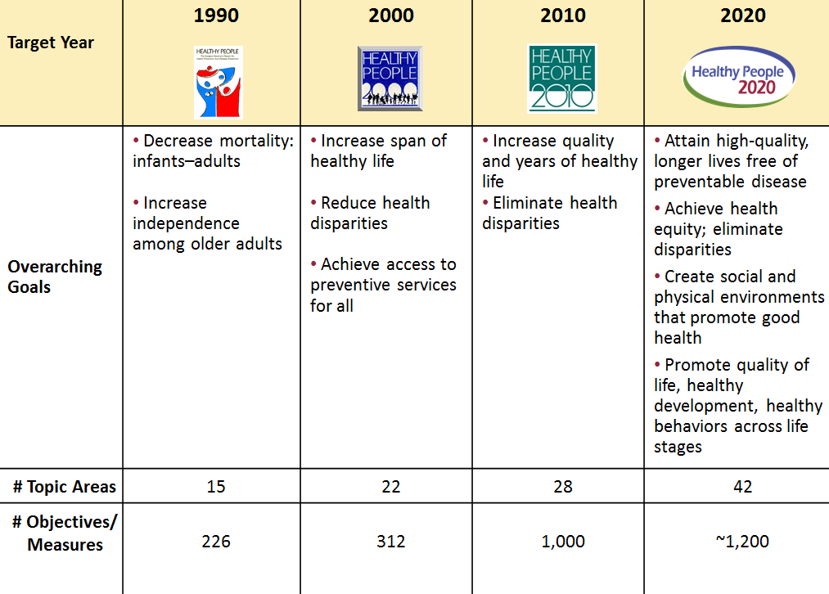
Evolution of Healthy People

Slide 7
Educational and Community-Based Programs
Play a key role in:
Preventing disease and injury
Improving health
Enhancing quality of life
Health and quality of life rely on many community systems and factors. Making changes within existing systems, can effectively improve the health of many in the community.
7

Slide 8
Importance of Educational and Community-Based Programs
Programs and strategies are designed to reach people outside of traditional health care settings
Schools: Health education curriculum and physical education
Worksites: Health screening and education, fitness programs, and worksite wellness programs
Community: Smoke-free policies to reduce second hand smoke exposure in indoor and outdoor spaces
8

Slide 9
Health Communication and Health Information Technology
Health communication refers to human and digital interactions that occur during the process of improving health and health care.
Health literacy is the capacity to obtain, communicate, process, and understand basic health information and services to make appropriate health decisions. –Affordable Care Act
9

Slide 10
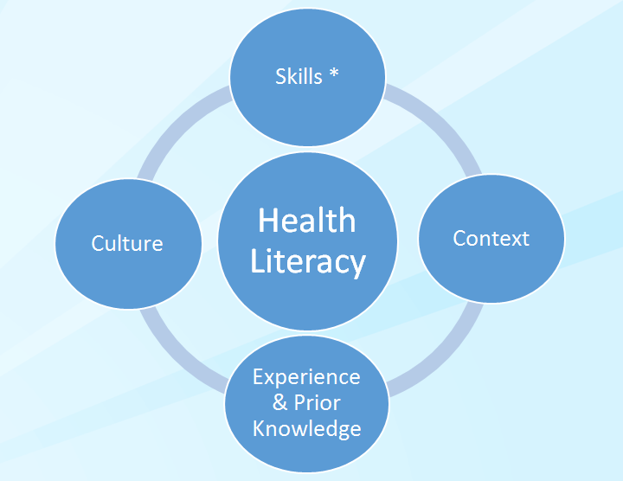
Influences on Health Literacy
*Health Literacy skills include the following:
Literacy
Numeracy
Speaking
Listening
Information-seeking
Technology use
10

Slide 11
Health Communication and Health Information Technology continued
Health information technology (Health IT) - the electronic systems health care professionals and patients use to store, share, and analyze health information.
Electronic health records
Personal health records
Electronic medical records
Electronic prescribing (e-prescribing)
Networks that connect them
11

Slide 12
Charles Rothwell, MBA, MS Director, National Center for Health Statistics Centers for Disease Control and Prevention

Slide 13
Presentation Overview
Tracking the Nation’s Progress
Educational and Community-Based Programs
Health Communication and Health Information Technology (IT)
13

Slide 14
Tracking the Nation’s Progress
90 HP2020 Measurable Educational and Community-Based Programs Objectives:
25 HP2020 Measurable Health Communication and Health IT Objectives:
18 | Target met
7 | Improving
14 | Little or no detectable change
17 | Getting worse
31 | Baseline data only
3 | Informational
8 | Target met
4 | Improving
3 | Little or no detectable change
1 | Getting worse
9 | Baseline data only
NOTES: The Educational and Community-Based Programs Topic Area contains 3 informational objectives and 7 developmental objectives. The Health Communication and Health IT Topic Area contains 3 developmental objectives. Measurable objectives are defined as having at least one data point currently available, or a baseline, and anticipate additional data points throughout the decade to track progress. Informational objectives are also measurable objectives, however, they do not have a target associated with their data.
14

Slide 15
Presentation Outline
Tracking the Nation’s Progress
Educational and Community-Based Programs
High school completion
School health education
College students receiving information on health risk behaviors
Medical schools (MD) with clinical prevention and population health content
Health Communication and Health Information Technology
15

Slide 16
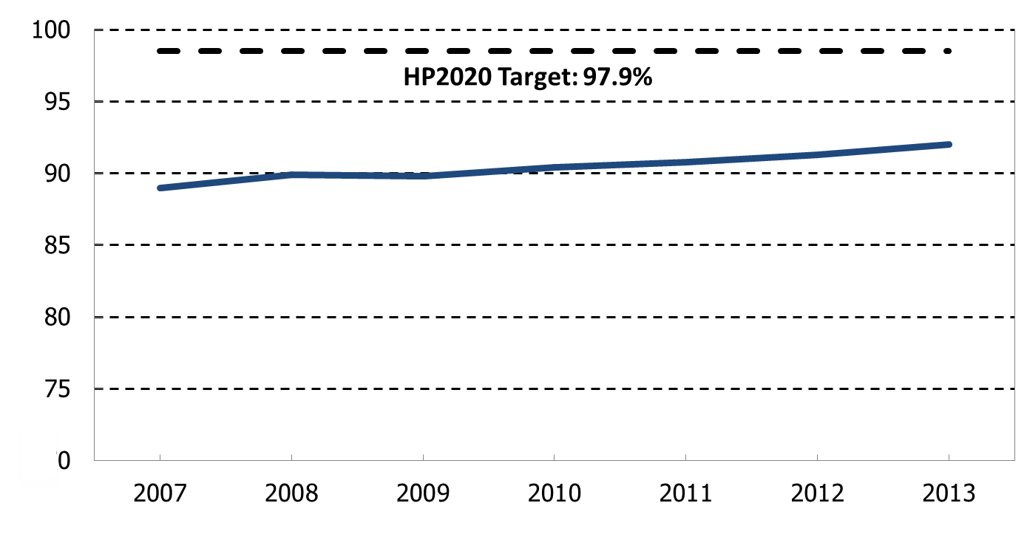
High School Completion
2007
2013
HP2020 Target: 97.9%
Increase desired
y
NOTES: I = 95% confidence interval. Data are for persons 18 to 24 years old not currently enrolled in high school who reported that they have received a high school diploma or its equivalent. The black and white race categories exclude persons of Hispanic origin. The Asian category include Pacific Islanders. Persons of Hispanic origin may be of any race. Respondents could select more than one race.
Obj. ECBP-6
16
SOURCE: Current Population Survey (CPS), Census and DOL/BLS.

Slide 17
Schools that Provide School Health Education
Percent
2006
2014
Target:
89.9%
Target:
89.1%
Target:
89.9%
Total
Unintended Pregnancy, HIV/AIDS, STD
Suicide
Alcohol/
Drugs
Tobacco
Use
Physical Activity
Unintentional
Injury
Dietary
Patterns
Violence
NOTES: I = 95% confidence interval. Target = HP2020 target for each objective. Data are for elementary, middle, and senior high schools that
provide health education to prevent health problems. Total includes unintended pregnancy, HIV/AIDS, and STD infection; suicide; alcohol or other
drug use; tobacco use and addiction; inadequate physical activity; unintentional injury; unhealthy dietary
patterns; and violence.
SOURCE: School Health Policies and Practices Study (SHPPS), CDC/NCHHSTP.
Objs. ECBP-2.1 through 2.9

Slide 18
College and University Students Who Receive Information on All Priority Health Risk Behaviors
Percent
Target
Met
NOTES: Data are for undergraduate college students in post-secondary institutions who received information on all priority health risk
behaviors from their institution. All priority areas include unintentional injury; tobacco use and addiction; suicide; violence; unintended
pregnancy; unhealthy dietary patterns; HIV/AIDS and STD infection; inadequate physical activity; and alcohol or other drug use.
SOURCE: National College Health Assessment (NCHA), American College Health Association (ACHA).
Obj. ECBP-7.1
Increase desired

Slide 19
College and University Students Who Receive Information on Health Risk Behaviors
Percent
2009
2014
Target:
72.8%
Target:
61.6%
Target:
57.2%
Target:
57.8%
Target:
43.9%
Target:
36.7%
Target:
32.1%
Target:
37.7%
Target:
30.0%
Target:
10.6%
All Priority
Risk Behaviors
Injury
Tobacco
Use
Suicide
Violence
Unintended
Pregnancy
Dietary
Patterns
HIV/AIDS,
STD
Physical Activity
Alcohol/
Drugs
NOTES: I = 95% confidence interval. Target = HP2020 target for each objective. Data are for undergraduate college students in post-secondary
institutions who received information on health risk behaviors from their institution. All priority areas include unintentional injury; tobacco use and
addiction; suicide; violence; unintended pregnancy; unhealthy dietary patterns; HIV/AIDS and STD
infection; inadequate physical activity; and alcohol or other drug use.
SOURCE: National College Health Assessment (NCHA), American College Health Association (ACHA).
Objs. ECBP-7.1 through 7.10
Increase desired

Slide 20
Medical Schools (MD) with Core Clinical Prevention and Population Health Content
Percent
2008
2013-2014
HP2020 Target:
94.3%
HP2020 Target:
86.5%
Cultural Diversity
Health Promotion/ Disease Prevention
Counseling
Evaluation of Health Sciences Literature
Environmental
Health
Public Health
Systems*
Global Health
NOTES: Data are for U.S. accredited medical schools that grant the Medical Doctor (MD) degree and include the content (cultural diversity, counseling
for health promotion and disease prevention, evaluation of health sciences literature, environmental health, public
health systems, global health) in required courses. *2008 and 2009-10 data are used for public health systems.
SOURCE: Annual LCME Medical School Questionnaires; Association of American Medical Colleges, Liaison Committee
on Medical Education (AAMC, LCME).
Objs. ECBP-12.1 through 12.6

Slide 21
Presentation Outline
Tracking the Nation’s Progress
Educational and Community-Based Programs
Health Communication and Health Information Technology (IT)
Internet access and use of health information technology
Patient reports of health information and help offered by health care providers
Patient reports of health care providers’ communication skills
21

Slide 22
Broadband and Mobile Internet Access at Home
Percent
2007
2014
HP2020 Target: 83.2%
HP2020 Target: 7.7%
Broadband Access
Access via Wireless/Mobile Device
NOTES: I = 95% confidence interval. Data are age adjusted to the 2000 standard population. Data for broadband access are for persons
aged 18 years and over who reported accessing the Internet at home via cable or satellite modem or DSL modem (broadband access).
Data for access via wireless/mobile device are for persons aged 18 years and over who reported accessing the internet at home via a
wireless/mobile device.
SOURCE: Health Information National Trends Survey (HINTS), NIH/NCI.
Objs. HC/HIT-6.2, 6.3

Slide 23
Public Use of Health Information Technology
Percent
2011
2015
Looked up health information on the Internet
Used online chat groups to learn about health topics
Filled a prescription
Scheduled appointment with health care provider
Communicated with health care provider by email
NOTES: I = 95% confidence interval. Data are for adults 18 years and older who used computers to: look up health information on the
Internet; use online chat groups to learn about health topics; fill a prescription on the Internet; schedule an appointment with a health
care provider using the Internet; or communicate with a health care provider over e-mail in the past 12 months.
SOURCE: National Health Interview Survey (NHIS), CDC/NCHS.

Slide 24
Internet Use for Health Information, 2015
Educational Attainment (Ages 25+)
NOTES: = 95% confidence interval. Except for education, data are for adults aged 18 and over who looked up health information on the Internet in the past 12 months. Data for the single race categories shown are for persons who reported only one racial group. Persons of Hispanic origin may be of any race. Black and white race categories exclude persons of Hispanic origin. Educational attainment is for adults 25 years and over.
I
SOURCE: National Health Interview Survey (NHIS), CDC/NCHS.
.

Slide 25
Physicians’ Use of Health Information Technology
Percent
2014
EHR/EMR and electronic sharing of data
EHR/EMR but no electronic sharing of data
Not using EHR/EMR
NOTES: EHR – Electronic Health Record. EMR – Electronic Medical Record system. Data are for office-based physicians who used an EHR or EMR system and shared any patient health information (e.g., lab results, imaging reports, problem lists, medication lists) electronically with any other providers, including hospitals, ambulatory providers, or laboratories.
SOURCE: National Electronic Health Records Survey (NEHRS), CDC/NCHS.
25

Slide 26
Patient Reports of Health Information and Help Offered by Health Care Providers
Percent
2011
HP2020 Target: 70.5%
HP2020 Target: 26.9%
HP2020 Target: 16.3%
Patients report help filling out forms
Patients report providers asked how they will follow instructions
Patients report easy-to-understand instructions
NOTES: I = 95% confidence interval. Data are for patients aged 18 years and over who reported they were always offered help in filling out
a form at the doctor’s or other health care provider’s office; that their health care provider always asked them to describe how instructions
would be followed, and always gave them easy-to-understand instructions about what to do about a specific illness or health condition in
the last 12 months.
SOURCE: Medical Expenditure Panel Survey (MEPS), AHRQ.
Objs. HC/HIT-1.1 through 1.3

Slide 27
Patient Reports of Easy-to-Understand Instructions from Health Care Provider, 2013
HP2020 Target: 70.5%
Increase desired
Educational Attainment (Ages 25+)
NOTES: = 95% confidence interval. Except for education, data are for patients aged 18 years and over who reported that in the last 12 months, doctors or other health providers always gave them easy-to-understand instructions about what to do about a specific illness or health condition. American Indian includes Alaska Native. Respondents were asked to select one or more races. Persons of Hispanic origin may be of any race. Black and White exclude persons of Hispanic origin. Data for the single race categories shown are for persons who reported only one racial group. Educational attainment is for adults 25 years and over.
I
SOURCE: Medical Expenditure Panel Survey (MEPS), AHRQ.
Obj. HC/HIT-1.1

Slide 28
Patient Reports of Health Care Providers’ Communication Skills
Percent
2007
2013
HP2020 Target: 68.2%
HP2020 Target: 66.0%
HP2020 Target: 65.0%
HP2020 Target: 54.0%
Always Spent Enough Time
Always Listen
Always Show Respect
Always Explain
NOTES: I = 95% confidence interval. Data are for patients aged 18 years and over who reported that their doctors always spent enough time
with them; always listened carefully to them; always showed respect for what they had to say; always explained things to them in a way that
was easy to understand in the last 12 months.
SOURCE: Medical Expenditure Panel Survey (MEPS), AHRQ.
Objs. HC/HIT-2.1 through 2.4

Slide 29
Patient Reports Health Care Providers Always Explain, 2013
HP2020 Target: 66.0%
Increase desired
Sex
Educational Attainment (Ages 25+)
NOTES: = 95% confidence interval. Except for education, data are for patients aged 18 years and over who report having their doctor always explain things to them in a way that was easy to understand in the last 12 months. American Indian includes Alaska Native. Respondents were asked to select one or more races. Persons of Hispanic origin may be of any race. Black and White exclude persons of Hispanic origin. Data for the single race categories shown are for persons who reported only one racial group. Educational attainment is for adults 25 years and over.
I
SOURCE: Medical Expenditure Panel Survey (MEPS), AHRQ.
Obj. HC/HIT-2.2

Slide 30
Key Takeaways – Educational and Community-Based Programs
So far in the decade, 25 objectives have met the target, while 17 objectives are getting worse, moving away from their targets.
Students are completing high school at an increasing rate, although disparities still exist by sex and race/ethnicity.
Grade schools teaching students about health education and risk behaviors have decreased over the past decade.
Colleges and universities are increasingly teaching students about health risk behaviors and these objectives have met their targets.
MD granting medical schools are generally increasing public health content in their curricula.
30

Slide 31
Key Takeaways – Health Communication and Health Information Technology
Use of broadband access at home is decreasing but the use of Internet at home via wireless/mobile devices is increasing.
Use of health information technology by the public and physicians is increasing.
Disparities persist in use of Internet and health information technology by race/ethnicity, country of birth, and educational attainment.
According to patient reports, health care providers’ communication skills are improving.
So far in the decade, 12 out of 25 Healthy People 2020 Health Communication and Health IT objectives have reached their targets or are improving.
31

Slide 32
Targeting Social Influences that Shape Health Literacy in Communities
Dr. Leonard Jack, Jr., PhD, MSc Director, Division of Community Health Centers for Disease Control and Prevention
June 16, 2016

Slide 33
The Centers for Disease Control and Prevention
33

Slide 34
CDC Division of Population Healthy Schools Program
Shared priorities between health and education:
Increase quantity and quality of physical education, health education and physical activity
Improve the nutritional quality of foods provided on school grounds
Improve the capacity of schools to manage chronic conditions
34

Slide 35
CDC Division of Population Healthy Schools Program
CDC’s Role:
Quality of health education in schools
Evidence-based guidelines and recommendations for school programs and policy
Tools and resources for educators and administrators
Training and professional development
35

Slide 36
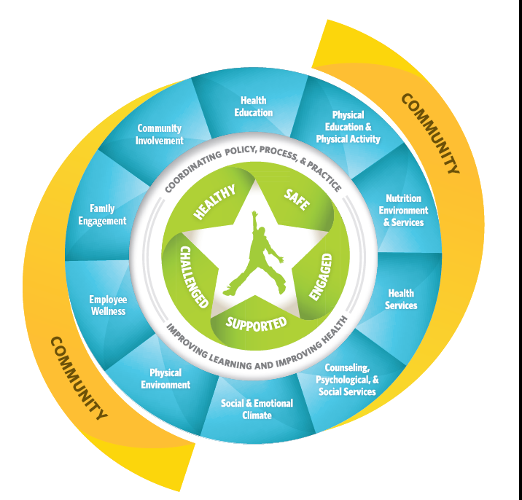
CDC Division of Population Health Healthy Schools Program
Whole School Whole Community Whole Child (WSCC)
36

Slide 37
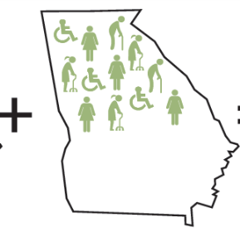
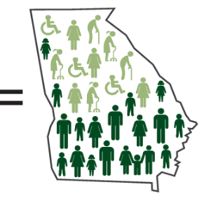
Twin Approach to Health Equity
Targeted culturally tailored interventions
to address the
greatest chronic disease burden
Twin Approach
Population-wide interventions with health equity in mind
37

Slide 38
CDC Division of Community Health Programs Funded in Fiscal Year 2014
PICH
Partnerships to Improve Community Health (PICH)
National Organizations
National Implementation and Dissemination for Chronic Disease Prevention (National Orgs)
REACH
Racial and Ethnic Approaches to Community Health (REACH 2014)
38

Slide 39
Partnerships to Improve Community Health (PICH)
Evidence-based strategies to improve the health of communities and reduce the prevalence of chronic disease
Multi-sectoral coalitions in:
Large cities and urban counties (≥ 500,000)
Small cities and counties (50,000- 499,999)
American Indian tribes and tribal organizations
39 awardees across the U.S.
39

Slide 40
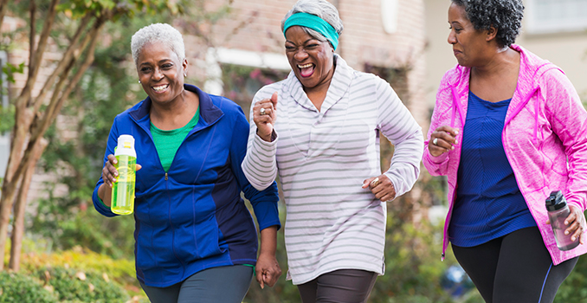
Partnerships to Improve Community Health (PICH)
Lima Family YMCA and Activate Allen County target 15 census tracts to improve health for persons at disproportionate risk for chronic disease.
40

Slide 41
National Implementation and Dissemination for Chronic Disease Prevention
Helps national organizations and local networks promote healthy communities, prevent chronic diseases, and reduce health disparities.
5 awardees
Capacity Building and Implementation
Dissemination and Training
41

Slide 42
National Implementation and Dissemination for Chronic Disease Prevention
The National WIC Association supports local WIC agencies to implement strategies to increase access to chronic disease prevention, risk education, and poor nutrition services.

Slide 43
Racial and Ethnic Approaches to Community Health (REACH)
Implements locally tailored evidence- and practice-based population-wide improvements in priority populations
Categories
Basic Implementation
Comprehensive Implementation
43

Slide 44
Racial and Ethnic Approaches to Community Health (REACH)
Greenwood Leflore Hospital collaborates with community organizations to improve community-clinical linkages in Mississippi.
44

Slide 45
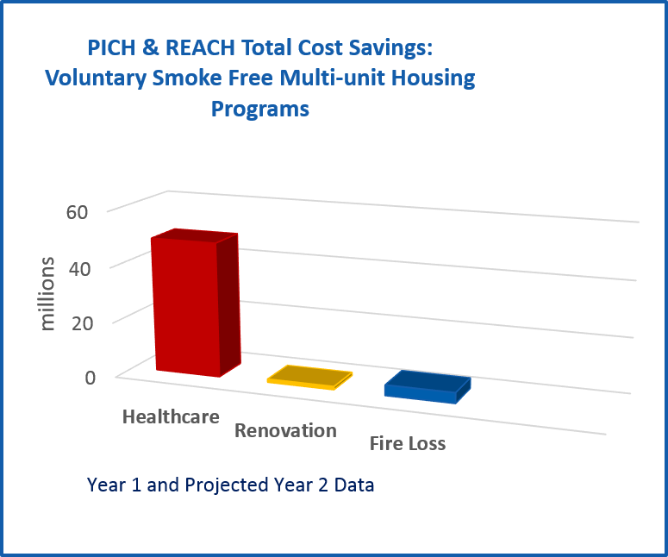
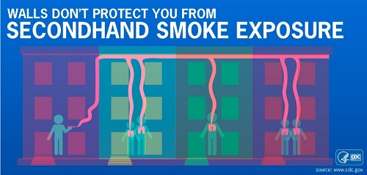
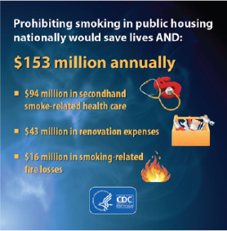
Early Program Achievements
Smoke Free Multi-unit Housing
Year 1 Actual & Year 2 Projected Reach = 470,286
182,000 children, 180,000 minority & 88,000 low income residents
Short-term Public Health Impacts
> 9,800 residents will quit smoking*
>167 hospitalizations prevented**
$53.6 Million Annual Cost Savings**
$48.7 M healthcare savings
$1.14 M renovation
$3.79 fire loss
*Community Guide 2012 **King et al. 2013

Slide 46
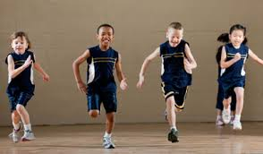
Early Program Achievements (cont.)
18 PICH and REACH Awardees
> 1.5 million students
60 minutes physical activity/day
Health Benefits (Short Term)*
Achieve & maintain healthy weight
Strong bone & muscle development
Increased academic achievement
Cost Benefits (Long Term)**
Each $1 generates $33.54 savings
Health care costs
Increased future earnings
Reduced crime & justice system costs
*Community Guide 2013, Cochrane Dobbins, 2013Cochrane Waters 2011 **WA SIPP 2015
46

Slide 47
Long-Term Outcomes
DCH programs reinforce activities towards three goals.
Reduce rates of death and disability due to tobacco use by 5%
Reduce prevalence of obesity by 3%3%
Reduce rates of death and disability due to diabetes, heart disease, and stroke by 3%3%
47

Slide 48
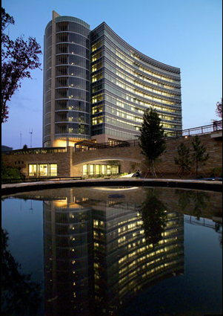
Future Focus of DCH
Continue to promote sustainable programs
Build the evidence base of best practices with maximum impact
Communicate the success of community based health approaches
Share the evidence and best practices with non-funded communities
48

Slide 49
Thank you!
For more information, please contact the Centers for Disease Control and Prevention
1600 Clifton Road NE, Atlanta, GA 30333
Telephone: 1-800-CDC-INFO (232-4636)/TTY: 1-888-232-6348
Visit: www.cdc.gov | Contact CDC at: 1-800-CDC-INFO or www.cdc.gov/info
The findings and conclusions in this report are those of the author and do not necessarily represent the official position of the CDC.
49

Slide 50
CDC Resources
Division of Population Health/Healthy Schools
http://www.cdc.gov/healthyschools
Division of Community Health
http://www.cdc.gov/nccdphp/dch/index.htm
Practitioner’s Guide to Advancing Health Equity
http://www.cdc.gov/nccdphp/dch/health-equity-guide/index.htm
Community Health Online Resource Center (CHORC)
http://www.cdc.gov/nccdphp/dch/online-resource/index.htm
50

Slide 51
Healthy People (HP) 2020 Progress Review Webinar
Targeting Social Influences that Shape Health Literacy in Communities:
The HRSA Perspective
Sarah R. Linde, M.D. Rear Admiral, U.S. Public Health Service Chief Public Health Officer Health Resources and Services Administration (HRSA) June 16, 2016

Slide 52
HRSA Mission
To improve health and
achieve health equity through
access to quality services,
a skilled health workforce and
innovative programs
52

Slide 53
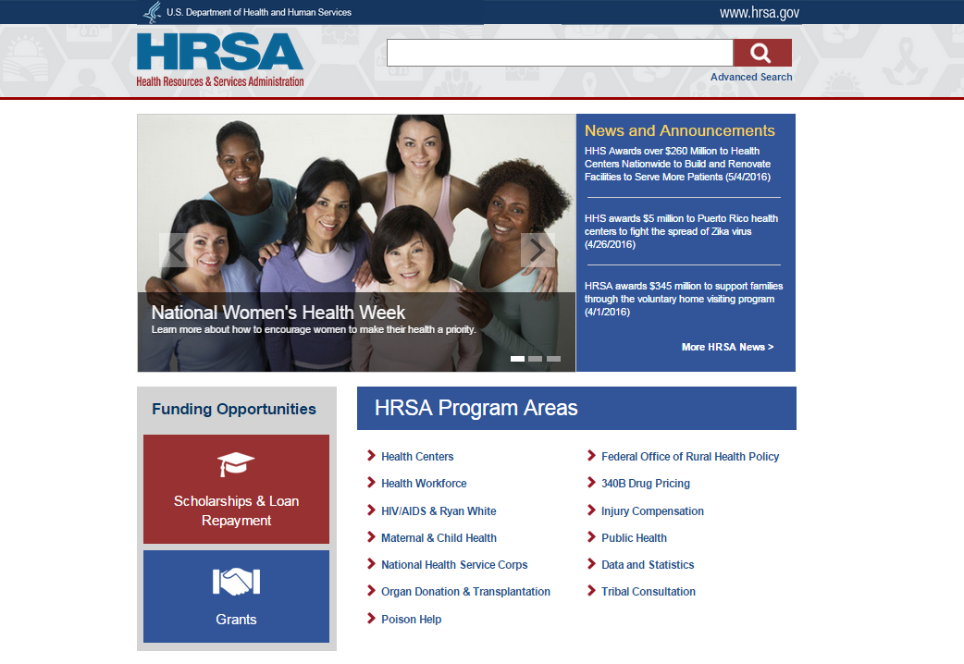
HRSA Webpage
53

Slide 54
HRSA Strategic Plan
Improve Access to Quality Care and Services
Strengthen the Health Workforce
Build Healthy Communities
Improve Health Equity
Strengthen Program Management and Operations
54

Slide 55
HRSA Goal 2: Strengthen the Health Workforce
Objective 2.1:
Advance the competencies of the healthcare and public health workforce
Objective 2.2:
Increase the diversity and distribution of the health workforce and the ability of providers to serve underserved populations and areas
55

Slide 56
HRSA Goal 3: Build Healthy Communities
Objective 3.2:
Strengthen the focus on health promotion and disease prevention across populations, providers, and communities

Slide 57
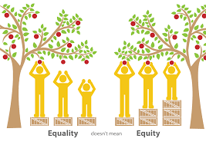
HRSA Goal 4: Improve Health Equity
Objective 4.1:
Reduce disparities in access and quality of care, and improve health outcomes across populations and communities
57

Slide 58
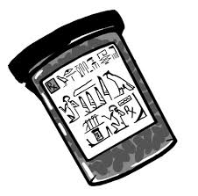
Why Literacy about Health Literacy Matters
Limited health literacy affects most adults at some point
Populations most likely to experience limited health literacy:
Adults over the age of 65 years
Racial and ethnic groups other than White
Recent refugees and immigrants
People with less than a high school degree or GED
People with incomes at or below the poverty level
Non-native speakers of English
Source: 2010 National Action Plan to Improve Health Literacy
558

Slide 59
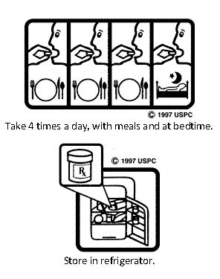
Innovative Approaches To Improve Health Literacy
Adopting User-Centered Design
Universal Precautions Approach
Targeting and Tailoring Communication
Making Organizational Changes Source: 2010 National Action Plan for Health Literacy

Slide 60
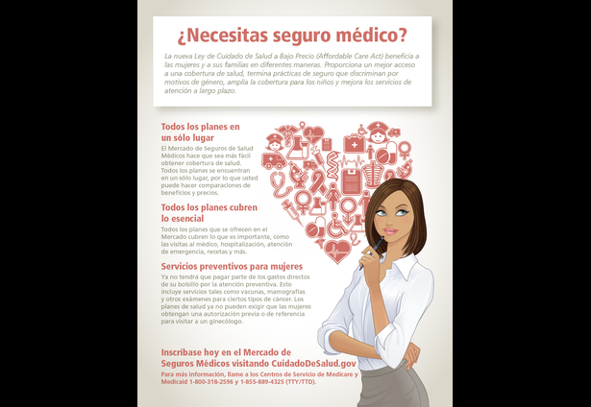
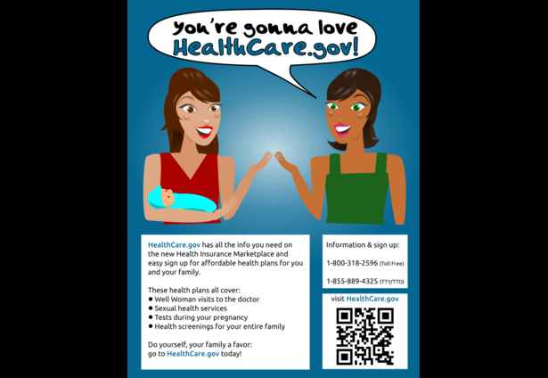
HRSA Women’s Health Care Counts Challenge

Slide 61
HRSA Regional Public Health Training Centers
61

Slide 62
HRSA HIV/AIDS Bureau
The In It Together project includes highly interactive online trainings
62

Slide 63
HRSA Support of HHS Biennial Health Literacy Action Plan
Seeking public input on information products
Using health literacy or plain language tools in creating or revising information products
Training Staff on Plain Language
Funding programs that empower people to be involved and active in their health
Performing research, implementation, and evaluation activities to improve health literacy
63

Slide 64
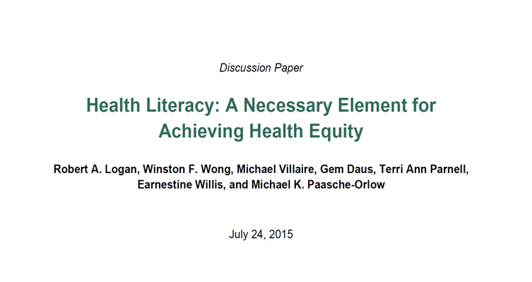
HRSA Office of Health Equity
http://www.nam.edu/perspectives/2015/Health-literacy-anecessary-element-for-achieving-health-equity

Slide 65
Summary
Health communication
Health information technology
Educational programs
Community-Based programs
65

Slide 66
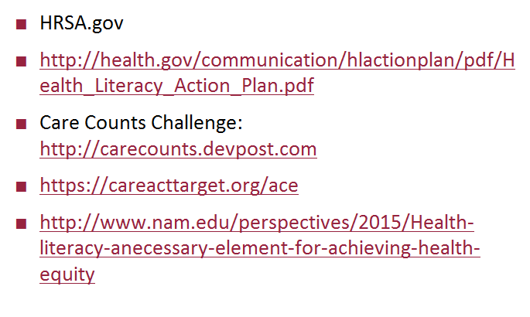
Resources
66

Slide 67
Thank You!
Sarah R. Linde, M.D.
RADM U.S. Public Health Service
Chief Public Health Officer
Health Resources and Services Administration
slinde@hrsa.gov
301-443-2216
67

Slide 68
Don Wright, MD, MPH Deputy Assistant Secretary for Health Director, Office of Disease Prevention and Health Promotion U.S. Department of Health and Human Services

Slide 69
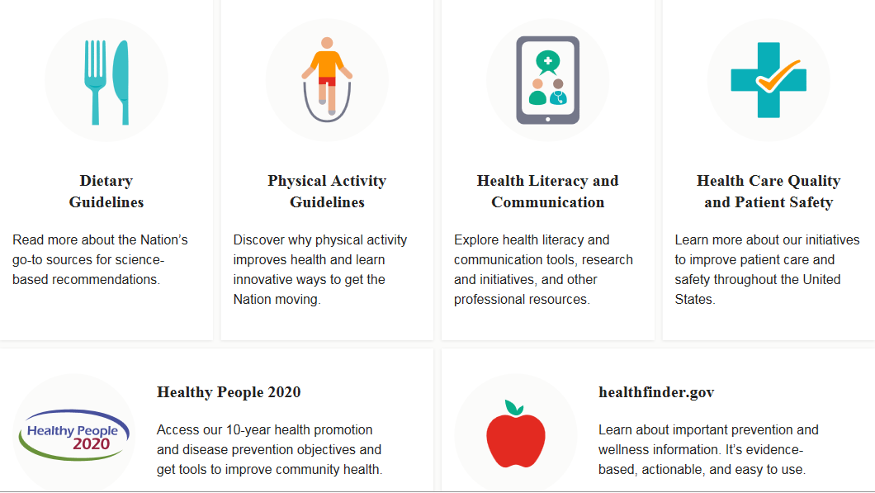
The Office of Disease Prevention and Health Promotion

Slide 70
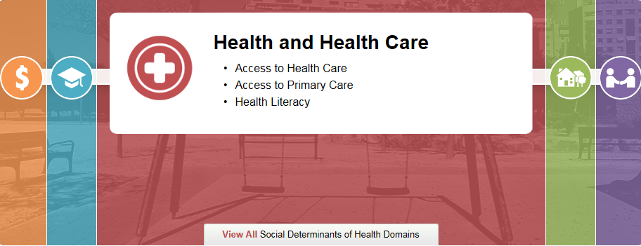
Health Communication and Health Information Technology
Goal: Use health communication strategies and health information technology (IT) to improve population health outcomes and health care quality, and to achieve health equity

Slide 71
Health Communication and Health Information Technology, Cont’d
Health Literacy Workgroup
National Action Plan to Improve Health Literacy
HHS Biennial Health Literacy Action Plan
Health Literate Care Model
National Quality Health Website Survey
Health Literacy Online
71

Slide 72
Health Literacy Workgroup
The workgroup collaborates to ensure that improving health literacy remains a priority for HHS.
The workgroup strives to:
Create understandable and actionable health information
Support and facilitate engaged and activated health consumers
Refresh the health literacy science base on a regular basis
72

Slide 73
Health Literacy Workgroup, Cont’d
Federal Collaboration
Administration for Children and Families (ACF)
Administration for Community Living (ACL)
Agency for Healthcare Research & Quality (AHRQ)
Assistant Secretary for Planning and Evaluation (ASPE)
Centers for Disease Control and Prevention (CDC)
Centers for Medicare & Medicaid Services (CMS)
Food and Drug Administration (FDA)
Health Resources and Services Administration (HRSA)
Indian Health Service (IHS)
Immediate Office of the Secretary (IOS)
National Institutes of Health (NIH)
Office of the Assistant Secretary for Health (OASH)
Office of the National Coordinator for Health Information Technology (ONC)
Substance Abuse and Mental Health Services Administration (SAMHSA)

Slide 74
National Action Plan to Improve Health Literacy
74

Slide 75
HHS Biennial Health Literacy Action Plan 2015-2017
The action plan was informed by:
HHS 2010 National Action Plan to Improve Health Literacy
Healthy People 2020 HC/HIT objectives
Results from health literacy research and evaluations funded by HHS
Input from agency leadership and staff
75

Slide 76
Health Literate Care Model
Koh, H.; Brach, C.; Harris, L.M.; and Parchman, M.L. (2013) “A Proposed ‘Health Literate Care Model Would Constitute A Systems Approach to Improving Patients’ Engagement in Care.” Health Affairs. No. 2 (357-367).

Slide 77
National Quality Health Website Survey
ODPHP led the development of objectives and targets specific to health-related websites, and their ability to:
Meet key reliability criteria (HC/HIT-8.1)
Follow established usability principles (HC/HIT-8.2)
Objectives HC/HIT-8.1 and 8.2 are measured with the National Quality Health Website Survey, which evaluates a sample of health websites using instruments to assess website information reliability and website usability
77

Slide 78
Health Literacy Online
778

Slide 79
healthfinder.gov
79

Slide 80
CDC’s Contribution to Health Literacy Improvement June 16, 2016

Slide 81
Katherine Lyon-Daniel, Ph.D. CDC Associate Director for Communication Healthy People 2020 Health Communication and Health IT Progress Review

Slide 82
CDC & Public Health Communication
Communication of accurate & timely information is 1 element of effective public health
Dr. Thomas Frieden, CDC Director, AJPH, 2014
CDC’s Office of the Associate Director for Communication (OADC) leads agency communication strategy & execution
Mission: leading customer-centered, science-based, & high-impact communication
Goals
Maximize strategic communication
Ensure CDC’s work is accessible, understandable, & actionable
Maximize public trust & credibility

Slide 83
CDC’s Communication Approach
3 of 12 OADC communication principles include health literacy techniques
Plain language works best to eliminate ambiguity in research results and health recommendations
CDC considers diverse cultural & societal values & beliefs when developing messages
CDC communication is science-based, timely, accurate, respectful, credible, & consistent
Communication expertise also is in Centers, Offices, divisions & branches

Slide 84
CDC’s Health Literacy Perspective
Health literacy results
when we bridge gaps
in communication
Health literacy techniques help professionals focus on audiences’ needs when they
- Share information with the public
- Inform the public’s health decisions
- Support protective health behaviors

Slide 85
Elements of CDC’s Approach to Health Literacy
CDC
Activities
Strategic
Plans
Healthy
People
Objectives
Plain
Writing
Act

Slide 86
CDC’s Support of HHS Health Literacy Work
Co-lead with ODPHP the HHS Health Literacy Workgroup
Co-lead with ODPHP & ONC the HP2020 Health Communication & Health IT Workgroup
Measuring the HP2020 objective on how risk information is communicated to the public
Proposed objective
Created measurement system
Providing data

Slide 87
How CDC is Promoting a Clear Communication Culture
How CDC is Promoting a Clear Communication Culture
^{Step 1: PLAN}
Who leads and participates in planning?
Does the plan explain what you will accomplish and why it’s important?
Who must approve and use the plan?
^{Step 6: REPORT}
Who is the audience for the data and what do they need to know?
How can you present the data to increase attention and lower information processing?
How will you distribute and promote the data and findings?
^{Step 2: CONNECT}
Who are the opinion leaders and gatekeepers?
Who will help implement the plan?
Who will persevere through the process?
COMMUNICATE
^{Step 5: MEASURE}
^{What is your evaluation plan?}
Which clear communication metrics do you have and which do you need to create?
How often do you need to measure?
Can you track activities and progress?
^{Step 3: TRAIN}
Who needs what types of clear communication training?
^{Who can train?}
How will you evaluate the training?
^{Step 4: PRODUCE}
Which public materials must use clear communication techniques?
Who must create and review the clear communication materials?
Will you focus on new or revise existing materials?

Slide 88
Examples of CDC’s Health Literacy Activities & Implementation
Health literacy website
CDC Clear Communication Index
Everyday Words plain language suggestions
Training and presentations
5 online health literacy courses
CDC.gov Features, Vital Signs & syndication of content
Messages in popular formats & channels
Social media
Tips from Former Smokers campaign

Slide 89
CDC’s Health Literacy Criteria
Science-based, standard clear communication criteria for developing and evaluating messages & materials
Index criteria cover
Main message, call to action, language, content organization, uncertainty
Health behaviors
Numeracy
Health risks
CDC Clear Communication Index

Slide 90
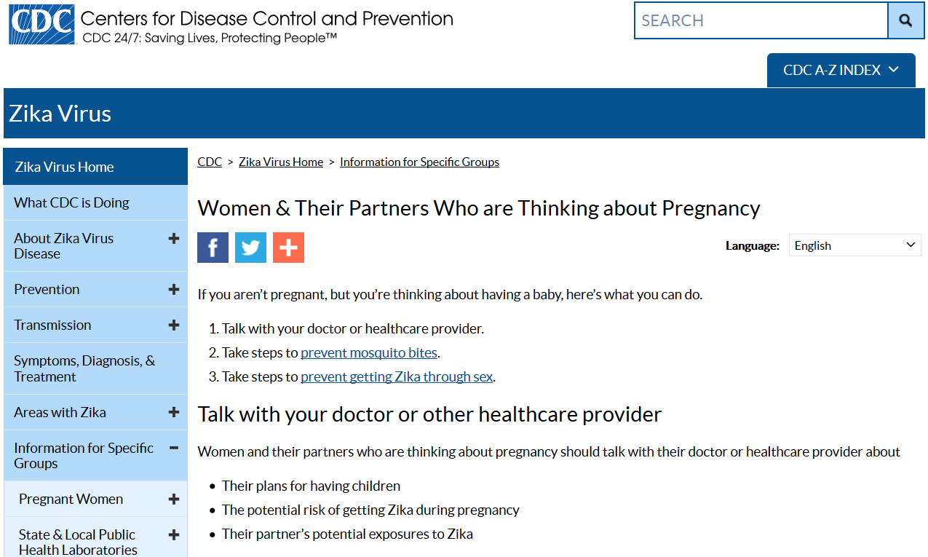
Example: Health Literacy in Practice with Zika Response

Slide 91
Next Steps
Consider how to meet the need for
plain language materials in languages other than English
formats other than printed text that people with limited literacy skills can use
audience testing of materials

Slide 92
Coco Lukas, MPH – Quality Coordinator Jane Meyer, MA – Health Education Manager
Healthy People 2020 Progress Review:
Targeting Social Influences
that Shape Health Literacy
in Communities

Slide 93
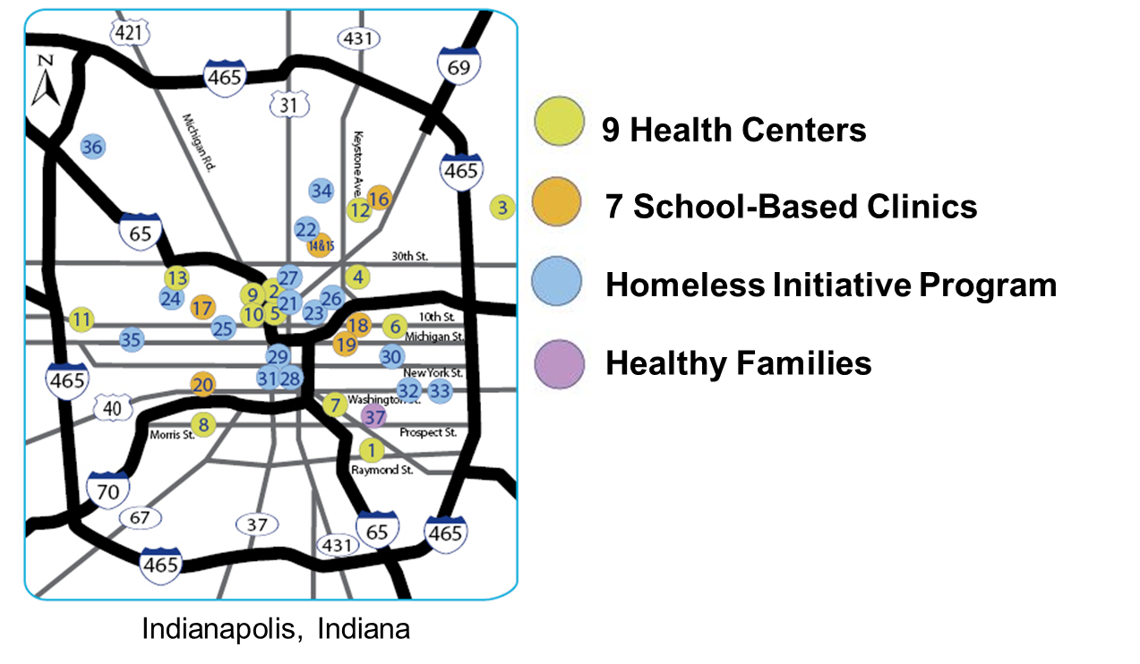
HealthNet is a Federally Qualified Health Center (FQHC)
HealthNet offers care to more than
59,000 patients each year
93
Notes:
93

Slide 94
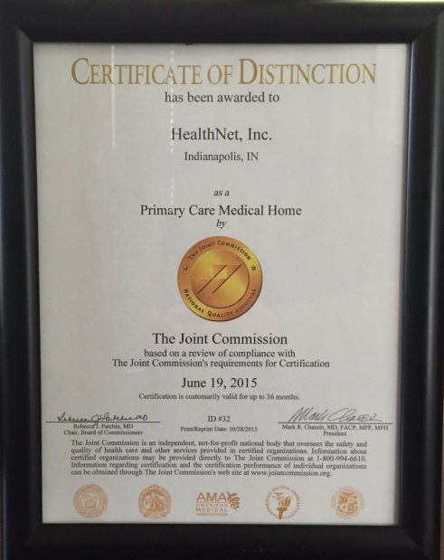
Patient-Centered Medical Home (PCMH)
­52 PCMH standards
­100% PCMH compliance at June 2015 survey
Two ­health literacy PCMH standards:
The interdisciplinary team identifies the patient’s health literacy needs
Patient education is consistent with the patient’s health literacy needs
94
Notes:
94

Slide 95
Health Literacy Universal Precautions
Anyone at anytime is at risk for not understanding their health information so we communicate in ways that everyone can understand
Why Health Literacy Universal Precautions?
You cannot tell by looking at someone
Literacy does not equal health literacy
Health literacy is situational
Everyone benefits
95

Slide 96
Health Literacy Committee
Our Purpose is to educate and support HealthNet staff and
providers
Our Tasks are to:
Educate all staff
Recognize and celebrate health literacy best practices
Simplify and improve materials
96

Slide 97
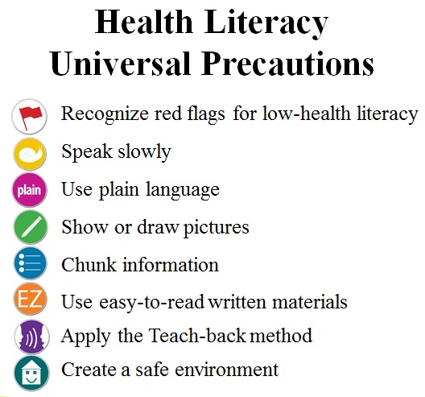
Educate All Staff
Developed training icons
New hire training
Essential annual training
97
Notes:
97

Slide 98
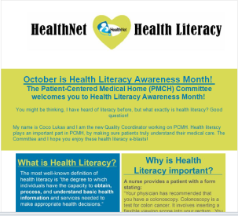
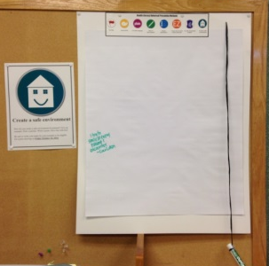
Recognize and Celebrate Health Literacy Best Practices
2013 Health Literacy Awareness Month
e-blasts to staff promoting health literacy methods: plain language, teach-back and storytelling
2014 Health Literacy Awareness Month
Visual/written depiction of how Health Literacy Universal Precaution methods are applied at each Health Center
2015 Health Literacy Awareness Month
Video highlighting the efforts of HealthNet Health Literacy Heroes
98
Notes:
98

Slide 99
Simplify and Improve Materials
99

Slide 100
Educational and Community-Based Programs
Insurance Outreach & Enrollment
Assist community with enrollment in state plans and the Marketplace
Train staff and simplify material
Healthy Families
Work with parents in their homes to build strong families
Simplify and improve participant survey
Tobacco Cessation and Nutrition
Support patients with behavior change
Develop easy-to-understand action plans and follow-up on patient progress
100
Notes:
100

Slide 101
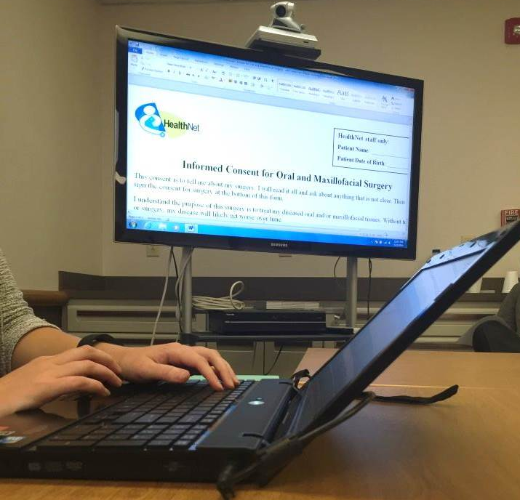
Measure of Success: Revision Inventory & Training Data
Revision Inventory
The number of plain language revisions increase yearly
Training Data
Training began in 2014
Every new hire is trained
95% of 238 new employees passed the health literacy quiz in one attempt (September 2014 – March 2016)
101
Notes:
101

Slide 102
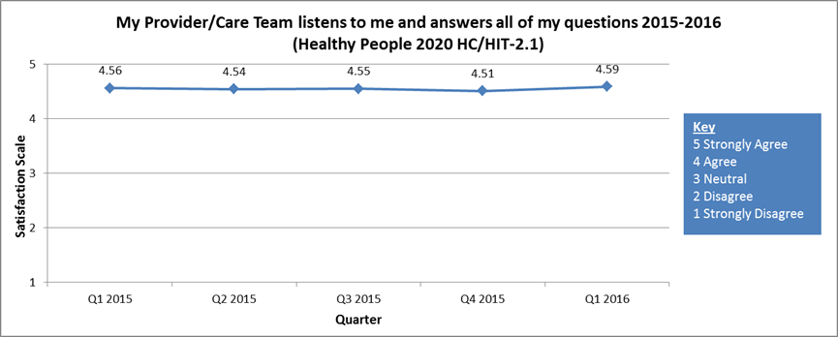
Measure of Success: Patient Feedback Trends
102

Slide 103
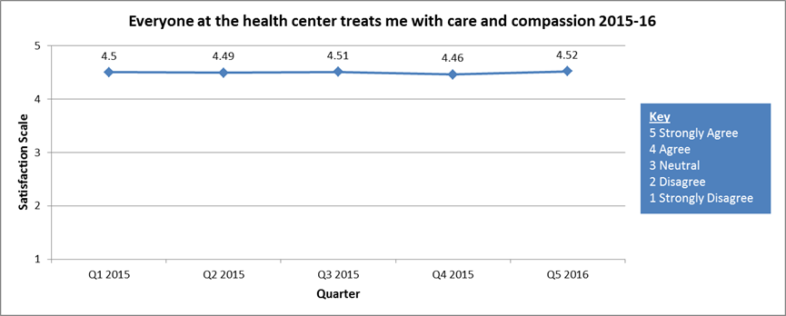
Measure of Success: Patient Feedback Trends
103

Slide 104
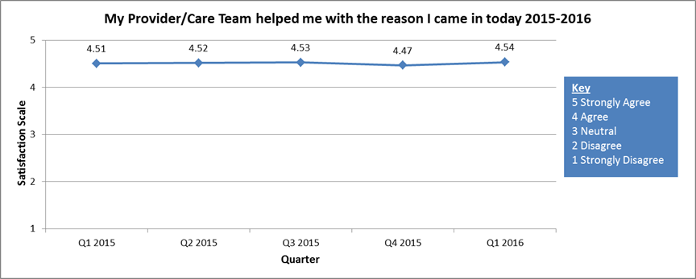
Measure of Success: Patient Feedback Trends
104

Slide 105
Opportunity for Improvement: Patient Feedback Trends
105

Slide 106
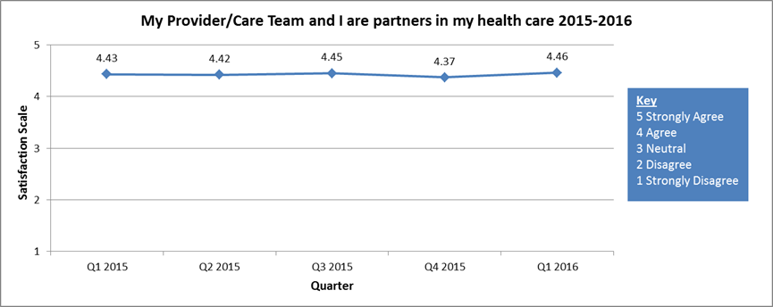
Opportunity for Improvement: Patient Feedback Trends
106

Slide 107
Our Next Steps
Patient Advisory Council
Obtain patient feedback
Patient Portal
Explain Patient Portal to patients
Clinical Measures
Link health literacy to clinical efforts
Health Literacy Month 2016
Assess staff training needs and if their needs were met
107
Notes:
107

Slide 108
Lessons Learned and Key Takeaways
Ensure your committee reflects all parts of your organization
Learn what works for your organization
Involve patients
Establish standards for written materials and communicate those with staff
Measure and track your efforts
108
Notes:
108

Slide 109
Resources
Universal Precautions Toolkit
http://www.ahrq.gov/professionals/quality-patient-safety/quality-resources/tools/literacy-toolkit/healthlittoolkit2.html
PCMH through The Joint Commission
https://www.jointcommission.org/accreditation/pchi.aspx
Contact Us
HealthNet, Inc.
(317) 957-2022
www.indyhealthnet.org
facebook.com/indyhealthnet
@indy_healthnet, @giveacareindy
Blog: GiveACareIndy.org
109
Notes:
109

Slide 110
Roundtable Discussion Carter Blakey, Deputy Director Office of Disease Prevention and Health Promotion

Slide 111
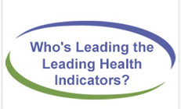
Who’s Leading the Leading Health Indictors? Webinar
Join us on Thursday, July 21st from 12:00 to 1:00 pm ET for a Healthy People 2020 Who’s Leading the Leading Health Indicators? webinar on Substance Abuse.
Registration on HealthyPeople.gov available soon
111

Slide 112
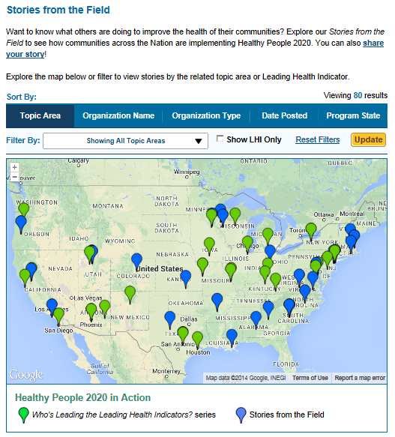
Healthy People 2020 Stories from the Field
A library of stories highlighting ways organizations across the country are implementing Healthy People 2020
Healthy People in Action
http://www.healthypeople.gov/2020/healthy-people-in-action/Stories-from-the-Field

Slide 113
Progress Review Planning Group
Audrey Williams
(CDC/ONDIEH)
Chandak Ghosh (HRSA)
Cynthia Baur (CDC/OD)
Linda Harris (HHS/ODPHP)
Victor Lazzaro (HHS/ONC)
Lana Moriarty (HHS/ONC)
Stan Lehman (CDC/OD)
Jennifer Villani (NIH/OD)
Lenee Simon (HHS/OASH)
Suzie BurkeBebee (HHS/ASPE)
Barbara Disckind (HHS/OWH)
Irma Arispe (CDC/NCHS)
David Huang (CDC/NCHS)
Leda Gurley (CDC/NCHS)
Asel Ryskulova (CDC/NCHS)
LaJeana Hawkins (CDC/NCHS)
Robin Pendley (CDC/NCHS)
Robin Cohen (CDC/NCHS)
Ninee Yang (CDC/NCHS)
Eric Jamoom (CDC/NCHS)
Carter Blakey (HHS/ODPHP)
Theresa Devine (HHS/ODPHP)
Caitie Blood (HHS/ODPHP)
Yen Lin (HHS/ODPHP)

Slide 114
Stay Connected
Web healthypeople.gov
Email healthypeople@hhs.gov
Twitter @gohealthypeople
LinkedIn Healthy People 2020
YouTube ODPHP (search “healthy people”)
Join the Healthy People Listserv & Consortium
114
Notes:
114

