Slide 1
National Center for Health Statistics Data Online Query System Overview
http://www.cdc.gov/nchs/doqs/

Slide 2
NCHS DOQS lets you run custom queries, display results in tables and charts, and export data for storing and further analysis.
Easy to use, NCHS DOQS runs in nearly all browsers and can be run without JavaScript.
Begin your query by selecting a dataset.

Slide 3
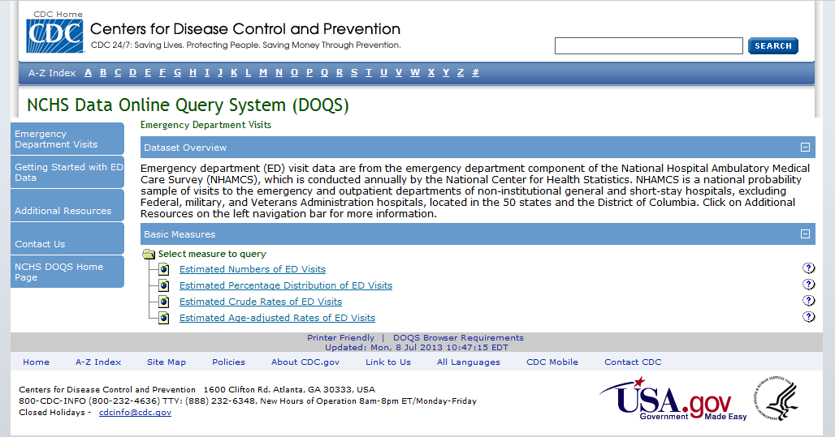
This page contains important information about using ED data with NCHS DOQS. It is recommended that all ED data users review it at least once to ensure that they understand how best to build their queries and how to correctly interpret their output.
Notes:
We should reverse the order relative to what John had before to go with the flow of building a query. If users click from the NCHS page, they will get to here first, so we should have this page here. We’d like to encourage them to look first at Getting Started with ED Data. Add text to the caption something like this: Click first on Getting Started with ED Data for important information about the data and building a query.

Slide 4
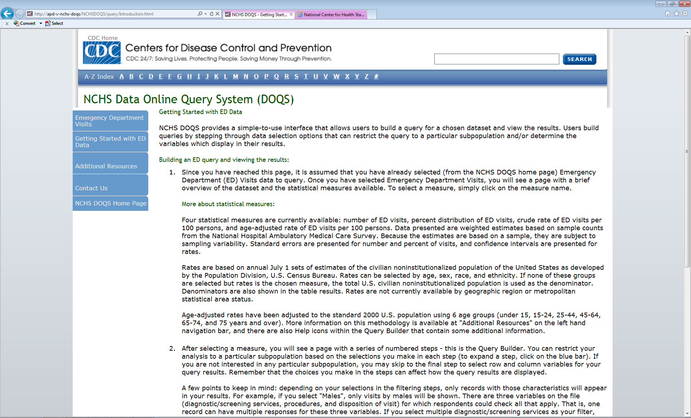
This page contains valuable information about mistakes to avoid when building your query, available statistical measures, proper citation of data, etc.
When you have finished reviewing Getting Started with ED Data, return to Emergency Department Visits to start building your query.

Slide 5
Next, select the measure you wish to explore. In our first example, we wish to find the annual number of ED visits by age and sex for 2008. Begin by selecting Estimated Numbers of ED Visits.

Slide 6
Before you run your first query, you must agree to the NCHS DOQS Data Use Agreement.
Notes:
This will need to have a new screen capture.

Slide 7
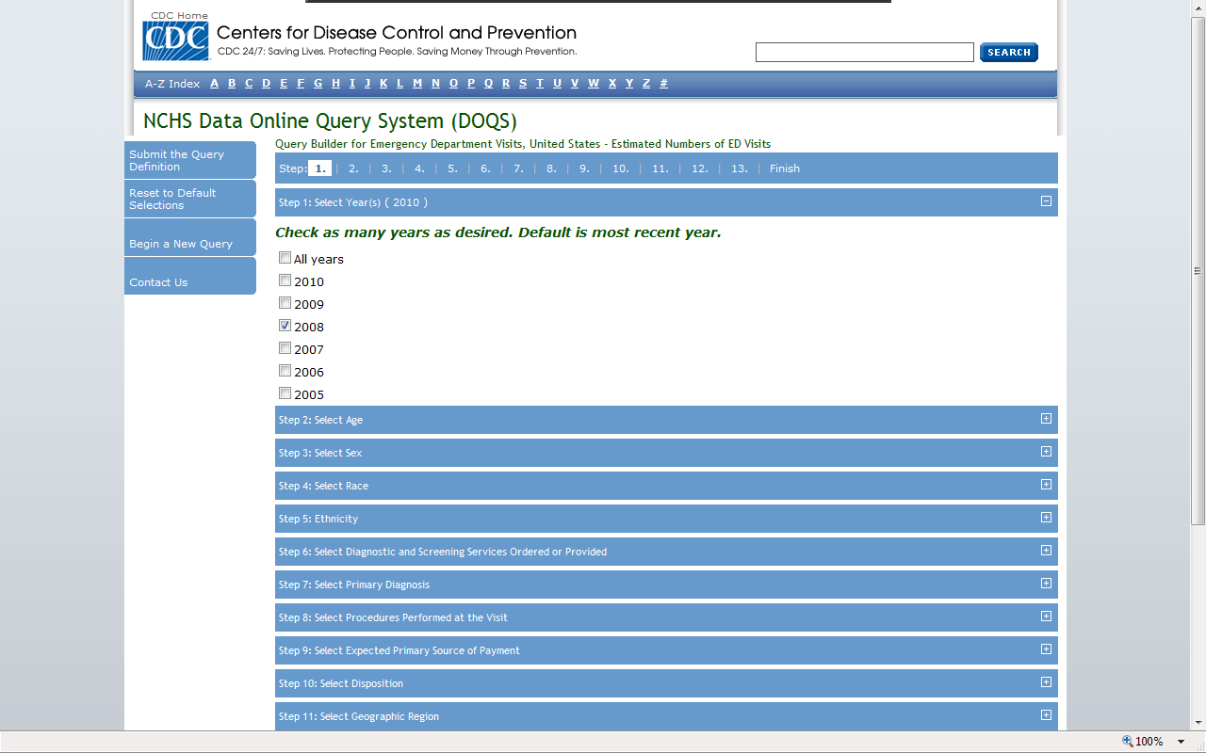
Example 1
It is important to note that Steps 1-12 are only necessary if you want to LIMIT your selections to certain subpopulations. In our example, we want 2008 data for males and females. So, we begin by making selections in Step 1.
Step 1: You can select any or all years of data - the default is the most recent year. If all years are selected, estimated numbers of visits returns cumulative totals, not multi-year averages. Select 2008.

Slide 8
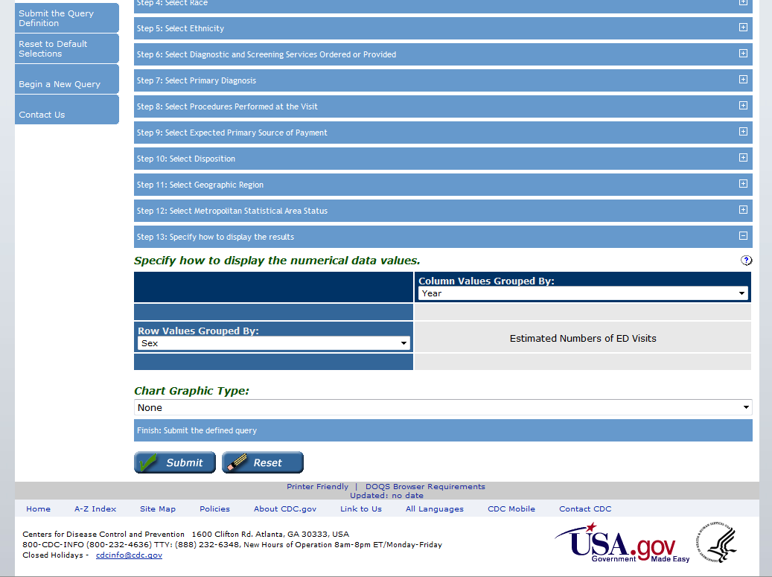
Example 1 (cont.)
Since we want data for both males and females, we don’t need to use Step 3 to restrict our selection to one or the other. Instead, just scroll down to Step 13 where you can specify how you would like to display the results of your query.
Step 13: Select Sex as the row variable and Year as the column variable. The default age group is the 6 standard age groups used in many NCHS reports
When you are ready, click Submit to run the query.

Slide 9
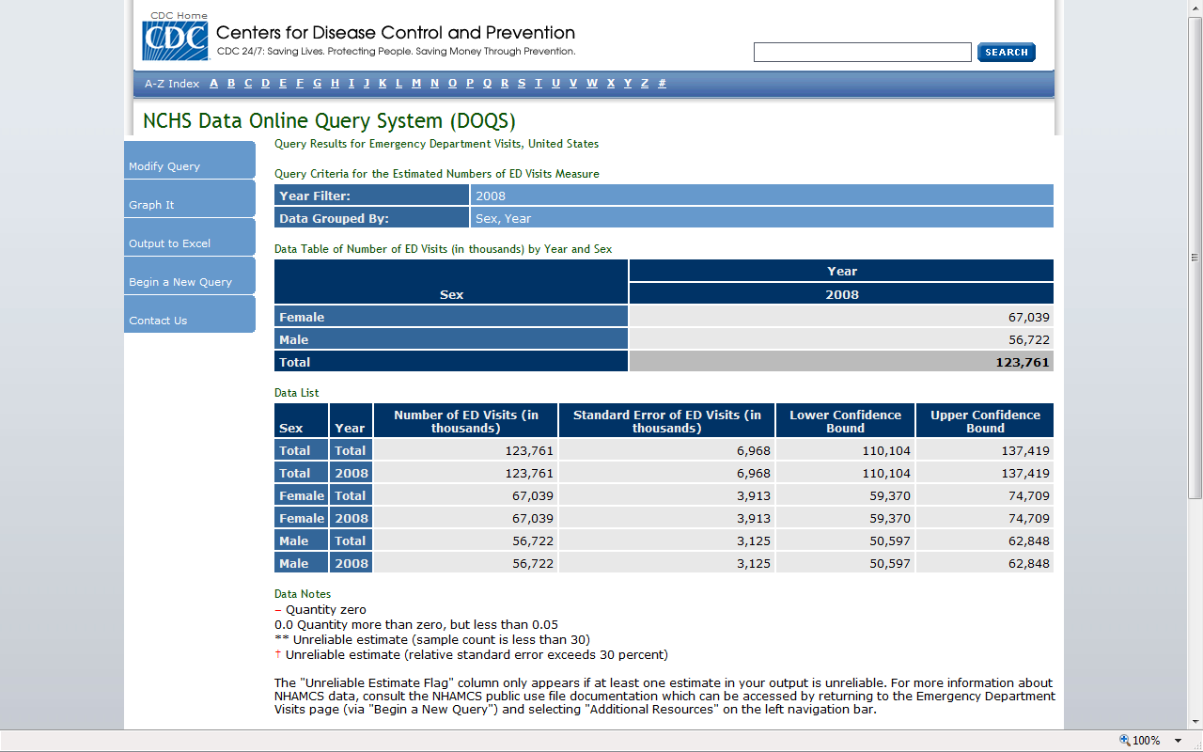
Output from Example 1 Query

Slide 10
You can go back and revise your selections for Steps 1-13 by selecting Modify Query.
If you would like to build a new query using a different measure, select Begin a New Query.

Slide 11
In our second example, we want to find the percent distribution of ED visits for persons under 18 years of age by expected primary source of payment for 2007-2008. Begin by selecting Estimated Percentage Distribution of ED Visits.
Notes:
It’s after this screen that the Agreement should be shown.

Slide 12
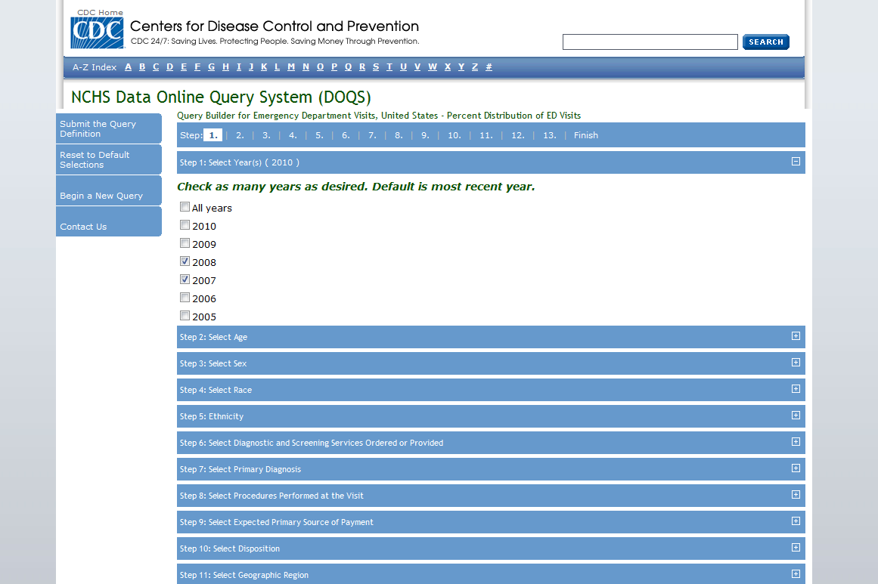
Example 2
Step 1: Select 2007 and 2008 , which will give us a bigger sample size and more reliable estimates.
Notes:
It’s after this screen that the Agreement should be shown.

Slide 13
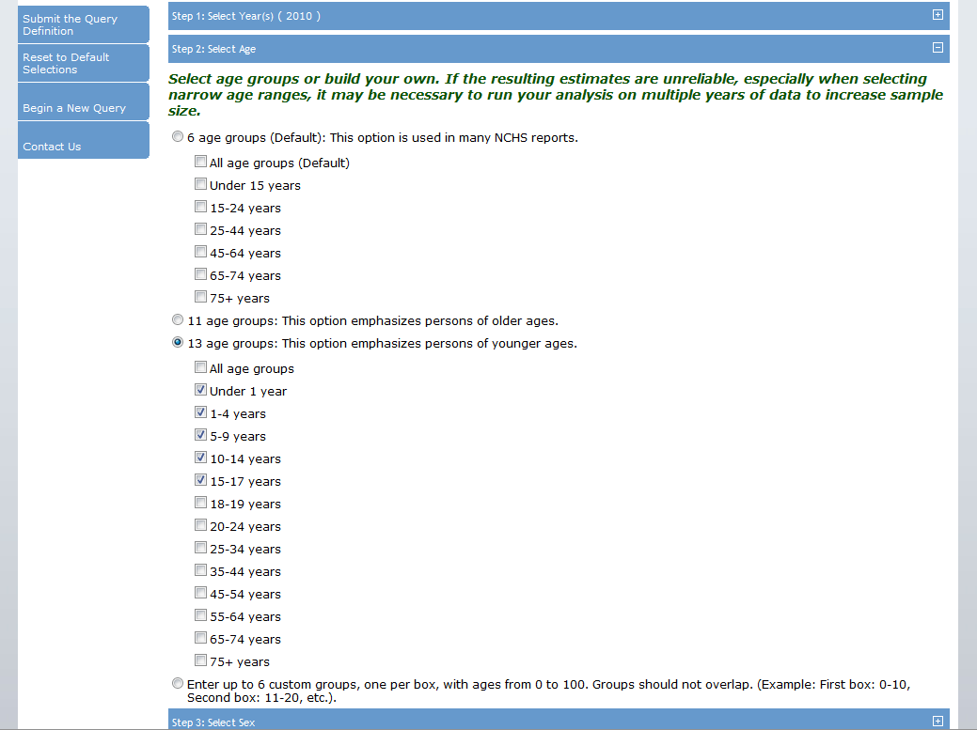
Example 2 (cont.)
Step 2: Select the 13 age groups category variable and select all age groups under 18 (i.e. Under 1 year, 1-4 years, 5-9 years, 10-14 years, 15-17 years).
Notes:
It’s after this screen that the Agreement should be shown.

Slide 14
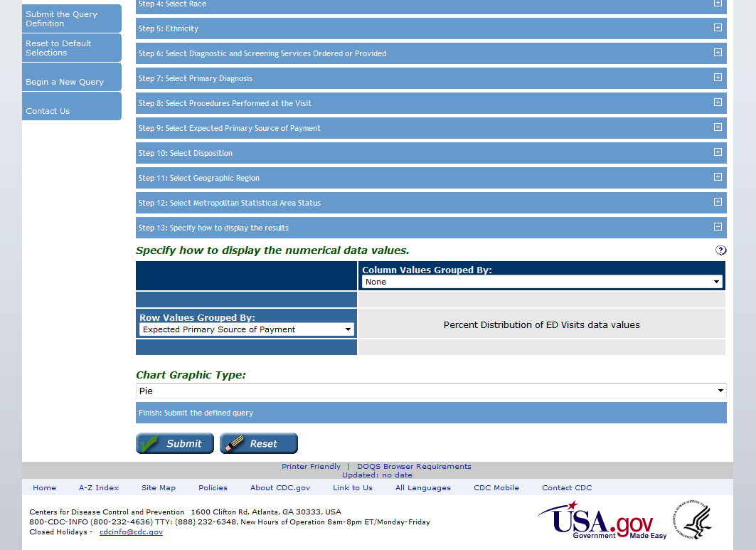
Example 2 (cont.)
Step 13: Select Expected Primary Source of Payment as the row variable. Note that we are looking for results for ages under 18 as a group, so it is not necessary to select Age Group as a row or column variable. In the Chart Graphic Type dropdown menu, select Pie.
Click Submit when you are finished.
Notes:
It’s after this screen that the Agreement should be shown.

Slide 15
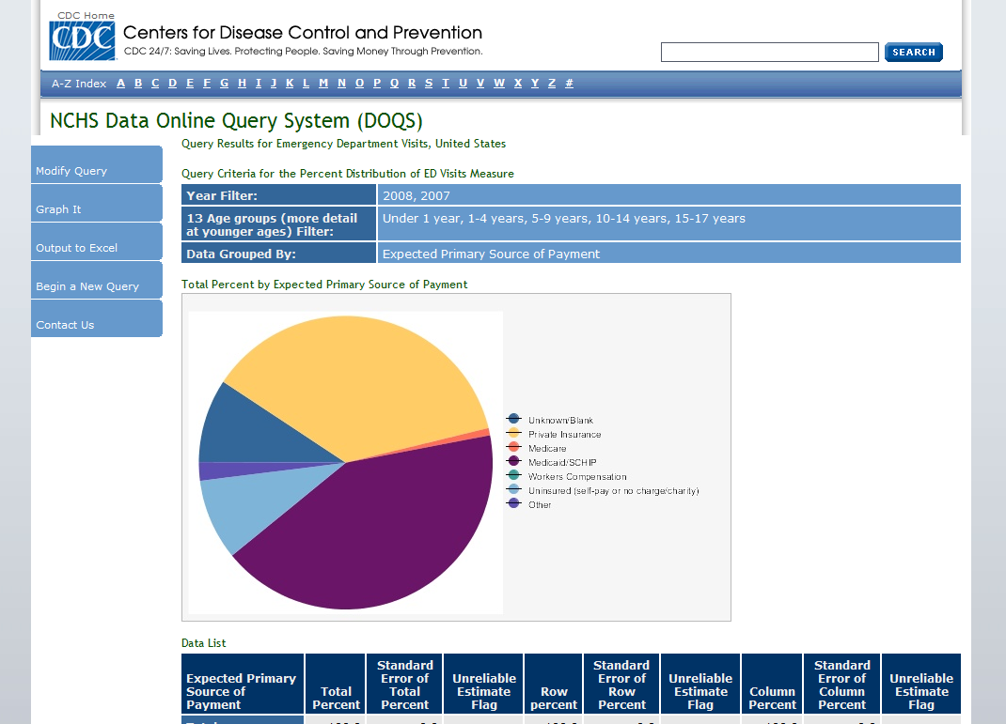
Output from Example 2 Query

Slide 16
In our third example, we want to find the annual rate of injury-related ED visits by persons 65 years and over for 2005-2010. Begin by selecting Estimated Crude Rates of ED Visits.
Notes:
It’s after this screen that the Agreement should be shown.

Slide 17
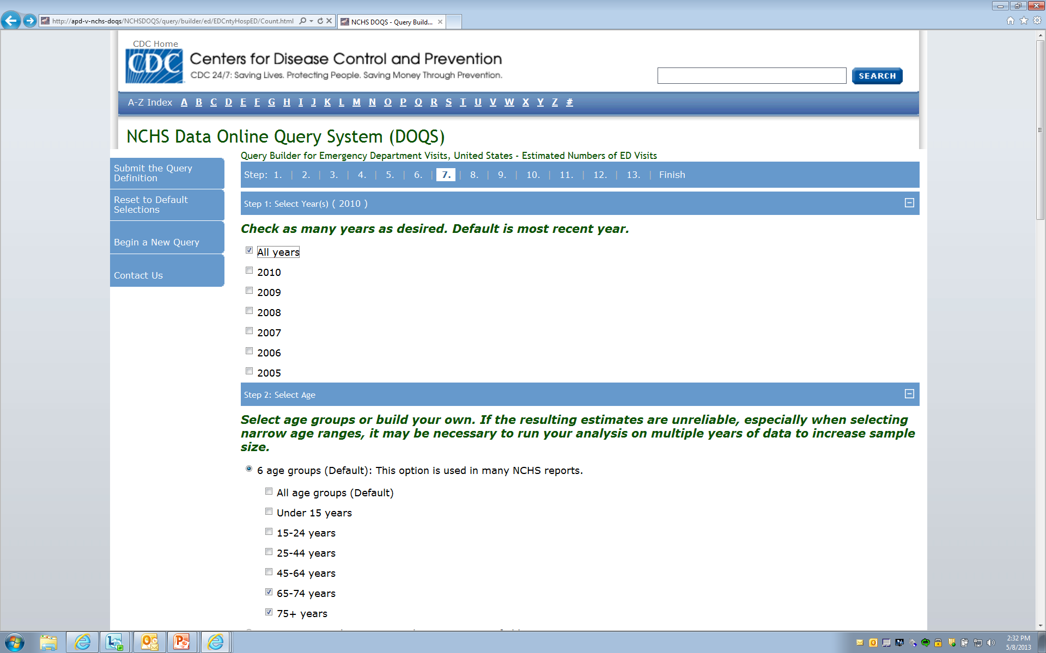
Example 3
Step 1: Select All years of data.
Step 2: Select age groups 65-74 years and 75+ years from the 6 standard age groups.

Slide 18
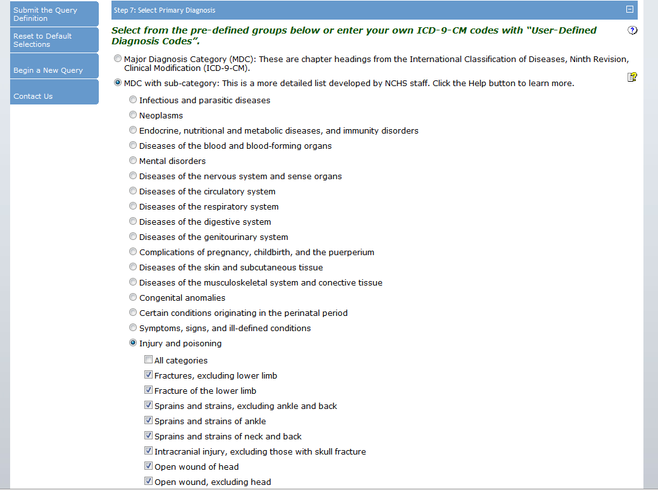
Example 3 (cont.)
Step 7: Select MDC with sub-category, then Injury and Poisoning, then check the first 11 boxes to get just the injury diagnoses. (Or enter a custom range for Primary diagnosis using the boxes provided.

Slide 19
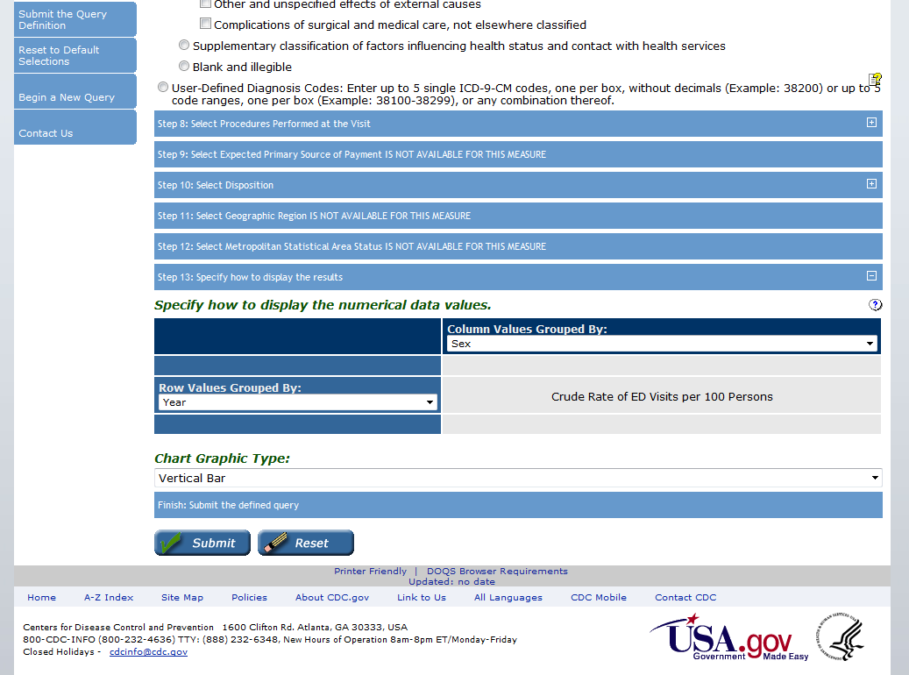
Example 3 (cont.)
Step 13: Select Age Group as the row variable and Year as the column variable. Select Vertical Bar as the chart graphic type.
When you are finished, click Submit.

Slide 20
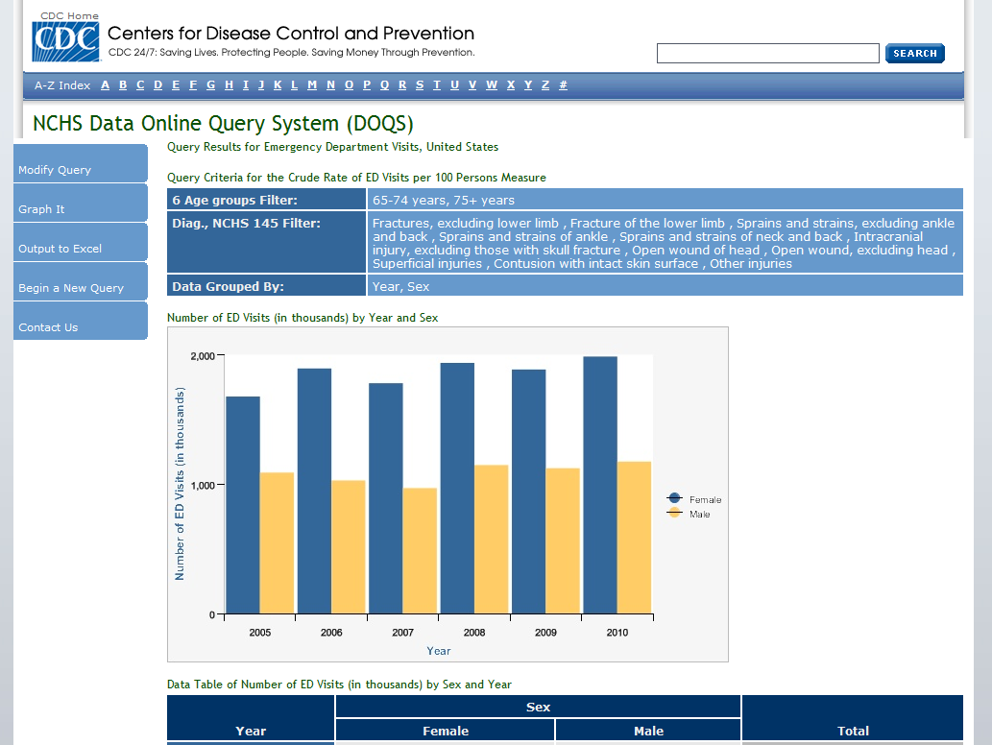
Output from Example 3 Query

Slide 21
In our last example, we want to find the age-adjusted rate of ED visits for chest pain for males and females in 2005 and 2010. Begin by selecting Estimated Age-adjusted Rates of ED Visits.
Notes:
It’s after this screen that the Agreement should be shown.

Slide 22
Example 4
Step 1: Select 2005 and 2010.
Notes:
It’s after this screen that the Agreement should be shown.

Slide 23
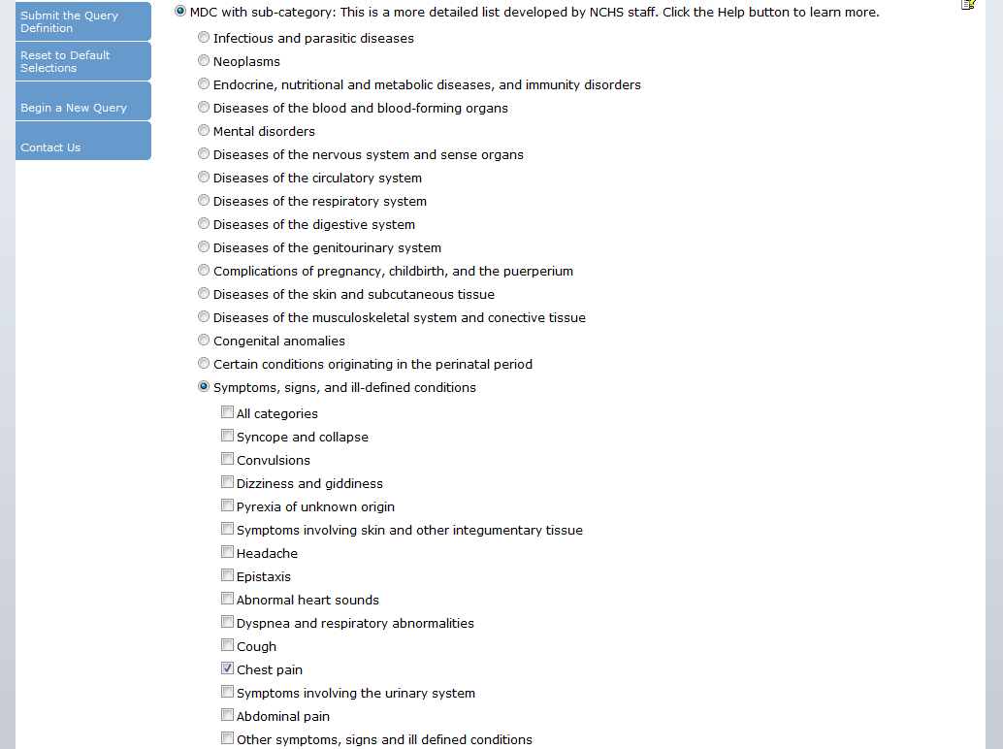
Example 4 (cont.)
Step 7: Select Chest Pain using the MDC with sub-category option. Click on Symptoms, Signs and Ill-Defined Conditions, then click on Chest Pain.
Notes:
It’s after this screen that the Agreement should be shown.

Slide 24
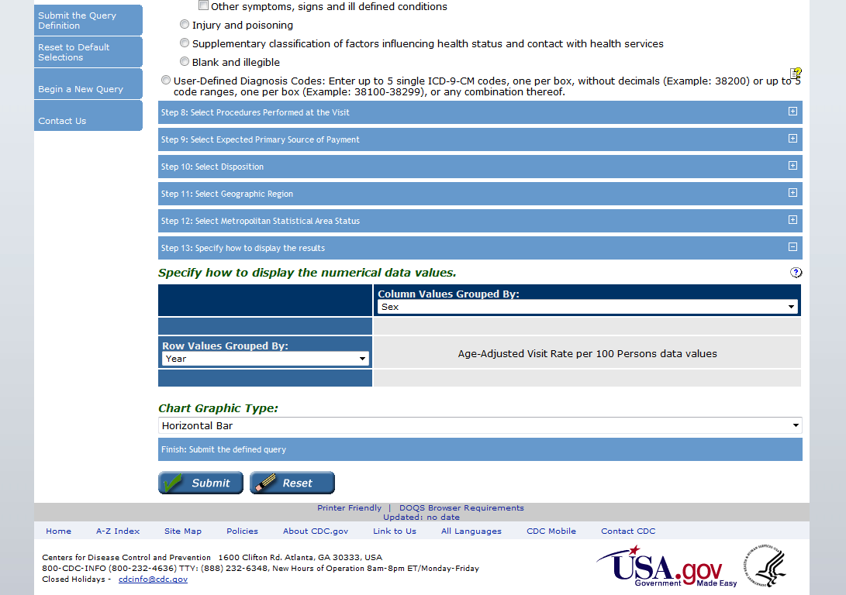
Example 4 (cont.)
Step 13: Select Year as the row variable and Sex as the column variable. By selecting Year, your table will show separate results for 2005 and 2010. If you had not selected Year, an estimate reflecting the combination of the two years would be displayed. For Chart Graphic Type, select Horizontal Bar.
When you are finished, click Submit.
Notes:
It’s after this screen that the Agreement should be shown.

Slide 25
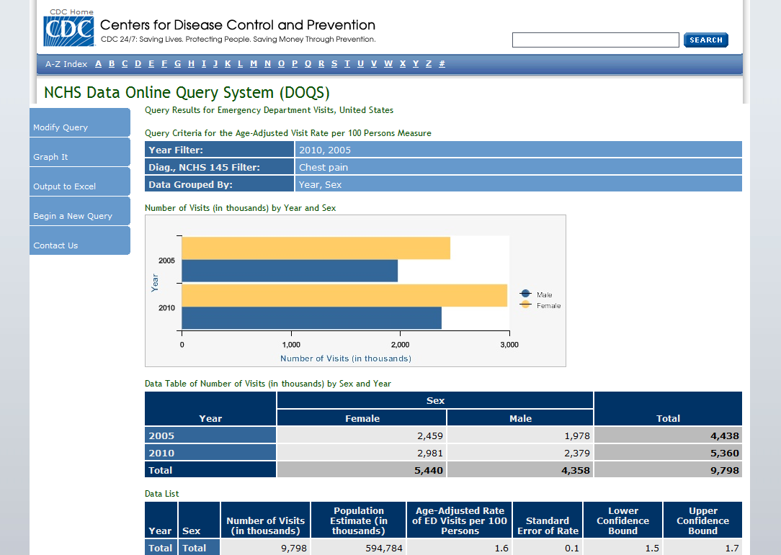
Output from
Example 4 Query

Slide 26
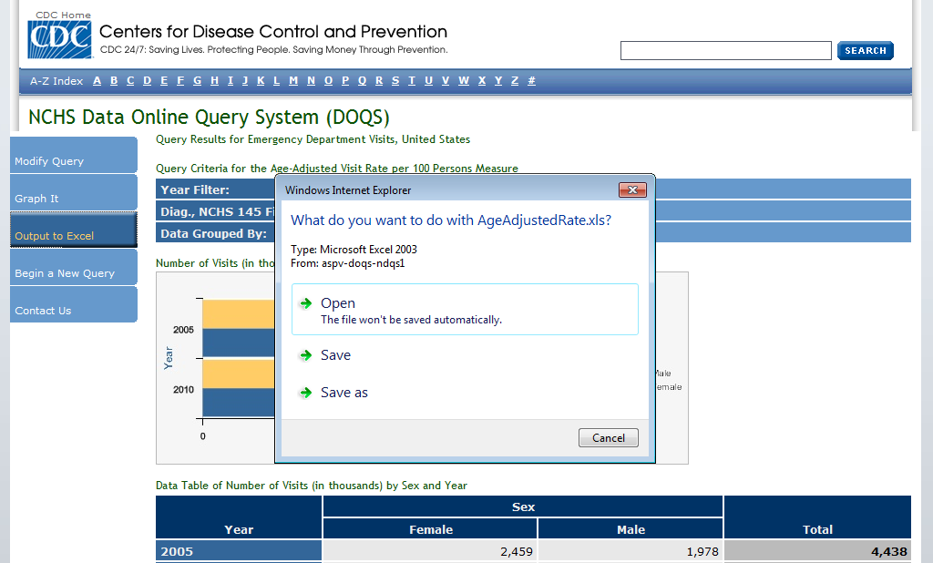
Once you complete your query, you can save it in Excel by selecting Output to Excel.

Slide 27
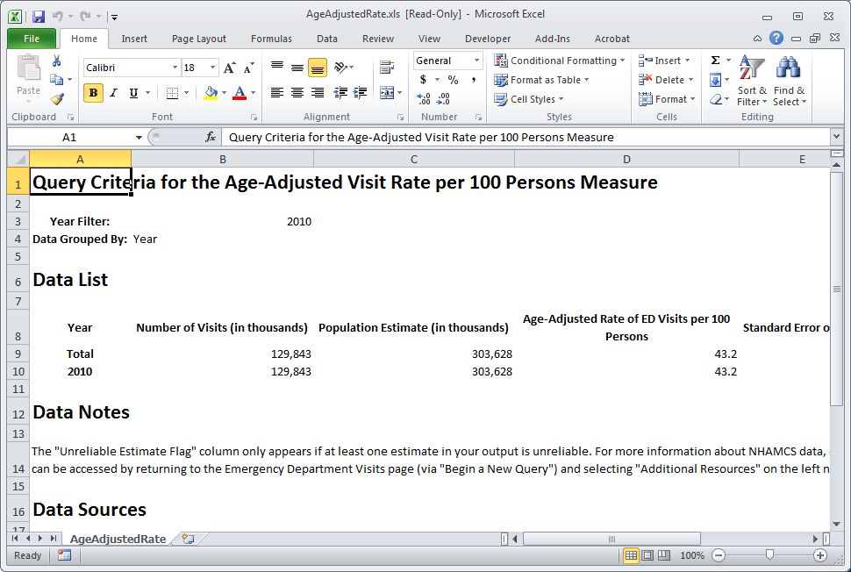
You can save the spreadsheet to your hard drive or network, save the data as a CSV file for importing into other statistical software, and take advantage of Excel’s expanded graphing capabilities.

Slide 28
We welcome your feedback!
Please visit the Contact Us page to send any questions or comments about the data, the application, and your overall experience with NCHS DOQS.

Slide 29
Thank you for using NCHS DOQS!

