Slide 1
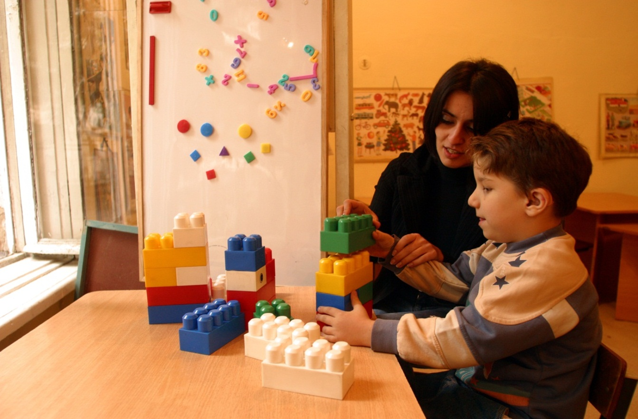
UNICEF’s work and planned activities on the measurement of child disability Claudia Cappa, PhD,
Statistics and Monitoring Section, UNICEF, NY

Slide 2
Objectives
Update on UNICEF’s current and future activities on child disability measurement:
UNICEF’s global database of child disability
Data collection work

Slide 3
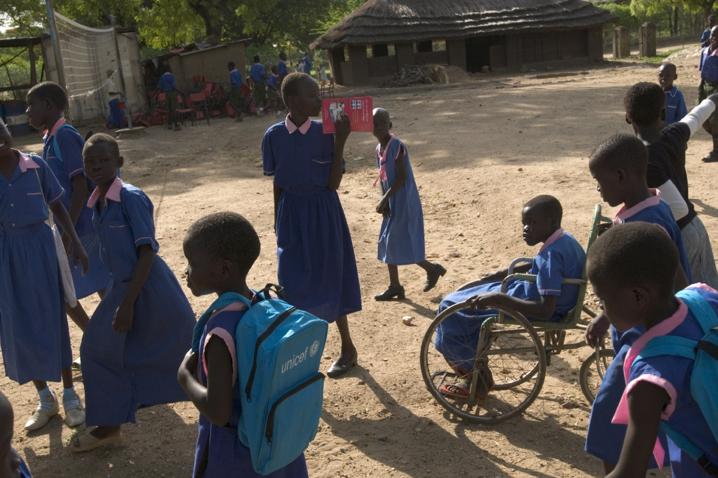
UNICEF’s global database on child disability

Slide 4
Overview of UNICEF’s global database on child disability
Includes reported estimates, indicators, definitions, questionnaires, methodology used, and any other available supporting documentation
More than 600 data sources found (household surveys or censuses)
Data were identified for 187 countries with a population coverage of more than 90% (180 with data on children)
170 countries with data both for children and adults
More than 400 data come from censuses
Oldest data source found = 1830

Slide 5
Review of prevalence studies
Reported prevalence rates vary from less than 1% to more than 50%
Different classifications, definitions and questionnaires
Outdated/offensive language and definitions
No survey designed to cover the whole population of disabled children = same questionnaire used in most cases for both adults and children
Data sources limited by age, and place of residence and other background characteristics

Slide 6
Dissemination
Next issues of UNICEF’s flagship publication, The State of the World’s Children (SOWC), will include a text box summarizing the main finding of this data compilation work
Article for publication in a peer-reviewed journal

Slide 7
Some example of questions

Slide 8
Ireland Population and Housing Census, 1901
Is he/she [all household members]:
Deaf
Dumb
Blind
Idiot
Imbecile or lunatic

Slide 9
Bolivia Demographic and Health Survey, 1997
Does [any child aged 6-17] have any of the following extreme physical impediments?
Mentally retarded
Deaf
Mute
Blind
Paralyzed
Crippled

Slide 10
Pakistan, Population and Housing Census, 1998
God forbid, is there any disabled person in the household? If so, state the nature of disability:
Blind
Deaf/Dumb
Physical handicapped
Mentally retarded
Multiple disabled
Insane
Others

Slide 11
Tanzania Population and Housing Census, 2002
Is he/she [all members of the household]:
Not disabled
Physically handicapped/leprosy
Visually impaired
Dumb
Hearing/speech impaired
Albino
Mentally handicapped
Multiple handicapped

Slide 12
How questions affected prevalence: The case of Uganda
Do you have difficulty seeing, hearing, walking, etc?
Does (name) have any difficulty in moving, seeing, hearing, speaking or learning, which has lasted or is expected to last 6 months or more?
Is anyone in the household disabled?

Slide 13
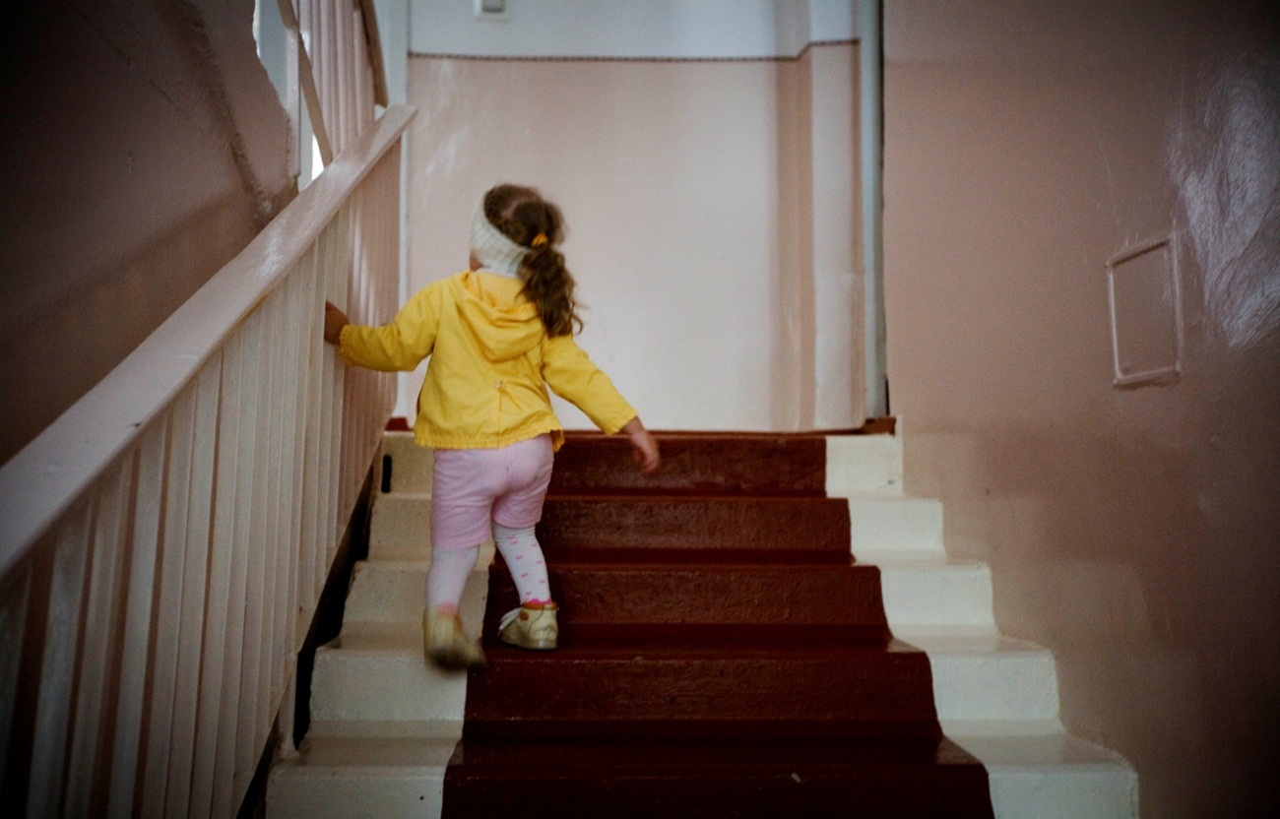
UNICEF’s work in the area of data collection

Slide 14
Rationale for measuring child disability
Information on the number and status of children with disabilities is needed to monitor on a population level the impacts of:
Improvements in child survival and the potential that these are accompanied by increases in the prevalence of child disability
Childhood exposures to nutritional deficiencies, environmental toxins, infectious diseases and trauma
Facilitate planning/monitoring of services and interventions designed to improved child wellbeing
Monitor and improve participation & quality of life
Equalization of opportunity for all children

Slide 15
UNICEF’s contribution
Support LAMI countries to develop their own disability statistics program and strengthen countries’ capacity to gather sound, relevant and comparable data on child disability

Slide 16
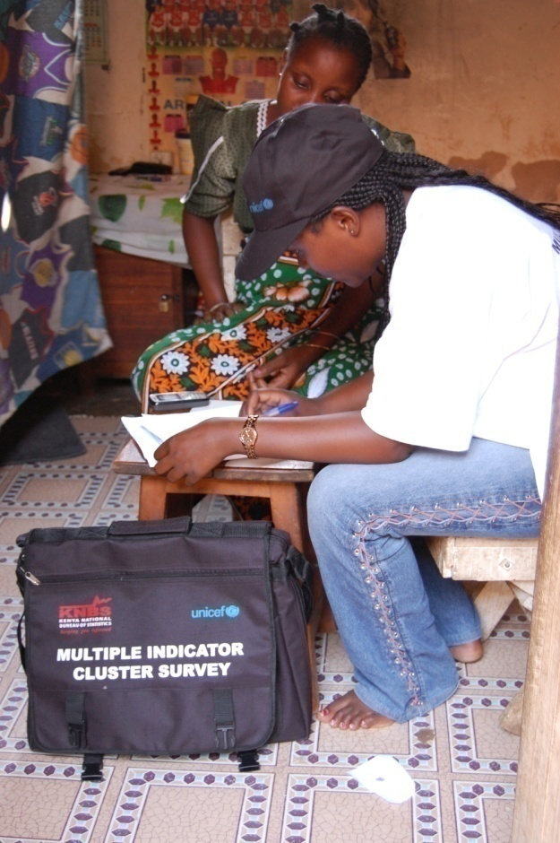
UNICEF’s support for data collection: the Multiple Indicator Cluster Surveys (MICS)

Slide 17
MICS: main characteristics
Household surveys designed to collect data on children and women and to provide evidence base for improved policy formulation and programme planning
Key data source for monitoring the MDGs, the World Fit for Children goals, and other major international commitments
More than 100 indicators (nutrition, child health, mortality, child protection, education, HIV, etc.)
Data available by background characteristics (sex, ethnicity, wealth, education, etc.), and at the national and subnational level
Harmonized with DHS
With DHS, largest source of comparable data on children and their families in the developing world

Slide 18
MICS rounds
Three rounds of MICS surveys completed since 1995
MICS1 (1995-1996)
MICS2 (2000-2001)
MICS3 (2005-2006)
Current activities:
MICS4 conducted mainly 2010-2012 in 64 surveys
Planning phase for MICS5 (2013-2014)

Slide 19
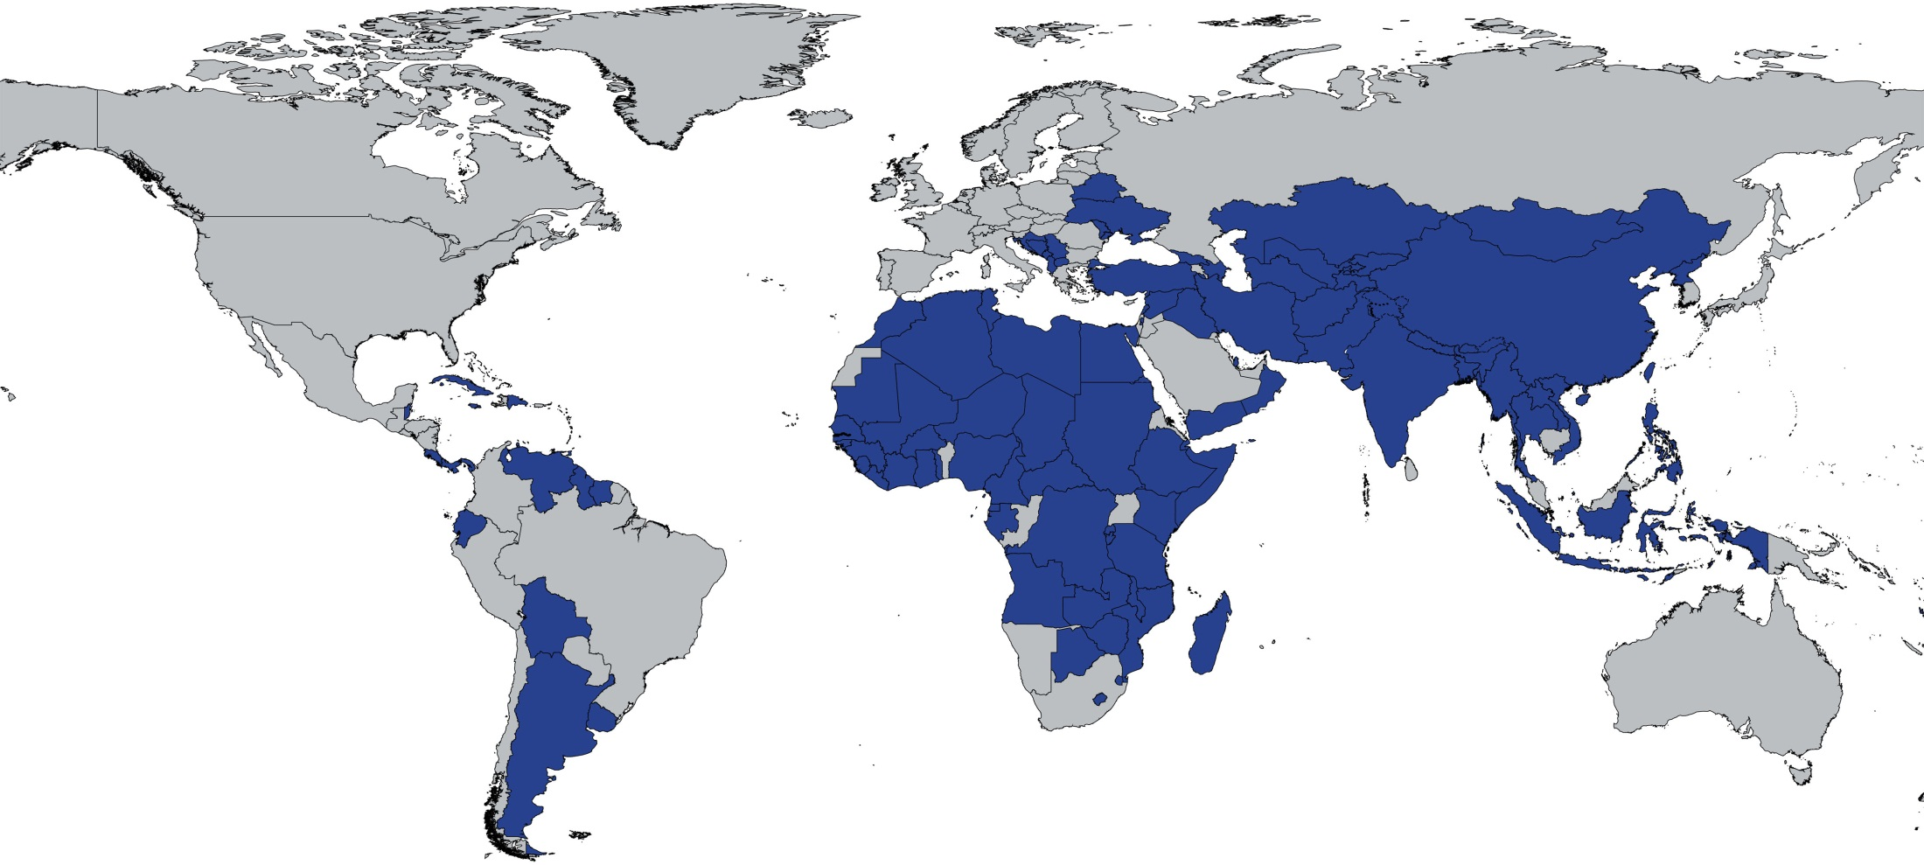
Multiple Indicator Cluster Surveys (MICS) Since 1995, more than 100 countries and more than 230 surveys*
Average sample size: around 10,000 households (994 – 102,000)
*Countries with at least one MICS survey, including sub-national as well as ongoing surveys as of January 2012

Slide 20
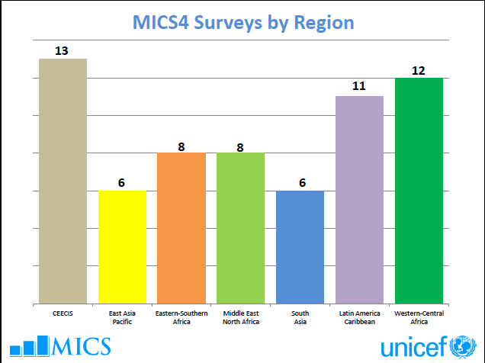

Slide 21
MICS methodology
Survey tools
Developed by UNICEF after consultations with relevant experts from various UN organizations as well as with interagency monitoring groups.
Implementation and capacity building
Surveys carried out by government organizations (with involvement of different ministries), with the support and assistance of UNICEF (HQ, RO and CO) and other partners
Technical assistance and training provided through regional workshops (questionnaire content, sampling and survey implementation, data processing, data quality and data analysis, and report writing and dissemination)
Implementation, including sample size determination, sample-stratification variables vary across countries and decisions about which modules to include is done at the country level

Slide 22
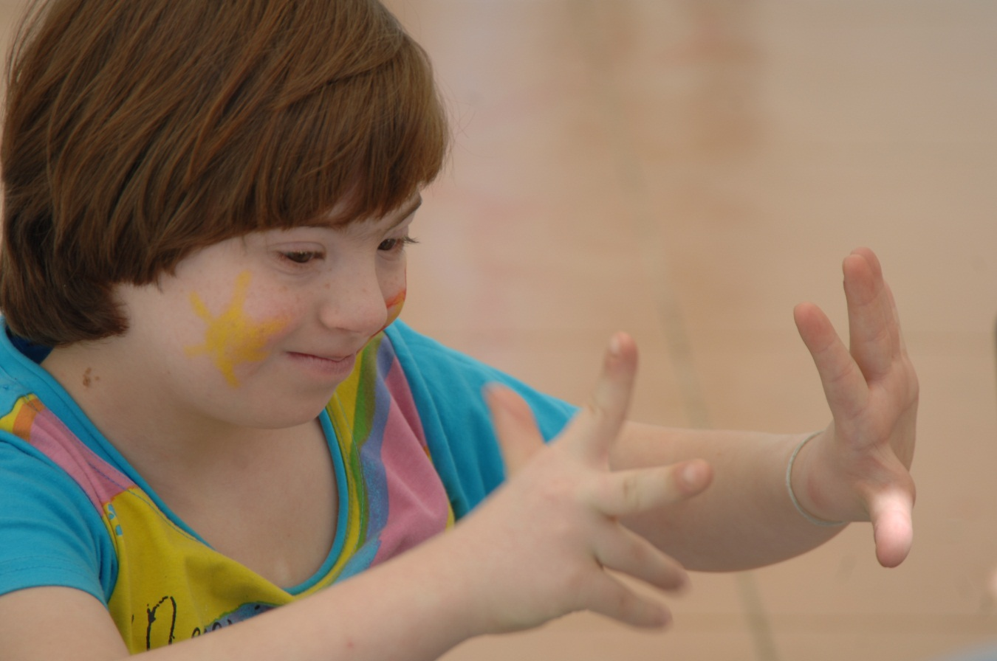
Child Disability in MICS

Slide 23
Child disability in MICS
MICS 2 (2000-2001), 22 countries collected data on child disability.
MICS 3 (2005-2006), 26 countries collected data on child disability, using the same standard set of questions (TQ)
- module administered in 19 written languages
MICS 4 (2010-2012), 6 countries (completed) as of October 2012
MIC 5 = Planning stage with methodological revisions being introduced

Slide 24
Methodological innovations - Part 1
New draft questionnaire developed in partnership with the Washington Group on Disability Statistics
The primary purpose of the questionnaire is to identify the sub-population of children that are at greater risk than the children of the same age of experiencing limited social participation due to functional limitations
Questionnaire can be included in any data collection effort as individual module

Slide 25
Rationale for revising the first-stage screening
Need to:
Avoid a medical approach
Use the ICF bio-psycho-social model
Strengthen the focus on activity limitations
Expand the age group
Consider age specificity when constructing questions
Include additional functional domains
Introduce changes in wording and terminology
Introduce changes in response categoriesto reflect the continuum of disability

Slide 26
Selected Domains
Seeing
Hearing
Mobility
Self-care
Communication
Learning
Emotions, behaviour, attention
Coping with change
Relationships
Playing

Slide 27
Methodological innovations – Part 2
Development of a standardized methodology/guidelines for follow-up assessments, based on existing best practice approaches for the evaluation of disability in children in developing countries
Objective: to validate data and collect additional information on the child, and his/her environment (including additional questions on participation, access to services, family life etc)
Methodology can be part of a stand alone survey or be used as second stage follow-up after a screening tool

Slide 28
Objectives of the second stage assessment
Assessment for specific domains of interest:
Mobility / motor, vision, hearing, communication, developmental / behaviour and learning
Functional limitations in broader environment
Physical, social, political, financial environments
Help with daily activities
Unmet needs
Follow-up and treatment for children in need

Slide 29
Content of the guidelines
Methodological package to include:
assessment tools
instructions
training program/materials
analysis plan and reporting template
minimum qualifications for the field team
ethical codes
protocols
procedures for follow-up

Slide 30
Processes and partnerships
Team of experts mobilized, including :
UNICEF Team in NY (1 survey coordinator, 2 survey specialists, 2 data processing experts, 2 data analysis experts, Disability Unit)
MICS coordinators in the regional and country offices
Washington Group on Disability Statistics
External partners (selected academics, NGOs and international organizations)
Some 30 international experts as contributors to the guidelines and 50 reviewers
Two international consultations (June 2012, June 2013)
Guidelines, tools and training materials to be tested and finalized in 2013

Slide 31
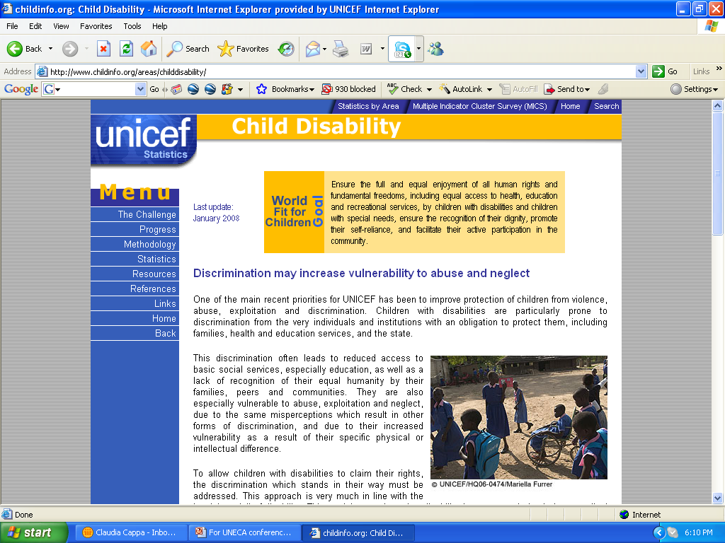

Slide 32
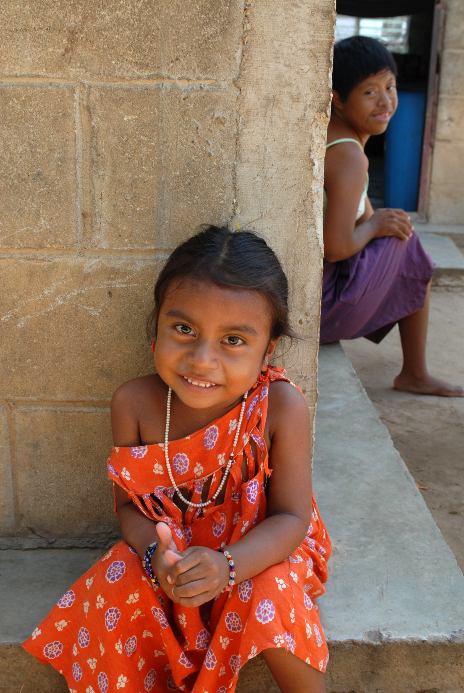
Thank you!
ccappa@unicef.org

