Slide 1
Saudi National Disability Registry
Mohammed AlJumah Sultan AlMubarak
On behalf of the Saudi Disability Registry Group
KACST and MoSA

Slide 2
Contents
Introduction about Saudi Arabia
Population
Geography
Disability Status in Saudi
Some Data from WHS
Perceived Challenges
Saudi National Registry
Rational
Structure
Milestone
Documentary presentation

Slide 3
Saudi Arabia – Key Facts
Saudi Arabia
Area | 2,149,690 sq. km
Natural resources | Petroleum, natural gas, iron, gold & copper
Population (Million) country comparison to the world: 47 Life Expectancy: 74.58 years Population Growth: 2.7% / Year | 28.79 million Urban population: 82.3% Expatriates: 5.5m
Age Structure
2%
≥ 65
24%
40-64
31%
14 -39
43%
0 -14

Slide 4
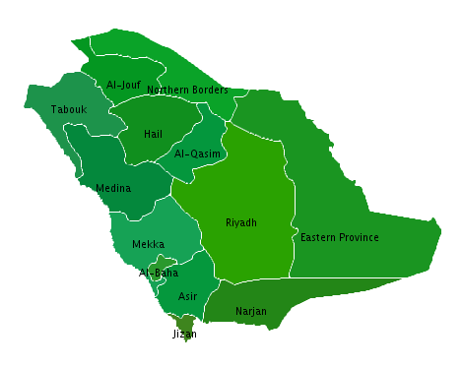
Saudi Arabia – Demography
13 Provinces
150 Cities
More than 2000 villages
Vast distances between cities
Saudi Arabia has an homogeneous population in that the people share common linguistic, religious and cultural values

Slide 5
Saudi Arabia – Regional Distribution of Population
East
Arar
North
Tabuk
Hail
Jubail
Buraidah
Madinah
Dhahran
12%
West
Jeddah
Dammam
13%
Riyadh
13%
34%
Makkah
16%
25%
Central
Abha
South West
Jizan
Najran

Slide 6
Saudi Arabia – Key Facts
Economic Overview

Slide 7
Status Of Disability Data In KSA
No single source of national data for disability in KSA
No formal data collection approach for the country
Very Limited publications have addressed prevalence of disability in KSA
In 2007, MOH commissioned the national world health survey as part of the WHO international campaign.
Despite its limitation of being non disability specific survey, The WHS presented the first opportunity to get an estimate figures on the prevalence of disability in KSA

Slide 8
WHS Questionnaire Structure & Analysis
Total of 8 self reported questions on Mobility, Self Care, Pain and Discomfort, Cognition, interpersonal activities, vision, sleep and energy affect.
Questions are on 5 points LIKERT scale (ranging from Non to Extreme), asking the patients how they felt about each of the above domains in the past 30 days.
A subject was considered disabled if he/she has answered any of the questions with “Severe”, or “Extreme”

Slide 9
WHS items involved in assessing disability

Slide 10
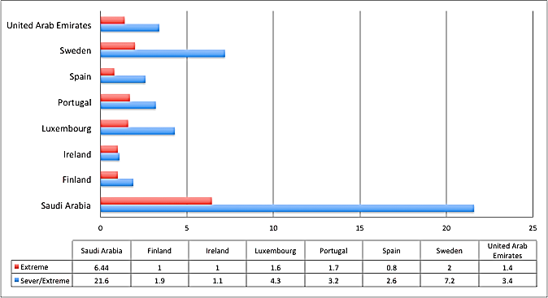
Prevalence of Disability IN KSA is Considerably higher than that of other high income countries
Prevalence of Subjects reported Extreme or Severe/Extreme Difficulties in one or more domains

Slide 11
In KSA, the Patterns of Disability Severity level Differs Between Males and Females
 | Men (n=2852; Weighted n=6,810,881.8) or % (SE) | Women (n=2947; Weighted n=7,086,101.6) % (SE)
Severe/Extreme Disability | 16.21(0.86) | 26.78 (1.07)
Extreme Disability | 5.08(0.49) | 7.76 (0.58)
Source: Ministry of Health, Saudi Arabia 2007 WHS Survey

Slide 12
Prevalence of Extreme Disability is higher among older age groups.
 | N | Weighted N | No | Yes
Age
≤19 Years | 326 | 758,352 | 96.96(1.20) | 3.04(1.20)
20-29 Years | 1708 | 4,079,240.8 | 96.03(0.57) | 3.97(0.57)
30-39 Years | 1491 | 3,635,929.4 | 96.56(0.65) | 3.44(0.65)
40-49 Years | 1048 | 2,505,355.4 | 96.72(0.61) | 3.28(0.61)
50-59 Years | 582 | 1,422,294.3 | 91.19(1.32) | 8.81(1.32)
60-69 Years | 343 | 814,935.6 | 85.86(2.15) | 14.14(2.15)
>70 Years | 301 | 680,869.8 | 61.39(3.11) | 38.61(3.11)
Source: Ministry of Health, Saudi Arabia, 2007 WHS Survey

Slide 13
At older Age Women have Twice the Prevalence of Extreme Disability Compared to Men in the Same Age Group
 | N | Weighted N | No | Yes
Male
≤19 Years | 168 | 377,797.4 | 96.29(2.04) | 3.71(2.04)
20-29 Years | 797 | 1,893,415.6 | 97.91(0.62) | 2.09(0.62)
30-39 Years | 647 | 1,595,906.4 | 98.55(0.61) | 1.45(0.61)
40-49 Years | 580 | 1,363722.1 | 97.61(0.71) | 2.39(0.71)
50-59 Years | 304 | 726,991.9 | 94.02(1.47) | 5.98(1.47)
60-69 Years | 184 | 451,930.7 | 90.47(2.58) | 9.53(2.58)
>70 Years | 172 | 401,111.6 | 62.64(4.35) | 37.36(4.35)
Female
≤19 Years | 158 | 380,554.6 | 97.62(1.27) | 2.38(1.27)
20-29 Years | 911 | 2,185,825.2 | 94.41(0.93) | 5.59(0.93)
30-39 Years | 844 | 2,040,023 | 95.01(0.96) | 4.99(0.96)
40-49 Years | 468 | 1,141,633.3 | 95.65(1.04) | 4.35(1.04)
50-59 Years | 278 | 695,302.4 | 88.24(2.22) | 11.76(2.22)
60-69 Years | 159 | 363,004.9 | 80.12(3.61) | 19.88(3.61)
>70 Years | 129 | 279,764.3 | 59.60(4.83) | 40.40(4.83)
Source: Ministry of Health, Saudi Arabia, 2007 WHS Survey

Slide 14
Disability Population
 | N=5799 (Weighted N=13,896,983.4), % (SE)
 | None | Mild | Moderate | Severe | Extreme
Mobility
Moving Around | 78.17 (0.68) | 11.99(0.52) | 6.19 (0.38) | 3.15 (0.29) | 0.50 (0.10)
Vigorous Activities | 63.58(0.92) | 15.23 (0.60) | 9.01(0.48) | 8.25 (0.45) | 3.92(0.29)
Self care
Self care | 91.41(0.43) | 5.21 (0.35) | 2.04(0.20) | 1.02(0.15) | 0.32(0.08)
Appearance | 91.60 (0.43) | 4.71(0.33) | 2.49(0.23) | 0.87(0.13) | 0.33(0.08)
Pain and Discomfort
Bodily Pain | 67.03(0.84) | 19.68(0.64) | 8.26(0.44) | 4.76(0.36) | 0.27(0.08)
Bodily Discomfort | 68.00(0.84) | 19.14(0.64) | 8.58(0.46) | 3.74(0.32) | 0.54(0.12)
Cognition
Memory | 75.44(0.75) | 15.72(0.60) | 6.25(0.38) | 2.37(0.23) | 0.21(0.08)
Learning | 76.60(0.75) | 14.06(0.58) | 5.36(0.37) | 3.03(0.28) | 0.95(0.15)
Source: Ministry of Health, Saudi Arabia

Slide 15
Implication Of Disability In KSA
2012 Survey report of Central Department of Statistics and Information, Saudi Arabia : 143,000 people above the age of 15 who are out of labor due to disability.
MoSA Registered beneficiary for the financial support is approximately 400,000 person with disability.

Slide 16
Social Services in Saudi Arabia
Ministry of Social Affairs

Slide 17
Social Service Programs address
The unemployed
Persons with disabilities
Widows and widowers
Females with no living family members to support them
Orphans
Families of those serving custodial sentences
Victims of natural disasters
Disability resulting form occupational hazards

Slide 18
Saudi Arabia Healthcare

Slide 19
Saudi Arabia – Key Facts
Healthcare
Healthcare & Social Development Budget 2013: USD 23.1 b. (+26%)
Total expenditure on health as % of GDP | 5.0%
Total expenditure on health per Capita | $ 1,150
Physicians Density Physicians (All Sectors): 66,014 | 0.94 physicians/1,000 population
Nursing | 129,792
Hospital Bed Density | 2.2 beds/1,000 population
Obesity - adult prevalence rate Country comparison to the world:19 | 35%
Diabetes – adult prevalence rate | 20%
Chronic Kidney Disease Prevalence | 9.3%

Slide 20
Saudi Arabia – Healthcare Segments
Saudi Healthcare System
Government sector (free)
Private sector (fee)
The Ministry of Health
Independent Government Bodies

Slide 21
Saudi Arabia – Governmental Sector
Healthcare
Referral hospitals (e.g. King Faisal Specialist Hospital and Research Center)
Ministry of higher education hospitals (teaching hospitals)
Royal commission for Jubail and Yanbu health services
Security Forces Medical Services
Army Forces Medical Services
National guard health affairs
ARAMCO hospitals

Slide 22
Challenges
limited preexisting epidemiological data
Wide geographic area
Large Number of independent stakeholder
Wide variability of connectivity of stakeholder
Unclear ownership of the Disability Registry

Slide 23
SAUDI NATIONAL DISABILITY REGISTRY

Slide 24
Objective
To create a database in the form of a national registry, that would
Provide vital information to the organizations catering to persons with disabilities
Aid in the provision of necessary services for this population
Allow information on persons with disabilities to be registered or to add information about persons with disabilities

Slide 25
The Role of the National Registry
No Centralized Data Hub
No National standards for Disability classification
No Coordination between benefits provider
Reliable data for better planning and equitable benefits distribution.
Employ national standards for disability classification
Platform for coordination between various stakeholders.
National Registry For People With Disability

Slide 26
Approach for Developing National Registry for People with Disability
The road map for developing the national registry
Feasibility Study
Call for Proposal
Implementation
& Deployment
Monitoring & Improvement
Initial Assessment
Selection of measurement tools
Develop Technical measurement.
Develop request for proposal.
Call for proposal
Review of technical and financial offers.
Selection of vendors and awarding the project
Development of the national registry
Initial pilot and assessment.
Role out of the final deployment of the national Registry.
Continuous monitoring.
Improve current registry according to feedback and trends

Slide 27
Action Plan
Creation of the team and drafting of the action plan
Engagement of Stake holders
Planning for collection of data and information
Questionnaire
Pilot testing
Final questionnaire
Standardization and Training

Slide 28
Action Plan (cont…)
Preparation of the organizational structure of the administrative and technical
Examination and study of different managerial and technical structures, local and international
Identification of detailed components for specific models of the administrative and technical structure for national records for disability
Benefit from consultation services, national, regional and international

Slide 29
Action Plan (cont…)
Establishment of equipment and facilities
Identification of technical requirements
Establishment of equipment and facilities
Data center
Main Office
Training for staff
Questionnaire/data gathering
Technical
Administrative

Slide 30
Data Source for the Registry
Interview
Questionnaire designed for the registry
Integration of the Washington Group Extended Set of Questions (WG ES-F)
Online input of data

Slide 31
Overview of Questionnaire
Demographic data
Modified Washington Group Extended Set on Functioning (WG ES-F)/ ICF Based Disability Component
Clinical/ Medical Background
Current diseases (ICD-10 Classification)
Current Medication
Exercise
Smoking
Alcohol Intake
Substance abuse
Reproductive function

Slide 32
Overview of Questionnaire (Cont…)
Disability Related Component
Financial Support
Other Types of Support
Respondent’s Perception of Current Support He/She Receives
Interview details
Who conducted the interview
Date
Respondent
Person with disability himself/herself
Guardian/other representative
Both

Slide 33
Approach for Developing National Registry for People with Disability
The road map for developing the national registry
Feasibility Study
Call for Proposal
Implementation
& Deployment
Monitoring & Improvement
Initial Assessment
Selection of measurement tools
Develop Technical measurement.
Develop request for proposal.
Call for proposal
Review of technical and financial offers.
Selection of vendors and awarding the project
Development of the national registry
Initial pilot and assessment.
Role out of the final deployment of the national Registry.
Continuous monitoring.
Improve current registry according to feedback and trends

Slide 34
Progress To date
Activities/Milestones
Status
Situation and Stakeholders analysis
Completed
Review of Available disability measure tools
Completed
Translation and Validation of ICF to Arabic
Completed
Develop Data collection and Analysis Protocol
Completed
Develop Human Resources Plan
Completed
Develop budget estimate
Completed
Develop Request for Proposal
Completed

Slide 35
National Registry Process
Registration & Validation
Benefit Request
Reporting and Planning
MOSA
Case Registration
Benefits Request
NDR
Validate Eligibility
Benefit Provider

Slide 36
Impact of The Registry
Stake Holder
Beneficiaries
Implications
MOSA
Persons with Disability
Universal Access to services
Ease of access to benefits
Awareness of the following : legislation , rights of persons with disabilities, and current programs for persons with disabilities
MOE
National Registry
MOH
Decision Makers
Reliable data for planning
Internationally-comparable data
Platform for information dissemination
Accurate reflection for the resources utilization
Others

Slide 37
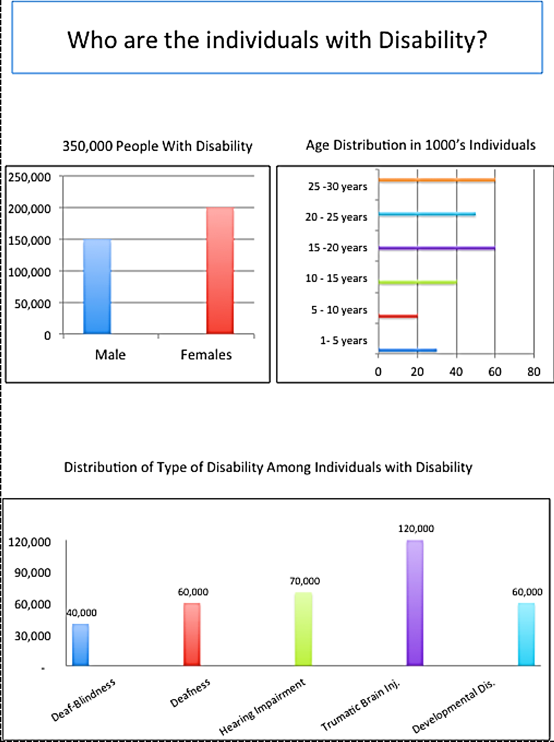
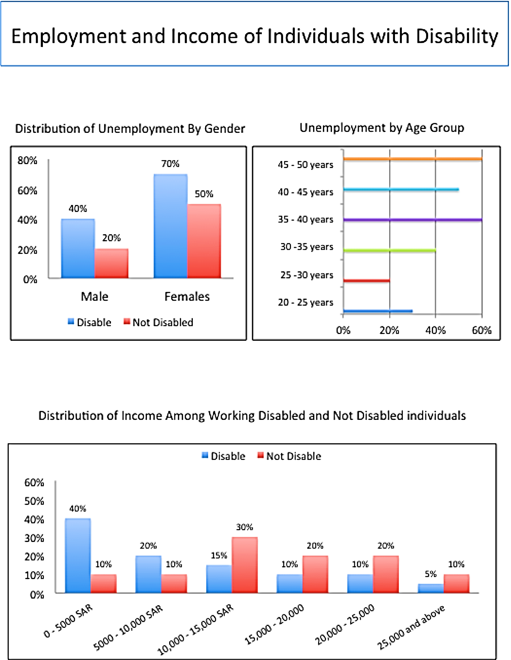
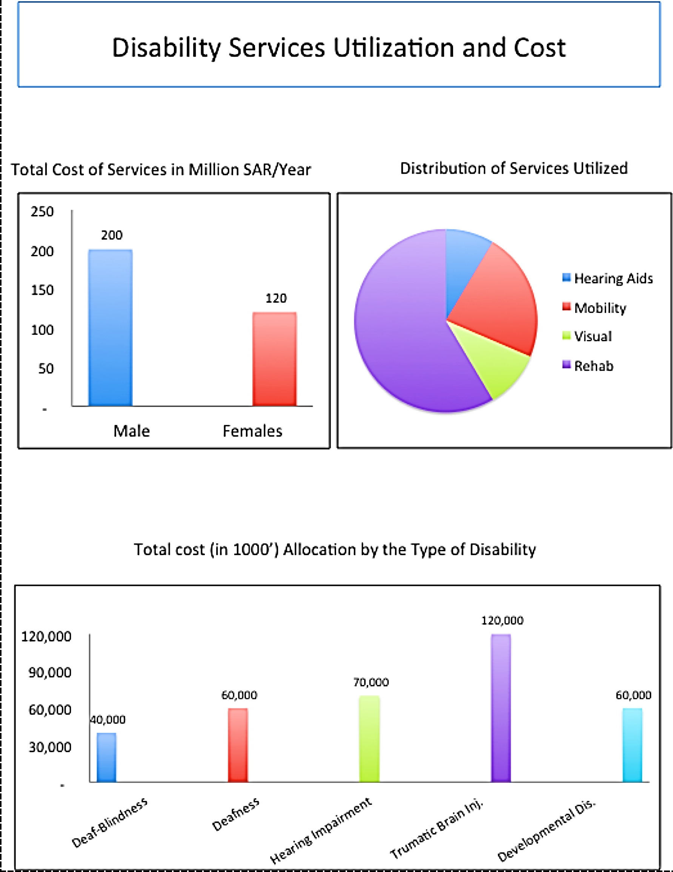
Some of The Key Analytics of the Registry

Slide 39
THANK YOU

