Slide 1
14th Annual Meeting of the Washington Group on Disability Statistics
Recommendations and Strategies for Implementation of the WG Short Set on Functioning (SS-F)
Julie Weeks (U.S.A.)
National Center for Health Statistics/
Washington Group on Disability Statistics

Slide 2
International Initiatives regarding the WG SS-F
Recommendations for Monitoring:
UN DESA/UNESCO Expert Group Meeting, Paris, July 2014
Follow-up conference on disability data, London, Oct 2014
Adoption in International Aid Programs:
UK Department for International Development (DFID)
US Agency for International Development (USAID)
The 2020 Round of Censuses:
UN Department of Economic and Social Affairs (DESA)
UN Economic Commission for Europe (ECE)

Slide 3
Recommendations for Monitoring
UN DESA / UNESCO Expert Group Meeting, July 2014
“Disability Data and Statistics, Monitoring and Evaluation toward Disability Inclusive Development Agenda toward 2015 and Beyond”
The objective of the Meeting was to develop policy to strengthen disability statistics and data collection efforts by the international system and national statistics agencies.
The work of the WG featured prominently at this meeting.
The WG SS-F was endorsed as the standard for disaggregating data by disability for the purpose of monitoring the UN Convention on the Rights of Persons with Disability and the post-2015 Sustainable Developments Goals.
London Conference, October 2014
“Disability Data – Demystifying Disability Statistics”

Slide 4
Adoption in International Aid Programs
UK – Department for International Development (DFID) has recommended the use of the WG SS-F of questions in all projects and programs that collect data on disability – or would disaggregate data on disability status.
US – Agency for International Development (USAID) has determined that a disability module will be included in a revision to the Demographic and Health Survey (DHS). This module will include the WG short set of questions.

Slide 5
The 2020 Round of Censuses
Currently both the UN Department of Economic and Social Affairs (DESA) and UN Economic Commission for Europe (ECE) are preparing for the 2020 round of censuses.
Expert group meetings, New York and Geneva, 2013-14
The WG has participated in both efforts, providing guidance on disability-related recommendations.
In both instances, recommendations for the 2020 census round will include text that specifies the WG SS-F as the method endorsed for the collection of disability data cross-nationally.

Slide 6
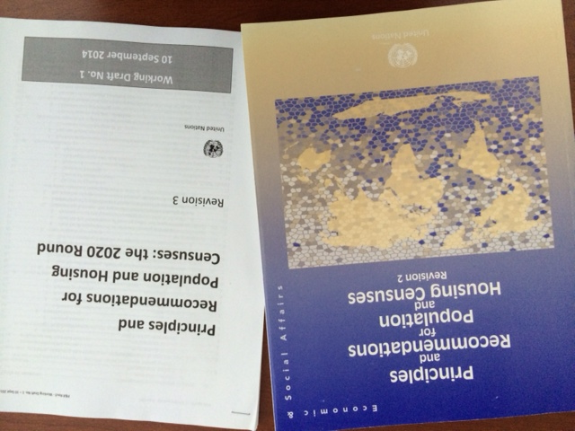
The 2020 Round of Censuses
“Principles and Recommendations for Population and Housing Censuses: the 2020 Round” Rev. 3 also denotes disability status as a core topic to be collected directly, similar to sex,
age and marital status.

