Slide 1
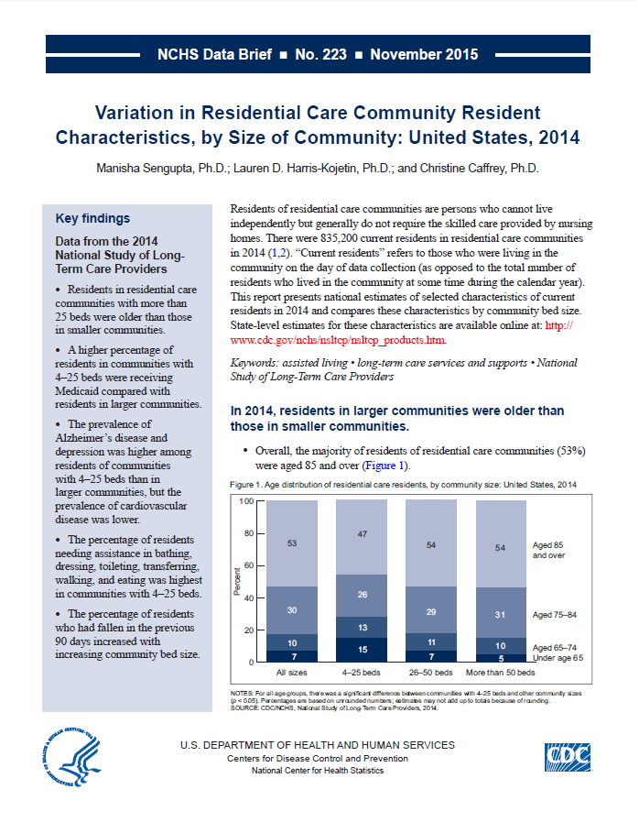
Health US 2014
This slide set contains figures from NCHS data brief No. 223: Variation in Residential Care Community Resident Characteristics, by Size of Community: United States, 2014
This Data Brief is available at:
http://www.cdc.gov/nchs/data/databriefs/db223.htm

Slide 2
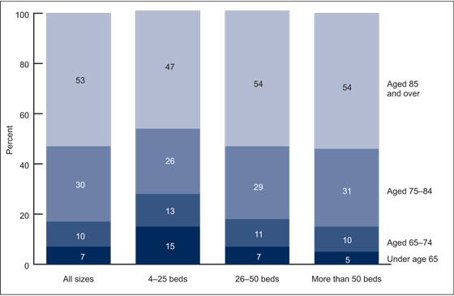
Age distribution of residential care residents, by community size: United States, 2014
NOTES: For all age groups, there was a significant difference between communities with 4–25 beds and other community sizes (p < 0.05). Percentages are based on unrounded numbers; estimates may not add up to totals because of rounding.
SOURCE: CDC/NCHS, Variation in Residential Care Community Resident Characteristics, by Size of Community: United States, 2014, NCHS Data Brief No. 223, Figure 1. Data from the National Study of Long-Term Care Providers (NSLTCP), 2014.

Slide 3
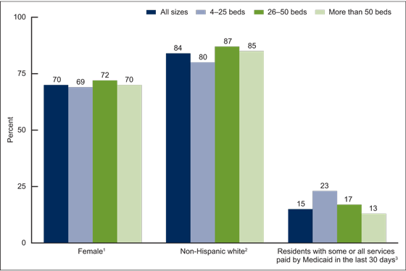
Selected characteristics of residential care residents, by community size: United States, 2014
¹Significant difference between communities with 26–50 beds and other community sizes (p < 0.05).
²Significant difference between communities with 4–25 beds and other community sizes (p < 0.05).
³Significant differences among communities with 4–25 beds, 26–50 beds, and more than 50 beds (p < 0.05); decrease by bed size is statistically significant (p < 0.05) based on a weighted least-squares regression test.
NOTE: For the Medicaid variable, cases with missing data are excluded; see "Data source and methods" for details.
SOURCE: CDC/NCHS, Variation in Residential Care Community Resident Characteristics, by Size of Community: United States, 2014, NCHS Data Brief No. 223, Figure 2. Data from the National Study of Long-Term Care Providers (NSLTCP), 2014.

Slide 4
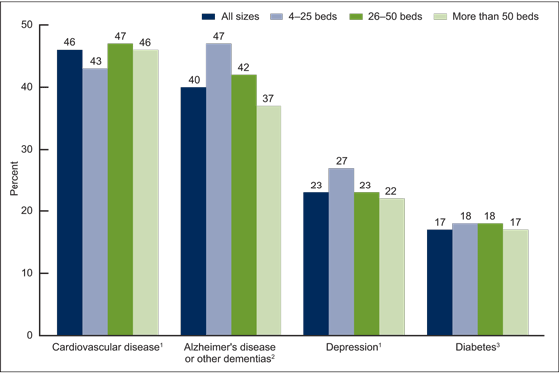
Selected diagnosed medical conditions among residential care residents, by community size: United States, 2014
¹Significant difference between communities with 4–25 beds and other community sizes (p < 0.05).
²Significant differences among communities with 4–25 beds, 26–50 beds, and more than 50 beds (p < 0.05); decrease by bed size is statistically significant (p < 0.05) based on a weighted least-squares regression test.
³Significant difference between communities with 4–25 beds and those with more than 50 beds (p< 0.05).
NOTE: Cases with missing data are excluded; see "Data source and methods" for details.
SOURCE: CDC/NCHS, Variation in Residential Care Community Resident Characteristics, by Size of Community: United States, 2014, NCHS Data Brief No. 223, Figure 3. Data from the National Study of Long-Term Care Providers (NSLTCP), 2014.

Slide 5
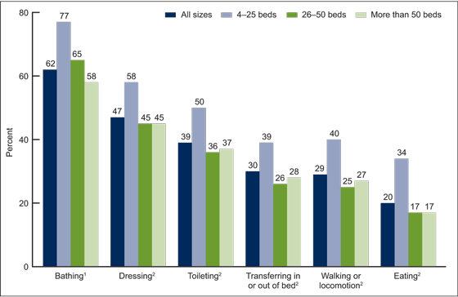
Need for assistance with selected activities of daily living among residential care residents, by community size: United States, 2014
¹Significant differences among communities with 4–25 beds, 26–50 beds, and more than 50 beds (p < 0.05); decrease by bed size is statistically significant (p < 0.05) based on weighted least-squares regression test.
²Significant difference between communities with 4–25 beds and other community sizes (p < 0.05).
NOTE: Cases with missing data are excluded; see "Data source and methods" for details.
SOURCE: CDC/NCHS, Variation in Residential Care Community Resident Characteristics, by Size of Community: United States, 2014, NCHS Data Brief No. 223, Figure 4. Data from the National Study of Long-Term Care Providers (NSLTCP), 2014.

Slide 6
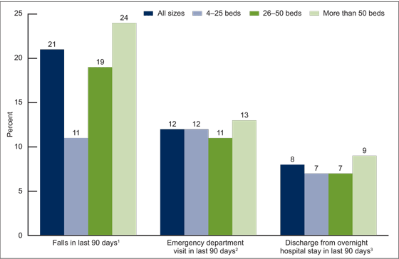
Falls, emergency department visits, and discharges from overnight hospital stays, among residential care residents, by community size: United States, 2014
¹Significant differences among communities with 4–25 beds, 26–50 beds, and more than 50 beds (p < 0.05); increase by bed size is statistically significant (p < 0.05) based on a weighted least-squares regression test.
²Significant difference between communities with 26–50 beds and those with more than 50 beds (p < 0.05).
³Significant difference between communities with more than 50 beds and other community sizes (p < 0.05).
NOTE: Cases with missing data are excluded; see "Data source and methods" for details.
SOURCE: CDC/NCHS, Variation in Residential Care Community Resident Characteristics, by Size of Community: United States, 2014, NCHS Data Brief No. 223, Figure 5. Data from the National Study of Long-Term Care Providers (NSLTCP), 2014.

Slide 7

For questions about this Data Brief or NSLTCP, please contact the Long-Term Care Statistics Branch at NCHS.
Email: ltcsbfeedback@cdc.gov
Phone: 301-458-4747
Visit us on the web at: http://www.cdc.gov/nchs/nsltcp.htm

