Slide 1
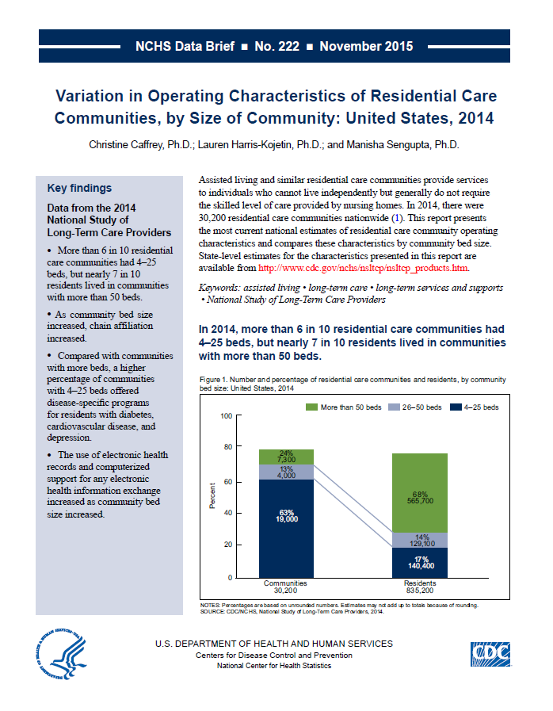
This slide set contains figures from NCHS data brief No. 222: Variation in Operating Characteristics of Residential Care Communities, by Size of Community: United States, 2014
This Data Brief is available at:
http://www.cdc.gov/nchs/data/databriefs/db222.htm

Slide 2
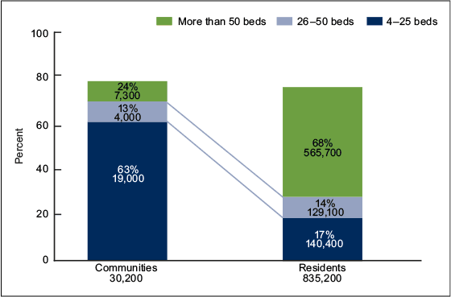
Number and percentage of residential care communities and residents, by community bed size: United States, 2014
NOTES: Percentages are based on unrounded numbers. Estimates may not add up to totals because of rounding.
SOURCE: CDC/NCHS, Variation in Operating Characteristics of Residential Care Communities, by Size of Community: United States, 2014, NCHS Data Brief No. 222, Figure 1. Data from the National Study of Long-Term Care Providers (NSLTCP), 2014.

Slide 3
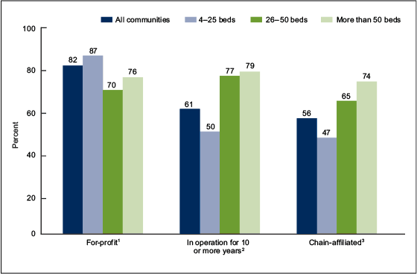
Selected residential care community operating characteristics, by community bed size: United States, 2014
¹Differences among communities with 4–25 beds, 26–50 beds, and more than 50 beds are significant at p < 0.05.
²Differences between communities with 4–25 beds and the other community bed sizes are significant at p < 0.05.
³Differences among communities with 4–25 beds, 26–50 beds, and more than 50 beds are significant at p < 0.05, and increase by bed size is statistically significant (p < 0.05) based on a weighted least-squares regression test.
NOTE: Figure excludes cases with missing data; see "Data source and methods" for details.
SOURCE: CDC/NCHS, Variation in Operating Characteristics of Residential Care Communities, by Size of Community: United States, 2014, NCHS Data Brief No. 222, Figure 2. Data from the National Study of Long-Term Care Providers (NSLTCP), 2014.

Slide 4
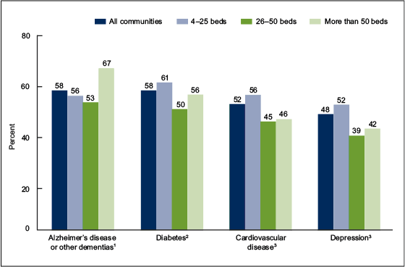
Disease-specific programs offered for selected conditions among residential care communities, by community bed size: United States, 2014
¹Differences between communities with more than 50 beds and the other community bed sizes are significant at p < 0.05.
²Differences among communities with 4–25 beds, 26–50 beds, and more than 50 beds are significant at p < 0.05.
³Differences between communities with 4–25 beds and the other community bed sizes are significant at p < 0.05.
NOTE: Figure excludes cases with missing data; see "Data source and methods" for details.
SOURCE: CDC/NCHS, Variation in Operating Characteristics of Residential Care Communities, by Size of Community: United States, 2014, NCHS Data Brief No. 222, Figure 3. Data from the National Study of Long-Term Care Providers (NSLTCP), 2014.

Slide 5
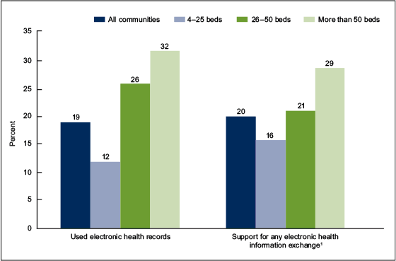
Use of electronic health records and support for electronic health information exchange among residential care communities, by community bed size: United States, 2014
¹Community's computerized system supports electronic health information exchange with physicians, pharmacies, or hospitals.
NOTES: Differences among communities with 4–25 beds, 26–50 beds, and more than 50 beds are significant at p < 0.05, and increase by bed size is statistically significant (p < 0.05) based on a weighted least-squares regression test. Figure excludes cases with missing data; see "Data source and methods" for details.
SOURCE: CDC/NCHS, Variation in Operating Characteristics of Residential Care Communities, by Size of Community: United States, 2014, NCHS Data Brief No. 222, Figure 4. Data from the National Study of Long-Term Care Providers (NSLTCP), 2014.

Slide 6

For questions about this Data Brief or NSLTCP, please contact the Long-Term Care Statistics Branch at NCHS.
Email: ltcsbfeedback@cdc.gov
Phone: 301-458-4747
Visit us on the web at: http://www.cdc.gov/nchs/nsltcp.htm

