Slide 1
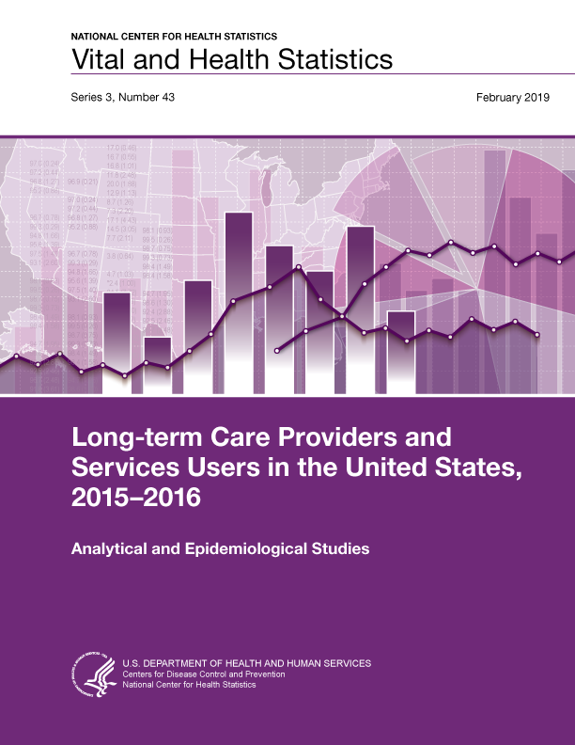
This slide set contains slides from Long-term
Care Providers and
Services Users in the United States,
2015–2016.
This report is available at:
https://www.cdc.gov/nchs/data/series/sr_03/sr03_43-508.pdf

Slide 2
.
Feel free to use these figure slides and the talking points in the notes page of each slide (click view, then notes page).
All material appearing in this product is in the public domain and may be reproduced or copied without permission; citing the source, however, is appreciated.
For questions about the report, figure slides or NSLTCP, please contact the Long-Term Care Statistics Branch at NCHS.
  Email: ltcsbfeedback@cdc.gov
  Phone: 301-458-4747
  Visit us on the web at: https://www.cdc.gov/nchs/nsltcp.htm

Slide 3
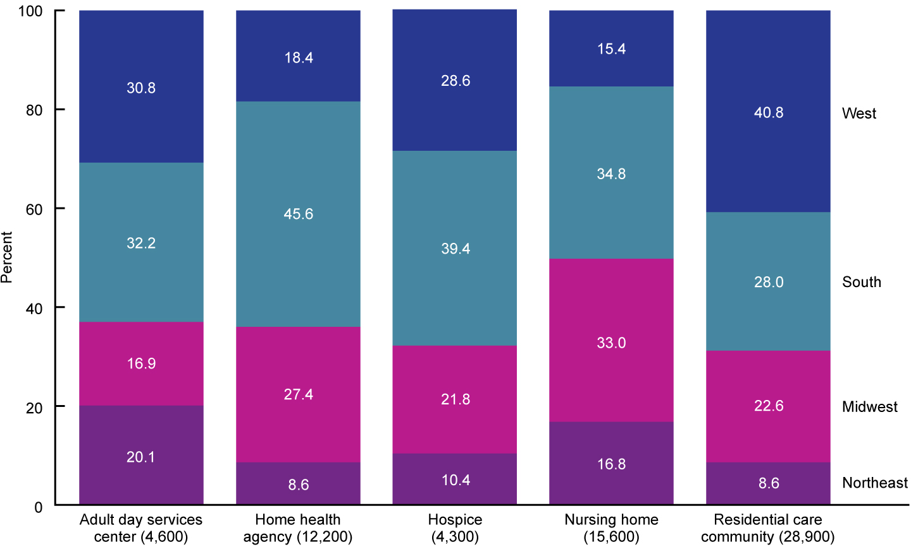
Percent distribution of long-term care services providers, by sector and region: United States, 2016
NOTES: Percentages are based on unrounded estimates. Percent distributions may not add to 100 because of rounding.
SOURCE: NCHS, “Long-term Care Providers and Services Users in the United States: 2015–2016,” Figure 1.
Notes:
The supply of providers in the five long-term care services sectors varied in their geographic distribution.
The largest share of adult day services centers (32.2%), home health agencies (45.6%), hospices (39.4%), and nursing homes (34.8%) was in the South, while the largest share of residential care communities (40.8%) was in the West (Figure 1).

Slide 4
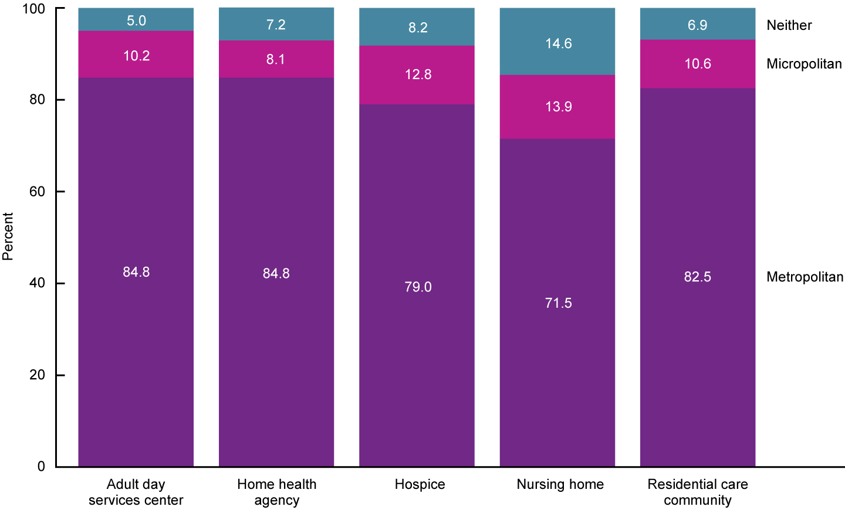
Percent distribution of long-term care services providers, by sector and metropolitan statistical area status:
United States, 2016
NOTES: Metropolitan statistical areas and micropolitan statistical areas are geographic entities delineated by the Office of Management and Budget for use by federal statistical agencies in collecting, tabulating, and publishing federal statistics. A metropolitan statistical area contains a core urban area of 50,000 or more population, and a micropolitan statistical area contains an urban core of at least 10,000 (but less than 50,000) population. Each metropolitan or micropolitan statistical area consists of one or more counties and includes the counties containing the core urban area, as well as any adjacent counties that have a high degree of social and economic integration (as measured by commuting to work) with the urban core (see reference 51 in report). Percentages are based on unrounded estimates. Percent distributions may not add to 100 because of rounding.
SOURCE: NCHS, “Long-term Care Providers and Services Users in the United States: 2015–2016,” Figure 2.
Notes:
Most providers in all five long-term care services sectors were in MSAs (Figure 2). This distribution reflects the higher population density in these areas.
Compared with hospices (79.0%) and nursing homes (71.5%), a greater percentage of adult day services centers (84.8%), home health agencies (84.8%), and residential care communities (82.5%) were located in metropolitan areas.

Slide 5
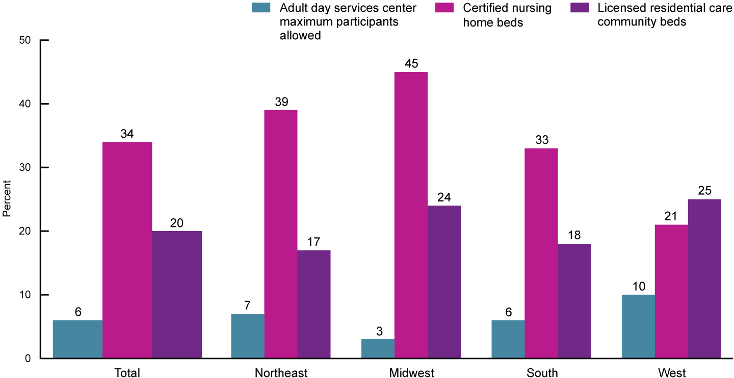
Long-term care services provider capacity per 1,000 people aged 65 and over, by sector and region:
United States, 2015–2016
NOTES: Capacity refers to the number of certified nursing home beds, the number of licensed residential care community beds, and the maximum number of adult day services center participants allowed. See Appendix II for definitions of capacity used for each sector. Capacity for home health agencies and hospices was not examined because licensed maximum capacity or a similar metric was not available. Rates are based on unrounded estimates.
SOURCE: NCHS, “Long-term Care Providers and Services Users in the United States: 2015–2016,” Figure 3.
Notes:
The supply of adult day services center capacity and nursing home and residential care beds varied by region (Figure 3).
Compared with other regions, the Midwest had the largest supply of nursing home beds (45) and the smallest supply of adult day services center capacity (3) per 1,000 persons aged 65 and over.
The West (25) and Midwest (24) had a larger supply of residential care beds per 1,000 persons aged 65 and over compared with the Northeast (17) and the South (18).
In the West, the supply of residential care beds (25) was greater than the supply of nursing home beds (21) per 1,000 persons aged 65 and over, whereas nursing home beds outnumbered residential care beds in all other regions.

Slide 6
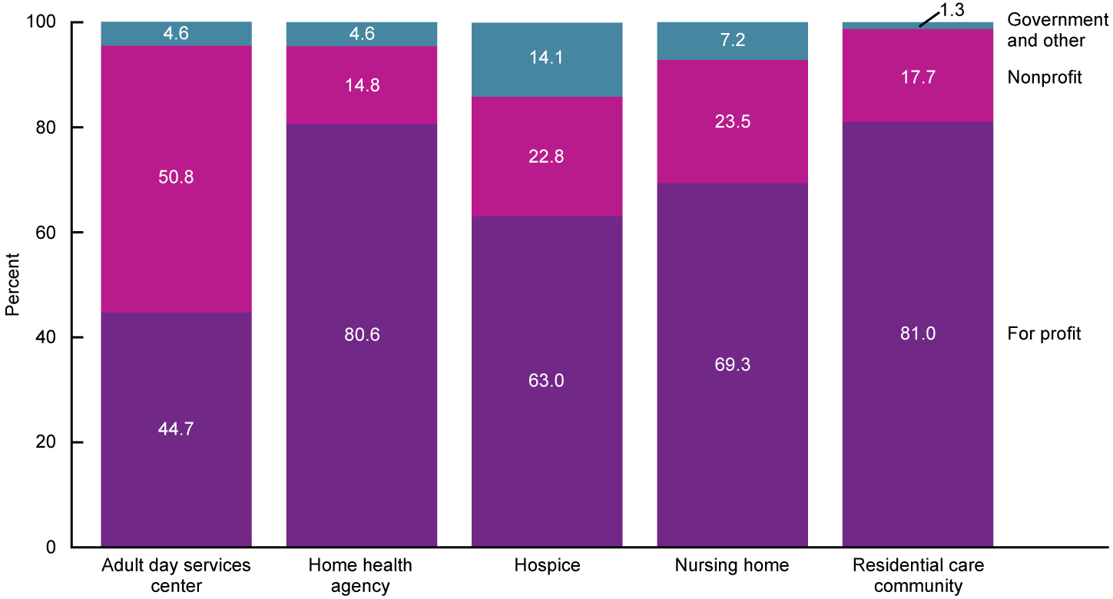
Percent distribution of long-term care services providers, by sector and ownership: United States, 2016
NOTES: See Appendix II for definitions of ownership used for each sector. Percentages are based on unrounded estimates. Percent distributions may not add to 100 because of rounding.
SOURCE: NCHS, “Long-term Care Providers and Services Users in the United States: 2015–2016,” Figure 4.
Notes:
In all sectors except adult day services centers, the majority of long-term care services providers were for profit (Figure 4).
Home health agencies (80.6%) and residential care communities (81.0%) had the highest percentages of for-profit ownership, while adult day services centers (44.7%) had the lowest percentage.
About one-half of adult day services centers were nonprofit (50.8%).

Slide 7
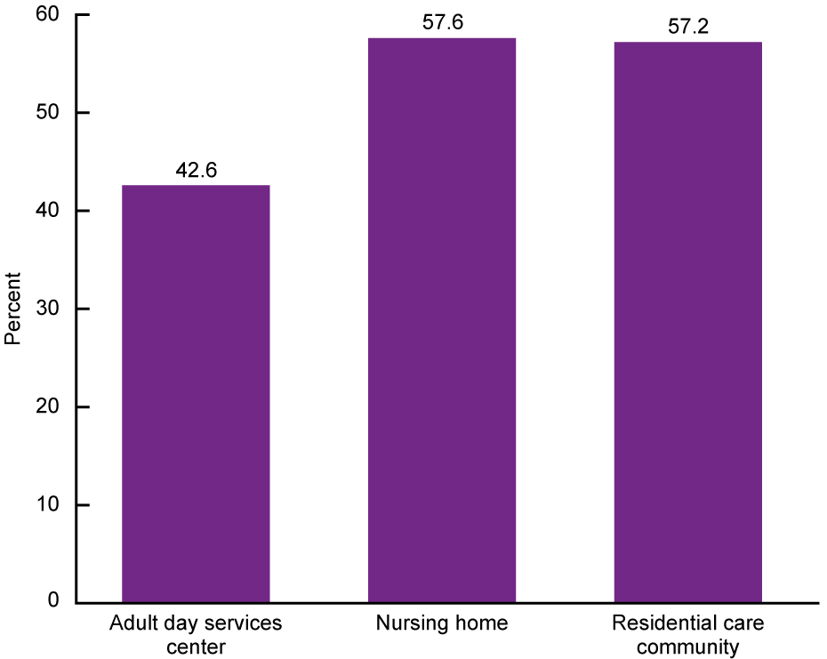
Percentage of long-term care services providers that are chain-affiliated, by sector: United States, 2016
NOTES: See Appendix II for definitions of chain affiliation used for each sector. Chain affiliation for home health agencies and hospices was not examined because this information was not available. Percentages are based on unrounded estimates.
SOURCE: NCHS, “Long-term Care Providers and Services Users in the United States: 2015–2016,” Figure 5.
Notes:
The majority of nursing homes (57.6%) and residential care communities (57.2%) were chain-affiliated, while fewer adult day services centers (42.6%) were part of a chain (Figure 5).
Chain affiliation for home health agencies and hospices was not examined because this information was not available.

Slide 8
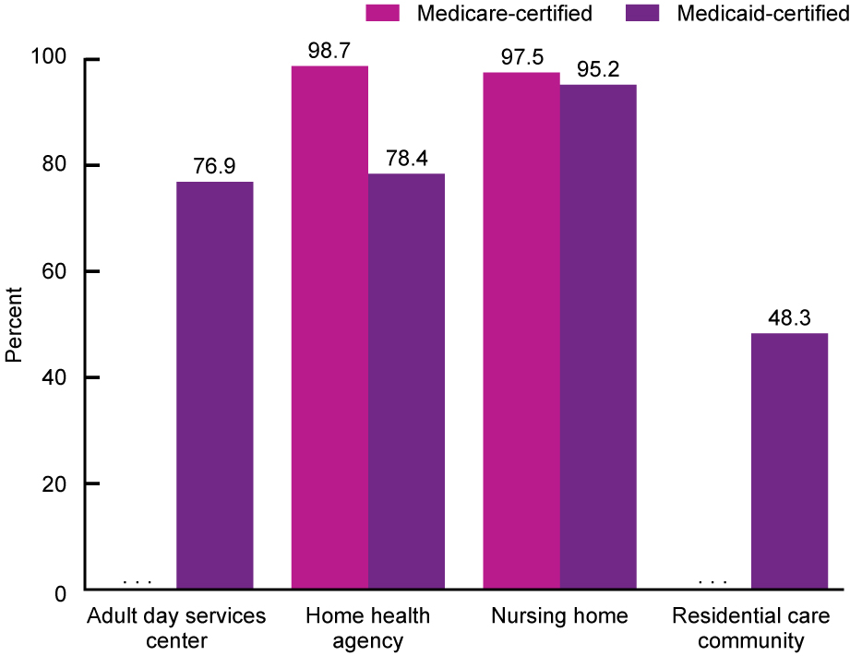
Percentage of long-term care services providers that are Medicare- and Medicaid-certified, by sector:
United States, 2016
. . . Category not applicable.
NOTES: See Appendix II for definitions of Medicare and Medicaid certifications used for each sector. Percentages are based on unrounded estimates.
SOURCE: NCHS, “Long-term Care Providers and Services Users in the United States: 2015–2016,” Figure 6.
Notes:
All data on home health agencies and nursing homes used in this report are only for Medicare- or Medicaid-certified providers, and all data on hospices are only for Medicare-certified hospices.
Almost all nursing homes (95.2%), about three-quarters of adult day services centers (76.9%) and home health agencies (78.4%), and almost one-half of residential care communities (48.3%) were authorized or certified to participate in Medicaid (Figure 6).
Information was not available on whether any of the Medicare-certified hospices were also certified by Medicaid.
Virtually all home health agencies (98.7%), hospices (100.0%; data not shown in figure), and nursing homes (97.5%) were Medicare-certified.
In 2016, Medicare did not certify or reimburse for services provided by adult day care services centers or residential care communities; therefore, these providers were not asked about Medicare certification.

Slide 9
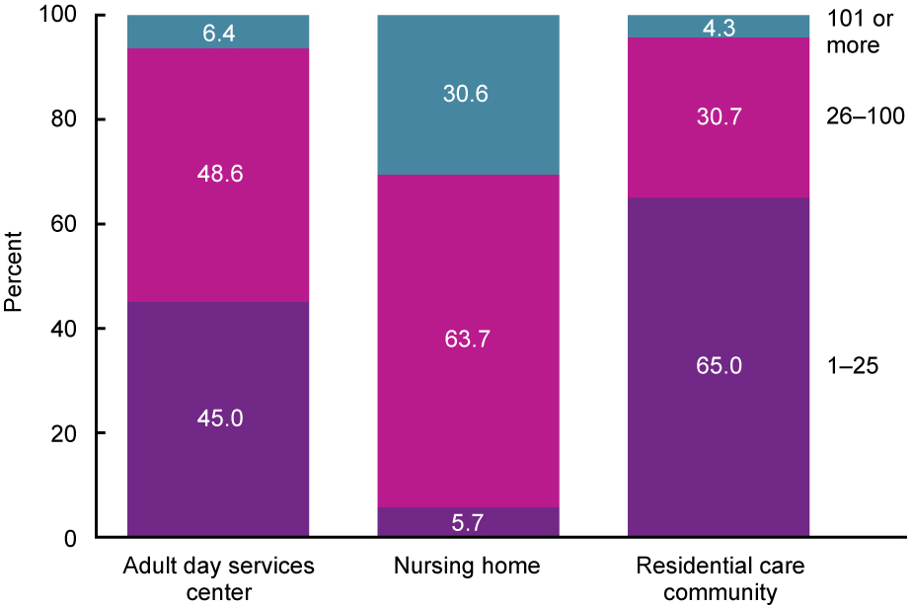
Percent distribution of long-term care services providers, by sector and number of people served daily: United States, 2016
NOTES: Number of people served categorizes the number of current residents (nursing homes and residential care communities) or the average daily attendance of participants in a typical week (adult day services centers) into three categories: 1–25, 26–100, and 101 or more. See Appendix II for definitions of number of people served for each sector. Figure does not include home health agencies or hospices because the data on services users in these sectors that were used for this report are about patients served annually, not daily. Daily use among home health agencies and hospices could not be derived from these data. Percentages are based on unrounded estimates. Percent distributions may not add to 100 because of rounding.
SOURCE: NCHS, “Long-term Care Providers and Services Users in the United States: 2015–2016,” Figure 7.
Notes:
The majority of nursing homes served between 26 and 100 residents daily (63.7%), while the majority of residential care communities served 25 residents or fewer daily (65.0%) (Figure 7).
Nearly one-half of adult day services centers served 26 to 100 participants daily (48.6%); 45.0% served 25 participants or fewer.
The percentage of nursing homes serving more than 100 persons daily (30.6%) was almost five times as large as the percentage of adult day services centers (6.4%) doing so and almost eight times as large as the percentage of residential care communities (4.3%) doing so (Figure 7).
Figure 7 does not include data for home health agencies or hospices because the data on services users in these sectors that were used for this report are for patients served annually, not daily. Daily use among home health agencies and hospices could not be derived from these data.

Slide 10
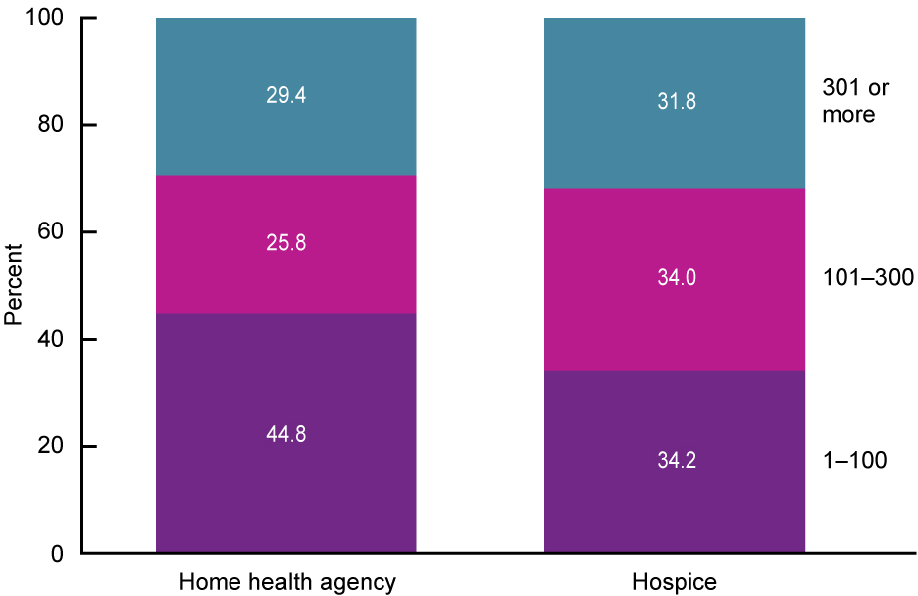
Percent distribution of long-term care services providers, by sector and number of people served annually:
United States, 2015
NOTES: Number of people served is derived from the number of home health patients whose episode of care ended at any time in 2015 and the number of hospice patients receiving care at any time in 2015, respectively, and has three categories: 1–100,
101–300, and 301 or more. See Appendix II for definitions of number of people served for each sector. This figure does not include adult day services centers, nursing homes, or residential care communities because the data on services users in these sectors that were used for this report are about services users served daily, not annually. Annual use among adult day services centers, nursing homes, or residential care communities could not be derived from these data. Percentages are based on unrounded estimates. Percent distributions may not add to 100 because of rounding.
SOURCE: NCHS, “Long-term Care Providers and Services Users in the United States: 2015–2016,” Figure 8.
Notes:
In terms of persons served annually, a home health agency served an average of 401 patients who were then discharged from the agency in 2015, while a hospice served an average of 353 patients during the year (Appendix III, Table V).
About 44.8% of home health agencies discharged 100 patients or fewer annually, while 25.8% discharged 101 to 300, and 29.4% discharged more than 300 (Figure 8).
The number of patients served annually per hospice agency was about evenly distributed, with about one-third of agencies each serving 1 to 100 patients (34.2%), 101 to 300 patients (34.0%), and more than 300 patients (31.8%).
Figure 8 does not include data for adult day services centers, nursing homes, or residential care communities because the data on services users in these sectors that were used for this report are for services users served daily, not annually. Annual use among adult day services centers, nursing homes, and residential care communities could not be derived from these data.

Slide 11
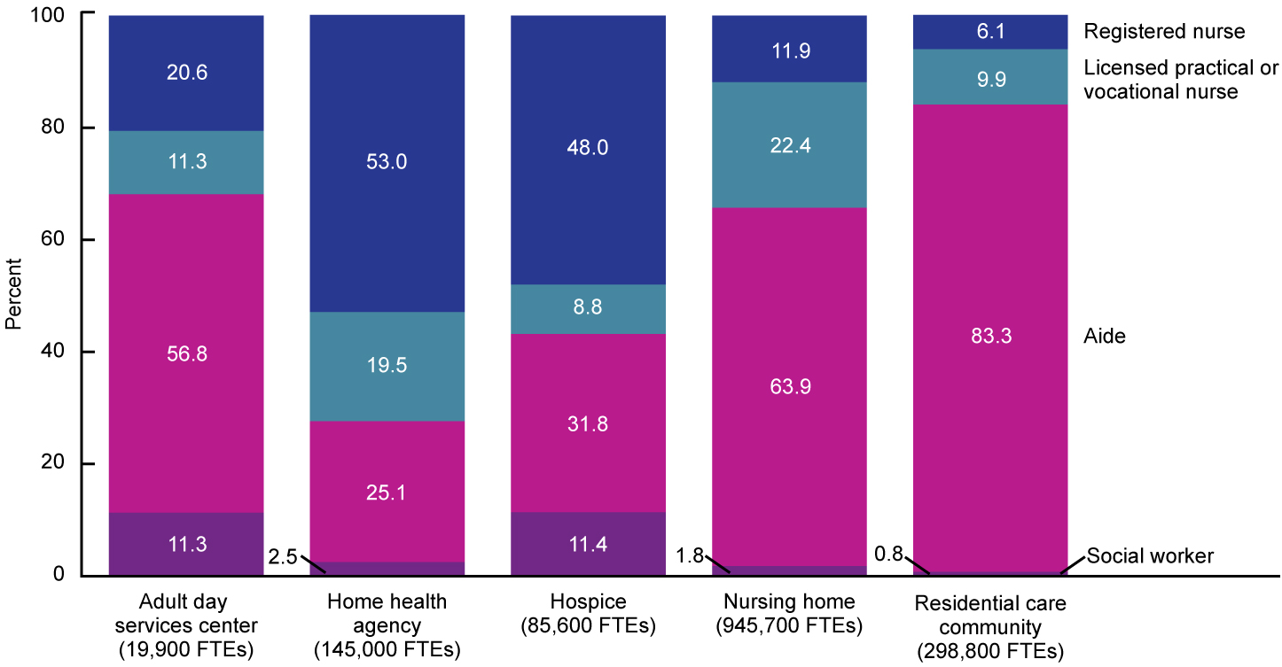
Total number and percent distribution of nursing and social work full-time equivalent employees, by sector and staff type: United States, 2016
NOTES: FTEs is full-time equivalent. Only employees are included for all staff types; contract staff are not included. For adult day services centers and residential care communities, aides refer to certified nursing assistants, home health aides, home care aides, personal care aides, personal care assistants, and medication technicians or medication aides. For home health agencies and hospices, aides refer to home health aides. For nursing homes, aides refer to certified nurse aides, medication aides, and medication technicians. Social workers include licensed social workers or persons with a bachelor's or master's degree in social work in adult day services centers and residential care communities; medical social workers in home health agencies and hospices; and qualified social workers in nursing homes. See the Appendix I Technical Notes for information on how outliers were identified and coded. Percentages are based on unrounded estimates. Percent distributions may not add to 100 because of rounding.
SOURCE: NCHS, “Long-term Care Providers and Services Users in the United States: 2015–2016,” Figure 9.
Notes:
In 2016, about 1,460,400 nursing employee FTEs—including RNs, LPNs or LVNs, and aides—and about 35,000 social work employee FTEs were working in the five sectors (data not shown).
Of these nursing and social work employees in the five sectors, 63.3% (945,700 FTEs) worked in nursing homes, 20.0% (298,800 FTEs) were residential care community employees, 9.7% (145,000 FTEs) were employed by home health agencies, 5.7% (85,600 FTEs) were employed by hospices, and 1.3% (19,900 FTEs) were adult day services center employees.
The relative distribution of social work and nursing employee FTEs varied across sectors. In adult day services centers (56.8%), nursing homes (63.9%), and residential care communities (83.3%), the majority of these employee FTEs were aides (Figure 9). However, in home health agencies (53.0%) and hospices (48.0%), RNs were the most common of these employee FTEs. Social work FTE employees were more common in adult day services centers (11.3%) and hospices (11.4%) than in the other sectors.
The administrative data used in this report for the home health, hospice, and nursing home sectors used less-inclusive wording to capture aides than was used in the questionnaire data for adult day services centers and residential care communities. Consequently, estimates using the administrative data may undercount the number of aides employed by providers in those sectors.

Slide 12
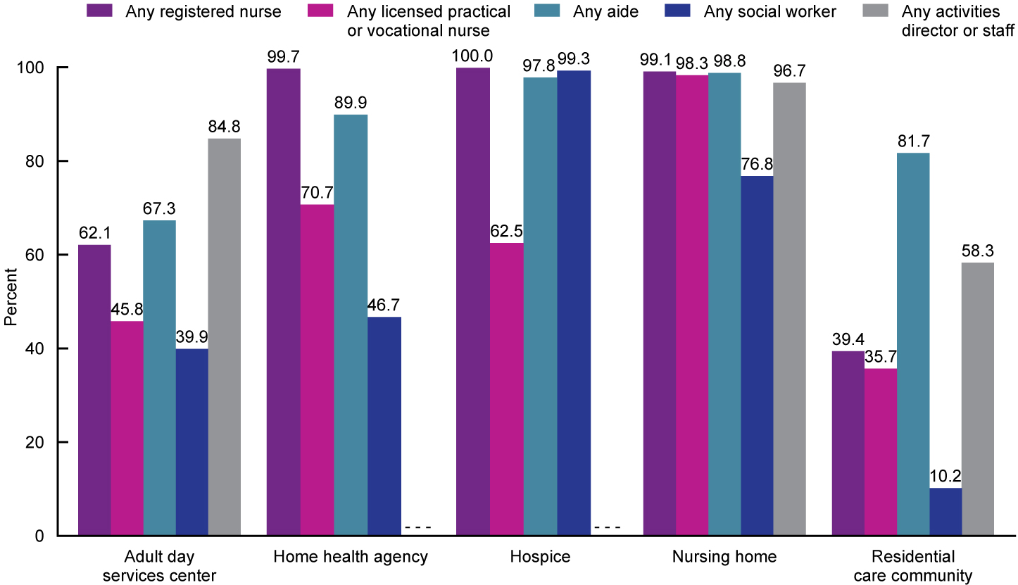
Percentage of long-term care services providers with any full-time equivalent employees, by sector and staff type: United States, 2016
- - - Data not available.
NOTES: Only employees are included for all staff types; contract staff are not included. For adult day services centers and residential care communities, aides refer to certified nursing assistants, home health aides, home care aides, personal care aides, personal care assistants, and medication technicians or medication aides. For home health agencies and hospices, aides refer to home health aides. For nursing homes, aides refer to certified nurse aides, medication aides, and medication technicians. Social workers include licensed social workers or persons with a bachelor’s or master’s degree in social work in adult day services centers and residential care communities; medical social workers in home health agencies and hospices; and qualified social workers in nursing homes. See the Appendix I Technical Notes for information on how outliers were identified and coded. Percentages are based on unrounded estimates.
SOURCE: NCHS, “Long-term Care Providers and Services Users in the United States: 2015–2016,” Figure 10.
Notes:
Among the four staff types examined across all five sectors, employing any aides showed the least variation by sector (Figure 10). In all five sectors, the majority of providers employed aides; nursing homes were most likely (98.8%) and adult day services centers were least likely (67.3%) to have any aides on staff.
The majority of providers in all sectors except residential care communities employed licensed nursing staff (either RNs, or LPNs or LVNs). Virtually all home health agencies, hospices, and nursing homes employed at least one RN (99.7%, 100.0%, and 99.1%, respectively). In contrast, 62.1% of adult day services centers and 39.4% of residential care communities directly employed any RNs. The majority of nursing homes (98.3%), home health agencies (70.7%), and hospices (62.5%) employed at least one LPN or LVN, whereas a minority of adult day services centers (45.8%) and residential care communities (35.7%) directly employed any LPNs or LVNs.
Employing any social workers showed the most variation across five sectors. Virtually all hospices employed social workers (99.3%), as did 76.8% of nursing homes. About 46.7% of home health agencies and 39.9% of adult day services centers employed social workers; however, only 10.2% of residential care communities directly employed social workers.
The majority of nursing homes (96.7%), adult day services centers (84.8%), and residential care communities (58.3%) directly employed an activities director or activities staff. Use of any activities staff was not examined for home health agencies and hospices because this information was not available.

Slide 13
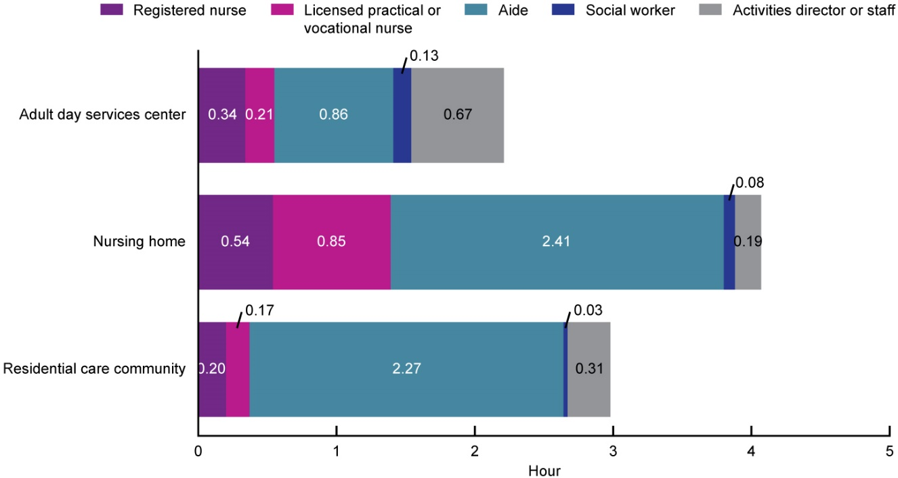
Average staff hours per resident or participant per day, by sector and staff type: United States, 2016
NOTES: Only employees are included for all staff types; contract staff are not included. For adult day services centers and residential care communities, aides refer to certified nursing assistants, home health aides, home care aides, personal care aides, personal care assistants, and medication technicians or medication aides. For home health agencies and hospices, aides refer to home health aides. For nursing homes, aides refer to certified nurse aides, medication aides, and medication technicians. Social workers include licensed social workers or persons with a bachelor’s or master’s degree in social work in adult day services centers and residential care communities; medical social workers in home health agencies and hospices; and qualified social workers in nursing homes. For adult day services centers, average hours per participant per day was computed by multiplying the number of full-time equivalent (FTE) employees for the staff type by 35 hours, and divided by average daily attendance of participants and by 5 days. For nursing homes and residential care communities, average hours per resident per day was computed by multiplying the number of FTE employees for the staff type by 35 hours, and divided by the number of current residents and by 7 days. See the Appendix I Technical Notes for information on how outliers were identified and coded. Hours per patient per day could not be provided for home health agencies or hospices, because the administrative data available provided total number of all patients served in a year, not the number served on a given day, which is needed to produce this estimate. Rates are based on unrounded estimates.
SOURCE: NCHS, “Long-term Care Providers and Services Users in the United States: 2015–2016,” Figure 11.
Notes:
For both licensed nursing staff types examined (i.e., RN, or LPN or LVN), the average staff hours per resident or participant per day was higher in nursing homes than in residential care communities and adult day services centers (Figure 11).
The average total licensed nursing hours (combining RNs with LPNs and LVNs) per resident or participant per day in nursing homes was more than twice the size of the corresponding ratios for residential care communities and adult day services centers. The average total licensed nursing hours per resident or participant per day was 1.39 (1 hour and 23 minutes) for nursing home residents, 0.55 (33 minutes) for adult day participants, and 0.37 (22 minutes) for residential care residents.
In contrast, the average social work staff hours per resident or participant per day was higher in adult day services centers (0.13 hours or 8 minutes) than in nursing homes (0.08 hours or 5 minutes) or residential care communities (0.03 hours or 2 minutes), and the average activities staff hours per resident or participant per day in adult day services centers (0.67 hours or 40 minutes) was more than twice the size of the ratio for residential care communities (0.31 hours or 19 minutes) or nursing homes (0.19 hours or 11 minutes).
The average total nursing hours per resident (combining RNs, LPNs or LVNs, and aides) per day in nursing homes was more than twice the size of the ratio for adult day services centers. The average total nursing hours per resident or participant per day was 3.80 (3 hours and 48 minutes) for nursing home residents, 2.64 (2 hours and 38 minutes) for residential care residents, and 1.41 (1 hour and 25 minutes) for adult day participants.
Hours per patient per day could not be provided for home health agencies or hospices, because the administrative data available provided total number of all patients served in a year, not the number served on a given day, which is needed to produce this estimate.

Slide 14
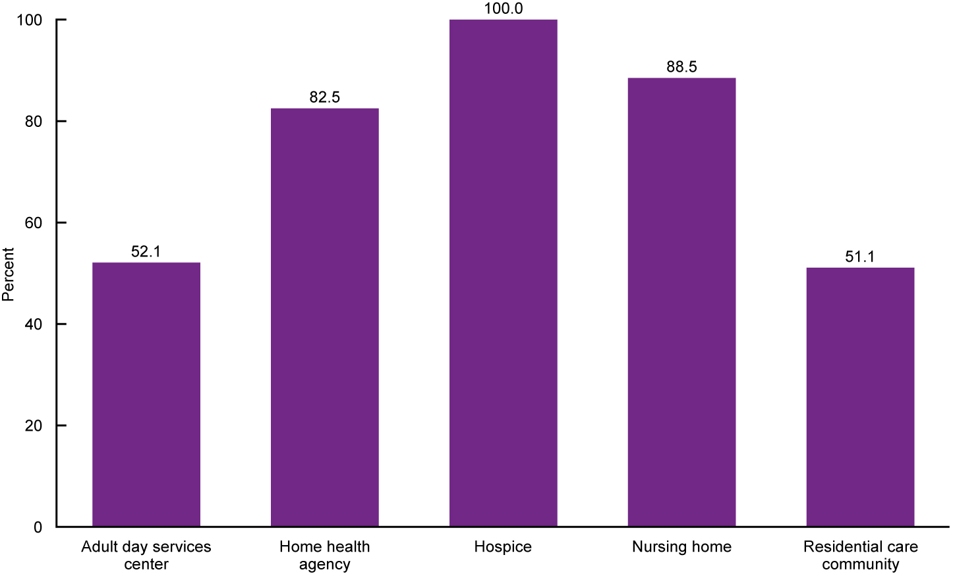
Percentage of long-term care services providers that provide social work services, by sector: United States, 2016
NOTES: Social work services refer to services provided by licensed social workers or persons with a bachelor’s or master’s degree in social work, and include an array of services such as psychosocial assessment, individual or group counseling, and referral services. See Appendix II for definitions of the provision of social work services for each sector. See the Appendix I Technical Notes for an explanation of differences in how services were measured in 2012, 2014, and 2016. Percentages are based on unrounded estimates.
SOURCE: NCHS, “Long-term Care Providers and Services Users in the United States: 2015–2016,” Figure 12.
Notes:
The majority of providers in all sectors offered social work services (Figure 12).
All hospices provided social work services (100.0%), as did most nursing homes (88.5%) and home health agencies (82.5%), likely because providing these services is required for Medicare certification.
Fewer adult day services centers (52.1%) and residential care communities (51.1%) reported providing social work services.

Slide 15
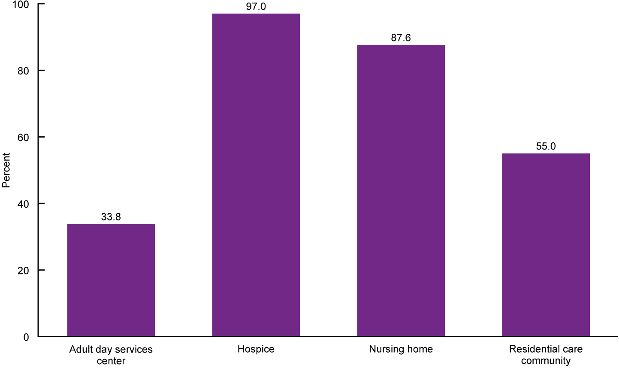
Percentage of long-term care services providers that provide mental health or counseling services, by sector: United States, 2016
NOTES: Mental health services refer to services that target residents' mental, emotional, psychological, or psychiatric well being, and include diagnosing, describing, evaluating, and treating mental conditions. See Appendix II for definitions of the provision of mental health services for each sector. See the Appendix I Technical Notes for an explanation of differences in how services were measured in 2012, 2014, and 2016. The available administrative data did not have information on whether or not home health agencies provided mental health or counseling services. Percentages are based on unrounded estimates.
SOURCE: NCHS, “Long-term Care Providers and Services Users in the United States: 2015–2016,” Figure 13.
Notes:
Mental health or counseling services were offered by most hospices (97.0%), nursing homes (87.6%), and the majority of residential care communities (55.0%), while about one-third of adult day services centers (33.8%) reported offering these services (Figure 13).

Slide 16
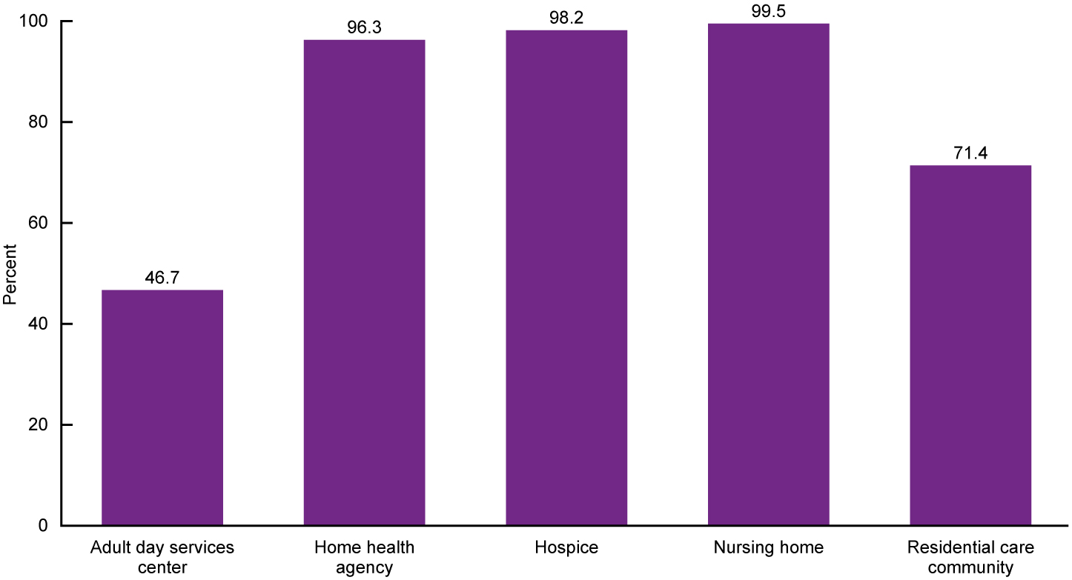
Percentage of long-term care services providers that provide any therapeutic services, by sector: United States, 2016
NOTES: Any therapeutic services refer to physical, occupational, or speech therapy services. See Appendix II for definitions of the provision of any therapeutic services for each sector. See the Appendix I Technical Notes for an explanation of differences in how services were measured in 2012, 2014, and 2016. Percentages are based on unrounded estimates.
SOURCE: NCHS, “Long-term Care Providers and Services Users in the United States: 2015–2016,” Figure 14.
Notes:
Virtually all nursing homes (99.5%), hospices (98.2%), and home health agencies (96.3%) offered therapeutic services, as did more than seven-tenths of residential care communities (71.4%) and almost one-half of adult day services centers (46.7%) (Figure 14).

Slide 17
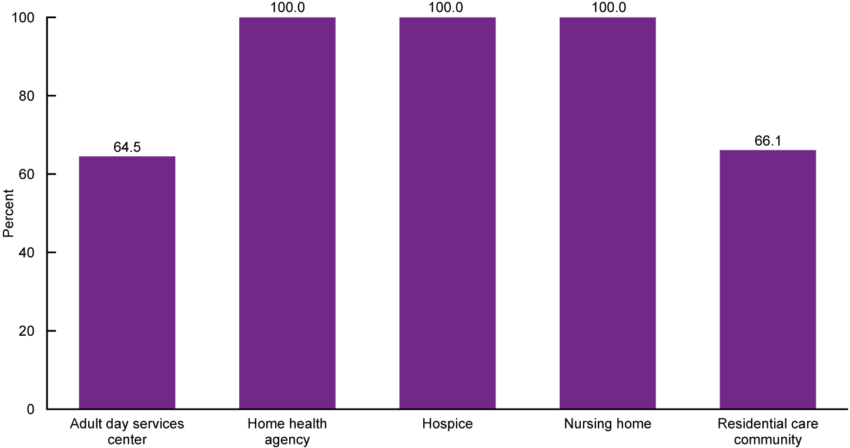
Percentage of long-term care services providers that provide skilled nursing or nursing services, by sector:
United States, 2016
NOTES: Skilled nursing services refer to services that must be performed by a registered nurse or licensed vocational or practical nurse and are medical in nature. See Appendix II for definitions of the provision of skilled nursing services for each sector. See the Appendix I Technical Notes for an explanation of differences in how services were measured in 2012, 2014, and 2016. Percentages are based on unrounded estimates.
SOURCE: NCHS, “Long-term Care Providers and Services Users in the United States: 2015–2016,” Figure 15.
Notes:
All home health agencies, hospices, and nursing homes (100.0%) offered skilled nursing or nursing services, as did the majority of adult day services centers (64.5%) and residential care communities (66.1%) (Figure 15).

Slide 18
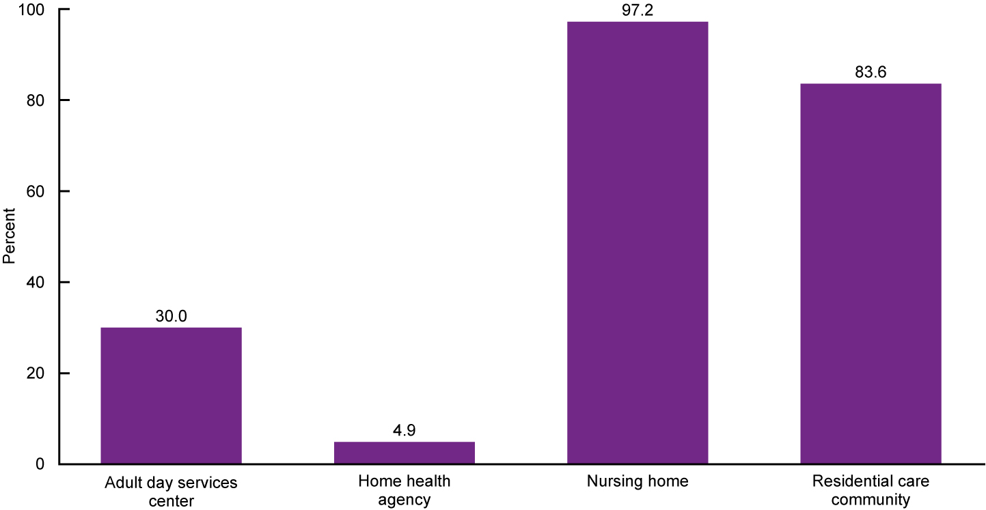
Percentage of long-term care services providers that provide pharmacy or pharmacist services, by sector:
United States, 2016
NOTES: Pharmacy services refer to the filling and delivery of prescriptions. See Appendix II for definitions of the provision of pharmacy services for each sector. See the Appendix I Technical Notes for an explanation of differences in how services were measured in 2012, 2014, and 2016. The available administrative data did not have information on whether or not hospices provided pharmacy or pharmacist services. Percentages are based on unrounded estimates.
SOURCE: NCHS, “Long-term Care Providers and Services Users in the United States: 2015–2016,” Figure 16.
Notes:
Nearly all nursing homes (97.2%) and more than four-fifths of residential care communities (83.6%) offered pharmacy or pharmacist services, while fewer adult day services centers (30.0%) and home health agencies (4.9%) provided these services (Figure 16).

Slide 19
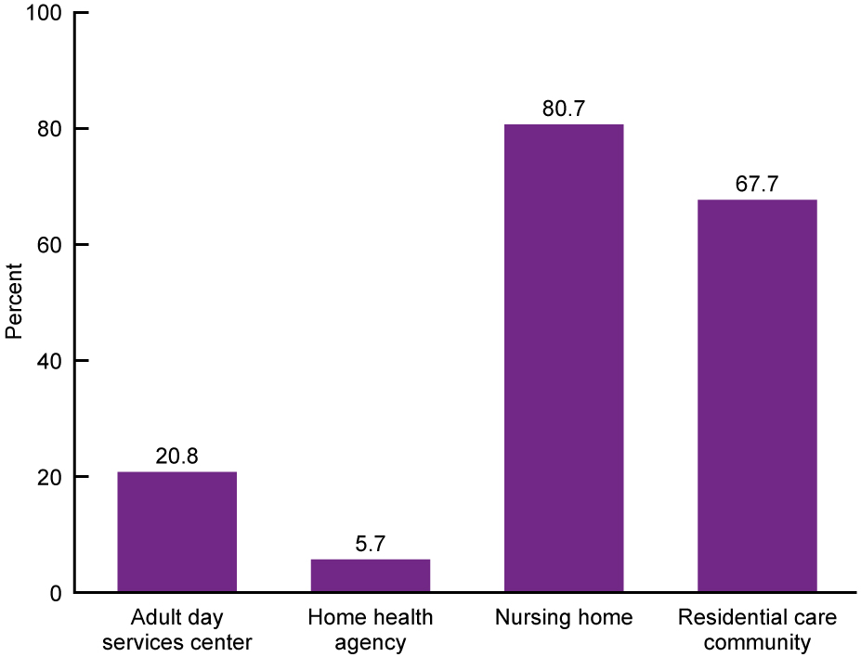
Percentage of long-term care services providers that provide hospice services, by sector: United States, 2016
NOTES: See Appendix II for definitions of the provision of hospice services for each sector. See the Appendix I
Technical Notes for an explanation of differences in how services were measured in 2012, 2014, and 2016. All hospices were expected to provide hospice services. Percentages are based on unrounded estimates.
SOURCE: NCHS, “Long-term Care Providers and Services Users in the United States: 2015–2016,” Figure 17.
Notes:
About 80.7% of nursing homes offered hospice services, compared with 67.7% of residential care communities, 20.8% of adult day services centers, and 5.7% of home health agencies (Figure 17).

Slide 20
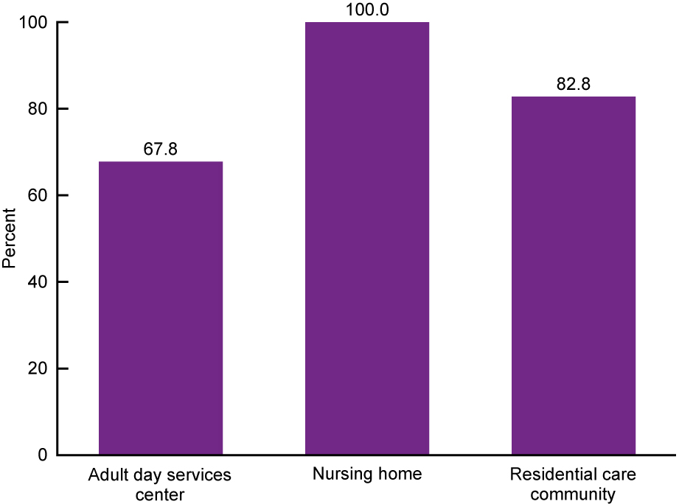
Percentage of long-term care services providers that provide dietary and nutritional services, by sector: United States, 2016
NOTES: See Appendix II for definitions of the provision of dietary and nutritional services for each sector. See the Appendix I Technical Notes for an explanation of differences in how services were measured in 2012, 2014, and 2016. The available administrative data did not have information on whether or not home health agencies or hospices provided dietary and nutritional services. Percentages are based on unrounded estimates.
SOURCE: NCHS, “Long-term Care Providers and Services Users in the United States: 2015–2016,” Figure 18.
Notes:
All nursing homes (100.0%) and 82.8% of residential care communities offered dietary and nutritional services, while 67.8% of adult day services centers provided these services (Figure 18).

Slide 21
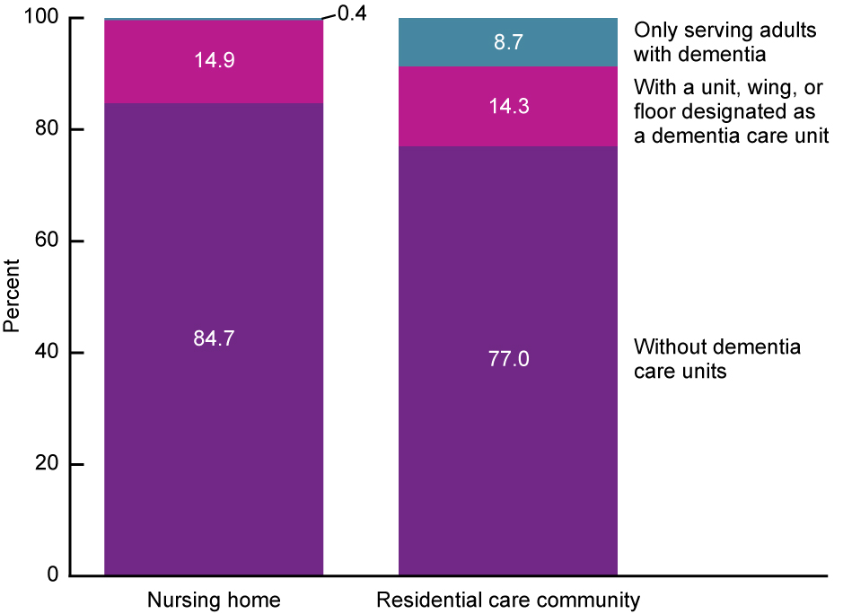
Percent distribution of long-term care services providers, by sector and dementia care unit: United States, 2016
NOTES: See Appendix II for definitions of dementia care units for each sector. Dementia care units or dementia-only providers were not examined for adult day services centers, home health agencies, or hospices because these topics are more relevant for residential sectors such as nursing homes and residential care communities. Percentages are based on unrounded estimates. Percent distributions may not add to 100 because of rounding.
SOURCE: NCHS, “Long-term Care Providers and Services Users in the United States: 2015–2016,” Figure 19.
Notes:
About 14.9% of nursing homes and 14.3% of residential care communities offered a dementia care unit within a larger facility or community (Figure 19).
While another 8.7% of residential care communities served only residents with dementia, few nursing homes (0.4%) did so.
Dementia care units or dementia-only providers were not examined for adult day services centers, home health agencies, or hospices because these topics are more relevant for residential sectors, such as nursing homes and residential care communities.

Slide 22
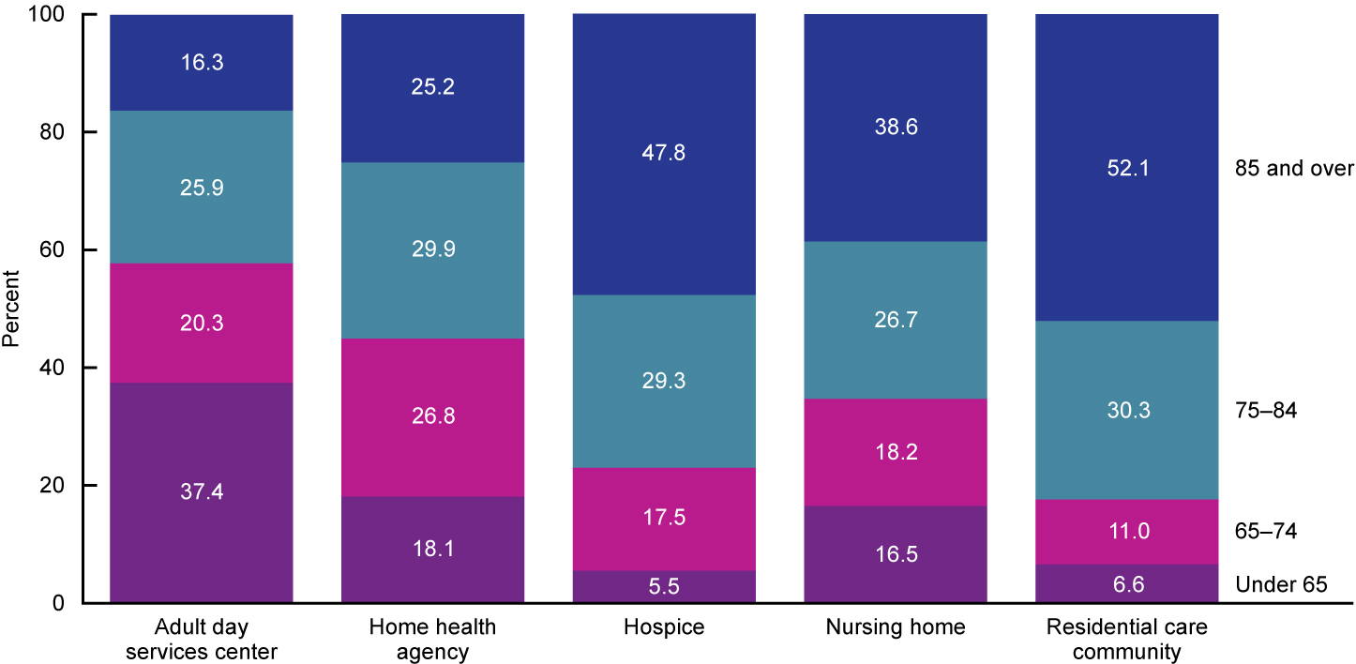
Percent distribution of long-term care services users, by sector and age group: United States, 2015 and 2016
NOTES: Denominators used to calculate percentages for adult day services centers, nursing homes, and residential care communities were the number of participants enrolled in adult day services centers, the number of residents in nursing homes, and the number of residents in residential care communities on a given day in 2016, respectively. Denominators used to calculate percentages for home health agencies and hospices were the number of patients whose episode of care ended at any time in 2015 and the number of patients for whom Medicare-certified hospices submitted a Medicare claim at any time in 2015, respectively. See the Appendix I Technical Notes for more information on the data sources used for each sector. Percentages are based on unrounded estimates. Percent distributions may not add to 100 because of rounding.
SOURCE: NCHS, “Long-term Care Providers and Services Users in the United States: 2015–2016,” Figure 20.
Notes:
The majority of long-term care services users were aged 65 and over: 94.6% of hospice patients, 93.4% of residential care residents, 83.5% of nursing home residents, 81.9% of home health patients, and 62.5% of participants in adult day services centers (Figure 20).
Among nursing home residents, 81.4% of short-stay residents and 85.1% of long-stay residents were aged 65 and over (Appendix III, Table IX).
The age composition of services users varied by sector, with residential care communities (52.1%), hospices (47.8%), and nursing homes (38.6%) serving more persons aged 85 and over, and adult day services centers (37.4%) serving more persons under age 65 than other sectors.
Among nursing home residents, 32.2% of short-stay residents and 43.5% of long-stay residents were aged 85 and over (Appendix III, Table IX).

Slide 23
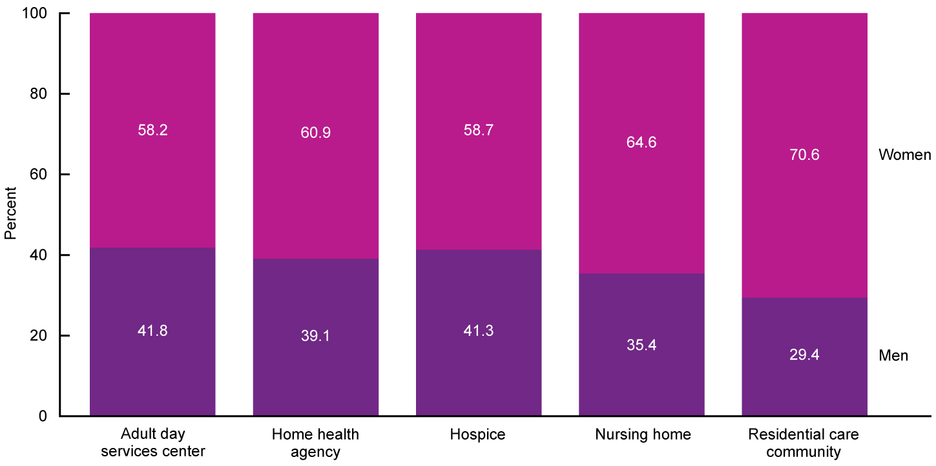
Percent distribution of long-term care services users, by sector and sex: United States, 2015 and 2016
NOTES: Denominators used to calculate percentages for adult day services centers, nursing homes, and residential care communities were the number of participants enrolled in adult day services centers, the number of residents in nursing homes, and the number of residents in residential care communities on a given day in 2016, respectively. Denominators used to calculate percentages for home health agencies and hospices were the number of patients whose episode of care ended at any time in 2015 and the number of patients for whom Medicare-certified hospices submitted a Medicare claim at any time in 2015, respectively. See the Appendix I Technical Notes for more information on the data sources used for each sector. Percentages are based on unrounded estimates. Percent distributions may not add to 100 because of rounding.
SOURCE: NCHS, “Long-term Care Providers and Services Users in the United States: 2015–2016,” Figure 21.
Notes:
In all five sectors, the users of long-term care services were overwhelmingly women, with residential care communities having the highest proportion (70.6%) (Figure 21).
Among nursing home residents, 60.3% of short-stay residents and 67.9% of long-stay residents were women (Appendix III, Table IX).

Slide 24
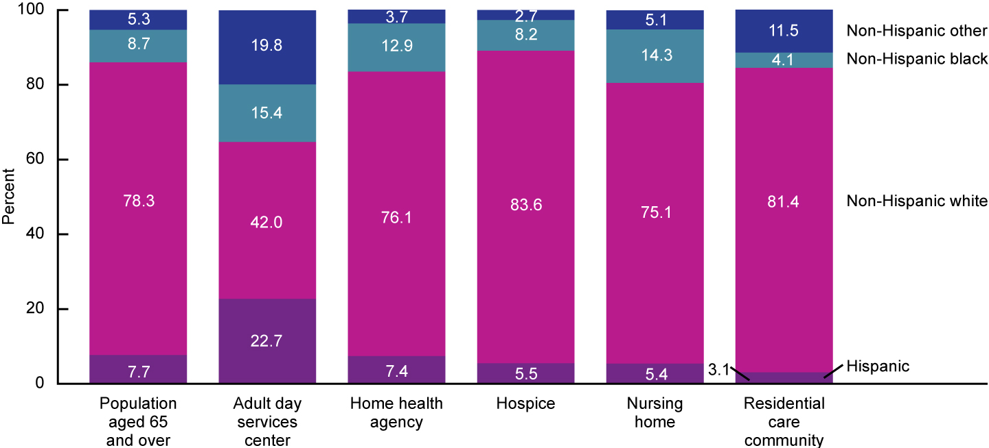
Percent distribution of long-term care services users, by sector and race and Hispanic origin:
United States, 2015 and 2016
NOTES: Denominators used to calculate percentages for adult day services centers, nursing homes, and residential care communities were the number of participants enrolled in adult day services centers, the number of residents in nursing homes, and the number of residents in residential care communities on a given day in 2016, respectively. Denominators used to calculate percentages for home health agencies and hospices were the number of patients for whom Medicare-certified home health agencies submitted a Medicare claim at any time in 2015 and the number of patients for whom Medicare-certified hospices submitted a Medicare claim at any time in 2015, respectively. For adult day services centers and residential care communities, includes non-Hispanic American Indian or Alaska Native, non-Hispanic Asian, non-Hispanic Native Hawaiian or Other Pacific Islander, non-Hispanic of two or more races, and unknown race and ethnicity. See the Appendix I Technical Notes for more information on the data sources used for each sector. Percentages are based on unrounded estimates. Percent distributions may not add to 100 because of rounding.
SOURCE: NCHS, “Long-term Care Providers and Services Users in the United States: 2015–2016,” Figure 22.
Notes:
Non-Hispanic white persons accounted for at least three-quarters of users in all long-term care services sectors except adult day services centers (Figure 22).
The percentage of non-Hispanic white persons was highest in hospice (83.6%) and residential care communities (81.4%), followed by home health agencies (76.1%) and nursing homes (75.1%). Less than one-half of the participants in adult day services centers were non-Hispanic white (42.0%).
Adult day services centers were the most racially and ethnically diverse among the five sectors: 15.4% of center participants were non-Hispanic black and 22.7% were Hispanic.
About one-tenth of home health patients (12.9%), nursing home residents (14.3%), and hospice patients (8.2%) were non-Hispanic black, while 4.1% of residential care residents were non-Hispanic black.
In nursing homes, 74.6% of short-stay residents and 75.6% of long-stay residents were non-Hispanic white, followed by non-Hispanic black (14.0% and 14.6% among short- and long-stay residents, respectively) (Appendix III, Table IX).

Slide 25
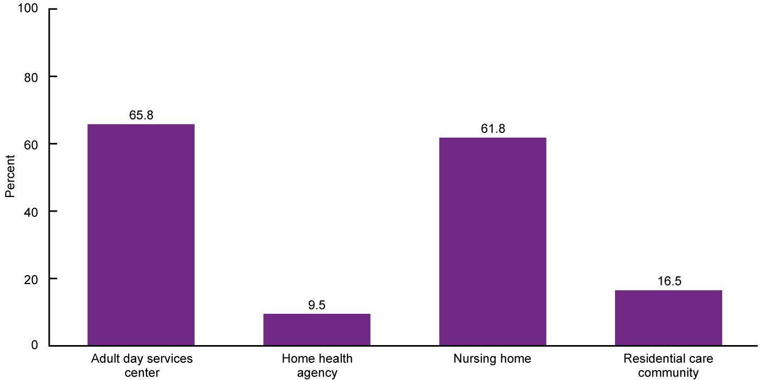
Percentage of long-term care services users with Medicaid as payer source, by sector: United States, 2015 and 2016
NOTES: Denominators used to calculate percentages for adult day services centers, nursing homes, and residential care communities were the number of participants enrolled in adult day services centers, the number of residents in nursing homes, and the number of residents in residential care communities on a given day in 2016, respectively. The denominator used to calculate the percentage for home health agencies was the number of patients whose episode of care ended at any time in 2015. Data on Medicaid as payer source were not available for hospice patients. See Appendix II for definitions of Medicaid as payer source for each sector. Percentages are based on unrounded estimates.
SOURCE: NCHS, “Long-term Care Providers and Services Users in the United States: 2015–2016,” Figure 23.
Notes:
The percentage of long-term care services users using Medicaid as a payer source was highest in adult day services centers (65.8%), followed by nursing homes (61.8%) (Figure 23).
Among residential care residents, 16.5% used Medicaid as a payer source, followed by 9.5% of home health patients.
Data on Medicaid as payer source were not available for hospice patients.

Slide 26
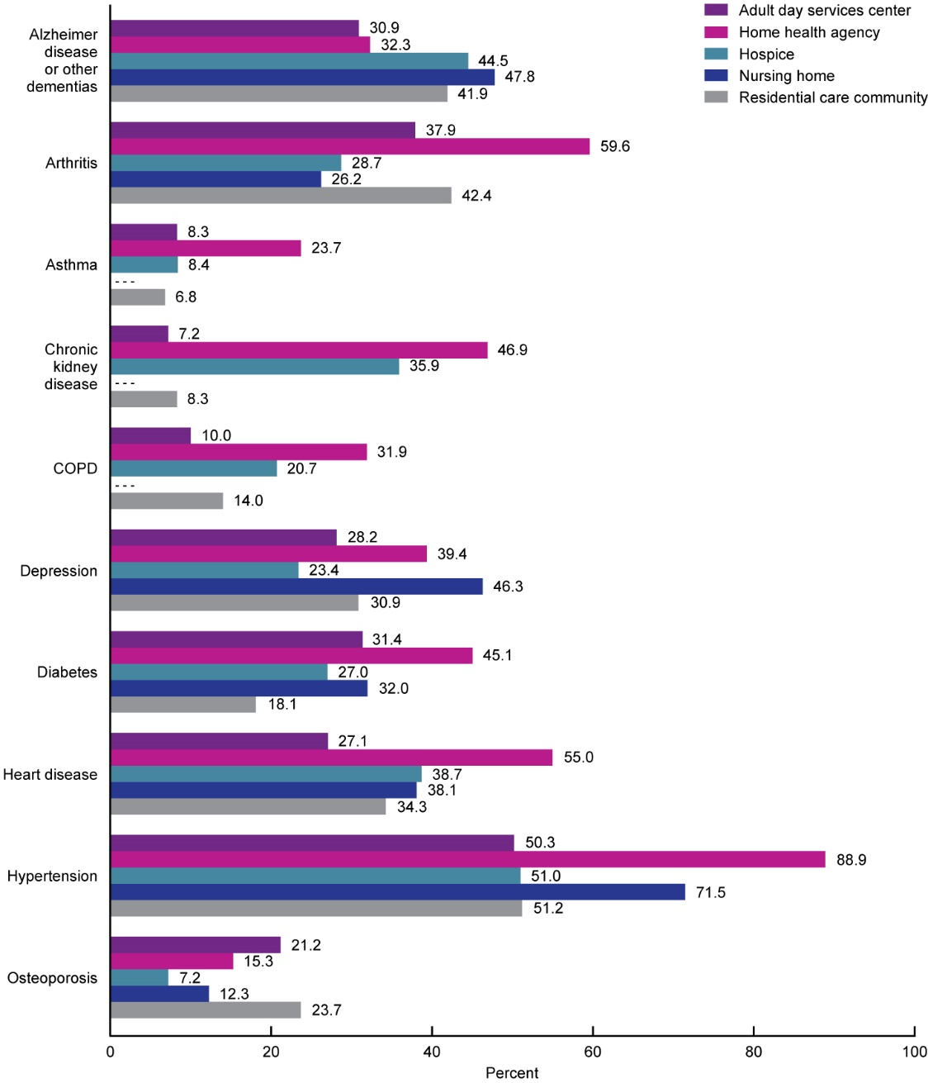
Percentage of long-term care services users with selected diagnoses, by sector: United States, 2015 and 2016
- - - Data not available.
NOTES: Denominators used to calculate percentages for adult day services centers, nursing homes, and residential care communities were the number of participants enrolled in adult day services centers, the number of residents in nursing homes, and the number of residents in residential care communities on a given day in 2016, respectively. Denominators used to calculate percentages for home health agencies and hospices were the number of patients for whom Medicare-certified home health agencies submitted a Medicare claim at any time in 2015 and the number of patients for whom Medicare-certified hospices submitted a Medicare claim at any time in 2015, respectively. See the Appendix I Technical Notes for more information on the data sources used for each sector. See Appendix II for definitions of conditions used for each sector. Percentages are based on unrounded estimates. Available data for nursing homes could not produce estimates for asthma, chronic kidney disease, and chronic obstructive pulmonary disease (COPD), because asthma and COPD were grouped together (21.2%), and only end-stage renal disease (12.9%) was available, which accounts for only a portion of residents with chronic kidney disease.
SOURCE: NCHS, “Long-term Care Providers and Services Users in the United States: 2015–2016,” Figure 24.
Notes:
Alzheimer disease or other dementias were most prevalent among nursing home residents (47.8%) and were least prevalent among adult day services center participants (30.9%) (Figure 24). The percentage of nursing home residents with a diagnosis of Alzheimer disease was higher among long-stay residents (58.9%) than among short-stay residents (36.7%) (Appendix III, Table IX).
Arthritis was most prevalent among home health patients (59.6%) and was least prevalent among nursing home residents (26.2% overall; 25.1% among short-stay residents and 29.7% among long-stay residents).
The percentage of long-term care services users with a diagnosis of asthma was highest among home health patients (23.7%) and lowest among residential care community residents (6.8%).
A diagnosis of chronic kidney disease was most common among home health patients (46.9%), followed by hospice patients (35.9%), and was least common among adult day services center participants (7.2%) and residential care community residents (8.3%).
Similarly, COPD was most common among home health patients (31.9%), followed by hospice patients (20.7%), residential care community residents (14.0%), and adult day services center participants (10.0%).
The percentage of long-term care services users with a diagnosis of depression was highest in nursing homes (46.3%) and lowest in hospices (23.4%) (Figure 24). Among nursing home residents, the prevalence of depression was higher among long-stay residents (53.0%) than short-stay residents (42.6%) (Appendix III, Table IX).
Diabetes was most prevalent among home health patients (45.1%), followed by nursing home residents (32.0% overall; 37.0% of short-stay residents and 32.2% of long-stay residents) and adult day services center participants (31.4%), but it was least prevalent among residential care community residents (18.1%).
A diagnosis of heart disease was most common among home health patients (55.0%).
Over one-half of long-term care services users in all five long-term care sectors had a diagnosis of hypertension, with the highest proportion among home health patients (88.9%).
The percentage of long-term care services users with a diagnosis of osteoporosis was highest in residential care communities (23.7%), followed by adult day services centers (21.2%), home health agencies (15.3%), nursing homes (12.3% overall; 9.8% of short-stay residents and 15.1% of long-stay residents), and hospices (7.2%).

Slide 27
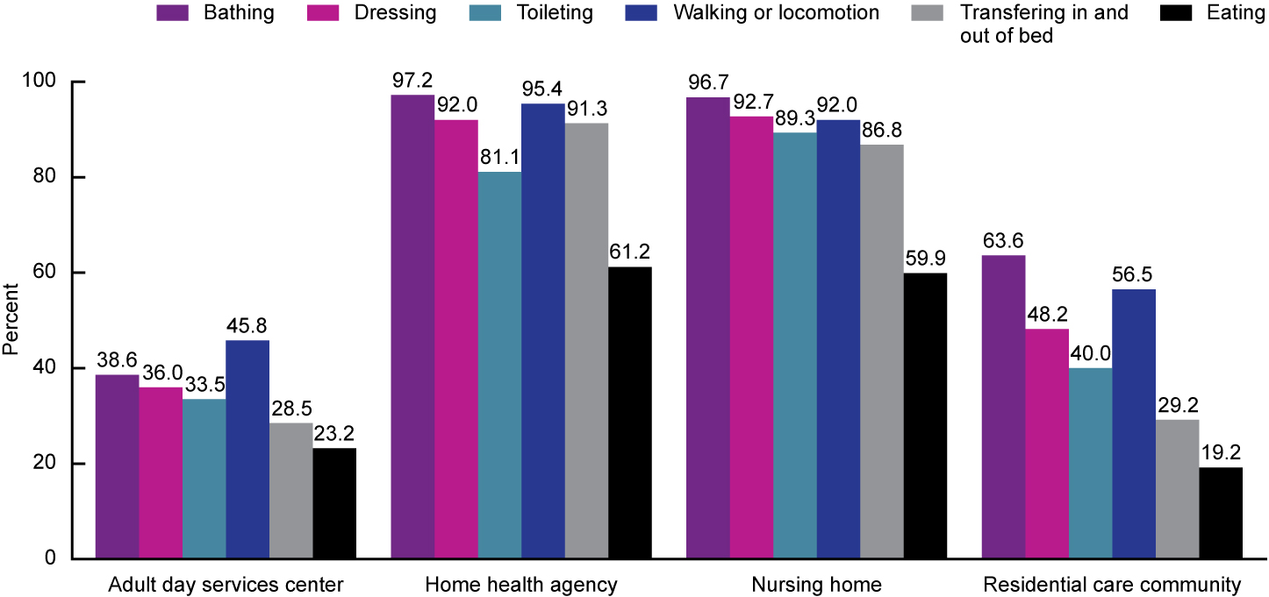
Percentage of long-term care services users needing any assistance with activities of daily living, by sector and activity: United States, 2015 and 2016
NOTES: Denominators used to calculate percentages for adult day services centers, nursing homes, and residential care communities were the number of participants enrolled in adult day services centers, the number of residents in nursing homes, and the number of residents in residential care communities on a given day in 2016, respectively. The denominator used to calculate the percentage for home health agencies was the number of patients whose episode of care ended at any time in 2015. Participants, patients, or residents were considered needing any assistance with a given activity if they needed help or supervision from another person or used assistive devices to perform the activity. See Appendix II for definitions of needing any assistance with activities of daily living used for each sector. Data on needing any assistance with activities of daily living were not available for hospice patients. Percentages are based on unrounded estimates.
SOURCE: NCHS, “Long-term Care Providers and Services Users in the United States: 2015–2016,” Figure 25.
Notes:
This report uses the need for assistance with six ADLs—bathing, dressing, toileting, walking or locomotion, transferring in and out of a chair or bed, and eating—to measure physical and cognitive functioning among residents in nursing homes and residential care communities, home health patients, and adult day services center participants. Data on need for assistance with ADLs were not available for hospice patients.
Overall, functional ability varied by sector. Within each sector except adult day services centers, the need for assistance with bathing was most common. The need for assistance with eating was least common within each of the five sectors (Figure 25).
Adult day services centers had fewer participants that needed assistance with four of the six ADLs (bathing, dressing, toileting, and walking or locomotion) than services users in other sectors.
Fewer adult day services center participants needed assistance with ADLs compared with services users in the other four sectors. Among adult day services center participants, the need for assistance with walking or locomotion was most common (45.8%).
While the prevalence of ADL needs differed by sector, at a minimum, 45.8% of services users across all sectors needed assistance with at least one of the six ADLs.

Slide 28
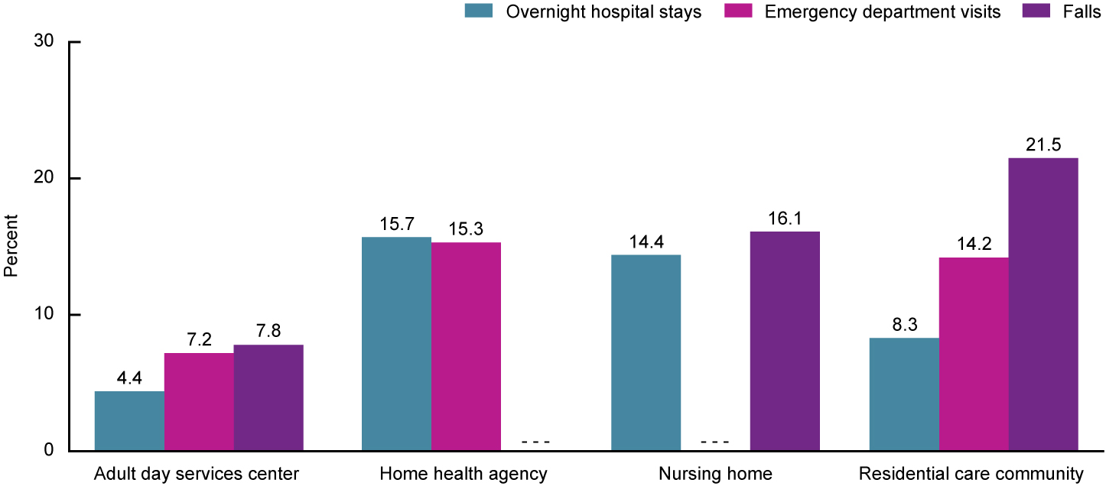
Percentage of long-term care services users with overnight hospital stays, emergency department visits, and falls, by sector: United States, 2015 and 2016
- - - Data not available.
NOTES: Denominators used to calculate percentages for adult day services centers, nursing homes, and residential care communities were the number of participants enrolled in adult day services centers, the number of residents in nursing homes, and the number of residents in residential care communities on a given day in 2016, respectively. The denominator used to calculate the percentage for home health agencies was the number of patients whose episode of care ended at any time in 2015. For adult day services centers and residential care communities, adverse events refer to the 90 days prior to the survey. For home health agencies, adverse events refer to a period since the last Outcome and Assessment Information Set. For nursing homes, falls refer to the period since admission or since the prior assessment, whichever is more recent. For hospices, data were not available for overnight hospital stays, emergency department visits, or falls. See the Appendix I Technical Notes for more information on the data sources used for each sector. See Appendix II for definitions of each adverse event used for each sector. Percentages are based on unrounded estimates.
SOURCE: NCHS, “Long-term Care Providers and Services Users in the United States: 2015–2016,” Figure 26.
Notes:
This report estimates the prevalence of overnight hospitalizations, emergency department visits, and falls as indicators of adverse, potentially avoidable events. For adult day services centers and residential care communities, adverse events refer to a period of 90 days prior to the survey. For home health agencies, adverse events refer to a period since the last Outcome and Assessment Information Set (OASIS) assessment. For nursing homes, falls refer to the period since admission or since the prior assessment, whichever is more recent. Varying reference periods by sector do not allow for direct comparisons between sectors.
About equal percentages of home health patients had overnight hospital stays (15.7%) and emergency department visits (15.3%) (Figure 26). About 14.4% of nursing home residents had overnight hospital stays; more short-stay residents had overnight hospital stays (23.8%) than long-stay residents (8.7%) (Appendix III, Table IX). About 8.3% of residential care community residents and 4.4% of adult day services center participants had overnight hospital stays. About 7.2% of adult day services center participants and 14.2% of residential care residents had emergency department visits.
About 21.5% of residential care community residents, 16.1% of nursing home residents, and 7.8% of adult day services center participants had falls. Among nursing home residents, more long-stay residents (19.1%) than short-stay residents (13.5%) had falls.
For home health patients, data for falls were not available. For nursing home residents, data for emergency department visits were not available, and data for hospitalizations were not reported because the timing of Medicare claims data did not match the other nursing home data sets used for this report. For hospice patients, data for emergency department visits, overnight hospital stays, and falls were not available.

