Slide 1
National Study of Long-Term Care Providers 2014
State Maps
Residential Care Communities
Division of Health Care Statistics

Slide 2
NSLTCP 2014 Residential Care State Maps Overview
This slide presentation (and accompanying presentation for adult day services sector) includes US maps for selected characteristics of the residential care communities and their residents. Characteristics include community ownership and chain status, disease specific programming, practices, and Medicaid utilization; and resident functioning, health conditions, and adverse events.
The data are from the National Center for Health Statistics’ (NCHS) 2013-2014 National Study of Long-Term Care Providers. Cases with missing data were excluded from the analyses on a variable by variable basis. Please visit the NSLTCP website to access published reports and state estimate tables and supplements, and to review the study’s methodology and documentation. All reports and products are easily accessible and can be downloaded at no cost.
Each map includes a title, legend, footnotes, and suggested talking points in the notes sections. The presentation is available in PDF and PowerPoint versions. The maps show states that are not statistically significantly different from the national estimate (white color), states that are statistically significantly lower than the national estimate (light gray blue), and states that are statistically significantly higher than the national estimate (bright blue). States where estimates cannot be reported are shaded with hash marks.
All material appearing in this presentation is in the public domain and may be reproduced or copied without permission; citation as to source is appreciated.
Suggested citation
Lendon, JP, Rome, V, and Sengupta, M. Maps of selected characteristics of residential care communities and residents in the United States: Data from the National Study of Long-Term Care Providers, 2013–2014. National Center for Health Statistics. 2017.
Division of Health Care Statistics

Slide 3
Links to NSLTCP Publications and Documentation
Study results and publications: https://www.cdc.gov/nchs/nsltcp/nsltcp_products.htm
Questionnaires, survey methodology, and related documentation: https://www.cdc.gov/nchs/nsltcp/nsltcp_questionnaires.htm
Division of Health Care Statistics

Slide 4
OWNERSHIP AND CHAIN STATUS
Division of Health Care Statistics

Slide 5
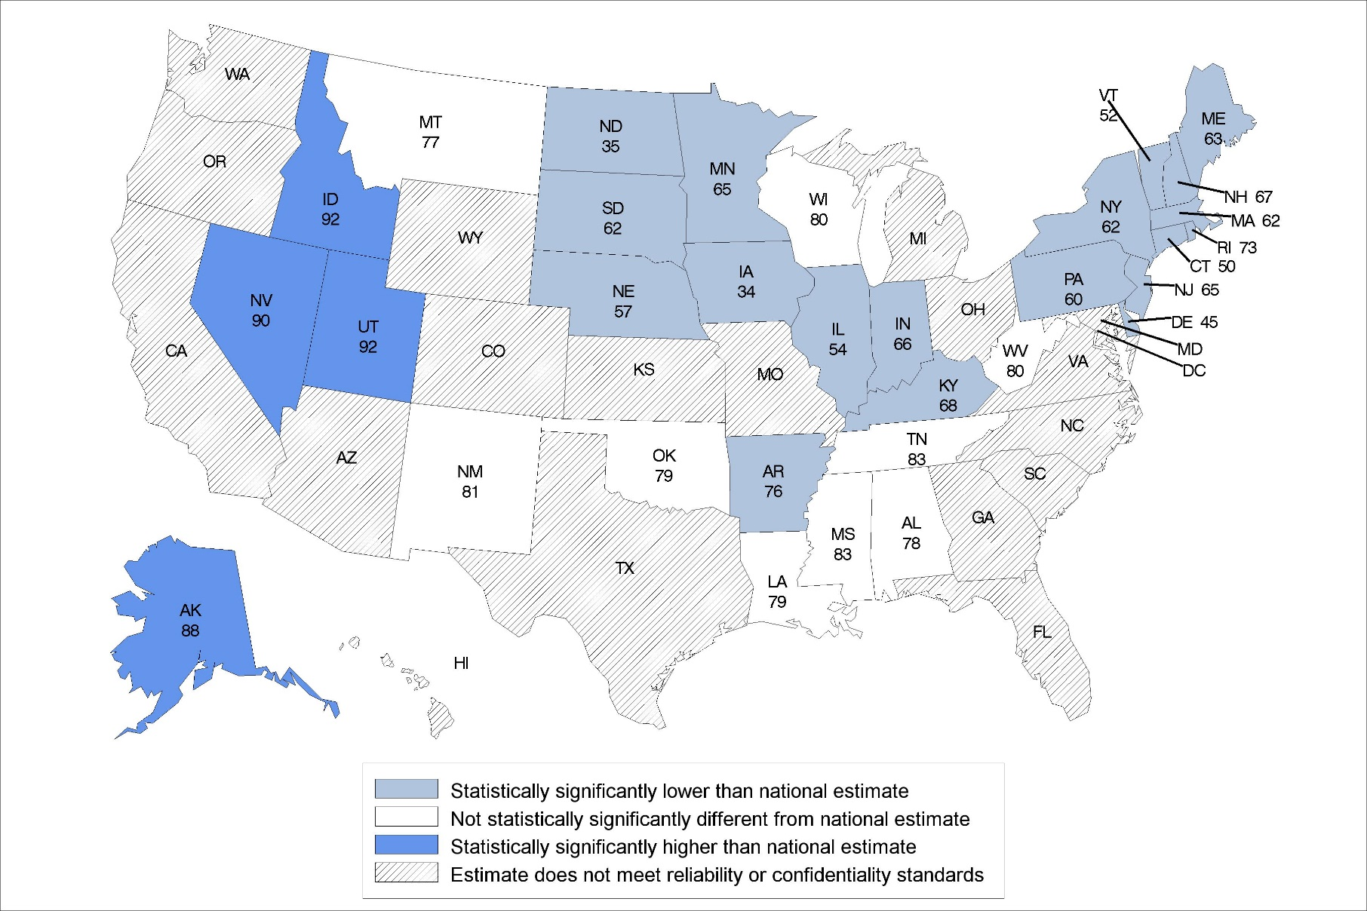
Percentage of residential care communities that are for-profit: United States, 2014
Statistical significance tested at p<0.05.
Note: The national percentage is 82%.
Source: NCHS, National Study of Long-Term Care Providers, 2014
Notes:
In 2014, the national percentage of for-profit residential care communities was 82%.
The percentages ranged from 34% in Iowa to 92% in Utah and Idaho.
The location of states statistically significantly higher than the national percentage was concentrated in the West.
The location of states statistically significantly lower than the national percentage was concentrated in the Midwest and Northeast regions.

Slide 6
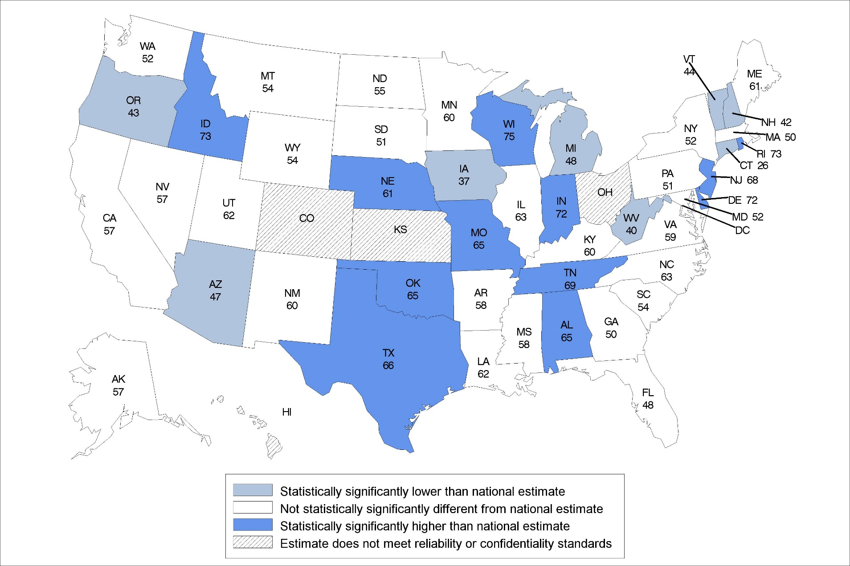
Percentage of residential care communities that are chain-affiliated: United States, 2014
Statistical significance tested at p<0.05.
Note: The national percentage is 56%.
Source: NCHS, National Study of Long-Term Care Providers, 2014
Notes:
In 2014, the national percentage of residential care communities that were affiliated with a chain was 56%.
The percentages ranged from 26% in Connecticut to 75% in Wisconsin.
States that were statistically significantly higher that the national percentage were located in the south and central regions of the United States.

Slide 7
DISEASE-SPECIFIC PROGRAMS
Division of Health Care Statistics

Slide 8
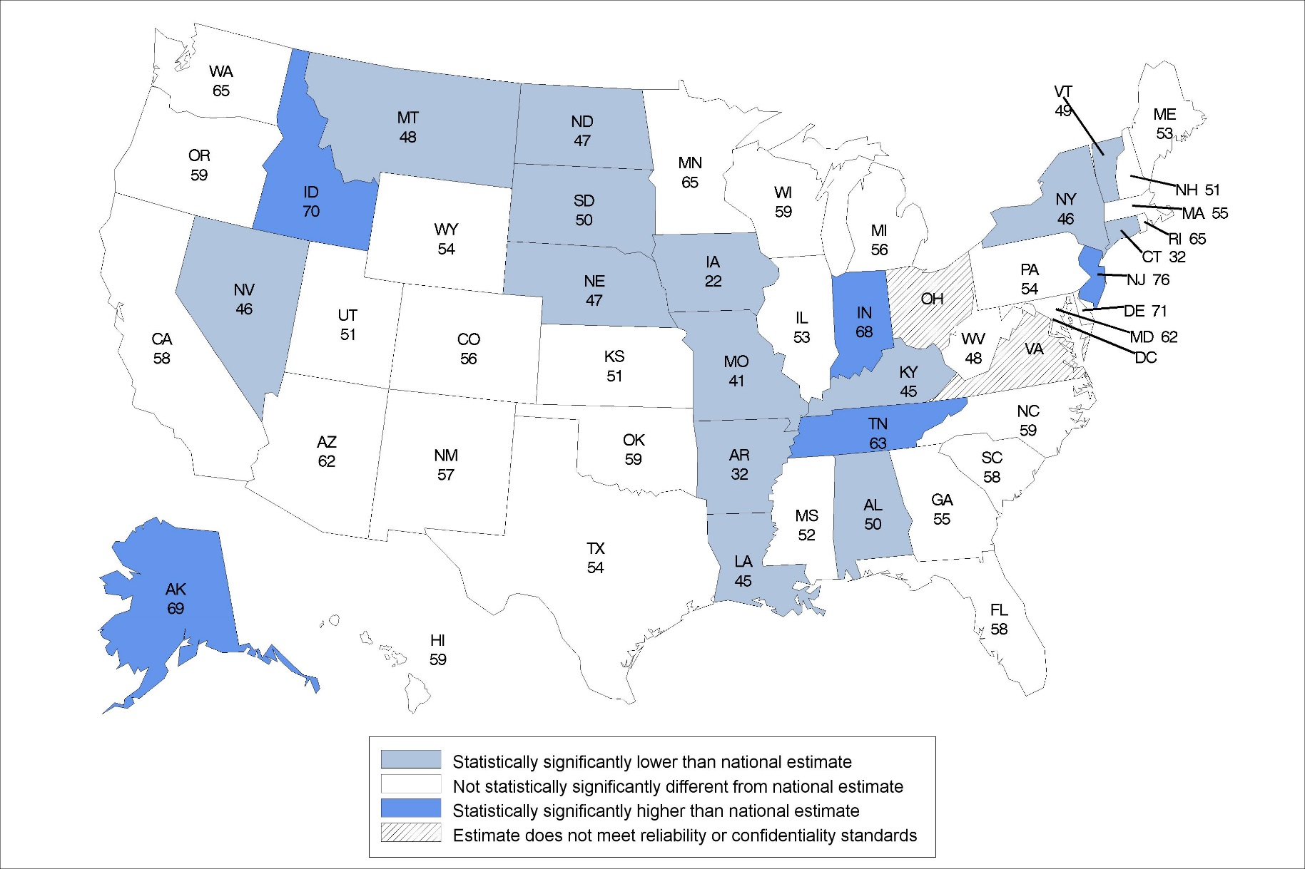
Percentage of residential care communities that offer disease-specific programs for Alzheimer’s disease: United States, 2014
Statistical significance tested at p<0.05.
Note: The national percentage is 58%.
Source: NCHS, National Study of Long-Term Care Providers, 2014
Notes:
In 2014, the national percentage of residential care communities that offer disease-specific programs for Alzheimer’s disease was 58%.
The percentages ranged from 22% in Iowa to 76% in New Jersey.
The location of states statistically significantly lower than the national percentage was concentrated in the middle of the country.

Slide 9
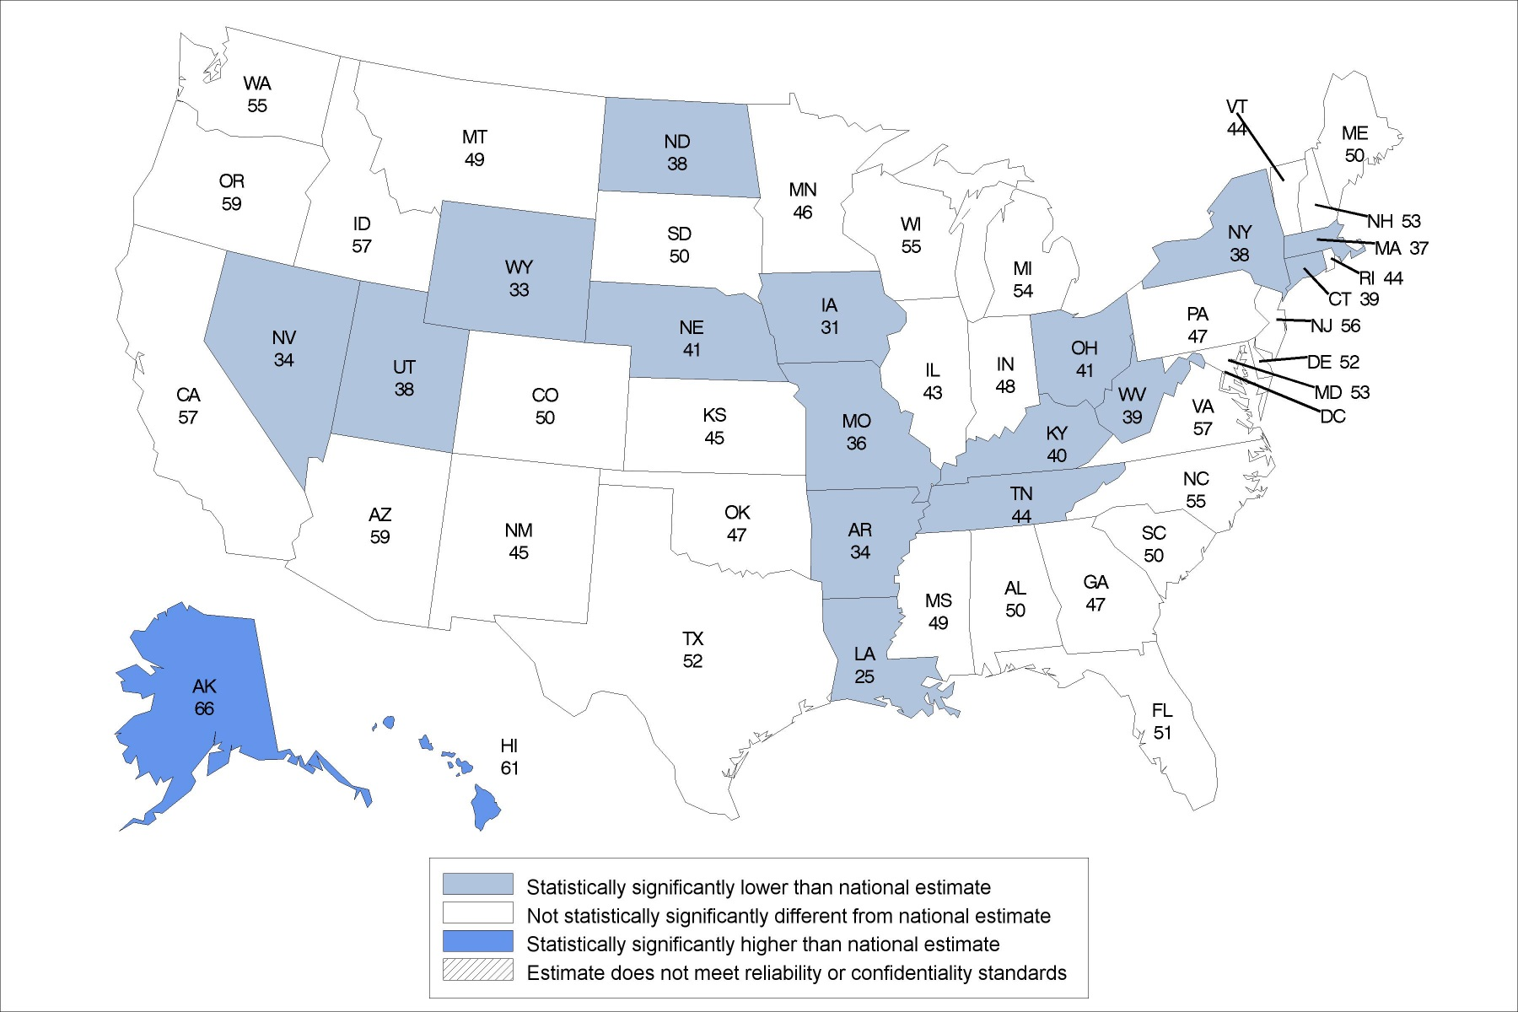
Percentage of residential care communities that offer disease-specific programs for cardiovascular disease: United States, 2014
Statistical significance tested at p<0.05.
Note: The national percentage is 52%.
Source: NCHS, National Study of Long-Term Care Providers, 2014
Notes:
In 2014, the national percentage of residential care communities that offer disease-specific programs for cardiovascular disease was 52%.
The percentages ranged from 25% in Louisiana to 66% in Alaska.
The location of states statistically significantly lower than the national percentage was concentrated in the middle of the country.
Only Alaska and Hawaii were statistically significantly higher than the national percentage.

Slide 10
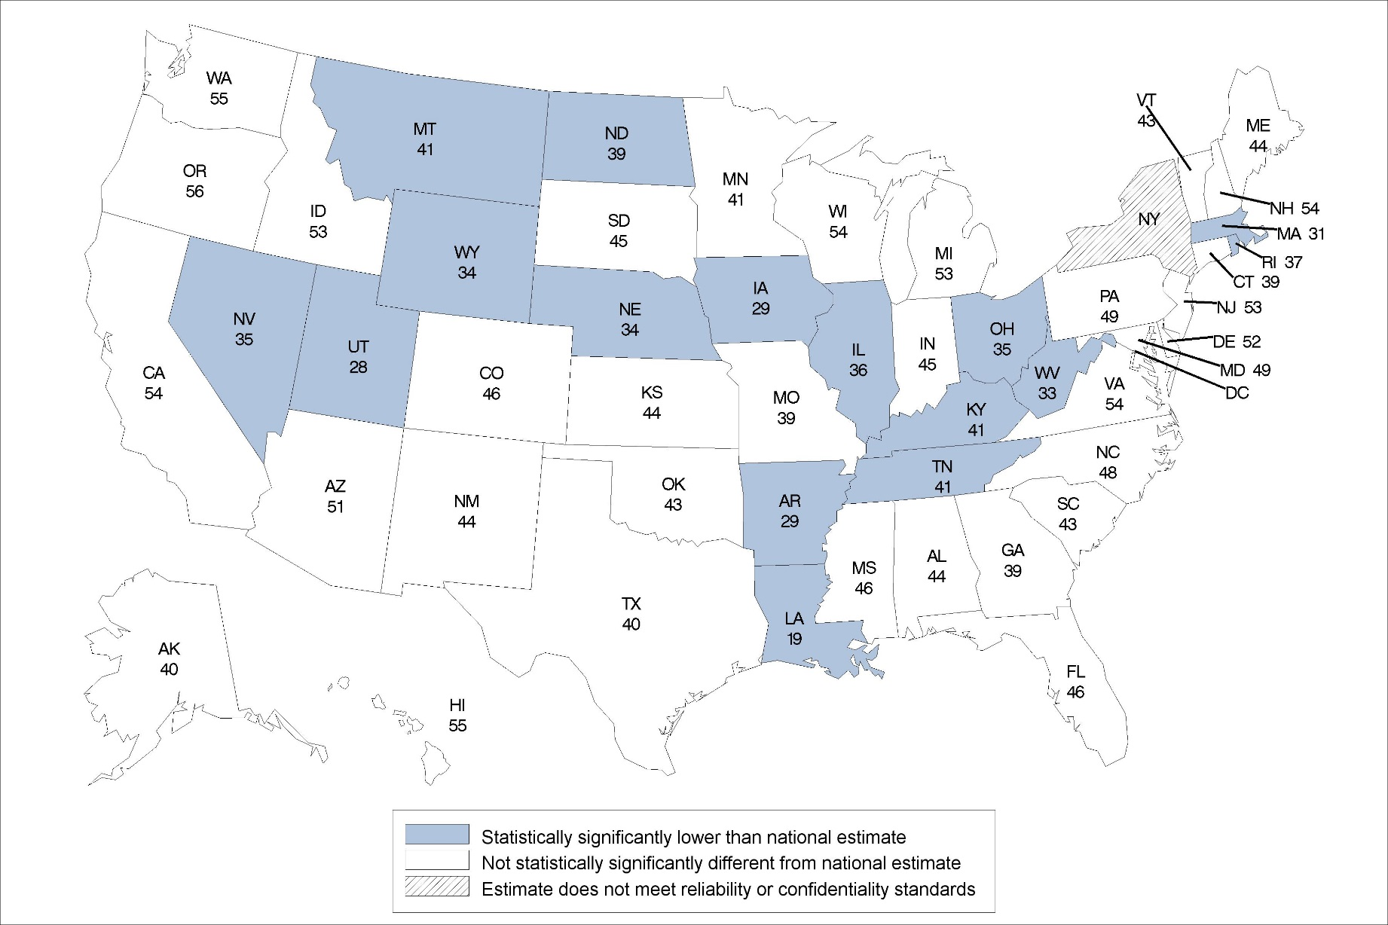
Percentage of residential care communities that offer disease-specific programs for depression: United States, 2014
Statistical significance tested at p<0.05.
Note: The national percentage is 48%.
Source: NCHS, National Study of Long-Term Care Providers, 2014
Notes:
In 2014, the national percentage of residential care communities that offer disease-specific programs for depression was 48%.
The lowest percentage was 19% in Louisiana and no states were statistically significantly greater than the national percentage.
The location of states statistically significantly lower than the national percentage was concentrated in the middle of the country.

Slide 11
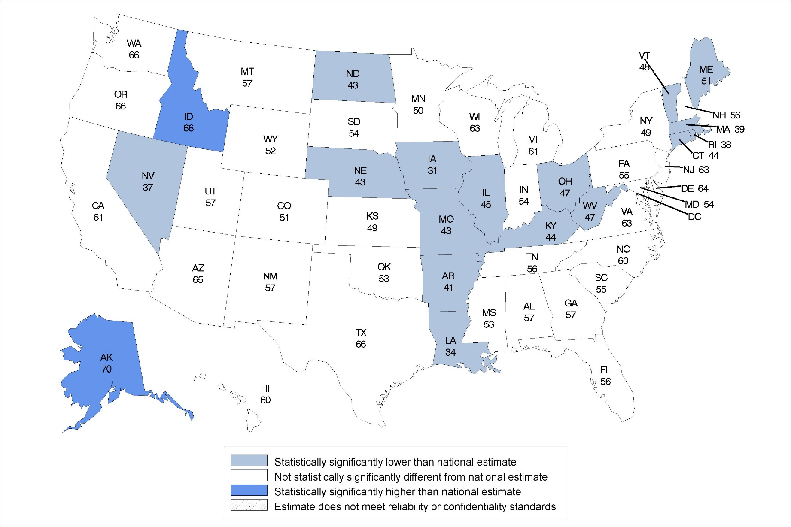
Percentage of residential care communities that offer disease-specific programs for diabetes: United States, 2014
Statistical significance tested at p<0.05.
Note: The national percentage is 58%.
Source: NCHS, National Study of Long-Term Care Providers, 2014
Notes:
In 2014, the national percentage of residential care communities that offer disease-specific programs for diabetes was 58%.
The percentages ranged from 31% in Iowa to 70% in Alaska.
The location of states statistically significantly lower than the national percentage was concentrated in the middle of the country.

Slide 12
PRACTICES
Division of Health Care Statistics

Slide 13
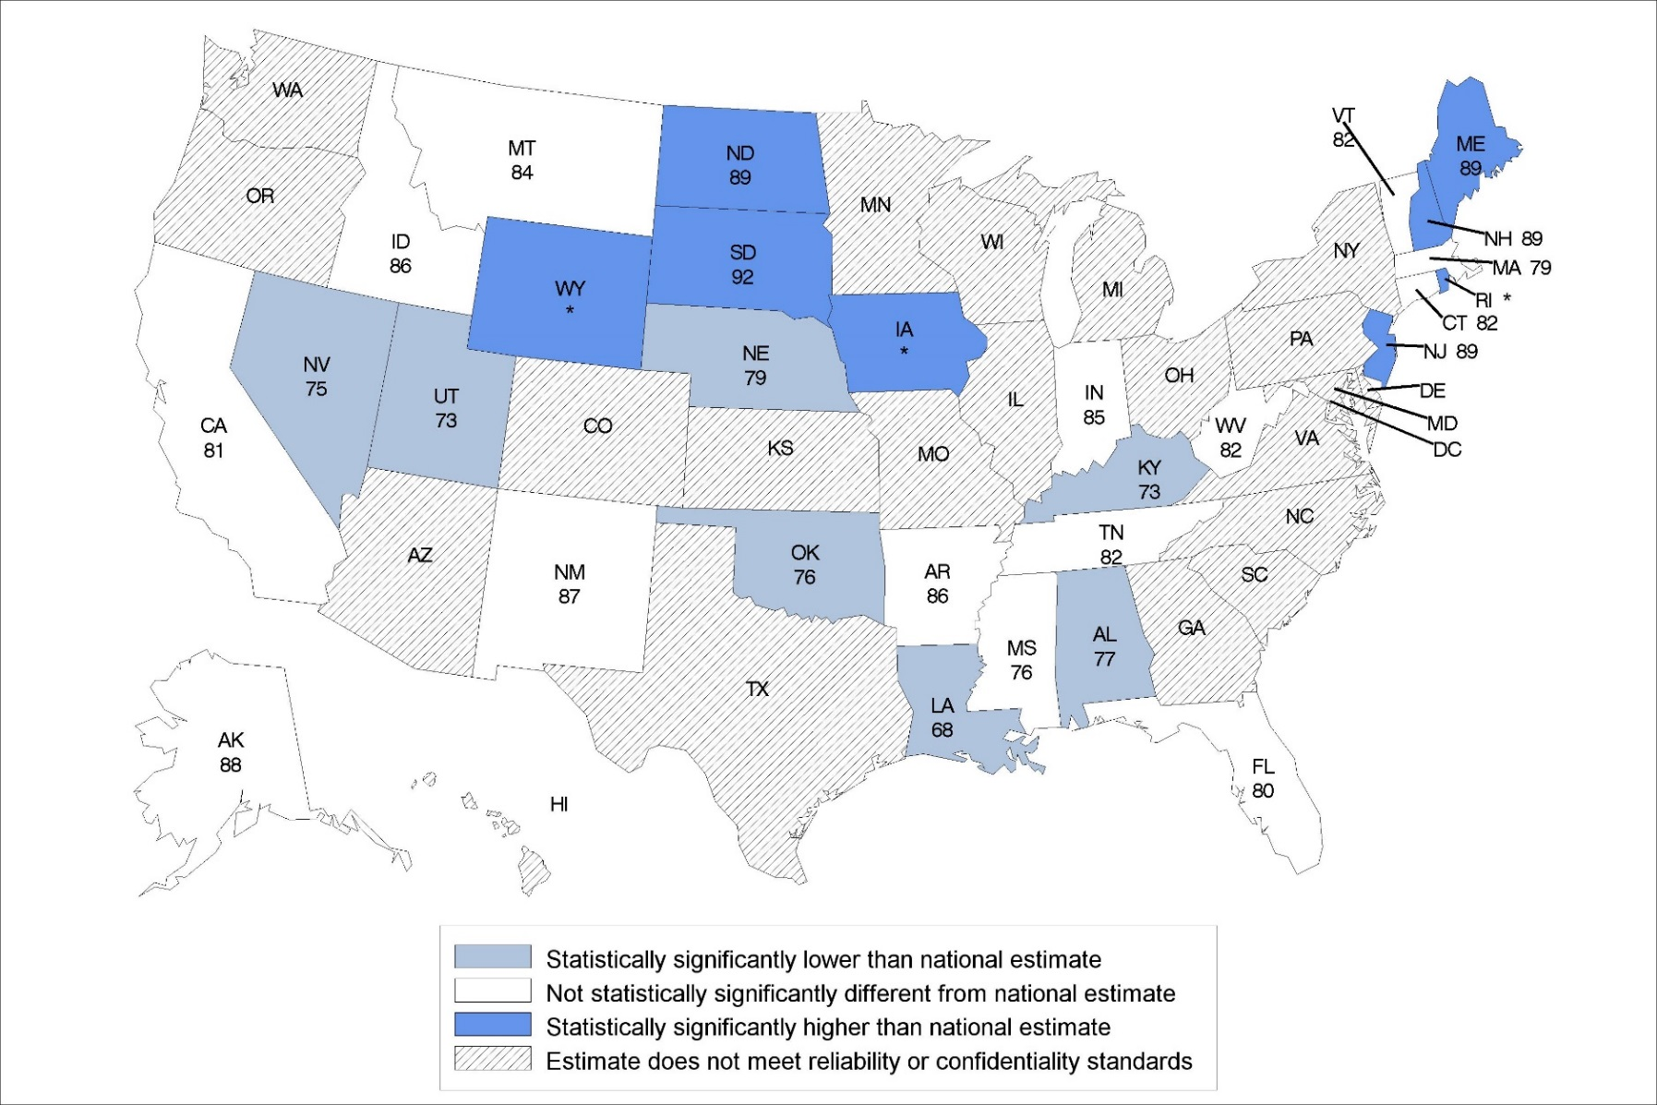
Percentage of residential care communities that screen for depression: United States, 2014
Statistical significance tested at p<0.05.
*Percentage is 90% or higher but estimate is not displayed as it may pose a disclosure risk.
Note: The national percentage is 83%.
Source: NCHS, National Study of Long-Term Care Providers, 2014
Notes:
In 2014, the national percentage of residential care communities that screened for depression was 83%.
The percentages ranged from 68% in Louisiana to 92% in South Dakota.
The location of states statistically significantly different from the national percentage was varied across the United States.

Slide 14
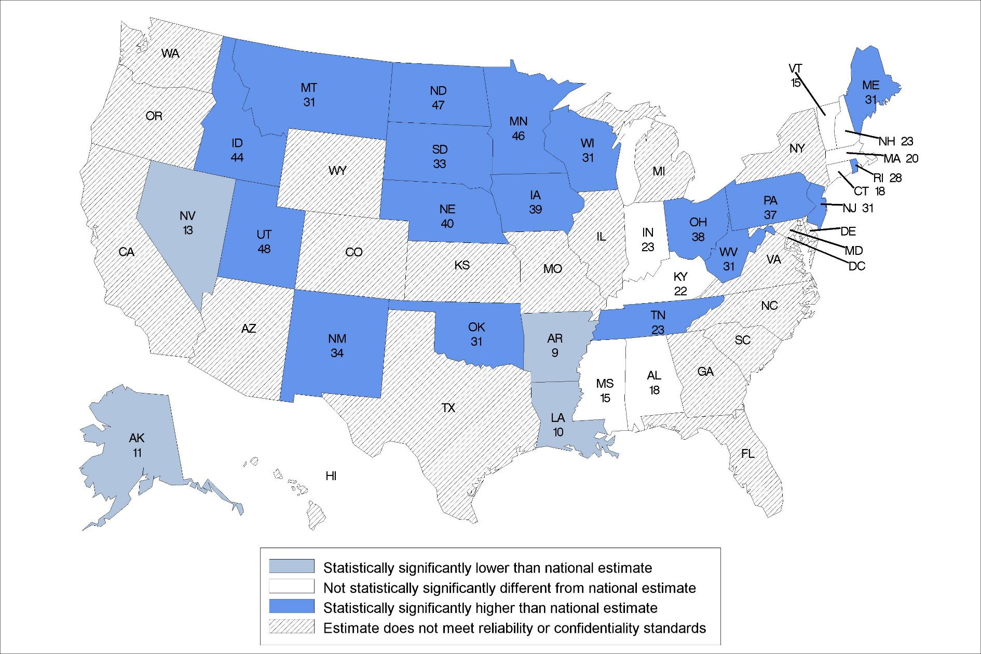
Percentage of residential care communities that use electronic health records: United States, 2014
Statistical significance tested at p<0.05.
Note: The national percentage is 19%.
Source: NCHS, National Study of Long-Term Care Providers, 2014
Notes:
In 2014, the national percentage of residential care communities that use electronic health records was 19%.
The percentages ranged from 9% in Arkansas to 48% in Utah.
The location of states statistically significantly different from the national percentage was varied across the United States.

Slide 15
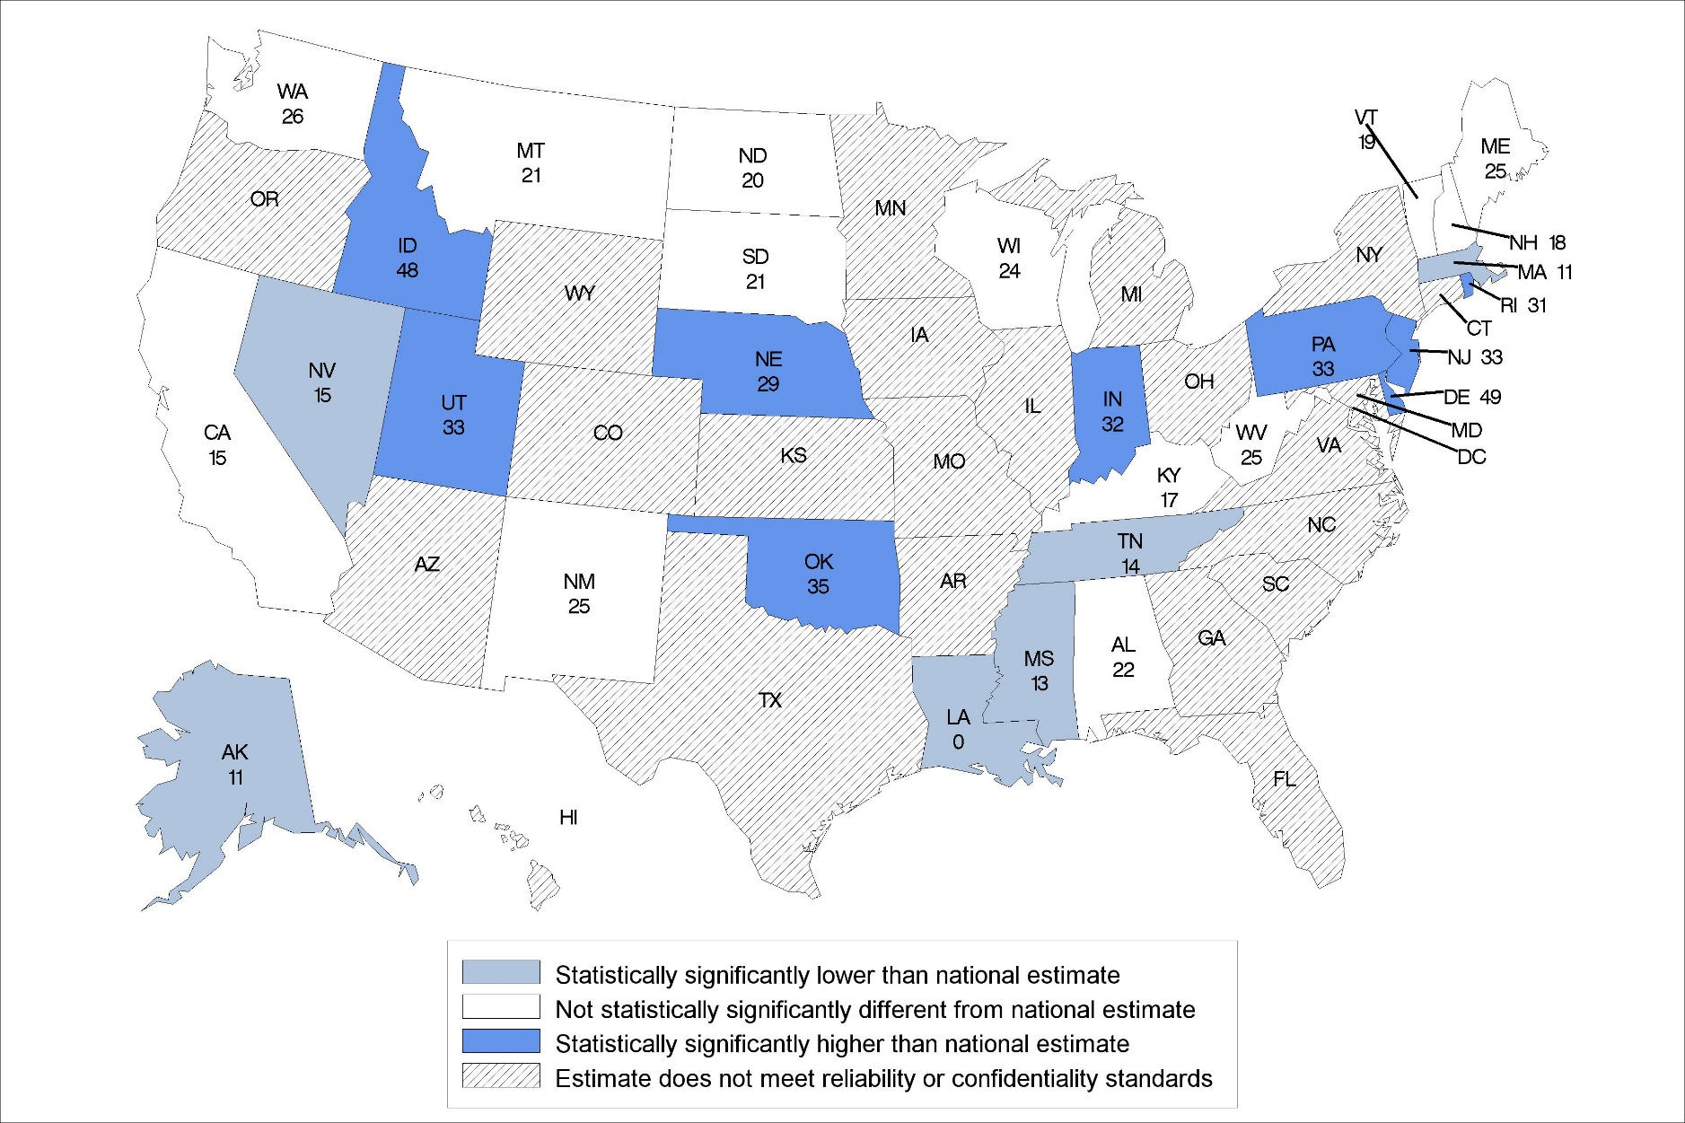
Percentage of residential care communities that had computerized support for electronic health information exchange: United States, 2014
Statistical significance tested at p<0.05.
Note: The national percentage is 20%.
Source: NCHS, National Study of Long-Term Care Providers, 2014
Notes:
In 2014, the national percentage of residential care communities that had computerized support for electronic health information exchange was 20%.
The percentages ranged from 0% in Louisiana to 49% in Delaware.

Slide 16
DEMENTIA CARE
Division of Health Care Statistics

Slide 17
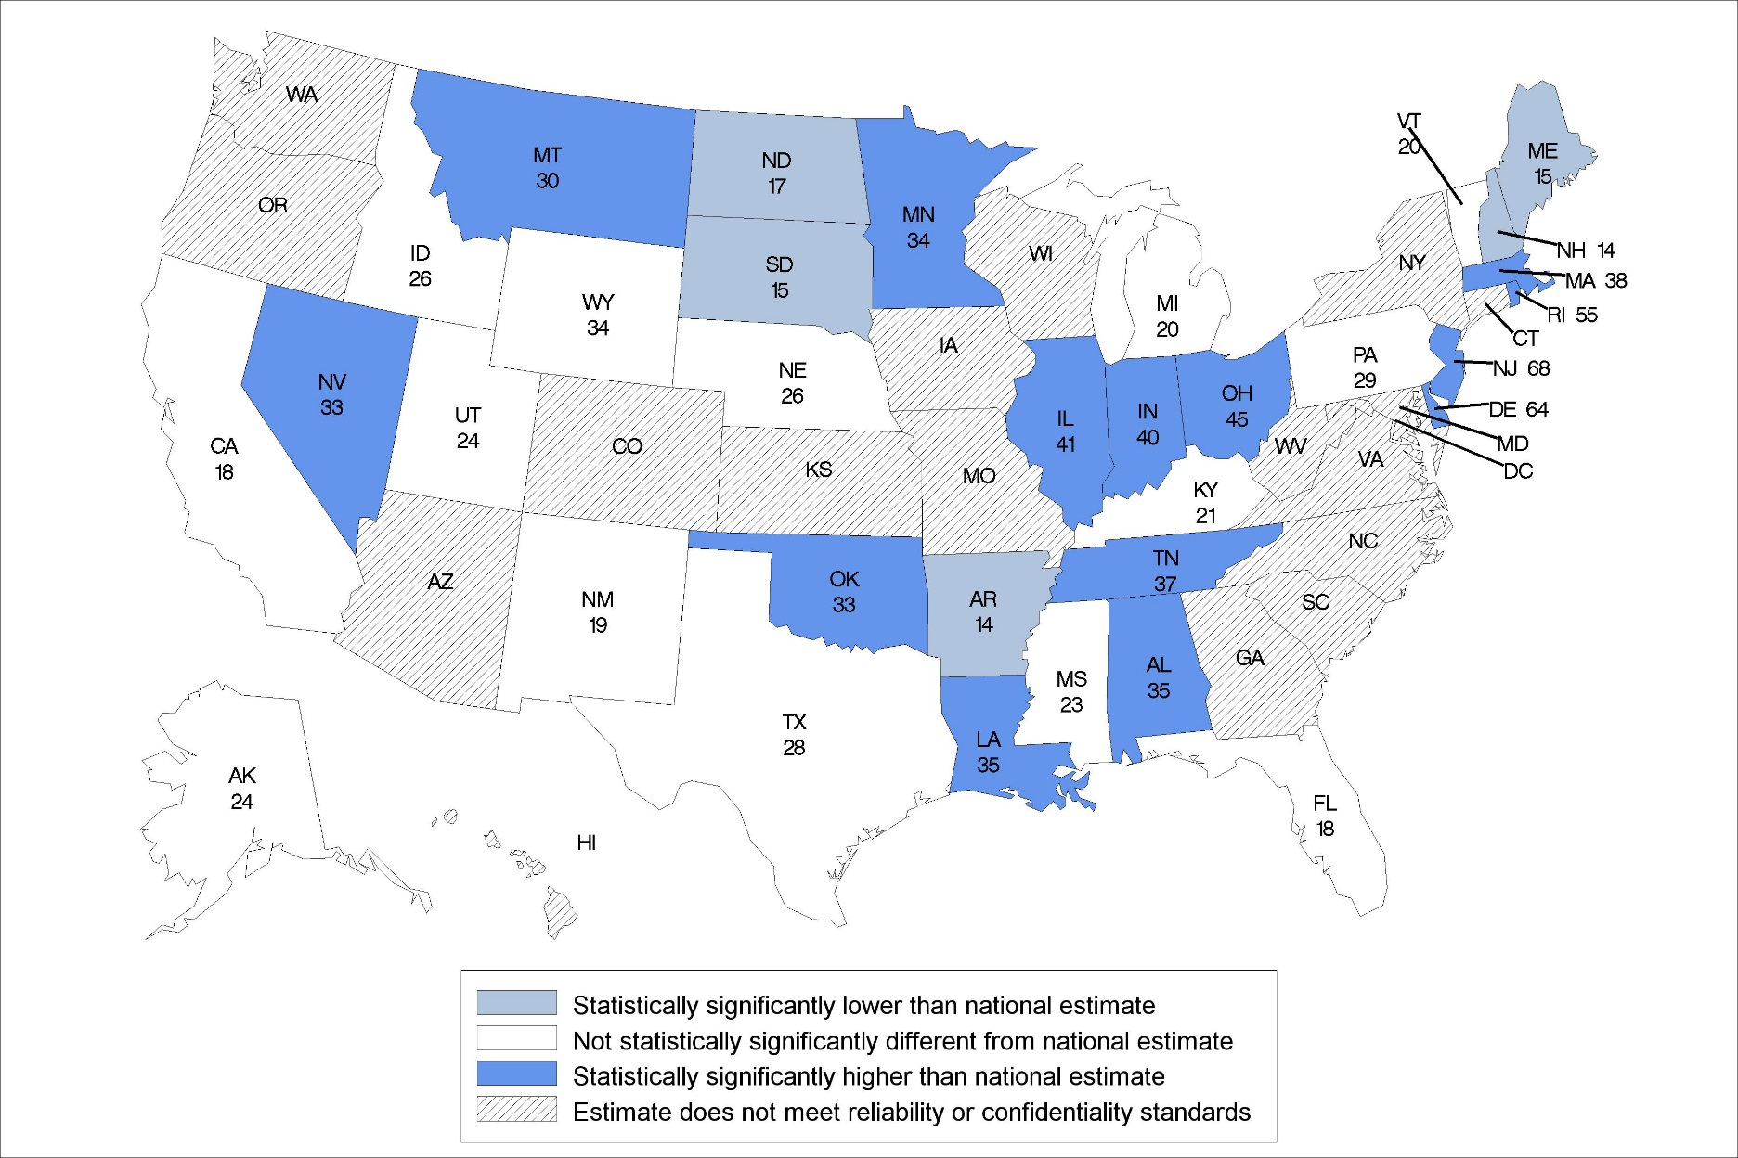
Percentage of residential care communities with a dementia care unit: United States, 2014
Statistical significance tested at p<0.05.
Note: The national percentage is 22%.
Source: NCHS, National Study of Long-Term Care Providers, 2014
Notes:
In 2014, the national percentage of residential care communities with a dementia special care unit was 22%.
The percentages ranged from 14% in Arkansas to 68% in New Jersey.
The location of states statistically significantly different from the national percentage was varied across the United States.

Slide 18
MEDICAID

Slide 19
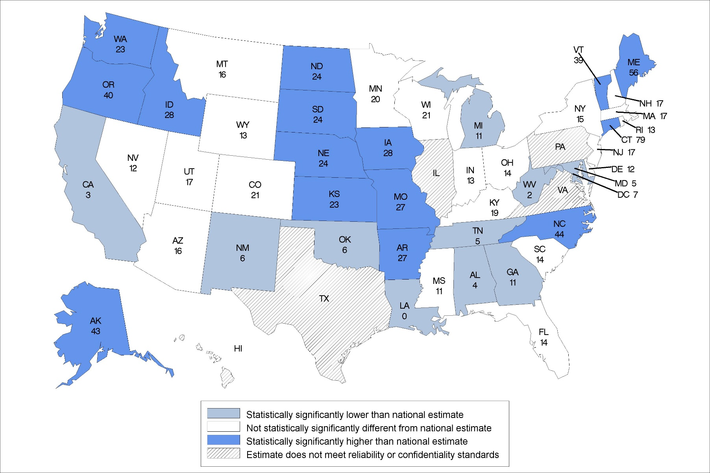
Percentage of residential care residents who used Medicaid for long-term care services in the past 30 days: United States 2014
Statistical significance tested at p<0.05.
Note: The national percentage is 15%.
Source: NCHS, National Study of Long-Term Care Providers, 2014
Notes:
In 2014, the national percentage of residential care residents whose care during the past 30 days was paid by Medicaid was 15%.
The percentages ranged from 0% in Louisiana to 79% in Connecticut.
The location of states statistically significantly different from the national percentage was varied across the United States.

Slide 20
ACTIVITIES OF DAILY LIVING
Division of Health Care Statistics

Slide 21
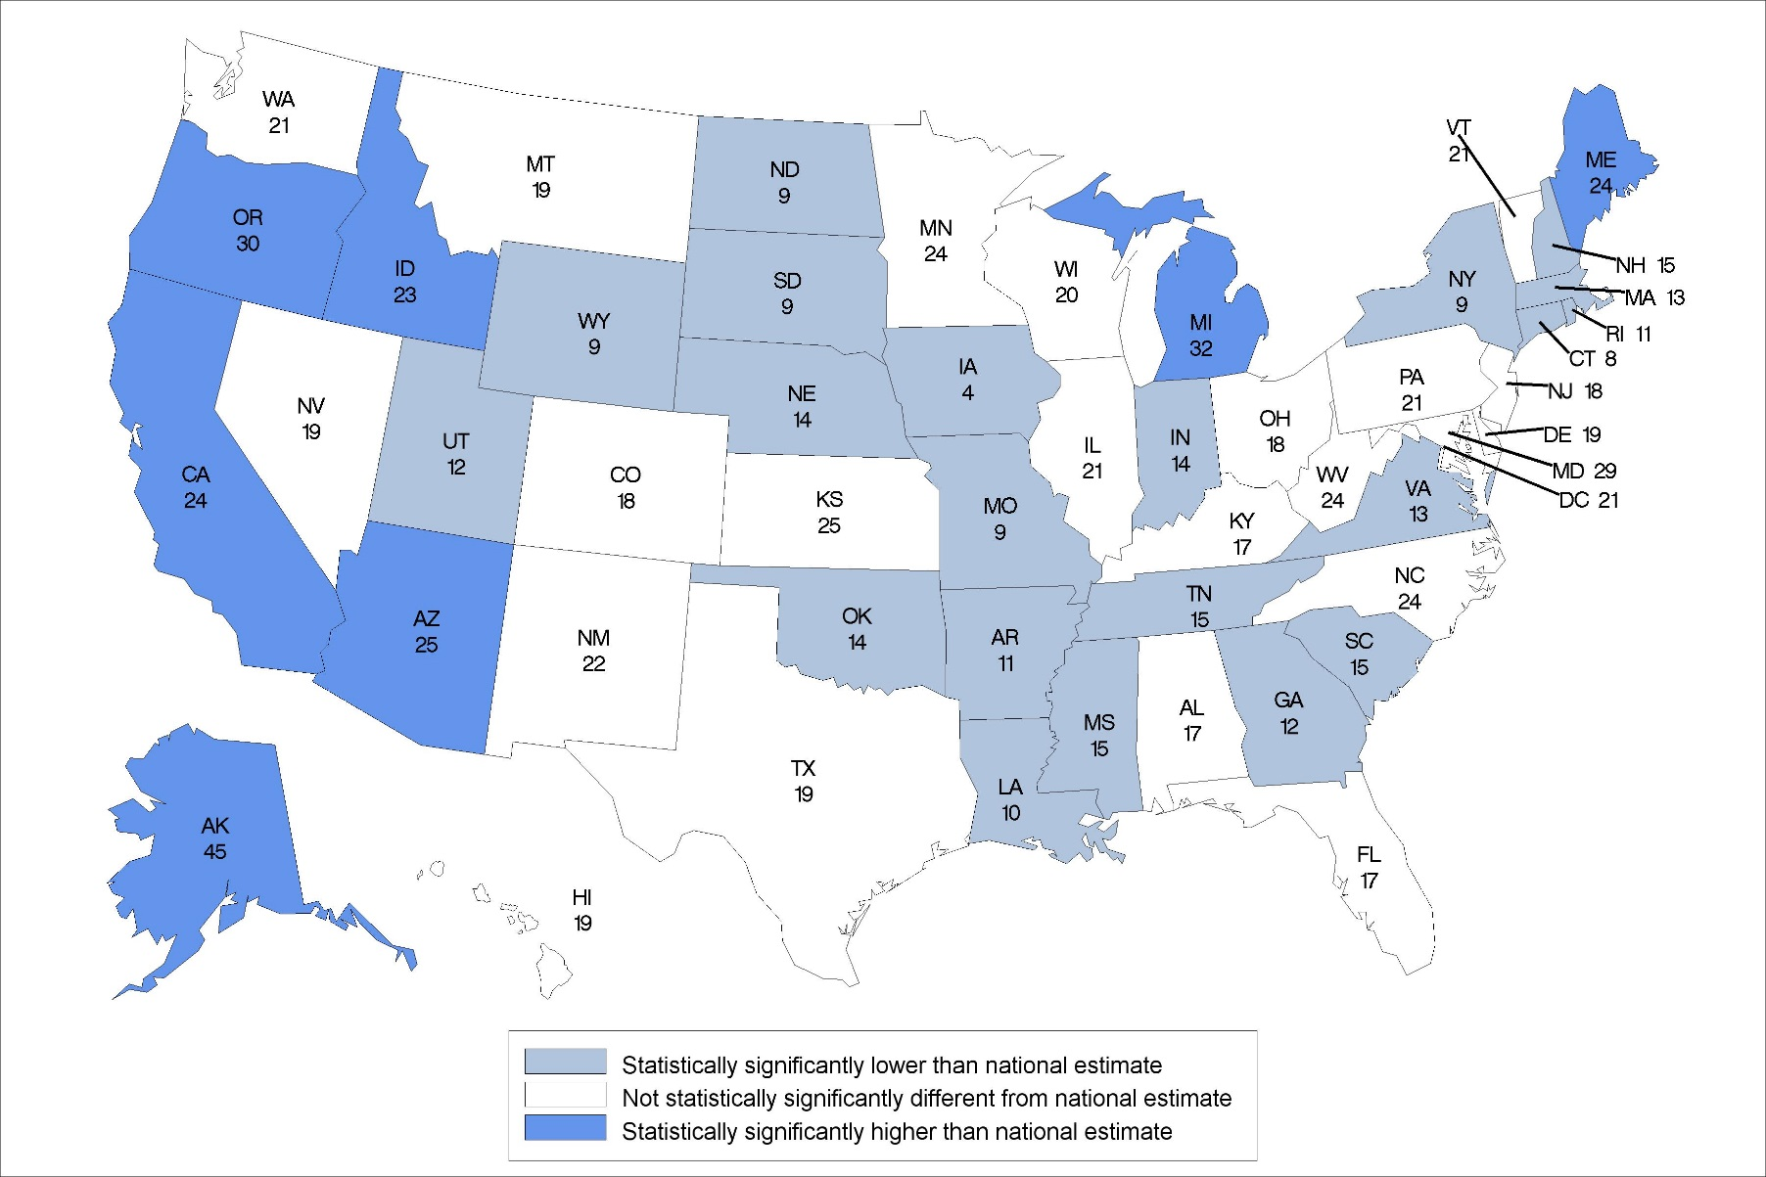
Percentage of residential care community residents that need assistance with eating: United States, 2014
Statistical significance tested at p<0.05.
Note: The national percentage is 20%.
Source: NCHS, National Study of Long-Term Care Providers, 2014
Notes:
In 2014, the national percentage of residential care residents that need assistance with eating was 20%.
The percentages ranged from 4% in Iowa to 45% in Alaska.
The location of states statistically significantly higher than the national percentage was concentrated in the West.

Slide 22
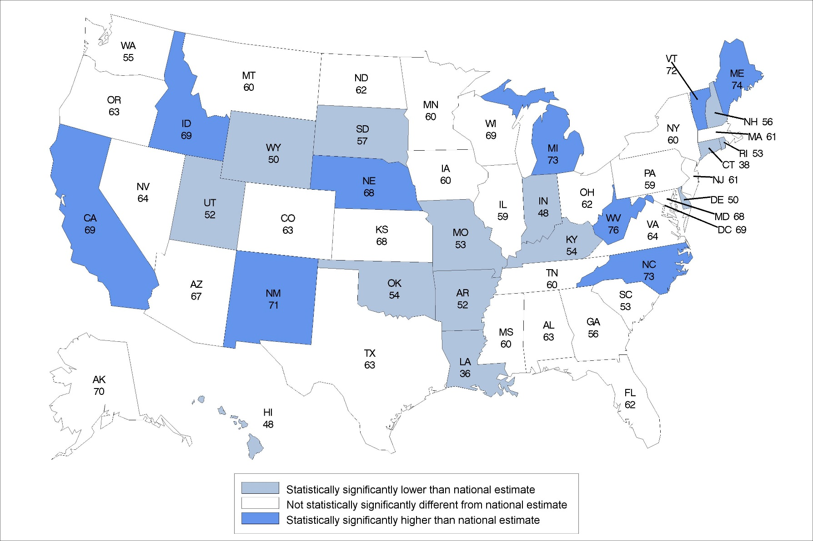
Percentage of residential care community residents that need assistance with bathing: United States, 2014
Statistical significance tested at p<0.05.
Note: The national percentage is 62%.
Source: NCHS, National Study of Long-Term Care Providers, 2014
Notes:
In 2014, the national percentage of residential care residents that need assistance with bathing was 62%.
The percentages ranged from 36% in Louisiana to 76% in West Virginia.
The location of states statistically significantly different from the national percentage varied across the United States.

Slide 23
MEDICATION USE

Slide 24
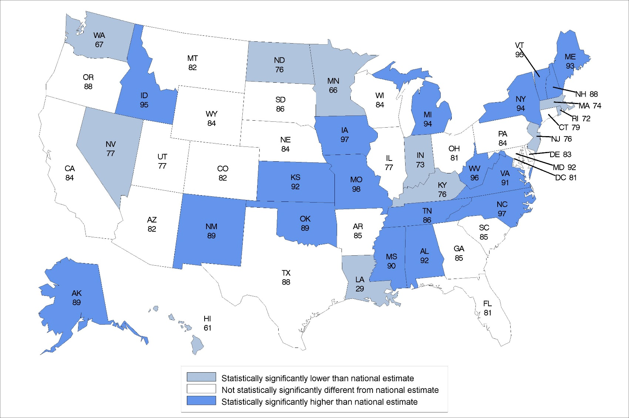
Percentage of residential care residents who received assistance with medication use: United States 2014
Statistical significance tested at p<0.05.
Note: The national percentage is 83%.
Source: NCHS, National Study of Long-Term Care Providers, 2014
Notes:
In 2014, the national percentage of residential care residents who received assistance with medication use was 83%.
The percentages ranged from 29% in Louisiana to 98% in Missouri.
The location of states statistically significantly different from the national percentage was varied across the United States.

Slide 25
HEALTH CONDITIONS
Division of Health Care Statistics

Slide 26
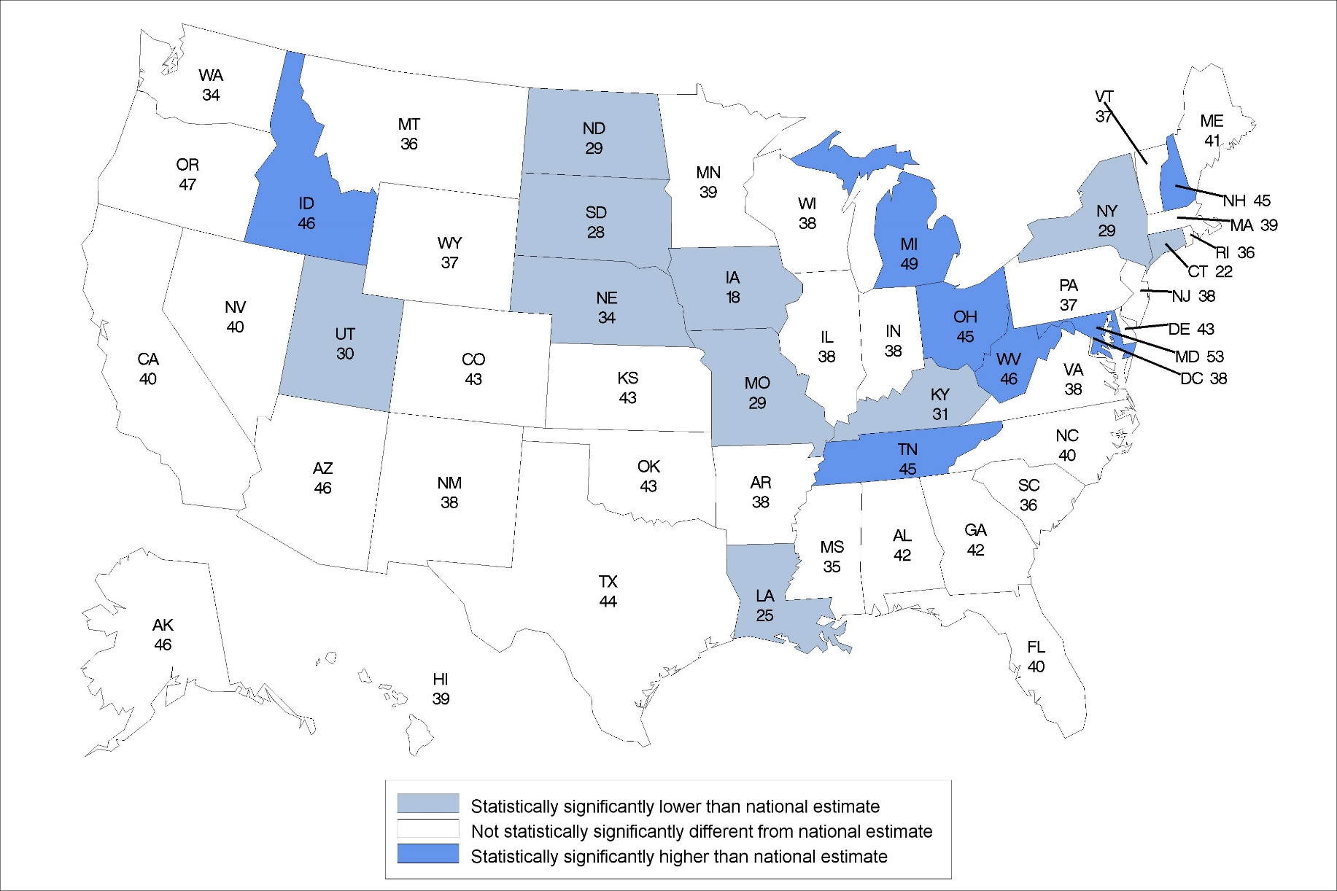
Percentage of residential care community residents diagnosed with Alzheimer’s disease or other dementias: United States, 2014
Statistical significance tested at p<0.05.
Note: The national percentage is 40%.
Source: NCHS, National Study of Long-Term Care Providers, 2014
Notes:
In 2014, the national percentage of residential care residents diagnosed with Alzheimer’s disease or other dementias was 40%.
The percentages ranged from 18% in Iowa to 53% in Maryland.
The majority of states were not statistically significantly different from the national percentage.
The location of states statistically significantly different from the national percentage varied across the United States.

Slide 27
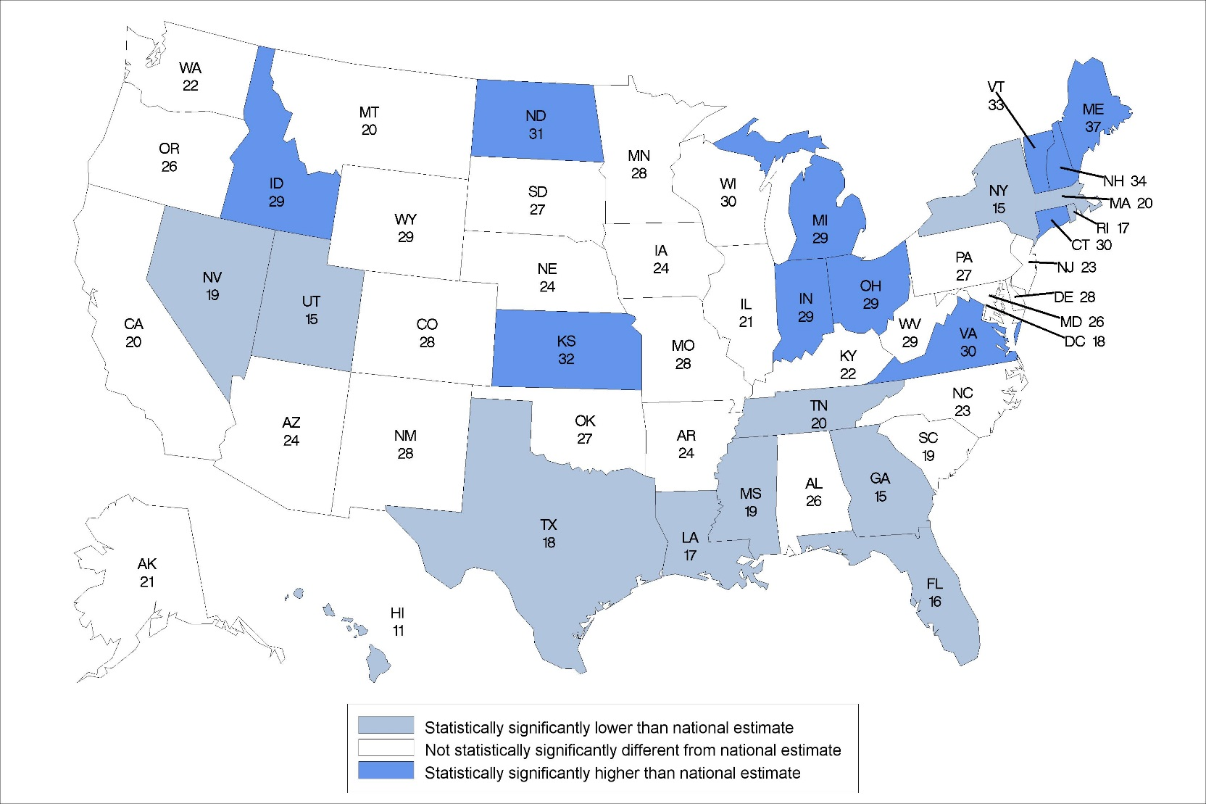
Percentage of residential care community residents diagnosed with depression: United States, 2014
Statistical significance tested at p<0.05.
Note: The national percentage is 23%.
Source: NCHS, National Study of Long-Term Care Providers, 2014
Notes:
In 2014, the national percentage of residential care residents diagnosed with depression was 23%.
The percentages ranged from 11% in Hawaii to 37% in Maine.
Approximately half of the states were not statistically significantly different from the national percentage and one quarter of states were each above and below the national percentage.
The location of states statistically significantly different from the national percentage varied across the United States.

Slide 28
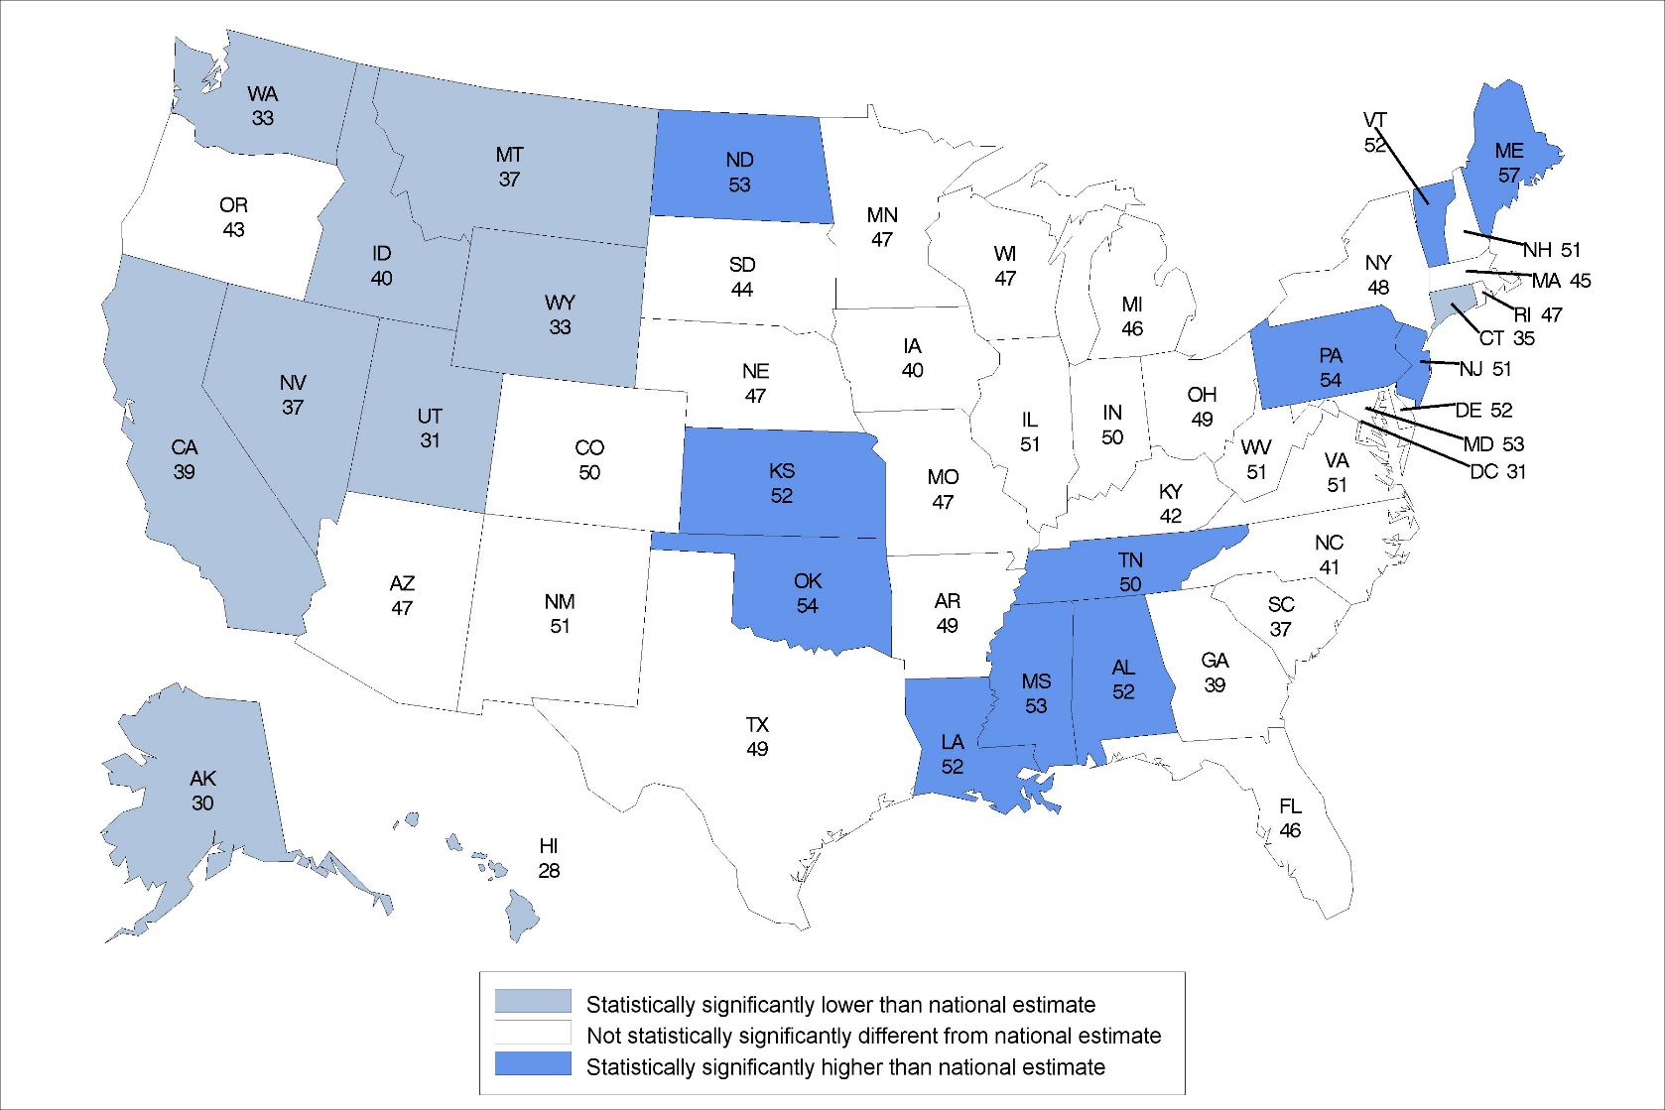
Percentage of residential care community residents diagnosed with cardiovascular disease: United States, 2014
Statistical significance tested at p<0.05.
Note: The national percentage is 46%.
Source: NCHS, National Study of Long-Term Care Providers, 2014
Notes:
In 2014, the national percentage of residential care residents diagnosed with cardiovascular disease was 46%.
The percentages ranged from 28% in Hawaii to 57% in Maine.
The location of states statistically significantly lower than the national percentage was concentrated in the West.
More than half of the states were not statistically significantly different from the national percentage.

Slide 29
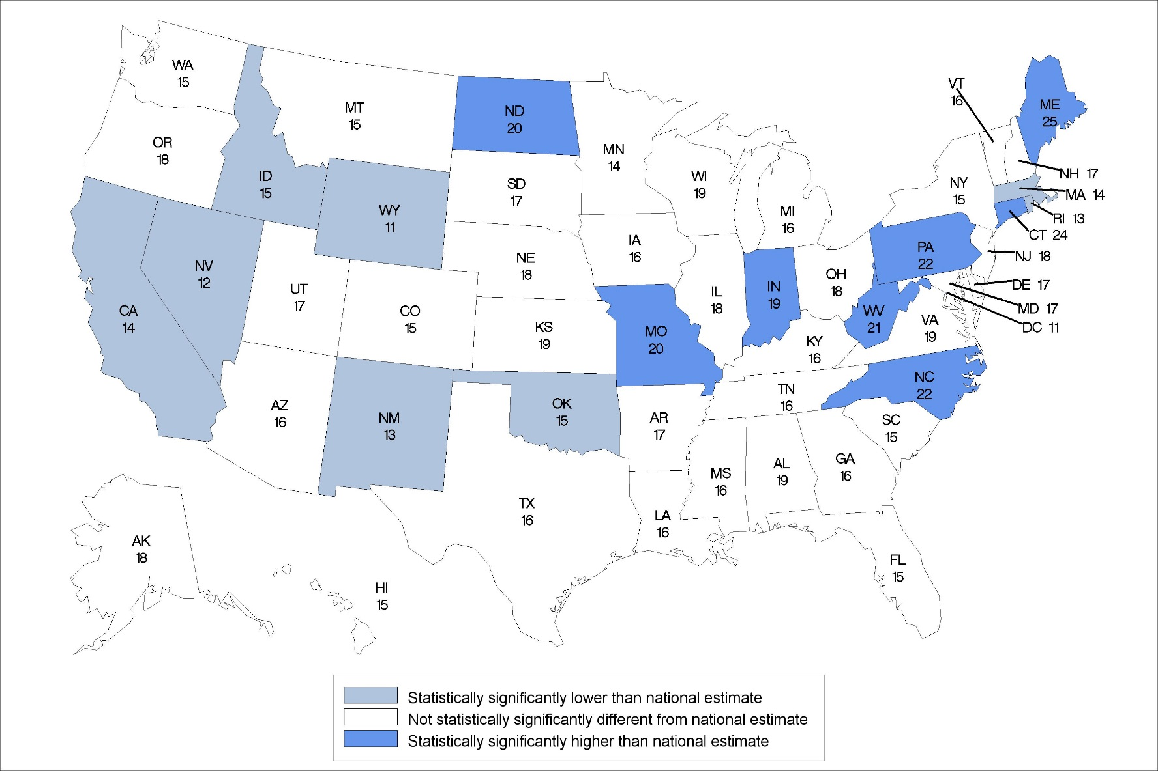
Percentage of residential care community residents diagnosed with diabetes: United States, 2014
Statistical significance tested at p<0.05.
Note: The national percentage is 17%.
Source: NCHS, National Study of Long-Term Care Providers, 2014
Notes:
In 2014, the national percentage of residential care residents diagnosed with diabetes was 17%.
The percentages ranged from 11% in Washington, DC and Wyoming to 25% in Maine.
The majority of states were not statistically significantly different from the national percentage.
The location of states statistically significantly different from the national percentage varied across the United States.

Slide 30
ADVERSE EVENTS

Slide 31
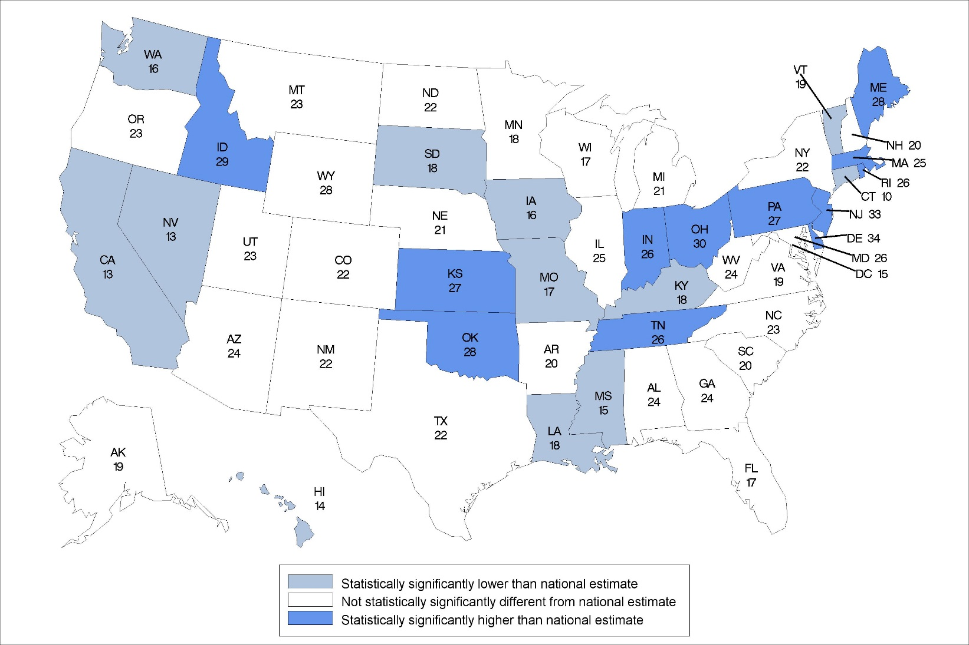
Percentage of residential care residents that had falls in the last 90 days: United States, 2014
Statistical significance tested at p<0.05.
Note: The national percentage is 21%
Source: NCHS, National Study of Long-Term Care Providers, 2014
Notes:
In 2014, the national percentage of residential care residents that experienced a fall was 21%.
The percentages ranged from 10% in Connecticut to 34% in Delaware.
The location of states statistically significantly different from the national percentage varied across the United States.

Slide 32
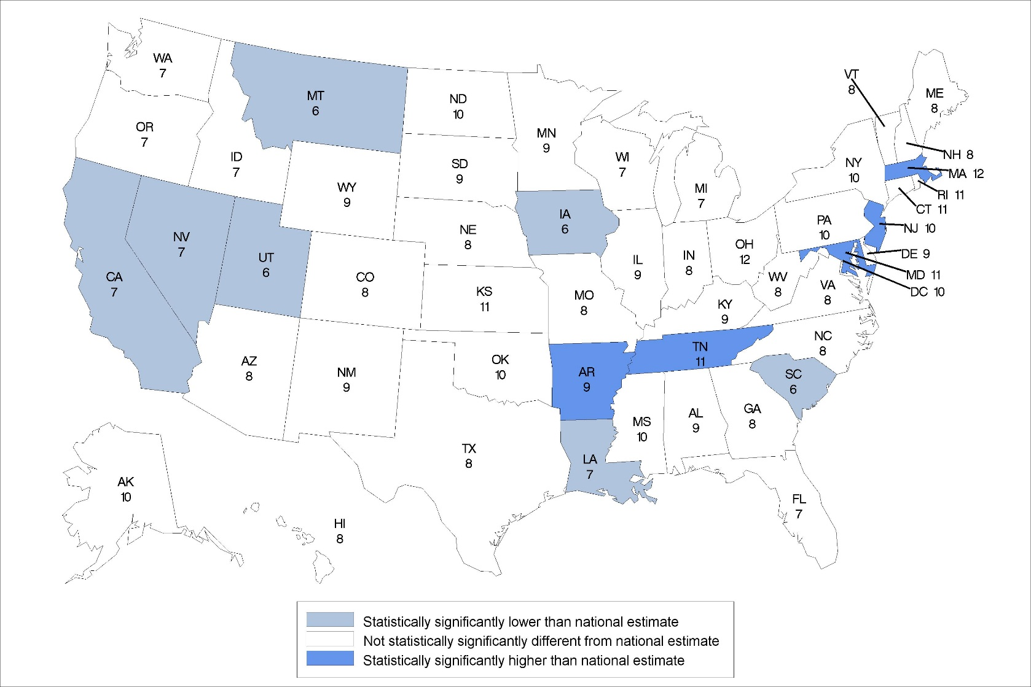
Percentage of residential care residents that had overnight hospitalizations in the last 90 days: United States, 2014
Statistical significance tested at p<0.05.
Note: The national percentage is 8%
Source: NCHS, National Study of Long-Term Care Providers, 2014
Notes:
In 2014, the national percentage of residential care residents that were hospitalized was 8%.
The percentages ranged from 6% in Iowa, Montana, South Carolina, and Utah to 12% in Massachusetts and Ohio.
The location of states statistically significantly higher than the national percentage were concentrated in Northeast and states significantly lower than the national percentage were in the West.

Slide 33
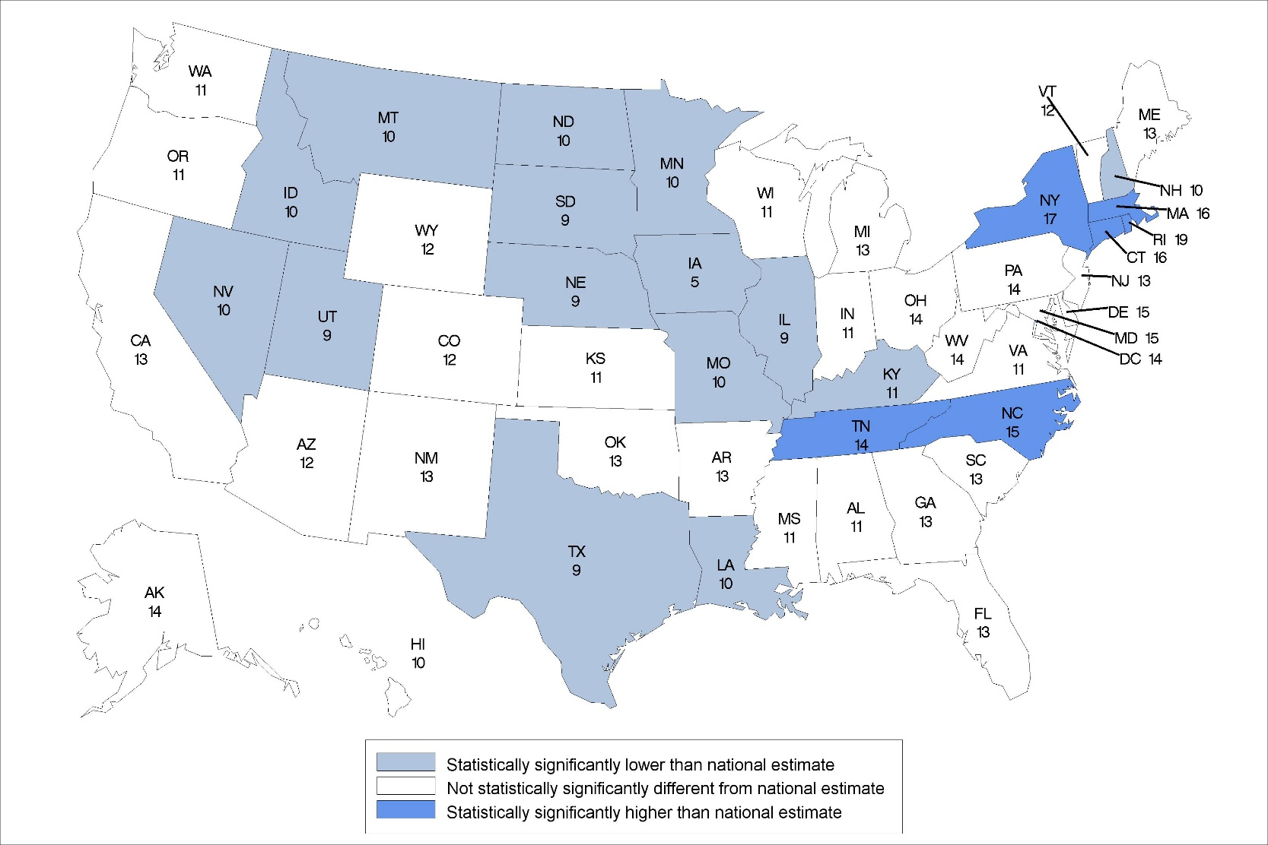
Percentage of residential care residents that had emergency room visits in the last 90 days: United States, 2014
Statistical significance tested at p<0.05.
Note: The national percentage is 12%
Source: NCHS, National Study of Long-Term Care Providers, 2014
Notes:
In 2014, the national percentage of residential care residents that had an emergency room visit was 12%.
The percentages ranged from 5% in Iowa to 19% in Rhode Island.
The location of states statistically significantly lower the national percentage was concentrated in the Midwest.

