Slide 1

Board of Scientific Counselors
Jennifer Madans, PhD
Acting Director, NCHS
May 9, 2019

Slide 2
Administrative and budget updates

Slide 3
New BSC Members and Departing Members
Welcome our new BSC Members
  Helen G. Levy, Ph.D.
  John R. Lumpkin, M.D., M.P.H.
  Kristen M. Olson, Ph.D.
  Andrey Peytchev, Ph.D.
Farewell to our BSC Members rotating off the Council
  Timothy J. Beebe, Ph.D.
  Sherry A. Glied, Ph.D.
  Mary Ellen Johantgen, Ph.D., R.N.

Slide 4
NCHS Budget
$5.397 million reduction
*Amount includes $15.397 million in Budget Authority for administrative and business services through the CDC Working Capital Fund.
**Amount includes funding for administrative and business services through the CDC Working Capital Fund.

Slide 5
NCHS Budget
In FY 2020, $155,000,000 is requested in Public Health Service (PHS) Evaluation Transfer
  $5,397,000 below the FY 2019 Enacted level
FY 2020 House Appropriations Bill
  $100,000,000 for CDC to lead improvement of public health data by providing support to Federal data modernization efforts including the National Center for Health Statistics, State, local, tribal and territorial partners
  Includes a multi-year plan, including at least five years of budget projections, as well as the innovation strategy for surveys conducted by the National Center for Health Statistics
NCHS has not had PHS Evaluation Transfer funds since FY14
Permissive Transfer to support the Unaccompanied Alien Children program
  $542 thousand in FY 2018
  $547 thousand in FY 2019

Slide 6
Notes:
Already updated

Slide 7
Program updates

Slide 8
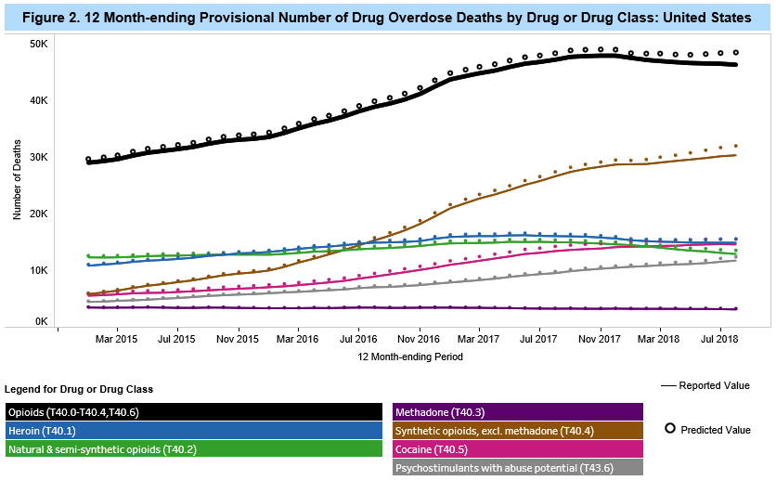
Division of Vital Statistics: Predicted Drug Overdose Death Counts
Predicted counts use a ‘multiplication factors’ based on the degree of underreporting in provisional data compared with final data.

Slide 9
Division of Vital Statistics:
New Opioid Funding
Build foundational mortality infrastructure of state vital registration programs
Expand interoperability capabilities at the state level
Enhance the NCHS mortality IT infrastructure
Support efforts to improve quality and timeliness of ME/C investigation and reporting of drug overdose deaths
New Opioid Funding Type | FY 2018 | FY 2019
Patient-Centered Outcomes Research Initiative | $2,613,000
Opioid Response Coordinating Unit | $7,830,000 | $11,500,000
TOTAL | $10,443,000 | $11,500,000

Slide 10
NHIS Annual Content Plan 2019 – 2027
Annual core
  Key measures
  Sociodemographics
Rotating core
  Newer topic areas
  Expanded detail
  Varying periodicity
Sponsored supplements
  “Sustaining” sponsors
  1- or 2-year modules
  5 min or less
One adult and one child randomly selected from each household
  Demographics for all HH members
  Family info collected from sample adult and parent of sample child

Slide 11

Timeline for 2019 NHIS Products and Public Use Data
January 2019 | Launch of the redesigned 2019 Questionnaire
December 2019 | First ER Products from the 2019 NHIS*
Late Summer 2020 | Public Use Data Files from the 2019 NHIS
*ER products based on Quarter 1 data, typically released in September, will not be available. NHIS staff need time to evaluate the quality of the data coming from the redesigned questionnaire.

Slide 12
Division of Health Care Statistics Updates
Electronic Health Record (EHR) Activities
Development continues for the Healthcare Electronic Health Record system for NAMCS and National Health Care Surveys (NHCS)
  Direct messaging is now operational for submission of EHR data
  EHR vendors have developed interfaces based on the HL7 CDA® R2 Implementation Guide: National Health Care Surveys, STU Release 1.0 or 1.2 – US Realm
  60 products certified
  Allscripts, Cerner, MedHost, NextGen, and Rhapsody Integration Engine among developers with certified products
  Registrations continue for the NHCS public health reporting registry
  Over 180,000 eligible professionals/eligible clinician registered
  Over 1,100 eligible hospitals/critical access hospitals registered

Slide 13
National Health and Nutrition Examination Survey (NHANES)
DHANES Director Update
  Kathryn Porter, DHANES Director, retiring September 1, 2019
  Recruitment underway for new DHANES Director
Contract solicitation – Gaining Cooperation
  Evaluate current NHANES methods, provide insights to improve response rates
Nonresponse bias analyses
  Multiple projects
  NHANES 17-18 NRBA draft report from contractor in July
NHANES 2021-22 Planning
Joint with NHIS: Evaluating feasibility of in-home phlebotomy for 2023

Slide 14
NHANES Pilots
Staggered incentive pilot - ongoing
  Conducting in first 8 survey locations of 2019 NHANES
Social media pilot – late summer 2019
  Evaluate impact of using Facebook and Instagram ads on participant engagement
Infant blood collection pilot – Fall 2019
  Evaluate feasibility of lowering the age range for blood collection. If successful, full implementation will provide critical data for dietary recommendations for children under 2 years of age.

Slide 15
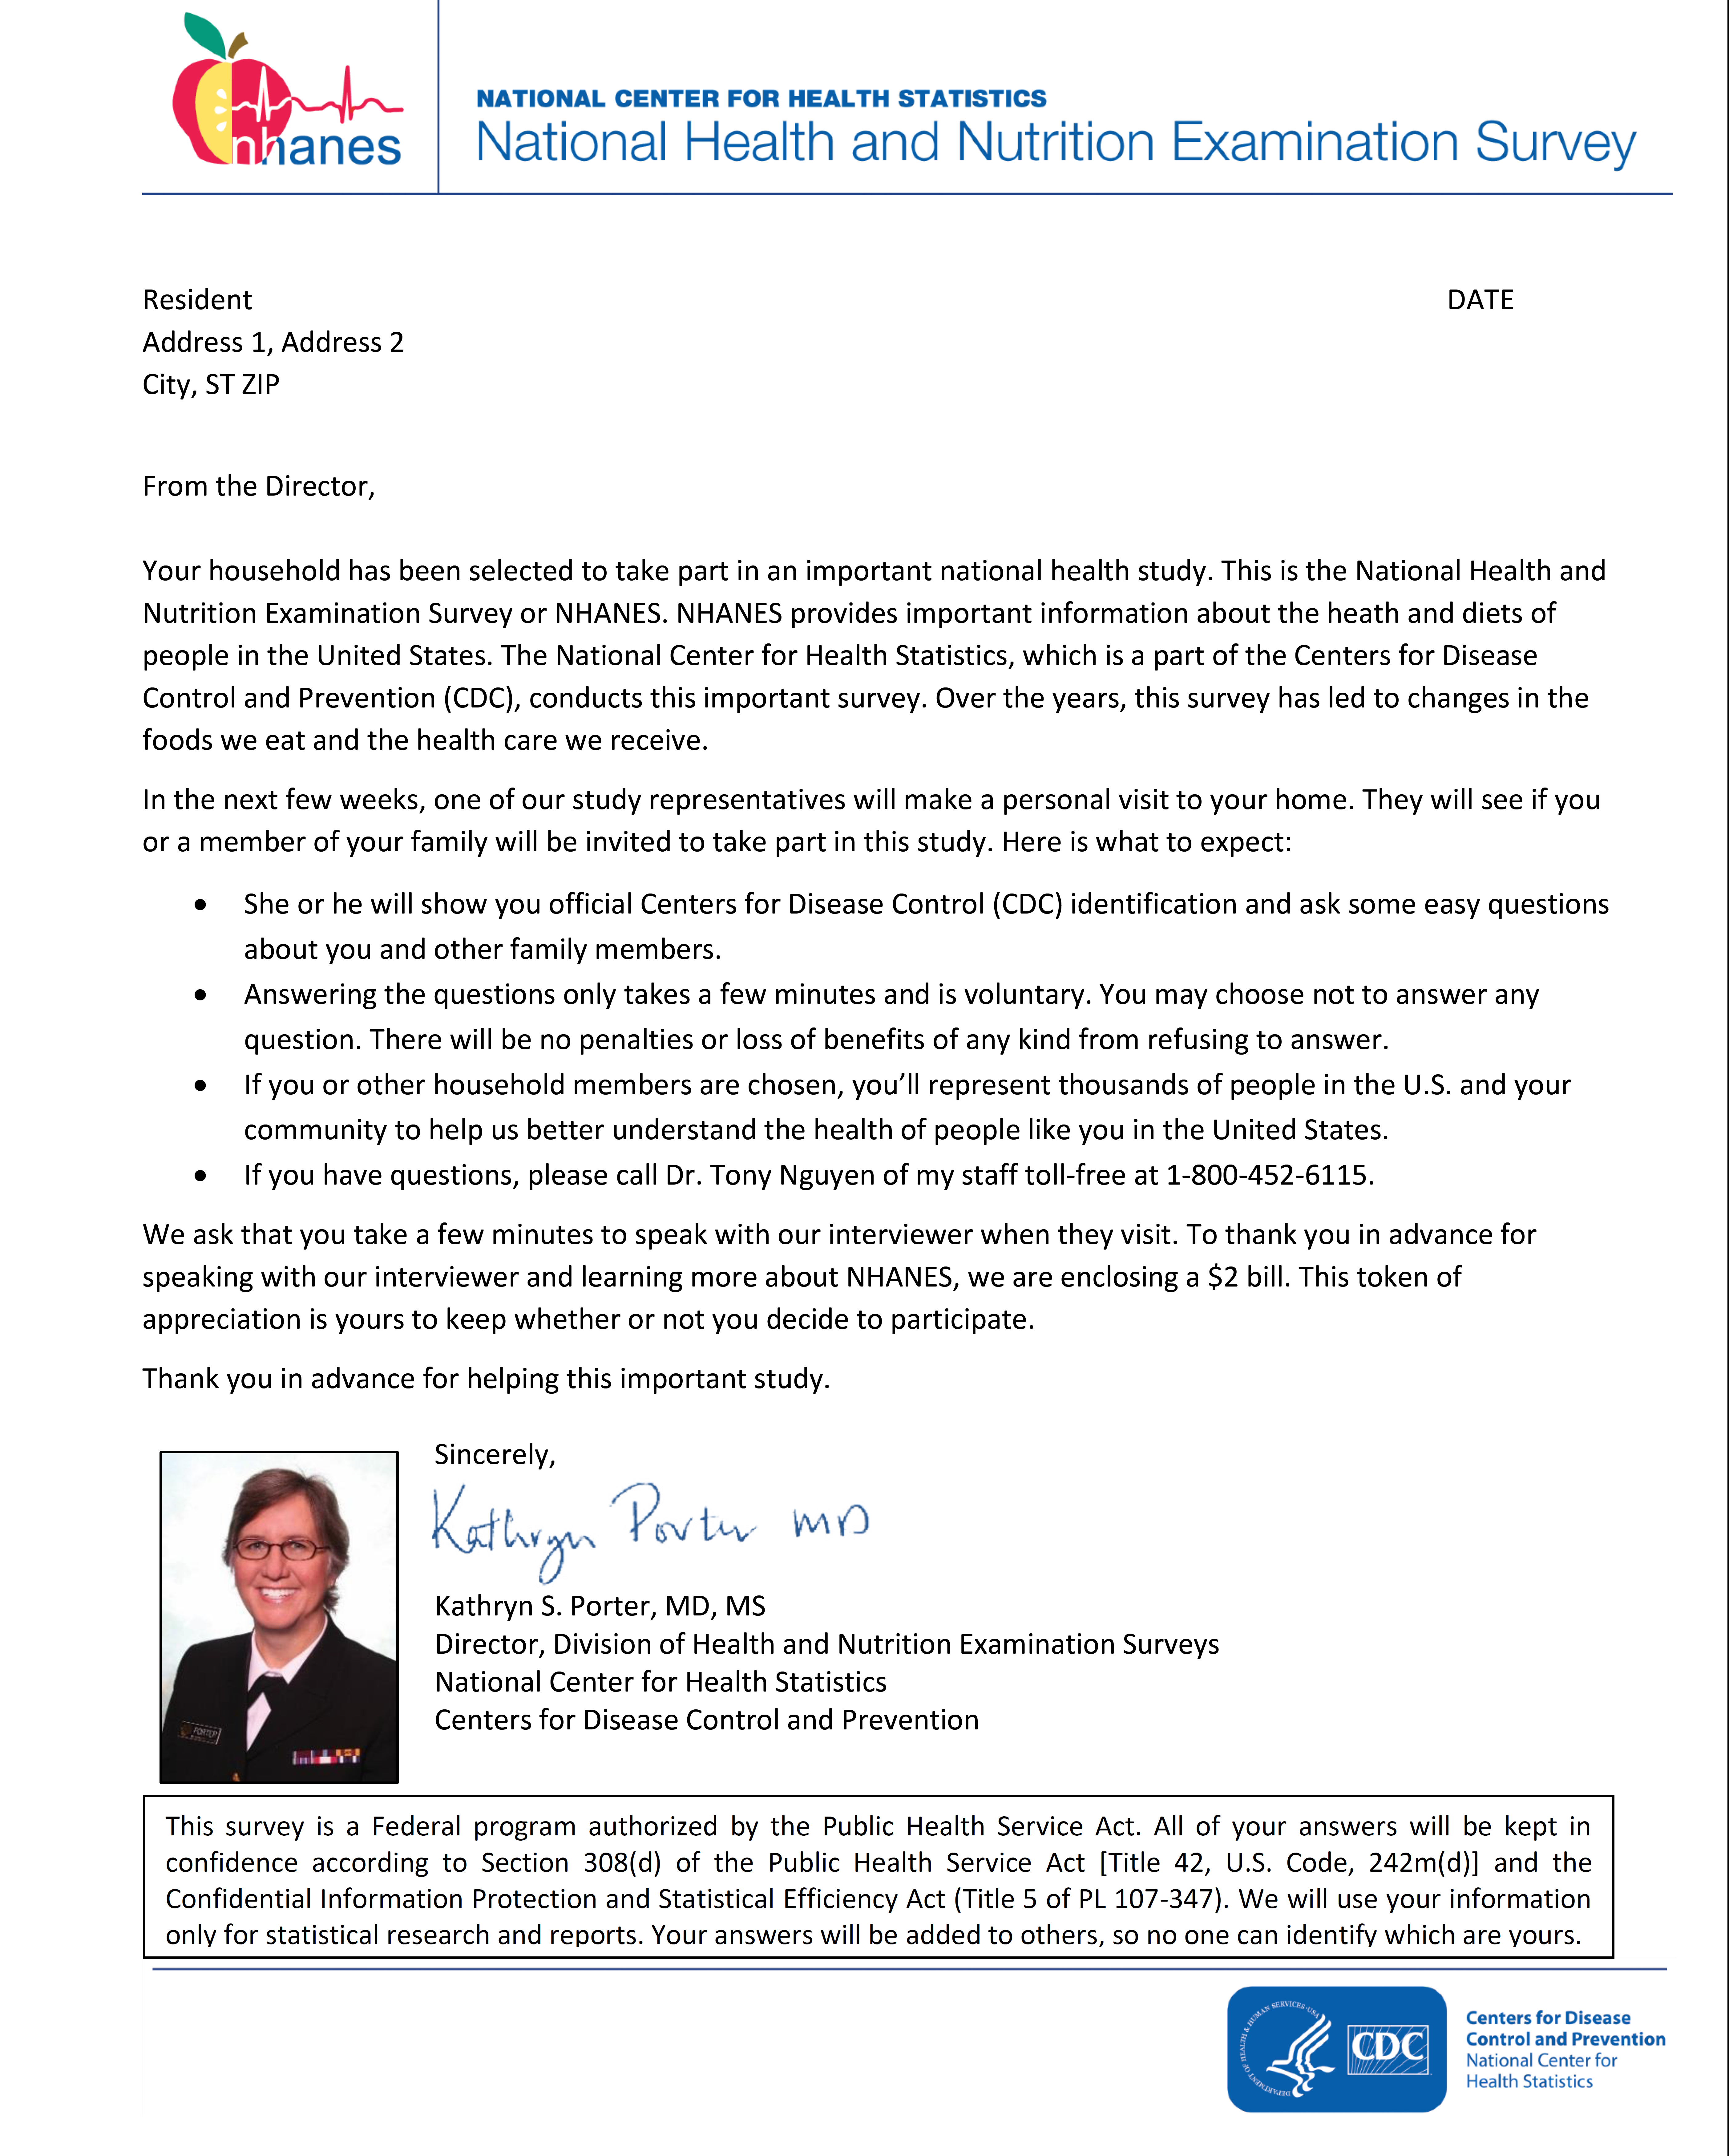
NHANES Staggered Incentive Pilot 2019
Screener Incentive
  0 control
  $2 pre-paid (cash)
  $5 promised (debit card)
Interview Incentive
  0 control
  $20 promised (debit card)
  $40 promised (debit card)

Slide 16
NHANES: Dental Fluorosis Data
What is Dental Fluorosis (DF)?
  Altered tooth enamel
  Results from exposure to dietary fluoride in childhood, prior tooth eruption
  Ranges from very mild (with small, barely visible white markings on the tooth) to severe (with pitting and dark brown stains)
NHANES collected data on DF
  During 1999-2004 and 2011-2016
  On persons 6-49 years in 99-04, 6-19y in 11-13, & 6-29y in 14-16
  Assessment made by dentist at MEC
  All fully erupted permanent teeth excluding third molars were assessed
  Each tooth scored using Dean’s Fluorosis Index
  A person was categorized as normal, questionable, very mild, mild, moderate, or severe

Slide 17

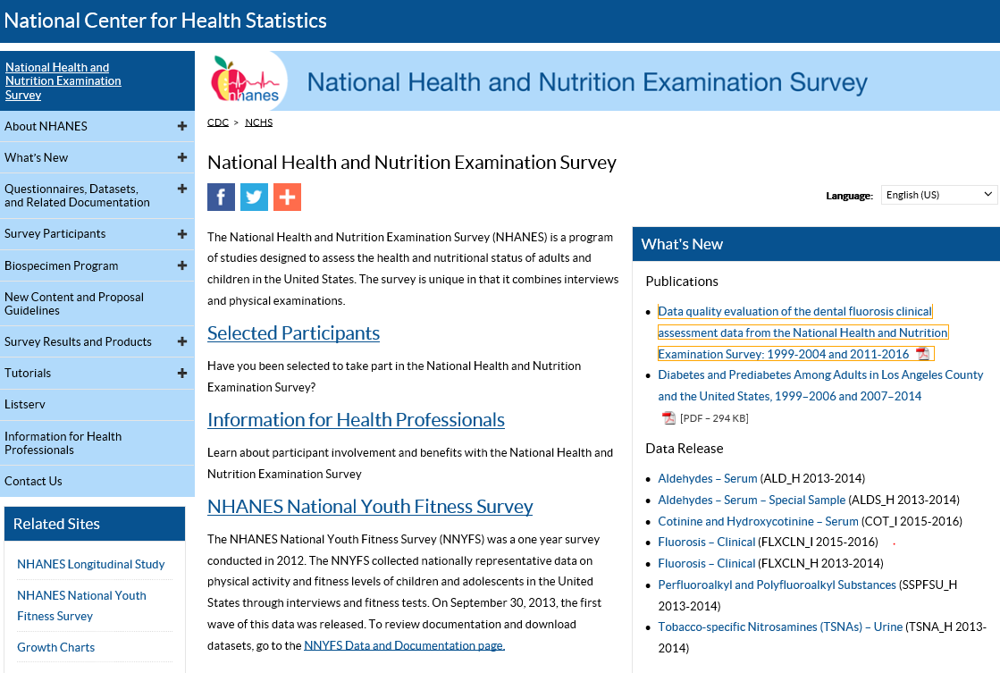
NHANES: Dental Fluorosis Data Release and Data Quality Review
April 22, 2019, DHANES released the 2013–14 and 2015–16 data files and documentation
This release also included a data quality report on all NHANES DF clinical assessment data from 1999–2004 and 2011–16
DHANES conducts routine QA/QC during data collection as well as before public data release for all NHANES data
The published Report provided a more detailed quality evaluation of all available data across the two 6-year time periods

Slide 18
NHANES: Dental Fluorosis Data Quality: Findings and Recommendation
Findings
Reliability Statistics: Kappa
Moderate to near prefect agreement between dental and reference examiner during 1999-2016; Moderate to substantial agreement with dental examiner on same participant a few days later (1999-2001)
Variability in prevalence estimates was seen within and across each 6-year time period
Synthetic birth cohort analysis
Prevalence was 9.5% in youth 6–9 years in 2001–04 and 46.9% in youth 16–19 years in 2011–14
Recommendation
The quality assessment findings in the published report should be strongly considered when determining whether the data are appropriate for the user’s analytic objectives, including studies of prevalence and trends.

Slide 19

Division of Research and Methodology
Research Data Center (RDC)
Neil Russell became RDC Director in January
The NCHS RDC remote submission system (i.e., ANDRE) was retired in April 2019
In FY2020, Census will implement a new cost model for access to FSRDCs; NCHS and ARHQ “sponsored” project will be charged for:
  Every Special Sworn Status application processed.
  Every year a project is active.
The Substance Abuse and Mental Health Services Administration (SAMHSA) became a data partner with NCHS; the National Survey on Drug Use and Health (NSDUH) restricted-use data are available through the FSRDC system, including an NCHS RDC in Parklawn.

Slide 20


Division of Research and Methodology
Collaborating Center for Questionnaire Design and Evaluation Research
Selected Current Question Evaluation Studies
Opioids
  Population: Use, Misuse, Impairment, Disorder
  Pregnant Women (PRAMS)
  Physician: Prescribing Practices
Disability
  ID/DD Question Development
  WG Items for ACS
  Labor Force Module with ILO
  Inclusive Education with UNICEF
NHIS
  Adult Health Behavior and Screening
  Children’s Health Behavior
  Injury
Other
  NHANES Message Testing/Non-responder Interviewing
  DHCS Long Term Care Record Alignment Study
  Verbal Autopsy
  NIOSH Gig Employment

Slide 21
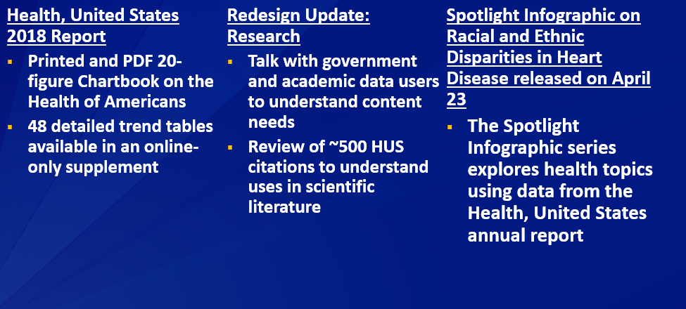
Office of Analysis and Epidemiology (OAE)
Health, United States

Slide 22
Healthy People 2030
A Federal Register Notice went out for a set of core (355), developmental (80), and research objectives (25) between 11/27/2018 and 1/11/2019.
  1,732 comments on Core objectives (online)
  327 comments on Developmental and Research objectives (online)
  530 new objectives proposed (online)

Slide 23
Next Steps for Healthy People (HP)
 | HP2030 | HP2020
December 2018 to January 2019 | Public Comment and Target Setting | Data updates; Leading Health Indicator (LHI) releases
Spring 2019 | Departmental Clearance and Data Template | Data updates; LHI releases
Summer 2019 | Launch data production and verification | Data updates; LHI releases
Fall 2019 | Finalization of HP2030 launch data | Finalization of HP2020 final data; LHI releases
Early 2020 | Launch of HP2030 | Closeout of HP2020
Late 2020 | Launch of DATA2030 | HP2020 Executive Summary
2021 | Launch of HP2030 LHIs | HP2020 Final Review

Slide 24
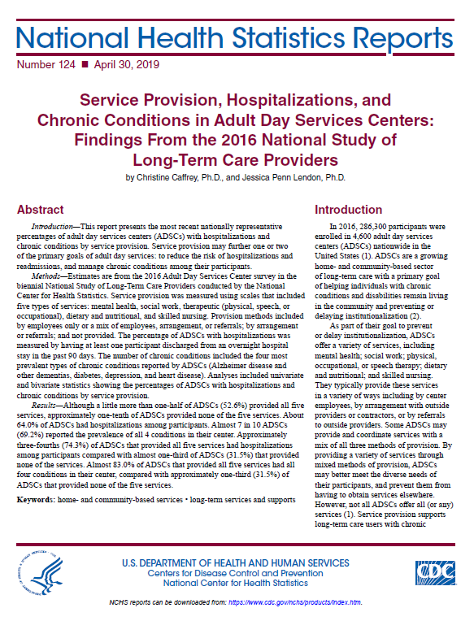
NCHS Publications Since Last BSC
Publication Type | Number Released*
TOTAL | 26
Data Briefs | 4
Early Release | 5
Reports | 12
Reporting Guidance | 1
Data Visualizations | 1
Web Tables | 3
*Released by NCHS Office of Information Services

Slide 25
Released Data Briefs Since Last BSC
Prescription Drug Use in the United States, 2015 – 2016
Strategies Used by Adults Aged 18 – 64 to Reduce their Prescription Drug Costs, 2017
Educational Attainment of Mothers Aged 25 and Over: United States, 2017
Characteristics of Office-Based Physician Visits, 2016

Slide 26
Upcoming NCHS Data Briefs
Strategies used by Adults Aged 65 and Over to Reduce Their Prescription Drug Costs, 2016-2017
Regional Variation in Private Dental Coverage and Care among Dentate Adults Aged 18-64 in the United States, 2014-2017
Dental Care Among Adults Aged 65 Years and Over, 2017

Slide 27
Upcoming NCHS Reports
Health Insurance Coverage: Estimates from the National Health Interview Survey, 2018 (Released Today, 5/9)
Births: Provisional Data for 2018
Quarterly Provisional Estimates for Selected Birth Indicators: Q4 2017 – Q4 2018
Quarterly Provisional Estimates for Infant Mortality: 2016 – Q2 2018
Trends in Cancer and Heart Disease Death Rates Among Adults Aged 45-64: United States, 1999-2017

Slide 28
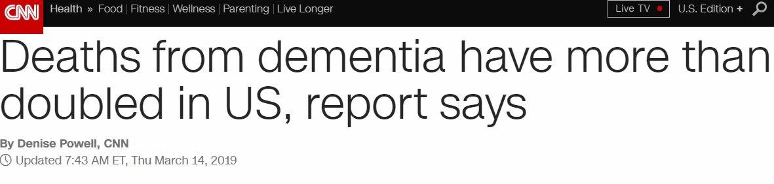

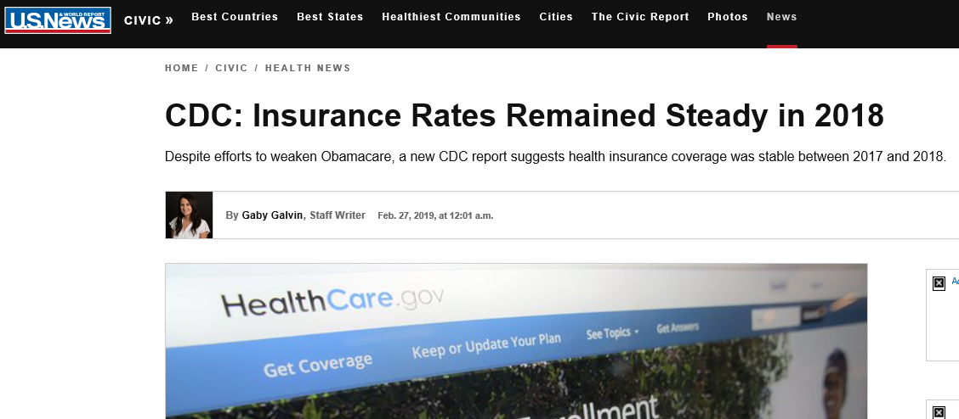
NCHS in the News
Insurance Rates Remained Steady in 2018

Slide 29
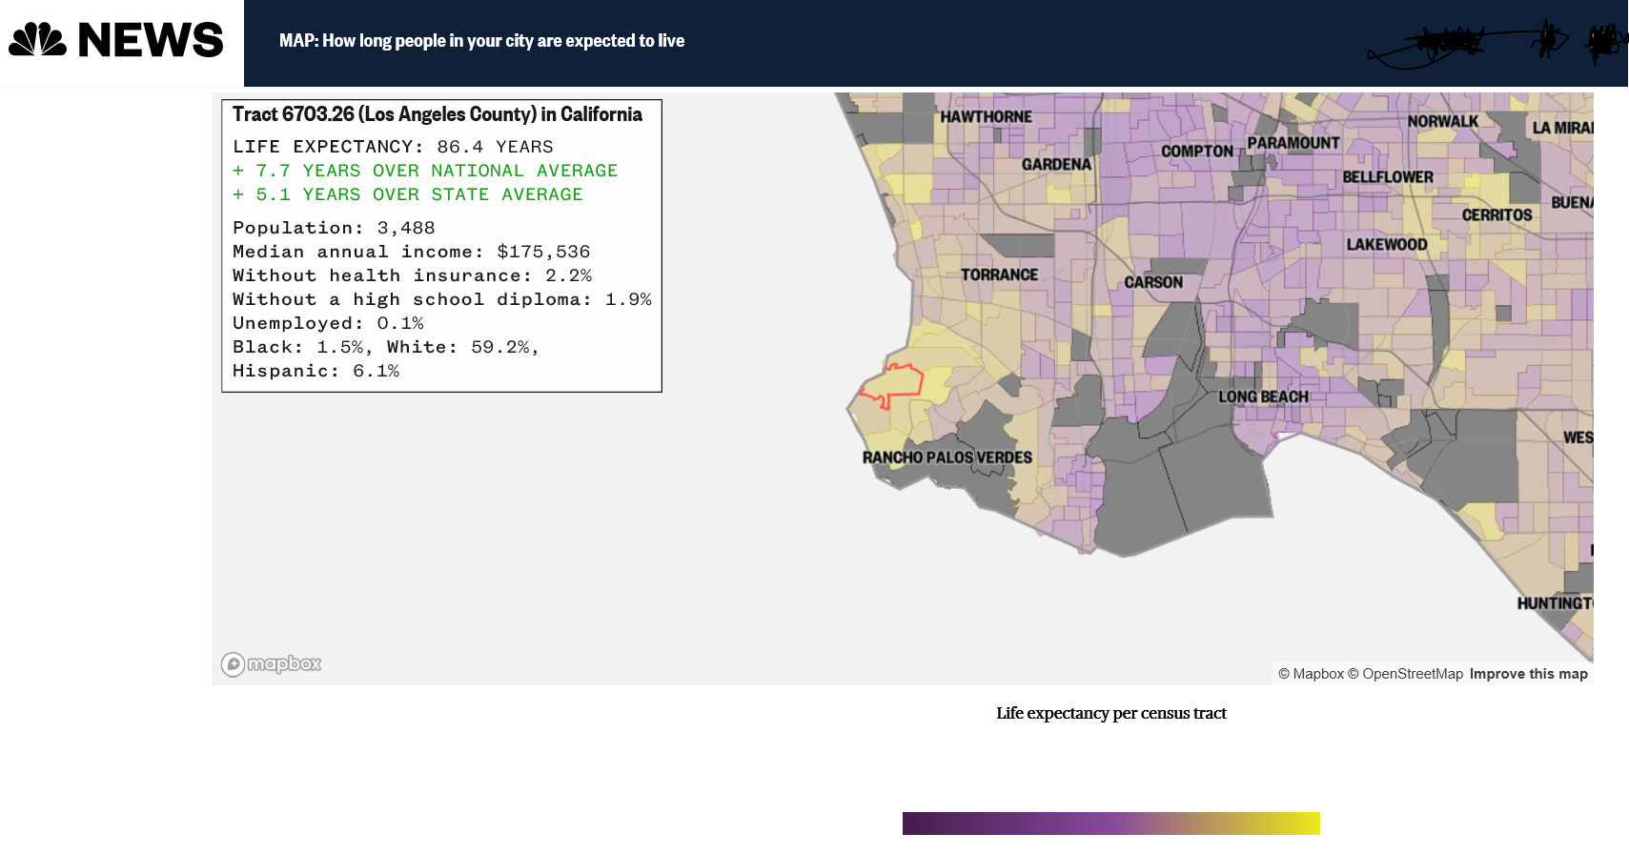
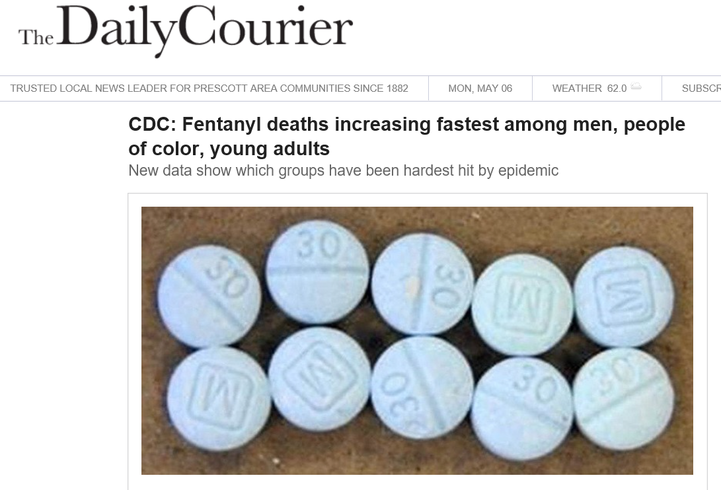




NCHS in the News
Map: How long people in your city are expected to live
Fentanyl deaths increasing fastest among men, people of color, young adults

Slide 30
Thank you

