Slide 1
Use of Literal Text in Death Certificate Data
National Center for Health Statistics
Robert N. Anderson, PhD
Chief, Mortality Statistics Branch
Division of Vital Statistics
NCHS Board of Scientific Counselors
Hyattsville, MD
May 9-10, 2019

Slide 2
Literal text from the death certificate
Original text as reported by the cause of death certifier
  in Part I of the cause of death section
  in Part II of the cause of death section
  in the “Describe how injury occurred” field
Entered directly into an electronic death registration system or transcribed from a paper certificate
Used as the basis for cause of death coding both automated (using SuperMICAR in MMDS) and manual

Slide 3
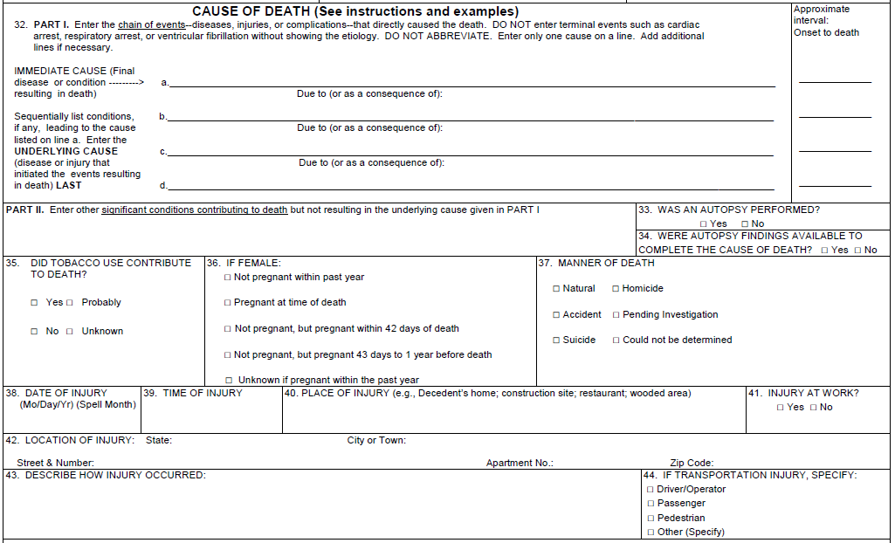
Causal sequence leading to death
Contributing conditions
Injury description including circumstances leading to the injury

Slide 4
Cardiac arrhythmia
Combined methamphetamine and fentanyl toxicity
x
Hypertensive heart disease
x
x
Accidental overdose of methamphetamine mixed with fentanyl

Slide 5
What else can be done with the additional detail not captured by ICD codes?
Evaluation of the quality of the ICD-coded data
  The text on which the codes are based can be easily reviewed
Better understand cause of death certification and what certifiers report on death certificates
  Terminology used to describe diseases and conditions
  Changes in terminology
  Emerging diseases
  Analysis of information reported, but not codeable to the ICD (e.g., bed sharing)

Slide 6
History
2003 – NCHS began collecting the literal text from death certificates in all states
  As of Jan 1, 2003, all states were using SuperMICAR
2005 – use of literal text to review potential coding errors
2006 – pilot project with what is now NCEZID staff to find Creutzfeldt- Jakob disease deaths that were being mis-coded
2007 – decision to release literal text data to federal agencies under a data use agreement; others required to use the RDC
  Data files released to the Division of Reproductive Health (CDC), NHTSA and CPSC
2010 – discovery of personal identifiers in the literal text fields and decision to restrict data to in-house staff

Slide 7
Major projects involving literal text data
Creutzfeldt-Jakob disease deaths
  With the Division of High Consequence Pathogens and Pathology (NCEZID/CDC)
Deaths involving consumer products
  Consumer Products Safety Commission
Non-traffic motor vehicle deaths
  National Highway Traffic Safety Administration
Sudden unexplained infant deaths
  With the Division of Reproductive Health (NCCDPHP/CDC)
Infant deaths associated with termination of pregnancy
Deaths due to drug-resistant infections

Slide 8
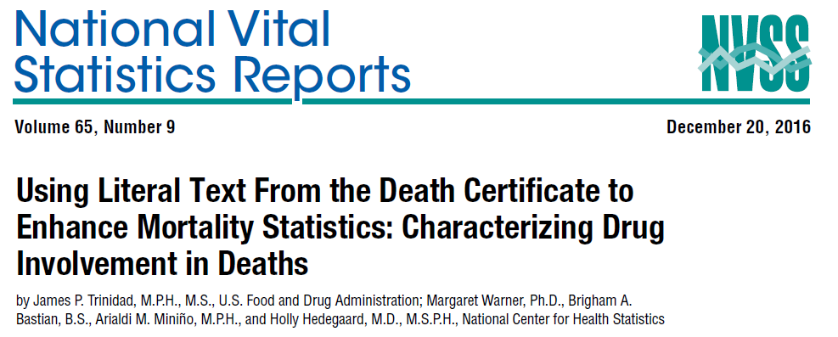
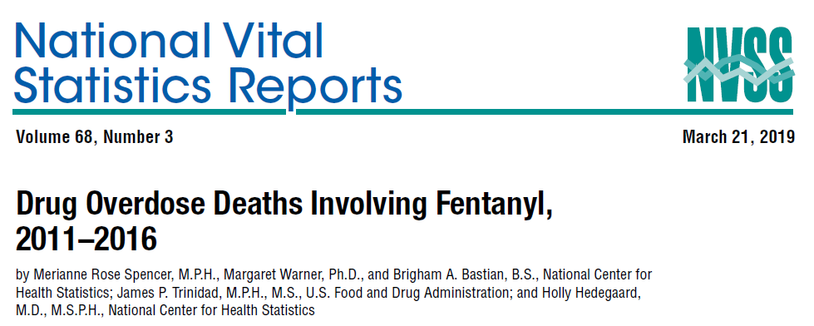
Drug Mentions with Involvement (DMI) data
Joint project with FDA
Developed to satisfy the need for greater specificity with regard to drugs than can be provided by ICD-10 codes
Contains information on specific drugs and associated variants
  E.g., search for oxycodone (principal variant) would return all deaths involving oxycodone and its variants (e.g., OxyContin, Percocet, Roxicet, etc)
Data for 2010-2016 are currently available in the RDC (2017 to follow shortly)

Slide 9
Current work and plans
Exploring use of literal text in surveillance system to identify emerging diseases and specific drugs
  Part of PCOR III project
Making the literal text available to researchers
  Redaction effort on 2016 data to remove personal identifiers is nearly complete
  Plans are to make these data available in the RDC
  Additional data years will be made available as redaction for each year is completed

Slide 10
  Robert Anderson
  Phone: 301-458-4073
  RNAnderson@cdc.gov

