Slide 1
Coronavirus Disease (COVID-19) Reporting Guidance and Provisional Death Data
Paul D. Sutton, Ph.D.
Deputy Director, Division of Vital Statistics
Board of Scientific Counselors Meeting
May 5, 2020

Slide 2
COVID-19 Response Timeline
February
26 | Decision made to develop certification guidance for COVID-19 deaths
March
4 | Preliminary Guidance for Certifying COVID-19 Deaths Released
17-20 | NCHS Cause of Death Coding System Updated
25 | Launched COVID-19 Death Data and Reporting Guidance https://www.cdc.gov/nchs/nvss/covid-19.htm
27 | Prioritized manual coding of cause of death for jurisdictions with a high volume of COVID-19 deaths.

Slide 3
COVID-19 Response Timeline – continued
April
2 | Final Guidance for Certifying COVID-19 Deaths Released
3 | First Provisional COVID-19 Death Counts Released https://www.cdc.gov/nchs/nvss/vsrr/covid19/index.htm
16 | Clinician Outreach and Communication Activity (COCA) webinar on Guidance for Certifying Deaths Due to Coronavirus Disease 2019 (COVID-19)
29 | Excess Deaths Associated with COVID-19 Visualization Released
May
1 | Redesigned Provisional COVID-19 Death Counts

Slide 4
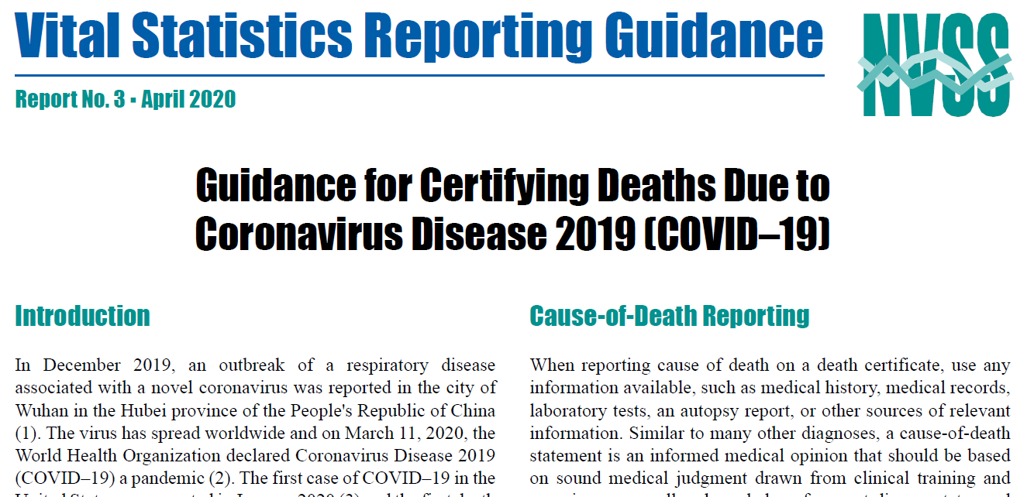
Guidance for Certifying COVID-19 Deaths
https://www.cdc.gov/nchs/data/nvss/vsrg/vsrg03-508.pdf

Slide 5
Guidance for Certifying COVID-19 Deaths: Key Points
If COVID–19 played a role in the death it should be mentioned on the death certificate
Normally abbreviations and acronyms are discouraged, but COVID–19 is unambiguous and is acceptable
Include pre-existing conditions that complicated death in Part 2 of the death certificate
It is acceptable to report COVID–19 on a death certificate as “probable” or “presumed” – certifiers should use their best clinical judgement in determining if a COVID–19 infection was likely

Slide 6
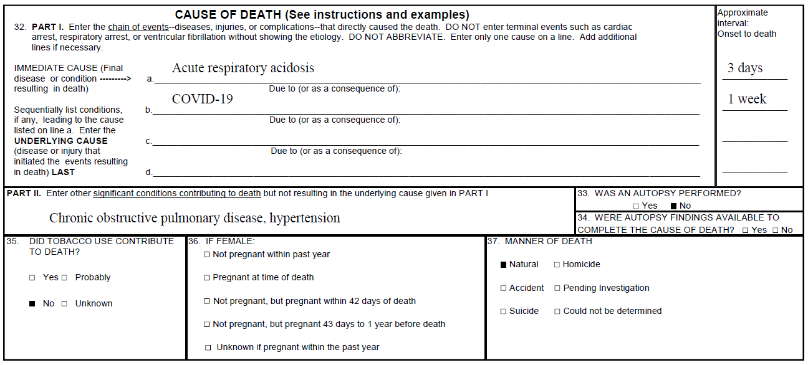
Guidance for Certifying COVID-19 Deaths: Example 1

Slide 7
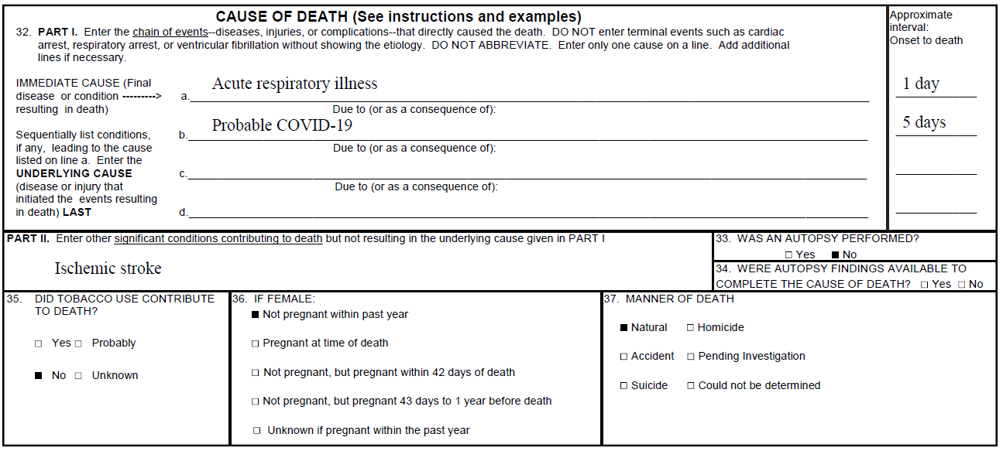
Guidance for Certifying COVID-19 Deaths: Example 2

Slide 8
COVID-19 Cause of Death Coding: ICD-10 Code
U07.1 -- COVID-19
Excludes: Coronavirus infection, unspecified site (B34.2) Severe acute respiratory syndrome [SARS], unspecified (U04.9)
The WHO has provided a second code, U07.2, for clinical or epidemiological diagnosis of COVID-19 where a laboratory confirmation is inconclusive or not available. Because laboratory test results are not typically reported on death certificates in the U.S., NCHS is not planning to implement U07.2 for mortality statistics.
The underlying cause depends upon what and where conditions are reported on the death certificate. However, the rules for coding and selection of the underlying cause of death are expected to result in COVID-19 being the underlying cause more often than not.

Slide 9
COVID-19 Cause of Death Coding: Coding Process
Update coding systems not set up to code COVID-19 or to accept U07.1
Establish rules for coding COVID-19 deaths
Initially all COVID-19 records had to be manually coded
Managing manual coding
Prioritization
Increase manual coding capacity
Systems modified to automatically code some COVID-19 deaths
Adjust coding rules

Slide 10
Provisional COVID-19 Death Counts
Data as of May 1, 2020
Week ending date in which the death occurred | COVID-19 Deaths (U07.1)¹ | Deaths from All Causes | Percent of Expected Deaths² | Pneumonia Deaths (J12.0–J18.9)³ | Deaths with Pneumonia and COVID-19 (J12.0–J18.9 and U07.1)³ | Influenza Deaths (J09–J11)⁴ | Deaths with Pneumonia, Influenza, or COVID-19 U07.1 or J09–J18.9)⁵
Total Deaths | 37,308 | 719,438 | 97 | 64,382 | 16,564 | 5,846 | 90,165
2/1/2020 | 0 | 57,266 | 97 | 3,688 | 0 | 469 | 4,157
2/8/2020 | 1 | 57,615 | 97 | 3,672 | 0 | 494 | 4,167
2/15/2020 | 0 | 56,878 | 97 | 3,693 | 0 | 517 | 4,210
2/22/2020 | 0 | 56,806 | 98 | 3,557 | 0 | 536 | 4,093
2/29/2020 | 5 | 56,843 | 99 | 3,626 | 3 | 619 | 4,247
3/7/2020 | 25 | 56,212 | 97 | 3,719 | 14 | 583 | 4,312
3/14/2020 | 49 | 53,968 | 95 | 3,676 | 25 | 578 | 4,277
3/21/2020 | 493 | 53,979 | 95 | 4,150 | 226 | 496 | 4,907
3/28/2020 | 2,712 | 57,430 | 103 | 5,624 | 1,235 | 410 | 7,463
4/4/2020 | 8,082 | 64,313 | 115 | 8,724 | 3,875 | 432 | 13,148
4/11/2020 | 12,262 | 66,577 | 120 | 9,841 | 5,468 | 430 | 16,744
4/18/2020 | 10,408 | 55,062 | 101 | 7,606 | 4,402 | 215 | 13,663
4/25/2020 | 3,271 | 26,489 | 49 | 2,806 | 1,316 | 67 | 4,777

Slide 11
Provisional COVID-19 Death Counts: Understanding the Numbers
Things to know about the data
Provisional counts are not final and are subject to change
Provisional data are not yet complete
Death counts should not be compared across jurisdictions
Why these numbers are different
Death certificates take time to be completed
States report at different rates
It takes extra time to code COVID-19 deaths
Other reporting systems use different definitions or methods for counting deaths
https://www.cdc.gov/nchs/data/nvss/coronavirus/Understanding-COVID-19-Provisional-Death-Counts.pdf

Slide 12
Provisional COVID-19 Death Counts: Demographic and Geographic Detail
Tabulated Data (counts and/or percentages)
COVID-19
Pneumonia and Influenza
Other Causes of Death (with and without COVID-19)
Demographic Detail
Sex
Age
Race/Hispanic origin
Geographic Detail
National
Jurisdiction/state
County
Counts 1-9 suppressed

Slide 13
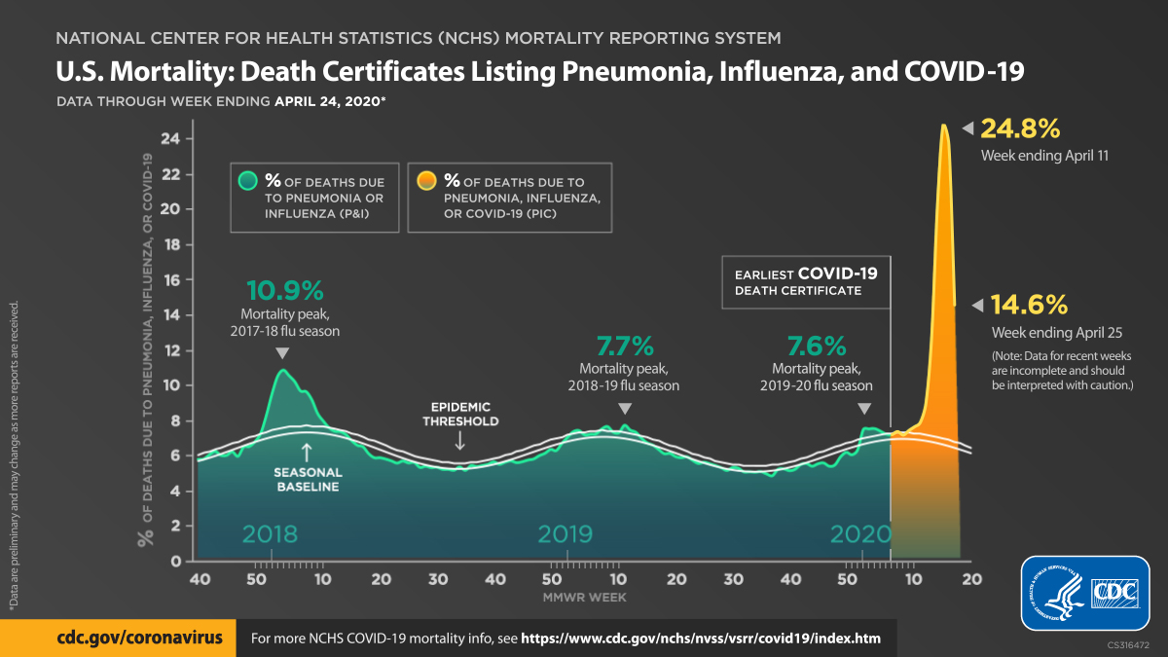

Slide 14
Provisional COVID-19 Death Counts: Race and Hispanic Origin
Data as of May 1, 2020
State | Indicator | Non-Hispanic White | Non-Hispanic Black or African American | Non-Hispanic American Indian or Alaska Native | Non-Hispanic Asian | Hispanic or Latino | Other
United States | COVID-19 deaths (%) | 52.1 | 21.2 | 0.3 | 6.1 | 16.5 | 3.8
 | Weighted population (%) | 40.4 | 18.4 | 0.2 | 12.1 | 26.9 | 1.9
 | Unweighted population (%) | 60.4 | 12.5 | 0.7 | 5.7 | 18.3 | 2.4
New York City | COVID-19 deaths (%) | 29.3 | 24.8 | 0 | 8.9 | 26.4 | 10.7
 | Weighted population (%) | 30.3 | 23.3 | 0.2 | 15.7 | 28.6 | 1.8
 | Unweighted population (%) | 32.1 | 22 | 0.2 | 14.7 | 29.2 | 1.8

Slide 15
Provisional COVID-19 Death Counts: Where to Find Them
Webpages
Coronavirus Disease (COVID-19) Death Data and Reporting Guidance https://www.cdc.gov/nchs/nvss/covid-19.htm
Provisional Death Counts for Coronavirus Disease (COVID-19) https://www.cdc.gov/nchs/nvss/vsrr/covid19/
Download and API Access
All data is simultaneously posted on data.cdc.gov
Export in a variety of formats
API for automated

Slide 16
Provisional COVID-19 Death Counts: Modeling and Visualizations
Excess Deaths Associated with COVID-19 - Visualization
https://www.cdc.gov/nchs/nvss/vsrr/covid19/excess_deaths.htm
United States

