Slide 1
Board of Scientific Counselors Update from the NCHS Director
Brian C. Moyer, Ph.D., NCHS Director
May 5, 2020

Slide 2
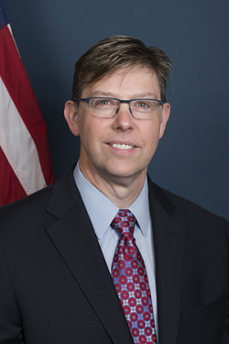
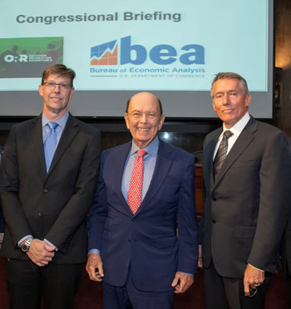
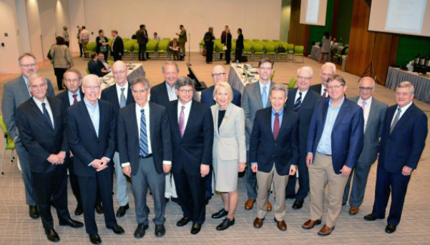
New NCHS Director

Slide 3
Toward an NCHS Vision …
Data modernization
Harness new data sources and techniques
Expand the capacity and scope of statistical analysis
Connect data across the statistical system
An NCHS Workforce for the Future
Coordinate
Collaborate
Empower

Slide 4
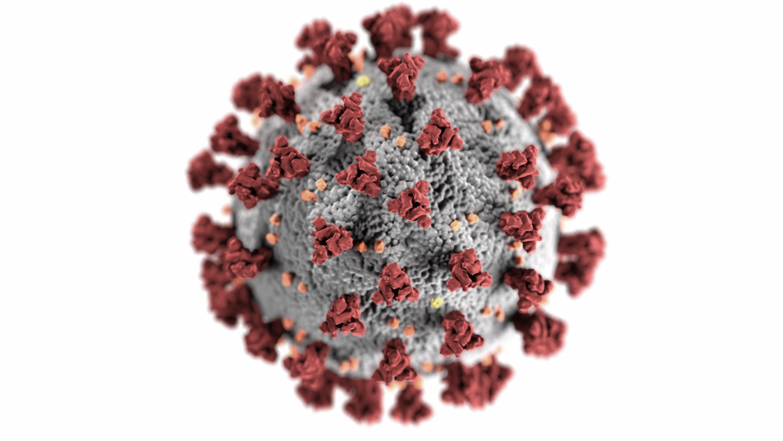
The COVID-19 Response
NCHS is …
Accelerating the availability of our statistics
Expanding our existing surveys
Partnering with the federal statistical community

Slide 5
FY 2020 Budget
*Amount includes funding for administrative and business services through the CDC Working Capital Fund.
Not included: NCHS relies on additional funding from CDC’s Public Health and Scientific Services Account, about $14 million annually.

Slide 6
Public Health Data Modernization Initiative
$50 million allocated to CDC for public health data modernization in the FY 2020 appropriations
Specific Congressional report language highlighted NCHS as a key recipient and implementer of these data modernization funds
To date, NCHS has received $3.4 million
$30 million requested for public health data modernization in the FY 2021 President’s Budget request
No mention of NCHS in the request for these funds

Slide 7
FY 2021 President’s Budget
Realignment of NCHS budget, not an increase in funding
Reduction in funding for FY 2021 by $5.4 million

Slide 8
COVID-19 Supplemental Funding for CDC
New CDC Funding | Coronavirus Preparedness and Response Supplemental Appropriations Act | The Coronavirus Aid, Relief, and Economic Security (CARES) Act | Paycheck Protection Program and Health Care Enhancement Act
Public Health Data Modernization | -- | $500 million | --
State and Local Response Grants | $950 million | $1.5 billion | --
Global Response Fund | $300 million | $500 million | --
Infectious Disease Rapid Response Reserve Fund | $300 million | $300 million | --
General/Unspecified | $650 million | $1.5 billion | $1.0 billion
Total | $2.2 billion | $4.3 billion | $1.0 billion
 | Available through FY 2022 | Available through FY 2024 | Available until expended

Slide 9
The Coronavirus Preparedness and Response Supplemental Appropriations Act
Became Public Law on March 6, 2020
$2.2 billion allocated to CDC
The first supplemental of four passed to date
NCHS has received $2 million to date
Supports vitals reporting
Additional funding requests TBD

Slide 10
The Coronavirus Aid, Relief, and Economic Security (CARES) Act
Became Public Law on March 27, 2020
$4.3 billion allocated to CDC
The third supplemental of four passed to date
NCHS has not received any funding to date
NCHS is working with CDC to provide input on the allocation of public health data modernization funding ($500 million)

Slide 11
Paycheck Protection Program and Health Care Enhancement Act
Became Public Law on April 24, 2020
$1 billion allocated to CDC
The fourth supplemental of four passed to date
Requires monthly reports from CDC on COVID-19 cases, hospitalizations, and deaths, including data grouped by demographic characteristics (race, ethnicity, age, sex, geographic region)

Slide 12
Recent Reports …
Upcoming Reports …
Increase in Suicide Mortality
Hypertension Prevalence and Control Among Adults
Marriage Rates in the United States, 1900 through 2018
Electronic Cigarette Use Among U.S. Adults
Sexual Activity and Contraceptive Use Among Teenagers Aged 15 – 19
Births: Provisional Data for 2019

Slide 13
Departing BSC Members, Thank you for your Advice and Service!
Ninez Ponce, M.P.P., Ph.D.
Mark Hayward, Ph.D.
Prashila Dullabh, M.D.
Darrell Gaskin, Ph.D.
Robert Santos, M.A.

