Slide 1
Social Determinants of Health
Notes:
The data included on these slides are related to our Center’s mission to reduce health inequities among populations most disproportionately affected by HIV, AIDS, STDs, TB and hepatitis, based on the available surveillance data. For the most part, these data were downloaded from the US Bureau of the Census; please see individual slides for exact source.

Slide 2
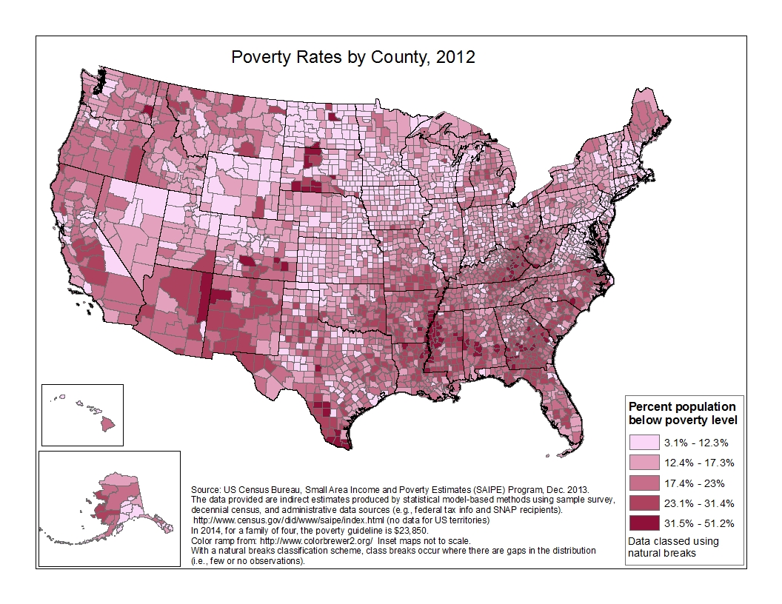
Notes:
POVERTY
This is a map of poverty rates, by US county (or equivalent) in 2012. The data are grouped into 5 classes, using natural breaks. The range is from 3.1% to 51.2%. Generally speaking, the highest percentages are found in the southern half of the US, as well as several counties in the Dakotas, and the lowest percentages in the midwest and northeast.
(No data for US territories.)

Slide 3
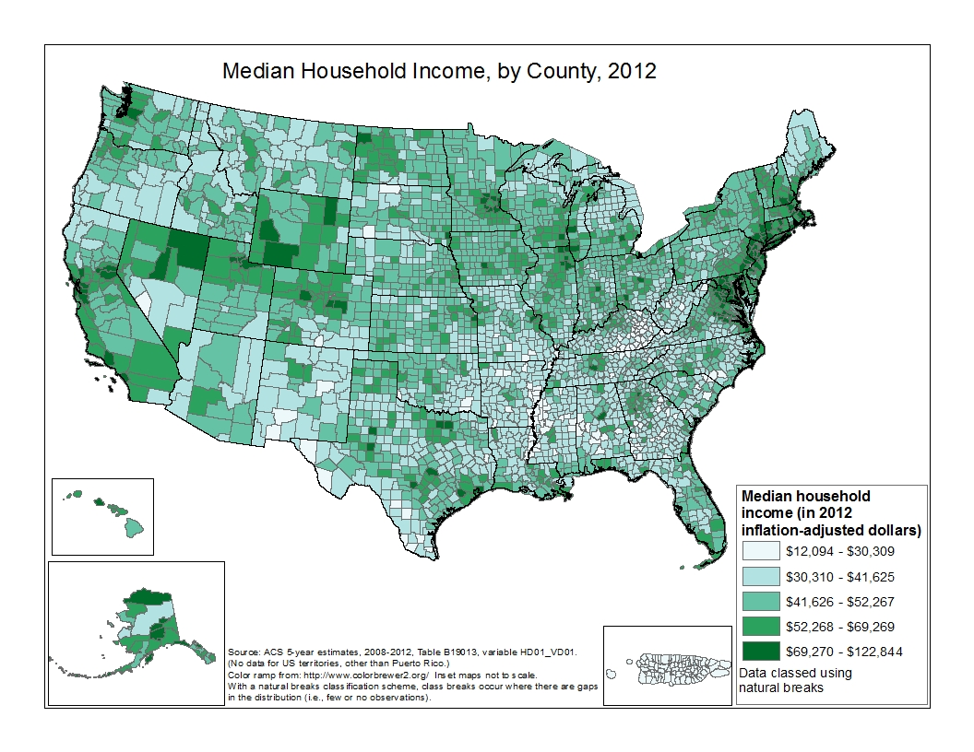
Notes:
MEDIAN HOUSEHOLD INCOME
This is a map of median household (HH) income, by US county (or equivalent) in 2012. The data are grouped into 5 classes, using natural breaks. The range is from $12,094 to $122,844. Generally speaking, the highest median HH incomes are found in the northeast and west, and the lowest median HH incomes are seen in Puerto Rico and parts of the south and southwest.
(No data for US territories, other than Puerto Rico.)

Slide 4
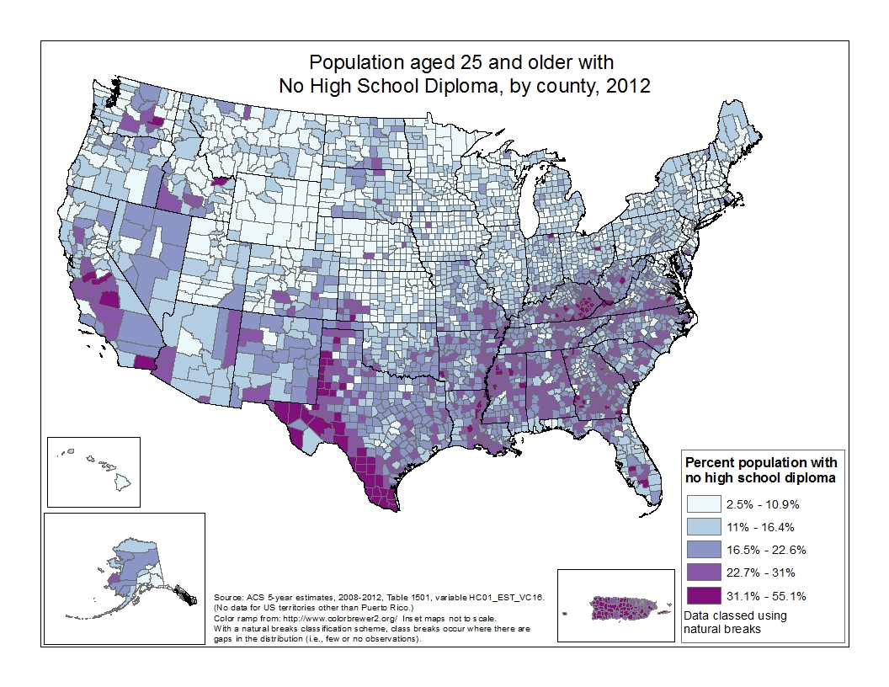
Notes:
PERCENT NO HIGH SCHOOL DEGREE
This is a map of percent of the population aged 25 and older with no high school diploma, by US county (or equivalent) in 2012. The data are grouped into 5 classes, using natural breaks. The range is from 2.5% to 55.1%. Generally speaking, the areas where almost one-third of the population aged 25 and over have no high school diploma are in southern California and the Texas border counties.
(No data for US territories, other than Puerto Rico.)

Slide 5
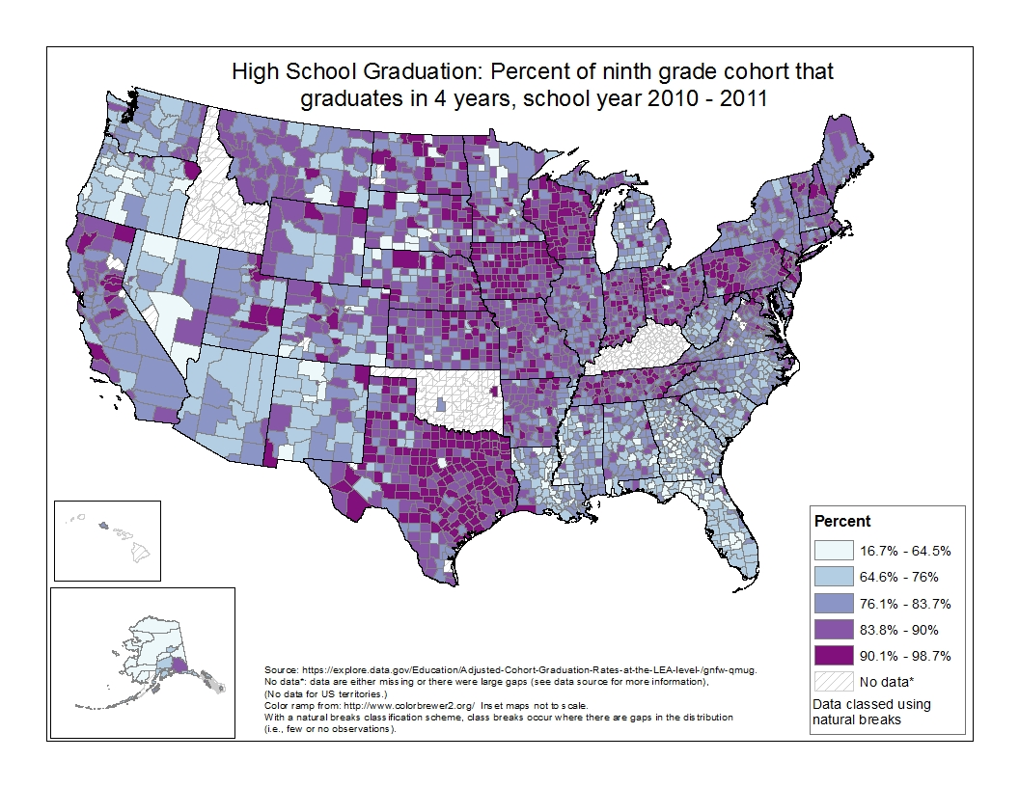
Notes:
HIGH SCHOOL GRADUATION
This is a map of percent of the ninth grade cohort that graduates in 4 years, by US county (or equivalent), the school year 2010-2011. The data are grouped into 5 classes, using natural breaks. The range is from 16.7% to 55.1%. Generally speaking, the areas where the cohort failed to graduate in 4 years are in the south. For Idaho, Kentucky, and Oklahoma, data were either missing or there were large gaps.
(No data for US territories.)

Slide 6
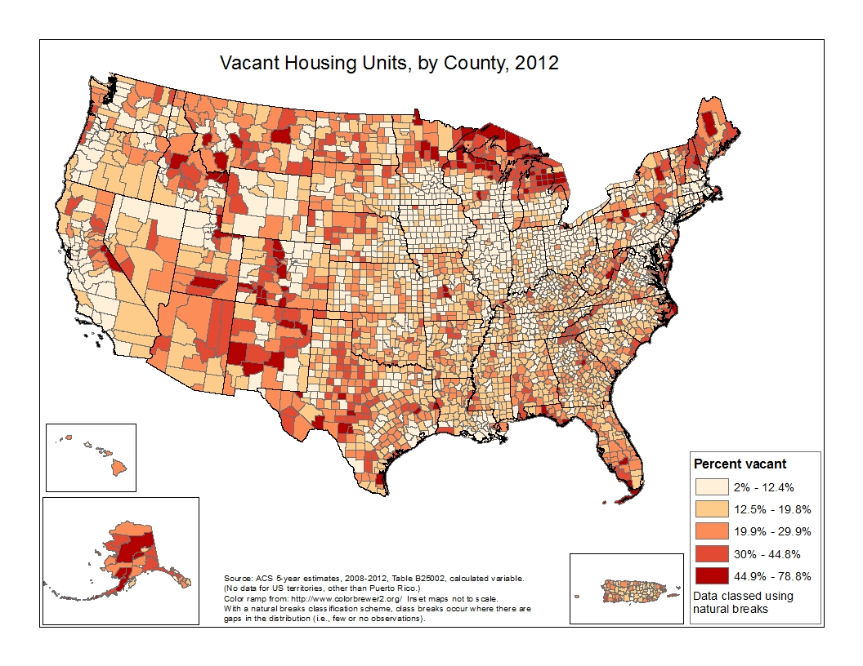
Notes:
VACANCY
This is a map of percent of vacant housing units, by US county (or equivalent) in 2012. The data are grouped into 5 classes, using natural breaks. The range is from 2% to 78.8%. Generally speaking, there is a higher percentage of vacant housing in the southwest and midwest than the south (aside from Florida); Alaska also has a high percentage of vacant housing units.
(No data for US territories, other than Puerto Rico.)

Slide 7
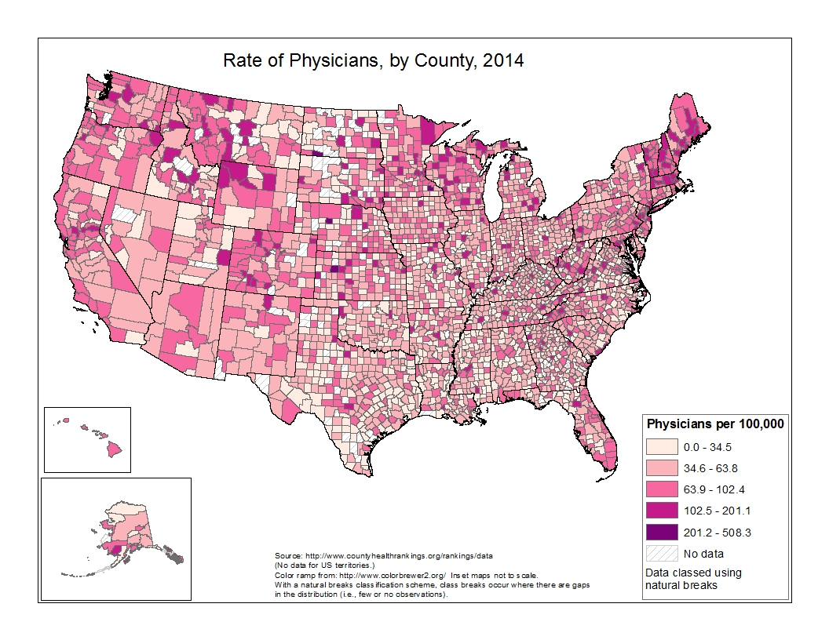
Notes:
PHYSICIANS PER 100,000
This is a map of the rate of physicians (per 100,000), by US county (or equivalent) in 2014. The data are grouped into 5 classes, using natural breaks. The range is from 0 to 508.3 per 100,000. Generally speaking, there is a lower rate of physicians per 100,000 in the south.
(No data for US territories.)

Slide 8
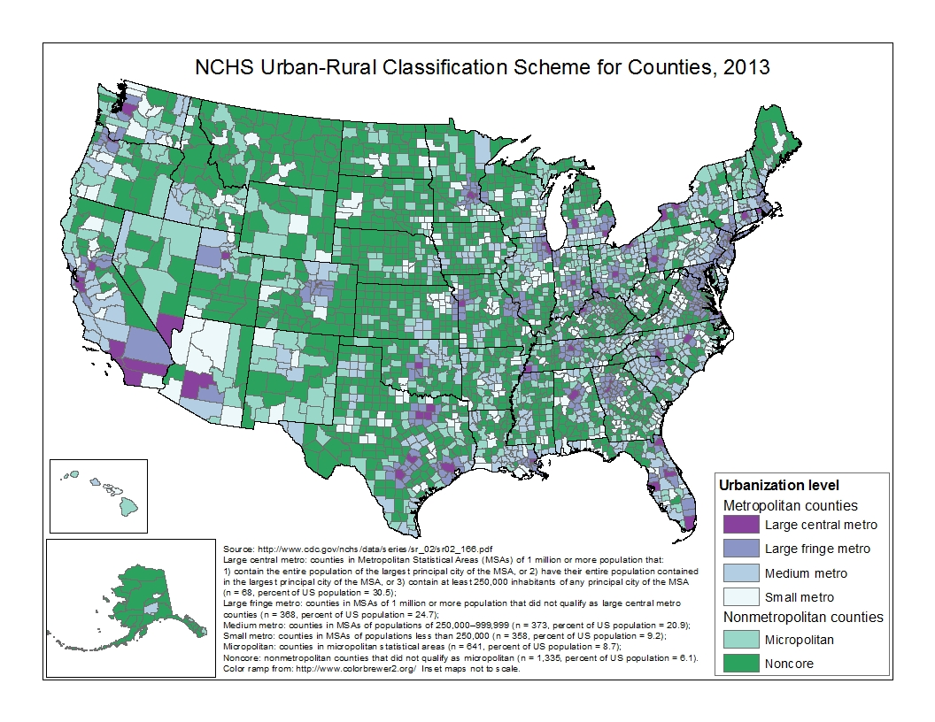
Notes:
NCHS Urban-Rural Classification Scheme for Counties, 2013
This scheme uses 2010 census population numbers and OMB standards for defining metropolitan statistical areas. 4 metro & 2 non-metro areas are produced by NCHS. The largest MSAs are separated into two groups, large central and fringe metro; NCHS says fringe metro may be very important in health status.
Large central metro: counties in Metropolitan Statistical Areas (MSAs) of 1 million or more population that:
1) contain the entire population of the largest principal city of the MSA, or 2) have their entire population contained
in the largest principal city of the MSA, or 3) contain at least 250,000 inhabitants of any principal city of the MSA
(n = 68, percent of US population = 30.5);
Large fringe metro: counties in MSAs of 1 million or more population that did not qualify as large central metro
counties (n = 368, percent of US population = 24.7);
Medium metro: counties in MSAs of populations of 250,000–999,999 (n = 373, percent of US population = 20.9);
Small metro: counties in MSAs of populations less than 250,000 (n = 358, percent of US population = 9.2);
Micropolitan: counties in micropolitan statistical areas (n = 641, percent of US population = 8.7);
Noncore: nonmetropolitan counties that did not qualify as micropolitan (n = 1,335, percent of US population = 6.1).
There are no data for PR or other territories.

