Slide 1

Deep Vein Thrombosis (DVT)
Know the Signs. Listen to Your Body.
Protect Your Health.
Notes:
Today we’re going to talk about blood clots, also known as Deep Vein Thrombosis [throm-bo-sis] or DVT.
We want you to know the signs and symptoms, listen to your body, and be able to protect your health.

Slide 2
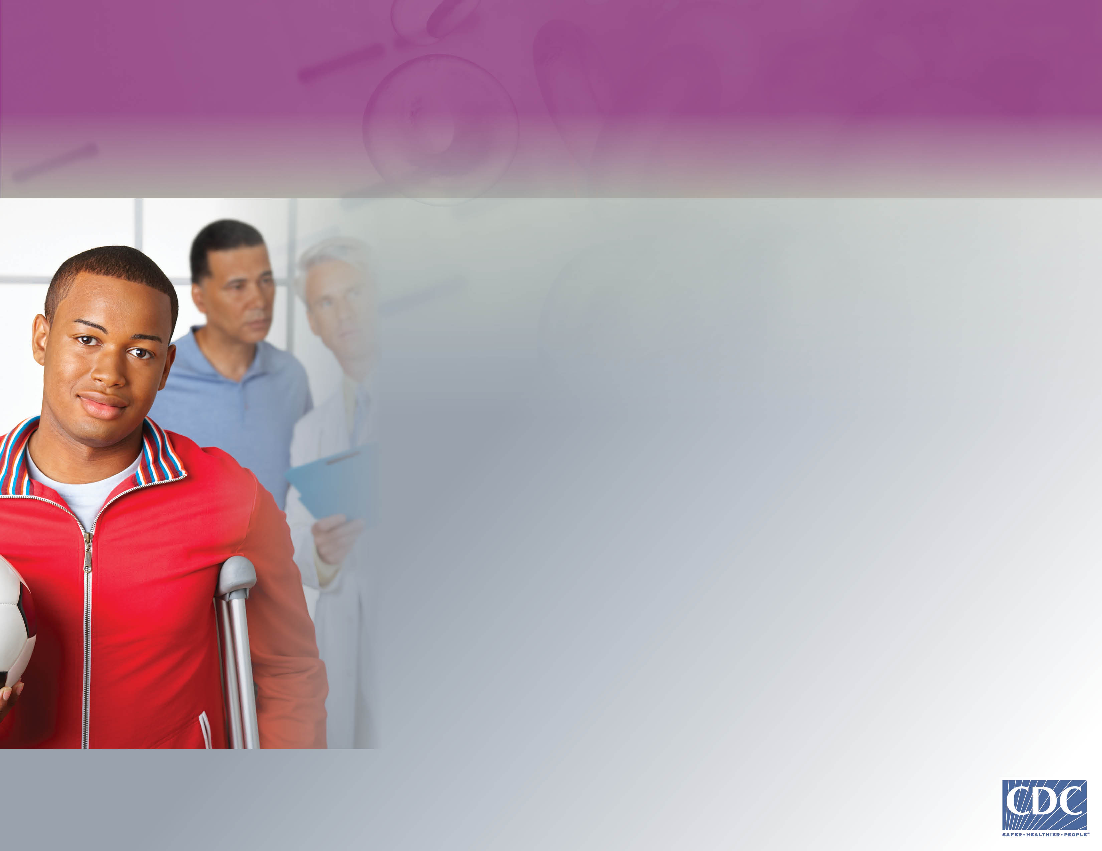
Do You Know About
Deep Vein Thrombosis (DVT)?
“I never thought about getting a blood clot. But last year I broke my leg and was laid up at home. Then, I had a DVT.”
Notes:
Do you know about Deep Vein Thrombosis?
“I never thought about getting a blood clot. But last year I broke my leg and was laid up at home. Then, I had a DVT.”

Slide 3
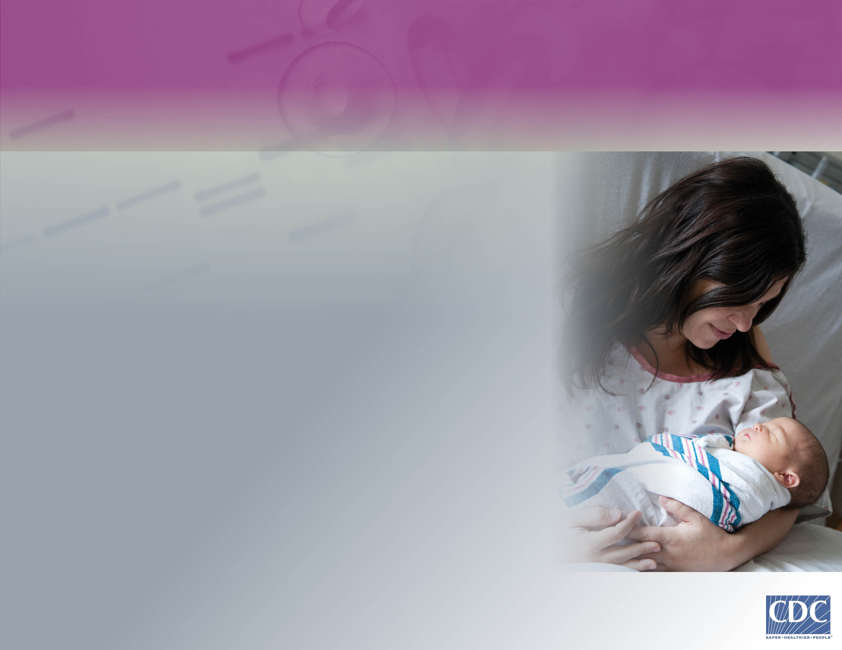
Do You Know About
Deep Vein Thrombosis (DVT)?1
“After my daughter was born, I was all about taking care of her. I didn't know my health could be at risk. But I got a DVT.”
Notes:
“After my daughter was born, I was all about taking care of her. I didn’t know my health could be at risk. But I got a DVT.”

Slide 4
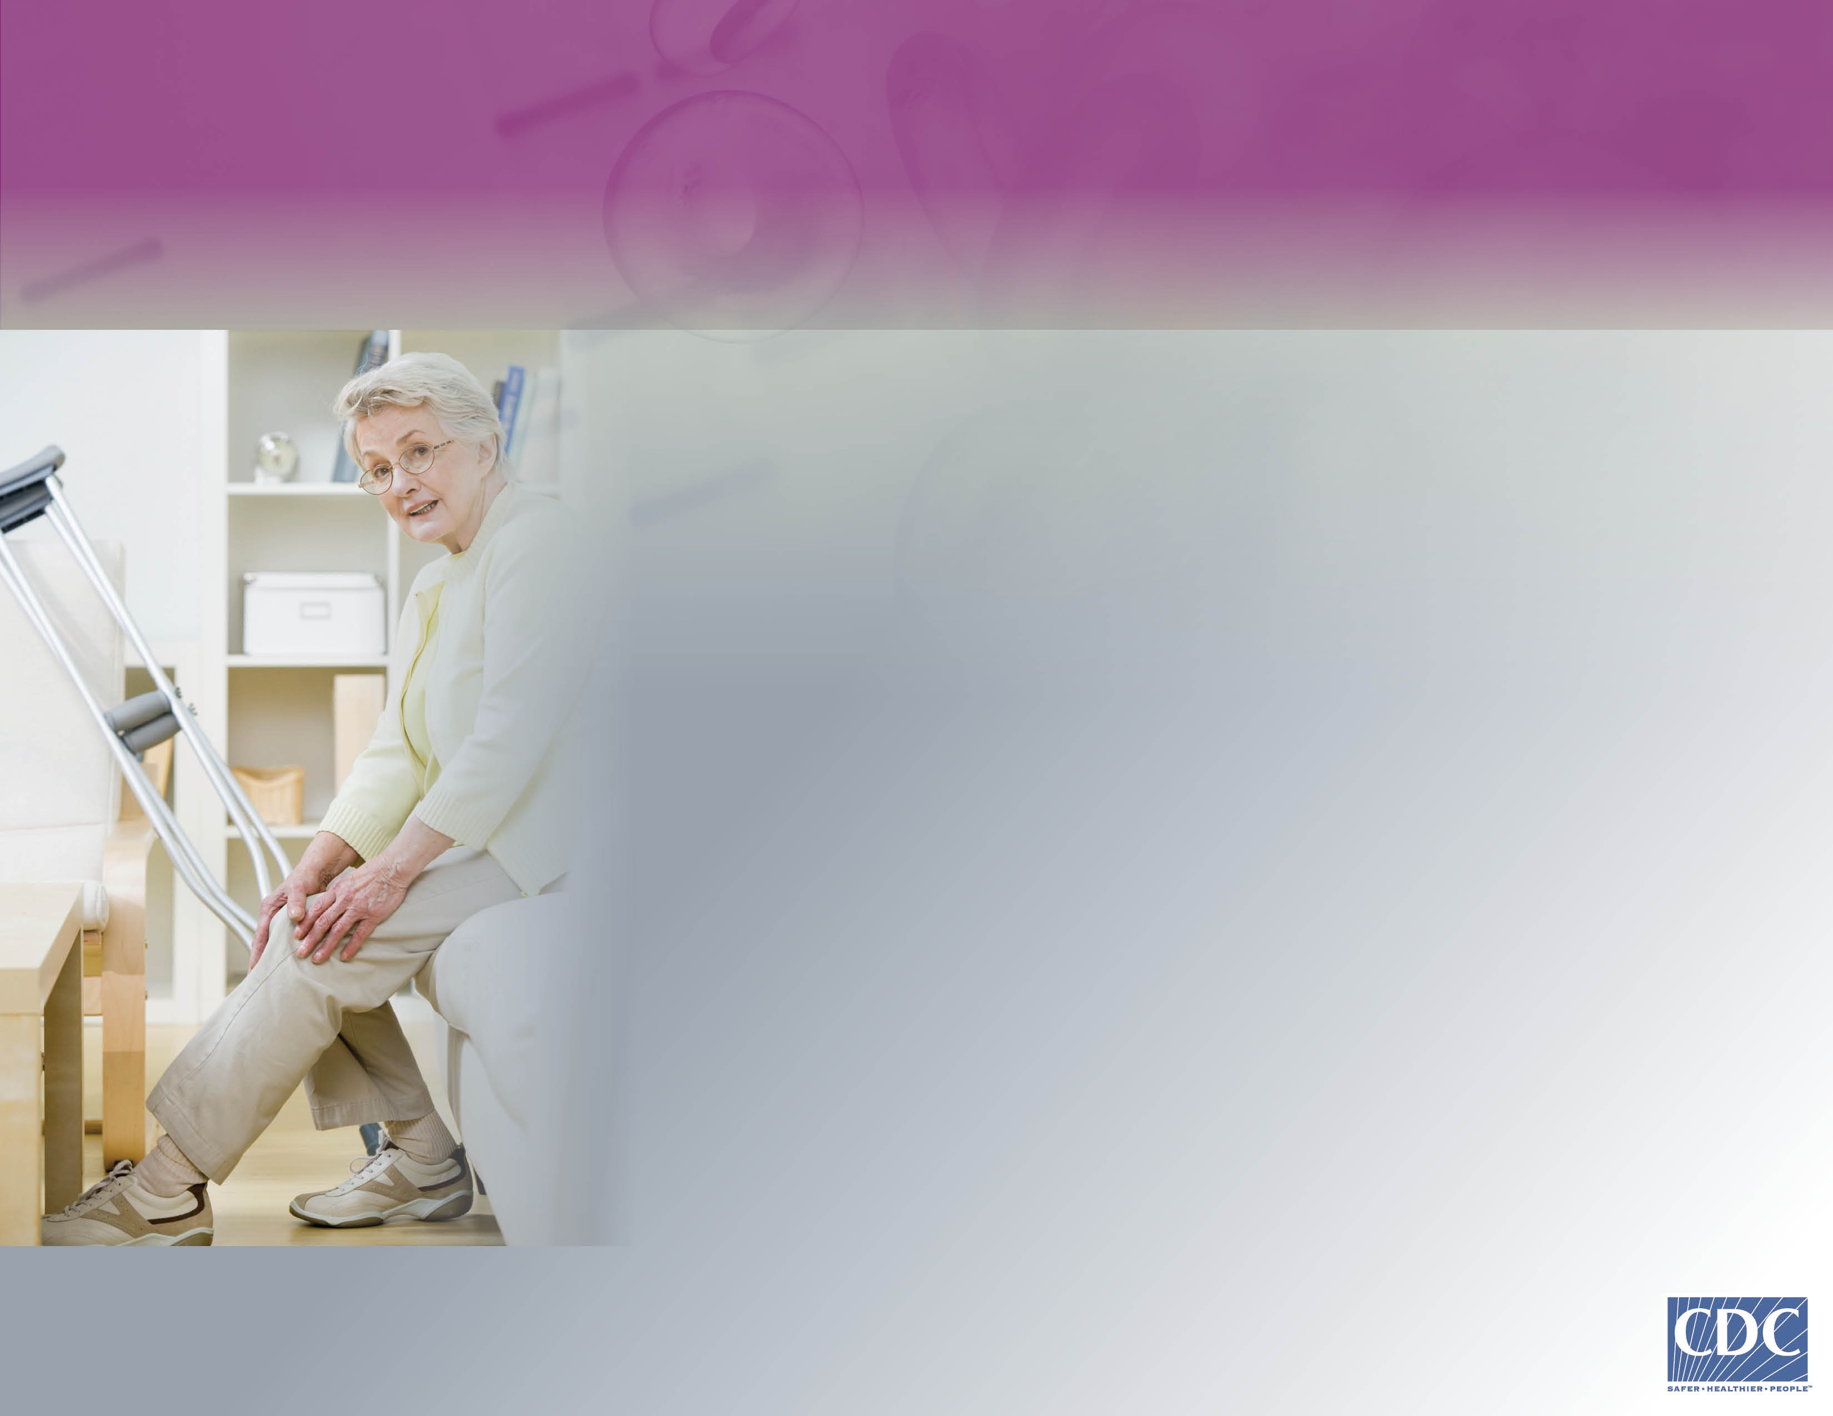
Do You Know About
Deep Vein Thrombosis (DVT)?2
“After surgery, I was so happy to get back home to recover. Then my leg swelled up and I didn’t know why. Turns out I had a DVT.”
Notes:
“After surgery, I was so happy to get back home to recover. Then my leg swelled up and I didn’t know why. Turns out I had a DVT.”

Slide 5
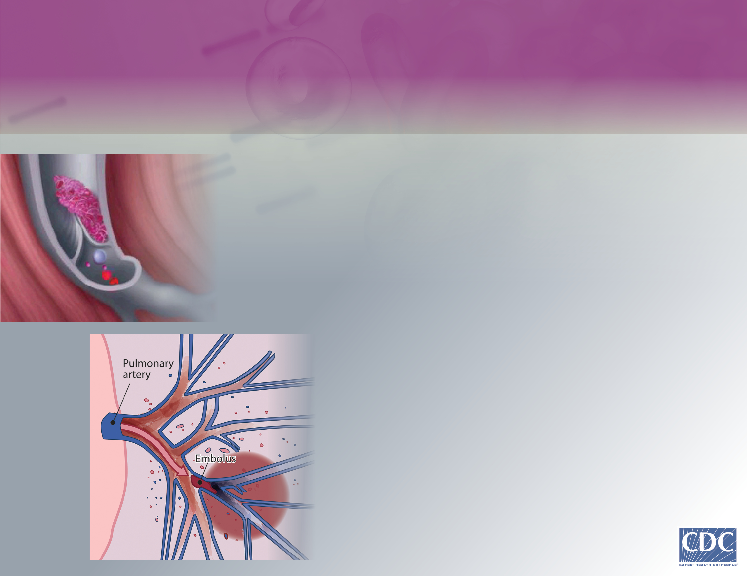
What Is Deep Vein Thrombosis (DVT)?
Deep Vein Thrombosis, or DVT, occurs when a large blood clot forms in a vein in your body, usually the leg.
Sometimes part of the clot breaks off and travels through the bloodstream to your lungs. This is called a Pulmonary Embolism, or PE, and can be fatal.
Notes:
What is Deep Vein Thrombosis?
Deep Vein Thrombosis, or DVT, occurs when a large blood clot forms, usually in the upper part of the leg from the knee to the pelvis.
Sometimes part of the blood clot breaks off and travels through the bloodstream to your lungs. This is called a Pulmonary Embolism, or a PE, and can be fatal.

Slide 6

From 350,000 to 900,000 per year
How Many People Are Affected
by Deep Vein Thrombosis (DVT)?
CDC estimates that each year between 350,000 and 900,000 Americans develop blood clots for the first time.¹
That's more than the number of new cases of
either breast cancer or prostate cancer during 2012.²
¹CDC Public Health Grand Rounds, 2013
²United States Cancer Statistics (USCS)
Notes:
How many people are affected by DVT?
DVT is a serious medical condition. The Centers for Disease Control and Prevention, or CDC, estimates that between 350,000 and 900,000 Americans develop blood clots for the first time each year.
That’s more than the number of new cases of either breast cancer or prostate cancer during 2012.

Slide 7

Why Should I Care About
Deep Vein Thrombosis (DVT)?
Everyone is at risk for a DVT.
DVT can cause serious illness, disability, and may even lead to death caused by a PE.
If you recognize the signs and symptoms early, DVT can be safely treated by your healthcare provider.
You can take steps to help prevent DVT.
Notes:
Why should I care about DVT?
DVT can cause serious illness, disability and even death. However, if you recognize the signs and symptoms early, DVT can be safely treated by your healthcare provider.
There are steps you can take to help prevent DVT.

Slide 8
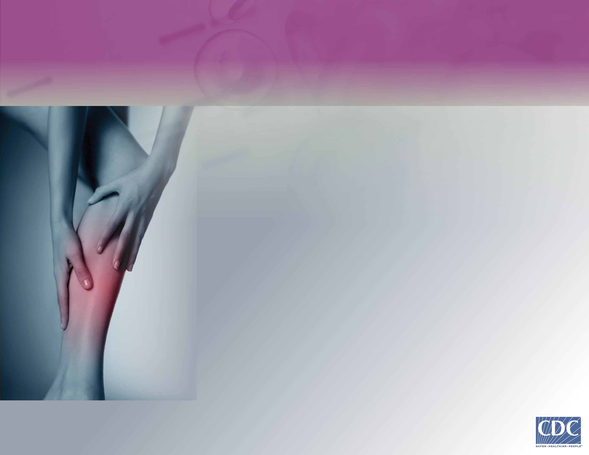
What Are the Signs and Symptoms of
Deep Vein Thrombosis (DVT)?
The most common signs and symptoms are combinations of:
New swelling of your arm or leg
Pain or tenderness you can't explain
Skin that's warm to the touch
Redness or discoloration of the skin
Recognized in time, DVT can be treated. If you think you have signs or symptoms, contact your doctor.
Notes:
First, it is helpful to know and be able to recognize the signs and symptoms of DVT.
The most common signs and symptoms are:
new swelling of your arm or leg
pain or tenderness that you can’t explain
skin that’s warm to the touch
redness or discoloration of the skin
If DVT is recognized in time, it can be successfully treated. If you think you have some of the signs or symptoms of DVT, contact your health care provider.

Slide 9
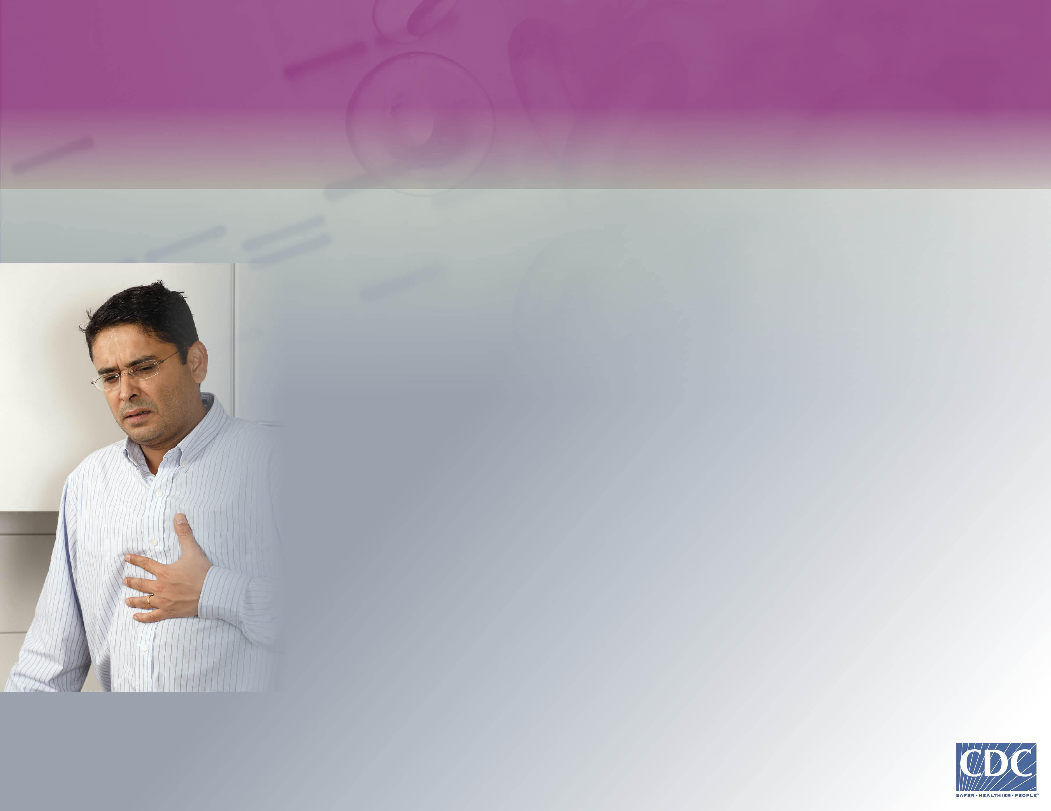
What Are the Signs and Symptoms of
Pulmonary Embolism (PE)? cont.
The most common signs and symptoms are combinations of:
Shortness of breath you can't explain
Chest pain, especially when you take deep breaths
Coughing up blood
Feeling lightheaded or fainting
Recognized in time, PE can be treated. If you think you have signs or symptoms,
seek medical attention right away. Left untreated, PE can result in death.
Notes:
Are you at risk for Deep Vein Thrombosis? DVT can happen to anybody, but there are things that can put you at even greater risk.
The strongest risk factors for DVT are associated with diseases or injuries, medical procedures, or treatments. These include a recent serious injury such as a broken bone, recent surgery, or sitting or lying in bed for long periods of time. Your risk also increases if you have active cancer or another chronic illness such as heart disease.

Slide 10
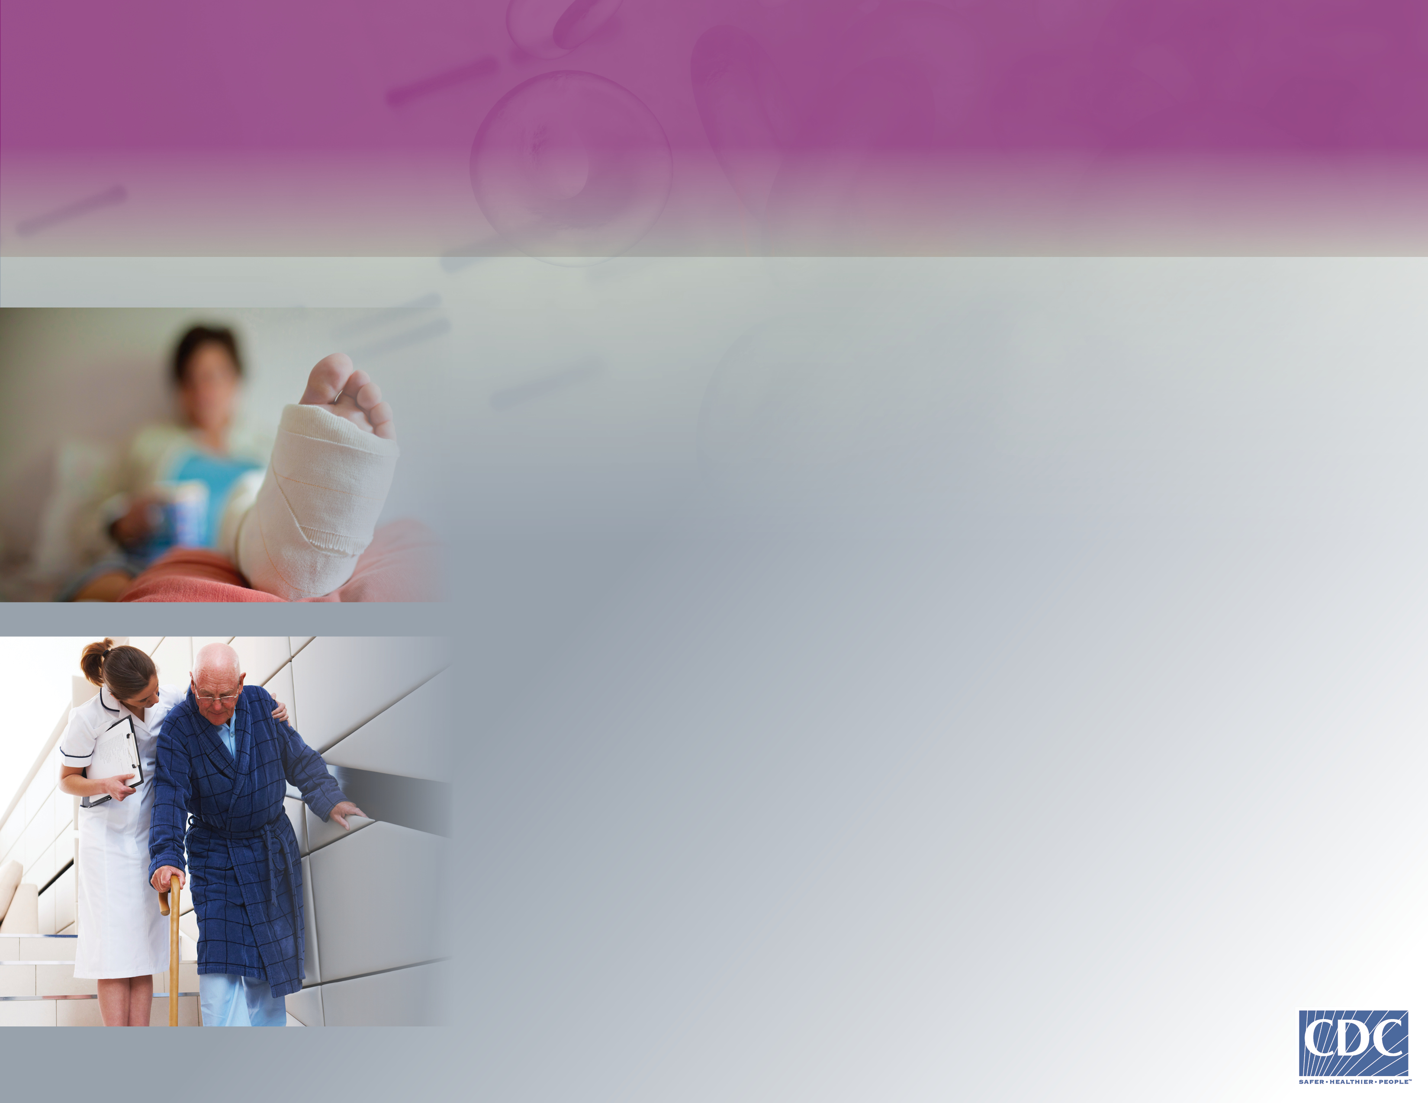
Am I at Risk for Deep Vein Thrombosis (DVT)?
Deep Vein Thrombosis (DVT) can happen to anybody. Risk factors include:
Recent serious injury such as a broken bone
Recent surgery
Sitting or lying down for long periods of time
Having active cancer
Notes:
Are you at risk for Deep Vein Thrombosis? DVT can happen to anybody, but there are things that can put you at even greater risk.
The strongest risk factors for DVT are associated with diseases or injuries, medical procedures, or treatments. These include a recent serious injury such as a broken bone, recent surgery, or sitting or lying in bed for long periods of time. Your risk also increases if you have active cancer or another chronic illness such as heart disease.

Slide 11
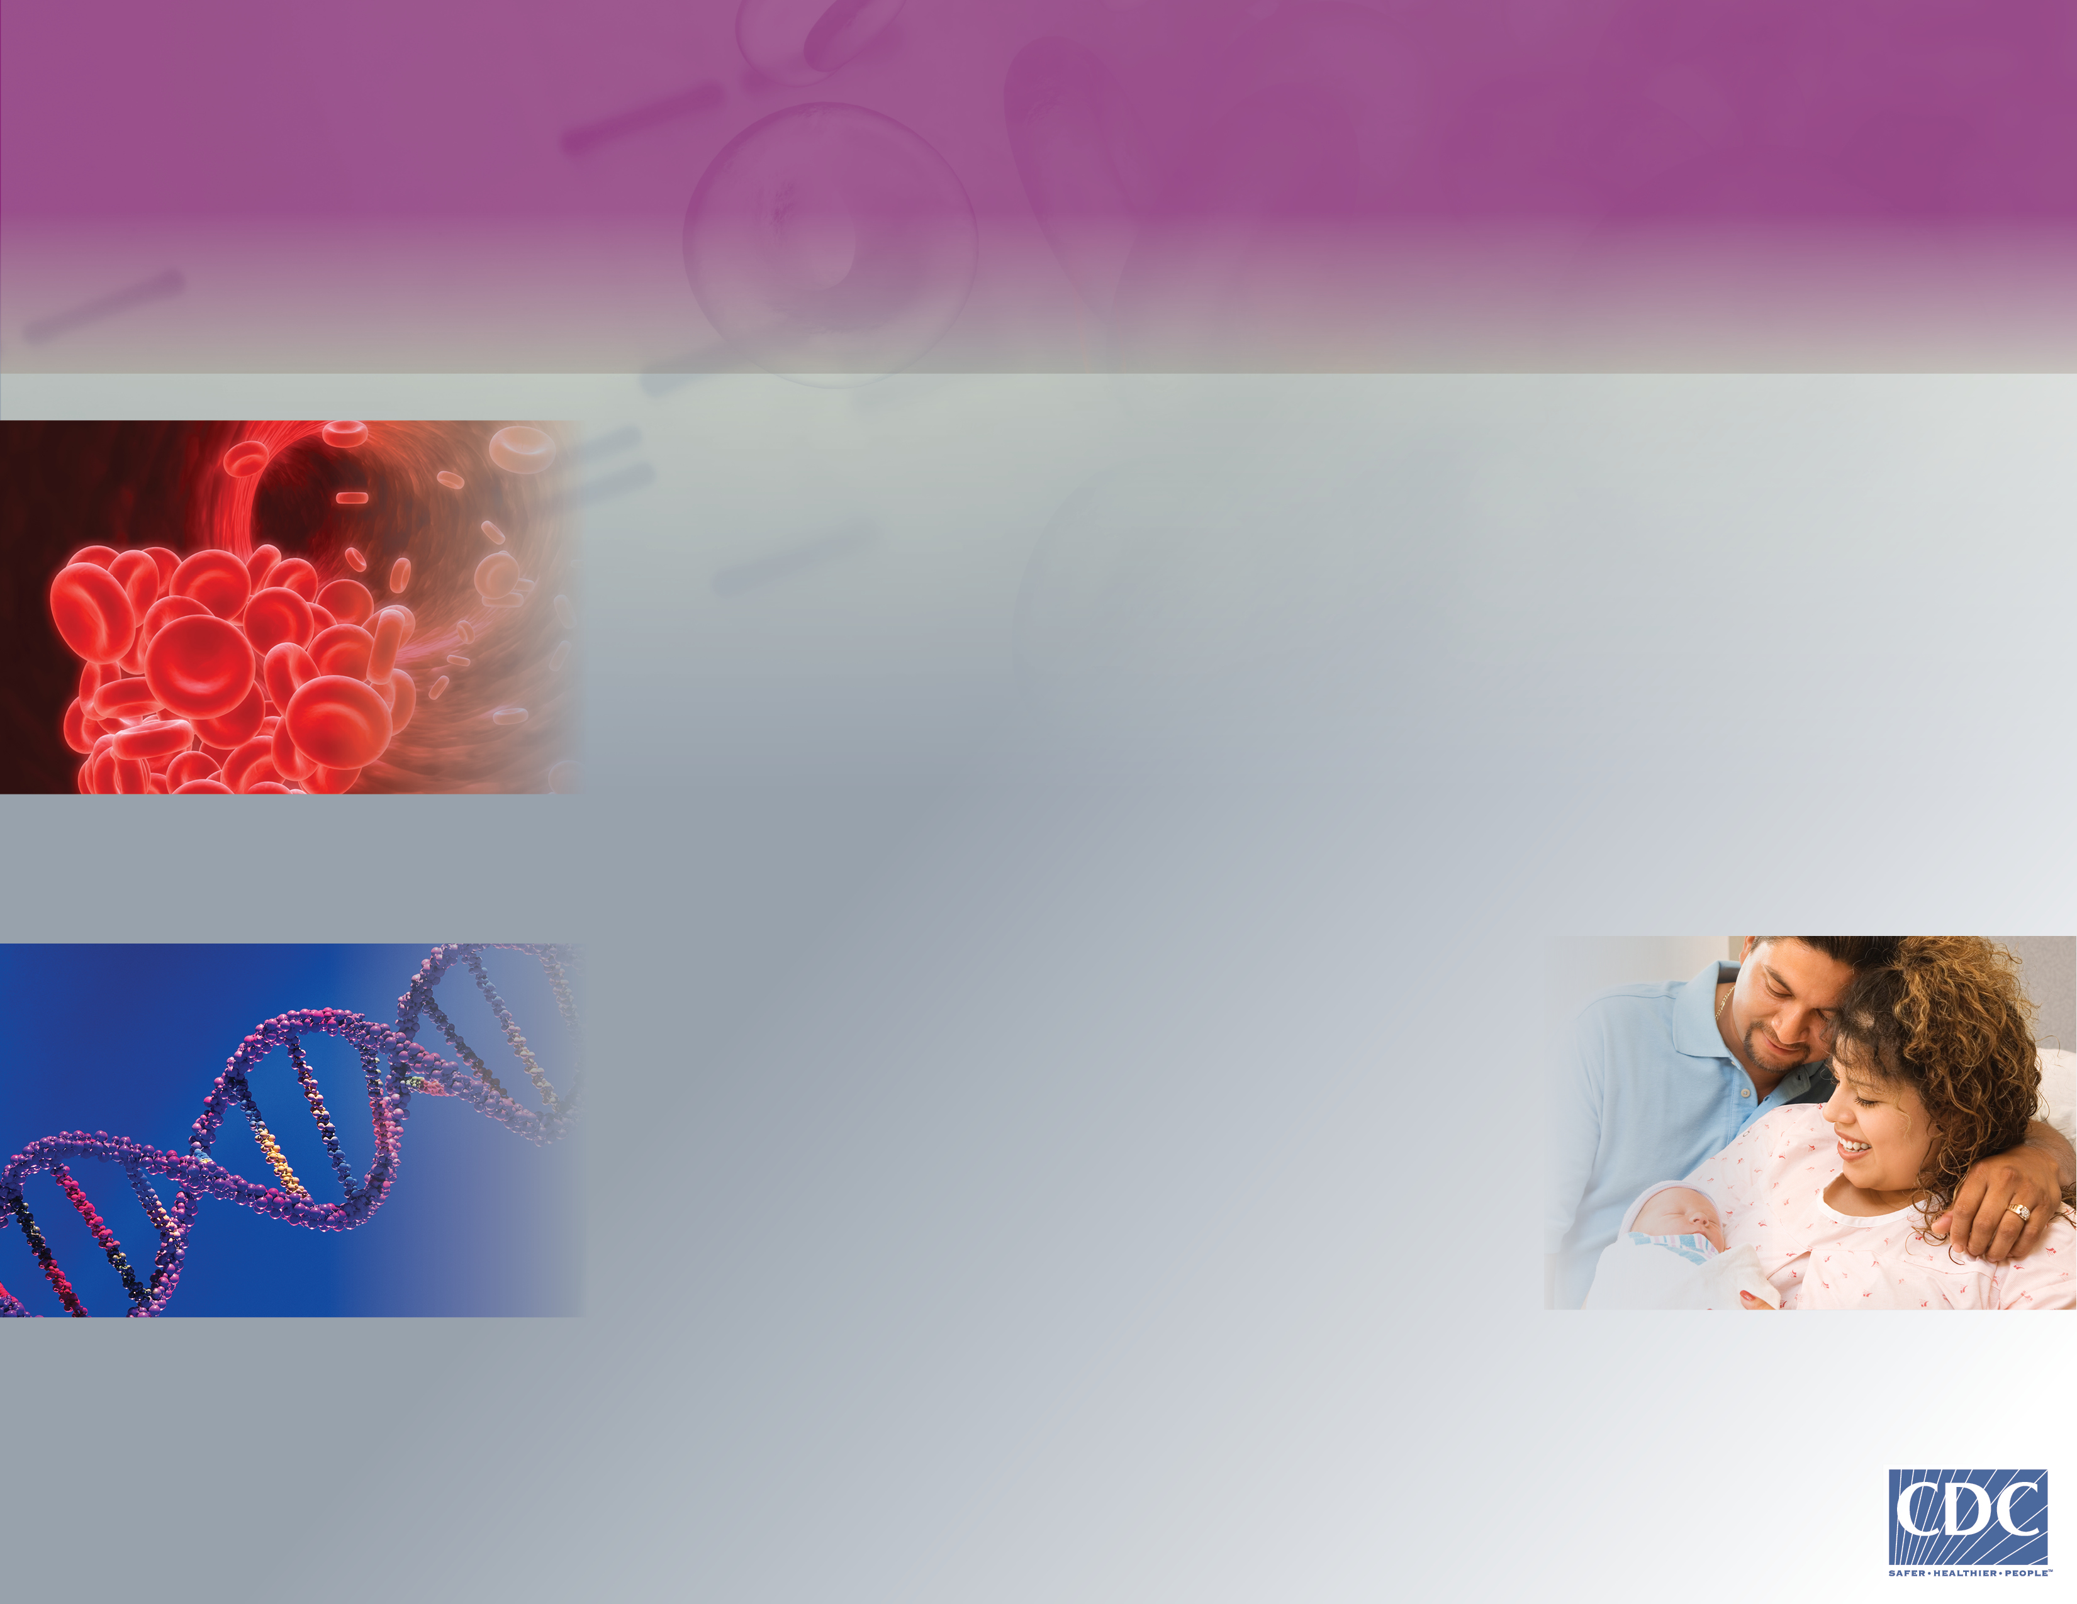
Am I at Risk for Deep Vein Thrombosis (DVT)?1
Other things that can put you
at risk for DVT include:
Having had a blood clot in the past
Having a family history of blood clotting disorders
Being pregnant or
recently giving birth
Taking birth control that
contains estrogen
(such as pills, patches, or rings) or hormone replacement therapy
Notes:
Other things that can put you at risk for DVT include having had a blood clot in the past or having a family history of blood clotting disorders. Being pregnant or recently giving birth, as well as taking birth control that contains estrogen or hormone replacement therapy, can also increase your risk for DVT.

Slide 12

Am I at Risk for Deep Vein Thrombosis (DVT)?2
A few more things that can put you
at risk for DVT include:
Being over age 65
Being overweight
Sitting during travel
longer than 4 hours
Notes:
Your risk for DVT also increases if you are older than 65 or are overweight. Also, sitting during travel for longer than four hours can increase your risk.

Slide 13
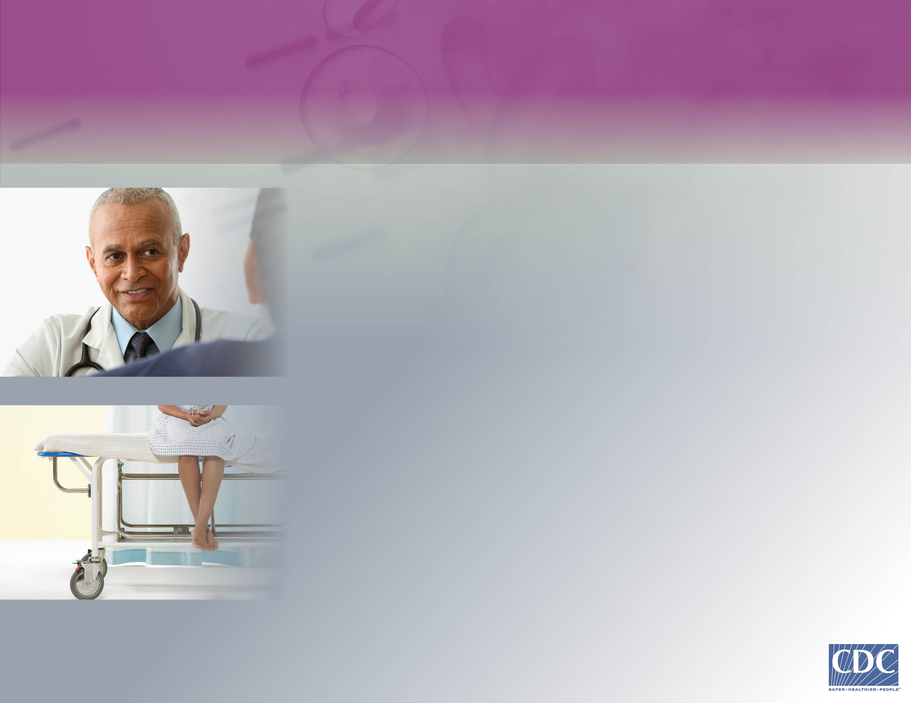
How Can I Prevent
Deep Vein Thrombosis (DVT)?
Most cases of DVT can be prevented.
Here are things you can do to protect your health:
Before any surgery, talk to your doctor about blood clots.
If you've had a stay in the hospital or been treated for a serious injury, ask what you can do to prevent blood clots.
Follow your doctor's instructions.
Notes:
Fortunately, most cases of Deep Vein Thrombosis can be prevented. Here are some things you can do to prevent DVT and protect your health.
Before you have any surgery, talk to your doctor about blood clots.
If you’ve been in the hospital or treated for a serious injury, ask what you can do to prevent blood clots.
And, be sure to follow the instructions your doctor gives you.

Slide 14
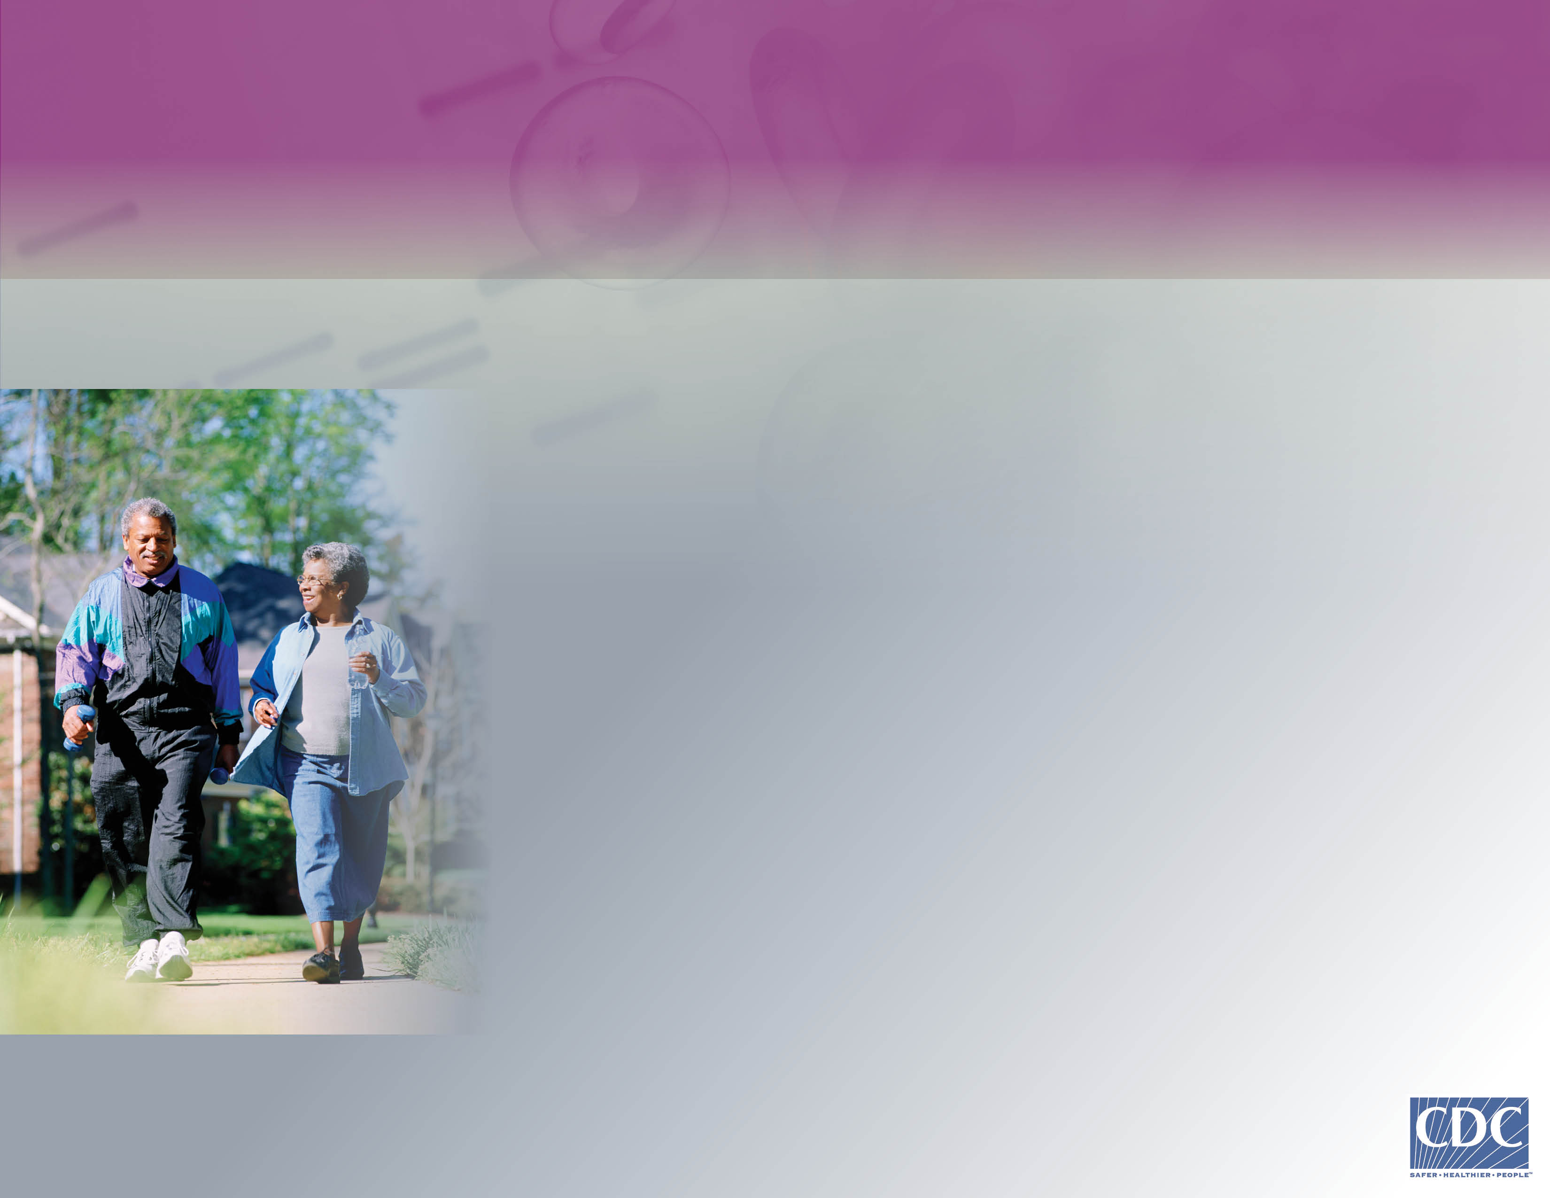
How Can I Prevent
Deep Vein Thrombosis (DVT)? cont.
Get up and move after sitting or lying down for long periods of time.
Move your lower legs while seated on long trips.
Maintain a healthy weight.
Know your family history of blood clots.
Tell your healthcare provider if you have other risk factors for DVT.
Notes:
There are other things you can do to help prevent Deep Vein Thrombosis.
Get up and move after you’ve been sitting or lying down for long periods of time. Move your lower legs while you’re seated on long trips. Maintain a healthy weight.
Know your family history of blood clots, and talk with your healthcare provider about your risk factors.

Slide 15
How Can I Learn More?
To learn more about Deep Vein Thrombosis (DVT) and Pulmonary Embolism (PE), including risks, signs, symptoms, and tips for prevention, visit www.cdc.gov/ncbddd/dvt.
Know the Signs. Listen to Your Body.
Protect Your Health.
Notes:
You may still have some questions about Deep Vein Thrombosis and Pulmonary Embolism. To learn more, including your risks, signs and symptoms, and tips for prevention, please visit the CDC website at www-dot-cdc-dot-gov-slash-ncbddd-slash-dvt.
Know the signs of DVT. Listen to your body and protect your health.

