Slide 1




Mapping Public Health
Notes:
Maps are used in public health to plan health interventions, monitor outbreaks, identify vulnerable populations, and communicate health data. They are invaluable visualization and analysis tools that scientists and researchers use to address health problems.
Note: These slides are made possible by the David J. Sencer CDC Museum Public Health Academy. https://www.cdc.gov/museum/education/lessons/

Slide 2
Terms to Know
 | a factor is completely responsible for a given outcome
 | a factor is partially responsible for a given outcome; other factors contribute, too
 | an increase in the number of cases of a disease above what is normally expected in that area
 | map type that shows rates of disease or health conditions using different shades or colors
 | relationship in which a factor causes an outcome
 | relationship in which two factors share the same pattern
 | the science of protecting and improving the health of people and their communities
 | map type that uses symbols to show where each case or exposure originated
Word Bank
Area map
Attribution
Causation
Contribution
Correlation
Epidemic
Public health
Spot map
Notes:
Terms to Know
Area map - map type that shows rates of disease or other health conditions using different shades or colors
Attribution - a factor is completely responsible for a given outcome
Causation - relationship in which a factor causes an outcome
Contribution - a factor is partially responsible for a given outcome; other factors contribute, too
Correlation - relationship in which two factors share the same pattern; no causality exists
Epidemic - an increase in the number of cases of a disease above what is normally expected in that population in that area
Public health - the science of protecting and improving the health of people and their communities
Spot map - map type that uses symbols to show where each case or exposure originated

Slide 3
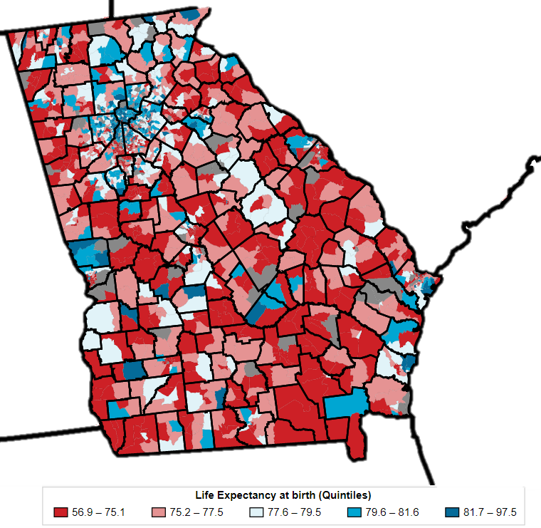
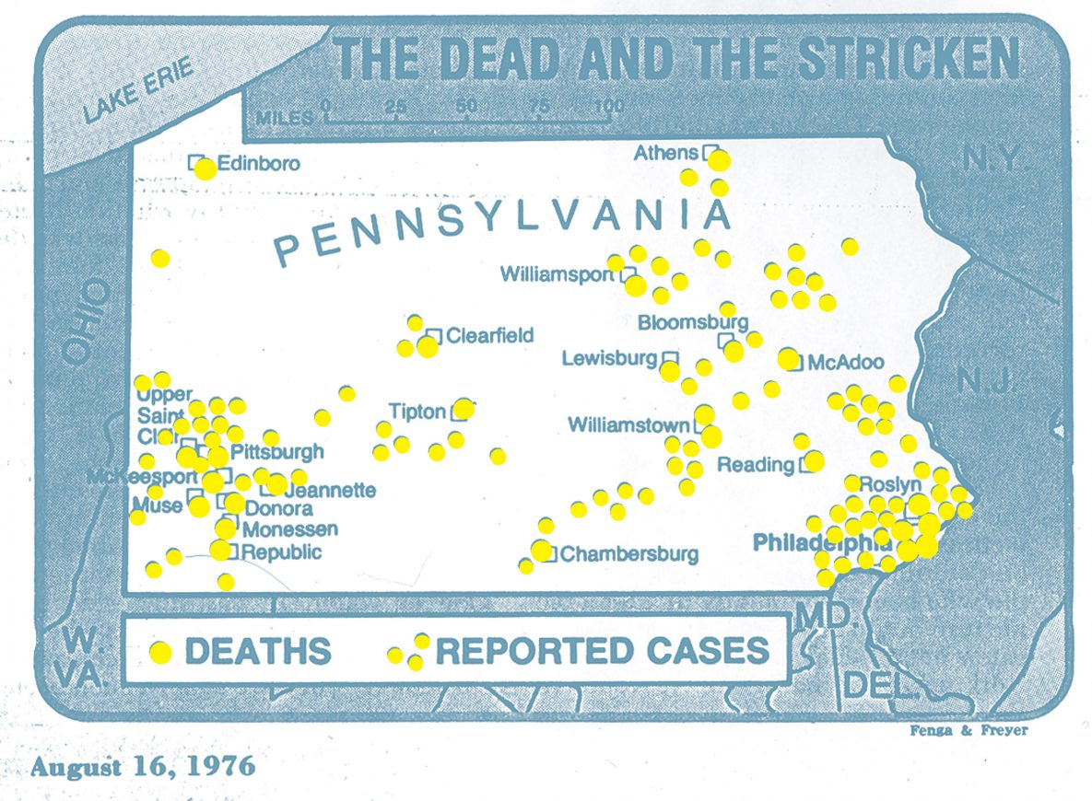
Understanding How Maps Are Used in Public Health
Maps are used in public health to show locations of health events and to visualize trends
Area maps use colors or shades to communicate trends or averages
Spot maps use dots or symbols to show the locations of individual cases
Area Map
Spot Map
Notes:
How are maps used in public health?
Maps are used in public health to show the geographic location of events or attributes. Two types of maps commonly used in field epidemiology are area maps and spot maps.
Area maps, such as the one pictured here, can be used to show rates of disease or other health conditions in different areas by using varied shades or colors. Area maps are useful for communicating trends or averages in an area and can be used to analyze outbreaks.
Spot maps use dots or other symbols to show where each case lived or was exposed. A spot map is useful for showing the geographic distribution of cases to trace causes of infection or exposure. Because it does not take the size of the population into account, a spot map does not show risk of disease. Even when a spot map shows many dots in the same area, the risk of acquiring disease may not be particularly high if that area is densely populated.

Slide 4

Think About It
In what ways have you seen maps used to communicate health data?
What are some possible problems with using maps to communicate information?
Give an example use for a spot map and one for an area map.

Slide 5
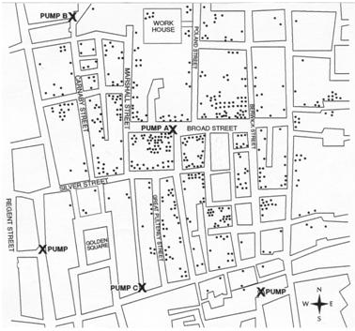
Maps and CDC
John Snow was an English
anesthesiologist who
investigated a London
cholera epidemic in 1854
Snow mapped the homes
and workplaces of people
with cholera
Map showed most cases
used the Broad Street
pump as a water source
Epidemic subsided after pump handle was removed
CDC uses similar epidemiological techniques today to visualize data, only with more sophisticated geographic information systems (GIS)
Notes:
In the mid-1800s, an anesthesiologist named John Snow was conducting a series of investigations in London that warrant his being considered the “father of field epidemiology.” Twenty years before the development of the microscope, Snow conducted studies of cholera outbreaks both to discover the cause of disease and to prevent its recurrence.
Snow conducted one of his studies in 1854, when an epidemic of cholera erupted in the Golden Square of London. He began his investigation by determining where in this area persons with cholera lived and worked. He created a spot map by marking each residence on a map of the area. Because Snow believed that water was a source of infection for cholera, he marked the location of water pumps on his map, then looked for a relationship between the distribution of cases of cholera and the location of pumps. Snow gathered information on where persons with cholera had obtained their water. From this information, Snow concluded that the Broad Street pump (Pump A) was the primary source of water and the most likely source of infection for most persons with cholera in the Golden Square area. After Snow presented his findings to municipal officials, the handle of the pump was removed, and the outbreak ended.
By using a map to locate instances of infection, Snow was able to help end an epidemic. Today, CDC uses geographic information systems (GIS) to store, visualize, analyze, and interpret geographic data. These computer-based systems help scientists answer questions about how location impacts disease and disability. For example, researchers at CDC have used GIS to identify how to target polio immunization campaigns in geographically isolated locations.

Slide 6
Maps and CDC
Correlation occurs when factors have the same pattern.
Causation occurs when one factor causes another.
  Attribution occurs when causation is linked to a single cause. This is rare!
  Contribution occurs when a factor is only one of multiple factors leading to a given outcome.
Ex: Ice cream sales and drowning deaths both go up in the summer and down in winter.
  Correlation: Both factors share the same pattern.
  Causation: There is no causation here. Just because both have the same pattern does not mean that eating ice cream causes drowning! Both are actually caused by contributing factors such as hot weather and available vacation time.
Notes:
When looking at patterns in map data, it is important to remember that correlation is not the same as causation. For example, ice cream sales and drowning deaths both increase during the hot summer months. Does that mean that eating ice cream causes people to drown? Of course not! The two trends are correlated because both share the same pattern, but eating ice cream does not cause one to drown. People just tend to eat more ice cream and go swimming when it’s hot outside. Remember this when analyzing map data. Just because two maps share the same pattern does not mean that one factor causes the other.
In public health, causation is generally broken down further by looking into the attribution and contribution of health factors. Attribution occurs when an outcome can be linked to one specific cause. A patient becoming seriously ill after being discharged from the hospital might be attributed to the nurse not providing him with instructions about medication or surgery aftercare. The patient’s poor outcome can be linked to a single cause. Generally, an outcome can be linked to several different factors, which is known as contribution. For instance, a patient with poor dental health might have financial, geographical, and psychological contributing factors. Attribution is uncommon, as most conditions have multiple factors that contribute to an outcome.

Slide 7
Think About It
How did Snow’s map help him to identify Pump A as the problem?
In addition to mapping cholera cases, what other surveillance data did Snow collect?
Obesity is an area of concern in public health. What other health concerns might have a correlation with obesity? What factors might show a contribution to obesity?

Slide 8

From the Expert
https://youtu.be/HE4yJYY4WH8
Notes:
Maps aren’t just used for analyzing public health information. They can also be used to communicate public health information to the public. CDC's Environmental Public Health Tracking Network connects people with vital information. Watch this video to see how the Missouri Tracking Program worked with local health officials to create an interactive, dynamic online map that makes cooling centers easy to find. In the summer, cooling centers can be critical for keeping people, especially seniors, from getting heat related illnesses. https://youtu.be/HE4yJYY4WH8

Slide 9
Think About It
Missouri used maps to direct people to nearby cooling centers during heat waves. Find an example of how maps are used in your community to direct people to public health related services.
Describe two ways that you have seen maps used in your life to communicate information related to public health (other than ways described in this lesson).
When you look at a map, what features do you look for to help you understand what you are seeing?

Slide 10
Give it a Try
Call to Action!
Map lung cancer mortality
Analyze public health maps
Share your findings
Why do you think participation is important?
Notes:
Call to Action
In order to understand how using maps impacts public health, it is essential that people see examples of the various ways maps can be used. You can help people by following these three steps:
Map lung cancer mortality. Examine data for lung cancer deaths and create a map that helps you analyze trends and patterns in disease occurrence. Use the map to generate ideas for health interventions based on the patterns you observed.
Analyze public health maps. Analyze several maps using CDC data to explore the different purposes maps serve in public health. Then use the information gathered to plan an intervention to address the health issue you studied.
Share your findings. One of the ways CDC communicates information is through social media. You can help CDC communicate the work they have done and are doing to improve public health across the globe.
Why Participate? A Message from CDC
Scientific and information literacy are lifelong skills that will allow you to process data and learn about new topics. By doing a deep dive into making and reading maps, you will gain a deeper understanding of the roles that maps play in public health. From planning global vaccination campaigns or choosing sites for health interventions to tracking the progress of epidemics, maps are an essential tool for health workers.
If you find yourself interested in the principles behind mapmaking and communicating information cleanly and effectively, check out CDC’s Cartographic Guidelines for Public Health: https://www.cdc.gov/dhdsp/maps/gisx/resources/Cartographic_Guidelines.pdf

Slide 11
Use the
Public Health Approach
Surveillance
What is the problem?
Risk Factor Identification
What is the cause?
Intervention
What works?
Implementation
How did we do it?
Surveillance
What is the problem?
Risk Factor Identification
What is the cause?
Intervention
What works?
Implementation
How did we do it?

Slide 12
Give it a Try
1. Map Lung Cancer Mortality
Use lung cancer mortality data to make an area map using different shades to show rates of lung cancer deaths
Analyze the map for patterns
Design interventions public health officials might consider to lower lung cancer deaths in affected areas
Notes:
Below is a ranked list by state of age-adjusted deaths from lung cancer per 100,000 people. Make a public health map using the data below to visually show rates of lung cancer deaths. Divide the states into four quartiles by rank as follows:
New York through Utah (rank #39-50) ← Lightest color
Florida through Connecticut (rank #26-38)
Missouri through Pennsylvania (rank #13-25)
Kentucky through Oklahoma (rank #1-12) ← Darkest color
Assign a color or shade to each quartile and color in the states on the map provided. It is common practice to use lighter shades for the lower numbers and darker or more intense shades for the higher numbers. Make sure to shade in the color key at the top left of the map, too.
[Data and map are available in the main lesson document or the student instruction document.]
What patterns do you see on the map?
How does the map help you to visualize patterns better than the table does?
What interventions might public health officials do after seeing this map to address any health disparities that are connected to geographical location?

Slide 13
Give it a Try
2. Analyze Public Health Maps
Map 1: Influenza: Analyze flu trends over time using the FluView dashboard
Map 2: Heart disease and stroke: Choose a health map to analyze
Map 3: Heart disease and stroke comparison: Compare two different health maps and discover trends
Design an intervention for one of the
three maps above
Notes:
Analyze Public Health Maps
Maps make visualization of data easier and allow scientists to see trends over time or by location. Complete the activities below to explore three different applications of maps.
Map 1: Influenza
One use of maps is to make the comparison of data from different time periods easier. CDC’s National Center for Immunization and Respiratory Diseases (NCIRD) tracks cases of influenza-like illness nationwide. This map will allow you to view a week-by-week progression of influenza-like illness across the United States. The weekly influenza surveillance report is prepared by the Influenza Division and is available here: https://www.cdc.gov/flu/weekly/usmap.htm
How to look at these data:
Choose a flu season (bottom left of map). Note: From March 2020 on, there isn’t much flu activity due to COVID-19 prevention measures like masking and social distancing also limiting the spread of other respiratory illnesses like influenza. Consider choosing an earlier flu season.
Take a minute to familiarize yourself with the color scale and what each color represents.
Look at the title of the map. Note that the title changes as the week changes. The flu season starts at week 40 (early October) of each year.
Hit play at the top of the screen and watch the season progress over the course of the year.
What are 3 things you noticed from the map?
Why is a map a better way to display this type of data rather than a table or graph?
For more detailed data about influenza-like illnesses, check out the FluView dashboard. https://gis.cdc.gov/grasp/fluview/fluportaldashboard.html
Map 2: Heart disease and stroke
Maps can be used to compare health information from different places. Use CDC’s Interactive Atlas of Heart Disease and Stroke to examine health data. Choose any topic from the menu to explore. You can use county or state data for any factor. https://nccd.cdc.gov/DHDSPAtlas
What topic did you choose to explore?
What are 3 things you noticed from the map?
Map 3: Heart disease and stroke comparison
Maps can also be used to compare different health factors for the same place. Using the same map tool, click the “View 2nd Map” option on the top toolbar to add a second map window. Now you can easily compare maps for two different diseases or demographics side by side.
Think of a question you want to investigate. Here are a few examples:
Which is more common: heart attacks or stroke?
Do men or women have more heart attacks?
How do maps of risk factors like obesity or smoking compare to maps of heart attacks?
How does the map of heart attack hospitalizations compare to the map of deaths?
What question did you decide to investigate using these maps?
What are 3 things you noticed from the map?
Design an intervention
Choose one of the three mapping activities and think about what you could do with the data provided. Use the public health approach (see page 4) to design an intervention. What risk factor has the data led you to explore? What intervention is appropriate to address this health issue? What barriers will you need to address for your intervention to be successful?

Slide 14
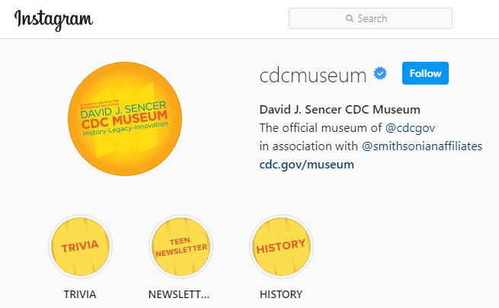
Give it a Try
3. Share Your Findings
Instagram @CDCmuseum
Notes:
Share Your Findings
The David J. Sencer CDC Museum uses award-winning exhibits and innovative programming to educate visitors about the value of public health and presents the rich heritage and vast accomplishments of CDC. Your findings could be a valuable contribution! Share your demonstration with the CDC Museum on Instagram using @CDCmuseum.

Slide 15

Questions?

