Slide 1
HIV Mortality 2021
Division of HIV Prevention
Notes:
This slide set presents data on HIV-related mortality through 2021.

Slide 2
HIV Mortality Slides
This slide set presents analyses of trends in rates and distributions of deaths in the United States, focusing on deaths with human immunodeficiency virus (HIV) disease as the underlying cause.
Death data for the general population were compiled from death certificates from all 50 states and the District of Columbia (DC) by the CDC’s National Center for Health Statistics (NCHS) and downloaded from the CDC WONDER Online Database https://wonder.cdc.gov/. For more information, see the NCHS Web site: http://www.cdc.gov/nchs/deaths.htm.
Data on deaths among persons with diagnosed HIV (including persons with HIV infection ever classified as stage 3 [AIDS]) in the 50 states and the District of Columbia are from the National HIV Surveillance System (NHSS).
Notes:
The slides in this series are based on data compiled by the National Center for Health Statistics (NCHS) from death certificates of US residents in the 50 states and the District of Columbia for the years 1987-2021 and downloaded from the CDC WONDER Online Database https://wonder.cdc.gov/ . The underlying cause of each death is selected from the conditions reported by physicians, medical examiners, and coroners in the cause-of-death section of the death certificate. When more than one condition is reported, the underlying cause is determined by using a set of standardized rules promulgated as part of the International Classification of Diseases (ICD). Additional information on the nature and sources of death-certificate data on causes of death may be found at the NCHS website. These data from NCHS are the sole source of information on all causes of death in the national population, allowing comparison of deaths due to HIV disease and deaths due to other causes.
Data re-release agreements between CDC and state/local HIV surveillance programs require certain levels of cell suppression at the state and county level to ensure confidentiality of personally identifiable information.

Slide 3
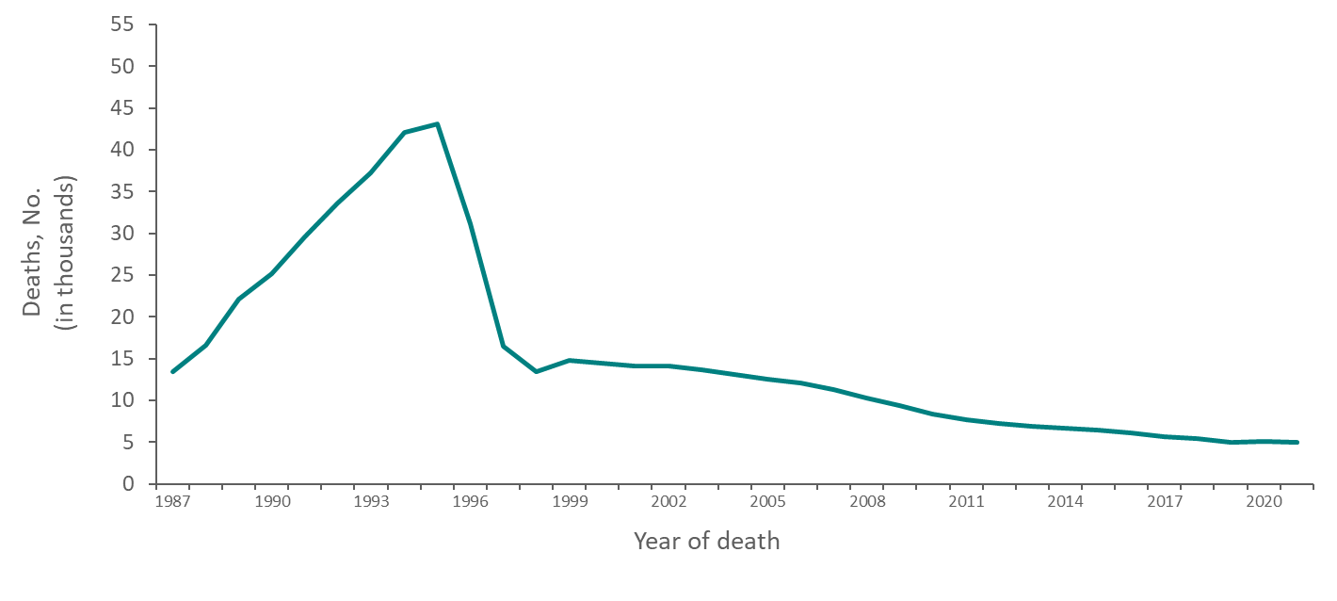
Deaths in the General Population with HIV Disease as the Underlying Cause Reported on Death Certificates, 1987−2021—United States
Note. Data from CDC WONDER Online Database based on death certificate data compiled by the National Center for Health Statistics.
Notes:
In 2021, there were 14,759 deaths (all causes, including COVID-19) among persons with HIV infection ever classified as stage 3 (AIDS). The cumulative number (1987‒2021) of deaths (all causes) among persons with HIV infection ever classified as stage 3 (AIDS) was 744,163. In 2021, there were 4,977 deaths in the general population that were attributed to HIV infection. The cumulative number (1987‒2021) of deaths attributable to HIV in the United States was 539,770.
The data for this slide come from death certificate data compiled by the National Center for Health Statistics (NCHS) and downloaded from the CDC WONDER Online Database https://wonder.cdc.gov/.

Slide 4
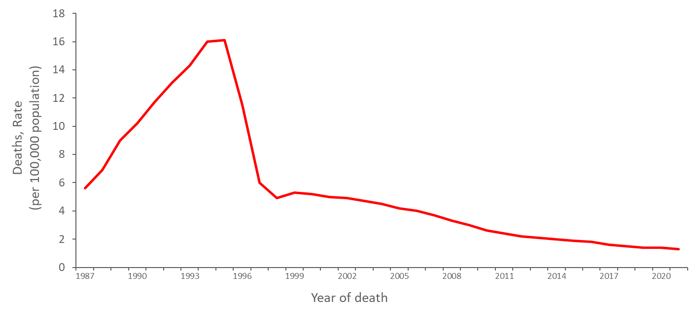
Trends in Annual Age-Adjusted Rates of Death in the General Population with HIV Disease as the Underlying Cause, 1987−2021—United States
Note. Data from CDC WONDER Online Database based on death certificate data compiled by the National Center for Health Statistics.
Notes:
The age-adjusted rate of death with HIV disease as the underlying cause increased almost linearly from 6 deaths per 100,000 population in 1987 to 16 deaths per 100,000 population in 1994 and 1995, then decreased to 6 deaths per 100,000 population in 1997. Thereafter, the rate almost leveled off at about 5 deaths per 100,000 population up to 2003, after which it decreased slowly through 2021. The age-adjusted HIV death rate decreased 29% from 1995 to 1996, 48% from 1996 to 1997, and 18% from 1997 to 1998. After 1998, the annual percentage decrease ranged from 0% to 13%.
The decrease in the rate in 1996 and 1997 was largely due to improvements in antiretroviral therapy. Prophylactic medications for opportunistic infections and the prevention of HIV infection may also have contributed to this decrease. The slowing of the rate of decrease after 1998 may reflect a lack of access to or effectiveness of therapy among some persons. Possible reasons for this include delay in diagnosis of HIV infection until symptoms have occurred, inadequate treatment after diagnosis, difficulty in adherence to medication regimens, and development of viral resistance to therapy. Other barriers to effective therapy include failure to be linked to care or continuously engaged in care after diagnosis.
The data for this slide come from death certificate data compiled by the National Center for Health Statistics (NCHS) and downloaded from the CDC WONDER Online Database https://wonder.cdc.gov/.

Slide 5
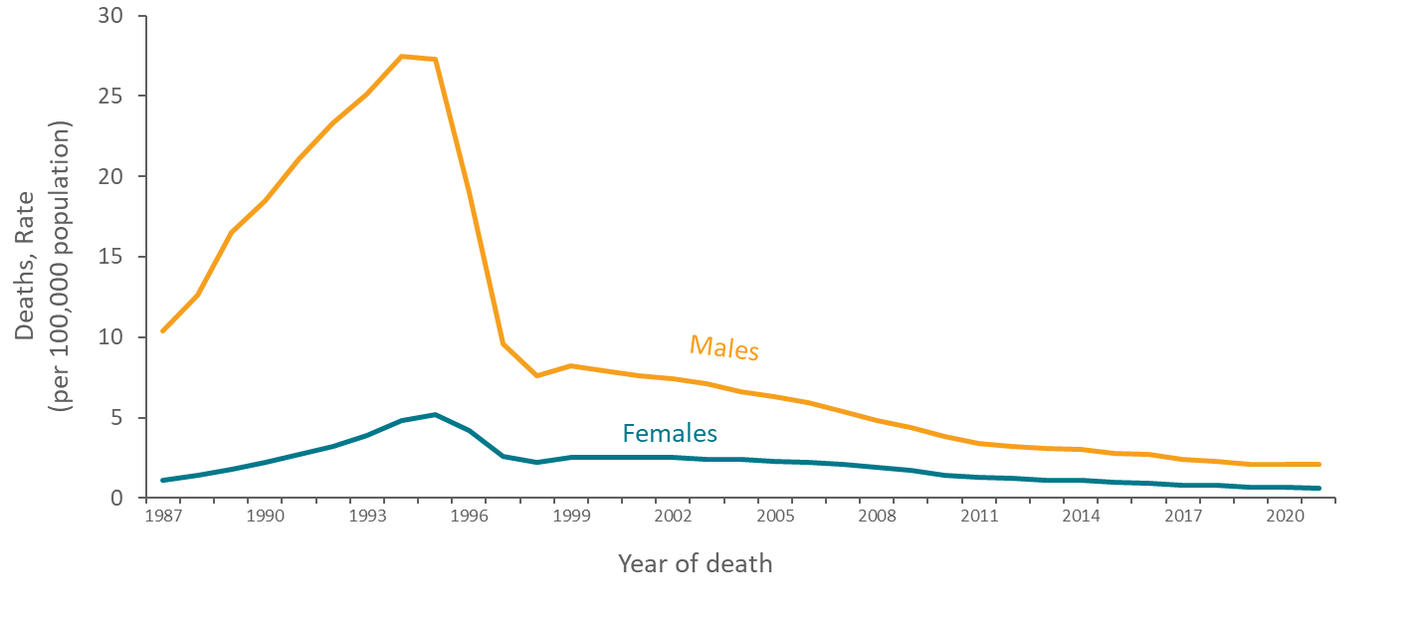
Trends in Annual Age-Adjusted Rates of Death in the General Population with HIV Disease as the Underlying Cause, by Sex, 1987−2021—United States
Note. Data from CDC WONDER Online Database based on death certificate data compiled by the National Center for Health Statistics.
Notes:
In the United States, the rate of death with HIV disease as the underlying cause among males has always been several times the rate among females, but the ratio of these rates has decreased from approximately 10-to-1 in 1987 to 3-to-1 in 1998 and later years. For both sexes, the rates of death with HIV disease as the underlying cause were highest in 1994 and 1995. After 1997, the average death rate among females has been about 2.0 deaths per 100,000 population. The rate among males continued to decrease slowly every year: from 1998 through 2021, the average annual percentage decrease was about 6%.
The data for this slide come from death certificate data compiled by the National Center for Health Statistics (NCHS) and downloaded from the CDC WONDER Online Database https://wonder.cdc.gov/. For details on reporting of sex and race/ethnicity, please see NCHS’s Funeral Director’s Handbook on Death Registration and Fetal Death Reporting (https://www.cdc.gov/nchs/data/nvss/handbook/2019-Funeral-Directors-Handbook-508.pdf).

Slide 6
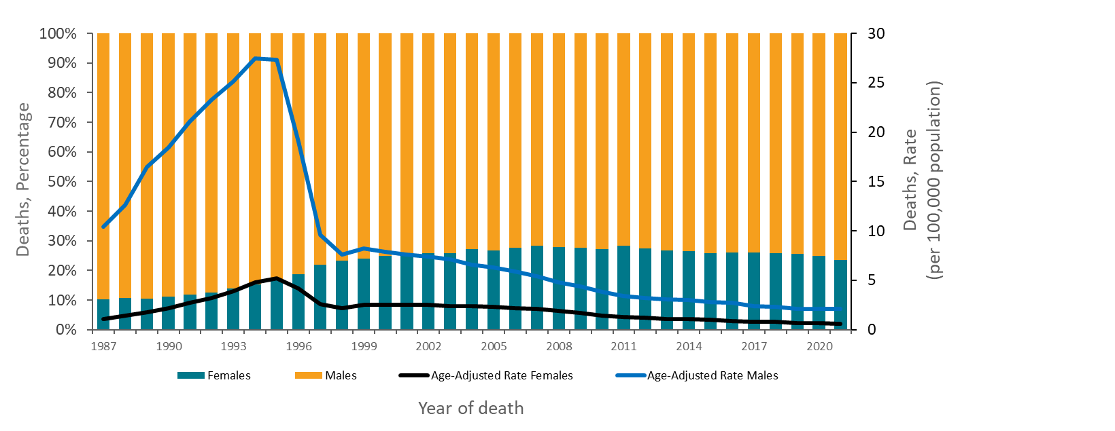
Trends in Annual Age-Adjusted Rates of Death and the Percentage Distribution of Deaths in the General Population with HIV Disease as the Underlying Cause by Sex, 1987–2021—United States
Note. Data from CDC WONDER Online Database based on death certificate data compiled by the National Center for Health Statistics.
Notes:
Another way to look at sex differences in HIV-related mortality trends is to examine the annual percentage distribution of deaths by sex. From 1987 through 2021, the percentage of females among persons who died of HIV disease increased from 10% to 24%.
The data for this slide comes from death certificate data compiled by the National Center for Health Statistics (NCHS) and downloaded from the CDC WONDER Online Database https://wonder.cdc.gov/. For details on reporting of sex and race/ethnicity, please see NCHS’s Funeral Director’s Handbook on Death Registration and Fetal Death Reporting

Slide 7
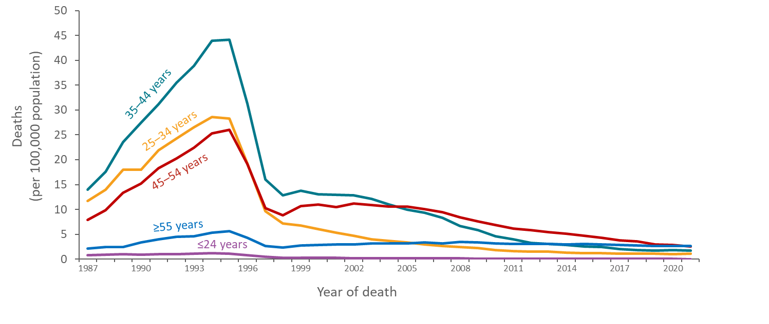
Trends in Annual Rates of Death in the General Population with HIV Disease as the Underlying Cause, by Age Group, 1987–2021—United States
Note. Data from CDC WONDER Online Database based on death certificate data compiled by the National Center for Health Statistics.
Notes:
Trends in the rate of death with HIV disease as the underlying cause have varied by age group. From 1995 through 1997, the rate of death dropped most rapidly among persons aged 25–34 and 35–44 years. After 1997, the rate of death continued to decline in these age groups and among persons aged 45-54 years but was nearly level in other age groups.
The data for this slide come from death certificate data compiled by the National Center for Health Statistics (NCHS) and downloaded from the CDC WONDER Online Database https://wonder.cdc.gov/.

Slide 8
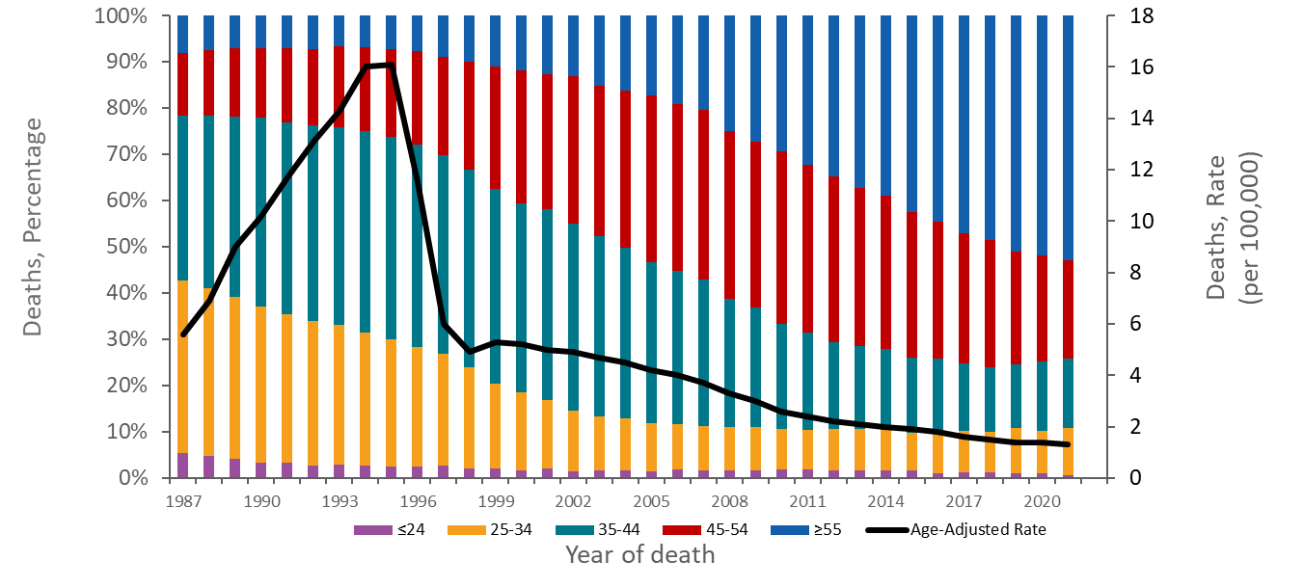
Trends in Annual Age-Adjusted Rates of Death and the Percentage Distribution of Deaths in the General Population with HIV Disease as the Underlying Cause by Age Group, 1987−2021—United States
Note. Data from CDC WONDER Online Database based on death certificate data compiled by the National Center for Health Statistics.
Notes:
From 1987 through 2021, the percentage of deaths with HIV disease as the underlying cause among persons younger than 35 years of age (represented by the bottom two components of the bars in the graph) decreased from 43% to 11%, while the percentage of deaths among older persons, particularly those 45 years or older (represented by the top two components of the bars), increased from 22% to 74%. One reason for these changes may be the longer survival of persons with HIV, allowing death to be postponed to older ages. An increase in the percentage of older age groups in the general population could also have affected these trends. Chronic diseases associated with advancing age might contribute to the risk or severity of complications of HIV disease.
From 1987 through 1993, 73% to 74% of deaths with HIV disease as the underlying cause were among persons 25 to 44 years of age (represented by the orange and teal components of the bars). After 1993, the percentage of deaths at 25 to 44 years of age began to decrease, reaching 25% by 2021.
The data for this slide come from death certificate data compiled by the National Center for Health Statistics (NCHS) and downloaded from the CDC WONDER Online Database https://wonder.cdc.gov/.

Slide 9
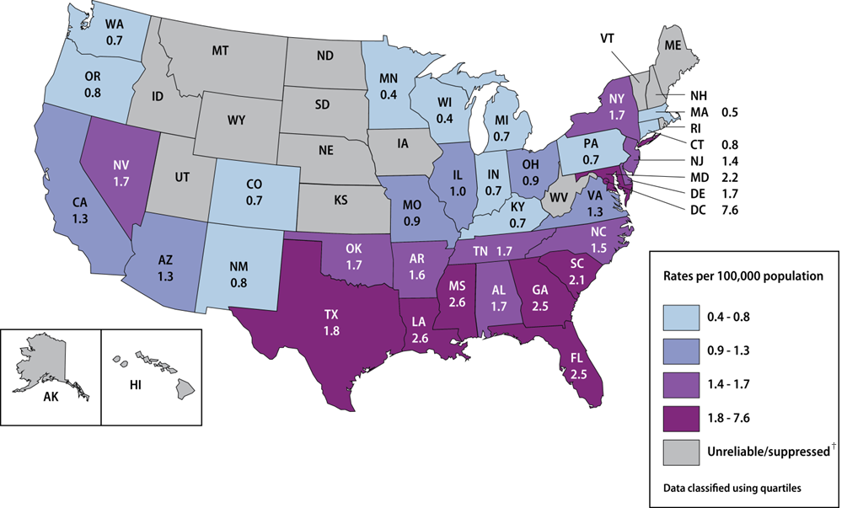
Age-Adjusted Rates* of Death in the General Population with HIV Disease as the Underlying Cause in the General Population, by State, 2021—United States
Note. Data from CDC WONDER Online Database based on death certificate data compiled by the National Center for Health Statistics.
*Per 100,000 population.
†Death rates are not shown when unreliable (rate is calculated with a numerator of 20 or less) or suppressed (the data meet the criteria for confidentiality constraints).
Notes:
Rates of deaths with HIV disease as the underlying cause were highest in the District of Columbia, states along the Gulf Coast (Florida, Louisiana and Mississippi), Georgia, Maryland, South Carolina, and Texas.
Data are suppressed when the data meet the criteria for confidentiality constraints. Death rates are considered unreliable when the rate is calculated with a numerator of 20 or less.
The data for this slide come from death certificate data compiled by the National Center for Health Statistics (NCHS) and downloaded from the CDC WONDER Online Database https://wonder.cdc.gov/.

Slide 10
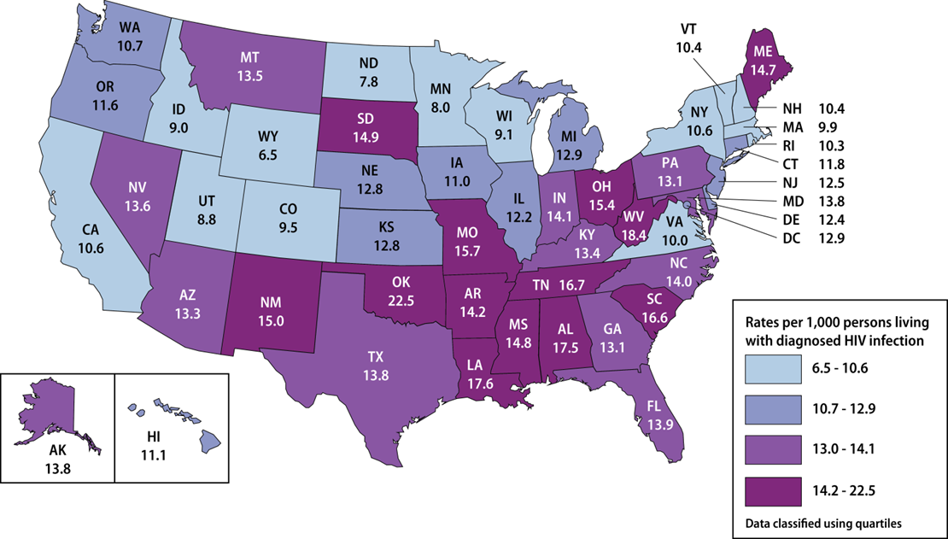
Age-Adjusted* Rates† of Death (any cause) among Persons with diagnosed HIV by State, 2021—United States
Note. Data from the National HIV Surveillance System.
*Standard: age distribution of 2000 US population.
†Per 1,000 persons living with diagnosed HIV infection.
Notes:
This slide uses data reported to the National HIV Surveillance System through December 31, 2022, and represents the deaths of persons with diagnosed HIV infection due to any underlying cause. To control for geographic differences in the prevalence of HIV, the death rates were based on denominators consisting of numbers of persons with a diagnosis of HIV infection, rather than the general populations of the states. The rates were highest in Alabama, Arkansas, Louisiana, Maine, Mississippi, Missouri, New Mexico, Ohio, Oklahoma, South Carolina, South Dakota, Tennessee, and West Virginia.
The differences in the rates among states may reflect differences in the extent to which persons with HIV residing in those states received an HIV diagnosis soon after contracting HIV, and if persons were prescribed timely, effective, and affordable treatment to which they diligently adhered.
Prevalence and death data for Mississippi and West Virginia should be interpreted with caution due to incomplete reporting of deaths to CDC for the year 2021.
The data for this slide comes from the National HIV Surveillance System.

Slide 11
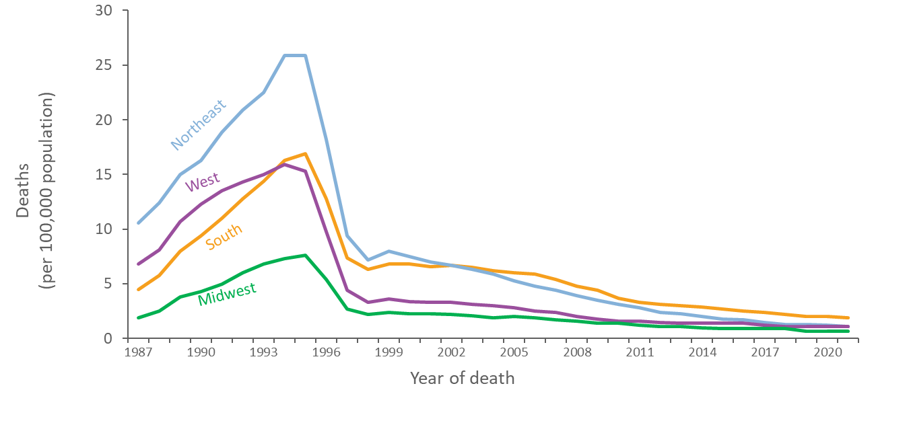
Trends in Age-Adjusted Annual Rates of Death in the General Population with HIV Disease as the Underlying Cause, by Region, 1987–2021—United States
Note. Data from CDC WONDER Online Database based on death certificate data compiled by the National Center for Health Statistics.
Notes:
In all four U.S. Census regions of the United States, the age-adjusted rate of death due to HIV disease increased until 1994 or 1995, and then rapidly decreased in 1996 and 1997, coinciding with the increase in the use of highly active antiretroviral therapy (HAART). The rate in each region leveled after 1998. The rate increased most slowly in the West and most rapidly in the South through 1995. As a result, the rate in the South exceeded the rate in the West by 1994. After 1995, the rate decreased more slowly in the South than in the other regions, with the rate in the South exceeding the rate in the Northeast after 2003.
The data for this slide come from death certificate data compiled by the National Center for Health Statistics (NCHS) and downloaded from the CDC WONDER Online Database https://wonder.cdc.gov/.
Midwest: Illinois, Indiana, Iowa, Kansas, Michigan, Minnesota, Missouri, Nebraska, North Dakota, Ohio, South Dakota, and Wisconsin.
Northeast: Connecticut, Maine, Massachusetts, New Hampshire, New Jersey, New York, Pennsylvania, Rhode Island, and Vermont.
South: Alabama, Arkansas, Delaware, District of Columbia, Florida, Georgia, Kentucky, Louisiana, Maryland, Mississippi, North Carolina, Oklahoma, South Carolina, Tennessee, Texas, Virginia, and West Virginia.
West: Alaska, Arizona, California, Colorado, Hawaii, Idaho, Montana, Nevada, New Mexico, Oregon, Utah, Washington, and Wyoming.

Slide 12
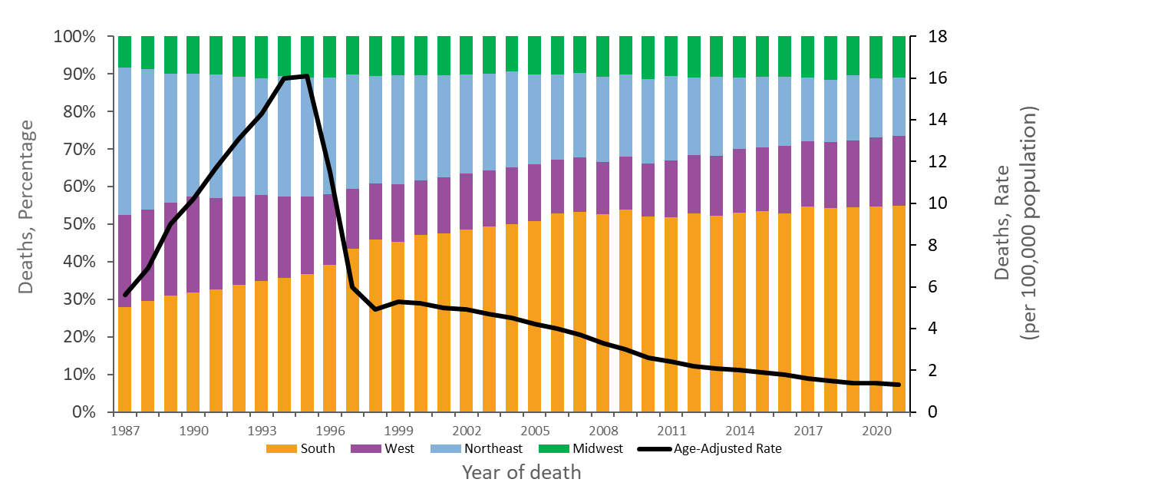
Trends in Annual Age-Adjusted Rates of Death and the Percentage Distribution of Deaths in the General Population with HIV Disease as the Underlying Cause by Region, 1987−2021—United States
Note. Data from CDC WONDER Online Database based on death certificate data compiled by the National Center for Health Statistics.
Notes:
Of persons who died of HIV disease from 1987 through 2021, the percentage who resided in the South increased from 28% to 55%, while the percentage in the Northeast decreased from 39% to 16%, and the percentage in the West decreased from 24% to 19%. The percentage in the Midwest has been relatively stable, ranging from 8% to 12%, and at 11% in 2021.
The data for this slide comes from death certificate data compiled by the National Center for Health Statistics (NCHS) and downloaded from the CDC WONDER Online Database https://wonder.cdc.gov/.
Midwest: Illinois, Indiana, Iowa, Kansas, Michigan, Minnesota, Missouri, Nebraska, North Dakota, Ohio, South Dakota, and Wisconsin.
Northeast: Connecticut, Maine, Massachusetts, New Hampshire, New Jersey, New York, Pennsylvania, Rhode Island, Vermont
South: Alabama, Arkansas, Delaware, District of Columbia, Florida, Georgia, Kentucky, Louisiana, Maryland, Mississippi, North Carolina, Oklahoma, South Carolina, Tennessee, Texas, Virginia, and West Virginia.
West: Alaska, Arizona, California, Colorado, Hawaii, Idaho, Montana, Nevada, New Mexico, Oregon, Utah, Washington, and Wyoming.

Slide 13
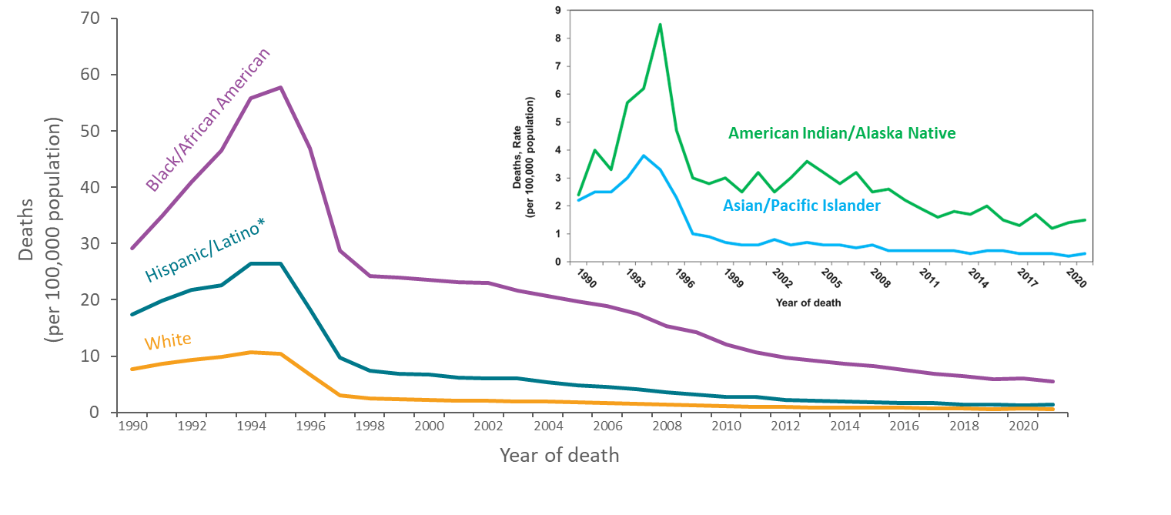
Trends in Age-Adjusted Annual Rates of Death in the General Population with HIV Disease as the Underlying Cause, by Race/Ethnicity, 1990–2021—United States
Note. Data from CDC WONDER Online Database based on death certificate data compiled by the National Center for Health Statistics.
*Hispanic/Latino persons can be of any race.
Notes:
The age-adjusted rate of death with HIV disease as the underlying cause has been highest among Black or African American persons and second highest among Hispanic or Latino persons. In every racial/ethnic group, the rate decreased greatly from 1995 through 1998. Among Black/African American persons, however, the percentage decrease in the rate from 1995 to 1998 was lower (58%) compared to a 67% decrease among American Indian/Alaska Native persons, a 72% decrease among Hispanic/Latino persons, a 73% decrease among Asian/Pacific Islander persons, and a 76% decrease among White persons.
Hispanic/Latino persons can be of any race.
For the calculation of national death rates by race and ethnicity, data for a few states were excluded for the years when death certificates for those states did not collect information on Hispanic/Latino ethnicity. The states for which data were omitted were: Connecticut and Louisiana in 1990, New Hampshire through 1992, and Oklahoma through 1996.
The data for this slide come from death certificate data compiled by the National Center for Health Statistics (NCHS). Data for years 1990-1998 were requested from NCHS and analyzed by CDC’s HIV Surveillance Branch. Data for years 1999-2021 were published and downloaded from the CDC WONDER Online Database https://wonder.cdc.gov/.
For details on reporting of sex and race/ethnicity, please see NCHS’s Funeral Director’s Handbook on Death Registration and Fetal Death Reporting (https://www.cdc.gov/nchs/data/nvss/handbook/2019-Funeral-Directors-Handbook-508.pdf).

Slide 14
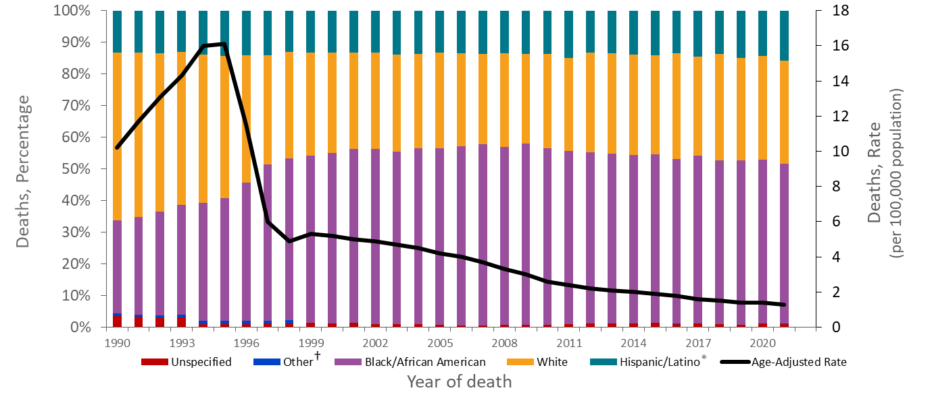
Trends in Annual Age-Adjusted Rates of Death and the Percentage Distribution of Deaths in the General Population with HIV Disease as the Underlying Cause by Race/Ethnicity, 1990−2021—United States
Note. Data from CDC WONDER Online Database based on death certificate data compiled by the National Center for Health Statistics.
* Hispanic/Latino persons can be of any race.
†Asian/Pacific Islander persons and American Indian/Alaska Native persons.
Notes:
From 1990 through 2021, the percentage of Black/African American persons among those who died of HIV disease as the underlying cause increased from 29% to 49%, while the percentage of White persons decreased from 53% to 32%. This shift in the racial/ethnic distribution of deaths accelerated from 1996 through 1998, coincident with the increasing use of highly active antiretroviral therapy, suggesting that the shift may have resulted in part from differential access to therapy. For all years, the percentage of Hispanic/Latino persons was stable, ranging from approximately 13% to 15%, and the percentage of persons in other racial/ethnic groups (including Asian/Pacific Islander persons and American Indian/Alaska Native persons) was stable, ranging from 1% to 2%. In addition, the percentage of persons of unspecified race/ethnicity decreased from 4% to around 1%.
Hispanic/Latino persons can be of any race.
For the calculation of the national percentage of deaths by race and ethnicity, data for a few states were excluded for the years when death certificates for those states did not collect information on Hispanic/Latino ethnicity. The states for which data were omitted are Connecticut and Louisiana in 1990, New Hampshire through 1992, and Oklahoma through 1996.
The data for this slide come from death certificate data compiled by the National Center for Health Statistics (NCHS) and downloaded from the CDC WONDER Online Database https://wonder.cdc.gov/.
For details on reporting of sex and race/ethnicity, please see NCHS’s Funeral Director’s Handbook on Death Registration and Fetal Death Reporting (https://www.cdc.gov/nchs/data/nvss/handbook/2019-Funeral-Directors-Handbook-508.pdf).

Slide 15
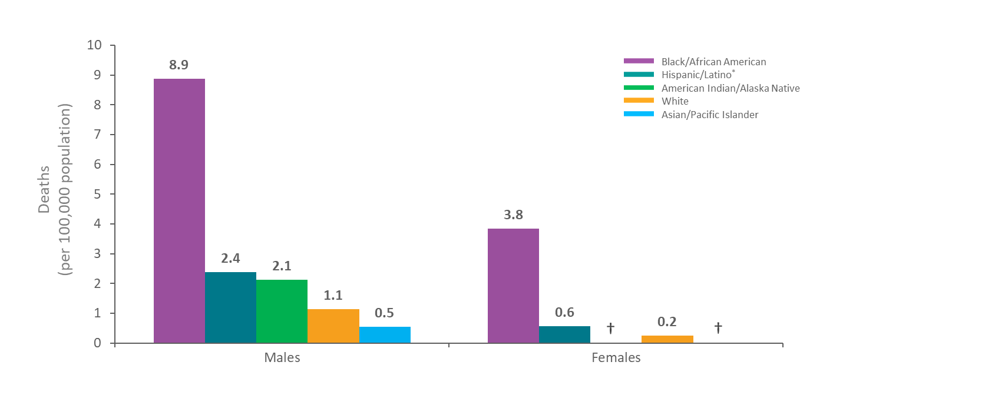
Age-Adjusted Average Annual Rate of Death in the General Population with HIV Disease as the Underlying Cause by Sex and Race/Ethnicity, 2017−2021—United States
Note. Data from CDC WONDER Online Database based on death certificate data compiled by the National Center for Health Statistics.
*Hispanic/Latino persons can be of any race.
† Unreliable rate due to a numerator of less than 20 deaths.
Notes:
For both males and females, in the most recent 5 years for which data were available, the average rates of death with HIV disease as the underlying cause among Black/African American persons were higher than the rates among Hispanic/Latino persons, which were higher than the rates among the remaining racial/ethnic groups. The rate among Black/African American females was higher than the rate among males in every racial/ethnic group, except Black/African American males. Among males, the rate among Asian/Pacific Islander persons were lower than the rates in each of the four other groups, including White persons, and the rate among American Indian/Alaska Native males was higher than the rate among White males.
Hispanic/Latino persons can be of any race.
Death rates are considered unreliable when the rate is calculated with a numerator of 20 or less.
Unreliable annual age-adjusted rates among American Indian/Alaska Native and Asian/Pacific Islander females.
The data for this slide comes from death certificate data compiled by the National Center for Health Statistics (NCHS) and downloaded from the CDC WONDER Online Database https://wonder.cdc.gov/. For details on reporting of sex and race/ethnicity, please see NCHS’s Funeral Director’s Handbook on Death Registration and Fetal Death Reporting (https://www.cdc.gov/nchs/data/nvss/handbook/2019-Funeral-Directors-Handbook-508.pdf).

Slide 16
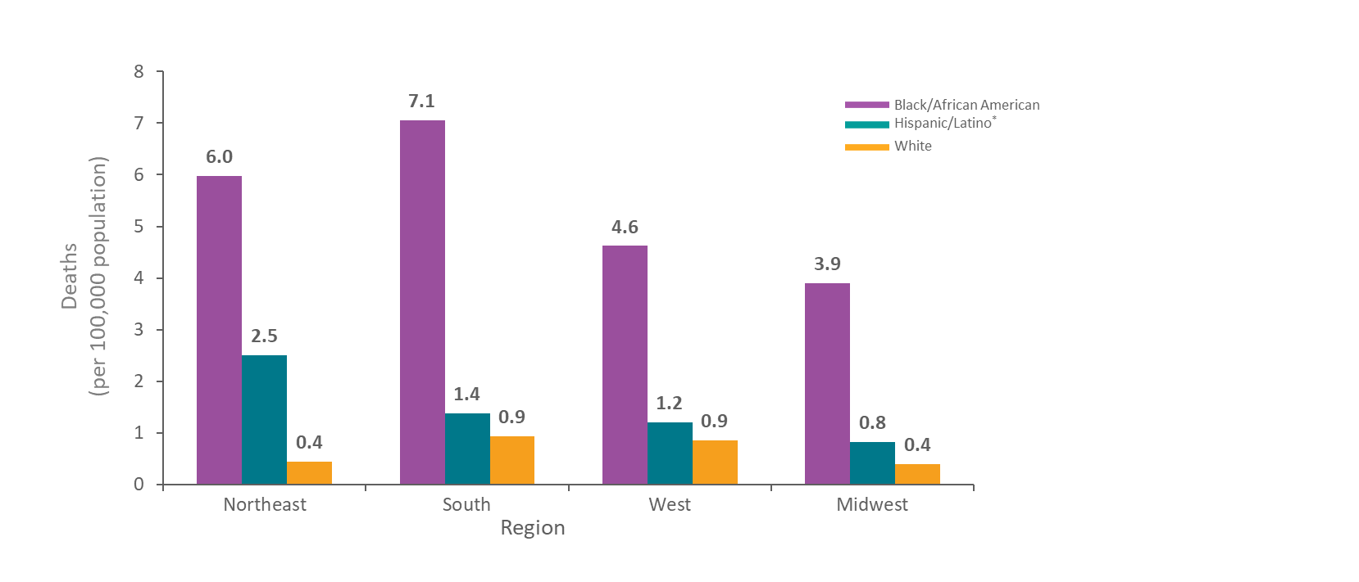
Age-Adjusted Average Annual Rate of Death in the General Population with HIV Disease as the Underlying Cause by Race/Ethnicity and Region, 2017−2021—United States
Note. Data from CDC WONDER Online Database based on death certificate data compiled by the National Center for Health Statistics.
*Hispanic/Latino persons can be of any race.
Notes:
This graph illustrates the average rates of death with HIV disease as the underlying cause by geographic region and race/ethnicity in the most recent five years for which data were available. Black/African American persons had the highest rate in each of the four regions. The rates among Black/African American persons were higher in the Northeast and South than in the other two regions (Northeast: 6.0 per 100,000; South: 7.1 per 100,000). The rates among Hispanic/Latino persons varied by region, with the highest rate in the Northeast (2.5 deaths per 100,000). The rates among White persons varied slightly by region, with the South and West having the highest average rates of deaths at 0.9 deaths per 100,000.
Across all regions, Black/African Americans had average rates of death several times higher than both Hispanic/Latino and White persons. Only in the Northeast was the rate among Hispanic/Latino persons several times as high as the rate among White persons. In the West, the rate among Hispanic/Latino persons was slightly higher than the rate among White persons.
Hispanic/Latino persons can be of any race.
Data for American Indian/Alaska Native persons and Asian/Pacific Islander persons were either unreliable or suppressed for years 2017-2021.
Data are suppressed when the data meet the criteria for confidentiality constraints. Death rates are flagged as unreliable when the rate is calculated with a numerator of 20 or less.
The data for this slide comes from death certificate data compiled by the National Center for Health Statistics (NCHS) and downloaded from the CDC WONDER Online Database https://wonder.cdc.gov/. For details on reporting of sex and race/ethnicity, please see NCHS’s Funeral Director’s Handbook on Death Registration and Fetal Death Reporting (https://www.cdc.gov/nchs/data/nvss/handbook/2019-Funeral-Directors-Handbook-508.pdf).
Midwest: Illinois, Indiana, Iowa, Kansas, Michigan, Minnesota, Missouri, Nebraska, North Dakota, Ohio, South Dakota, and Wisconsin.
Northeast: Connecticut, Maine, Massachusetts, New Hampshire, New Jersey, New York, Pennsylvania, Rhode Island, Vermont.
South: Alabama, Arkansas, Delaware, District of Columbia, Florida, Georgia, Kentucky, Louisiana, Maryland, Mississippi, North Carolina, Oklahoma, South Carolina, Tennessee, Texas, Virginia, and West Virginia.
West: Alaska, Arizona, California, Colorado, Hawaii, Idaho, Montana, Nevada, New Mexico, Oregon, Utah, Washington, and Wyoming.

Slide 17
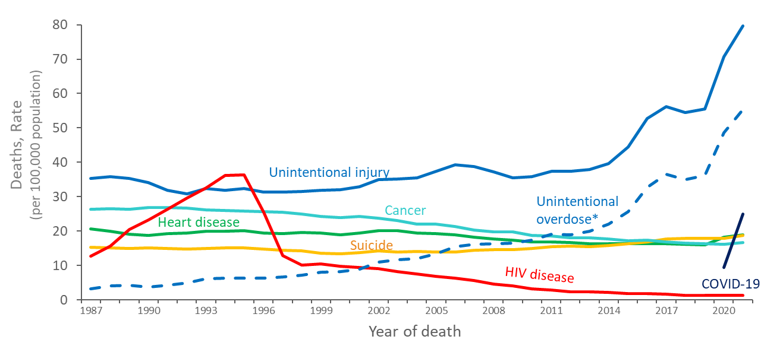
Trends in Annual Rates of Death in the General Population with HIV Disease as the Underlying Cause versus the 5 Leading Causes among Persons Aged 25–44 Years, 1987–2021—United States
Note. Data from CDC WONDER Online Database based on death certificate data compiled by the National Center for Health Statistics.
* Deaths with an underlying cause of unintentional overdose are a subset of deaths with an underlying cause of unintentional injury.
Notes:
Focusing on persons aged 25 to 44 years emphasizes the importance of HIV disease among causes of death. Compared with rates among other age groups, the rate of death with HIV disease as the underlying cause is relatively high in this age group, but rates of death due to other causes are relatively low. HIV disease was the leading cause of death among persons 25 to 44 years old in 1994 and 1995. In 1995, HIV disease caused about 30,500 deaths, or 19% of all deaths in this age group. The rank of HIV disease fell to 3rd place from 1997 through 1998, to 5th place in 1999 and 2000, to 6th place from 2001, eventually falling to 13th place in 2021 causing about 1,200 deaths, or less than 1% of all deaths in this age group.
The rate of death with an underlying cause of unintentional injury has increased significantly from 1987 to 2021 among all persons aged 25 to 44 years. In 2021, there were 70,896 deaths due to unintentional injury, accounting for 34% of deaths, and a rate of 233.1 deaths per 100,000 persons aged 25 to 44. The rate of deaths due to unintentional overdose (defined as deaths due to unintentional or accidental poisoning by and exposure to noxious substances), a subset of the deaths with an underlying cause of unintentional injury, has also significantly increased from 1987 to 2021. Approximately 69% (49,237 deaths) of the deaths caused by unintentional injury had an underlying cause of unintentional overdose in 2021.
The data for this slide come from death certificate data compiled by the National Center for Health Statistics (NCHS) and downloaded from the CDC WONDER Online Database https://wonder.cdc.gov/.

Slide 18
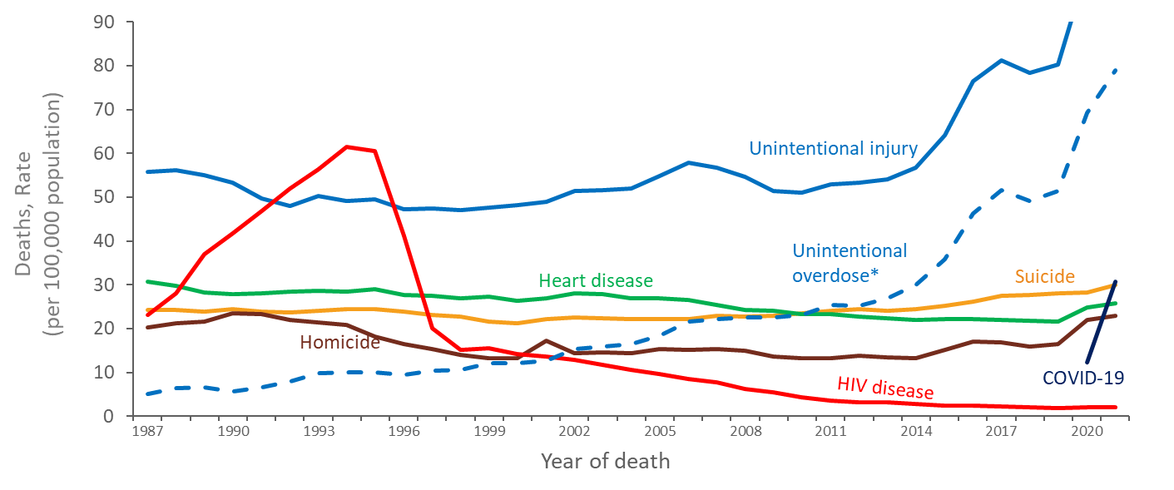
Trends in Annual Rates of Death in the General Population with HIV Disease as the Underlying Cause versus the 5 Leading Causes among Males Aged 25–44 Years, 1987–2021—United States
Note. Data from CDC WONDER Online Database based on death certificate data compiled by the National Center for Health Statistics.
*Deaths with an underlying cause of unintentional overdose are a subset of deaths with an underlying cause of unintentional injury.
Notes:
Among males aged 25 to 44 years, HIV disease was the leading cause of death from 1992 through 1996. Then the rank of death due to HIV disease fell to 3rd place from 1997 and 1998, to 5th place in 1999, then fell to 10th place in 2021 causing almost 1,000 deaths, or less than 1% of all deaths in this age group.
The rate of death with an underlying cause of unintentional injury has increased significantly from 1987 to 2021 among males aged 25 to 44 years. In 2021, there were 51,813 deaths due to unintentional injury, accounting for 37% of deaths, and a rate of 115 deaths per 100,000 males aged 25 to 44. The rate of deaths due to unintentional overdose (defined as deaths due to unintentional or accidental poisoning by and exposure to noxious substances), a subset of the deaths with an underlying cause of unintentional injury, has also significantly increased from 1987 to 2021. Approximately 68% (35,455 deaths) of the deaths caused by unintentional injury had an underlying cause of unintentional overdose in 2021.
The data for this slide come from death certificate data compiled by the National Center for Health Statistics (NCHS) and downloaded from the CDC WONDER Online Database https://wonder.cdc.gov/. For details on reporting of sex and race/ethnicity, please see NCHS’s Funeral Director’s Handbook on Death Registration and Fetal Death Reporting (https://www.cdc.gov/nchs/data/nvss/handbook/2019-Funeral-Directors-Handbook-508.pdf).

Slide 19
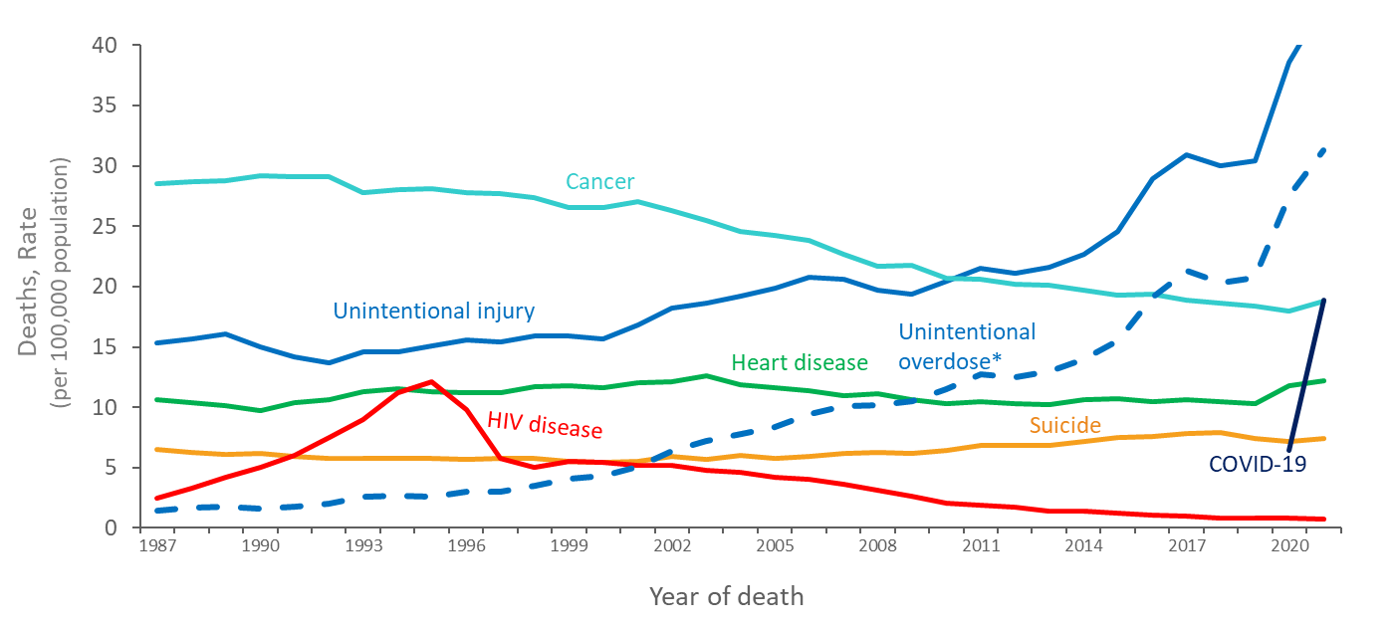
Trends in Annual Rates of Death in the General Population with HIV Disease as the Underlying Cause versus the 5 Leading Causes among Females Aged 25–44 Years, 1987–2021—United States
Note. Data from CDC WONDER Online Database based on death certificate data compiled by the National Center for Health Statistics.
* Deaths with an underlying cause of unintentional overdose are a subset of deaths with an underlying cause of unintentional injury.
Notes:
Among females aged 25 to 44 years, HIV disease was the leading cause of death in 1995, when HIV disease caused more than 5,000 deaths, or 11% of all deaths in this group. Thereafter, the rate of death due to HIV disease dropped to about the same as the rate due to suicide in the late 1990’s and early 2000’s and is currently lower than both the rate of suicide and chronic liver disease. From 1998 through 2007, HIV disease caused about 2,000 deaths per year, or about 5% of all deaths in this group. From 2008 through 2009, HIV disease caused about 1,000 deaths per year. In 2021, HIV disease fell to 15th place and caused 294 deaths, or less than 1% of all deaths in this group.
The rate of death with an underlying cause of unintentional injury has increased significantly from 1987 to 2021 among females aged 25 to 44 years. In 2021, there were 19,083 deaths due to unintentional injury, accounting for 28% of deaths, and a rate of 43.4 deaths per 100,000 females aged 25 to 44. The rate of deaths due to unintentional overdose (defined as deaths due to unintentional or accidental poisoning by and exposure to noxious substances), a subset of the deaths with an underlying cause of unintentional injury, has also significantly increased from 1987 to 2021. Approximately 72% (13,782 deaths) of the deaths caused by unintentional injury had an underlying cause of unintentional overdose in 2021.
The data for this slide come from death certificate data compiled by the National Center for Health Statistics (NCHS) and downloaded from the CDC WONDER Online Database https://wonder.cdc.gov/. For details on reporting of sex and race/ethnicity, please see NCHS’s Funeral Director’s Handbook on Death Registration and Fetal Death Reporting (https://www.cdc.gov/nchs/data/nvss/handbook/2019-Funeral-Directors-Handbook-508.pdf).

Slide 20
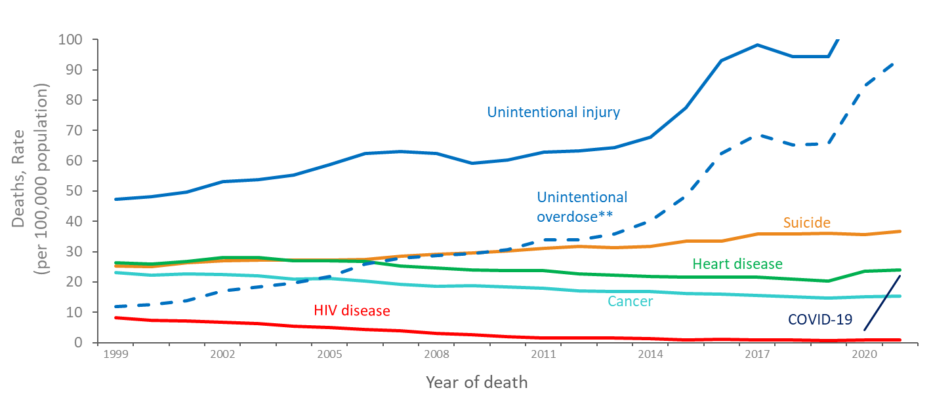
Trends in Annual Rates of Death in the General Population with HIV Disease as the Underlying Cause versus the 5 Leading Causes among White* Males Aged 25–44 Years 1999–2021—United States
Note. Data from CDC WONDER Online Database based on death certificate data compiled by the National Center for Health Statistics.
*Does not include persons of Hispanic/Latino ethnicity.
** Deaths with an underlying cause of unintentional overdose are a subset of deaths with an underlying cause of unintentional injury.
Notes:
Among White males aged 25 to 44 years, the rate of death with HIV disease as the underlying cause of death was ranked as the 5th leading cause of death in 1999 and 2000, falling to 9th from 2009 through 2012. The rate of HIV disease as the underlying cause of death continued to fall and was ranked 16th among all causes of death in 2021, when it caused about 200 deaths, or less than 1% of all deaths in this group.
Does not include persons of Hispanic/Latino ethnicity.
The data for this slide come from death certificate data compiled by the National Center for Health Statistics (NCHS) and downloaded from the CDC WONDER Online Database https://wonder.cdc.gov/. For details on reporting of sex and race/ethnicity, please see NCHS’s Funeral Director’s Handbook on Death Registration and Fetal Death Reporting (https://www.cdc.gov/nchs/data/nvss/handbook/2019-Funeral-Directors-Handbook-508.pdf).

Slide 21
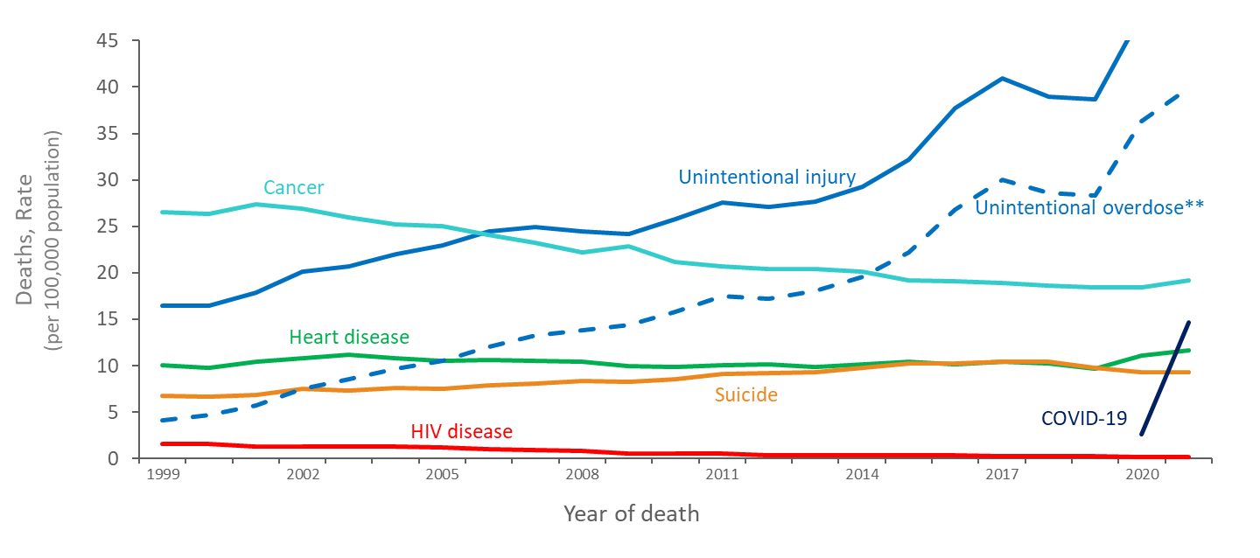
Trends in Annual Rates of Death in the General Population with HIV Disease as the Underlying Cause versus the 5 Leading Causes among White* Females Aged 25–44 Years, 1999–2021—United States
Note. Data from CDC WONDER Online Database based on death certificate data compiled by the National Center for Health Statistics.
*Does not include persons of Hispanic/Latino ethnicity.
** Deaths with an underlying cause of unintentional overdose are a subset of deaths with an underlying cause of unintentional injury.
Notes:
Among White females aged 25 to 44 years, the rate of death with HIV disease as the underlying cause of death was ranked as the 9th leading cause of death in 1999 and 2000, falling to 10th in 2001 then 11th in 2002. The rate of HIV disease as the underlying cause of death continued to fall and was ranked 23rd among all causes of death in 2021, when it caused 52 deaths, or less than 1% of all deaths in this group.
Does not include persons of Hispanic/Latino ethnicity.
The data for this slide come from death certificate data compiled by the National Center for Health Statistics (NCHS) and downloaded from the CDC WONDER Online Database https://wonder.cdc.gov/. For details on reporting of sex and race/ethnicity, please see NCHS’s Funeral Director’s Handbook on Death Registration and Fetal Death Reporting (https://www.cdc.gov/nchs/data/nvss/handbook/2019-Funeral-Directors-Handbook-508.pdf).

Slide 22
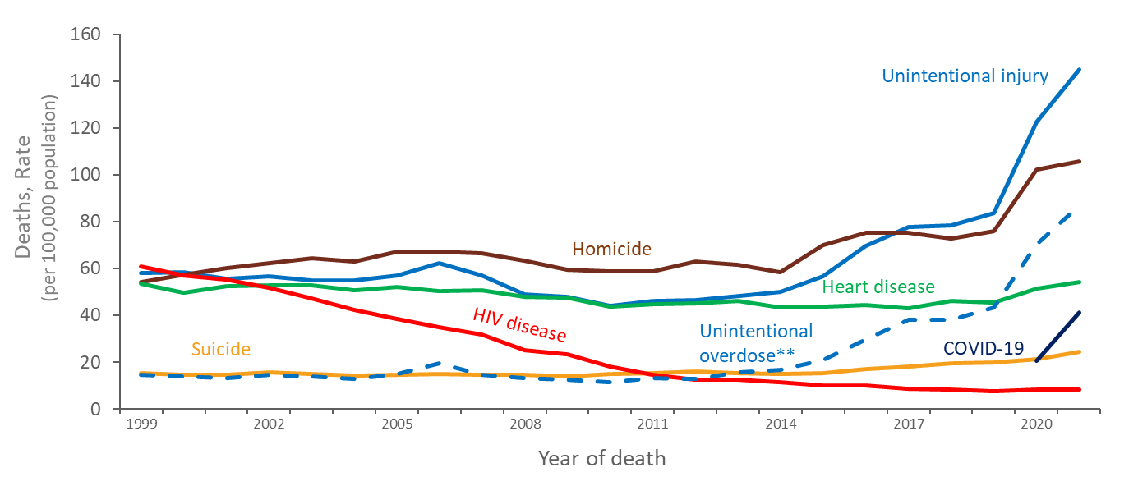
Trends in Annual Rates of Death in the General Population with HIV Disease as the Underlying Cause versus the 5 Leading Causes among Black/African American* Males Aged 25–44 Years, 1999–2021—United States
Note. Data from CDC WONDER Online Database based on death certificate data compiled by the National Center for Health Statistics.
*Does not include persons of Hispanic/Latino ethnicity.
** Deaths with an underlying cause of unintentional overdose are a subset of deaths with an underlying cause of unintentional injury.
Notes:
Among Black/African American males aged 25 to 44 years, HIV disease was the leading cause of death in 1999, falling to 3rd in 2000 and 2001. The rate of HIV disease as the underlying cause of death continued to fall and was ranked 7th among all causes of death in 2021, when HIV disease caused about 500 deaths, or about 2% of all deaths in this group.
Does not include persons of Hispanic/Latino ethnicity.
The data for this slide come from death certificate data compiled by the National Center for Health Statistics (NCHS) and downloaded from the CDC WONDER Online Database https://wonder.cdc.gov/. For details on reporting of sex and race/ethnicity, please see NCHS’s Funeral Director’s Handbook on Death Registration and Fetal Death Reporting (https://www.cdc.gov/nchs/data/nvss/handbook/2019-Funeral-Directors-Handbook-508.pdf).

Slide 23
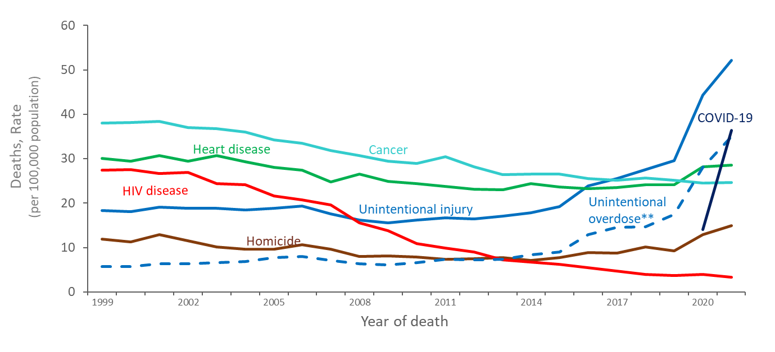
Trends in Annual Rates of Death in the General Population due to HIV Disease as the Underlying Cause versus the 5 Leading Causes among Black/African American* Females Aged 25–44 Years, 1999–2021—United States
Note. Data from CDC WONDER Online Database based on death certificate data compiled by the National Center for Health Statistics.
*Does not include persons of Hispanic/Latino ethnicity.
** Deaths with an underlying cause of unintentional overdose are a subset of deaths with an underlying cause of unintentional injury.
Notes:
Among Black/African American females aged 25 to 44 years, the rate of death with HIV disease as the underlying cause was the 3rd leading cause of death in 1999 through 2007. The rate of HIV disease as the underlying cause of death continued to fall and was ranked 12th among all causes of death in 2021, when it caused about 200 deaths, or about 1% of all deaths in this group.
Does not include persons of Hispanic/Latino ethnicity.
The data for this slide come from death certificate data compiled by the National Center for Health Statistics (NCHS) and downloaded from the CDC WONDER Online Database https://wonder.cdc.gov/. For details on reporting of sex and race/ethnicity, please see NCHS’s Funeral Director’s Handbook on Death Registration and Fetal Death Reporting (https://www.cdc.gov/nchs/data/nvss/handbook/2019-Funeral-Directors-Handbook-508.pdf).

Slide 24
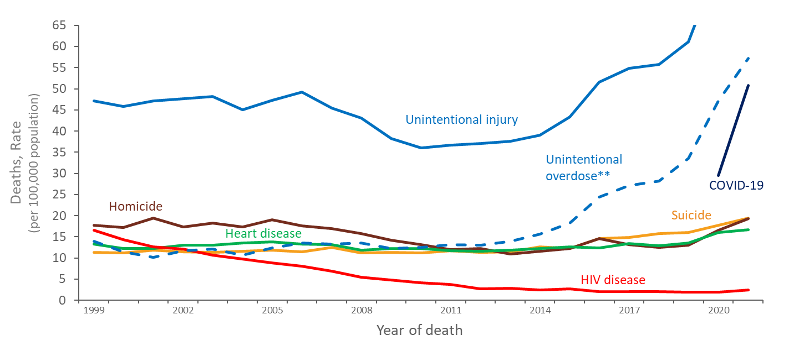
Trends in Annual Rates of Death in the General Population with HIV Disease as the Underlying Cause versus the 5 Leading Causes among Hispanic/Latino* Males Aged 25–44 Years, 1999–2021—United States
Note. Data from CDC WONDER Online Database based on death certificate data compiled by the National Center for Health Statistics.
*Hispanic/Latino persons can be of any race.
** Deaths with an underlying cause of unintentional overdose are a subset of deaths with an underlying cause of unintentional injury
Notes:
Among Hispanic/Latino males aged 25 to 44 years, HIV disease was the 3rd leading cause of death in 1999 and 2000, falling to 4th in 2001. The rate of HIV disease as the underlying cause of death continued to fall and was ranked 10th among all causes of death in 2021, when it caused about 200 deaths, or about 1% of all deaths in the group.
Hispanic/Latino persons can be of any race.
The data for this slide come from death certificate data compiled by the National Center for Health Statistics (NCHS) and downloaded from the CDC WONDER Online Database https://wonder.cdc.gov/. For details on reporting of sex and race/ethnicity, please see NCHS’s Funeral Director’s Handbook on Death Registration and Fetal Death Reporting (https://www.cdc.gov/nchs/data/nvss/handbook/2019-Funeral-Directors-Handbook-508.pdf).

Slide 25
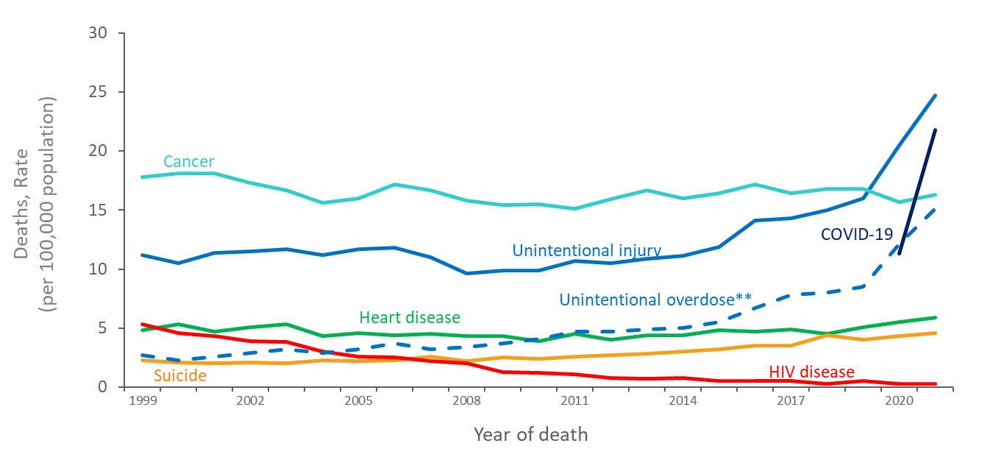
Trends in Annual Rates of Death in the General Population due to HIV Disease as the Underlying Cause versus the 5 Leading Causes among Hispanic/Latino* Females, Aged 25–44 Years, 1999–2021—United States
Note. Data from CDC WONDER Online Database based on death certificate data compiled by the National Center for Health Statistics.
*Hispanic/Latino persons can be of any race.
** Deaths with an underlying cause of unintentional overdose are a subset of deaths with an underlying cause of unintentional injury
Notes:
Among Hispanic/Latino females aged 25 to 44 years, HIV disease was the 3rd leading cause of death in 1999, falling to 4th in 2000. The rate of HIV disease as the underlying cause of death continued to fall and was ranked 17th among all causes of death in 2021, when it caused 27 deaths, or less than 1% of all deaths in the group.
Hispanic/Latino persons can be of any race.
The data for this slide come from death certificate data compiled by the National Center for Health Statistics (NCHS) and downloaded from the CDC WONDER Online Database https://wonder.cdc.gov/. For details on reporting of sex and race/ethnicity, please see NCHS’s Funeral Director’s Handbook on Death Registration and Fetal Death Reporting (https://www.cdc.gov/nchs/data/nvss/handbook/2019-Funeral-Directors-Handbook-508.pdf).

Slide 26
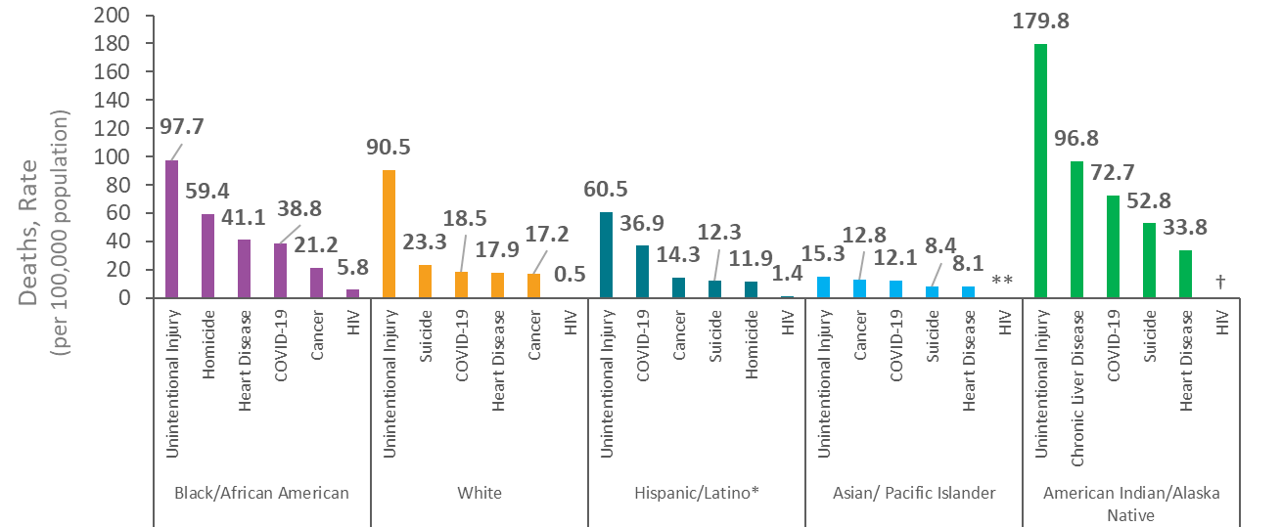
Annual Rate of Death in the General Population with HIV Disease as the Underlying Cause versus the 5 Leading Causes among Persons Aged 25–44 Years, By Race/Ethnicity 2021—United States
Note. Data from CDC WONDER Online Database based on death certificate data compiled by the National Center for Health Statistics.
*Hispanic/Latino persons can be of any race.
**Rate of death is less than 0.5 deaths per 100,000 persons.
† Unreliable rate due to a numerator of less than 20 deaths.
Notes:
Unintentional Injury was the highest underlying cause of death among all race/ethnicity groups aged 25 to 44 years in 2021, accounting for 70,896 deaths, or about 34% of deaths in this age group. Deaths due to unintentional injury impacted American Indian/Alaska Native persons aged 25-44 the greatest, at a rate of 179.8 deaths per 100,000 persons. Deaths with an underlying cause of HIV disease continue to disproportionally affect Black/African American persons, with an overall rate of 5.8 deaths per 100,000 persons in 2021.
In 2021, COVID-19 was among the leading causes of death for all race/ethnicity groups aged 24-44 years. Deaths due to COVID-19 among Black/African persons and American Indian/Alaska Native persons aged 25-44 years were disproportionate, at a rate of 16.6 deaths per 100,000 and 72.7 deaths per 100,000, relatively.
Death rates are considered unreliable when the rate is calculated with a numerator of 20 or less.
Hispanic/Latino persons can be of any race.
The data for this slide come from death certificate data compiled by the National Center for Health (NCHS) Statistics and downloaded from the CDC WONDER Online Database https://wonder.cdc.gov/. For details on reporting of sex and race/ethnicity, please see NCHS’s Funeral Director’s Handbook on Death Registration and Fetal Death Reporting (https://www.cdc.gov/nchs/data/nvss/handbook/2019-Funeral-Directors-Handbook-508.pdf).

Slide 27
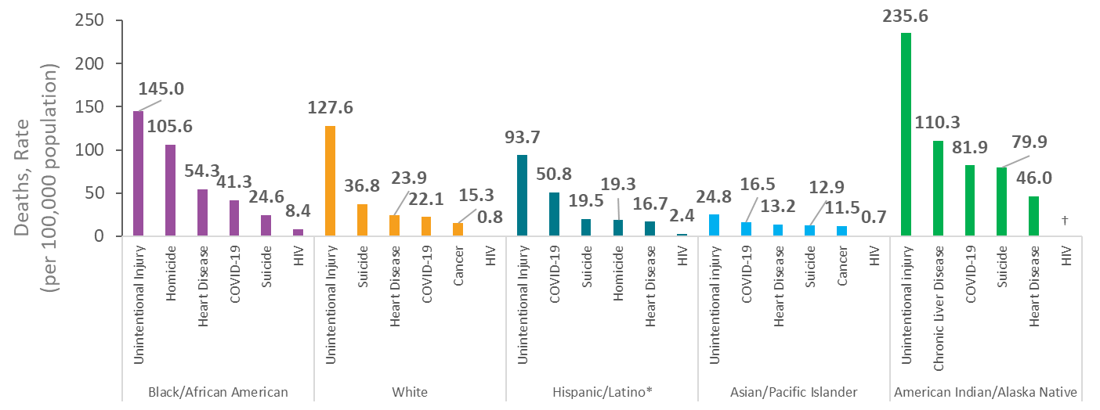
Annual Rate of Death in the General Population with HIV Disease as the Underlying Cause versus the 5 Leading Causes among Males Aged 25–44 Years, By Race/Ethnicity, 2021—United States
Note. Data from CDC WONDER Online Database based on death certificate data compiled by the National Center for Health Statistics.
*Hispanic/Latino persons can be of any race.
† Unreliable rate estimate due to a numerator of less than 20 deaths.
Notes:
Unintentional Injury was the highest underlying cause of death among all males in all race/ethnicity groups aged 25 to 44 years in 2021, accounting for 51,813 deaths, or about 37% of the deaths in this group. Deaths due to unintentional injury impacted American Indian/Alaska Native males aged 25-44 the greatest, at a rate of 235.6 deaths per 100,000 persons. Deaths with an underlying cause of HIV disease are disproportionate among Black/African American males, with an overall rate of 8.4 deaths per 100,000 persons in 2021.
Death rates are considered unreliable when the rate is calculated with a numerator of 20 or less.
Hispanic/Latino persons can be of any race.
The data for this slide come from death certificate data compiled by the National Center for Health Statistics (NCHS) and downloaded from the CDC WONDER Online Database https://wonder.cdc.gov/. For details on reporting of sex and race/ethnicity, please see NCHS’s Funeral Director’s Handbook on Death Registration and Fetal Death Reporting (https://www.cdc.gov/nchs/data/nvss/handbook/2019-Funeral-Directors-Handbook-508.pdf).

Slide 28
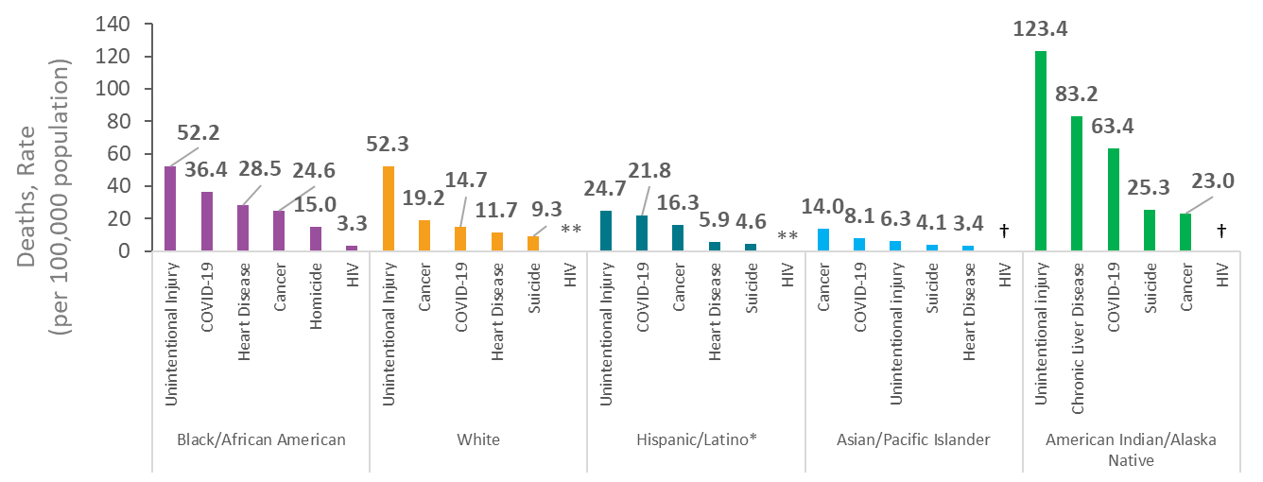
Annual Rate of Death in the General Population with HIV Disease as the Underlying Cause versus the 5 Leading Causes among Females Aged 25–44 Years, By Race/Ethnicity, 2021—United States
Note. Data from CDC WONDER Online Database based on death certificate data compiled by the National Center for Health Statistics.
*Hispanic/Latino persons can be of any race.
**Rate of death is less than 0.5 deaths per 100,000 persons.
† Unreliable rate due to a numerator of less than 20 deaths.
Notes:
Unintentional Injury was the highest underlying cause of death among all females of all race/ethnicity groups aged 25 to 44 years in 2021, accounting for 19,083 deaths, or about 28% of deaths in this group. Deaths with an underlying cause of HIV disease are disproportional among Black/African American females, with an overall rate of 3.3 deaths per 100,000 persons in 2021.
Death rates are considered unreliable when the rate is calculated with a numerator of 20 or less.
Hispanic/Latino persons can be of any race.
The data for this slide come from death certificate data compiled by the National Center for Health Statistics (NCHS) and downloaded from the CDC WONDER Online Database https://wonder.cdc.gov/. For details on reporting of sex and race/ethnicity, please see NCHS’s Funeral Director’s Handbook on Death Registration and Fetal Death Reporting (https://www.cdc.gov/nchs/data/nvss/handbook/2019-Funeral-Directors-Handbook-508.pdf).

Slide 29
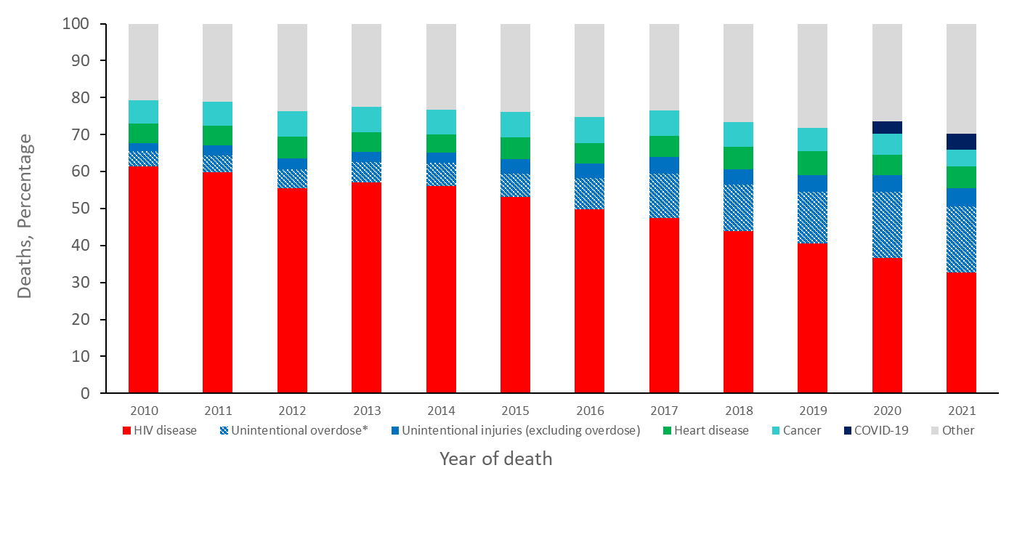
Percentages of 5 Leading Causes of Death among Persons Aged 25–44 Years with Diagnosed HIV Infection, 2010–2021—United States
Note. Data on cause of death among persons with diagnosed HIV infection are from the National HIV Surveillance System (NHSS) and presented for persons with a known cause of death.
*Deaths with an underlying cause of unintentional overdose are a subset of deaths with an underlying cause of unintentional injury.
Notes:
Among persons aged 25 to 44 years with diagnosed HIV who died during 2010-2021 and have a known cause of death, an underlying cause of HIV disease accounted for the highest percentage of deaths, at 61% in 2010 falling to 33% in 2021. In 2021, 23% of deaths among this group were due to unintentional injury, including 18% of which were due to unintentional overdose.
The data presented in this slide are from the National HIV Surveillance System (NHSS).

Slide 30
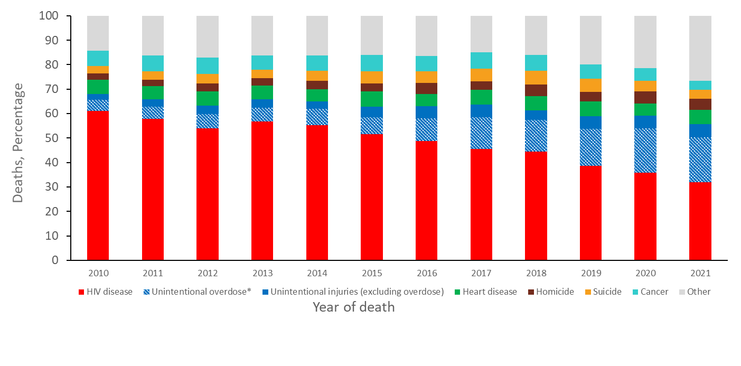
Percentages of 5 Leading Causes of Death among Males Aged 25-44 Years with Diagnosed HIV Infection, Based on Assigned Sex at Birth, 2010–2021—United States
Note. Data on cause of death among persons with diagnosed HIV infection are from the National HIV Surveillance System (NHSS) and presented for persons with a known cause of death.
*Deaths with an underlying cause of unintentional overdose are a subset of deaths with an underlying cause of unintentional injury.
Notes:
Among persons assigned male sex at birth aged 25 to 44 years with diagnosed HIV who died during 2010 to 2021 and have a known cause of death, an underlying cause of HIV disease accounted for the highest percentage of deaths, at 61% in 2010 falling to 32% in 2021. In 2021, 24% deaths in this group were due to unintentional injury, including 18% of which were due to unintentional overdose. Two causes of death ranked fifth with equal number of deaths in 2021 among males with diagnosed HIV infection: suicide and cancer.
The data presented in this slide are from the National HIV Surveillance System (NHSS).

Slide 31
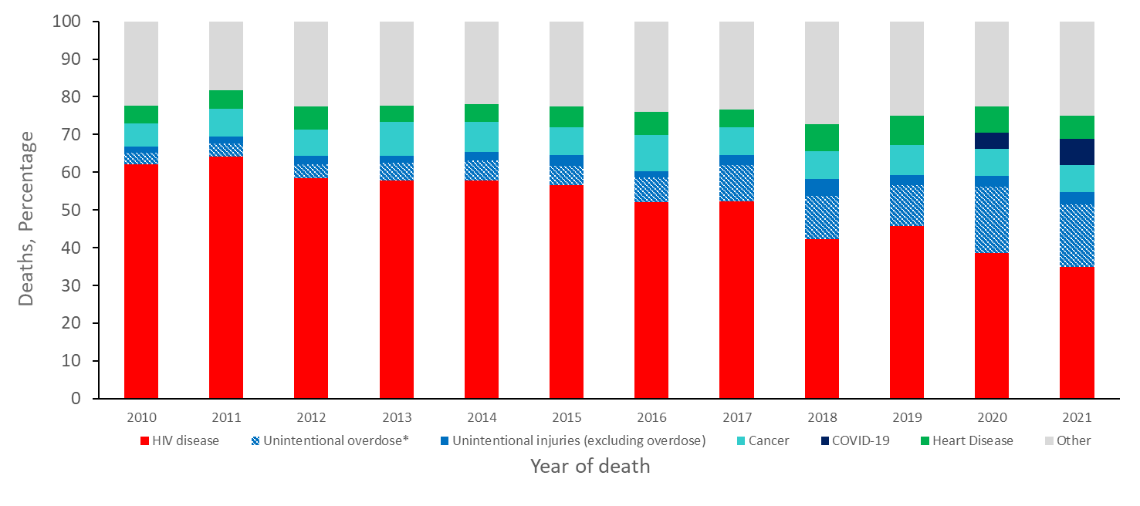
Percentages of 5 Leading Causes of Death among Females Aged 25-44 Years with Diagnosed HIV Infection, Based on Assigned Sex at Birth, 2010–2021—United States
Note. Data on cause of death among persons with diagnosed HIV infection are from the National HIV Surveillance System (NHSS) and presented for persons with a known cause of death.
*Deaths with an underlying cause of unintentional overdose are a subset of deaths with an underlying cause of unintentional injury.
Notes:
Among persons assigned female sex at birth aged 25 to 44 years with diagnosed HIV who died during 2010 to 2021 and have a known cause of death, an underlying cause of HIV disease accounted for the highest percentage of deaths, at 62% in 2010 falling to 35% in 2021. In 2021, 20% of deaths in this group were due to unintentional injury, including 17% of which were due to unintentional overdose.
The data presented in this slide are from the National HIV Surveillance System (NHSS).

Slide 32
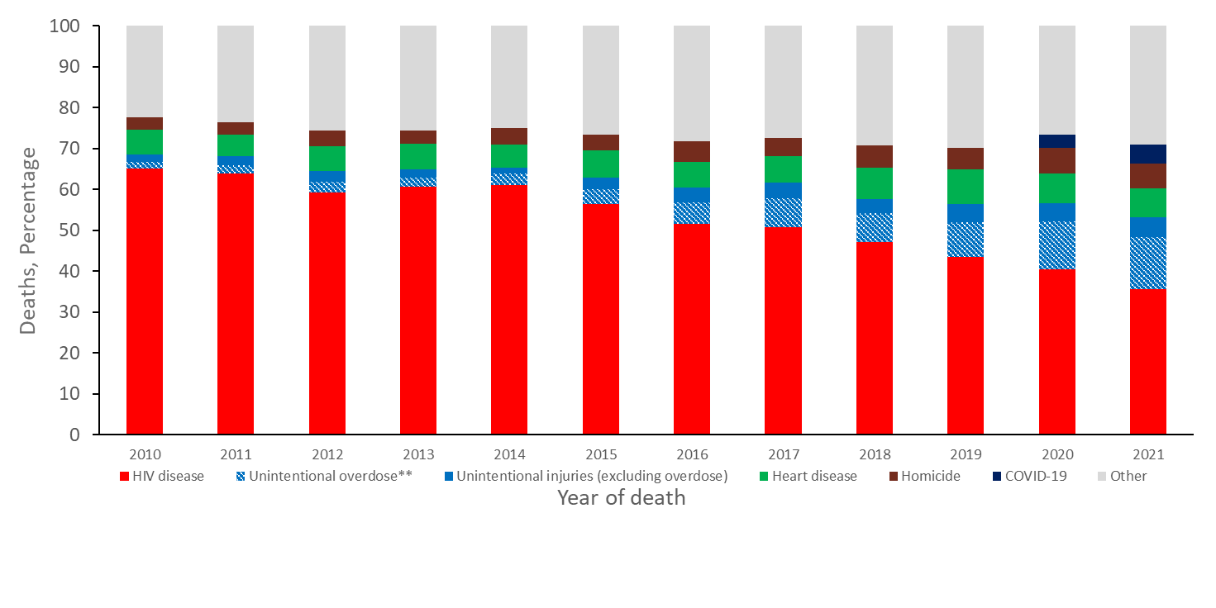
Percentages of 5 Leading Causes of Death among Black/African American* Persons Aged 25-44 Years with Diagnosed HIV Infection, 2010–2021—United States
Note. Data on cause of death among persons with diagnosed HIV infection are from the National HIV Surveillance System (NHSS) and presented for persons with a known cause of death.
*Does not include persons of Hispanic/Latino ethnicity.
**Deaths with an underlying cause of unintentional overdose are a subset of deaths with an underlying cause of unintentional injury.
Notes:
Among Black/African American persons aged 25 to 44 years with diagnosed HIV who died during 2010 to 2021 and have a known cause of death, an underlying cause of HIV disease accounted for the highest percentage of deaths, at 65% in 2010 falling to 36% in 2021. In 2021, 18% of deaths in this group were due to unintentional injury, including 13% of which were due to unintentional overdose.
The data presented in this slide are from the National HIV Surveillance System (NHSS).

Slide 33
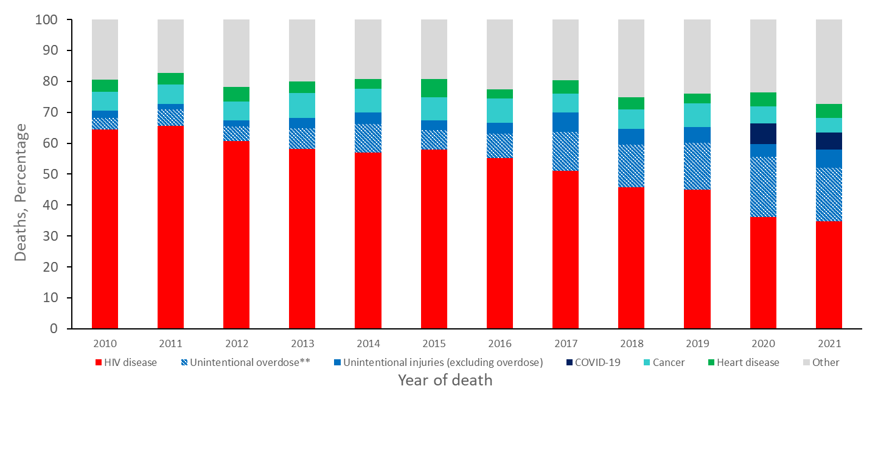
Percentages of 5 Leading Causes of Death among Hispanic/Latino* Persons Aged 25-44 Years with Diagnosed HIV Infection, 2010–2021—United States
Note. Data on cause of death among persons with diagnosed HIV infection are from the National HIV Surveillance System (NHSS) and presented for persons with a known cause of death.
*Hispanic/Latino persons can be of any race.
**Deaths with an underlying cause of unintentional overdose are a subset of deaths with an underlying cause of unintentional injury.
Notes:
Among Hispanic/Latino persons aged 25 to 44 years with diagnosed HIV who died during 2010 to 2021 and have a known cause of death, an underlying cause of HIV disease accounted for the highest percentage of deaths, at 64% in 2010 falling to 35% in 2021. In 2021, 23% of deaths in this group were due to unintentional injury, including 17% of which were due to unintentional overdose.
The data presented in this slide are from the National HIV Surveillance System (NHSS).

Slide 34
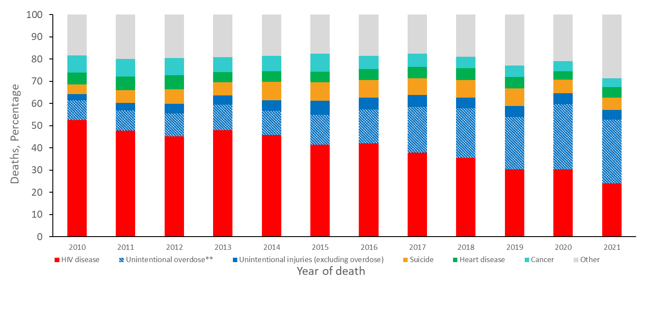
Percentages of 5 Leading Causes of Death among White* Persons Aged 25–44 Years with Diagnosed HIV Infection, 2010–2021—United States
Note. Data on cause of death among persons with diagnosed HIV infection are from the National HIV Surveillance System (NHSS) and presented for persons with a known cause of death.
*Does not include persons of Hispanic/Latino ethnicity.
**Deaths with an underlying cause of unintentional overdose are a subset of deaths with an underlying cause of unintentional injury.
Notes:
Among White persons aged 25 to 44 years with diagnosed HIV who died during 2010 to 2021 and have a known cause of death, an underlying cause of HIV disease accounted for the highest percentage of deaths, at 52% in 2010 falling to 24% in 2021. In 2021, 33% of deaths in this group were due to unintentional injury, including 29% of which were due to unintentional overdose.
The data presented in this slide are from the National HIV Surveillance System (NHSS).

Slide 35
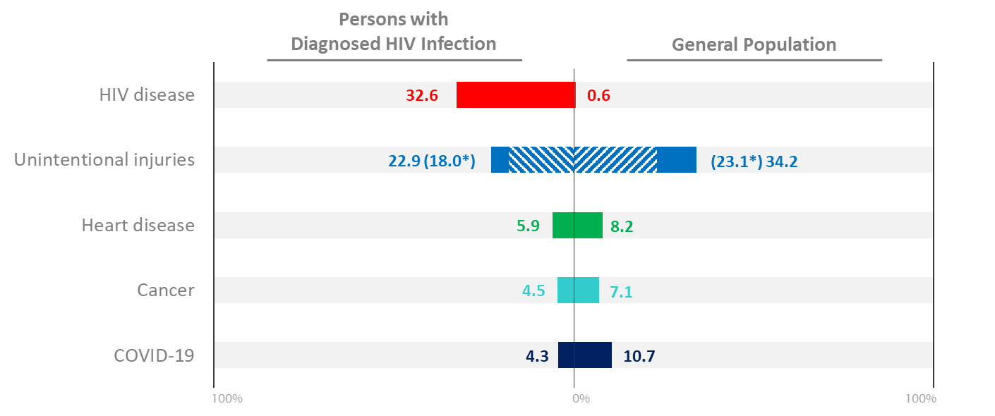
Percentages of 5 Leading Causes of Death among Persons Aged 25–44 Years with Diagnosed HIV Infection Compared to the General Population, 2021—United States
Note. Data on cause of death among persons with diagnosed HIV infection are from the National HIV Surveillance System (NHSS) and presented for persons with a known cause of death. Data on cause of death among the general population are from CDC WONDER.
*Deaths with an underlying cause of unintentional overdose, denoted with blue stripes, are a subset of deaths with an underlying cause of unintentional injury, denoted with solid and striped blue.
Notes:
In 2021, among all persons aged 25 to 44 years, less than 1% of deaths had an underlying cause of HIV disease in the general population, compared to 33% of deaths among persons with diagnosed HIV who died during 2010 to 2021 and have a known cause of death. Unintentional injury accounted for 23% of deaths among persons aged 25 to 44 with diagnosed HIV with a known cause of death, compared to 34% of deaths among the general population. Deaths with an underlying cause of heart disease, cancer, and COVID-19 also ranked among the top 5 causes of death among persons with diagnosed HIV in this age group, accounting for 6%, 5%, and 4% of deaths, respectively, compared to deaths in the general population for these causes, accounting for 8%, 7%, and 11%, respectively.
The data presented in this slide are from the National HIV Surveillance System (NHSS) and from death certificate data compiled by the National Center for Health Statistics (NCHS) and downloaded from the CDC WONDER Online Database https://wonder.cdc.gov/. For details on reporting of sex and race/ethnicity for NCHS data, please see NCHS’s Funeral Director’s Handbook on Death Registration and Fetal Death Reporting (https://www.cdc.gov/nchs/data/nvss/handbook/2019-Funeral-Directors-Handbook-508.pdf).

Slide 36
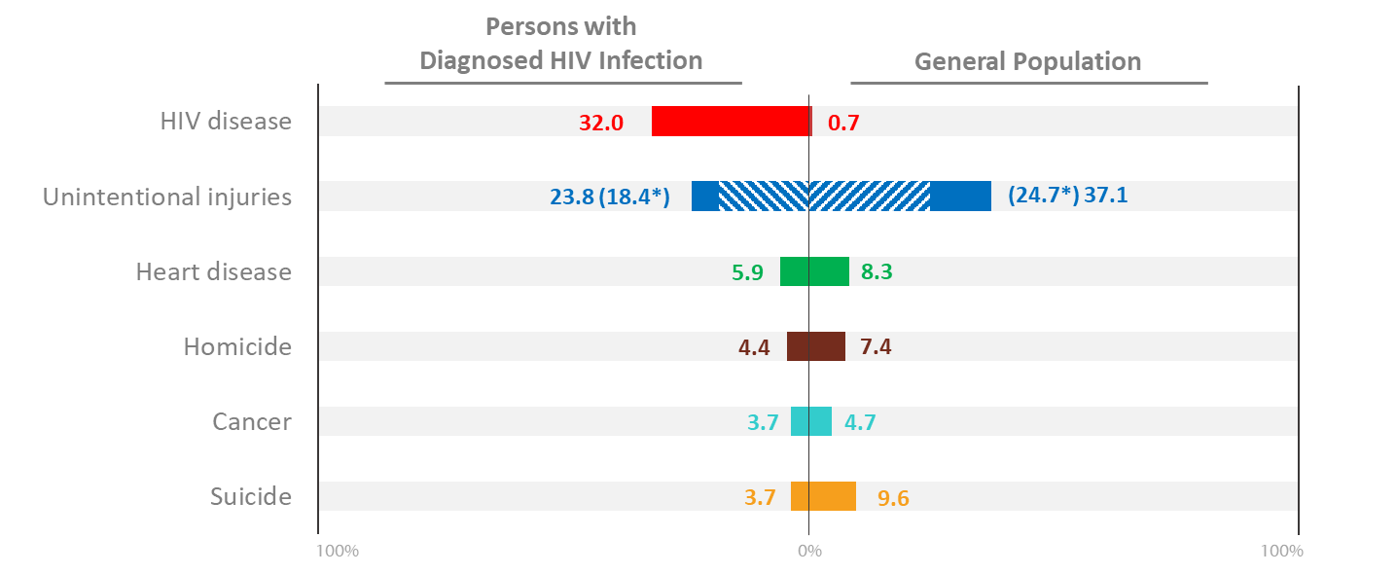
Percentages of 5 Leading Causes of Death among Males Aged 25–44 Years with Diagnosed HIV Infection Compared to the General Population, 2021—United States
Note. Data on cause of death among persons with diagnosed HIV infection are from the National HIV Surveillance System (NHSS) and presented for persons with a known cause of death. Data on cause of death among the general population are from CDC WONDER.
*Deaths with an underlying cause of unintentional overdose, denoted with blue stripes, are a subset of deaths with an underlying cause of unintentional injury, denoted with solid and striped blue.
Notes:
In 2021, among all males aged 25 to 44 years, less than 1% of deaths had an underlying cause of HIV disease in the general population, compared to 32% of deaths among males with diagnosed HIV who died during 2010 to 2021 and have a known cause of death. Unintentional injury accounted for 24% of deaths among males aged 25 to 44 with diagnosed HIV with a known cause of death, compared to 37% of deaths among the general population. Deaths with an underlying cause of heart disease, homicide, cancer, and suicide also ranked among the top 6 causes of death among males with diagnosed HIV in this age group, accounting for 6%, 4%, 4% and 4% of deaths, respectively, compared to deaths among males in the general population for these causes, accounting for 8%, 7%, 5%, and 10%, respectively. Two causes of death ranked fifth with equal number of deaths in 2021 among males with diagnosed HIV infection: suicide and cancer.
The data presented in this slide are from the National HIV Surveillance System (NHSS) and from death certificate data compiled by the National Center for Health Statistics (NCHS) and downloaded from the CDC WONDER Online Database https://wonder.cdc.gov/. For details on reporting of sex and race/ethnicity for NCHS data, please see NCHS’s Funeral Director’s Handbook on Death Registration and Fetal Death Reporting (https://www.cdc.gov/nchs/data/nvss/handbook/2019-Funeral-Directors-Handbook-508.pdf).

Slide 37
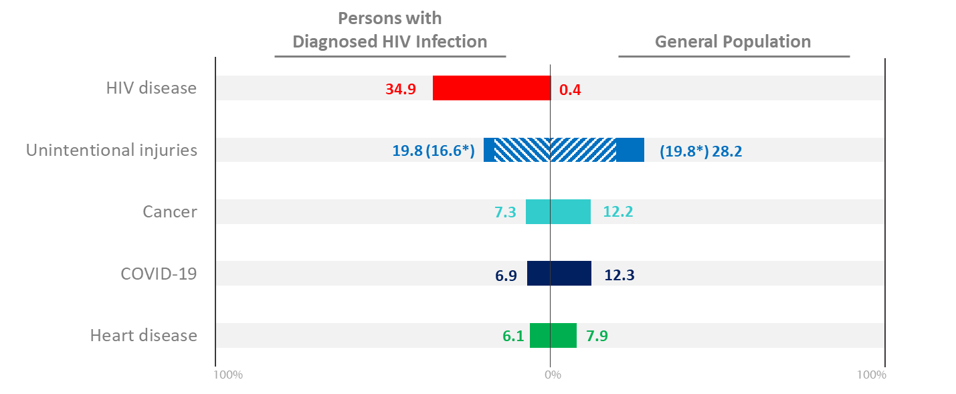
Percentages of 5 Leading Causes of Death among Females Aged 25–44 Years with Diagnosed HIV Infection Compared to the General Population, 2021—United States
Note. Data on cause of death among persons with diagnosed HIV infection are from the National HIV Surveillance System (NHSS) and presented for persons with a known cause of death. Data on cause of death among the general population are from CDC WONDER.
*Deaths with an underlying cause of unintentional overdose, denoted with blue stripes, are a subset of deaths with an underlying cause of unintentional injury, denoted with solid and striped blue.
Notes:
In 2021, among all females aged 25 to 44 years, less than 1% of deaths had an underlying cause of HIV disease in the general population, compared to 35% of deaths among females with diagnosed HIV who died during 2010 to 2021 and have a known cause of death. Unintentional injury accounted for 20% of deaths among females aged 25 to 44 with diagnosed HIV with a known cause of death, compared to 28% of deaths among the general population. Deaths with an underlying cause of cancer, COVID-19, and heart disease also ranked among the top 5 causes of death among females with diagnosed HIV in this age group, accounting for 7%, 7%, and 6% of deaths, respectively, compared to deaths among females in the general population for these causes, accounting for 12%, 12%, and 8%, respectively.
The data presented in this slide are from the National HIV Surveillance System (NHSS) and from death certificate data compiled by the National Center for Health Statistics (NCHS) and downloaded from the CDC WONDER Online Database https://wonder.cdc.gov/. For details on reporting of sex and race/ethnicity for NCHS data, please see NCHS’s Funeral Director’s Handbook on Death Registration and Fetal Death Reporting (https://www.cdc.gov/nchs/data/nvss/handbook/2019-Funeral-Directors-Handbook-508.pdf).

Slide 38
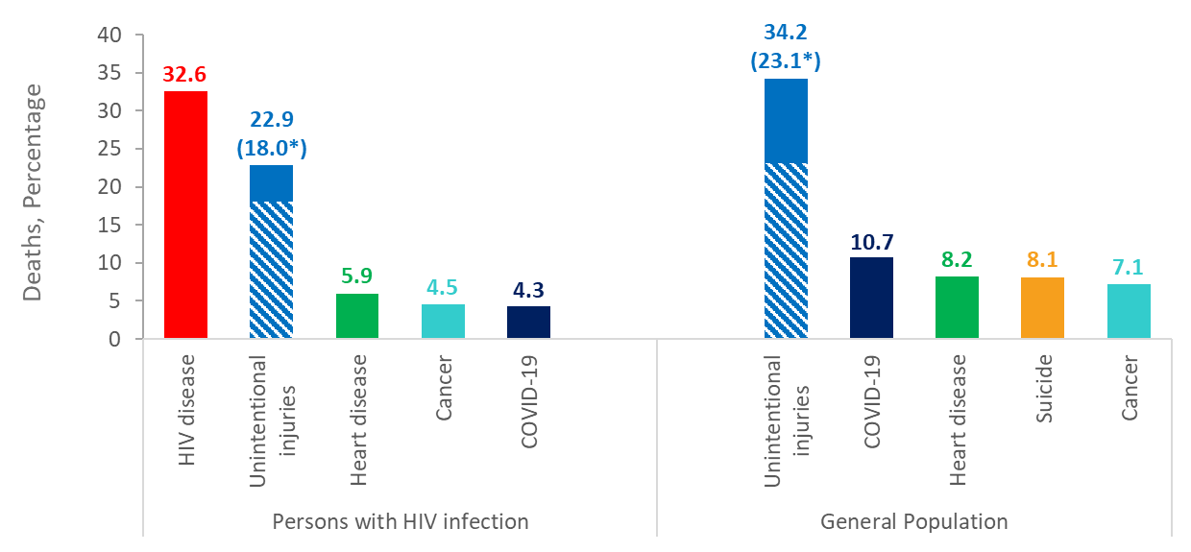
Percentages of 5 Leading Causes of Death among Persons Aged 25–44 Years with Diagnosed HIV Infection Compared to the 5 Leading Causes of Death among Persons Aged 25–44 Years the General Population, 2021—United States
Note. Data on cause of death among persons with diagnosed HIV infection are from the National HIV Surveillance System (NHSS) and presented for persons with a known cause of death. Data on cause of death among the general population are from CDC WONDER.
* Deaths with an underlying cause of unintentional overdose, denoted with blue stripes, are a subset of deaths with an underlying cause of unintentional injury, denoted with solid and striped blue.
Notes:
This slide displays the top 5 causes of death, by percentage of deaths), among persons aged 25 to 44 with diagnosed HIV with a known cause of death and the top 5 causes of death, by percentage, of persons aged 25 to 44 in the general population.
The data presented in this slide are from the National HIV Surveillance System (NHSS) and from death certificate data compiled by the National Center for Health Statistics (NCHS) and downloaded from the CDC WONDER Online Database https://wonder.cdc.gov/. For details on reporting of sex and race/ethnicity for NCHS data, please see NCHS’s Funeral Director’s Handbook on Death Registration and Fetal Death Reporting (https://www.cdc.gov/nchs/data/nvss/handbook/2019-Funeral-Directors-Handbook-508.pdf).

Slide 39
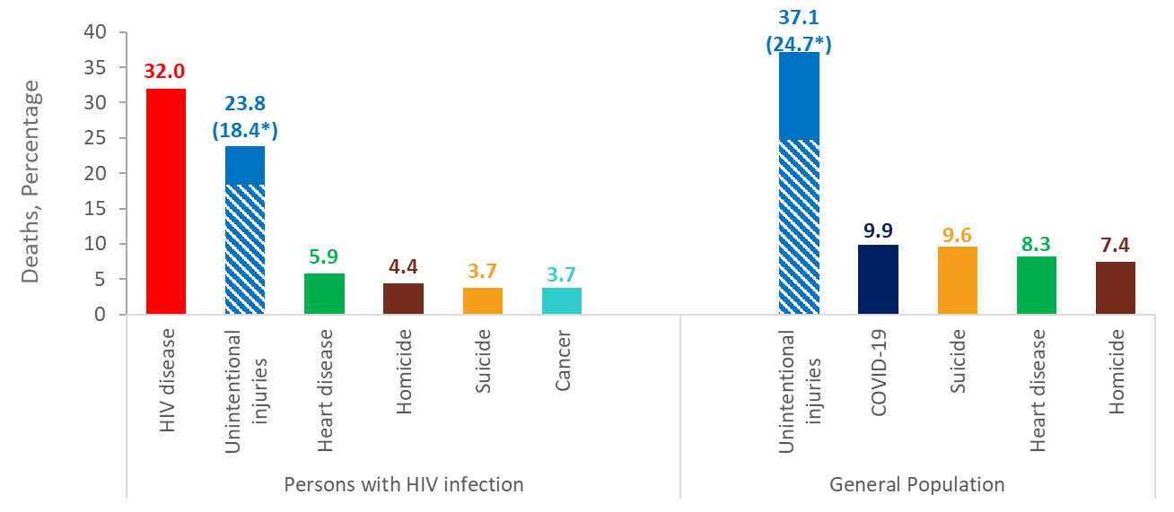
Percentages of 5 Leading Causes of Death among Males Aged 25–44 Years with Diagnosed HIV Infection Compared to the 5 Leading Causes of Death among Males Aged 25–44 Years in the General Population, 2021—United States
Note. Data on cause of death among persons with diagnosed HIV infection are from the National HIV Surveillance System (NHSS) and presented for persons with a known cause of death. Data on cause of death among the general population are from CDC WONDER.
*Deaths with an underlying cause of unintentional overdose, denoted with blue stripes, are a subset of deaths with an underlying cause of unintentional injury, denoted with solid and striped blue.
Notes:
This slide displays the top 5 causes of death, by percentage of deaths), among persons assigned male sex at birth aged 25 to 44 with diagnosed HIV who died during 2010-2021 and have a known cause of death and the top 5 causes of death, by percentage, of males aged 25 to 44 in the general population. Two causes of death ranked fifth with equal number of deaths in 2021 among males with diagnosed HIV infection: suicide and cancer.
The data presented in this slide are from the National HIV Surveillance System (NHSS) and from death certificate data compiled by the National Center for Health Statistics (NCHS) and downloaded from the CDC WONDER Online Database https://wonder.cdc.gov/. For details on reporting of sex and race/ethnicity for NCHS data, please see NCHS’s Funeral Director’s Handbook on Death Registration and Fetal Death Reporting (https://www.cdc.gov/nchs/data/nvss/handbook/2019-Funeral-Directors-Handbook-508.pdf).

Slide 40
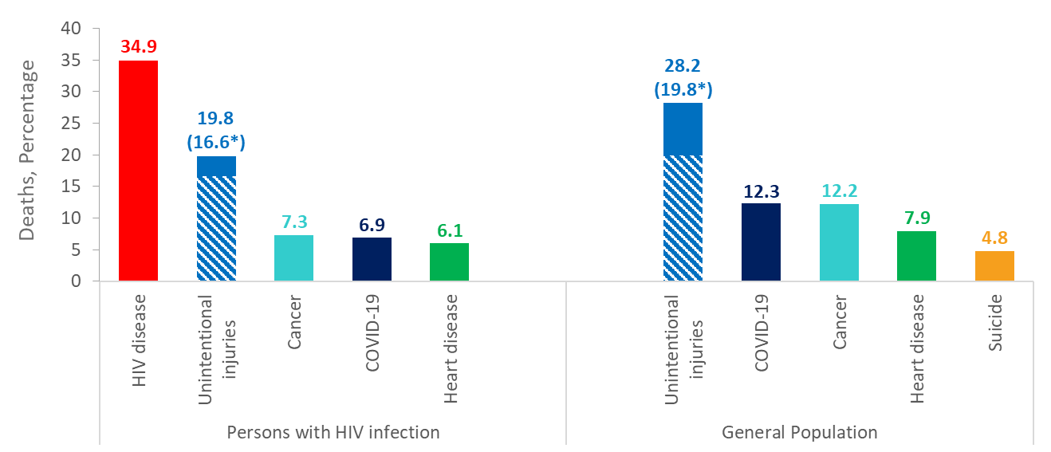
Percentages of 5 Leading Causes of Death among Females Aged 25–44 Years with Diagnosed HIV Infection Compared to the 5 Leading Causes of Death among Females Aged 25–44 Years in the General Population, 2021—United States
Note. Data on cause of death among persons with diagnosed HIV infection are from the National HIV Surveillance System (NHSS) and presented for persons with a known cause of death. Data on cause of death among the general population are from CDC WONDER.
*Deaths with an underlying cause of unintentional overdose, denoted with blue stripes, are a subset of deaths with an underlying cause of unintentional injury, denoted with solid and striped blue.
Notes:
This slide displays the top 5 causes of death, by percentage of deaths, among persons assigned female sex at birth aged 25 to 44 with diagnosed HIV who died during 2010-2021 and have a known cause of death and the top 5 causes of death, by percentage, of females aged 25 to 44 in the general population.
The data presented in this slide are from the National HIV Surveillance System (NHSS) and from death certificate data compiled by the National Center for Health Statistics (NCHS) and downloaded from the CDC WONDER Online Database https://wonder.cdc.gov/. For details on reporting of sex and race/ethnicity for NCHS data, please see NCHS’s Funeral Director’s Handbook on Death Registration and Fetal Death Reporting (https://www.cdc.gov/nchs/data/nvss/handbook/2019-Funeral-Directors-Handbook-508.pdf).

Slide 41
Conclusions
After rapidly increasing since the 1980s, the annual rate of death due to HIV disease peaked around 1994, then decreased rapidly through 1997. In recent years, the rate of death due to HIV disease continues to slowly decline, decreasing from 2.6 deaths per 100,000 in 2010 to 1.3 deaths per 100,000 in 2021.
Among the general population in 2021, persons dying of HIV disease increasingly consist of:
males (76%) (
Black/African American persons (49%)
residents of the South (55%)
persons 45 years of age or older (73%)
Among persons aged 25 to 44 with diagnosed HIV who died in 2021 and have a known cause of death:
36% of Black/African American persons died due to HIV disease compared to 24% of White persons
35% of females died due to HIV disease compared to 32% of males
HIV disease continues to remain among the leading causes of death among all persons aged 25 to 44 years, ranking 13th in 2021.
HIV disease as an underlying cause of death is particularly high among Black/African American persons aged 25 to 44 years, ranking the 7th leading cause among Black males and the 12th leading cause among Black females in 2021.

