Slide 1

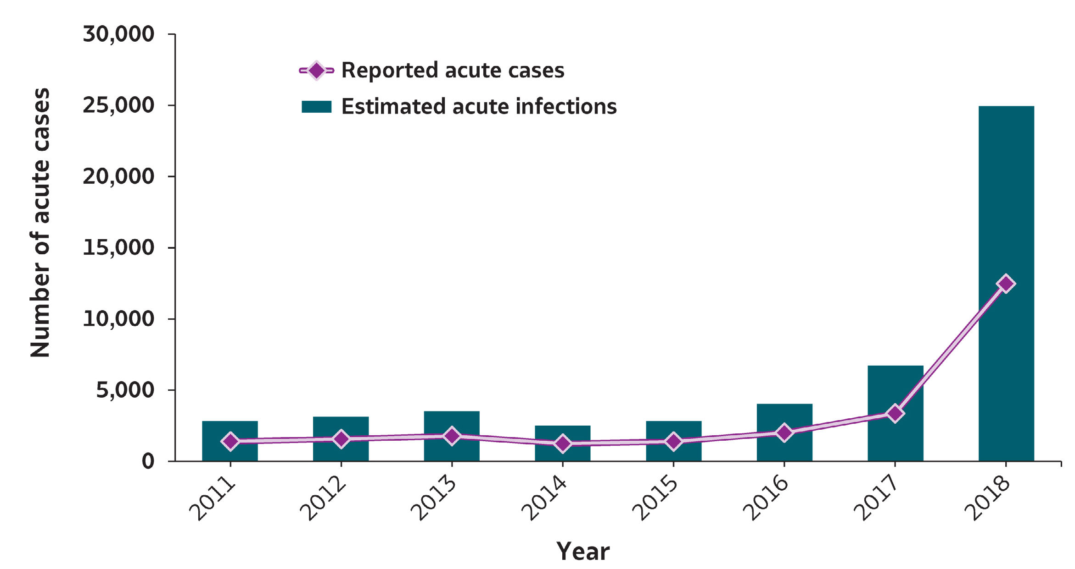
VIRAL HEPATITIS
SURVEILLANCE
Figure 1.1. Number of reported hepatitis A cases and estimated infections* — United States, 2011–2018
Source: CDC, National Notifiable Diseases Surveillance System
* The number of estimated viral hepatitis infections was determined by multiplying the number of reported cases by a factor that adjusted for under-ascertainment and under-reporting⁽⁷⁾. The 95% bootstrap confidence intervals for the estimated number of infections are shown in the Appendix.

Slide 2
VIRAL HEPATITIS
SURVEILLANCE
Figure 1.1. Number of reported hepatitis A cases and estimated infections* — United States, 2011–2018
Hepatitis A | 2011 | 2012 | 2013 | 2014 | 2015 | 2016 | 2017 | 2018
Reported cases | 1,398 | 1,562 | 1,781 | 1,239 | 1,390 | 2,007 | 3,366 | 12,474
Estimated cases | 2,800 | 3,100 | 3,500 | 2,500 | 2,800 | 4,000 | 6,700 | 24,900
Source: CDC, National Notifiable Diseases Surveillance System
* The number of estimated viral hepatitis infections was determined by multiplying the number of reported cases by a factor that adjusted for under-ascertainment and under-reporting⁽¹⁰⁾. The 95% bootstrap confidence intervals for the estimated number of infections are shown in the Appendix.

Slide 3
VIRAL HEPATITIS SURVEILLANCE
Table 1.1. Number and rate* of reported cases† of hepatitis A, by state or jurisdiction — United States, 2014–2018
State | 2014 |  | 2015 |  | 2016 |  | 2017 |  | 2018
 | No. | Rate* | No. | Rate* | No. | Rate* | No. | Rate* | No. | Rate*
Alabama | 15 | 0.3 | 23 | 0.5 | 19 | 0.4 | 23 | 0.5 | 38 | 0.8
Alaska | 1 | 0.1 | 4 | 0.5 | 2 | 0.3 | — | — | 1 | 0.1
Arizona | 29 | 0.4 | 54 | 0.8 | 32 | 0.5 | 59 | 0.8 | 77 | 1.1
Arkansas | 2 | 0.1 | 10 | 0.3 | 13 | 0.4 | 7 | 0.2 | 254 | 8.4
California | 142 | 0.4 | 179 | 0.5 | 229 | 0.6 | 947 | 2.4 | 189 | 0.5
Colorado | 23 | 0.4 | 25 | 0.5 | 22 | 0.4 | 65 | 1.2 | 31 | 0.5
Connecticut | 23 | 0.6 | 9 | 0.3 | 16 | 0.4 | 17 | 0.5 | 15 | 0.4
Delaware | 1 | 0.1 | 2 | 0.2 | 1 | 0.1 | 6 | 0.6 | 7 | 0.7
District of Columbia | U | U | U | U | 4 | 0.6 | 3 | 0.4 | 11 | 1.6
Florida | 90 | 0.5 | 108 | 0.5 | 115 | 0.6 | 261 | 1.2 | 548 | 2.6
Georgia | 24 | 0.2 | 30 | 0.3 | 44 | 0.4 | 24 | 0.2 | 84 | 0.8
Hawaii | 5 | 0.4 | 6 | 0.4 | 285 | 20.0 | 8 | 0.6 | 4 | 0.3
Idaho | 7 | 0.4 | 9 | 0.5 | 7 | 0.4 | 4 | 0.2 | 5 | 0.3
Illinois | 82 | 0.6 | 57 | 0.4 | 71 | 0.6 | 73 | 0.6 | 93 | 0.7
Indiana | 20 | 0.3 | 19 | 0.3 | 18 | 0.3 | 21 | 0.3 | 964 | 14.4
Iowa | 12 | 0.4 | 16 | 0.5 | 16 | 0.5 | 9 | 0.3 | 10 | 0.3
Kansas | 7 | 0.2 | 7 | 0.2 | 5 | 0.2 | 6 | 0.2 | 14 | 0.5
Kentucky | 19 | 0.4 | 16 | 0.4 | 9 | 0.2 | 71 | 1.6 | 3,560 | 79.7
Louisiana | 5 | 0.1 | 5 | 0.1 | 12 | 0.3 | 8 | 0.2 | 37 | 0.8
Maine | 8 | 0.6 | 8 | 0.6 | 8 | 0.6 | 7 | 0.5 | 9 | 0.7
Maryland | 27 | 0.5 | 19 | 0.3 | 37 | 0.6 | 29 | 0.5 | 52 | 0.9
Massachusetts | 43 | 0.6 | 34 | 0.5 | 64 | 0.9 | 52 | 0.8 | 364 | 5.3
Michigan | 45 | 0.5 | 51 | 0.5 | 112 | 1.1 | 670 | 6.7 | 299 | 3.0
Minnesota | 19 | 0.3 | 21 | 0.4 | 15 | 0.3 | 30 | 0.5 | 16 | 0.3
Mississippi | 3 | 0.1 | 2 | 0.1 | 2 | 0.1 | 3 | 0.1 | 13 | 0.4
Missouri | 20 | 0.3 | 9 | 0.1 | 16 | 0.3 | 27 | 0.4 | 243 | 4.0
Montana | 5 | 0.5 | 2 | 0.2 | 3 | 0.3 | 3 | 0.3 | — | —
Nebraska | 9 | 0.5 | 6 | 0.3 | 21 | 1.1 | 4 | 0.2 | 6 | 0.3
Nevada | 5 | 0.2 | 11 | 0.4 | 14 | 0.5 | 19 | 0.6 | 41 | 1.4
New Hampshire | 5 | 0.4 | 2 | 0.2 | 8 | 0.6 | 7 | 0.5 | 12 | 0.9
New Jersey | 59 | 0.7 | 59 | 0.7 | 74 | 0.8 | 71 | 0.8 | 70 | 0.8
New Mexico | 8 | 0.4 | 6 | 0.3 | 4 | 0.2 | 4 | 0.2 | 23 | 1.1
New York | 84 | 0.4 | 123 | 0.6 | 99 | 0.5 | 218 | 1.1 | 165 | 0.8
North Carolina | 38 | 0.4 | 45 | 0.4 | 52 | 0.5 | 29 | 0.3 | 103 | 1.0
North Dakota | 9 | 1.2 | 5 | 0.7 | 2 | 0.3 | — | — | — | —
Ohio | 32 | 0.3 | 36 | 0.3 | 36 | 0.3 | 45 | 0.4 | 1,687 | 14.4
Oklahoma | 17 | 0.4 | 11 | 0.3 | 11 | 0.3 | 9 | 0.2 | 5 | 0.1
Oregon | 13 | 0.3 | 28 | 0.7 | 15 | 0.4 | 20 | 0.5 | 23 | 0.5
Pennsylvania | 48 | 0.4 | 43 | 0.3 | 62 | 0.5 | 69 | 0.5 | 99 | 0.8
Rhode Island | 8 | 0.8 | 4 | 0.4 | 4 | 0.4 | 6 | 0.6 | 7 | 0.7
South Carolina | 6 | 0.1 | 16 | 0.3 | 21 | 0.4 | 21 | 0.4 | 30 | 0.6
South Dakota | 3 | 0.4 | 2 | 0.2 | 1 | 0.1 | 1 | 0.1 | 1 | 0.1
Tennessee | 12 | 0.2 | 14 | 0.2 | 7 | 0.1 | 6 | 0.1 | 654 | 9.7
Texas | 124 | 0.5 | 147 | 0.5 | 139 | 0.5 | 129 | 0.5 | 88 | 0.3
Utah | 8 | 0.3 | 8 | 0.3 | 12 | 0.4 | 159 | 5.1 | 135 | 4.3
Vermont | 1 | 0.2 | 3 | 0.5 | 5 | 0.8 | 2 | 0.3 | 3 | 0.5
Virginia | 27 | 0.3 | 50 | 0.6 | 190 | 2.3 | 46 | 0.5 | 82 | 1.0
Washington | 26 | 0.4 | 26 | 0.4 | 31 | 0.4 | 28 | 0.4 | 35 | 0.5
West Virginia | 12 | 0.6 | 8 | 0.4 | 15 | 0.8 | 6 | 0.3 | 2,247 | 124.4
Wisconsin | 7 | 0.1 | 9 | 0.2 | 7 | 0.1 | 16 | 0.3 | 15 | 0.3
Wyoming | 1 | 0.2 | 3 | 0.5 | — | — | 18 | 3.1 | 5 | 0.9
Total | 1,239 | 0.4 | 1,390 | 0.4 | 2,007 | 0.6 | 3,366 | 1.0 | 12,474 | 3.8
Source: CDC, National Notifiable Diseases Surveillance System.
* Rate per 100,000
population.
† For the case definition, see https://wwwn.cdc.gov/nndss/conditions/hepatitis-a-acute/.
—: No reported cases. The reporting jurisdiction did not submit any cases to CDC.
N: Not reportable. The disease or condition was not reportable by law, statue, or regulation in the reporting jurisdiction.
U: Unavailable. The data are unavailable.

Slide 4
VIRAL HEPATITIS SURVEILLANCE
Figure 1.2. Rates of reported hepatitis A, by state — United States, 2017–2018
US Average (2018): 3 .8
Source: CDC, National Notifiable Diseases Surveillance System.

Slide 5
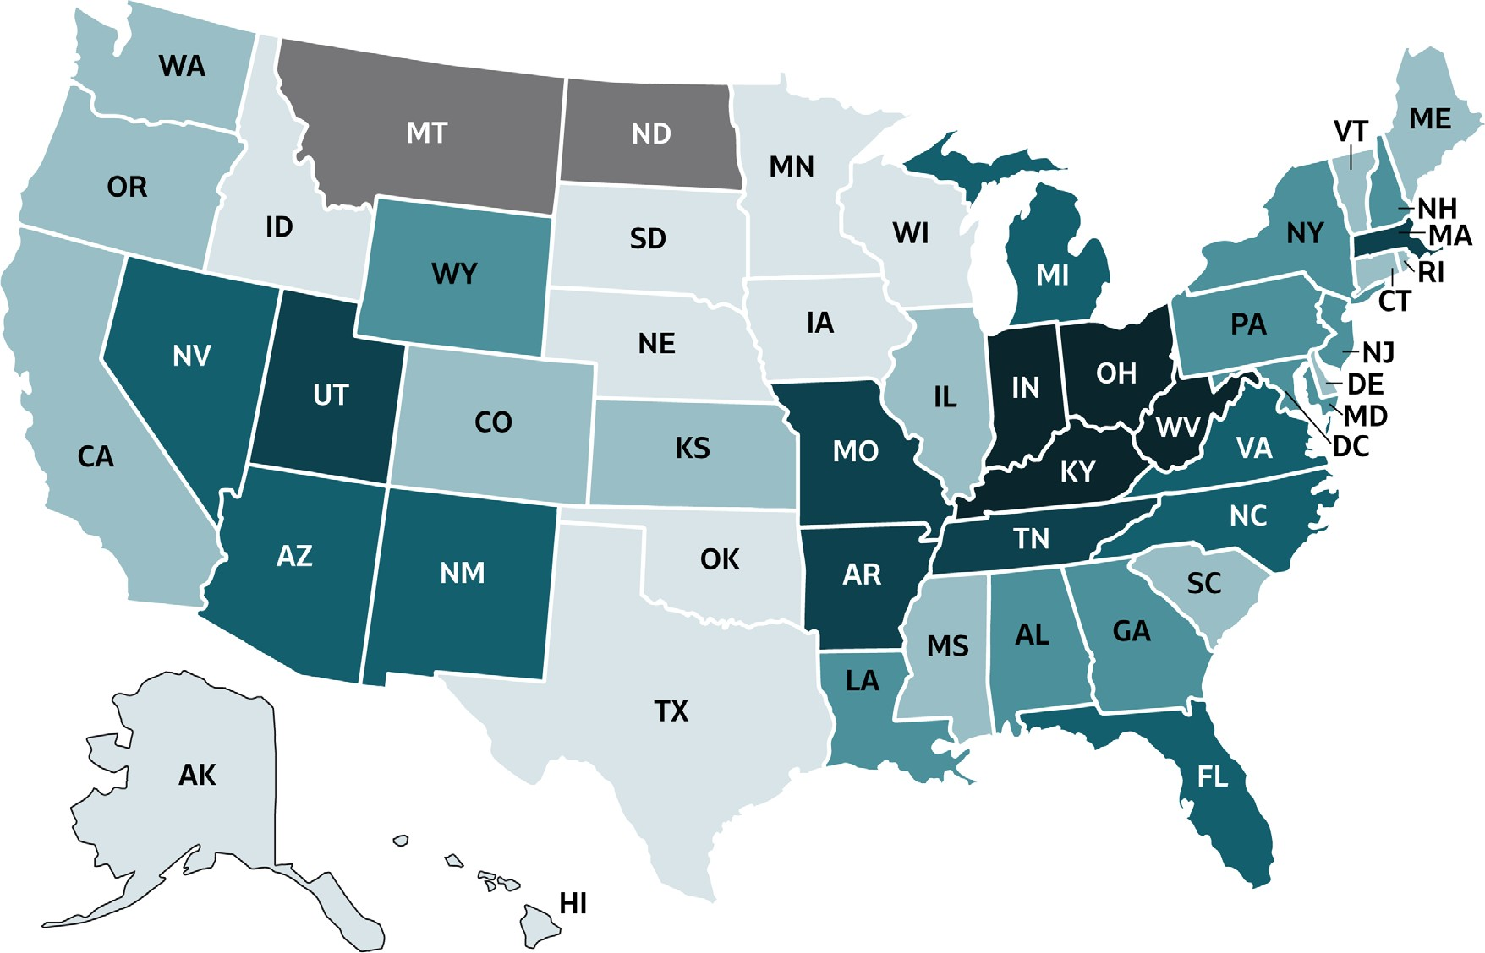
VIRAL HEPATITIS
SURVEILLANCE
Figure 1.3. Rates of reported hepatitis A, by state or jurisdiction — United States, 2018
https://wwwdev.cdc.gov/hepatitis/statistics/2018surveillance/index.htm

Slide 6
VIRAL HEPATITIS
SURVEILLANCE
Figure 1.3. Rates of reported hepatitis A, by state or jurisdiction — United States, 2018
Color Key | Cases/100,000 Population | States
 | 0-0.3 | AK, HI, ID, IA, MN, NE, OK, SD, TX, WI
 | >0.3-0.7 | CA, CO, CT, DE, IL, KS, ME, MS, OR, RI, SC, VT, WA
 | >0.7-0.9 | AL, GA, LA, MD, NH, NJ, NY, PA, WY
 | >0.9-3.9 | AZ, DC, FL, MI, NV, NM, NC, VA
 | >3.9-9.7 | AR, MA, MO, TN, UT
 | >9.7-124.4 | IN, KY, OH, WV
 | No reported cases | MT, ND
Source: CDC, National Notifiable Diseases Surveillance System.

Slide 7
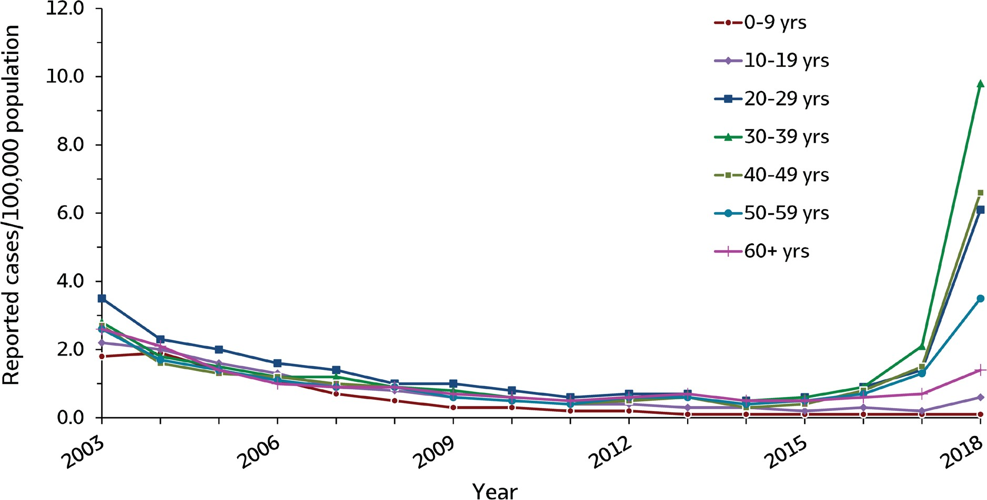
VIRAL HEPATITIS
SURVEILLANCE
Figure 1.4. Rates of reported hepatitis A, by age group — United States, 2003–2018
Source: CDC, National Notifiable Diseases Surveillance System.

Slide 8
VIRAL HEPATITIS
SURVEILLANCE
Figure 1.4. Rates of reported hepatitis A, by age group — United States, 2003–2018
Age (years) | 2003 | 2004 | 2005 | 2006 | 2007 | 2008 | 2009 | 2010 | 2011 | 2012 | 2013 | 2014 | 2015 | 2016 | 2017 | 2018
0-9 | 1.8 | 1.9 | 1.4 | 1.1 | 0.7 | 0.5 | 0.3 | 0.3 | 0.2 | 0.2 | 0.1 | 0.1 | 0.1 | 0.1 | 0.1 | 0.1
10-19 | 2.2 | 2.0 | 1.6 | 1.3 | 0.9 | 0.8 | 0.6 | 0.5 | 0.4 | 0.4 | 0.3 | 0.3 | 0.2 | 0.3 | 0.2 | 0.6
20-29 | 3.5 | 2.3 | 2.0 | 1.6 | 1.4 | 1.0 | 1.0 | 0.8 | 0.6 | 0.7 | 0.7 | 0.5 | 0.6 | 0.9 | 1.4 | 6.1
30-39 | 2.8 | 1.8 | 1.5 | 1.2 | 1.2 | 0.9 | 0.8 | 0.6 | 0.5 | 0.5 | 0.7 | 0.5 | 0.6 | 0.9 | 2.1 | 9.8
40-49 | 2.7 | 1.6 | 1.3 | 1.2 | 1.0 | 0.9 | 0.6 | 0.5 | 0.4 | 0.5 | 0.6 | 0.3 | 0.4 | 0.8 | 1.5 | 6.6
50-59 | 2.6 | 1.7 | 1.4 | 1.1 | 0.9 | 0.9 | 0.6 | 0.5 | 0.4 | 0.6 | 0.6 | 0.4 | 0.5 | 0.7 | 1.3 | 3.5
60+ | 2.6 | 2.1 | 1.4 | 1.0 | 0.9 | 0.9 | 0.7 | 0.6 | 0.5 | 0.6 | 0.7 | 0.5 | 0.5 | 0.6 | 0.7 | 1.4
Source: CDC, National Notifiable Diseases Surveillance System.

Slide 9
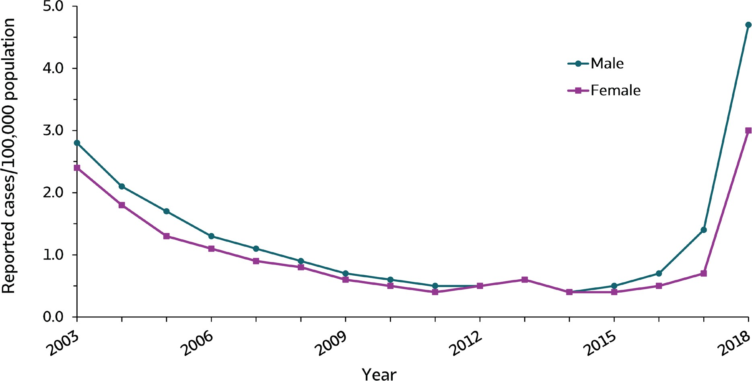
VIRAL HEPATITIS
SURVEILLANCE
Figure 1.5. Rates of reported hepatitis A, by sex — United States, 2003–2018
Source: CDC, National Notifiable Diseases Surveillance System.

Slide 10
VIRAL HEPATITIS
SURVEILLANCE
Figure 1.5. Rates of reported hepatitis A, by sex — United States, 2003–2018
Sex | 2003 | 2004 | 2005 | 2006 | 2007 | 2008 | 2009 | 2010 | 2011 | 2012 | 2013 | 2014 | 2015 | 2016 | 2017 | 2018
Male | 2.8 | 2.1 | 1.7 | 1.3 | 1.1 | 0.9 | 0.7 | 0.6 | 0.5 | 0.5 | 0.6 | 0.4 | 0.5 | 0.7 | 1.4 | 4.7
Female | 2.4 | 1.8 | 1.3 | 1.1 | 0.9 | 0.8 | 0.6 | 0.5 | 0.4 | 0.5 | 0.6 | 0.4 | 0.4 | 0.5 | 0.7 | 3.0
Source: CDC, National Notifiable Diseases Surveillance System.

Slide 11
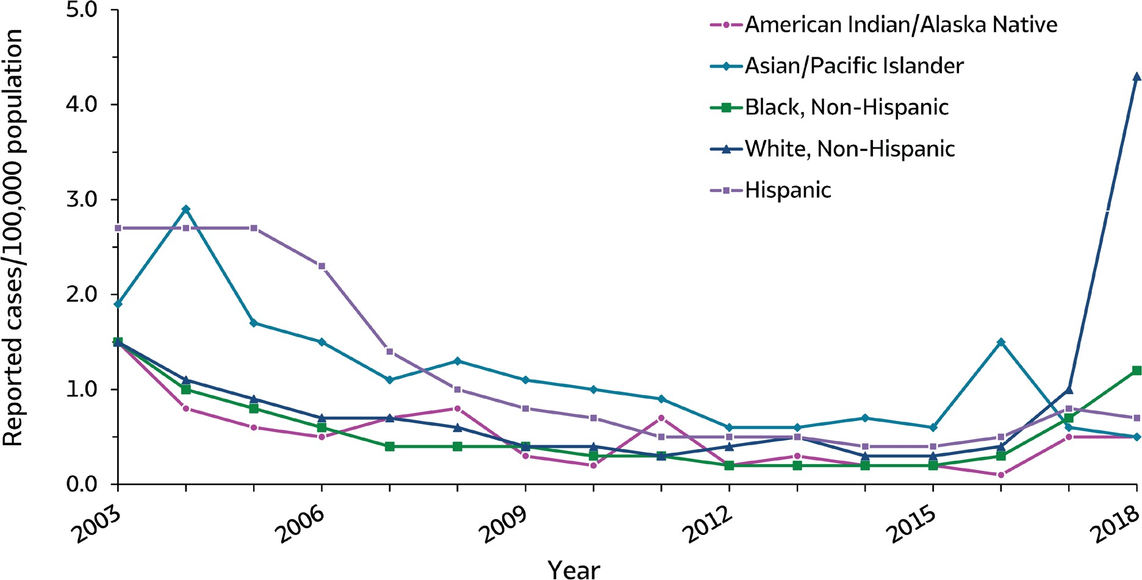
VIRAL HEPATITIS
SURVEILLANCE
Figure 1.6. Rates of reported hepatitis A, by race/ethnicity — United States, 2003–2018
Source: CDC, National Notifiable Diseases Surveillance System.

Slide 12
VIRAL HEPATITIS
SURVEILLANCE
Figure 1.6. Rates of reported hepatitis A, by race/ethnicity — United States, 2003–2018
Race/ Ethnicity | 2003 | 2004 | 2005 | 2006 | 2007 | 2008 | 2009 | 2010 | 2011 | 2012 | 2013 | 2014 | 2015 | 2016 | 2017 | 2018
American Indian/ Alaska Native | 1.5 | 0.8 | 0.6 | 0.5 | 0.7 | 0.8 | 0.3 | 0.2 | 0.7 | 0.2 | 0.3 | 0.2 | 0.2 | 0.1 | 0.5 | 0.5
Asian/Pacific Islander | 1.9 | 2.9 | 1.7 | 1.5 | 1.1 | 1.3 | 1.1 | 1.0 | 0.9 | 0.6 | 0.6 | 0.7 | 0.6 | 1.5 | 0.6 | 0.5
Black, Non-Hispanic | 1.5 | 1.0 | 0.8 | 0.6 | 0.4 | 0.4 | 0.4 | 0.3 | 0.3 | 0.2 | 0.2 | 0.2 | 0.2 | 0.3 | 0.7 | 1.2
White, Non-Hispanic | 1.5 | 1.1 | 0.9 | 0.7 | 0.7 | 0.6 | 0.4 | 0.4 | 0.3 | 0.4 | 0.5 | 0.3 | 0.3 | 0.4 | 1.0 | 4.3
Hispanic | 2.7 | 2.7 | 2.7 | 2.3 | 1.4 | 1.0 | 0.8 | 0.7 | 0.5 | 0.5 | 0.5 | 0.4 | 0.4 | 0.5 | 0.8 | 0.7
Source: CDC, National Notifiable Diseases Surveillance System.

Slide 13
VIRAL HEPATITIS SURVEILLANCE
Table 1.2. Number and rate* of reported cases† of hepatitis A, by demographic characteristics — United States 2014–2018
Demographic characteristic | 2014 |  | 2015 |  | 2016 |  | 2017 |  | 2018
 | No. | Rate* | No. | Rate* | No. | Rate* | No. | Rate* | No. | Rate*
Total§ | 1,239 | 0.4 | 1,390 | 0.4 | 2,007 | 0.6 | 3,366 | 1.0 | 12,474 | 3.8
Age group (years)
0–9 | 41 | 0.1 | 48 | 0.1 | 47 | 0.1 | 40 | 0.1 | 54 | 0.1
10–19 | 114 | 0.3 | 97 | 0.2 | 131 | 0.3 | 86 | 0.2 | 231 | 0.6
20–29 | 246 | 0.5 | 287 | 0.6 | 392 | 0.9 | 659 | 1.4 | 2,763 | 6.1
30–39 | 207 | 0.5 | 233 | 0.6 | 391 | 0.9 | 893 | 2.1 | 4,268 | 9.8
40–49 | 139 | 0.3 | 164 | 0.4 | 333 | 0.8 | 621 | 1.5 | 2,658 | 6.6
50–59 | 182 | 0.4 | 205 | 0.5 | 297 | 0.7 | 554 | 1.3 | 1,509 | 3.5
60+ | 304 | 0.5 | 353 | 0.5 | 409 | 0.6 | 509 | 0.7 | 987 | 1.4
Sex
Male | 645 | 0.4 | 726 | 0.5 | 1,107 | 0.7 | 2,209 | 1.4 | 7,497 | 4.7
Female | 591 | 0.4 | 662 | 0.4 | 897 | 0.5 | 1,149 | 0.7 | 4,952 | 3.0
Race/ethnicity
American Indian/ Alaskan Native | 4 | 0.2 | 5 | 0.2 | 3 | 0.1 | 13 | 0.5 | 15 | 0.5
Asian/Pacific Islander | 135 | 0.7 | 114 | 0.6 | 299 | 1.5 | 124 | 0.6 | 104 | 0.5
Black, Non-Hispanic | 82 | 0.2 | 71 | 0.2 | 137 | 0.3 | 303 | 0.7 | 508 | 1.2
White, Non-Hispanic | 566 | 0.3 | 701 | 0.3 | 865 | 0.4 | 1,979 | 1.0 | 8670 | 4.3
Hispanic | 211 | 0.4 | 219 | 0.4 | 293 | 0.5 | 471 | 0.8 | 413 | 0.7
HHS Region¶
Region 1 | 88 | 0.6 | 60 | 0.4 | 105 | 0.7 | 91 | 0.6 | 410 | 2.8
Region 2 | 143 | 0.5 | 182 | 0.6 | 173 | 0.6 | 289 | 1.0 | 235 | 0.8
Region 3 | 115 | 0.4 | 122 | 0.4 | 309 | 1.0 | 159 | 0.5 | 2,498 | 8.1
Region 4 | 207 | 0.3 | 254 | 0.4 | 269 | 0.4 | 438 | 0.7 | 5,030 | 7.6
Region 5 | 205 | 0.4 | 193 | 0.4 | 259 | 0.5 | 855 | 1.6 | 3,074 | 5.9
Region 6 | 156 | 0.4 | 179 | 0.4 | 179 | 0.4 | 157 | 0.4 | 407 | 1.0
Region 7 | 48 | 0.3 | 38 | 0.3 | 58 | 0.4 | 46 | 0.3 | 273 | 1.9
Region 8 | 49 | 0.4 | 45 | 0.4 | 40 | 0.3 | 246 | 2.1 | 172 | 1.4
Region 9 | 181 | 0.4 | 250 | 0.5 | 560 | 1.1 | 1,033 | 2.0 | 311 | 0.6
Region 10 | 47 | 0.4 | 67 | 0.5 | 55 | 0.4 | 52 | 0.4 | 64 | 0.5
Source: CDC, National Notifiable Diseases Surveillance System.
* Rate per 100,000 population.
† For the case definition, see https://wwwn.cdc.gov/nndss/conditions/hepatitis-a-acute/.
§ Numbers reported in each category may not add up to the total number of reported cases in a year due to cases with missing data or, in the case of race/ethnicity, cases categorized as “Other”.
¶ Health and Human Services Regions were categorized according to the grouping of states and U.S. Territories assigned under each of the ten Department of Health and Human Services regional offices (https://www.hhs.gov/about/agencies/iea/regional-offices/index.html). For the purposes of this report, regions with U.S. territories (Region 2 and Region 9) contain data from states only.

Slide 14
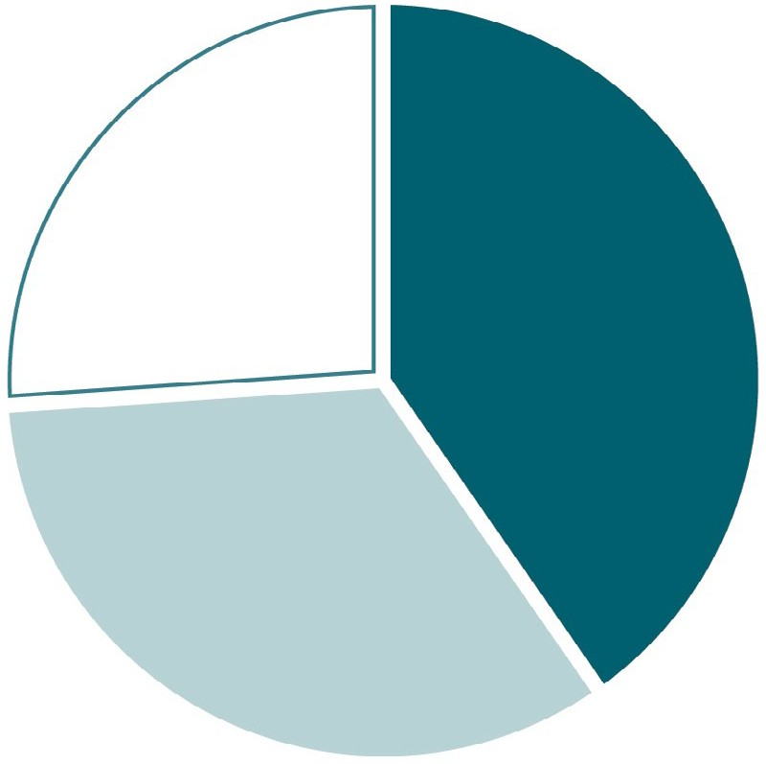
VIRAL HEPATITIS
SURVEILLANCE
Figure 1.7. Availability of information on risk behaviors/exposures* associated with reported cases of hepatitis A — United States, 2018
3,251
(26%)
5,026
(40%)
Risk identified*
No risk identified Risk data missing
4,197
(34%)

Slide 15
VIRAL HEPATITIS
SURVEILLANCE
Table 1.3. Reported risk behaviors/exposures† among reported cases of hepatitis A — United States, 2018
Risk behaviors/exposures | Risk identified* | No risk identified | Risk data missing
Injection drug use | 4,247 | 4,224 | 4,003
Sexual contact § | 299 | 4,728 | 7,447
Household contact (non-sexual) § | 260 | 4,767 | 7,447
Other contact § | 312 | 4,715 | 7,447
Men who have sex with men ¶ | 194 | 1,362 | 5,941
International travel | 114 | 6,896 | 5,464
Source: CDC, Nationally Notifiable Diseases Surveillance System
* Case reports with at least one of the following risk behaviors/ exposures reported 2–6 weeks prior to symptom onset: 1) injection drug use; 2) sexual, household, or other contact; 3) men who have sex with men; 4) travel to hepatitis A-endemic region.
† Reported cases may include more than one risk behavior/exposure.
§ Cases with more than one type of contact reported were categorized according to a hierarchy: (1) sexual contact; (2) household contact (non- sexual); (3) other contact with hepatitis A case
¶ A total of 7,497 hepatitis A cases were reported among males in 2018.

Slide 16
VIRAL HEPATITIS SURVEILLANCE
Table 1.4. Number and rate* of deaths with hepatitis A listed as a cause of death† among US residents, by demographic characteristic and year — United States, 2014–2018
Demographic characteristic | 2014 |  | 2015 |  | 2016 |  | 2017 |  | 2018
 | No. | Rate (95% CI) | No. | Rate (95% CI) | No. | Rate (95% CI) | No. | Rate (95% CI) | No. | Rate (95% CI)
Age group (years)
0–44 | 4 | UR§ | 5 | UR§ | 6 | UR§ | 9 | UR§ | 33 | 0.02 (0.01-0.02)
45–64 | 35 | 0.04 (0.03-0.06) | 25 | 0.03 (0.02-0.04) | 33 | 0.04 (0.03-0.06) | 35 | 0.04 (0.03-0.06) | 72 | 0.09 (0.07-0.11)
65+ | 37 | 0.08 (0.06-0.11) | 37 | 0.08 (0.05-0.11) | 31 | 0.06 (0.04-0.09) | 47 | 0.09 (0.07-0.12) | 66 | 0.13 (0.10-0.16)
Race/ethnicity
White, Non-Hispanic | 51 | 0.02 (0.02-0.03) | 45 | 0.01 (0.00-0.01) | 50 | 0.02 (0.01-0.02) | 69 | 0.02 (0.02-0.03) | 150 | 0.06 (0.05-0.07)
Other | 25 | _{S}¶ | 22 | _{S}¶ | 20 | _{S}¶ | 22 | _{S}¶ | 21 | _{S}¶
Sex
Male | 42 | 0.02 (0.01-0.03) | 38 | 0.02 (0.01-0.03) | 38 | 0.01 (0.01-0.02) | 63 | 0.03 (0.02-0.03) | 115 | 0.07 (0.06-0.08)
Female | 34 | 0.01 (0.01-0.02) | 29 | 0.01 (0.00-0.01) | 32 | 0.01 (0.01-0.02) | 28 | 0.00 (0.00-0.00) | 56 | 0.02 (0.02-0.03)
Overall | 76 | 0.02 (0.02-0.03) | 67 | 0.01 (0.01-0.02) | 70 | 0.01 (0.00-0.02) | 91 | 0.02 (0.02-0.03) | 171 | 0.05 (0.04-0.06)
Source: CDC, National Center for Health Statistics, Multiple Cause of Death 1999–2018 on CDC WONDER Online Database. Data are from the 2014–2018 Multiple Cause of Death files and are based on information from all death certificates filed in the vital records offices of the fifty states and the District of Columbia through the Vital Statistics Cooperative Program. Deaths of nonresidents (e.g., nonresident aliens, nationals living abroad, residents of Puerto Rico, Guam, the Virgin Islands, and other U.S. Territories) and fetal deaths are excluded. Numbers are slightly lower than previously reported for 2013–2016 due to NCHS standards which restrict displayed data to US residents. Accessed at http://wonder.cdc.gov/mcd-icd10.html on February 14, 2020. CDC WONDER dataset documentation and technical methods can be accessed at https://wonder.cdc.gov/wonder/help/mcd.html#.
* Rates for race/ethnicity, sex, and the overall total are age-adjusted per 100,000 U.S. standard population in 2000 using the following age group distribution (in years):
<1, 1–4, 5–14, 15–24, 25–34, 35–44, 45–54, 55–64, 65–74, 75–84, and 85+. For age-adjusted death rates, the age-specific death rate is rounded to one decimal place before proceeding to the next step in the calculation of age-adjusted death rates for NCHS Multiple Cause of Death on CDC WONDER. This rounding step may affect the precision of rates calculated for small numbers of deaths. Missing data are not included.
† Cause of death is defined as one of the multiple causes of death and is based on the International Classification of Diseases, 10th Revision (ICD-10) codes B15 (hepatitis A).
UR§ Unreliable rate: Rates where death counts were less than 20 were not displayed due to the instability associated with those rates. S¶ Suppressed: CDC WONDER did not have the functionality to calculate rates for the “Other” race/ethnicity group.

Slide 17
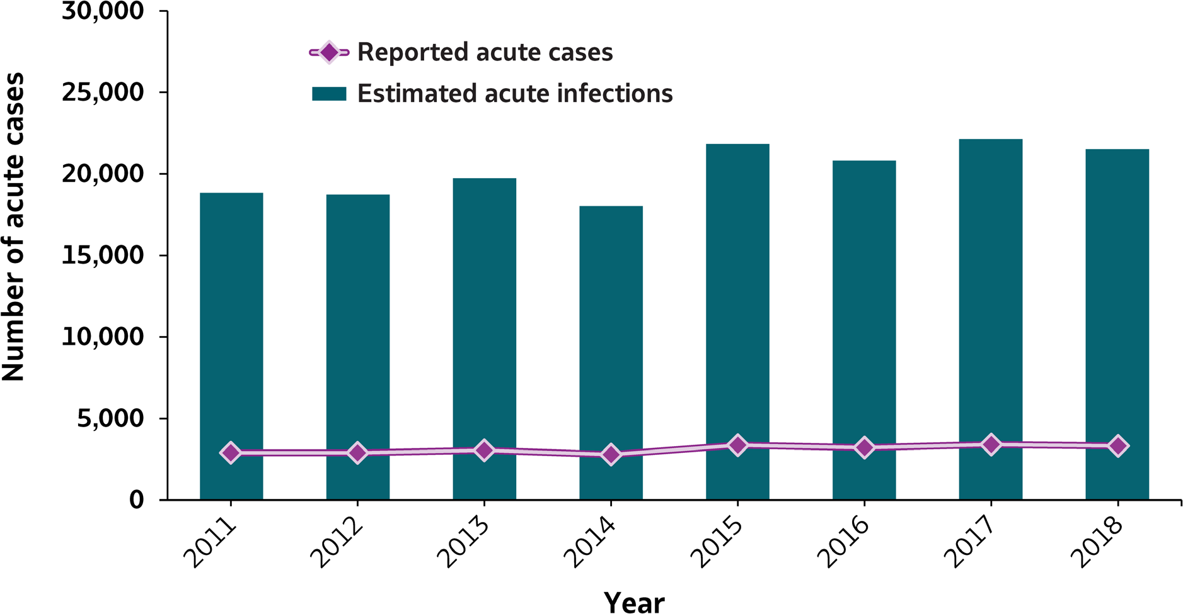
VIRAL HEPATITIS
SURVEILLANCE
Figure 2.1. Number of reported acute hepatitis B cases and estimated infections* — United States, 2011–2018
Source: CDC, National Notifiable Diseases Surveillance System
* The number of estimated viral hepatitis infections was determined by multiplying the number of reported cases by a factor that adjusted for under-ascertainment and under-reporting⁽⁷⁾. The 95% bootstrap confidence intervals for the estimated number of infections are shown in the Appendix.

Slide 18
VIRAL HEPATITIS
SURVEILLANCE
Figure 2.1. Number of reported acute hepatitis B cases and estimated infections* — United States, 2011–2018
Hepatitis B | 2011 | 2012 | 2013 | 2014 | 2015 | 2016 | 2017 | 2018
Reported cases | 2,903 | 2,895 | 3,050 | 2,791 | 3,370 | 3,218 | 3,409 | 3,322
Estimated cases | 18,900 | 18,800 | 19,800 | 18,100 | 21,900 | 20,900 | 22,200 | 21,600
Source: CDC, National Notifiable Diseases Surveillance System
* The number of estimated viral hepatitis infections was determined by multiplying the number of reported cases by a factor that adjusted for under-ascertainment and under-reporting⁽¹⁰⁾. The 95% bootstrap confidence intervals for the estimated number of infections are shown in the Appendix.

Slide 19
VIRAL HEPATITIS SURVEILLANCE
Table 2.1. Number and rate* of reported cases†of acute hepatitis B, by state or jurisdiction — United States, 2014–2018
State | 2014 |  | 2015 |  | 2016 |  | 2017 |  | 2018
 | No. | Rate* | No. | Rate* | No. | Rate* | No. | Rate* | No. | Rate*
Alabama | 117 | 2.4 | 101 | 2.1 | 59 | 1.2 | 82 | 1.7 | 48 | 1.0
Alaska | 3 | 0.4 | 3 | 0.4 | 6 | 0.8 | 9 | 1.2 | 7 | 0.9
Arizona | 31 | 0.5 | 25 | 0.4 | 14 | 0.2 | 26 | 0.4 | 23 | 0.3
Arkansas | 28 | 0.9 | 36 | 1.2 | 49 | 1.6 | 46 | 1.5 | 47 | 1.6
California | 110 | 0.3 | 160 | 0.4 | 115 | 0.3 | 126 | 0.3 | 105 | 0.3
Colorado | 29 | 0.5 | 28 | 0.5 | 28 | 0.5 | 32 | 0.6 | 21 | 0.4
Connecticut | 9 | 0.3 | 6 | 0.2 | 7 | 0.2 | 10 | 0.3 | 10 | 0.3
Delaware | 8 | 0.9 | 8 | 0.8 | 3 | 0.3 | 9 | 0.9 | 7 | 0.7
District of Columbia | U | U | U | U | U | U | U | U | U | U
Florida | 313 | 1.6 | 432 | 2.1 | 558 | 2.7 | 588 | 2.8 | 617 | 2.9
Georgia | 103 | 1.0 | 119 | 1.2 | 100 | 1.0 | 106 | 1.0 | 179 | 1.7
Hawaii | 6 | 0.4 | 14 | 1.0 | — | — | — | — | 3 | 0.2
Idaho | 6 | 0.4 | 8 | 0.5 | 6 | 0.4 | 6 | 0.3 | 6 | 0.3
Illinois | 58 | 0.5 | 55 | 0.4 | 37 | 0.3 | 27 | 0.2 | 25 | 0.2
Indiana | 126 | 1.9 | 133 | 2.0 | 146 | 2.2 | 170 | 2.5 | 169 | 2.5
Iowa | 9 | 0.3 | 16 | 0.5 | 10 | 0.3 | 12 | 0.4 | 14 | 0.4
Kansas | 11 | 0.4 | 19 | 0.7 | 21 | 0.7 | 24 | 0.8 | 16 | 0.5
Kentucky | 164 | 3.7 | 162 | 3.7 | 222 | 5.0 | 236 | 5.3 | 260 | 5.8
Louisiana | 87 | 1.9 | 87 | 1.9 | 48 | 1.0 | 73 | 1.6 | 57 | 1.2
Maine | 12 | 0.9 | 9 | 0.7 | 53 | 4.0 | 77 | 5.8 | 52 | 3.9
Maryland | 40 | 0.7 | 40 | 0.7 | 27 | 0.4 | 34 | 0.6 | 53 | 0.9
Massachusetts | 30 | 0.4 | 25 | 0.4 | 31 | 0.5 | 51 | 0.7 | 46 | 0.7
Michigan | 50 | 0.5 | 56 | 0.6 | 45 | 0.5 | 61 | 0.6 | 77 | 0.8
Minnesota | 16 | 0.3 | 19 | 0.3 | 21 | 0.4 | 23 | 0.4 | 16 | 0.3
Mississippi | 48 | 1.6 | 50 | 1.7 | 31 | 1.0 | 44 | 1.5 | 40 | 1.3
Missouri | 31 | 0.5 | 35 | 0.6 | 40 | 0.7 | 31 | 0.5 | 18 | 0.3
Montana | — | — | 4 | 0.4 | 1 | 0.1 | 3 | 0.3 | 1 | 0.1
Nebraska | 8 | 0.4 | 3 | 0.2 | 8 | 0.4 | 10 | 0.5 | 3 | 0.2
Nevada | 21 | 0.7 | 25 | 0.9 | 22 | 0.7 | 30 | 1.0 | 23 | 0.8
New Hampshire | 4 | 0.3 | — | — | — | — | — | — | 4 | 0.3
New Jersey | 77 | 0.9 | 85 | 0.9 | 59 | 0.7 | 57 | 0.6 | 64 | 0.7
New Mexico | 2 | 0.1 | 2 | 0.1 | 1 | 0.0 | 1 | 0.0 | 2 | 0.1
New York | 95 | 0.5 | 80 | 0.4 | 103 | 0.5 | 81 | 0.4 | 56 | 0.3
North Carolina | 100 | 1.0 | 165 | 1.6 | 170 | 1.7 | 190 | 1.8 | 220 | 2.1
North Dakota | — | — | 2 | 0.3 | 2 | 0.3 | — | — | 2 | 0.3
Ohio | 171 | 1.5 | 409 | 3.5 | 299 | 2.6 | 285 | 2.4 | 310 | 2.7
Oklahoma | 57 | 1.5 | 37 | 0.9 | 32 | 0.8 | 41 | 1.0 | 6 | 0.2
Oregon | 32 | 0.8 | 24 | 0.6 | 20 | 0.5 | 23 | 0.6 | 18 | 0.4
Pennsylvania | 68 | 0.5 | 61 | 0.5 | 43 | 0.3 | 69 | 0.5 | 61 | 0.5
Rhode Island | U | U | U | U | U | U | U | U | U | U
South Carolina | 37 | 0.8 | 30 | 0.6 | 34 | 0.7 | 40 | 0.8 | 45 | 0.9
South Dakota | 3 | 0.4 | 2 | 0.2 | 2 | 0.2 | 2 | 0.2 | 1 | 0.1
Tennessee | 232 | 3.5 | 243 | 3.7 | 204 | 3.1 | 215 | 3.2 | 192 | 2.8
Texas | 122 | 0.5 | 159 | 0.6 | 156 | 0.6 | 106 | 0.4 | 102 | 0.4
Utah | 11 | 0.4 | 10 | 0.3 | 5 | 0.2 | 18 | 0.6 | 36 | 1.1
Vermont | 4 | 0.6 | 3 | 0.5 | 2 | 0.3 | 1 | 0.2 | 3 | 0.5
Virginia | 61 | 0.7 | 69 | 0.8 | 56 | 0.7 | 61 | 0.7 | 58 | 0.7
Washington | 44 | 0.6 | 34 | 0.5 | 45 | 0.6 | 45 | 0.6 | 51 | 0.7
West Virginia | 186 | 10.1 | 272 | 14.7 | 268 | 14.6 | 212 | 11.7 | 132 | 7.3
Wisconsin | 11 | 0.2 | 5 | 0.1 | 9 | 0.2 | 14 | 0.2 | 14 | 0.2
Wyoming | U | U | U | U | U | U | 2 | 0.3 | 2 | 0.3
Total | 2,791 | 0.9 | 3,370 | 1.1 | 3,218 | 1.0 | 3,409 | 1.1 | 3,322 | 1.0
Source: CDC, National Notifiable Diseases Surveillance System.
* Rate per 100,000
population.
†For case definition see https:// wwwn.cdc.gov/nndss/conditions/ hepatitis-b-acute/case- definition/2012/.
—: No reported cases. N: Not reportable. The disease or The reporting jurisdiction condition was not reportable by did not submit any cases law, statue, or regulation in the to CDC. reporting jurisdiction.
U: Unavailable. The data are unavailable.

Slide 20
VIRAL HEPATITIS SURVEILLANCE
Figure 2.2. Rates of reported acute hepatitis B, by state* — United States, 2017–2018
US Average (2018): 1 .0
Source: CDC, National Notifiable Diseases Surveillance System.
* Excludes District of Columbia and Rhode Island

Slide 21
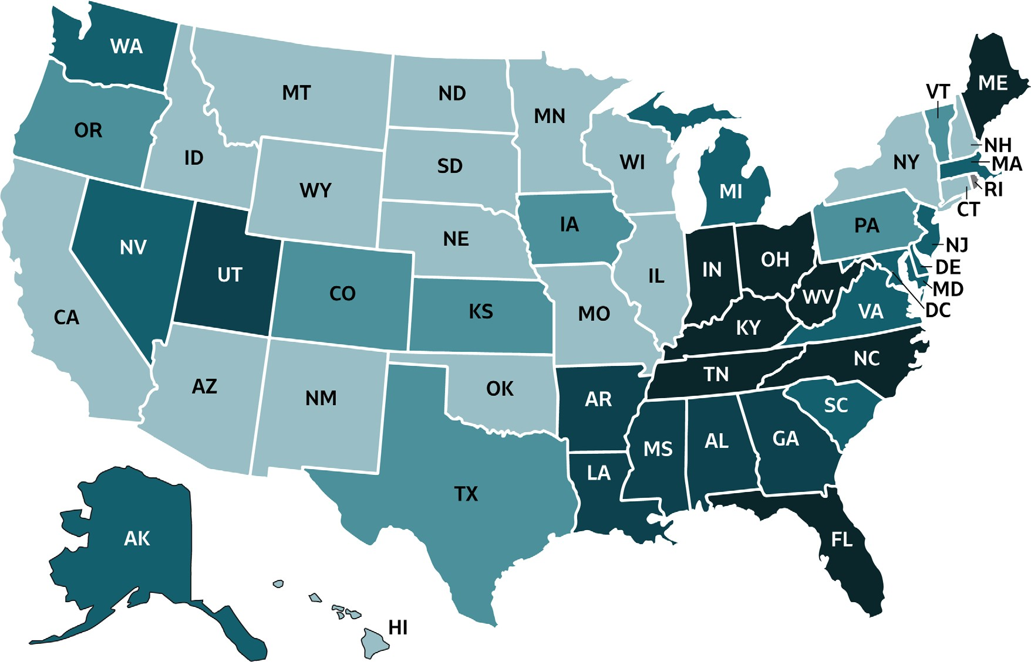
VIRAL HEPATITIS
SURVEILLANCE
Figure 2.3. Rates of reported acute hepatitis B, by state or jurisdiction — United States, 2018
Source: CDC, National Notifiable Diseases Surveillance System.

Slide 22
VIRAL HEPATITIS
SURVEILLANCE
Figure 2.3. Rates of reported hepatitis B, by state or jurisdiction — United States, 2018
Color Key | Cases/100,000 Population | States
 | 0-0.3 | AZ, CA, CT, HI, ID, IL, MN, MO, MT, NE, NH, NM, NY, ND, OK, SD, WI, WY
 | >0.3-0.6 | CO, IA, KS, OR, PA, TX, VT
 | >0.6-0.9 | AK, DE, MD, MA, MI, NV, NJ, SC, VA, WA
 | >0.9-2.0 | AL, AR, GA, LA, MS, UT
 | >2.0-7.3 | FL, IN, KY, ME, NC, OH, TN, WV
 | Data Not Available | DC, RI
Source: CDC, National Notifiable Diseases Surveillance System.

Slide 23
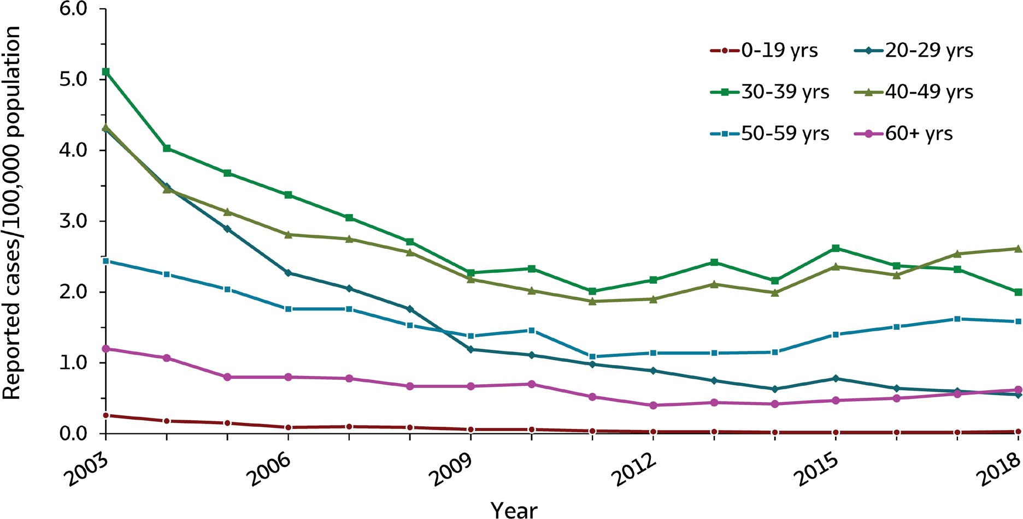
VIRAL HEPATITIS
SURVEILLANCE
Figure 2.4. Rates of reported acute hepatitis B, by age group — United States, 2003–2018
Source: CDC, National Notifiable Diseases Surveillance System.

Slide 24
VIRAL HEPATITIS
SURVEILLANCE
Figure 2.4. Rates of reported acute hepatitis B, by age group — United States, 2003–2018
Age (years) | 2003 | 2004 | 2005 | 2006 | 2007 | 2008 | 2009 | 2010 | 2011 | 2012 | 2013 | 2014 | 2015 | 2016 | 2017 | 2018
0-19 | 0.3 | 0.2 | 0.2 | 0.1 | 0.1 | 0.1 | 0.1 | 0.1 | 0.0 | 0.0 | 0.0 | 0.0 | 0.0 | 0.0 | 0.0 | 0.0
20-29 | 4.3 | 3.5 | 2.9 | 2.3 | 2.1 | 1.8 | 1.2 | 1.1 | 1.0 | 0.9 | 0.8 | 0.6 | 0.8 | 0.6 | 0.6 | 0.6
30-39 | 5.1 | 4.0 | 3.7 | 3.4 | 3.1 | 2.7 | 2.3 | 2.3 | 2.0 | 2.2 | 2.4 | 2.2 | 2.6 | 2.4 | 2.3 | 2.0
40-49 | 4.3 | 3.5 | 3.1 | 2.8 | 2.8 | 2.6 | 2.2 | 2.0 | 1.9 | 1.9 | 2.1 | 2.0 | 2.4 | 2.2 | 2.5 | 2.6
50-59 | 2.4 | 2.3 | 2.0 | 1.8 | 1.8 | 1.5 | 1.4 | 1.5 | 1.1 | 1.1 | 1.1 | 1.2 | 1.4 | 1.5 | 1.6 | 1.6
60+ | 1.2 | 1.1 | 0.8 | 0.8 | 0.8 | 0.7 | 0.7 | 0.7 | 0.5 | 0.4 | 0.4 | 0.4 | 0.5 | 0.5 | 0.6 | 0.6
Source: CDC, National Notifiable Diseases Surveillance System.

Slide 25
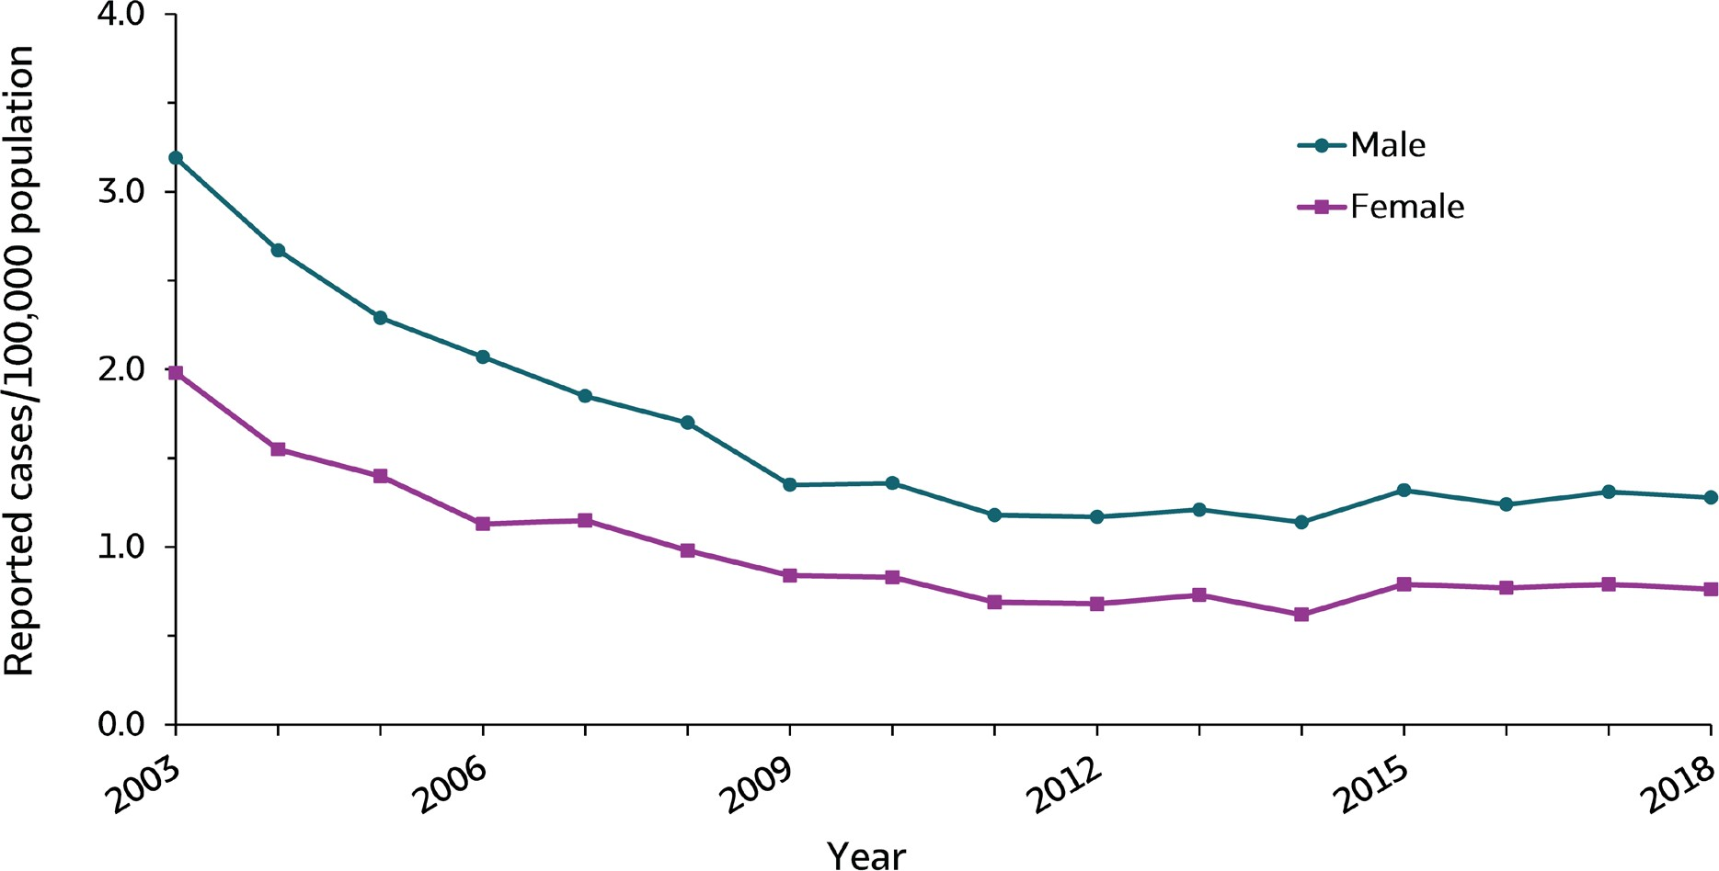
VIRAL HEPATITIS
SURVEILLANCE
Figure 2.5. Rates of reported acute hepatitis B, by sex — United States, 2003–2018
Source: CDC, National Notifiable Diseases Surveillance System.
27

Slide 26
VIRAL HEPATITIS
SURVEILLANCE
Figure 2.5. Rates of reported acute hepatitis B, by sex — United States, 2003–2018
Sex | 2003 | 2004 | 2005 | 2006 | 2007 | 2008 | 2009 | 2010 | 2011 | 2012 | 2013 | 2014 | 2015 | 2016 | 2017 | 2018
Male | 3.2 | 2.7 | 2.3 | 2.1 | 1.9 | 1.7 | 1.4 | 1.4 | 1.2 | 1.2 | 1.2 | 1.1 | 1.3 | 1.2 | 1.3 | 1.3
Female | 2.0 | 1.6 | 1.4 | 1.1 | 1.2 | 1.0 | 0.8 | 0.8 | 0.7 | 0.7 | 0.7 | 0.6 | 0.8 | 0.8 | 0.8 | 0.8
Source: CDC, National Notifiable Diseases Surveillance System.
27

Slide 27
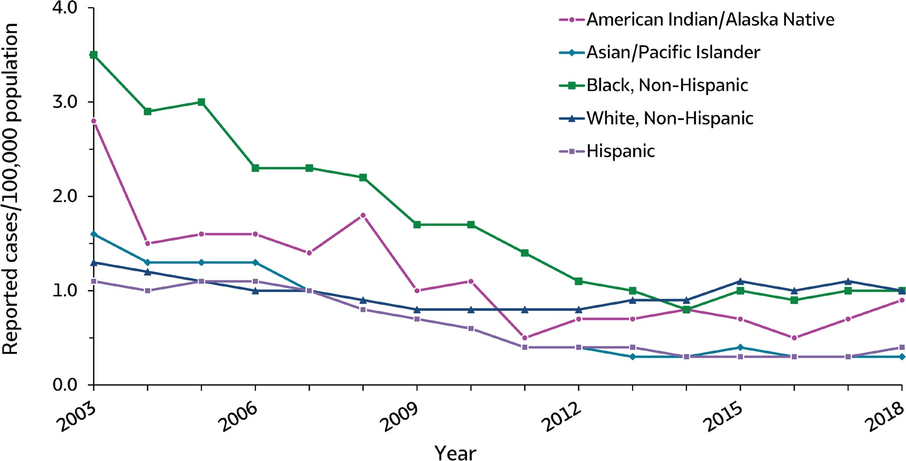
VIRAL HEPATITIS
SURVEILLANCE
Figure 2.6. Rates of reported acute hepatitis B, by race/ethnicity — United States, 2003–2018
Source: CDC, National Notifiable Diseases Surveillance System.

Slide 28
VIRAL HEPATITIS
SURVEILLANCE
Figure 2.6. Rates of reported acute hepatitis B, by race/ethnicity — United States, 2003–2018
Race/ Ethnicity | 2003 | 2004 | 2005 | 2006 | 2007 | 2008 | 2009 | 2010 | 2011 | 2012 | 2013 | 2014 | 2015 | 2016 | 2017 | 2018
American Indian/ Alaska Native | 2.8 | 1.5 | 1.6 | 1.6 | 1.4 | 1.8 | 1.0 | 1.1 | 0.5 | 0.7 | 0.7 | 0.8 | 0.7 | 0.5 | 0.7 | 0.9
Asian/Pacific Islander | 1.6 | 1.3 | 1.3 | 1.3 | 1.0 | 0.8 | 0.7 | 0.6 | 0.4 | 0.4 | 0.3 | 0.3 | 0.4 | 0.3 | 0.3 | 0.3
Black, Non-Hispanic | 3.5 | 2.9 | 3.0 | 2.3 | 2.3 | 2.2 | 1.7 | 1.7 | 1.4 | 1.1 | 1.0 | 0.8 | 1.0 | 0.9 | 1.0 | 1.0
White, Non-Hispanic | 1.3 | 1.2 | 1.1 | 1.0 | 1.0 | 0.9 | 0.8 | 0.8 | 0.8 | 0.8 | 0.9 | 0.9 | 1.1 | 1.0 | 1.1 | 1.0
Hispanic | 1.1 | 1.0 | 1.1 | 1.1 | 1.0 | 0.8 | 0.7 | 0.6 | 0.4 | 0.4 | 0.4 | 0.3 | 0.3 | 0.3 | 0.3 | 0.4
Source: CDC, National Notifiable Diseases Surveillance System.

Slide 29
VIRAL HEPATITIS SURVEILLANCE
Table 2.2. Number and rate* of reported cases† of acute hepatitis B, by demographic characteristics, region — United States 2014–2018
Demographic characteristic | 2014 |  | 2015 |  | 2016 |  | 2017 |  | 2018
 | No. | Rate* | No. | Rate* | No. | Rate* | No. | Rate* | No. | Rate*
Total§ | 2,791 | 0.9 | 3,370 | 1.1 | 3,218 | 1.1 | 3,409 | 1.1 | 3,322 | 1.0
Age group (years)
0–19 | 14 | 0.0 | 19 | 0.0 | 18 | 0.0 | 16 | 0.0 | 27 | 0.0
20–29 | 282 | 0.6 | 348 | 0.8 | 286 | 0.6 | 271 | 0.6 | 249 | 0.6
30–39 | 888 | 2.2 | 1,094 | 2.6 | 1,000 | 2.4 | 998 | 2.3 | 868 | 2.0
40–49 | 818 | 2.0 | 961 | 2.4 | 906 | 2.2 | 1,028 | 2.5 | 1,052 | 2.6
50–59 | 504 | 1.2 | 615 | 1.4 | 655 | 1.5 | 700 | 1.6 | 675 | 1.6
60+ | 272 | 0.4 | 312 | 0.5 | 342 | 0.5 | 395 | 0.6 | 450 | 0.6
Sex
Male | 1,778 | 1.1 | 2,080 | 1.3 | 1,957 | 1.2 | 2,095 | 1.3 | 2,050 | 1.3
Female | 1,001 | 0.6 | 1,280 | 0.8 | 1,252 | 0.8 | 1,301 | 0.8 | 1,260 | 0.8
Race/ethnicity
American Indian/ Alaskan Native | 21 | 0.8 | 18 | 0.7 | 14 | 0.5 | 19 | 0.7 | 25 | 0.9
Asian/Pacific Islander | 53 | 0.3 | 67 | 0.4 | 56 | 0.3 | 64 | 0.3 | 55 | 0.3
Black, Non-Hispanic | 343 | 0.8 | 398 | 1.0 | 386 | 0.9 | 411 | 1.0 | 405 | 1.0
White, Non-Hispanic | 1,713 | 0.9 | 2,150 | 1.1 | 2,059 | 1.0 | 2,197 | 1.1 | 2,084 | 1.0
Hispanic | 158 | 0.3 | 175 | 0.3 | 194 | 0.3 | 196 | 0.3 | 222 | 0.4
HHS Region¶
Region 1 | 59 | 0.4 | 43 | 0.3 | 93 | 0.7 | 139 | 1.0 | 115 | 0.8
Region 2 | 172 | 0.6 | 165 | 0.6 | 162 | 0.6 | 138 | 0.5 | 120 | 0.4
Region 3 | 363 | 1.2 | 450 | 1.5 | 397 | 1.3 | 385 | 1.3 | 311 | 1.0
Region 4 | 1,114 | 1.8 | 1,302 | 2.0 | 1,378 | 2.1 | 1,501 | 2.3 | 1,601 | 2.4
Region 5 | 432 | 0.8 | 677 | 1.3 | 557 | 1.1 | 580 | 1.1 | 611 | 1.2
Region 6 | 296 | 0.7 | 321 | 0.8 | 286 | 0.7 | 267 | 0.6 | 214 | 0.5
Region 7 | 59 | 0.4 | 73 | 0.5 | 79 | 0.6 | 77 | 0.5 | 51 | 0.4
Region 8 | 43 | 0.4 | 46 | 0.4 | 38 | 0.3 | 57 | 0.5 | 63 | 0.5
Region 9 | 168 | 0.3 | 224 | 0.4 | 151 | 0.3 | 182 | 0.4 | 154 | 0.3
Region 10 | 85 | 0.6 | 69 | 0.5 | 77 | 0.6 | 83 | 0.6 | 82 | 0.6
Source: CDC, National Notifiable Diseases Surveillance System.
* Rate per 100,000 population.
† For the case definition, see https://wwwn.cdc.gov/nndss/conditions/hepatitis-b-acute/
§ Numbers reported in each category may not add up to the total number of reported cases in a year due to cases with missing data or, in the case of race/ethnicity, cases categorized as “Other”.
¶ Health and Human Services Regions were categorized according to the grouping of states and U.S. Territories assigned under each of the ten Department of Health and Human Services regional offices (https://www.hhs.gov/about/agencies/iea/regional-offices/index.html). For the purposes of this report, regions with US territories (Region 2 and Region 9) contain data from states only.

Slide 30
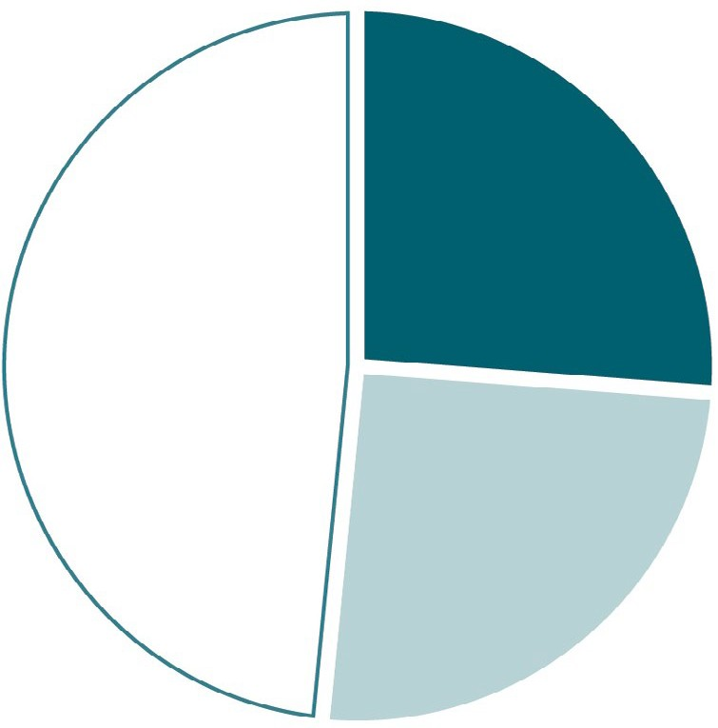
VIRAL HEPATITIS
SURVEILLANCE
Figure 2.7. Availability of information on risk behaviors/exposures* associated with reported cases of acute hepatitis B — United States, 2018
870
(26%)
1,609
(48%)
Risk identified*
No risk identified Risk data missing
843
(25%)
Source: CDC, Nationally Notifiable Diseases Surveillance System.
* Case reports with at least one of the following risk behaviors/ exposures reported 6 weeks to 6 months prior to symptom onset: 1) injection drug use; 2) multiple sex partners; 3) underwent surgery; 4) men who have sex with men; 5) sexual contact with suspected/confirmed hepatitis B case; 6) sustained a percutaneous injury; 7) household contact with suspected/confirmed hepatitis B case; 8) occupational exposure to blood; 9) dialysis; and 10) transfusion.

Slide 31
VIRAL HEPATITIS
SURVEILLANCE
Table 2.3. Reported risk behaviors/exposures† among reported cases of acute hepatitis B — United States, 2018
Risk behaviors/exposures | Risk identified* | No risk identified | Risk data missing
Injection drug use | 549 | 969 | 1,804
Multiple sex partners | 199 | 671 | 2,452
Surgery | 117 | 962 | 2,243
Men who have sex with men § | 49 | 353 | 1,648
Sexual Contact ¶ | 42 | 603 | 2,677
Needlestick | 71 | 959 | 2,292
Household contact (non-sexual) § | 12 | 633 | 2,677
Occupational | 4 | 1,369 | 1,949
Dialysis patient | 13 | 1,022 | 2,287
Transfusion | 1 | 1,103 | 2,218
Source: CDC, Nationally Notifiable Diseases Surveillance System.
* Case reports with at least one of the following risk behaviors/ exposures reported 6 weeks to 6 months prior to symptom onset: 1) injection drug use;
2) multiple sex partners; 3) underwent surgery; 4) men who have sex with men; 5) sexual contact with suspected/confirmed hepatitis B case; 6) sustained a percutaneous injury; 7) household contact with suspected/confirmed hepatitis B case; 8) occupational exposure to blood; 9) dialysis; and 10) transfusion.
† Reported cases may include more than one risk behavior/exposure.
§ A total of 2,050 acute hepatitis B cases were reported among males in 2018.
¶ Cases with more than one type of contact reported were categorized according to a hierarchy: (1) sexual contact; (2) household contact (non-sexual).

Slide 32
VIRAL HEPATITIS SURVEILLANCE
Table 2.4. Number of newly reported cases* of perinatal hepatitis B, by state or jurisdiction — United States, 2018
State | Perinatal Hepatitis B
Alabama | —
Alaska | 1
Arizona | 1
Arkansas | —
California | 4
Colorado | —
Connecticut | —
Delaware | —
District of Columbia | U
Florida | 2
Georgia | 1
Hawaii | —
Idaho | —
Illinois | —
Indiana | —
Iowa | —
Kansas | —
Kentucky | 1
Louisiana | —
Maine | —
Maryland | —
Massachusetts | —
Michigan | 1
Minnesota | —
Mississippi | —
Missouri | —
Montana | —
Nebraska | —
Nevada | —
New Hampshire | —
New Jersey | —
New Mexico | —
New York | 4
North Carolina | —
North Dakota | —
Ohio | 1
Oklahoma | 1
Oregon | —
Pennsylvania | 3
Rhode Island | U
South Carolina | —
South Dakota | —
Tennessee | 1
Texas | 1
Utah | —
Vermont | —
Virginia | —
Washington | 1
West Virginia | —
Wisconsin | —
Wyoming | —
Total | 23
Source: CDC, National Notifiable Diseases Surveillance System.
* For case definition, see https:// wwwn.cdc.gov/nndss/conditions/ hepatitis-b-perinatal-virus-infection/
—: No reported cases. The reporting jurisdiction did not submit any cases to CDC.
N: Not reportable. The disease or condition U: Unavailable.
was not reportable by law, statue, or regulation in the reporting jurisdiction.
The data are unavailable.

Slide 33
VIRAL HEPATITIS SURVEILLANCE
Table 2.5. Number of newly reported cases* of chronic hepatitis B, by state or jurisdiction — United States, 2018
State | Chronic Hepatitis B
Alabama | N
Alaska | 30
Arizona | 180
Arkansas | N
California | —
Colorado | 186
Connecticut | N
Delaware | 140
District of Columbia | U
Florida | 2,090
Georgia | 1,421
Hawaii | U
Idaho | 72
Illinois | 545
Indiana | 342
Iowa | 54
Kansas | 41
Kentucky | N
Louisiana | 274
Maine | 70
Maryland | 690
Massachusetts | 308
Michigan | 329
Minnesota | 305
Mississippi | N
Missouri | 450
Montana | 15
Nebraska | 51
Nevada | U
New Hampshire | U
New Jersey | 407
New Mexico | 28
New York | 1,806
North Carolina | 509
North Dakota | 41
Ohio | 683
Oklahoma | 53
Oregon | 96
Pennsylvania | 834
Rhode Island | U
South Carolina | 184
South Dakota | 21
Tennessee | 644
Texas | N
Utah | 95
Vermont | 13
Virginia | 446
Washington | 391
West Virginia | 304
Wisconsin | 42
Wyoming | 17
Total | 14,207
Source: CDC, National Notifiable Diseases Surveillance System.
* For case definition, see https://wwwn.cdc.gov/nndss/ conditions/hepatitis-b-chronic/
—: No reported cases. The reporting jurisdiction did not submit any cases to CDC.
N: Not reportable. The disease or condition
was not reportable by law, statue, or regulation in the reporting jurisdiction.
U: Unavailable. The data are unavailable.

Slide 34
VIRAL HEPATITIS SURVEILLANCE
Table 2.6. Number and rate* of deaths with hepatitis B listed as a cause of death† among U.S. residents, by jurisdiction and year — United States, 2014–2018
State | 2014 |  | 2015 |  | 2016 |  | 2017 |  | 2018
 | No. | Rate* | No. | Rate* | No. | Rate* | No. | Rate* | No. | Rate*
Alabama | 20 | 0.37 | 15 | UR§ | 19 | UR§ | 19 | UR§ | 19 | UR§
Alaska | _{S}¶ | UR§ | _{S}¶ | UR§ | _{S}¶ | UR§ | _{S}¶ | UR§ | _{S}¶ | UR§
Arizona | 38 | 0.48 | 30 | 0.36 | 29 | 0.34 | 19 | UR§ | 31 | 0.34
Arkansas | 18 | UR§ | 12 | UR§ | 10 | UR§ | 22 | 0.60 | 17 | UR§
California | 406 | 0.96 | 355 | 0.82 | 337 | 0.78 | 346 | 0.80 | 304 | 0.67
Colorado | 23 | 0.38 | 23 | 0.40 | 23 | 0.39 | 32 | 0.51 | 26 | 0.39
Connecticut | 14 | UR§ | 17 | UR§ | _{S}¶ | UR§ | _{S}¶ | UR§ | 13 | UR§
Delaware | _{S}¶ | UR§ | _{S}¶ | UR§ | _{S}¶ | UR§ | _{S}¶ | UR§ | _{S}¶ | UR§
District of Columbia | 15 | UR§ | _{S}¶ | UR§ | 11 | UR§ | 12 | UR§ | _{S}¶ | UR§
Florida | 105 | 0.40 | 108 | 0.40 | 98 | 0.36 | 129 | 0.45 | 109 | 0.41
Georgia | 51 | 0.47 | 43 | 0.37 | 35 | 0.30 | 34 | 0.28 | 40 | 0.35
Hawaii | 25 | 1.47 | 13 | UR§ | 26 | 1.50 | 15 | UR§ | 14 | UR§
Idaho | _{S}¶ | UR§ | _{S}¶ | UR§ | _{S}¶ | UR§ | _{S}¶ | UR§ | _{S}¶ | UR§
Illinois | 31 | 0.21 | 30 | 0.21 | 40 | 0.28 | 30 | 0.19 | 31 | 0.20
Indiana | 26 | 0.35 | 21 | 0.27 | 26 | 0.32 | 29 | 0.34 | 16 | UR§
Iowa | 12 | UR§ | _{S}¶ | UR§ | 16 | UR§ | 15 | UR§ | 19 | UR§
Kansas | _{S}¶ | UR§ | _{S}¶ | UR§ | 15 | UR§ | 11 | UR§ | 12 | UR§
Kentucky | 30 | 0.66 | 26 | 0.54 | 36 | 0.72 | 35 | 0.75 | 47 | 0.98
Louisiana | 49 | 0.88 | 36 | 0.63 | 26 | 0.49 | 30 | 0.53 | 36 | 0.60
Maine | _{S}¶ | UR§ | _{S}¶ | UR§ | _{S}¶ | UR§ | _{S}¶ | UR§ | _{S}¶ | UR§
Maryland | 29 | 0.44 | 25 | 0.38 | 31 | 0.43 | 31 | 0.43 | 37 | 0.52
Massachusetts | 38 | 0.47 | 46 | 0.54 | 32 | 0.37 | 36 | 0.47 | 28 | 0.36
Michigan | 33 | 0.27 | 35 | 0.29 | 27 | 0.18 | 28 | 0.22 | 33 | 0.25
Minnesota | 18 | UR§ | 31 | 0.45 | 25 | 0.42 | 21 | 0.30 | 33 | 0.51
Mississippi | 23 | 0.65 | 20 | 0.61 | 22 | 0.64 | 23 | 0.67 | 20 | 0.61
Missouri | 18 | UR§ | 20 | 0.25 | 13 | UR§ | 19 | UR§ | 24 | 0.31
Montana | _{S}¶ | UR§ | _{S}¶ | UR§ | _{S}¶ | UR§ | _{S}¶ | UR§ | _{S}¶ | UR¶
Nebraska | _{S}¶ | UR§ | _{S}¶ | UR§ | _{S}¶ | UR§ | _{S}¶ | UR§ | 10 | UR§
Nevada | 10 | UR§ | 18 | UR§ | 23 | 0.66 | 13 | UR§ | 20 | 0.51
New Hampshire | _{S}¶ | UR§ | _{S}¶ | UR§ | _{S}¶ | UR§ | _{S}¶ | UR§ | _{S}¶ | UR¶
New Jersey | 49 | 0.44 | 48 | 0.45 | 39 | 0.34 | 43 | 0.43 | 41 | 0.39
New Mexico | 11 | UR§ | _{S}¶ | UR§ | _{S}¶ | UR§ | _{S}¶ | UR§ | _{S}¶ | UR¶
New York | 147 | 0.64 | 115 | 0.50 | 138 | 0.60 | 123 | 0.50 | 115 | 0.47
North Carolina | 34 | 0.29 | 40 | 0.34 | 42 | 0.37 | 36 | 0.29 | 35 | 0.27
North Dakota | _{S}¶ | UR§ | _{S}¶ | UR§ | _{S}¶ | UR§ | _{S}¶ | UR§ | _{S}¶ | UR§
Ohio | 58 | 0.41 | 58 | 0.44 | 44 | 0.34 | 55 | 0.42 | 42 | 0.32
Oklahoma | 31 | 0.71 | 34 | 0.77 | 43 | 0.95 | 40 | 0.95 | 54 | 1.16
Oregon | 28 | 0.59 | 35 | 0.67 | 27 | 0.54 | 29 | 0.52 | 23 | 0.45
Pennsylvania | 46 | 0.29 | 44 | 0.27 | 41 | 0.25 | 35 | 0.20 | 34 | 0.22
Rhode Island | _{S}¶ | _{S}¶ | _{S}¶ | UR§ | _{S}¶ | UR§ | _{S}¶ | UR§ | 11 | UR§
South Carolina | 30 | 0.54 | 22 | 0.35 | 38 | 0.60 | 26 | 0.39 | 26 | 0.42
South Dakota | _{S}¶ | UR§ | _{S}¶ | UR§ | _{S}¶ | UR§ | _{S}¶ | UR§ | _{S}¶ | UR§
Tennessee | 54 | 0.68 | 54 | 0.70 | 55 | 0.71 | 63 | 0.83 | 50 | 0.61
Texas | 140 | 0.49 | 130 | 0.43 | 149 | 0.51 | 150 | 0.51 | 119 | 0.40
Utah | _{S}¶ | UR§ | 10 | UR§ | _{S}¶ | UR§ | 11 | UR§ | _{S}¶ | UR§
Vermont | _{S}¶ | UR§ | _{S}¶ | UR§ | _{S}¶ | UR§ | _{S}¶ | UR§ | _{S}¶ | UR§
Virginia | 23 | 0.23 | 25 | 0.26 | 23 | 0.24 | 29 | 0.30 | 28 | 0.28
Washington | 56 | 0.66 | 48 | 0.53 | 47 | 0.55 | 47 | 0.56 | 53 | 0.57
West Virginia | 16 | UR§ | 21 | 0.89 | 11 | UR§ | 14 | UR§ | 23 | 1.26
Wisconsin | 16 | UR§ | 18 | UR§ | 19 | UR§ | 21 | 0.31 | 19 | UR§
Wyoming | _{S}¶ | UR§ | _{S}¶ | UR§ | _{S}¶ | UR§ | _{S}¶ | UR§ | _{S}¶ | UR§
Total | 1,837 | 0.50 | 1,707 | 0.46 | 1,690 | 0.45 | 1,727 | 0.46 | 1,649 | 0.43
Source: CDC, National Center for Health Statistics, Multiple Cause of Death 1999–2018 on CDC WONDER Online Database. Data are from the 2014–2018 Multiple Cause of Death files and are based on information from all death certificates filed in the vital records offices of the fifty states and the District of Columbia through the Vital Statistics Cooperative Program. Deaths of nonresidents (e.g., nonresident aliens, nationals living abroad, residents of Puerto Rico, Guam, the Virgin Islands, and other U.S. Territories) and fetal deaths are excluded. Numbers are slightly lower than previously reported for 2013–2016 due to NCHS standards which restrict displayed data to U.S. residents. Accessed at http://wonder.cdc.gov/mcd-icd10.html on February 14, 2020. CDC WONDER dataset documentation and technical methods can be accessed at https://wonder.cdc.gov/wonder/help/mcd.html#.
* Rates are age-adjusted per 100,000 U.S. standard population in 2000 using the following age group distribution (in years): <1, 1–4, 5–14, 15–24, 25–34, 35–44, 45–54, 55–64, 65–74, 75–84, and 85+. For age-adjusted death rates, the age-specific death rate is rounded to one decimal place before proceeding to the next step in the calculation of age-adjusted death rates for NCHS Multiple Cause of Death on CDC WONDER. This rounding step may affect the precision of rates calculated for small numbers of deaths. Missing data are not included.
† Cause of death is defined as one of the multiple causes of death and is based on the International Classification of Diseases, 10th Revision (ICD-10) codes B16, B17.0, B18.0, B18.1 (hepatitis B). UR§ Unreliable rate: Rates where death counts were less than 20 were not displayed due to the instability associated with those rates.
S¶ Suppressed: Sub-national data representing fewer than ten deaths (0-9) are suppressed or CDC WONDER did not have the functionality to calculate rates.

Slide 35
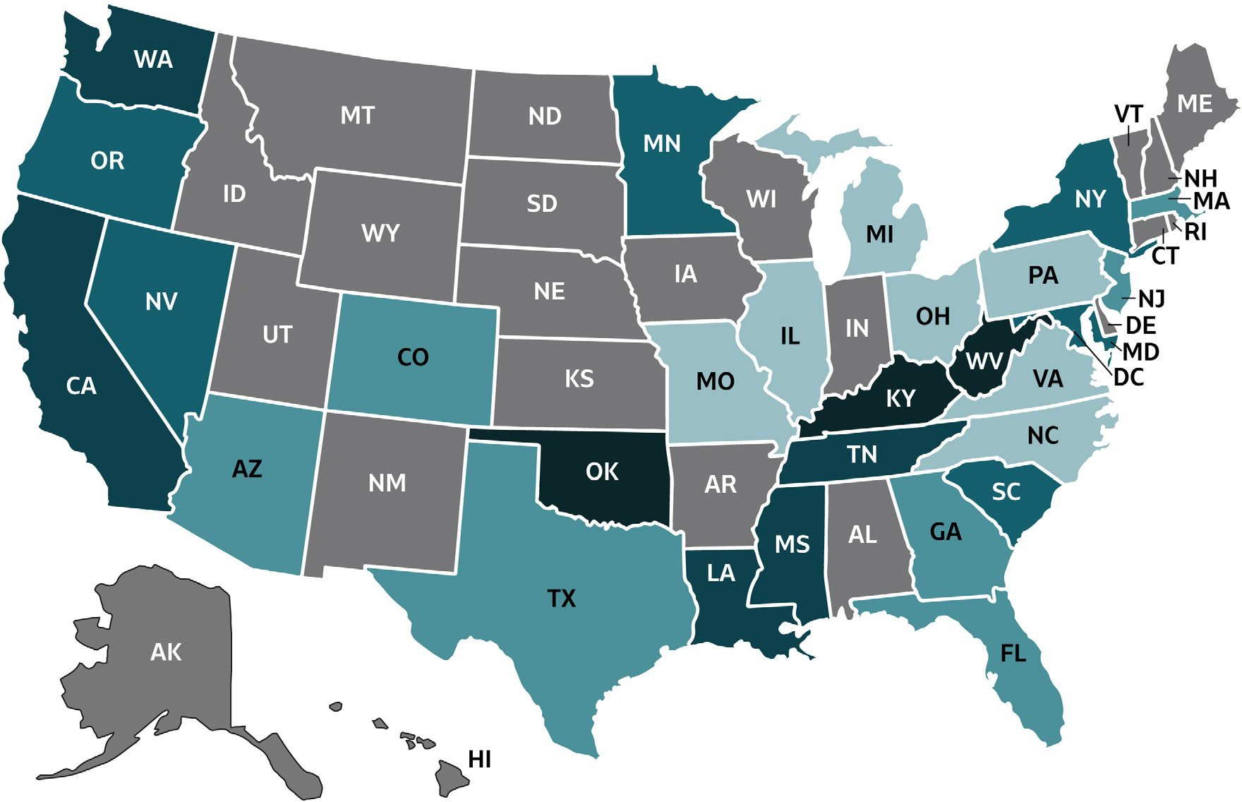
VIRAL HEPATITIS
SURVEILLANCE
Figure 2.8. Rate of deaths with hepatitis B listed as a cause of death among U.S. residents, by jurisdiction and year — United States, 2018
Color Key | Cases/100,000 Population | States
 | 0-0.33 | IL, MI, MO, NC, OH, PA, VA
 | >0.33-0.41 | AZ, CO, FL, GA, MA, NJ, TX
 | >0.41-0.52 | MD, MN, NV, NY, OR, SC
 | >0.52-0.68 | CA, LA, MS, TN, WA
 | >0.68-1.26 | KY, OK, WV
 | Unreliable rate | AL, AK, AR, CT, DE, DC, HI, ID, IN, IA, KS, ME, MT, NE, NH, NM, ND, RI, SD, UT, VT, WI, WY
Source: CDC, National Center for Health Statistics, Multiple Cause of Death 2018 on CDC WONDER Online Database. Unreliable rates where death counts were less than 20 were not displayed due to the instability associated with those rates.

Slide 36
VIRAL HEPATITIS SURVEILLANCE
Table 2.7. Number and rate* of deaths with hepatitis B listed as a cause of death† among U.S. residents, by demographic characteristics, region, and year — United States, 2014–2018
Demographic characteristic | 2014 |  | 2015 |  | 2016 |  | 2017 |  | 2018
 | No. | Rate (95% CI) | No. | Rate (95% CI) | No. | Rate (95% CI) | No. | Rate (95% CI) | No. | Rate (95% CI)
Age group (years)
0–34 | 35 | 0.02 (0.02-0.03) | 30 | 0.02 (0.01- 0.03) | 39 | 0.03 (0.02-0.04) | 29 | 0.02 (0.01-0.03) | 32 | 0.02 (0.01-0.03)
35–44 | 126 | 0.31 (0.26-0.37) | 118 | 0.29 (0.24-0.34) | 116 | 0.29 (0.23-0.34) | 106 | 0.26 (0.21-0.31) | 122 | 0.3 (0.24-0.35)
45–54 | 384 | 0.88 (0.80-0.97) | 330 | 0.76 (0.68-0.85) | 324 | 0.76 (0.67-0.84) | 323 | 0.76 (0.68-0.85) | 283 | 0.68 (0.60-0.76)
55–64 | 682 | 1.7 (1.57-1.83) | 610 | 1.49 (1.37-1.61) | 576 | 1.39 (1.28-1.50) | 548 | 1.3 (1.20-1.41) | 520 | 1.23 (1.12-1.34)
65–74 | 356 | 1.35 (1.21-1.49) | 382 | 1.39 (1.25-1.53) | 383 | 1.34 (1.20-1.47) | 417 | 1.4 (1.27-1.54) | 422 | 1.38 (1.25-1.52)
75+ | 254 | 1.28 (1.12-1.44) | 236 | 1.17 (1.02-1.32) | 252 | 1.22 (1.07-1.37) | 303 | 1.43 (1.27-1.59) | 270 | 1.23 (1.08-1.38)
Race/ethnicity
White, Non-Hispanic | 851 | 0.33 (0.30-0.46) | 805 | 0.28 (0.26-0.30) | 767 | 0.29 (0.27-0.31) | 776 | 0.28 (0.26-0.30) | 760 | 0.27 (0.25-0.29)
Black, Non-Hispanic | 330 | 0.81 (0.72-0.89) | 318 | 0.75 (0.67-0.84) | 315 | 0.73 (0.65-0.81) | 320 | 0.74 (0.66-0.83) | 304 | 0.7 (0.62-0.79)
Hispanic | 156 | 0.4 (0.33-0.46) | 136 | 0.32 (0.27-0.38) | 128 | 0.3 (0.25-0.36) | 109 | 0.26 (0.21-0.32) | 122 | 0.28 (0.23-0.33)
Asian/ Pacific Islander, Non-Hispanic | 475 | 2.69 (2.44-2.93) | 419 | 2.23 (2.01-2.45) | 454 | 2.38 (2.16-2.60) | 492 | 2.45 (2.23-2.67) | 439 | 2.1 (1.90-2.30)
American Indian/ Alaska Native, Non-Hispanic | 10 | UR§ | 13 | UR§ | 16 | UR§ | 17 | UR§ | 6 | UR§
Sex
Male | 1,301 | 0.74 (0.70-0.78) | 1,270 | 0.7 (0.66-0.74) | 1,231 | 0.67 (0.64-0.71) | 1,275 | 0.7 (0.66-0.74) | 1,191 | 0.65 (0.61-0.69)
Female | 536 | 0.27 (0.24-0.29) | 437 | 0.21 (0.19-0.23) | 459 | 0.22 (0.20-0.24) | 452 | 0.23 (0.20-0.25) | 458 | 0.22 (0.20-0.24)
DHHS Region
Region 1: Boston | 76 | 0.42 (0.33-0.54) | 81 | 0.43 (0.34-0.54) | 56 | 0.28 (0.21-0.37) | 60 | 0.35 (0.27-0.46) | 64 | 0.34 (0.26-0.45)
Region 2: New York | 196 | 0.58 (0.50-0.67) | 163 | 0.48 (0.41-0.56) | 177 | 0.51 (0.43-0.59) | 166 | 0.47 (0.39-0.54) | 156 | 0.44 (0.36-0.51)
Region 3: Philadelphia | 137 | 0.38 (0.31-0.44) | 126 | 0.35 (0.28-0.41) | 118 | 0.32 (0.26-0.38) | 128 | 0.32 (0.27-0.38) | 130 | 0.35 (0.29-0.41)
Region 4: Atlanta | 347 | 0.46 (0.41-0.51) | 328 | 0.43 (0.38-0.48) | 345 | 0.44 (0.39-0.49) | 365 | 0.45 (0.41-0.50) | 346 | 0.45 (0.40-0.50)
Region 5: Chicago | 182 | 0.3 (0.25-0.34) | 193 | 0.32 (0.27-0.36) | 181 | 0.29 (0.25-0.33) | 184 | 0.29 (0.24-0.33) | 174 | 0.28 (0.24-0.33)
Region 6: Dallas | 249 | 0.58 (0.51-0.66) | 220 | 0.5 (0.43-0.56) | 230 | 0.51 (0.44-0.57) | 247 | 0.55 (0.48-0.62) | 230 | 0.47 (0.41-0.53)
Region 7: Kansas City | 41 | 0.27 (0.19-0.37) | 44 | 0.26 (0.19-0.36) | 52 | 0.33 (0.24-0.44) | 50 | 0.29 (0.22-0.39) | 65 | 0.38 (0.29-0.48)
Region 8: Denver | 39 | 0.33 (0.23-0.45) | 42 | 0.35 (0.25-0.47) | 35 | 0.27 (0.19-0.38) | 48 | 0.37 (0.27-0.49) | 34 | 0.25 (0.17-0.35)
Region 9: San Francisco | 479 | 0.88 (0.80-0.97) | 416 | 0.72 (0.65-0.79) | 415 | 0.73 (0.66-0.80) | 393 | 0.69 (0.62-0.76) | 369 | 0.62 (0.56-0.69)
Region 10: Seattle | 91 | 0.57 (0.45-0.70) | 94 | 0.56 (0.45-0.69) | 81 | 0.51 (0.40-0.63) | 86 | 0.52 (0.41-0.64) | 81 | 0.47 (0.37-0.59)
Overall | 1,837 | 0.5 (0.47-0.52) | 1,707 | 0.46 (0.44-0.49) | 1,690 | 0.45 (0.43-0.48) | 1,727 | 0.46 (0.44-0.49) | 1,649 | 0.43 (0.41-0.45)
Source: CDC, National Center for Health Statistics, Multiple Cause of Death 1999–2018 on CDC WONDER Online Database. Data are from the 2014–2018 Multiple Cause of Death files and are based on information from all death certificates filed in the vital records offices of the fifty states and the District of Columbia through the Vital Statistics Cooperative Program. Deaths of nonresidents (e.g., nonresident aliens, nationals living abroad, residents of Puerto Rico, Guam, the Virgin Islands, and other U.S. Territories) and fetal deaths are excluded. Numbers are slightly lower than previously reported for 2013–2016 due to NCHS standards which restrict displayed data to U.S. residents. Accessed at http://wonder.cdc.gov/mcd-icd10.html on February 14, 2020. CDC WONDER dataset documentation and technical methods can be accessed at https://wonder.cdc.gov/wonder/help/mcd.html#.
* Rates for race/ethnicity, sex, and the overall total are age-adjusted per 100,000 U.S. standard population in 2000 using the following age group distribution (in years): <1, 1–4, 5–14, 15–24, 25–34, 35–44, 45–54, 55–64, 65–74, 75–84, and 85+. For age-adjusted death rates, the age-specific death rate is rounded to one decimal place before proceeding to the next step in the calculation of age-adjusted death rates for NCHS Multiple Cause of Death on CDC WONDER. This rounding step may affect the precision of rates calculated for small numbers of deaths. Missing data are not included.
† Cause of death is defined as one of the multiple causes of death and is based on the International Classification of Diseases, 10th Revision (ICD-10) codes B16, B17.0, B18.0, B18.1 (hepatitis B). UR§ Unreliable rate: Rates where death counts were less than 20 were not displayed due to the instability associated with those rates.

Slide 37
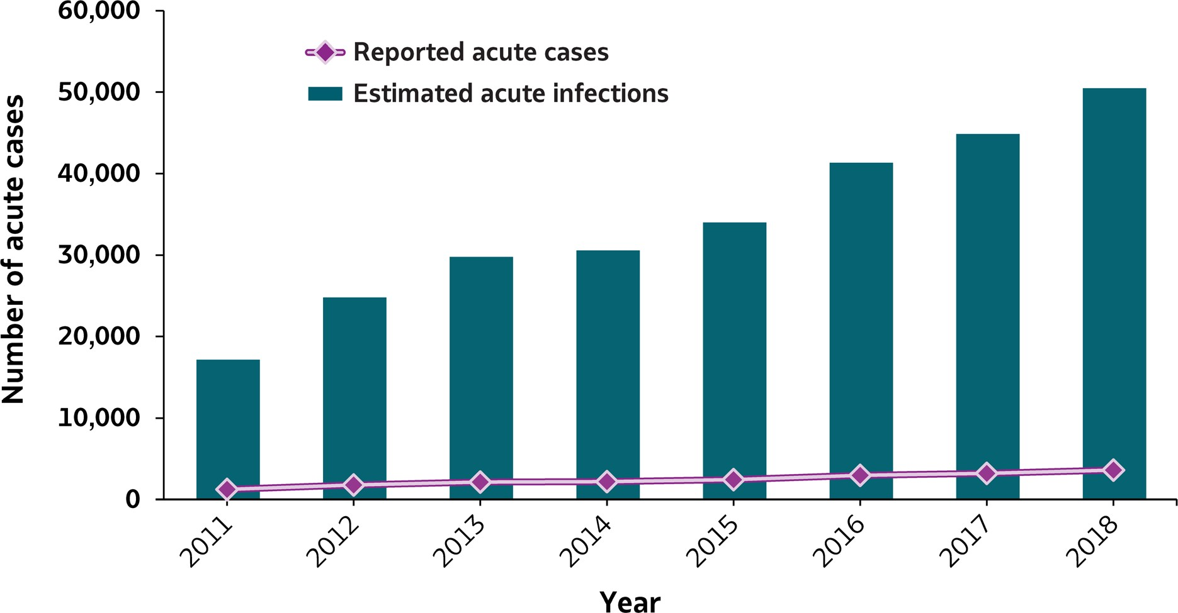
VIRAL HEPATITIS
SURVEILLANCE
Figure 3.1. Number of reported acute hepatitis C cases and estimated infections* — United States, 2011–2018
Source: CDC, National Notifiable Diseases Surveillance System.
* The number of estimated viral hepatitis infections was determined by multiplying the number of reported cases by a factor that adjusted for under-ascertainment and under-reporting⁽⁷⁾. The 95% bootstrap confidence intervals for the estimated number of infections are shown in the Appendix.

Slide 38
VIRAL HEPATITIS
SURVEILLANCE
Figure 3.1. Number of reported acute hepatitis C cases and estimated infections* — United States, 2011–2018
Hepatitis C | 2011 | 2012 | 2013 | 2014 | 2015 | 2016 | 2017 | 2018
Reported cases | 1,232 | 1,778 | 2,138 | 2,194 | 2,436 | 2,967 | 3,216 | 3,621
Estimated cases | 17,100 | 24,700 | 29,700 | 30,500 | 33,900 | 41,200 | 44,700 | 50,300
Source: CDC, National Notifiable Diseases Surveillance System
* The number of estimated viral hepatitis infections was determined by multiplying the number of reported cases by a factor that adjusted for under-ascertainment and under-reporting⁽¹⁰⁾. The 95% bootstrap confidence intervals for the estimated number of infections are shown in the Appendix.

Slide 39
VIRAL HEPATITIS SURVEILLANCE
Table 3.1. Number and rate* of reported cases of acute hepatitis C, by state or jurisdiction — United States, 2014–2018
State | 2014 |  | 2015 |  | 2016 |  | 2017 |  | 2018
 | No. | Rate* | No. | Rate* | No. | Rate* | No. | Rate* | No. | Rate*
Alabama | 35 | 0.7 | 70 | 1.4 | 32 | 0.7 | 17 | 0.3 | 52 | 1.1
Alaska | N | N | N | N | N | N | N | N | N | N
Arizona | U | U | U | U | U | U | U | U | U | U
Arkansas | 13 | 0.4 | 2 | 0.1 | — | — | 1 | 0.0 | 10 | 0.3
California | 73 | 0.2 | 59 | 0.2 | 60 | 0.2 | 103 | 0.3 | 114 | 0.3
Colorado | 33 | 0.6 | 40 | 0.7 | 35 | 0.6 | 42 | 0.7 | 46 | 0.8
Connecticut | — | — | — | — | 17 | 0.5 | 9 | 0.3 | 10 | 0.3
Delaware | U | U | 4 | 0.4 | 25 | 2.6 | 4 | 0.4 | U | U
District of Columbia | U | U | U | U | U | U | U | U | U | U
Florida | 93 | 0.5 | 126 | 0.6 | 236 | 1.1 | 357 | 1.7 | 435 | 2.0
Georgia | 57 | 0.6 | 84 | 0.8 | 93 | 0.9 | 100 | 1.0 | 84 | 0.8
Hawaii | — | — | — | — | — | — | — | — | — | —
Idaho | 6 | 0.4 | 4 | 0.2 | 7 | 0.4 | 8 | 0.5 | 4 | 0.2
Illinois | 27 | 0.2 | 31 | 0.2 | 21 | 0.2 | 39 | 0.3 | 93 | 0.7
Indiana | 122 | 1.8 | 138 | 2.1 | 146 | 2.2 | 191 | 2.9 | 266 | 4.0
Iowa | U | U | U | U | U | U | U | U | U | U
Kansas | 28 | 1.0 | 22 | 0.8 | 15 | 0.5 | 19 | 0.7 | 13 | 0.4
Kentucky | 176 | 4.0 | 119 | 2.7 | 103 | 2.3 | 83 | 1.9 | 164 | 3.7
Louisiana | 22 | 0.5 | 24 | 0.5 | 5 | 0.1 | 7 | 0.1 | 8 | 0.2
Maine | 31 | 2.3 | 30 | 2.3 | 25 | 1.9 | 21 | 1.6 | 23 | 1.7
Maryland | 42 | 0.7 | 38 | 0.6 | 35 | 0.6 | 32 | 0.5 | 38 | 0.6
Massachusetts | 228 | 3.4 | 249 | 3.7 | 424 | 6.2 | 327 | 4.8 | 110 | 1.6
Michigan | 78 | 0.8 | 83 | 0.8 | 107 | 1.1 | 152 | 1.5 | 142 | 1.4
Minnesota | 40 | 0.7 | 37 | 0.7 | 51 | 0.9 | 57 | 1.0 | 60 | 1.1
Mississippi | U | U | U | U | U | U | U | U | U | U
Missouri | 6 | 0.1 | 8 | 0.1 | 24 | 0.4 | 49 | 0.8 | 74 | 1.2
Montana | 13 | 1.3 | 15 | 1.5 | 20 | 1.9 | 14 | 1.3 | 8 | 0.8
Nebraska | 2 | 0.1 | 8 | 0.4 | 2 | 0.1 | 2 | 0.1 | 2 | 0.1
Nevada | 6 | 0.2 | 12 | 0.4 | 16 | 0.5 | 35 | 1.2 | 19 | 0.6
New Hampshire | N | N | N | N | N | N | 25 | 1.9 | 25 | 1.8
New Jersey | 113 | 1.3 | 130 | 1.5 | 122 | 1.4 | 125 | 1.4 | 96 | 1.1
New Mexico | 16 | 0.8 | 40 | 1.9 | 18 | 0.9 | 16 | 0.8 | 22 | 1.0
New York | 126 | 0.6 | 121 | 0.6 | 179 | 0.9 | 188 | 0.9 | 236 | 1.2
North Carolina | 111 | 1.1 | 144 | 1.4 | 82 | 0.8 | 114 | 1.1 | 149 | 1.4
North Dakota | — | — | — | — | 1 | 0.1 | 1 | 0.1 | 10 | 1.3
Ohio | 105 | 0.9 | 122 | 1.1 | 187 | 1.6 | 159 | 1.4 | 282 | 2.4
Oklahoma | 45 | 1.2 | 35 | 0.9 | 32 | 0.8 | 46 | 1.2 | 28 | 0.7
Oregon | 15 | 0.4 | 13 | 0.3 | 19 | 0.5 | 35 | 0.8 | 14 | 0.3
Pennsylvania | 69 | 0.5 | 129 | 1.0 | 225 | 1.8 | 224 | 1.7 | 249 | 1.9
Rhode Island | U | U | U | U | U | U | U | U | U | U
South Carolina | 4 | 0.1 | 5 | 0.1 | 10 | 0.2 | 13 | 0.3 | 15 | 0.3
South Dakota | — | — | — | — | 20 | 2.3 | 19 | 2.2 | 19 | 2.2
Tennessee | 123 | 1.9 | 173 | 2.6 | 150 | 2.3 | 142 | 2.1 | 157 | 2.3
Texas | 47 | 0.2 | 48 | 0.2 | 40 | 0.1 | 35 | 0.1 | 46 | 0.2
Utah | 38 | 1.3 | 30 | 1.0 | 76 | 2.5 | 81 | 2.6 | 120 | 3.8
Vermont | 4 | 0.6 | 1 | 0.2 | 5 | 0.8 | 9 | 1.4 | 4 | 0.6
Virginia | 54 | 0.6 | 52 | 0.6 | 43 | 0.5 | 62 | 0.7 | 47 | 0.6
Washington | 82 | 1.2 | 63 | 0.9 | 62 | 0.9 | 52 | 0.7 | 101 | 1.3
West Virginia | 62 | 3.4 | 63 | 3.4 | 94 | 5.1 | 102 | 5.6 | 70 | 3.9
Wisconsin | 49 | 0.9 | 64 | 1.1 | 103 | 1.8 | 94 | 1.6 | 134 | 2.3
Wyoming | U | U | U | U | U | U | 5 | 0.9 | 22 | 3.8
Total | 2,194 | 0.7 | 2,436 | 0.8 | 2,967 | 1.0 | 3,216 | 1.0 | 3,621 | 1.2
Source: CDC, National Notifiable Diseases Surveillance System.
* Rate per 100,000
population.
† For case definition, see https://wwwn.cdc.gov/nndss/ conditions/hepatitis-c-acute/
—: No reported cases. The reporting jurisdiction did not submit any cases to CDC.
N: Not reportable. The disease or condition was not reportable by law, statue, or regulation in the reporting jurisdiction.
U: Unavailable. The data are unavailable.

Slide 40
VIRAL HEPATITIS SURVEILLANCE
Figure 3.2. Rates of reported acute hepatitis C, by state* — United States, 2017–2018
US Average (2018): 1 .2
Source: CDC, National Notifiable Diseases Surveillance System.
* Excludes Alaska, Arizona, Delaware, District of Columbia, Hawaii, Iowa, Mississippi, and Rhode Island.

Slide 41
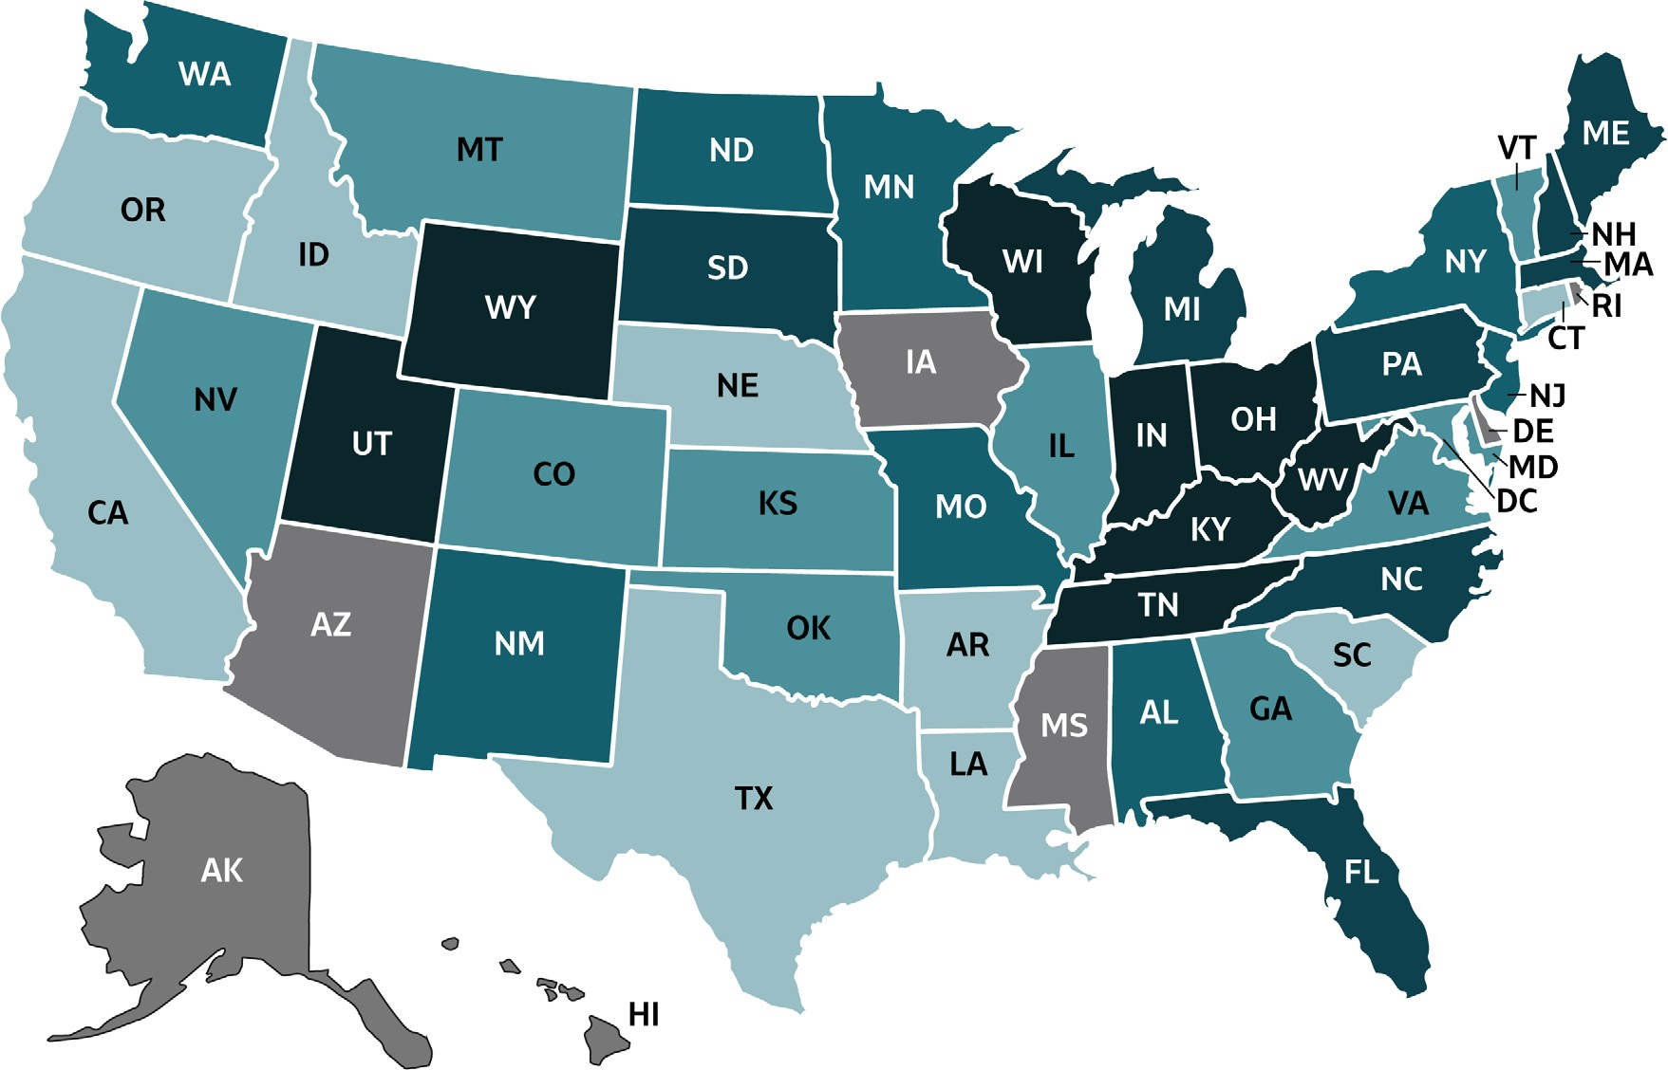
VIRAL HEPATITIS
SURVEILLANCE
Figure 3.3. Rates of reported acute hepatitis C, by state or jurisdiction — United States, 2018
Source: CDC, National Notifiable Diseases Surveillance System.

Slide 42
VIRAL HEPATITIS
SURVEILLANCE
Figure 3.3. Rates of reported acute hepatitis C, by state or jurisdiction — United States, 2018
Color Key | Cases/100,000 Population | States
 | 0-0.3 | AR, CA, CT, ID, LA, NE, OR, SC, TX
 | >0.3-0.9 | CO, GA, IL, KS, MD, MT, NV, OK, VT, VA
 | >0.9-1.3 | AL, MN, MO, NJ, NM, NY, ND, WA
 | >1.3-2.2 | FL, ME, MA, MI, NH, NC, PA
 | >2.2-4.0 | IN, KY, OH, SD, TN, UT, WV, WI, WY
 | Data Not Available | AK, AZ, DE, DC, HI, IA, MS, RI
Source: CDC, National Notifiable Diseases Surveillance System.

Slide 43
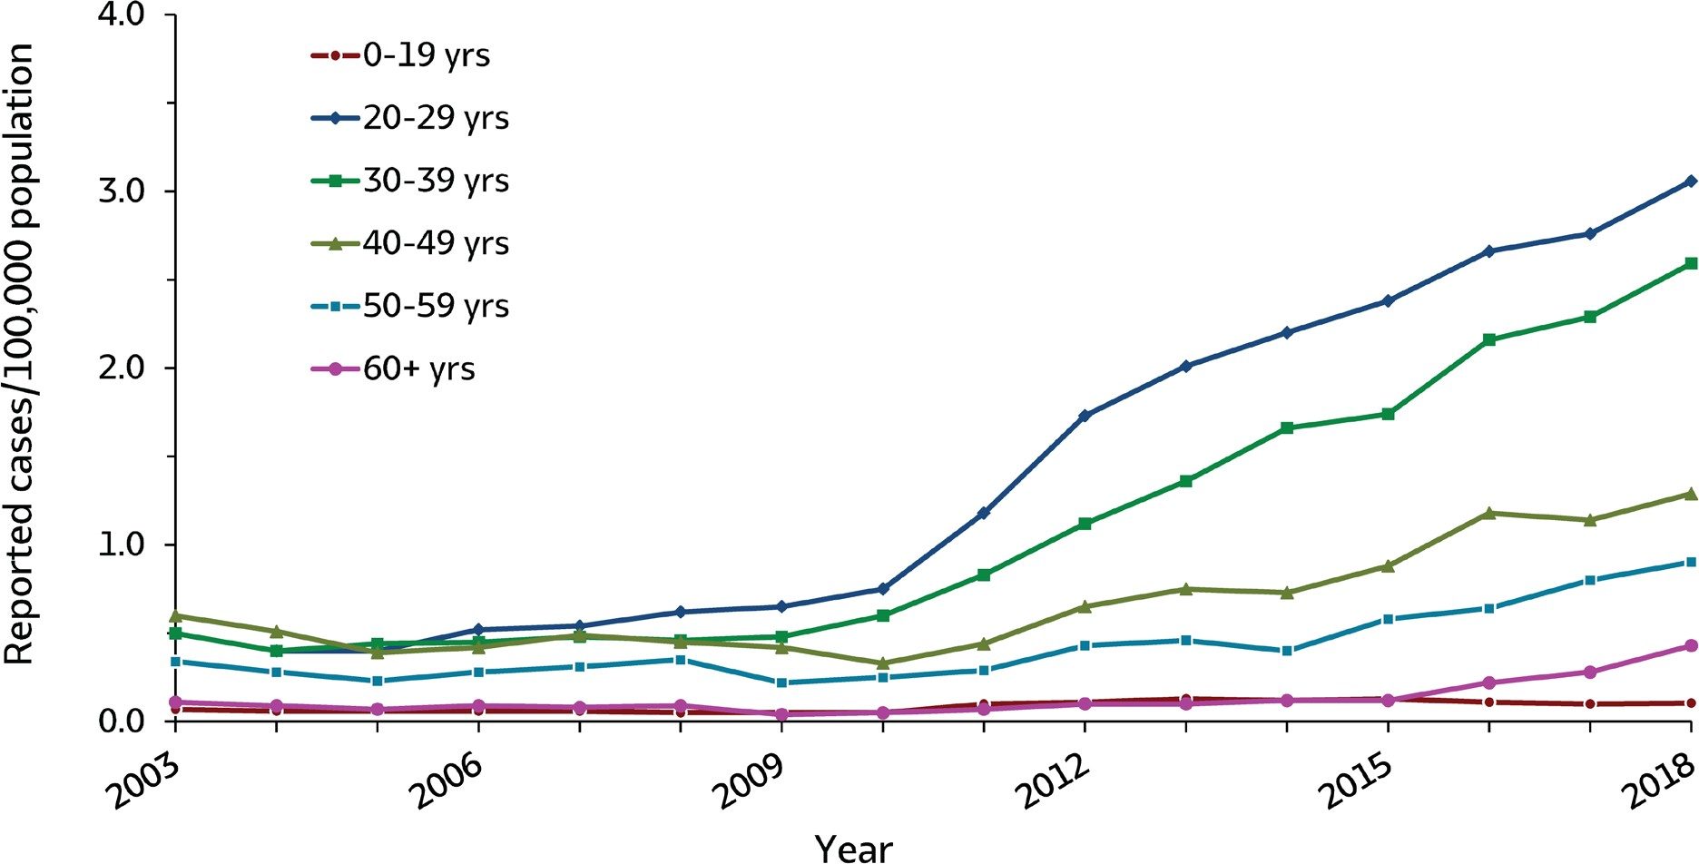
VIRAL HEPATITIS
SURVEILLANCE
Figure 3.4. Rates of reported acute hepatitis C, by age group — United States, 2003–2018
Source: CDC, National Notifiable Diseases Surveillance System.

Slide 44
VIRAL HEPATITIS
SURVEILLANCE
Figure 3.4. Rates of reported acute hepatitis C, by age group — United States, 2003–2018
Age (years) | 2003 | 2004 | 2005 | 2006 | 2007 | 2008 | 2009 | 2010 | 2011 | 2012 | 2013 | 2014 | 2015 | 2016 | 2017 | 2018
0-19 | 0.1 | 0.1 | 0.1 | 0.1 | 0.1 | 0.1 | 0.1 | 0.1 | 0.1 | 0.1 | 0.1 | 0.1 | 0.1 | 0.1 | 0.1 | 0.1
20-29 | 0.5 | 0.4 | 0.4 | 0.5 | 0.5 | 0.6 | 0.7 | 0.8 | 1.2 | 1.7 | 2.0 | 2.2 | 2.4 | 2.7 | 2.8 | 3.1
30-39 | 0.5 | 0.4 | 0.4 | 0.5 | 0.5 | 0.5 | 0.5 | 0.6 | 0.8 | 1.1 | 1.4 | 1.7 | 1.7 | 2.2 | 2.3 | 2.6
40-49 | 0.6 | 0.5 | 0.4 | 0.4 | 0.5 | 0.5 | 0.4 | 0.3 | 0.4 | 0.7 | 0.8 | 0.7 | 0.9 | 1.2 | 1.1 | 1.3
50-59 | 0.3 | 0.3 | 0.2 | 0.3 | 0.3 | 0.4 | 0.2 | 0.3 | 0.3 | 0.4 | 0.5 | 0.4 | 0.6 | 0.6 | 0.8 | 0.9
60+ | 0.1 | 0.1 | 0.1 | 0.1 | 0.1 | 0.1 | 0.0 | 0.1 | 0.1 | 0.1 | 0.1 | 0.1 | 0.1 | 0.2 | 0.3 | 0.4
Source: CDC, National Notifiable Diseases Surveillance System.

Slide 45
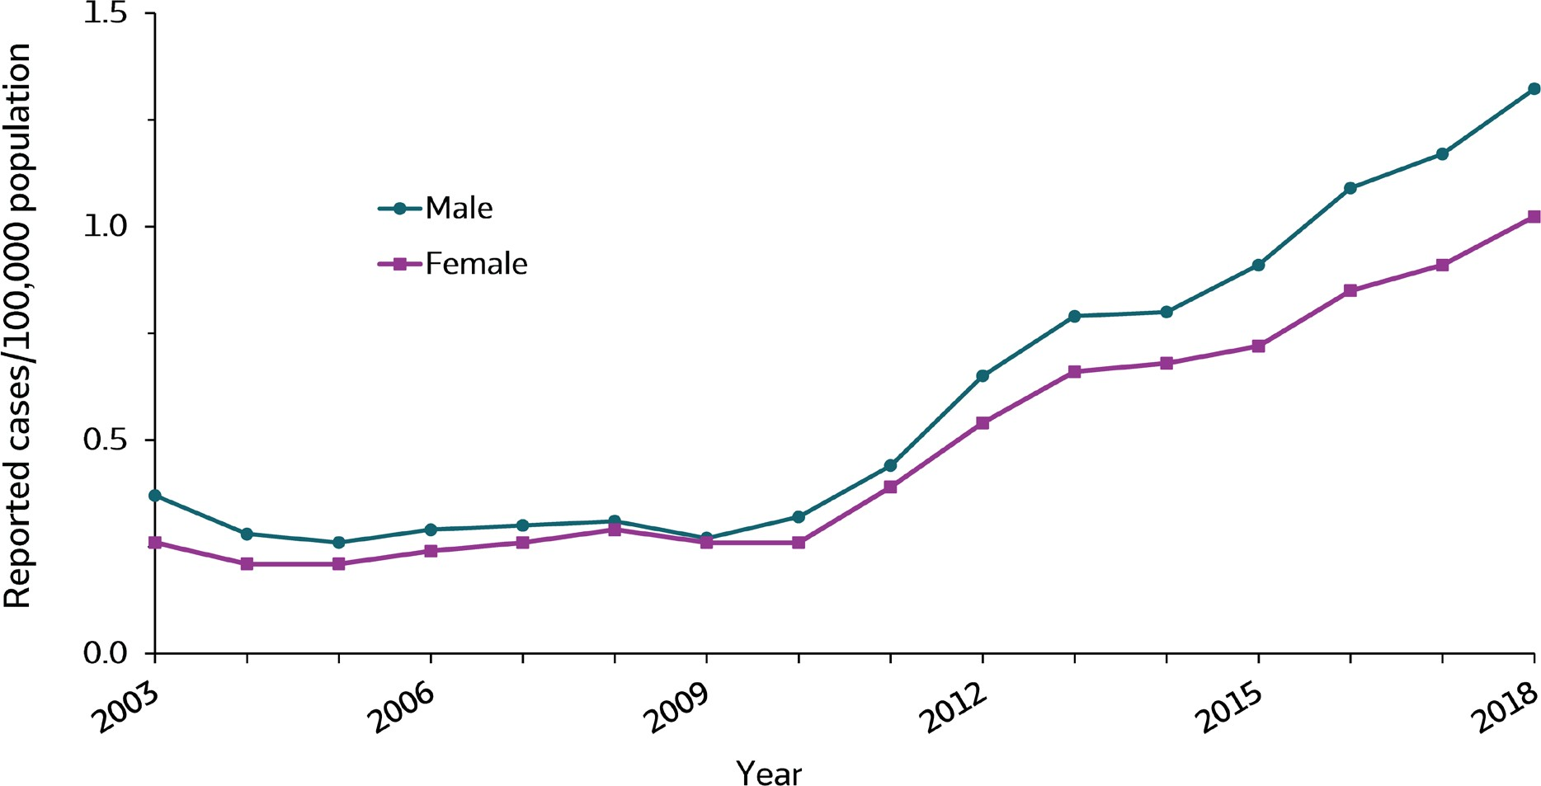
VIRAL HEPATITIS
SURVEILLANCE
Figure 3.5. Rates of reported acute hepatitis C, by sex — United States, 2003–2018
Source: CDC, National Notifiable Diseases Surveillance System.

Slide 46
VIRAL HEPATITIS
SURVEILLANCE
Figure 3.5. Rates of reported acute hepatitis C, by sex — United States, 2003–2018
Sex | 2003 | 2004 | 2005 | 2006 | 2007 | 2008 | 2009 | 2010 | 2011 | 2012 | 2013 | 2014 | 2015 | 2016 | 2017 | 2018
Male | 0.4 | 0.3 | 0.3 | 0.3 | 0.3 | 0.3 | 0.3 | 0.3 | 0.4 | 0.7 | 0.8 | 0.8 | 0.9 | 1.1 | 1.2 | 1.3
Female | 0.3 | 0.2 | 0.2 | 0.2 | 0.3 | 0.3 | 0.3 | 0.3 | 0.4 | 0.5 | 0.7 | 0.7 | 0.7 | 0.9 | 0.9 | 1.0
Source: CDC, National Notifiable Diseases Surveillance System.

Slide 47
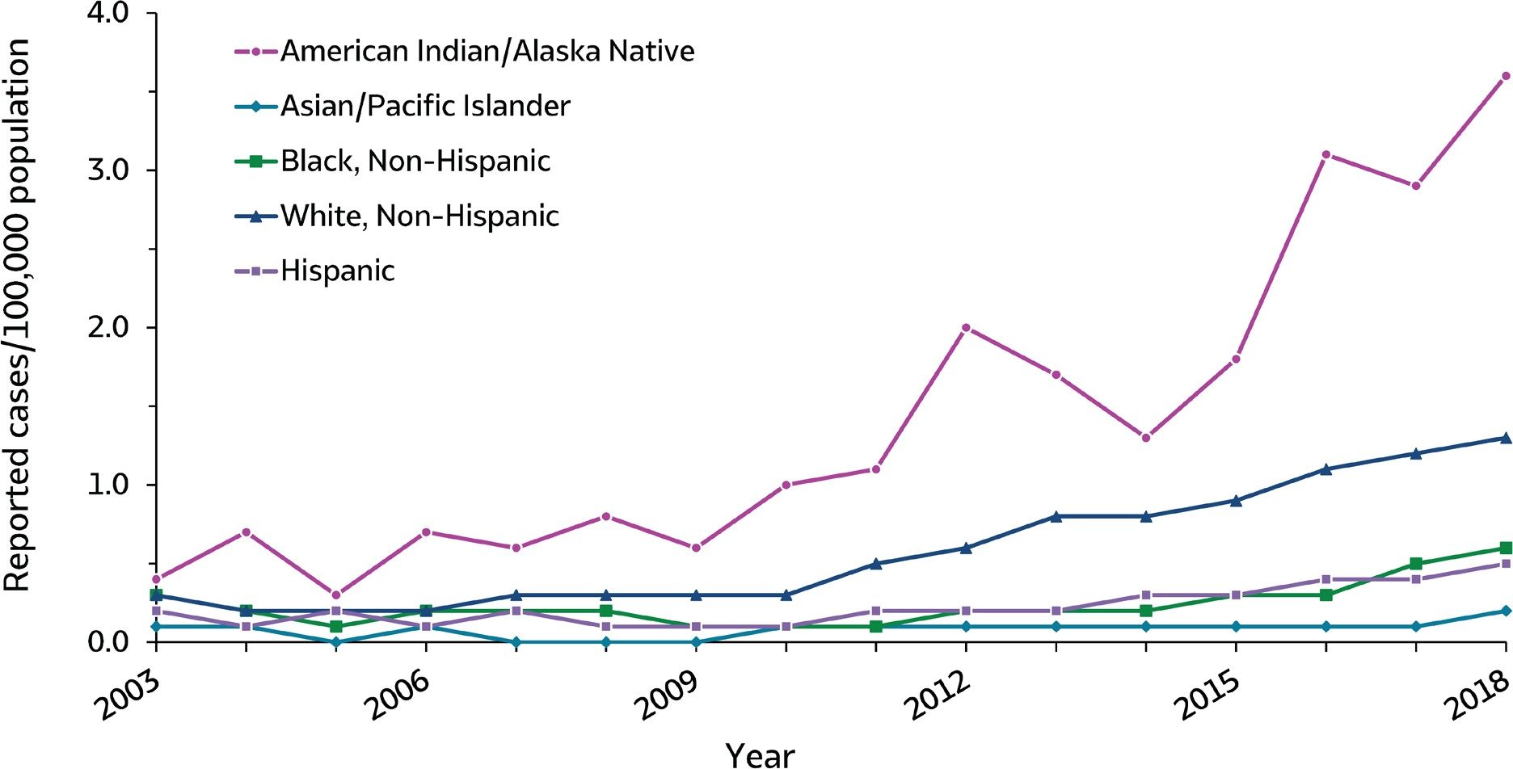
VIRAL HEPATITIS
SURVEILLANCE
Figure 3.6. Rates of reported acute hepatitis C, by race/ethnicity — United States, 2003–2018
Source: CDC, National Notifiable Diseases Surveillance System.

Slide 48
VIRAL HEPATITIS
SURVEILLANCE
Figure 3.6. Rates of reported acute hepatitis C, by race/ethnicity — United States, 2003–2018
Race/ Ethnicity | 2003 | 2004 | 2005 | 2006 | 2007 | 2008 | 2009 | 2010 | 2011 | 2012 | 2013 | 2014 | 2015 | 2016 | 2017 | 2018
American Indian/ Alaska Native | 0.4 | 0.7 | 0.3 | 0.7 | 0.6 | 0.8 | 0.6 | 1.0 | 1.1 | 2.0 | 1.7 | 1.3 | 1.8 | 3.1 | 2.9 | 3.6
Asian/Pacific Islander | 0.1 | 0.1 | 0.0 | 0.1 | 0.0 | 0.0 | 0.0 | 0.1 | 0.1 | 0.1 | 0.1 | 0.1 | 0.1 | 0.1 | 0.1 | 0.2
Black, Non-Hispanic | 0.3 | 0.2 | 0.1 | 0.2 | 0.2 | 0.2 | 0.1 | 0.1 | 0.1 | 0.2 | 0.2 | 0.2 | 0.3 | 0.3 | 0.5 | 0.6
White, Non-Hispanic | 0.3 | 0.2 | 0.2 | 0.2 | 0.3 | 0.3 | 0.3 | 0.3 | 0.5 | 0.6 | 0.8 | 0.8 | 0.9 | 1.1 | 1.2 | 1.3
Hispanic | 0.2 | 0.1 | 0.2 | 0.1 | 0.2 | 0.1 | 0.1 | 0.1 | 0.2 | 0.2 | 0.2 | 0.3 | 0.3 | 0.4 | 0.4 | 0.5
Source: CDC, National Notifiable Diseases Surveillance System.

Slide 49
VIRAL HEPATITIS SURVEILLANCE
Table 3.2. Number and rate* of reported cases† of acute hepatitis C, by demographic characteristics and region — United States 2014–2018
Demographic characteristic | 2014 |  | 2015 |  | 2016 |  | 2017 |  | 2018
 | No. | Rate* | No. | Rate* | No. | Rate* | No. | Rate* | No. | Rate*
Total§ | 2,194 | 0.7 | 2,436 | 0.8 | 2,967 | 1.0 | 3,216 | 1.0 | 3,621 | 1.2
Age group (years)
0–19 | 88 | 0.1 | 99 | 0.1 | 86 | 0.1 | 103 | 0.1 | 81 | 0.1
20–29 | 918 | 2.2 | 999 | 2.4 | 1,135 | 2.7 | 1,189 | 2.8 | 1,310 | 3.1
30–39 | 643 | 1.7 | 682 | 1.7 | 868 | 2.2 | 937 | 2.3 | 1,070 | 2.6
40–49 | 282 | 0.7 | 337 | 0.9 | 452 | 1.2 | 441 | 1.1 | 494 | 1.3
50–59 | 166 | 0.4 | 240 | 0.6 | 264 | 0.6 | 332 | 0.8 | 366 | 0.9
60+ | 70 | 0.1 | 77 | 0.1 | 141 | 0.2 | 185 | 0.3 | 295 | 0.4
Sex
Male | 1,167 | 0.8 | 1,334 | 0.9 | 1,627 | 1.1 | 1,775 | 1.2 | 2,012 | 1.3
Female | 1,025 | 0.7 | 1,093 | 0.7 | 1,310 | 0.8 | 1,431 | 0.9 | 1,605 | 1.0
Race/ethnicity
American Indian/ Alaskan Native | 29 | 1.3 | 39 | 1.7 | 70 | 3.1 | 67 | 2.9 | 83 | 3.6
Asian/Pacific Islander | 11 | 0.1 | 16 | 0.1 | 25 | 0.1 | 23 | 0.1 | 29 | 0.2
Black, Non-Hispanic | 74 | 0.2 | 112 | 0.3 | 130 | 0.3 | 202 | 0.5 | 231 | 0.6
White, Non-Hispanic | 1,569 | 0.8 | 1,724 | 0.9 | 2,109 | 1.1 | 2,227 | 1.2 | 2,405 | 1.3
Hispanic | 124 | 0.2 | 148 | 0.3 | 191 | 0.4 | 234 | 0.4 | 280 | 0.5
HHS Region¶
Region 1 | 263 | 3.0 | 280 | 3.2 | 471 | 3.8 | 391 | 2.8 | 172 | 1.2
Region 2 | 239 | 0.8 | 251 | 0.9 | 301 | 1.0 | 313 | 1.1 | 332 | 1.2
Region 3 | 227 | 0.8 | 286 | 1.0 | 422 | 1.4 | 424 | 1.4 | 404 | 1.4
Region 4 | 599 | 1.0 | 721 | 1.2 | 706 | 1.1 | 826 | 1.3 | 1,056 | 1.7
Region 5 | 421 | 0.8 | 475 | 0.9 | 615 | 1.2 | 692 | 1.3 | 977 | 1.9
Region 6 | 143 | 0.4 | 149 | 0.4 | 95 | 0.2 | 105 | 0.2 | 114 | 0.3
Region 7 | 36 | 0.3 | 38 | 0.3 | 41 | 0.4 | 70 | 0.6 | 89 | 0.8
Region 8 | 84 | 0.8 | 85 | 0.8 | 152 | 1.4 | 162 | 1.4 | 225 | 1.9
Region 9 | 79 | 0.2 | 71 | 0.2 | 76 | 0.2 | 138 | 0.3 | 133 | 0.3
Region 10 | 103 | 0.8 | 80 | 0.6 | 88 | 0.7 | 95 | 0.7 | 119 | 0.9
Source: CDC, National Notifiable Diseases Surveillance System.
* Rate per 100,000 population.
† For the case definition, see https://wwwn.cdc.gov/nndss/conditions/hepatitis-c-acute/
§ Numbers reported in each category may not add up to the total number of reported cases in a year due to cases with missing data or, in the case of race/ethnicity, cases categorized as “Other.”
¶ Health and Human Services Regions were categorized according to the grouping of states and U.S. Territories assigned under each of the ten Department of Health and Human Services regional offices (https://www.hhs.gov/about/agencies/iea/regional-offices/index.html). For the purposes of this report, regions with U.S. territories (Region 2 and Region 9) contain data from states only.

Slide 50
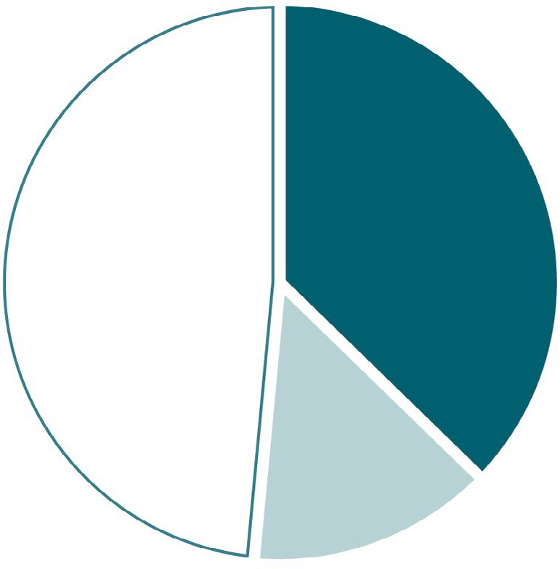
VIRAL HEPATITIS
SURVEILLANCE
Figure 3.7. Availability of information on risk behaviors/exposures* associated with reported cases of acute hepatitis C — United States, 2018
1,350
(37%)
1,757
(49%)
Risk identified*
No risk identified Risk data missing
514
(14%)
Source: CDC, Nationally Notifiable Diseases Surveillance System.
* Case reports with at least one of the following risk behaviors/ exposures reported 6 weeks to 6 months prior to symptom onset: 1) injection drug use; 2) sex contact with suspected/confirmed hepatitis C patient; 3) men who have sex with men; 4) multiple sex partners; 5) occupational exposure to blood; 6) dialysis patient; 7) receive blood transfusion; 8) underwent surgery.

Slide 51
VIRAL HEPATITIS
SURVEILLANCE
Table 3.3. Reported risk behaviors/exposures† among reported cases of acute hepatitis C — United States, 2018
Risk behaviors/exposures | Risk identified* | No risk identified | Risk data missing
Injection drug use | 1,102 | 433 | 2,086
Multiple sex partners | 212 | 462 | 2,947
Surgery | 124 | 832 | 2,665
Sexual contact§ | 105 | 278 | 3,238
Needlesticsk | 91 | 781 | 2,749
Men who have sex with men¶ | 33 | 277 | 1,702
Household contact (non-sexual)§ | 30 | 353 | 3,238
Dialysis patient | 18 | 1,041 | 2,562
Occupational | 7 | 1,145 | 2,469
Transfusion | 1 | 956 | 2,664
Source: CDC, Nationally Notifiable Diseases Surveillance System.
* Case reports with at least one of the following risk behaviors/ exposures reported 6 weeks to 6 months prior to symptom onset: 1) injection drug use; 2) sex contact with suspected/confirmed hepatitis C patient; 3) men who have sex with men; 4) multiple sex partners; 5) occupational exposure to blood; 6) dialysis patient; 7) receive blood transfusion; 8) underwent surgery.
† Reported cases may include more than one risk behavior/exposure.
§ Cases with more than one type of contact reported were categorized according to a hierarchy: (1) sexual contact; (2) household contact (non-sexual).
¶ A total of 2,012 acute hepatitis C cases were reported among males in 2018.

Slide 52
VIRAL HEPATITIS SURVEILLANCE
Table 3.4. Number of newly reported cases* of perinatal hepatitis C, by state or jurisdiction — United States, 2018
State | Perinatal Hepatitis C
Alabama | —
Alaska | 1
Arizona | —
Arkansas | 1
California | 14
Colorado | 2
Connecticut | —
Delaware | U
District of Columbia | —
Florida | 36
Georgia | 3
Hawaii | —
Idaho | —
Illinois | 6
Indiana | 20
Iowa | —
Kansas | 1
Kentucky | —
Louisiana | 3
Maine | —
Maryland | 3
Massachusetts | 10
Michigan | 11
Minnesota | 1
Mississippi | —
Missouri | —
Montana | 1
Nebraska | —
Nevada | 2
New Hampshire | —
New Jersey | 10
New Mexico | —
New York | 3
North Carolina | —
North Dakota | —
Ohio | 44
Oklahoma | —
Oregon | —
Pennsylvania | 20
Rhode Island | U
South Carolina | —
South Dakota | —
Tennessee | 4
Texas | N
Utah | 4
Vermont | —
Virginia | 8
Washington | 4
West Virginia | —
Wisconsin | 2
Wyoming | —
Total | 214
Source: CDC, National Notifiable Diseases Surveillance System.
* For case definition, see https:// wwwn.cdc.gov/nndss/conditions/ hepatitis-c-perinatal-infection/
—: No reported cases. The reporting jurisdiction did not submit any cases to CDC.
N: Not reportable. The disease or condition
was not reportable by law, statue, or regulation in the reporting jurisdiction.
U: Unavailable. The data are unavailable.

Slide 53
VIRAL HEPATITIS SURVEILLANCE
Table 3.5. Number of newly reported cases* of chronic hepatitis C, by state or jurisdiction — United States, 2018
State | Chronic Hepatitis C
Alabama | N
Alaska | 872
Arizona | U
Arkansas | N
California | —
Colorado | 2,871
Connecticut | 1,897
Delaware | U
District of Columbia | U
Florida | 16,193
Georgia | 5,451
Hawaii | U
Idaho | 872
Illinois | 4,965
Indiana | N
Iowa | 1,498
Kansas | 1,272
Kentucky | N
Louisiana | 6,640
Maine | 888
Maryland | 3,882
Massachusetts | 4,772
Michigan | 4,058
Minnesota | 1,225
Mississippi | —
Missouri | 4,658
Montana | 967
Nebraska | 696
Nevada | U
New Hampshire | 224
New Jersey | 3,882
New Mexico | 956
New York | 8,047
North Carolina | N
North Dakota | 717
Ohio | 10,582
Oklahoma | 1,569
Oregon | 3,000
Pennsylvania | 12,874
Rhode Island | U
South Carolina | 3,071
South Dakota | 422
Tennessee | 9,949
Texas | N
Utah | 1,012
Vermont | 463
Virginia | 4,772
Washington | 5,219
West Virginia | 4,832
Wisconsin | 2,090
Wyoming | 355
United States | 137,713
Source: CDC, National Notifiable Diseases Surveillance System.
* For case definition, see —: No reported cases. The N: Not reportable. The disease or condition
https://wwwn.cdc.gov/nndss/ reporting jurisdiction did not was not reportable by law, statue, or
U: Unavailable. The data are unavailable.
conditions/hepatitis-c-chronic/ submit any cases to CDC. regulation in the reporting jurisdiction.

Slide 54
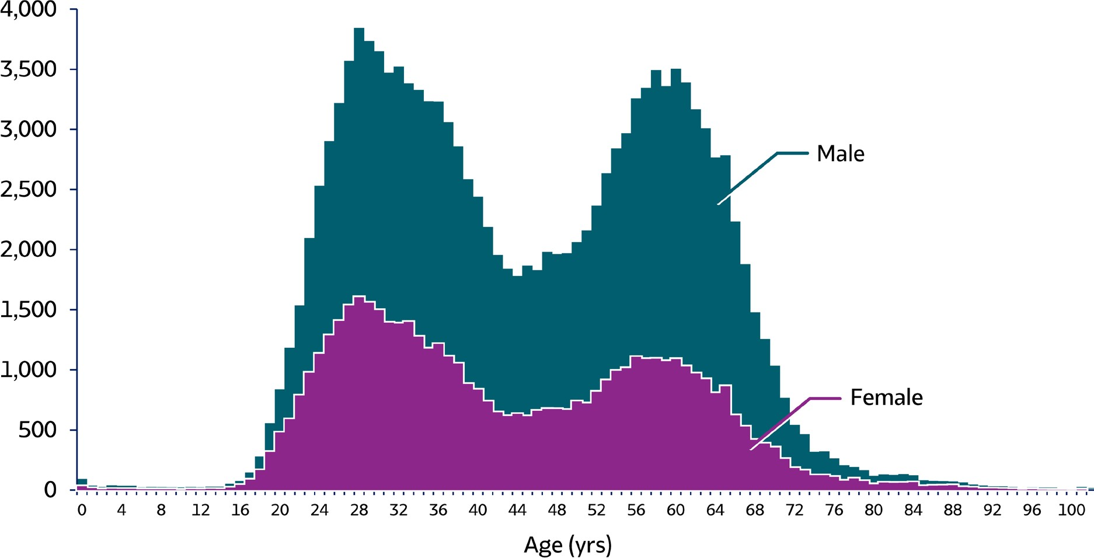
VIRAL HEPATITIS
SURVEILLANCE
Figure 3.8. Number of newly reported* chronic hepatitis C cases† by sex and age — United States, 2018 (N=137,713)
Source: CDC, National Notifiable Diseases Surveillance System.
* During 2018, cases of chronic hepatitis C were either not reportable by law, statute, or regulation; not reported; or otherwise unavailable to CDC from Alabama, Arizona, Arkansas, California, Delaware, District of Columbia, Hawaii, Indiana, Kentucky, Mississippi, Nevada, North Carolina, Rhode Island, and Texas.
† Only confirmed, newly diagnosed, chronic hepatitis C cases are included. For the complete case definition, see https://wwwn.cdc.gov/nndss/conditions/hepatitis-c- chronic/case-definition/2016/.

Slide 55
VIRAL HEPATITIS
SURVEILLANCE
Figure 3.8. Number of newly reported* chronic hepatitis C cases† by sex and age — United States, 2018 (N=137,713)
This graph shows the number of newly reported chronic hepatitis C cases by sex and age in the United States for 2018. Males overall had higher rates of hepatitis C than females. Both males and females showed a biphasic pattern of new infections, with infections rising throughout late teens and early twenties, decreasing through the twenties and thirties, rising again in the late forties through early sixties, then declining for the remaining years.
Source: CDC, National Notifiable Diseases Surveillance System.
* During 2018, cases of chronic hepatitis C were either not reportable by law, statute, or regulation; not reported; or otherwise unavailable to CDC from Alabama, Arizona, Arkansas, California, Delaware, District of Columbia, Hawaii, Indiana, Kentucky, Mississippi, Nevada, North Carolina, Rhode Island, and Texas.
† Only confirmed, newly diagnosed, chronic hepatitis C cases are included. For the complete case definition, see https://wwwn.cdc.gov/nndss/conditions/hepatitis-c- chronic/case-definition/2016/.

Slide 56
VIRAL HEPATITIS SURVEILLANCE
Table 3.6. Number and rate* of deaths with hepatitis C listed as a cause of death† among U.S. residents, by jurisdiction and year — United States, 2014–2018
State | 2014 |  | 2015 |  | 2016 |  | 2017 |  | 2018
 | No. | Rate* | No. | Rate* | No. | Rate* | No. | Rate* | No. | Rate*
Alabama | 246 | 3.97 | 187 | 3.08 | 166 | 2.63 | 188 | 2.97 | 167 | 2.54
Alaska | 60 | 7.13 | 41 | 4.95 | 50 | 5.38 | 38 | 4.38 | 40 | 5.00
Arizona | 553 | 6.90 | 567 | 6.90 | 500 | 5.81 | 480 | 5.45 | 348 | 3.84
Arkansas | 160 | 4.39 | 183 | 5.01 | 184 | 4.91 | 169 | 4.43 | 150 | 3.86
California | 3,409 | 7.66 | 3,245 | 7.19 | 2,917 | 6.33 | 2,630 | 5.58 | 2,391 | 4.98
Colorado | 352 | 5.49 | 362 | 5.51 | 385 | 5.74 | 386 | 5.62 | 387 | 5.48
Connecticut | 156 | 3.25 | 153 | 3.20 | 123 | 2.52 | 130 | 2.61 | 89 | 1.72
Delaware | 50 | 3.91 | 45 | 3.41 | 47 | 3.63 | 49 | 3.80 | 34 | 2.33
District of Columbia | 92 | 13.21 | 101 | 13.93 | 95 | 13.37 | 83 | 11.42 | 70 | 9.40
Florida | 1,266 | 4.71 | 1,270 | 4.62 | 1,222 | 4.26 | 1,222 | 4.16 | 1,005 | 3.34
Georgia | 426 | 3.58 | 396 | 3.26 | 368 | 2.98 | 344 | 2.66 | 326 | 2.46
Hawaii | 87 | 4.99 | 68 | 3.70 | 70 | 3.75 | 67 | 3.48 | 49 | 2.42
Idaho | 110 | 5.44 | 99 | 4.79 | 115 | 5.40 | 84 | 3.82 | 108 | 4.87
Illinois | 364 | 2.33 | 399 | 2.56 | 354 | 2.18 | 288 | 1.72 | 279 | 1.67
Indiana | 263 | 3.26 | 270 | 3.26 | 295 | 3.60 | 269 | 3.16 | 259 | 2.98
Iowa | 112 | 3.04 | 125 | 3.19 | 109 | 2.67 | 122 | 3.01 | 98 | 2.40
Kansas | 126 | 3.62 | 141 | 4.11 | 148 | 4.20 | 141 | 3.83 | 130 | 3.48
Kentucky | 250 | 4.70 | 270 | 5.09 | 269 | 5.05 | 306 | 5.58 | 319 | 5.77
Louisiana | 400 | 7.25 | 396 | 7.15 | 383 | 6.60 | 382 | 6.49 | 352 | 5.92
Maine | 59 | 3.42 | 57 | 3.05 | 40 | 1.87 | 32 | 1.60 | 34 | 1.69
Maryland | 335 | 4.42 | 366 | 4.84 | 327 | 4.32 | 340 | 4.41 | 352 | 4.44
Massachusetts | 303 | 3.65 | 317 | 3.71 | 261 | 2.98 | 267 | 3.00 | 211 | 2.33
Michigan | 511 | 3.88 | 512 | 3.77 | 415 | 3.06 | 368 | 2.61 | 384 | 2.72
Minnesota | 245 | 3.50 | 234 | 3.40 | 240 | 3.28 | 235 | 3.19 | 209 | 2.81
Mississippi | 171 | 4.82 | 162 | 4.57 | 183 | 5.08 | 159 | 4.38 | 141 | 3.70
Missouri | 314 | 4.13 | 275 | 3.50 | 258 | 3.23 | 247 | 3.06 | 244 | 3.09
Montana | 55 | 3.77 | 77 | 5.76 | 75 | 5.71 | 68 | 4.89 | 76 | 5.36
Nebraska | 77 | 3.49 | 82 | 3.60 | 78 | 3.25 | 79 | 3.29 | 72 | 3.26
Nevada | 181 | 5.33 | 173 | 4.80 | 181 | 4.97 | 153 | 4.00 | 140 | 3.59
New Hampshire | 62 | 3.18 | 65 | 3.28 | 68 | 3.57 | 57 | 2.90 | 64 | 3.36
New Jersey | 446 | 3.93 | 400 | 3.52 | 378 | 3.24 | 342 | 2.90 | 309 | 2.64
New Mexico | 205 | 8.29 | 195 | 8.05 | 203 | 8.12 | 175 | 6.70 | 163 | 6.30
New York | 1,092 | 4.42 | 979 | 3.89 | 789 | 3.06 | 701 | 2.71 | 615 | 2.40
North Carolina | 495 | 4.08 | 532 | 4.19 | 511 | 3.92 | 460 | 3.44 | 426 | 3.11
North Dakota | 24 | 2.78 | 32 | 3.55 | 20 | 2.25 | 23 | 2.88 | 23 | 2.52
Ohio | 567 | 3.78 | 559 | 3.70 | 546 | 3.58 | 541 | 3.48 | 480 | 3.16
Oklahoma | 523 | 11.62 | 510 | 11.02 | 538 | 11.46 | 555 | 11.84 | 534 | 11.00
Oregon | 563 | 10.79 | 514 | 9.68 | 491 | 8.90 | 518 | 9.24 | 466 | 8.03
Pennsylvania | 629 | 3.73 | 726 | 4.18 | 564 | 3.28 | 563 | 3.15 | 417 | 2.37
Rhode Island | 104 | 7.70 | 97 | 7.26 | 89 | 6.57 | 76 | 5.15 | 91 | 6.37
South Carolina | 271 | 4.38 | 294 | 4.67 | 299 | 4.51 | 302 | 4.51 | 259 | 3.70
South Dakota | 31 | 3.18 | 35 | 3.33 | 37 | 3.46 | 29 | 2.56 | 30 | 2.80
Tennessee | 554 | 6.83 | 592 | 7.27 | 482 | 5.89 | 469 | 5.57 | 517 | 6.01
Texas | 1,860 | 6.41 | 1,996 | 6.72 | 1,886 | 6.12 | 1,888 | 6.03 | 1,708 | 5.30
Utah | 91 | 3.34 | 98 | 3.47 | 85 | 2.98 | 68 | 2.29 | 78 | 2.59
Vermont | 33 | 3.86 | 43 | 4.87 | 35 | 3.72 | 40 | 4.44 | 30 | 3.32
Virginia | 335 | 3.27 | 330 | 3.15 | 327 | 3.03 | 290 | 2.68 | 272 | 2.48
Washington | 644 | 7.21 | 651 | 7.06 | 517 | 5.53 | 528 | 5.46 | 466 | 4.76
West Virginia | 110 | 4.72 | 107 | 4.65 | 118 | 4.85 | 116 | 4.94 | 108 | 4.90
Wisconsin | 205 | 2.70 | 208 | 2.78 | 214 | 2.70 | 145 | 1.82 | 151 | 1.90
Wyoming | 36 | 4.77 | 30 | 3.95 | 38 | 4.89 | 41 | 5.50 | 42 | 5.84
Total | 19,613 | 5.01 | 19,566 | 4.91 | 18,093 | 4.42 | 17,253 | 4.13 | 15,713 | 3.72
Source: CDC, National Center for Health Statistics, Multiple Cause of Death 1999–2018 on CDC WONDER Online Database. Data are from the 2014–2018 Multiple Cause of Death files and are based on information from all death certificates filed in the vital records offices of the fifty states and the District of Columbia through the Vital Statistics Cooperative Program. Deaths of nonresidents (e.g., nonresident aliens, nationals living abroad, residents of Puerto Rico, Guam, the Virgin Islands, and other U.S. Territories) and fetal deaths are excluded. Numbers are slightly lower than previously reported for 2013–2016 due to NCHS standards which restrict displayed data to U.S. residents. Accessed at http://wonder.cdc.gov/mcd-icd10.html on February 14, 2020. CDC WONDER dataset documentation and technical methods can be accessed at https://wonder.cdc.gov/wonder/help/mcd.html#.
* Rates are age-adjusted per 100,000 U.S. standard population in 2000 using the following age group distribution (in years): <1, 1–4, 5–14, 15–24, 25–34, 35–44, 45–54, 55–64, 65–74, 75– 84, and 85+. For age-adjusted death rates, the age-specific death rate is rounded to one decimal place before proceeding to the next step in the calculation of age-adjusted death rates for NCHS Multiple Cause of Death on CDC WONDER. This rounding step may affect the precision of rates calculated for small numbers of deaths. Missing data are not included.
† Cause of death is defined as one of the multiple causes of death and is based on the International Classification of Diseases, 10th Revision (ICD-10) codes B17.1, and B18.2 (hepatitis C).

Slide 57
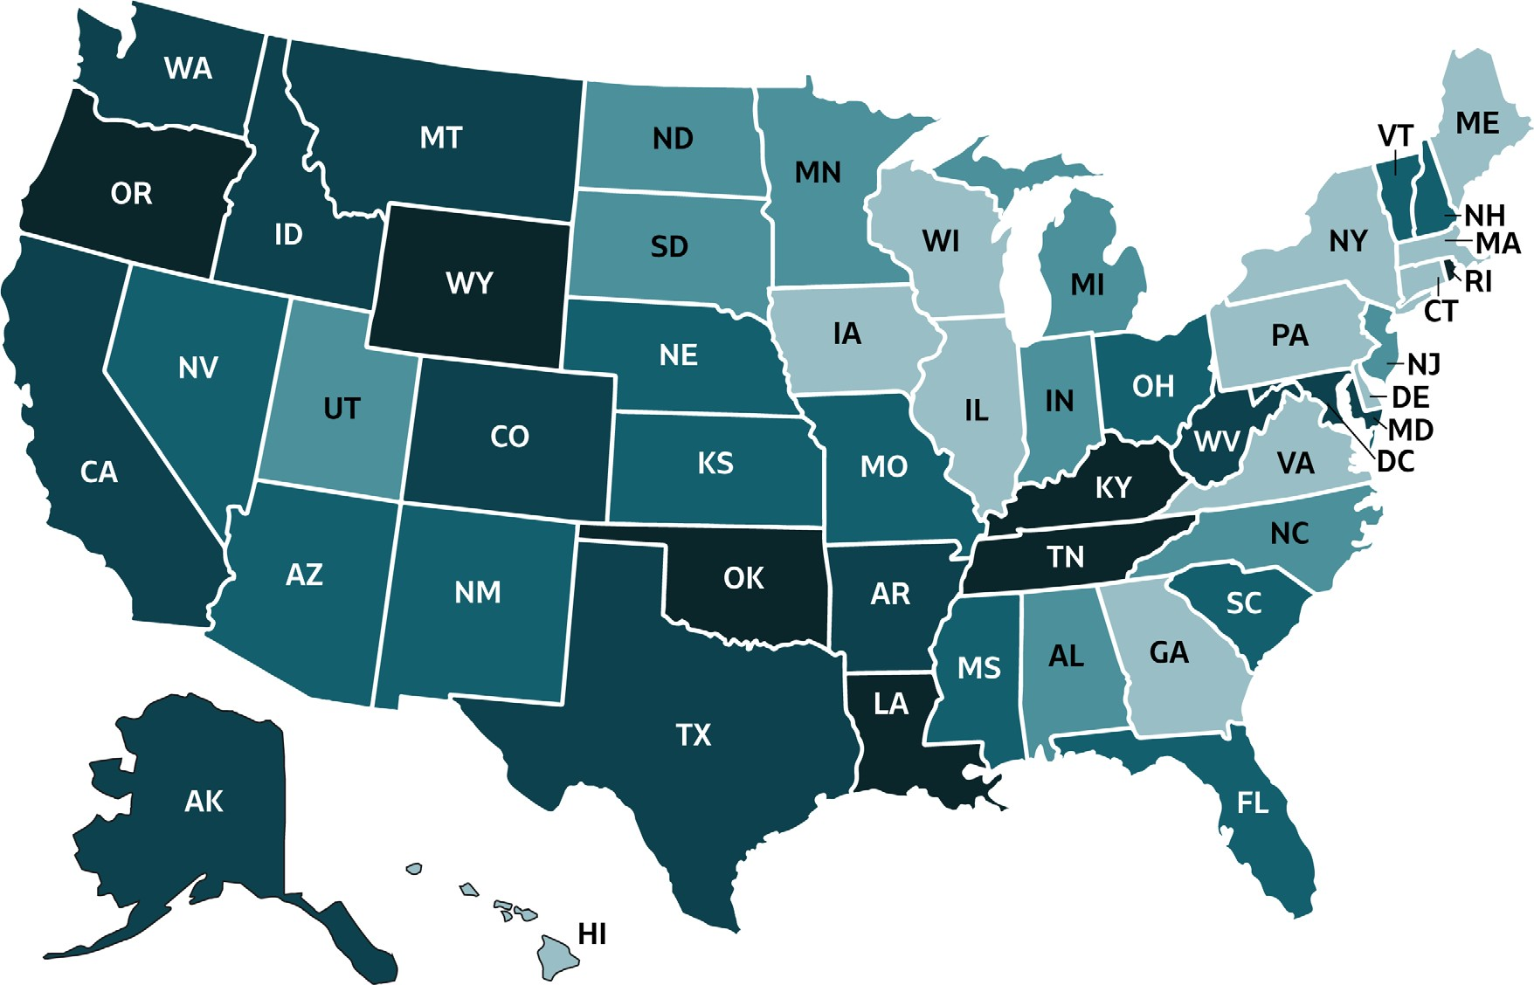
VIRAL HEPATITIS
SURVEILLANCE
Figure 3.9. Rate of deaths with hepatitis C listed as a cause of death among US residents, by jurisdiction and year — United States, 2018
 | Cases/100,000 Population | States
 | 0-2.49 | CT, DE, GA, HI, IL, IA, ME, MA, NY, PA, VA, WI
 | >2.49-3.12 | AL, IN, MI, MN, MO, NJ, NC, ND, SD, UT
 | >3.12-3.85 | AZ, FL, KS, MS, NE, NV, NH, OH, SC, VT
 | >3.85-5.49 | AK, AR, CA, CO, ID, MD, MT, TX, WA, WV
 | >5.49-11.00 | DC, KY, LA, NM, OK, OR, RI, TN, WY
Source: CDC, National Center for Health Statistics, Multiple Cause of Death 2018 on CDC WONDER Online Database.

Slide 58
VIRAL HEPATITIS SURVEILLANCE
Table 3.7. Number and rate* of deaths with hepatitis C listed as a cause of death† among U.S. residents, by demographic characteristics, region, and year— United States, 2014–2018
Demographic characteristic | 2014 |  | 2015 |  | 2016 |  | 2017 |  | 2018
 | No. | Rate* (95% CI) | No. | Rate* (95% CI) | No. | Rate* (95% CI) | No. | Rate* (95% CI) | No. | Rate* (95% CI)
Age group (years)
0–34 | 162 | 0.11 (0.09-0.13) | 196 | 0.13 (0.11-0.15) | 164 | 0.11 (0.09-0.13) | 180 | 0.12 (0.10-0.14) | 212 | 0.14 (0.12-0.16)
35–44 | 549 | 1.36 (1.24-1.47) | 592 | 1.46 (1.34-1.58) | 532 | 1.31 (1.20-1.43) | 507 | 1.24 (1.13-1.35) | 499 | 1.21 (1.10-1.31)
45–54 | 4,108 | 9.45 (9.16-9.74) | 3,659 | 8.47 (8.20-8.75) | 3,026 | 7.07 (6.82-7.32) | 2,556 | 6.03 (5.80-6.27) | 2,040 | 4.90 (4.69-5.11)
55–64 | 9,976 | 24.89 (24.40-25.38) | 9,678 | 23.68 (23.20-24.15) | 9,011 | 21.73 (21.28-22.18) | 8,275 | 19.70 (19.28-20.13) | 7,297 | 17.26 (16.87-17.66)
65–74 | 3,382 | 12.81 (12.38-13.24) | 4,009 | 14.55 (14.10-15.00) | 4,071 | 14.22 (13.78-14.66) | 4,397 | 14.81 (14.38-15.25) | 4,429 | 14.52 (14.10-14.95)
75+ | 1,431 | 7.21 (6.84-7.58) | 1,431 | 7.08 (6.71-7.45) | 1,288 | 6.25 (5.91-6.59) | 1,329 | 6.28 (5.94-6.61) | 1,235 | 5.63 (5.32-5.94)
Race/ethnicity
White, Non-Hispanic | 12,438 | 4.42 (4.34-4.50) | 12,329 | 4.35 (4.27-4.43) | 11,389 | 3.95 (3.88-4.03) | 10,781 | 3.70 (3.63-3.78) | 9,858 | 3.35 (3.28-3.42)
Black, Non-Hispanic | 3,535 | 8.12 (7.85-8.39) | 3,602 | 8.13 (7.86-8.40) | 3,360 | 7.42 (7.16-7.68) | 3,262 | 7.03 (6.79-7.28) | 2,978 | 6.31 (6.08-6.54)
Hispanic | 2,792 | 6.90 (6.63-7.16) | 2,737 | 6.48 (6.23-6.74) | 2,510 | 5.76 (5.53-6.00) | 2,399 | 5.29 (5.08-5.51) | 2,190 | 4.64 (4.44-4.84)
Asian/ Pacific Islander, Non-Hispanic | 419 | 2.43 (2.19-2.67) | 415 | 2.32 (2.09-2.55) | 384 | 2.03 (1.82-2.24) | 368 | 1.86 (1.67-2.05) | 300 | 1.43 (1.27-1.60)
American Indian/ Alaska Native, Non-Hispanic | 287 | 10.05 (8.86-11.24) | 324 | 11.45 (10.18-12.73) | 285 | 9.80 (8.63-10.97) | 299 | 10.24 (9.04-11.44) | 264 | 9.05 (7.93-10.17)
Sex
Male | 13,962 | 7.38 (7.26-7.51) | 14,043 | 7.27 (7.15-7.40) | 12,815 | 6.48 (6.36-6.59) | 12,287 | 6.12 (6.01-6.23) | 11,242 | 5.53 (5.42-5.63)
Female | 5,651 | 2.82 (2.75-2.90) | 5,523 | 2.71 (2.63-2.78) | 5,278 | 2.54 (2.47-2.61) | 4,966 | 2.32 (2.26-2.39) | 4,471 | 2.09 (2.02-2.15)
DHHS Region
Region 1: Boston | 717 | 3.77 (3.48-4.05) | 732 | 3.78 (3.50-4.07) | 616 | 3.10 (2.85-3.35) | 602 | 2.97 (2.72-3.21) | 519 | 2.56 (2.33-2.79)
Region 2: New York | 1,538 | 4.27 (4.05-4.49) | 1,379 | 3.78 (3.58-3.98) | 1167 | 3.12 (2.94-3.30) | 1,043 | 2.76 (2.59-2.93) | 924 | 2.48 (2.31-2.64)
Region 3: Philadelphia | 1,551 | 3.95 (3.75-4.15) | 1,675 | 4.17 (3.96-4.37) | 1,478 | 3.68 (3.48-3.87) | 1,441 | 3.53 (3.35-3.72) | 1,253 | 3.04 (2.87-3.22)
Region 4: Atlanta | 3,679 | 4.61 (4.46-4.76) | 3,703 | 4.53 (4.38-4.68) | 3,500 | 4.18 (4.03-4.32) | 3,450 | 4.03 (3.89-4.16) | 3,160 | 3.60 (3.47-3.72)
Region 5: Chicago | 2,155 | 3.23 (3.10-3.37) | 2,182 | 3.24 (3.11-3.38) | 2,064 | 3.01 (2.88-3.15) | 1,846 | 2.63 (2.51-2.75) | 1,762 | 2.52 (2.40-2.64)
Region 6: Dallas | 3,148 | 6.94 (6.69-7.18) | 3,280 | 7.08 (6.83-7.33) | 3,194 | 6.69 (6.45-6.92) | 3,169 | 6.54 (6.31-6.77) | 2,907 | 5.85 (5.64-6.07)
Region 7: Kansas City | 629 | 3.96 (3.40-3.99) | 623 | 3.58 (3.29-3.87) | 593 | 3.31 (3.04-3.59) | 589 | 3.24 (2.97-3.51) | 544 | 3.04 (2.78-3.30)
Region 8: Denver | 589 | 4.44 (4.07-4.80) | 634 | 4.67 (4.30-5.04) | 640 | 4.69 (4.32-5.06) | 615 | 4.38 (4.02-4.73) | 636 | 4.45 (4.09-4.80)
Region 9: San Francisco | 4,230 | 7.30 (7.07-7.52) | 4,053 | 6.84 (6.63-7.05) | 3,668 | 6.08 (5.88-6.28) | 3,330 | 5.37 (5.19-5.56) | 2,928 | 4.63 (4.46-4.80)
Region 10: Seattle | 1,377 | 8.10 (7.66-8.54) | 1,305 | 7.49 (7.08-7.91) | 1,173 | 6.56 (6.17-6.94) | 1,168 | 6.38 (6.01-6.76) | 1,080 | 5.79 (5.43-6.14)
Overall | 19,613 | 5.01 (4.93-5.08) | 19,566 | 4.91 (4.84-4.98) | 18,093 | 4.42 (4.36-4.49) | 17,253 | 4.13 (4.07-4.20) | 15,713 | 3.72 (3.66-3.78)
Source: CDC, National Center for Health Statistics, Multiple Cause of Death 1999–2018 on CDC WONDER Online Database. Data are from the 2014–2018 Multiple Cause of Death files and are based on information from all death certificates filed in the vital records offices of the fifty states and the District of Columbia through the Vital Statistics Cooperative Program. Deaths of nonresidents (e.g., nonresident aliens, nationals living abroad, residents of Puerto Rico, Guam, the Virgin Islands, and other U.S. Territories) and fetal deaths are excluded. Numbers are slightly lower than previously reported for 2013–2016 due to NCHS standards which restrict displayed data to U.S. residents. Accessed at http://wonder.cdc.gov/mcd-icd10.html on February 14, 2020. CDC WONDER dataset documentation and technical methods can be accessed at https://wonder.cdc.gov/wonder/help/mcd.html#.
* Rates for race/ethnicity, sex, and the overall total are age-adjusted per 100,000 U.S. standard population in 2000 using the following age group distribution (in years): <1, 1–4, 5–14, 15–24, 2 SYMFONISK 5–34, 35–44, 45–54, 55–64, 65–74, 75–84, and 85+. Missing data are not included. For age-adjusted death rates, the age-specific death rate is rounded to one decimal place before proceeding to the next step in the calculation of age-adjusted death rates for NCHS Multiple Cause of Death on CDC WONDER. This rounding step may affect the precision of rates calculated for small numbers of deaths.
† Cause of death is defined as one of the multiple causes of death and is based on the International Classification of Diseases, 10th Revision (ICD-10) codes B17.1, and B18.2 (hepatitis C).

