Slide 1
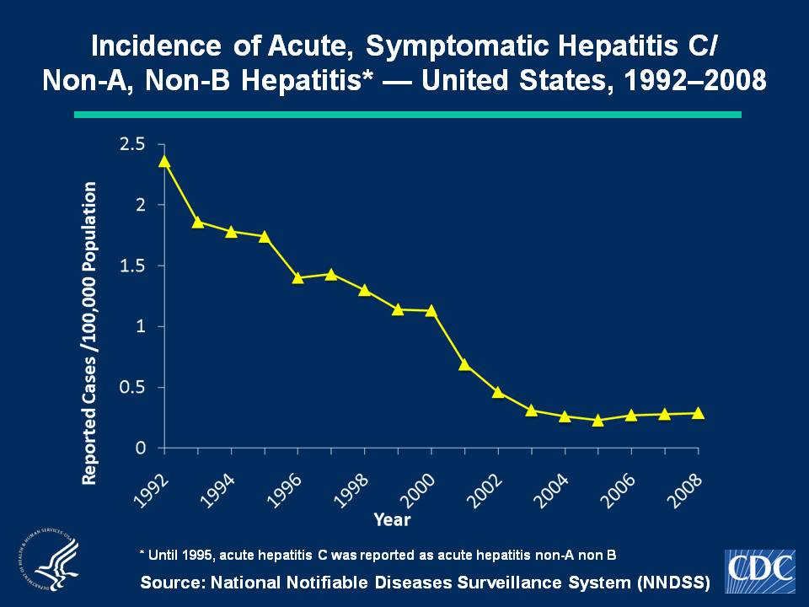
Notes:
Slide 1c - Incidence of Acute, Symptomatic Hepatitis C/Non-A, Non-B Hepatitis* — United States, 1992–2008
No hepatitis C vaccine exists. In 2008, a total of 878 acute, symptomatic cases of hepatitis C hepatitis were reported nationwide. The overall incidence rate for hepatitis C hepatitis virus remained stable at 0.3 cases per 100,000 population

Slide 2
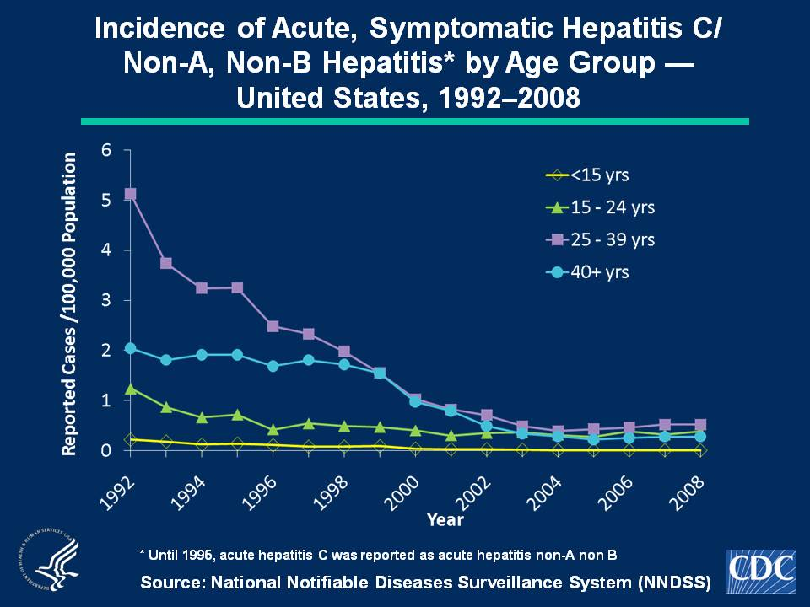
Notes:
Slide 2c - Incidence of Acute, Symptomatic Hepatitis C/Non-A, Non-B Hepatitis* by Age Group — United States, 1992–2008
Since 2003, acute, symptomatic hepatitis C hepatitis rates have plateaued within all age groups. In 2008, rates increased slightly among persons aged 15-24 years (0.4 cases per 100,000 population) and were highest for persons aged 25-39 years (0.5 cases per 100,000 population). Few cases were reported among persons aged < 15 years.

Slide 3
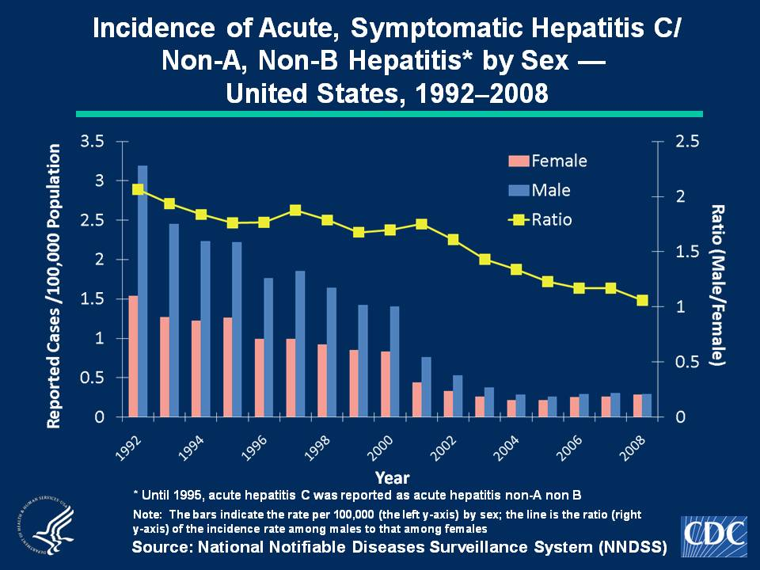
Notes:
Slide 3c - Incidence of Acute, Symptomatic Hepatitis C/Non-A, Non-B Hepatitis* by Sex — United States, 1992–2008
Historically, rates of acute, symptomatic hepatitis C hepatitis have been higher among males than females. Since 2002, the male-to-female ratio of rates has declined and was nearly 1 in 2008. In 2008, incidence among males and females was 0.3 cases per 100,000 population.

Slide 4
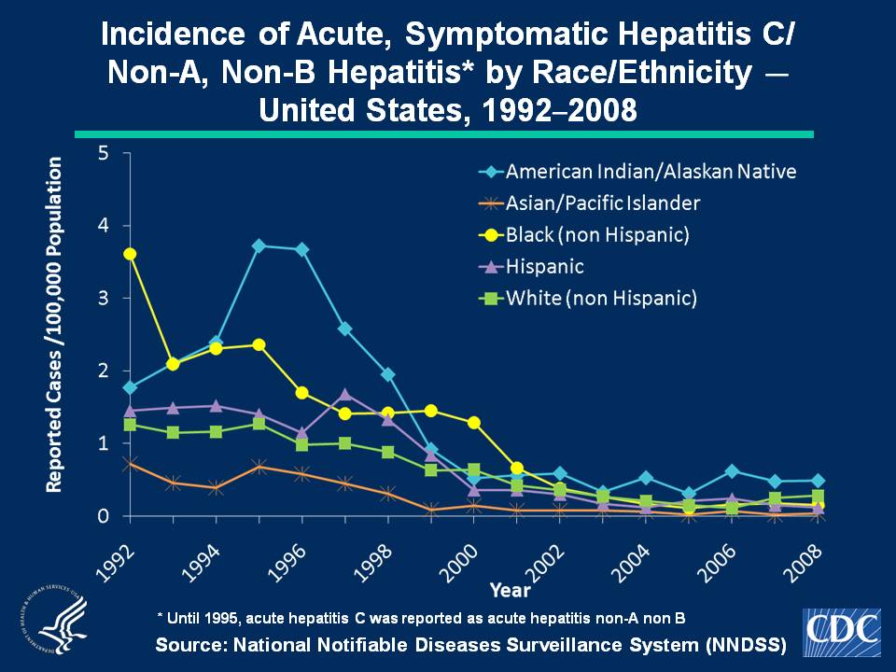
Notes:
Slide 4c - Hepatitis C/Non-A, Non-B Hepatitis* by Race/Ethnicity — United States, 1992–2008
In 2008, acute, symptomatic hepatitis C hepatitis rates were highest among American Indian/Alaskan Natives (0.5 cases per 100,000 population) and lowest among Asian/Pacific Islanders (0.04 cases per 100,000 population).

