Slide 1
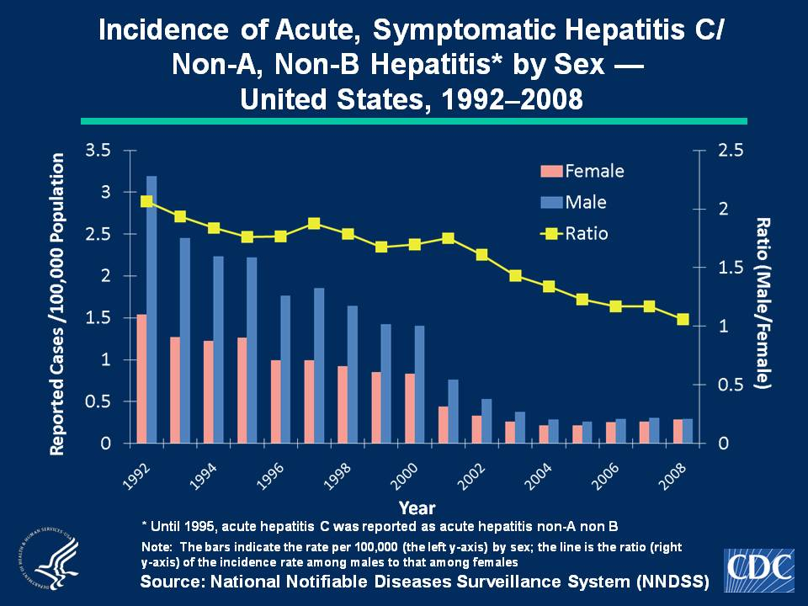
Notes:
Slide 3c - Incidence of Acute, Symptomatic Hepatitis C/Non-A, Non-B Hepatitis* by Sex — United States, 1992–2008
Historically, rates of acute, symptomatic hepatitis C hepatitis have been higher among males than females. Since 2002, the male-to-female ratio of rates has declined and was nearly 1 in 2008. In 2008, incidence among males and females was 0.3 cases per 100,000 population.

