Slide 1
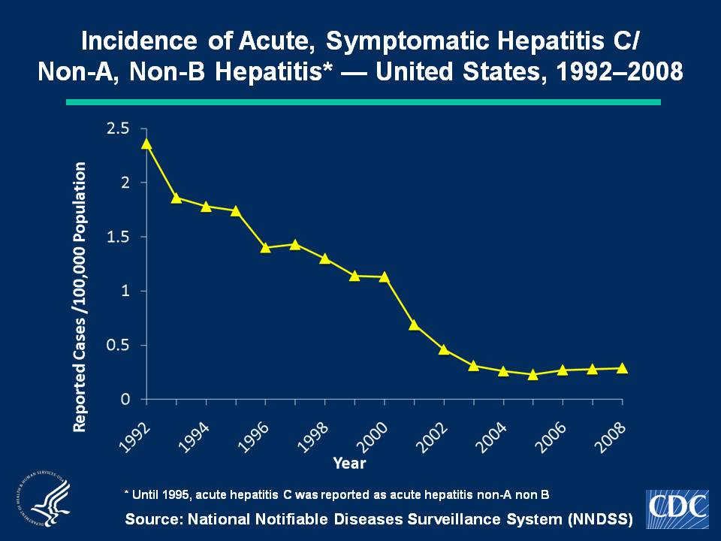
Notes:
Slide 1c - Incidence of Acute, Symptomatic Hepatitis C/Non-A, Non-B Hepatitis* — United States, 1992–2008
No hepatitis C vaccine exists. In 2008, a total of 878 acute, symptomatic cases of hepatitis C hepatitis were reported nationwide. The overall incidence rate for hepatitis C hepatitis virus remained stable at 0.3 cases per 100,000 population

