Slide 1
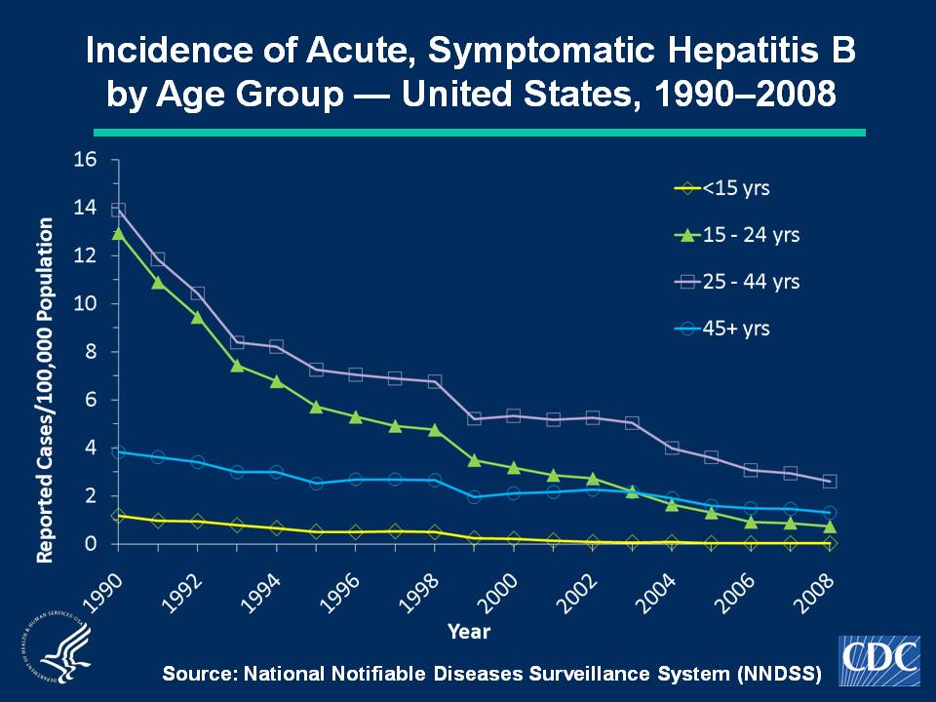
Notes:
Slide 3b - Incidence of Acute, Symptomatic Hepatitis B by Age Group — United States, 1990–2008
These data indicate acute, symptomatic hepatitis B rates have differed by age; the highest rates were observed among persons aged 15-44 years; the lowest rates were among persons aged < 15 years. In 2008, rates were highest for persons aged 25-44 years (2.6 cases per 100,000 population); the lowest rates were among children < 15 years (0.02 cases per 100,000 population).

