Slide 1
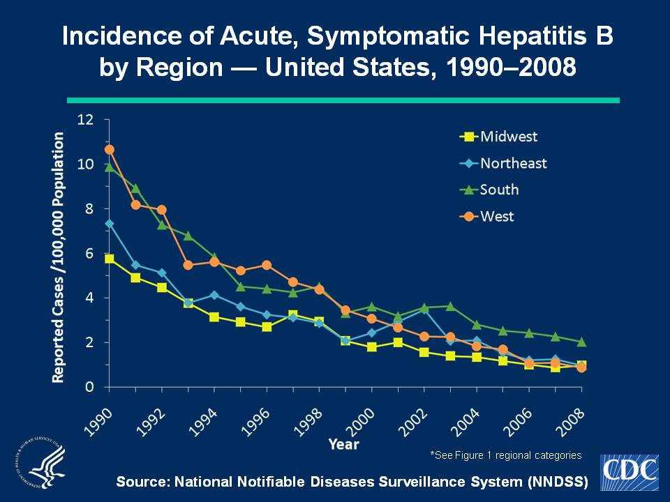
Notes:
Slide 2b - Incidence of Acute, Symptomatic Hepatitis B by Region — United States, 1990–2008
Hepatitis B rates have varied geographically. Higher rates were reported in the western and southern regions of the United States. During 2000-2008, rates in the South have been higher than in other regions of the United States.
The Midwest is comprised of the following states: Illinois, Indiana, Iowa, Kansas, Michigan, Minnesota, Missouri, Nebraska, North Dakota, Ohio, South Dakota, and Wisconsin. The Northeast is comprised of the following states: Connecticut, Maine, Massachusetts, New Hampshire, New Jersey, New York, Pennsylvania, Rhode Island, and Vermont. The South is comprised of the following states: Alabama, Arkansas, Delaware, District of Columbia, Florida, Georgia, Kentucky, Louisiana, Maryland, Mississippi, North Carolina, Oklahoma, South Carolina, Tennessee, Texas, Virginia, and West Virginia. The West is comprised of the following states: Alaska, Arizona, California, Colorado, Hawaii, Idaho, Montana, Nevada, New Mexico, Oregon, Utah, Washington, and Wyoming.

