Slide 1
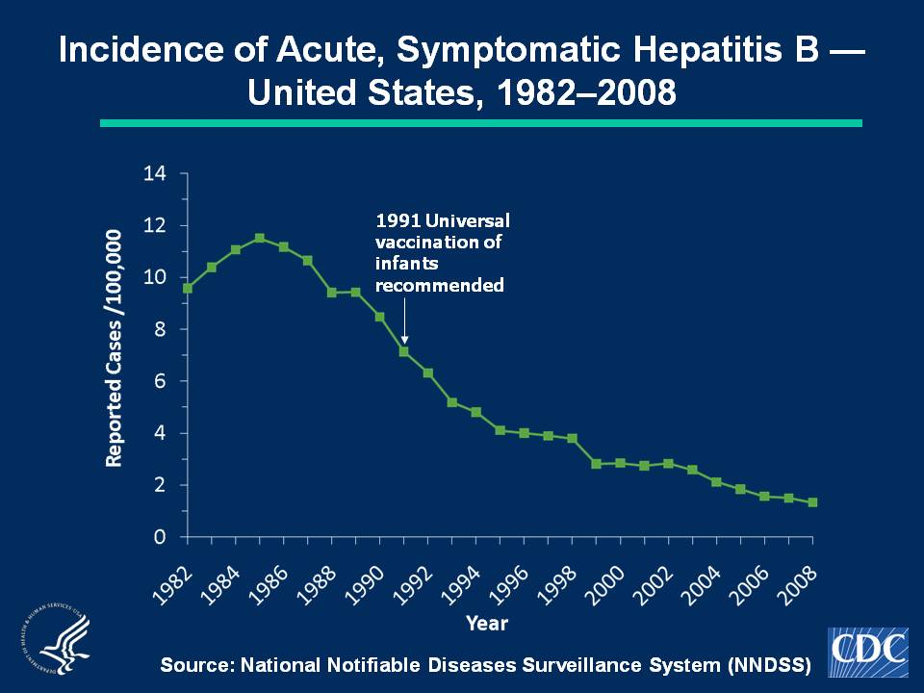
Notes:
Slide 1b - Incidence of Acute, Symptomatic Hepatitis B — United States, 1982–2008
Hepatitis B vaccine was licensed in 1981 and in 1991 a comprehensive strategy by the Advisory Committee on Immunization Practices (ACIP) was recommended for the elimination of hepatitis B virus transmission in the United States. In 2008, a total of 4,033 acute, symptomatic cases of hepatitis B were reported nationwide. The 2008 national incidence rate of 1.3 cases per 100,000 population was the lowest ever recorded.

