Slide 1
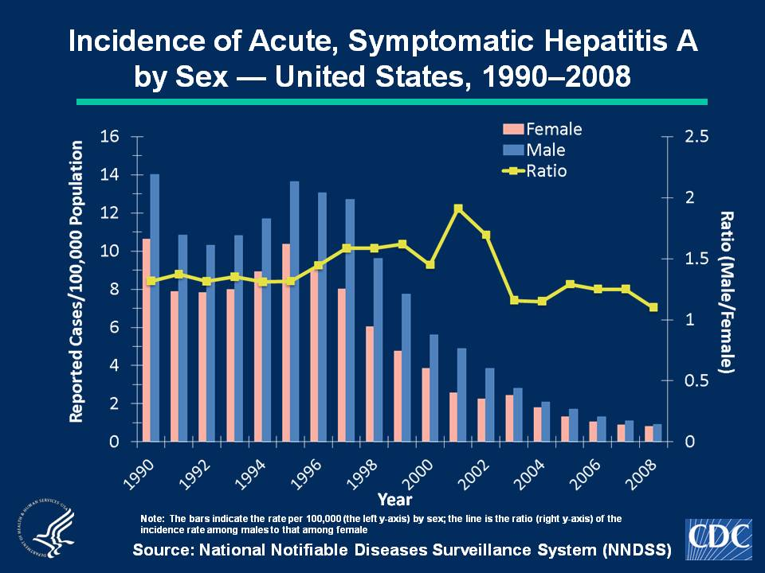
Notes:
Slide 4a. Incidence of Acute, Symptomatic Hepatitis A by Sex — United States, 1990–2008.
Historically, rates of acute, symptomatic hepatitis A have been higher among males than females; during 1996-2002, the difference in the sex-specific rates increased until nearly 2 male cases were observed for every female case. However, since 2006, overall rates have declined more among males than among females. In 2008, incidence among males was 0.9 cases per 100,000 population, compared with 0.8 cases per 100,000 population among females (Slide 5).

