Slide 1
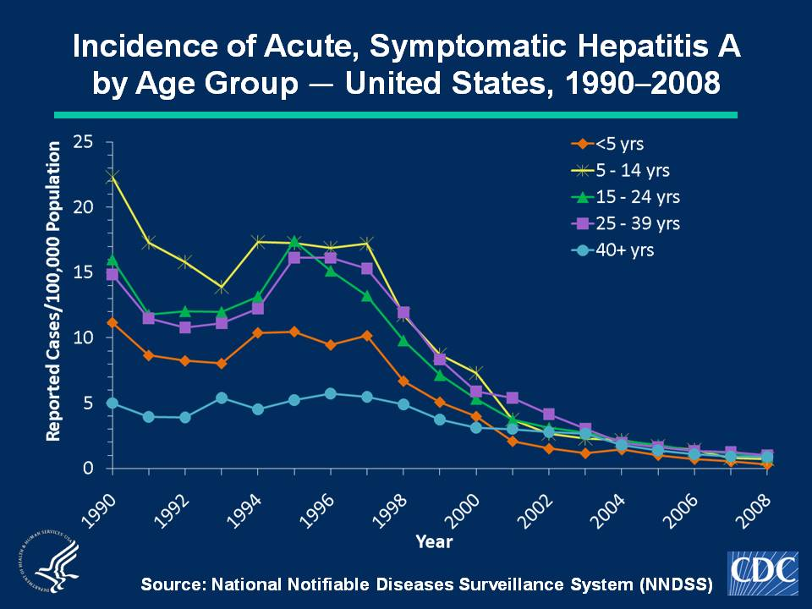
Notes:
Slide 3a. Incidence of Acute, Symptomatic Hepatitis A by Age Group — United States, 1990–2008.
Historically, acute, symptomatic hepatitis A rates have differed by age; the highest rates were observed among children and young adults; the lowest rates were among persons aged ≥ 40 years. In 2008, rates were highest for persons aged 25-39 years (1.0 cases per 100,000 population); the lowest rates were among children < 5 years (0.3 cases per 100,000 population).

