Slide 1
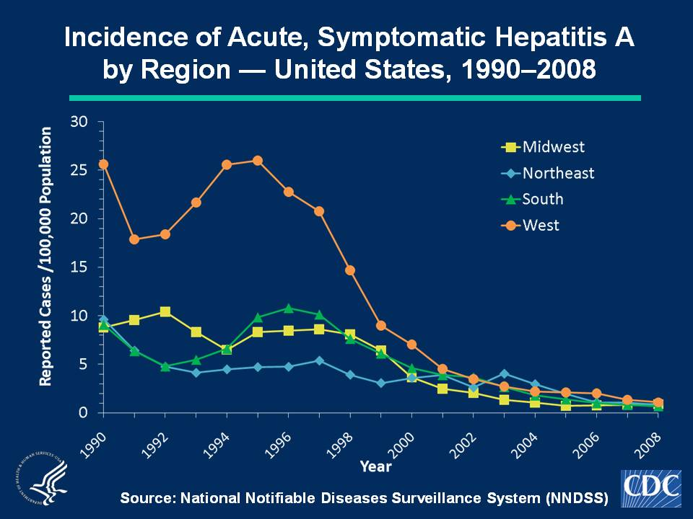
Notes:
Slide 2a. Incidence of Acute, Symptomatic Hepatitis A by Region — United States, 1990–2008.
Historically, hepatitis A rates have varied geographically. Higher rates were reported in the western region of the United States. Incidence in the West has declined substantially, most notably after issuance in 1999 of recommendations for routine childhood vaccination in states with consistently elevated rates of hepatitis A. Since 2002, rates in the West have been approximately equal to those in other regions of the United States.
The Midwest is comprised of the following states: Illinois, Indiana, Iowa, Kansas, Michigan, Minnesota, Missouri, Nebraska, North Dakota, Ohio, South Dakota, and Wisconsin. The Northeast is comprised of the following states: Connecticut, Maine, Massachusetts, New Hampshire, New Jersey, New York, Pennsylvania, Rhode Island, and Vermont. The South is comprised of the following states: Alabama, Arkansas, Delaware, District of Columbia, Florida, Georgia, Kentucky, Louisiana, Maryland, Mississippi, North Carolina, Oklahoma, South Carolina, Tennessee, Texas, Virginia, and West Virginia. The West is comprised of the following states: Alaska, Arizona, California, Colorado, Hawaii, Idaho, Montana, Nevada, New Mexico, Oregon, Utah, Washington, and Wyoming.

