Slide 1
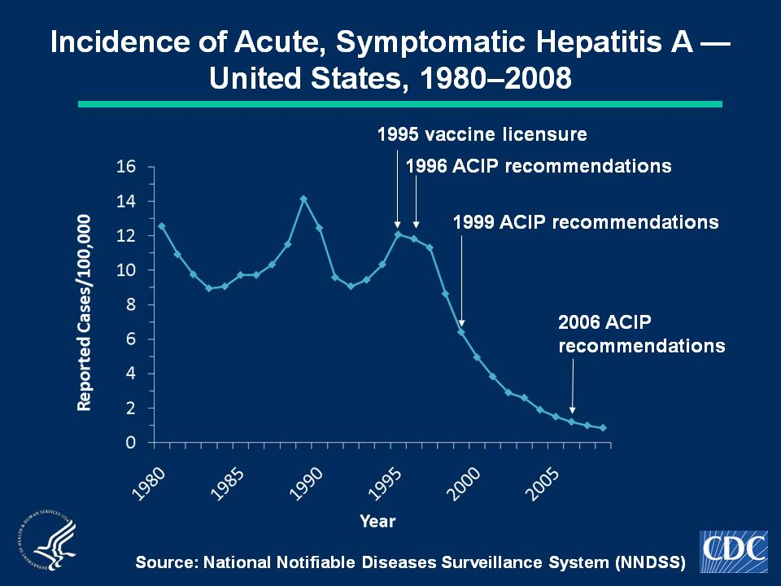
Notes:
Slide 1a. Incidence of Acute, Symptomatic Hepatitis A — United States, 1980–2008.
Hepatitis A vaccine was licensed in 1995 and the Advisory Committee on Immunization Practices (ACIP) made hepatitis A vaccination recommendations in 1996, 1999, and 2006. In 2008, a total of 2,585 acute, symptomatic cases of hepatitis A were reported. The 2008 national incidence rate of 0.9 per 100,000 population was the lowest ever recorded.

