Slide 1
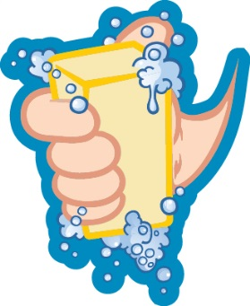
Handwashing
Around the World

Slide 2
How many hands are in the world?

Slide 3
How many hands are in the world?
13,947,476,866

Slide 4
How many hands are in the world?
13,947,476,866
But many don’t get washed, and that can make people sick.

Slide 5
What does sanitation mean?

Slide 6
What does sanitation mean?
Flushing away bathroom waste safely in a toilet or latrine.

Slide 7
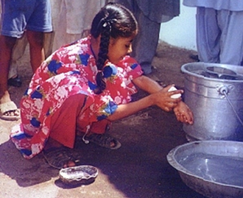
What does sanitation mean?
Flushing away bathroom waste safely in a toilet or latrine.
More than 1 in 3 people in the world don’t have this.
This means waste can spread germs onto the ground, water, and food.

Slide 8
More than 800,000 kids around the world die each year.

Slide 9
More than 800,000 kids around the world die each year. Why?
Why?

Slide 10
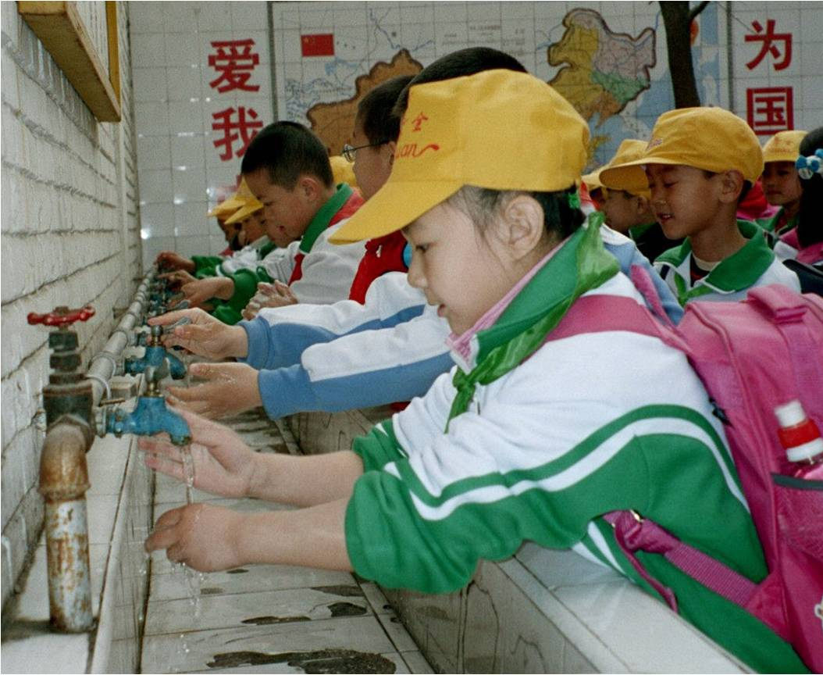
That’s almost 10 times as many kids as live in Atlanta!
More than 800,000 kids around the world die each year because of diarrhea they get from water that’s not safe to drink, not washing their hands, or having bad sanitation.

Slide 11
How can handwashing help kids?

Slide 12
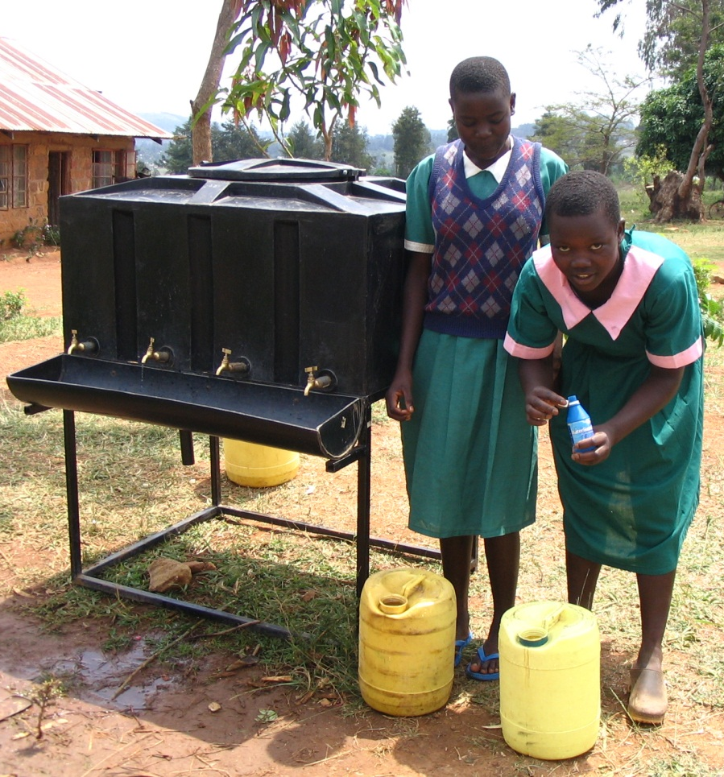
How can handwashing help kids?
Handwashing and good hygiene can help kids
Stay healthy
Not have diarrhea or colds
Not get family members sick
Not miss school
In some places, even learn better & grow taller!

Slide 13
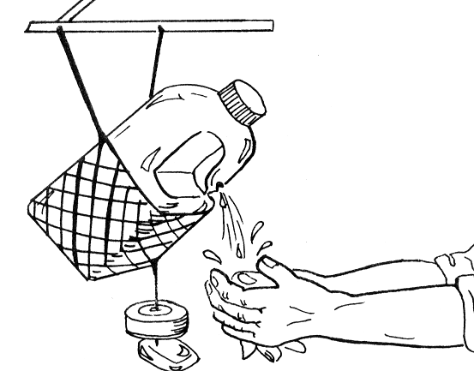
What is this?

Slide 14
What is this?
A tippy tap!

Slide 15
What is this?
A tippy tap!
Some people make their own handwashing stations out of plastic jugs or water bottles in many places where they don’t have sinks.

Slide 16
What can we do to prevent almost 1 in 10 sicknesses around the world?

Slide 17
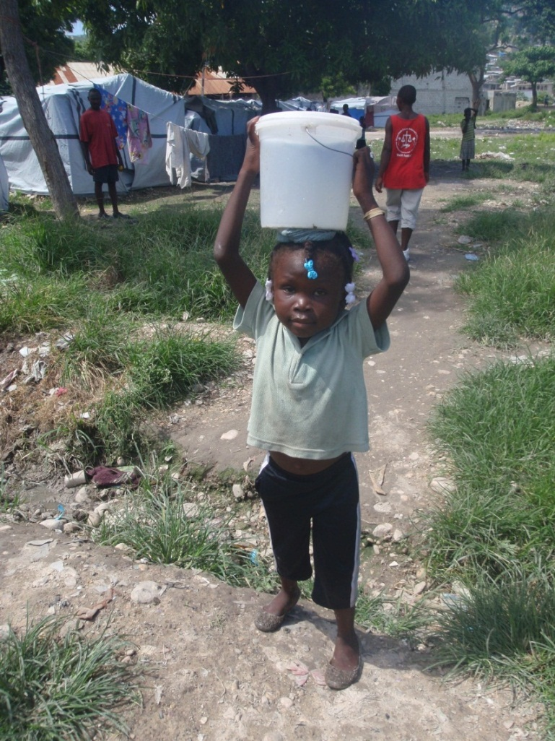
What can we do to prevent almost 1 in 10 sicknesses around the world?
More handwashing
Safer drinking water
Better sanitation

Slide 18
It starts with you!
[Video below and at http://www.cdc.gov/CDCTV/WashYourHands]

