Slide 1
Healthy Community Design
Making the Healthy Choice the Easy Choice
Name
Title
Org
Notes:
What’s the most important number in determining your health? Your age? Your blood pressure or cholesterol level? How about your address? Your address plays an important role in how long you live and how good you feel. That’s because every time you step out your door, your health is affected by the physical design of your community. Many of us would really like to make healthy choices. But that can be hard if things like sidewalks, parks and healthy foods aren’t available in our community.
Today, I’m going to give you a brief overview on how the design of your community can help or hurt your health. Then I’m going to introduce a checklist for you to use in the breakout sessions this afternoon as a guide to help you make INSERT COMMUNITY NAME happier and healthier.

Slide 2
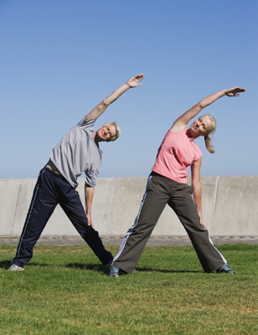
What is Health?
Health is the state of complete physical, mental and social well-being and not merely the absence of disease or infirmity
- World Health Organization
Notes:
So what is health? Here’s a popular definition. This definition defines health as more than being free of disease or not feeling sick; it is also about emotional and mental health such as feelings as happiness, contentment, and security. So health is about healthy bodies AND minds.
****
Source:
World Health Organization. Frequently asked questions [online]. No date. [cited 2010 August 11]. Available from URL: http://www.who.int/suggestions/faq/en/.

Slide 3



What Factors Determine Our Health?
Family Health History
Environment
Behaviors/Lifestyles
Notes:
How healthy you are is different for everyone. That’s because three major factors determine our health:
Family Health History: Many people have a family health history of some chronic diseases (like cancer, coronary heart disease, and diabetes) and health conditions (like high blood pressure). People who have a close family member with a chronic disease may have a higher risk for developing that disease than those without such a family member.
Behaviors/Lifestyles: Some people are able to eat healthily, get regular physical activity and maintain a healthy weight; they don’t smoke and have a lifestyle that puts them at lower risk for injury or developing a disease.
Environment – The environment can directly influence our health, like if we breathe in polluted air or drink contaminated water. But the physical environment where we are born, grow, live, work, worship, and age can also influence our behavior and lifestyle. So how your community is designed can affect your physical and mental health. And you can make your community healthier through healthy community design.
***
Sources:
Centers for Disease Control and Prevention. Public health genomics: Family health history [online]. 2010 March 8 [cited 2010 Aug 11]. Available from URL www.cdc.gov/genomics/famhistory/index.htm.
World Health Organization. Social determinants of health [online]. No date [cited 2010 August 11]. Available from URL www.who.int/social_determinants/en/.

Slide 4
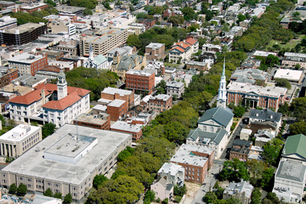

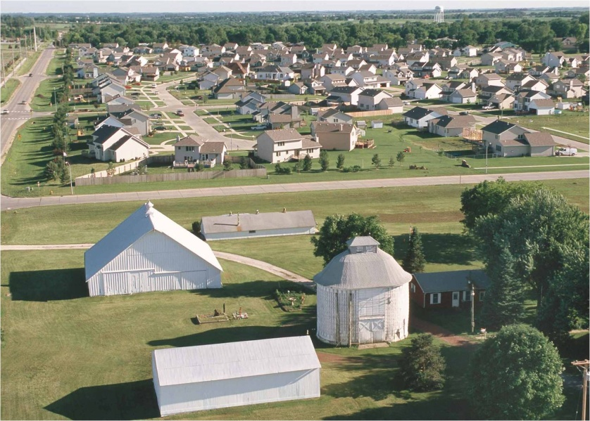
What is community design?
Notes:
Where our schools, parks, grocery stores, homes, or employment centers are located make up a community’s design. How the streets are arranged is part of community design, too— so are its highways. Community design includes all the human-made structures that make up a community.
Community design is usually decided by a community’s planning processes----and today you are going to be planners! Just because something is a certain way now, doesn’t mean it has to be that way forever. We can change the design of our community and make it healthier for everyone.

Slide 5
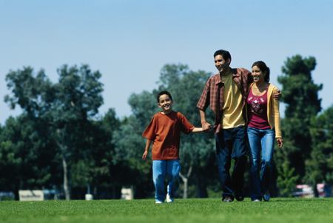
What is Healthy Community Design?
Planning and designing communities that make the healthy choice the easy choice.
Notes:
Making a community happier and healthier for everyone: That’s healthy community design. Healthy community design is planning and designing communities that make the healthy choice the easy choice. it makes healthy lifestyle choices easy and accessible for all community members.
Healthy community design links the traditional concepts of planning (such as land use, transportation, community facilities, parks, and open space) with health themes (such as physical activity, public safety, healthy food access, mental health, air and water quality, and social equity issues).
***
Source:
Design for Health. Integrating health into comprehensive planning [online]. No date [cited 2010 Aug 11]. Available from URL: www.designforhealth.net/resources/integratinghealthissue.html.

Slide 6
How Can Community Design Affect Our Health?
Social Connections
Air Quality
Physical Activity Levels
Access to Healthy Foods
Water Quality
Traffic-related Crashes
Social Equity
Climate Change/Extreme Weather
Notes:
Community design can affect our health in a variety of ways. Because of time, I will touch upon some of the issues in red. I also have two fact sheets available that explain further how all of these issues are affected by community design. We also have a Healthy Places Web site which I will give you the link at the end of the presentation.
NOTE TO PRESENTER: Factsheets are: 1) Healthy Community Design and 2) Health Issues Related to Healthy Community Design. They are available in the Healthy Community Design Checklist toolkit and on the Healthy Places website at www.cdc.gov/healthyplaces.

Slide 7

Physical Activity Levels
A sedentary lifestyle is a primary risk factor in
Cardiovascular disease
Stroke
All causes of death
Notes:
It is a well-established fact that physical activity prolongs life. And people who live in communities where it is safer to walk or bike to daily activities like shopping, work, school, and recreation are generally more physically active—JUST FROM THEIR SHORT TRIPS GETTING AROUND TOWN. Incorporating physical activity into our daily routines helps reduce our risk from leading chronic disease killers like stroke, cardiovascular disease, and some types of cancer such as colon and breast cancer.
How much regular physical activity does The Centers for Disease Control and Prevention recommend to maintain good health? CDC recommends that adults ages 16-64 take a minimum 10-minute brisk walk 3 times a day, 5 days a week. Imagine making your community one where you could achieve that every day by walking or biking to school and work, or running errands. YOU WOULD HARDLY NOTICE THAT YOU WERE GETTING YOUR RECOMMENDED DOSE OF PHYSICAL ACTIVITY!
***
Sources:
McCann BA, Ewing R. Measuring the effects of sprawl: A national analysis of physical activity, obesity and chronic disease. Smart Growth America Surface Transportation Policy Project: September 2003. Available from URL: www.smartgrowthamerica.org/report/HealthSprawl8.03.pdf [cited 2010 Aug 11].
Centers for Disease Control and Prevention. Physical activity for everyone [online]. 2010 June 21. [cited 2010 Aug 11]. Available from URL: www.cdc.gov/physicalactivity/everyone/guidelines/.
US Department of Health and Human Services. Physical activity and health: a report of the Surgeon General. Atlanta, Georgia: US Department of Health and Human Services, Public Health Service, CDC, National Center for Chronic Disease Prevention and Health Promotion; 1996.
NIH Consensus Development Panel on Physical Activity and Cardiovascular Health. NIH Consensus Conference: physical activity and cardiovascular health. JAMA 1996;276:241-246.
Wannamethee SG, et al. Lifestyle and 15-year survival free of heart attack, stroke, and diabetes in middle-aged British men. Arch Internal Med 1998;158(22):2433-40.
Wannamethee SG, et al. Physical activity and the prevention of stroke. J Cardiovasc Risk 1999;6(4):213-6.
Pate RR, et al. Physical activity and public health: a recommendation from the Centers for Disease Control and Prevention and the American College of Sports Medicine. JAMA 1995;273:402-407.
Lee IM, Paffenbarger RS Jr. Associations of light, moderate, and vigorous intensity physical activity with longevity. The Harvard Alumni Health Study. Am J Epidemiol 2000;151:293-9.
Wannamethee SG, et al. Changes in physical activity, mortality and incidence of coronary heart disease in older men. Lancet 1998;351:1603-08.
Wei M, et al. Relationship between low cardiorespiratory fitness and mortality in normal-weight, overweight, and obese men. JAMA 1999;282:1547-1553.
Sesso HD, et al. Physical activity and cardiovascular disease risk in middle-aged and older women. Am J Epidemiol 1999;150(4):408-16.
Wei M, et al. Relationship Between Low cardiorespiratory fitness and mortality in normal-weight, overweight, and obese men. JAMA 1999;282:1547-1553.
Blair SN, et al. Influences of cardiorespiratory fitness and other precursors on cardiovascular disease and all-cause mortality in men and women. JAMA 1996;276:205-210.

Slide 8
Obesity Trends* Among U.S. Adults
BRFSS, 1990, 2000, 2010
(*BMI ≥30, or about 30 lbs. overweight for 5’4” person)
1990
2000
2010
No Data <10% 10%–14% 15%–19% 20%–24% 25%–29% ≥30%
Notes:
Why is daily physical activity important? Because we have an obesity epidemic in this country. These maps show obesity trends among U.S. adults in 1990, 2000 and 2010. The map keeps getting more and more red: we are becoming an obese nation. Today, more than 1/3 of U.S. adults are obese; nearly 17% of U.S. children and adolescents are obese. Since 1980, obesity rates for adults have doubled and rates for children have tripled. Children and adolescents are developing obesity-related diseases, such as type 2 diabetes, that were once seen only in adults. Obese children are more likely to have risk factors for cardiovascular disease, including high cholesterol levels, high blood pressure, and abnormal glucose tolerance.
NOTE TO PRESENTER: If audience asks - Obesity is defined as a body mass index (BMI)of 30 or higher; overweight is defined as a BMI of 25 or higher.
***
Sources:
Centers for Disease Control and Prevention. Chronic disease prevention and health promotion: the obesity epidemic [online]. 2009 Dec 17. [cited 2010 Aug 11]. Available from URL: http://www.cdc.gov/chronicdisease/resources/publications/AAG/obesity.htm.
Centers for Disease Control and Prevention. Children’s health & built environment [online]. 2009 Jun 16. [cited 2010 Sep 16]. http://www.cdc.gov/healthyplaces/healthtopics/children.htm.

Slide 9
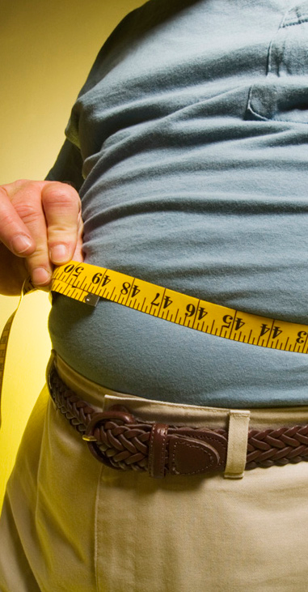
Health Consequences of Obesity
Coronary heart disease
Stroke
Type 2 diabetes
Cancer (endometrial, breast, and colon)
Hypertension (high blood pressure)
Dyslipidemia (high cholesterol or high levels of blood triglycerides)
Liver and Gallbladder disease
Sleep apnea and breathing problems
Osteoarthritis (a degeneration of cartilage and bone breaking down within a joint)
Ob-gyn problems (abnormal periods, infertility)
Notes:
And the health consequences of obesity? There are many. Here you see the list in order of highest prevalence.
Obesity also has economic consequences: In 2008, medical costs associated with obesity were estimated at $147 billion; the medical costs for people who are obese were $1,429 higher than those of normal weight.
***
Sources:
Centers for Disease Control and Prevention. Health consequences [online]. 2009 Dec 17. [cited 2011 Sep 13]. Available from URL: http://www.cdc.gov/obesity/causes/health.html.
Centers for Disease Control and Prevention. Overweight and obesity: Adult obesity facts [online]. 2012 Aug 13. [cited 2012 Nov 21]. Available from URL: http://www.cdc.gov/obesity/data/adult.html.

Slide 10
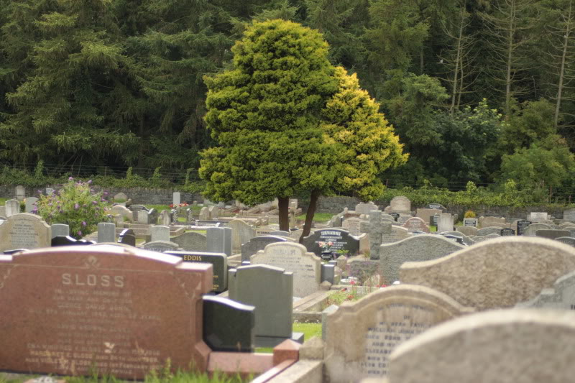
OUR Community Statistics
Top chronic disease killers (averaged over the past five years):
Cardiovascular disease X%
Cancer X%
Diabetes X%
Source: LIST SOURCE AND DATE HERE
Notes:
I have some stats on chronic diseases in YOUR community over the last five years. Getting more physically active and eating healthier could help reduce these diseases that are killing more than x% of YOUR COMMUNITY residents.
NOTE TO PRESENTER: Customize this slide to reflect the top chronic disease killers in your community—the more local the data to your geographic area the better. This will ensure the greatest impact on your audience. For sources of health data, see the Sources of Health Data fact sheet in the Healthy Community Design Checklist toolkit.

Slide 11
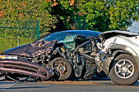
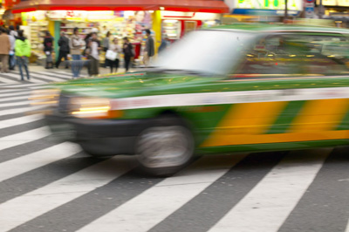
Traffic-Related Injuries and Deaths
Annual Statistics
30,000+ deaths
2+ million nonfatal injuries
$90 billion economic burden
The leading cause of death among persons aged 5–34 in U.S.
Notes:
But what if you don’t feel safe getting your daily physical activity by walking or biking in your community because of speeding cars or unsafe crosswalks? Communities that make it easier and safer to walk, bike or take public transit help reduce the number of cars on the road AND also help reduce some of annual statistics shown on this slide. That’s why it’s important for there to be room for bikes and pedestrians. That often means slowing down the speed of moving vehicles, creating bike lanes and making sure crosswalks are well-marked.
***
Sources:
Centers for Disease Control and Prevention. Motor vehicle safety [online]. 2011 May 20. [cited 2011 Jul 5]. Available from URL: http://www.cdc.gov/Motorvehiclesafety/index.html.
Centers for Disease Control and Prevention. 10 leading causes of injury deaths by age group highlighting
unintentional injury deaths, United States – 2007. No date. [cited 2011 Jul 5]. Available from URL: http://www.cdc.gov/injury/wisqars/pdf/Unintentional_2007-a.pdf.
Centers for Disease Control and Prevention. National estimates of the 10 leading causes of nonfatal injuries treated in hospital emergency departments, United States – 2008. No date. [cited 2011 Jul 5]. Available from URL: http://www.cdc.gov/injury/wisqars/pdf/Nonfatal_2008-a.pdf.
U.S. Department of Transportation. National Highway Traffic Safety Administration, National Center for Statistics and Analysis. Traffic safety facts 2008: a compilation of motor vehicle crash data from the fatality analysis reporting System and the general estimates system. Washington, DC: NHTSA; 2008. [cited 2010 Aug 11]. Available from URL: http://www-nrd.nhtsa.dot.gov/Pubs/811170.pdf.
Naumann R, Dellinger A, Zaloshnia E, Lawrence, B, Miller T. Incidence and Total Lifetime Costs of Motor Vehicle-Related Fatal and Nonfatal Injury by Road User Type, United States, 2005. Traffic Injury Prevention, Vol. 11, Issue 4, p. 353-360. August 2010.
Centers for Disease Control and Prevention. Costs of transportation-related injuries and deaths in the United States, 2005 [online]. 2011 26 Sept[cited 2012 18 Jul]. Available from URL: http://www.cdc.gov/motorvehiclesafety/data/cost-estimates.html.

Slide 12
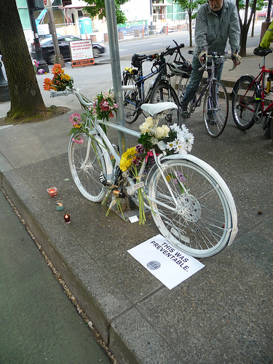
Pedestrian/Bicyclist Fatalities in
[name] County [year]
Total fatalities (all crashes): [number]
Pedestrian fatalities: [number]
Bicyclist (or Other Cyclist) Fatalities: [number]
Placeholder photo only
Source::National Highway Traffic Safety Administration State Traffic Safety Information
Notes:
Here are the total fatalities all crashes, and pedestrian and bicycle fatalities statistics for [name] County in [year].*
***
Sources:
Jacobsen PL. Safety in numbers: more walkers and bicyclists, safer walking and bicycling. Injury Prevention, 2003; 9:205-209. Available at URL: http://injuryprevention.bmj.com/content/9/3/205.full
*NOTE TO PRESENTER: Crash statistics for your county are available in the Highway Traffic Safety Administration State Traffic Information database at http://www-nrd.nhtsa.dot.gov/departments/nrd-30/ncsa/STSI/USA%20WEB%20REPORT.HTM.

Slide 13
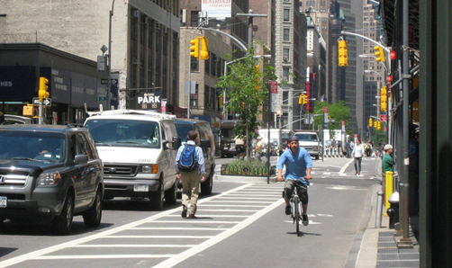
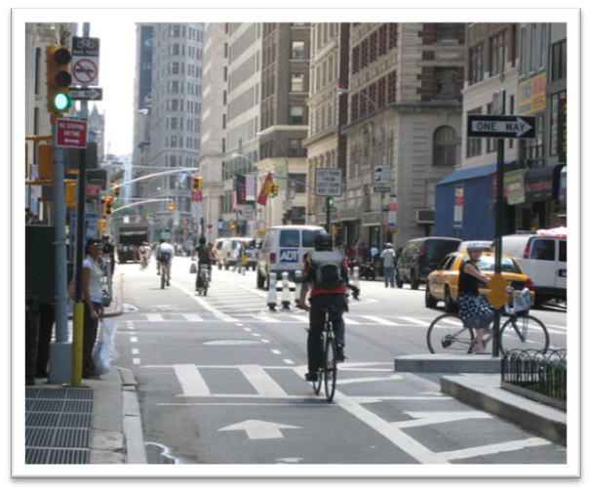
Active Transit Reduce Collisions
Motorists adjust their behavior if more people bike and walk.
Photo Credit: http://www.flickr.com/photos/designforhealth
Notes:
One study showed that there is safety in numbers: A motorist is less likely to collide with a person walking and bicycling if more people walk or bicycle.
***
Sources:
Jacobsen PL. Safety in numbers: more walkers and bicyclists, safer walking and bicycling. Injury Prevention, 2003; 9:205-209. Available at URL: http://injuryprevention.bmj.com/content/9/3/205.full

Slide 14

Healthy Food Access
Healthy foods may not be readily available
Healthy foods may be too expensive
Low-income/underserved communities have less access to healthy foods
Notes:
Communities where healthy foods are not accessible and affordable may also be contributing to the obesity epidemic in the United States. In fact, scientific studies have found that low-income and underserved communities often have less access to stores that sell healthy food, especially high-quality fruits and vegetables.
Good nutrition is vital to good health and disease prevention. But it’s hard for people to eat fruits and vegetables (and avoid junk food) if they CAN’T FIND QUALITY, AFFORDABLE fruits and vegetables IN THEIR NEIGHBORHOOD!
***
Sources:
Mari Gallagher Research & Consulting Group. Examining the impact of food deserts on public health in Detroit, 2007. [cited 2010 Aug 11]. Available from URL: http://marigallagher.com/projects/2/.
Story M, Kaphingst KM, Robinson-O'Brien R, Glanz K. Creating healthy food and eating environments: policy and environmental approaches. Annual Review of Public Health, April 2008;29:253–72.
Powell L. Food store availability and neighborhood characteristics in the United States. Preventive Medicine 2007;44:189–195.
Liese AD, Weis KE, Pluto D, Smith E, Lawson A. Food store types, availability and cost of foods in a rural environment. J Am Dietetic Assoc 2007;107(11):1916–23.
Zenk SN, Schulz AJ, Israel BA, James SA, Bao SM, Wilson ML. Fruit and vegetable access differs by community racial composition and socioeconomic position in Detroit, Michigan. Ethn Dis 2006;16(1):275–80.
Glanz, et al. Healthy nutrition environments: concepts and measures. Am J Health Promotion. 2005;19(5):330–3, ii.
Horowitz CR, Colson KA, Hebert PL, Lancaster K. Barriers to buying healthy foods for people with diabetes: evidence of environmental disparities. Am J Pub Health. 2004;94:1549–54.

Slide 15
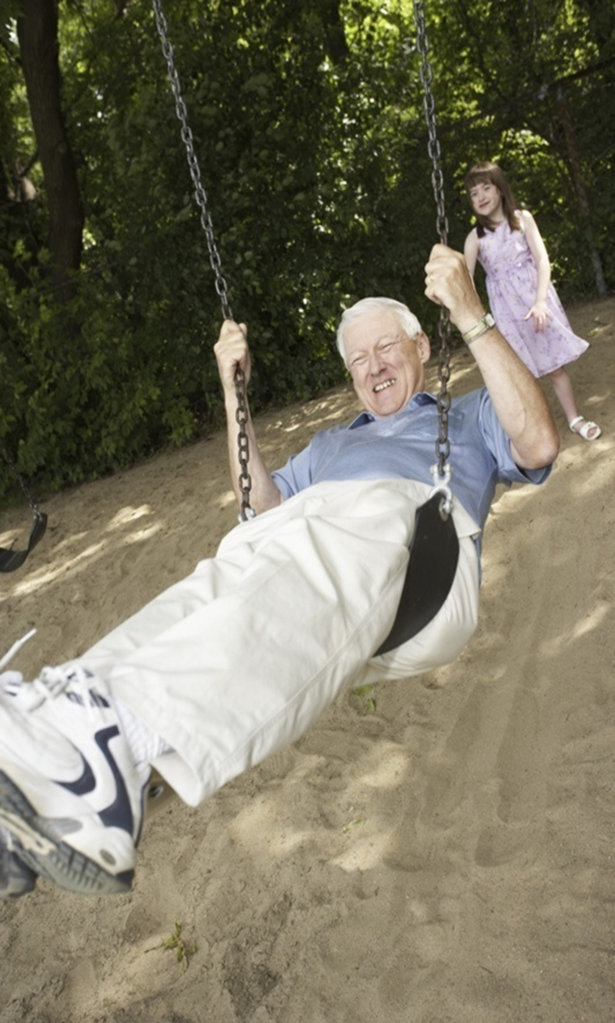
Social Connections
The fabric of a community
  Creating social bonds and sense of community through
  Social interaction
  Civic engagement
  Personal recreation
  Increasing social connections through
  Parks, public spaces
  Mixed-use communities
http://www.healthyalberta.com/Images/AL_Intergenerational_PHOTO.jpg
Notes:
Do you remember in the definition of health that it also included mental health? Social connections have a lot to do with mental health. Social connections are created through things such as community improvement, social networking, civic engagement, personal recreation, and other activities that create social bonds between individuals and groups. Such activities and bonds can have a POSITIVE effect on mental and physical health.
Social connections can be increased when you have:
Parks, green spaces and public places for leisure and social activities
Communities that are mixed-use, which means a mix of housing, civic, and commercial spaces, including retail, restaurants, and offices. Mixed use allows for more spontaneous social interaction and helps people to get to know their neighbors. AND, when people don’t have to travel very far to work, school or shopping, they have more time for fun and social activities.
***
Sources:
Centers for Disease Control and Prevention. Healthy places: social capital [online]. 2009 Nov 16. [cited 2010 Aug 11]. Available from URL: http://www.cdc.gov/healthyplaces/healthtopics/social.htm.
Etzioni A. The spirit of community : the reinvention of american society. New York: Crown Publishers; 1993.
Putnam R. bowling alone: the collapse and revival of american community. New York: Simon & Schuster; 2000.
Mo R and Wilkie C. Changing places: rebuilding community in the age of sprawl. New York: Henry Holt and Co.; 1997.
Calthorpe P. The Next American Metropolis: Ecology, Community, and the American Dream. Princeton: Princeton Architectural Press, 1993.

Slide 16

Social Equity
Everyone has access and the ability to meet their needs in their community
Everyone has the ability to remain in their community throughout their lives
Everyone has many housing options at different price levels
Everyone has access to neighborhood centers that support jobs, commercial activity, and amenities
Notes:
Social equity is a cornerstone of social capital. Communities where people of all abilities and ages can move about their community for all their needs, and, should they choose, remain in their community all their lives.
Diverse housing options and price levels so that all persons regardless of income can live in the same community where they work, play and worship.
Neighborhoods clustered around one or more well-defined neighborhood centers that support jobs of all types and skills, commercial activity, and a range of amenities.
Social equity means that every community member, regardless of age, income, ability or cultural custom should have:
Fair access to livelihood, education, and resources
Full participation in the political and cultural life of the community

Slide 17
Healthy Community Design Principles
Mixed-land use: homes, shops, schools, and work are close together
Public transit
Pedestrian and bicycle-friendly
Accessible and socially equitable community
Housing for different incomes and different stages of life
Green spaces and parks that are easy to walk to
Safe public places for social interaction
Fresh, healthy food outlets
Notes:
17
Let’s review how healthy community design can improve our health where we live, work, play and worship. Here are some healthy community design principles. Many of these principles that make communities healthier also make them more attractive and affordable places, too. They are
Mixed-land use that supports short distances between homes, workplaces, schools, and recreation so people can walk or bike more easily to them.
Public transit to reduce the dependence on automobiles.
Pedestrian and bicycle infrastructure, including sidewalks and bike paths that are safely removed from automobile traffic, as well as good right-of-way laws and clear, easy-to-follow signage.
A community that is accessible and socially equitable to all residents regardless of age, ability, income and cultural custom.
Housing for different incomes and stages of life.
Green space and parks that are safe and easily accessible by walking or biking.
Safe public spaces for social interaction.
Fresh, healthy food outlets
***
Source:
Environmental Protection Agency. Low-Impact Development (LID) [online]. 2010 July 28. [cited 2010 Aug 11].
Available from URL: http://water.epa.gov/polwaste/green/.

Slide 18
Healthy Community Design Benefits
Improve air and water quality
Lower the risk of traffic-related injuries
Easier to include physical activity into everyday life
Increase access to healthy food
Increase social connectivity and sense of community
Ensure social equity for all community members
Promote good mental health
Notes:
Incorporating healthy community design principles provides many benefits like:
Creating safe and convenient streets and sidewalks that encourage community members to incorporate physical activity into their daily routine by biking and walking.
Increasing access to healthy foods.
Providing transportation options--like public transit, biking, and walking– that help reduce traffic and air pollution.

Slide 19

Questions to Ask Decision-Makers
Are you considering the health impacts of your decisions?
Do your decisions offer healthy community design benefits?
Are you making the healthy choice the easy choice for all community members?
Notes:
So how do you make sure your community is a healthy community? By coming to meetings like these and making sure you ask decision-makers questions like these:
Are you considering the health impact of your decisions by seeking advice from public health professionals on the potential health effects of a project or policy before it is built or implemented?
Do your decisions offer the healthy community design benefits mentioned in this presentation?
Are you making the healthy choice—are you even able to make the healthy choice? Whether it be having access to affordable, healthy foods; riding your bike or taking transit to work; or giving children the chance to walk safely to school—are those easy choices for everyone in your community regardless of age, income, and ability?

Slide 20
Healthy Community Design Checklist
Use the checklist during discussions to ask if the proposed plan will
Give me healthier and more affordable food choices
Allow me to get around easier without a car
Get me outside and physically active for at least 30 minutes a day
Make me feel safer in [your community name]
Offer more opportunities to get to know my neighbors
Make [your community name] livable for all people regardless of age, income or physical ability
Let me live in a clean environment
Notes:
We are hoping to help make it easier to ask those questions in the discussions today with the Health Community Design checklist. The checklist is a guide to make sure that any plans for your community are plans that will make your community healthier. Or it may get you to thinking about a healthy community design element that your community needs like better access to fresh fruits and vegetables.

Slide 21
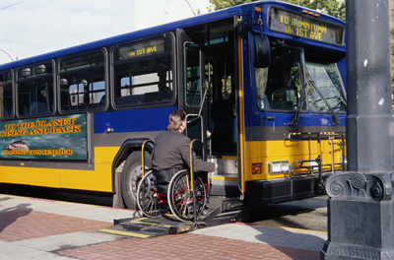

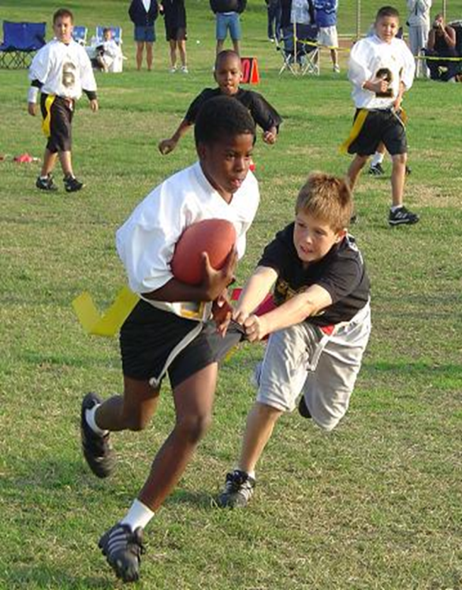
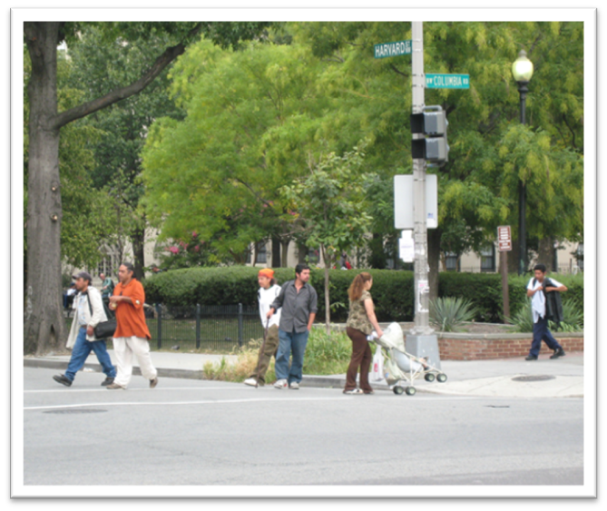

Healthy Living
Source: www.pedbikeimages.org / Ryan Snyder
Photo Credit: http://www.flickr.com/photos/designforhealth/
Notes:
Just by using this checklist during the discussions today, you could help transform YOUR COMMUNITY into A PLACE that embraces healthy living for people of all ages, incomes and abilities, and provides a variety of transportation options. Today you can help make the healthy choice the easy choice for all.

Slide 22

For More Information
Name
Title
Organization
Email address/phone number
Healthy Places Web site: www.cdc.gov/healthyplaces
Notes:
I will be around all day during the discussions, so feel free to ask me any questions about the checklist or any other questions about healthy community design. For more information on healthy community design, visit CDC’s Healthy Places Web site.
Thank you.

