Slide 1
Name
Subject
IETA Program Overview
Date
CS317438H

Slide 2
Agenda
IETA program overview
Application process
Competencies
Eligibility
Home office requirements
Program timeline
Notes:
I am LCDR Felicia Warren. I am an African American woman with brown hair and glasses, and I am wearing the U.S. Public Health Service Commissioned Corps modified service dress blue uniform. I have a white IETA background.
We are recording today’s webinar, and it will be posted on the IETA website as soon as it is made available.
The webinar will include an overview of the IETA program and a description of the application process, including the program’s competencies and eligibility criteria. The presentation will also include information about the program requirements for participants and home offices and the program timeline.
We have allotted half of the hour for Q&A. We ask that you please type your questions into the chat. We will answer questions received in the chat following the presentations. Please note that we also have frequently asked questions on the website that we will keep updated throughout the IETA application process. If you have a specific question about your eligibility, we ask that you send that email to ieta@cdc.gov.
Poll:
As we transition into the formal presentation, we invite you to answer one poll question. We will review the responses after the webinar.
And now, I would like to turn it over to Alyson to present on the IETA program.

Slide 3
What is IETA?
A 12-month competency-based training program offered by CDC’s Global Health Center
Offers HHS employees the opportunity to gain global public health experience while providing technical assistance to CDC country offices and partners
The program is comprised of:
Multi-day orientation and closing workshops
Completion of all HHS and Dept of State security requirements
12-week (minimum), supervised international field assignment
Notes:
I am CDR Alyson Rose-Wood and I am a white woman with brown hair, and I am wearing the U.S. Public Health Service Commissioned Corps modified service dress blue uniform. I have a white IETA background.
The IETA program is a 12-month competency-based program comprised of several multi-day workshops and a 12-week, consecutive, supervised field assignment in one of the countries where CDC has an overseas presence.
It is designed to offer HHS employees of all professional backgrounds an opportunity to gain overseas experience while providing technical assistance to CDC country offices and partners.
Aside from attending the workshops and the supervised field assignment, IETA participants continue to work in their current positions throughout the 12-month program.

Slide 4
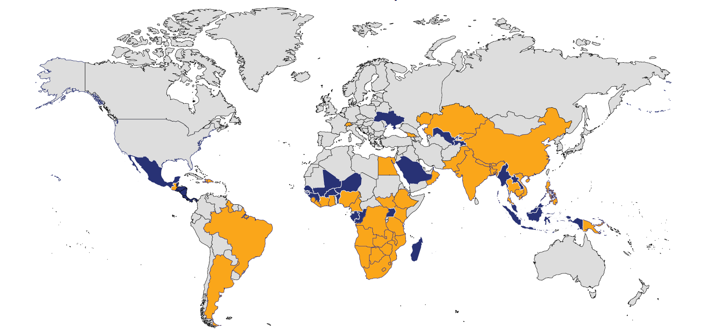
Countries where IETA participants have served
Notes:
The map on this slide highlights in blue and orange all the countries where CDC works and has a presence in that country. The 44 countries that are colored in orange are where previous IETA field assignments have taken place.
It is important to understand that in applying to the IETA program, you are agreeing to be matched with a country where CDC has a presence. The country you are matched with could be a high-threat country as defined by the U.S. Department of State. In fact, any country could become a high-threat country. To be successful in the IETA program, you need to be willing to provide your technical expertise where there is a need.

Slide 5
Eligibility criteria
Be a full-time HHS federal employee (Civil Service or U.S. Public Health Service Commissioned Corps officer).
Be at the GS-11 grade or above or O-3 rank or above.
Be in current position for 12 or more consecutive months as of September 1.
Excluding deployments, have not worked in a U.S. Embassy as an HHS federal employee.
Be available to travel for a minimum 12-week international field assignment between January 15 to September 1.
Have permission from first-level and second-level supervisors to apply and fully participate.
Notes:
The IETA program seeks applicants from all professional backgrounds. Through our discussions with CDC country offices, we know that a wide range of skillsets and technical expertise areas are welcomed.
This slide outlines the eligibility criteria for the program. To be eligible, you must be a full-time HHS employee—either civil service or a U.S. Public Health Service Officer--at the GS-11 grade or above or O-3 rank or above. Title-42 employees who are U.S. citizens are eligible to apply as are Term employees. You must be in your current position for 12 or more consecutive months as of September 1. Excluding deployments, you must not have previously worked in a U.S. Embassy as an HHS federal employee. You must be available for the minimum 12-week international field assignment between January 15 and September 1. And, you need to have permission from your first-level and second-level supervisors to apply and fully participate in the program. Receiving supervisory permission is part of the application process which we will cover later in the presentation. If you are unsure if you meet the eligibility criteria, e-mail the IETA program at ieta@cdc.gov.

Slide 6
IETA Home Office Requirements
Support the participant’s time away from current position to attend training workshops and complete their 12-week minimum field assignment.
Cover the salary, benefits, and travel to Atlanta, Georgia for the orientation and closing workshops.
Review the draft field assignment statement of work in collaboration with participant, host office, and IETA program.
Notes:
This slide outlines the three requirements that the IETA program has of the participant’s home office. In signing the application form, supervisors need to understand that their program will need to do the following three things:
Number 1: Ensure that the participant can fully participate in all training workshops and the minimum 12-week field assignment.
Number 2: Cover the participant’s salary and benefits throughout the program as well as any domestic travel costs associated with IETA program training. The host program—or CDC country office—pays all costs associated with the international field assignment such as airfare, lodging, and meals and incidentals.
Number 3: Review the draft field assignment statement of work in collaboration with the participant, host program, and IETA program.

Slide 7
Applying to the IETA program
Application materials will be available on the IETA website each summer.
Complete the application electronically.
A complete application includes the following documents:
Application with essay responses and signature
Evaluation form with signatures (first-level and second-level supervisors, and, for U.S. Public Health Service Commissioned Corps officers, the signature of the home agency liaison officer)
Resumé template*
SF-50 for civilians or PHS-7063 (Personnel Order Form)
E-mail completed application to ieta@cdc.gov.
Notes:
This slide covers the process for applying to the IETA program. All application materials are made available on the IETA website each summer. For the fiscal year 2024 program year, the application will open on Friday, June 30 and all applications must be received by 11:59 pm Eastern time on August 15, 2023.
A complete application includes the following four documents that we ask that you complete electronically: the application form with essay responses and signature, the supervisor evaluation form with signatures, the IETA resume template, and your SF-50 for civilians or PHS personnel order form #7063. For the SF-50 requirement for civilians, please make sure the SF-50 you submit covers the 12 months prior to September 1 of the year you are are applying.
If you are U.S. Public Health Service Commissioned Corps officer, your home agency’s Commissioned Corps liaison will also need to sign the application.
We ask that you e-mail the completed application to ieta@cdc.gov no later than August 15.

Slide 8
IETA Competencies
Notes:
This slide shows the IETA competency model which consists of four domains and their associated competencies. The four domains are: Leadership, Cross-Cultural Humility, Diplomacy, and Technical Expertise.
The IETA competencies provide the framework for the entire IETA program—from the screening of applicants to the training experiences we provide. They also describe the capabilities each IETA participant should be able to demonstrate following program completion. Having the IETA program be competency-based ensures that we are building a cadre of skilled IETA alumni essential for supporting HHS’s global mission.
The IETA program is designed to provide the trainings and hands-on experiences so that each participant develops their abilities in each domain you see here.
You can access a complete description of these competencies on the IETA website.
Alt Text:

Slide 9
Selection Process
Screening Criteria | Description
Career goals | Identify global health career goals that support CDC’s global mission.
Cultural humility | Demonstrate the ability to live, work, and interact with people across a wide variety of cultural and social backgrounds.
Flexibility | Demonstrate ability to function well under uncertainty and frequently changing conditions.
Personal accountability | Own what happens as a result of your choices and actions.
Team player | Collaborate with others and care more about helping a team to succeed than individual success.
Technical expertise | Articulate how skillsets will contribute to HHS global health programs.
Notes:
This slide describes IETA’s “Best Fit” model which is designed to help potential candidates consider whether IETA is an appropriate program to advance their public health career. This list gives an overview of the six screening criteria that the IETA program will use to screen applicants. This list might help you determine whether you will be successful as an IETA participant.
First, we screen applicants on how IETA aligns with their career goals. We are seeking applicants who are trying to decide if working internationally for HHS is right for them.
We will also screen applicants for their abilities in five areas of the IETA competency model: cross-cultural humility, flexibility, personal accountability, the skillsets you would bring to the program—which we refer to as technical expertise and being a team player.
While trainings we provide in the IETA program might enhance a participant’s abilities in these five areas, we seek participants who already demonstrate these abilities innately.
All complete applications will be reviewed and scored by a screening panel that consists of a mix of CDC staff who have extensive experience working internationally for the agency, IETA program alumni, and subject matter experts in the field(s) of technical expertise identified by the candidates.
The screening panel will review and rate each applicant based on the six screening criteria on this slide.
To decrease the likelihood for factors such as unconscious bias towards names, genders, work location, etc., each application reviewed by the screening panel will be blinded—identification details on each application will be removed by IETA program staff prior to screening.
The highest scoring applicants will be invited to interview virtually.
Following reference checks, finalists will take part in the matching process with host programs.

Slide 10
IETA Annual Program Timeline
September
Finalists announced
October
IETA program begins
Jan 15-Sept 1
IETA field assignments
September
Closing workshop
Summer
Apply to the program
Notes:
This slide shows a very high-level timeline of the program. The IETA website goes into more detail.
The IETA application process takes place every summer with finalists announced in late September.
The program officially begins in October. Alongside a multi-day orientation in Atlanta, Georgia, the field assignment solicitation and matching process takes place in the fall.
The IETA program works with participants throughout the fall to ensure that they have completed all the necessary steps to be ready to travel to their field assignment in the new calendar year. This includes getting cleared medically with the U.S. Department of State and completing all necessary security trainings required by the U.S. Government.
Assignments take place between January 15 and September 1.
A multi-day closing workshop takes place in September.

Slide 11
For more information on the IETA program, visit:
www.cdc.gov/globalhealth/ieta/
For questions, contact ieta@cdc.gov
Notes:
This concludes our formal presentation on the IETA program.

