Slide 1
System for Enteric Disease, Response, Investigation, and Coordination
Current as of January 22, 2020

Slide 2
What is SEDRIC?
The System for Enteric Disease Response, Investigation, and Coordination
  Web-based platform (in the cloud) developed by CDC and Palantir Technologies
  Facilitates collaborative multistate outbreak investigations of enteric disease
SEDRIC is a customized, off-the-shelf web-based software system with four major capabilities
  Integrate multiple surveillance data sources in real time
  Visualize outbreak data rapidly in one place
  Provide a secure platform for partner collaboration
  Manage a repository of historic surveillance and outbreak data

Slide 3
Who uses SEDRIC?
SEDRIC facilitates secure electronic data-sharing among partners during outbreak investigations
Partners currently using SEDRIC are epidemiologists, laboratorians, and regulators from
  State and local health departments
  CDC
  FDA
  USDA-FSIS, USDA-APHIS

Slide 4
How does SEDRIC work?
CDC partners have access to SEDRIC for free
Data Visualizations
  Manage and visualize clusters under investigation
  Visualize trends in time and space
  Visualize relationships
Data Management
  Secure data sharing across agencies in real-time
  Data exploration
  Integration of future data sources

Slide 5
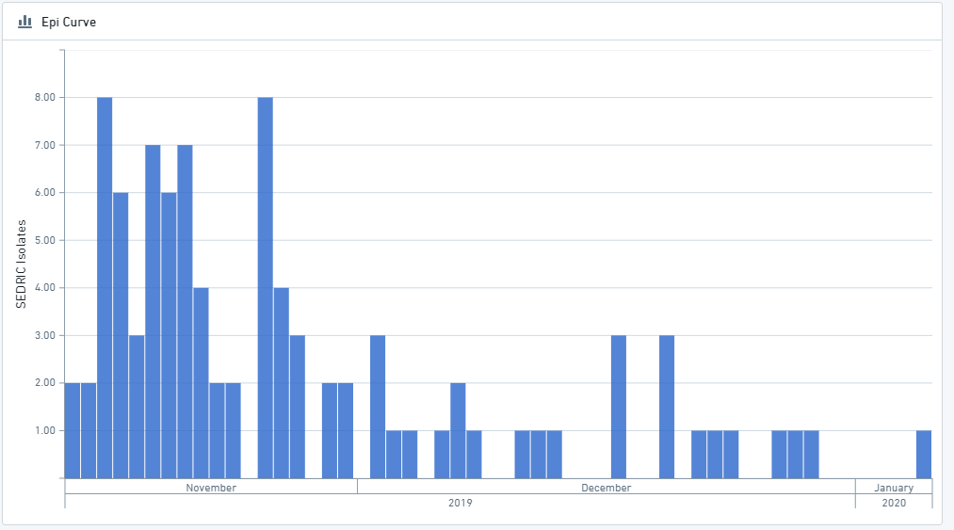

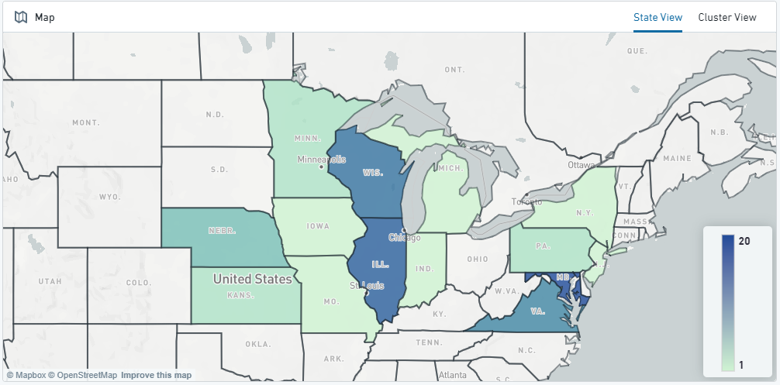


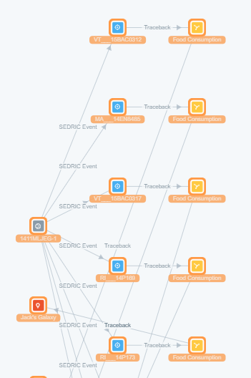


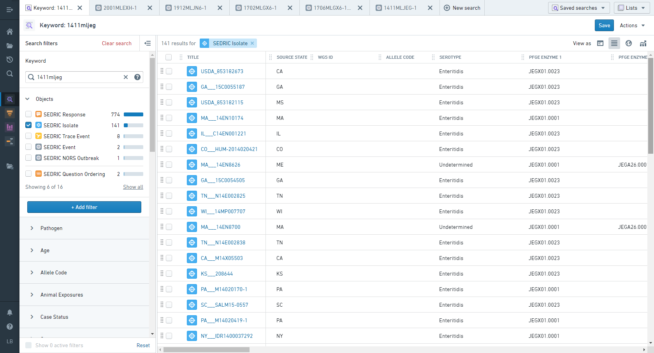






How does this happen?
National surveillance data
Ingests surveillance and investigation data
EDMI
Data exploration, secure sharing, and visualization
Investigation data from labs, epidemiologists, environmental health, regulatory agencies from state, federal partners

Slide 6
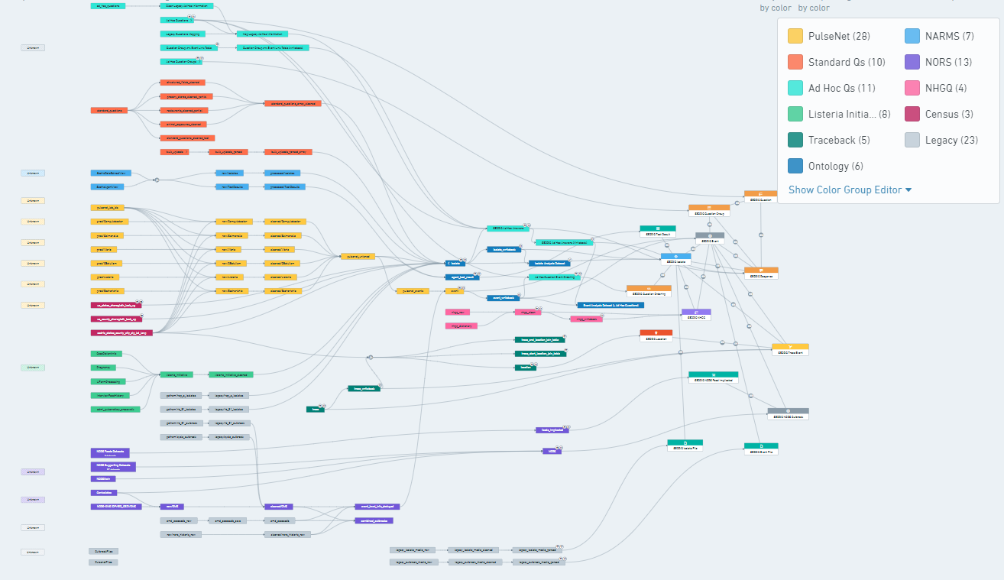
How does this happen?

Slide 7
Highlights and Limitations
Highlights
  Intuitive GUI design, easy to learn
  No software to download, entirely web-based
  Surveillance data available in almost real-time
  Multiple surveillance sources available under a single platform (and more being added!)
  Fast (and pretty!) graphics
  Secure, real-time data sharing
Limitations
  Not an analytical platform
  Uni-directional data flow

Slide 8
Tool Comparison
 | Web Portal | CIFOR Epi-Lab Software | SEDRIC
Cluster detection | Y (sophisticated) | Y (basic) | Y (basic)
Cluster detection speed | Slower | Faster | Manual
Exposure information | N | Y | Y
Mapping | Y | Y | Y
Ad hoc queries | Y | N | Y
Joining lab and epi data | N | Y (single state data only) | Y (share multistate data)
Automated | Y (once/day) | Y (low, but improving?) | Y (every hour)
Range of agents/serotype | PulseNet only | PulseNet only | PulseNet and other pathogens

Slide 9
Important Web Links
https://sedric.cdc.gov
https://www.cdc.gov/foodsafety/outbreaks/investigating-outbreaks/sedric.html
  Information about SEDRIC
  Library of Training Documents
  Link to login

Slide 10
NEW UPGRADE, FEATURES, AND DATA!
As of March 12, 2020:
  SEDRIC upgraded platforms, no longer needing access to Java
  Added integrations from Epi Info for our National Hypothesis Generating Questionnaire
  Bulk uploading epidemiological updates has returned
  Cluster detection
  Allele Code/PFGE Pattern Crosswalk
  … and much, much more!

Slide 11
Data Views and Tools
Home Screen
  Navigate to multiple search features or select a tool to use
Explore Outbreaks
  Searchable information for events, from outbreak codes to NORS outbreaks to Outbreak Management System entries
Explore and Update Isolates
  Line list views, searchable isolate information, dashboards, and mapping
Object Explorer
  All searchable data for filtering, viewing, sorting, and summary statistics
NHGQ
  Overall views of NHGQ data, along with analyzable charts for each outbreak
Test Results (NARMS)
  Provides antimicrobial susceptibility results for both phenotypic and genotypic testing
NORS Outbreak
  Provides read-only information on NORS reports and allows searching across the NORS dataset
Tools
  Cluster detection
  Allele code/PFGE pattern crosswalk
  Pathogen predictor
  Text analysis
  FoodNet Calculator

Slide 12
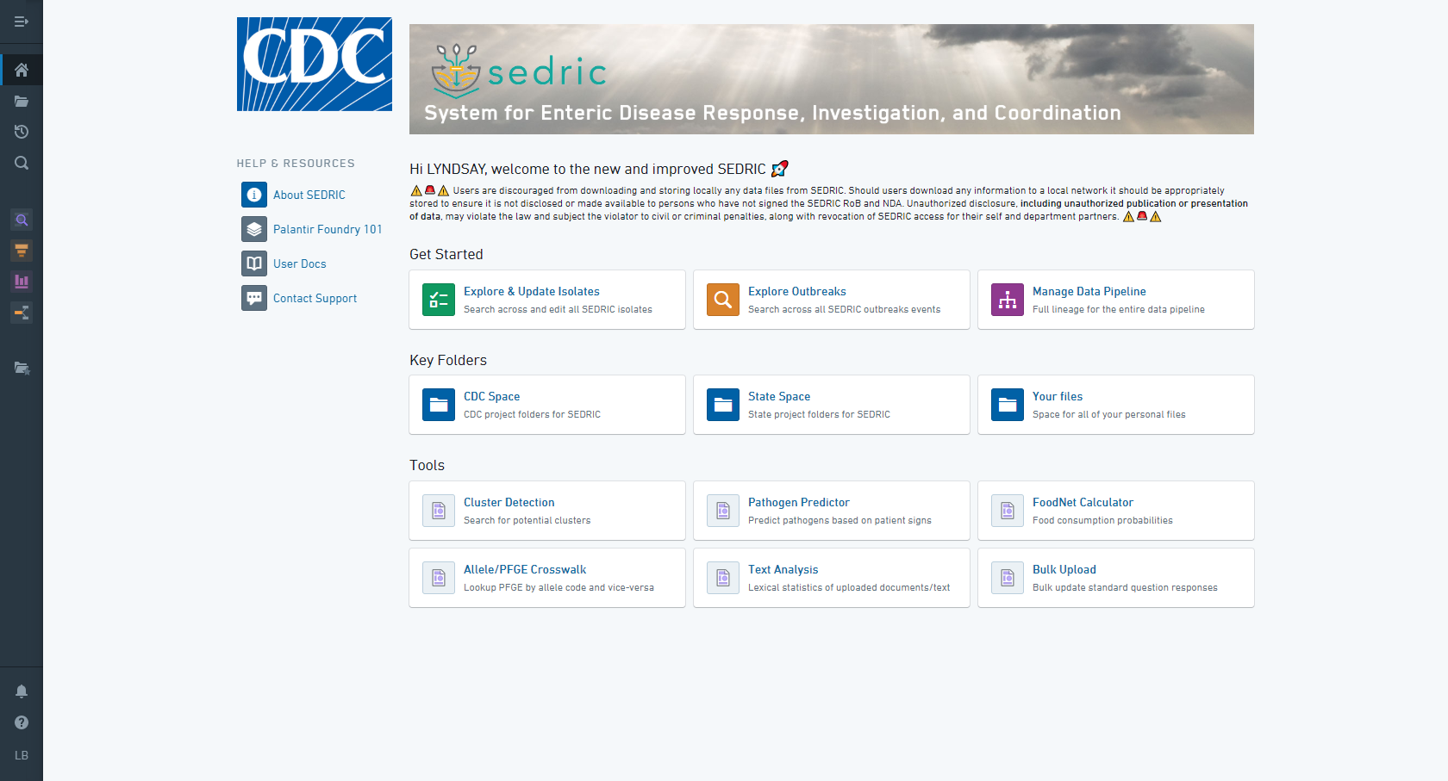
Home Screen
Welcome screen where buttons for views and tools can be found
Contact user support
User documents available

Slide 13
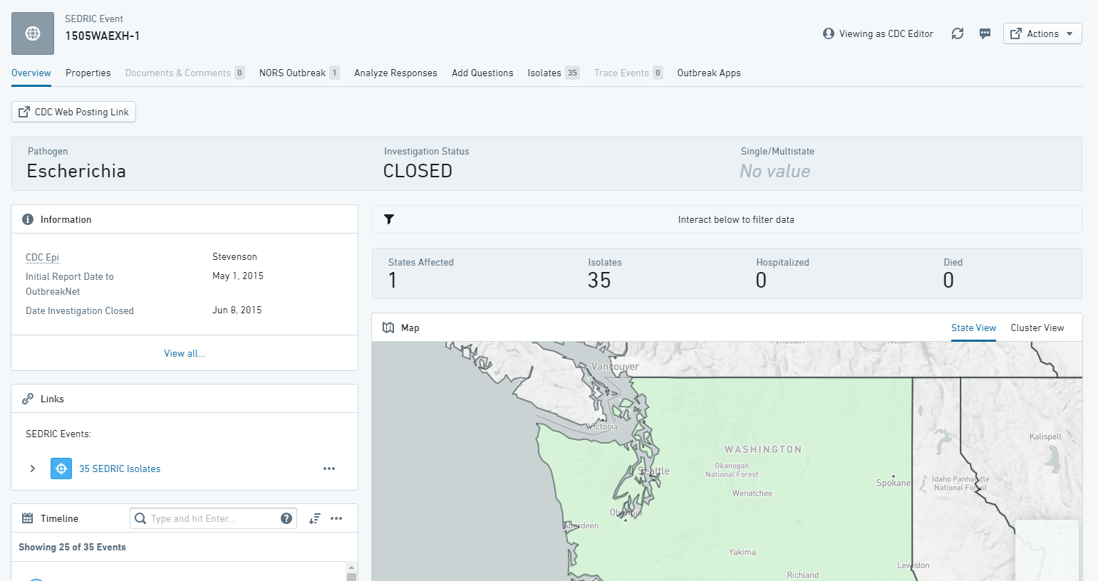
Explore and Update Outbreaks
Look at lists and dashboards of information on events
Search across outbreaks
Important documents and questionnaires housed in a single location
Link to NORS

Slide 14
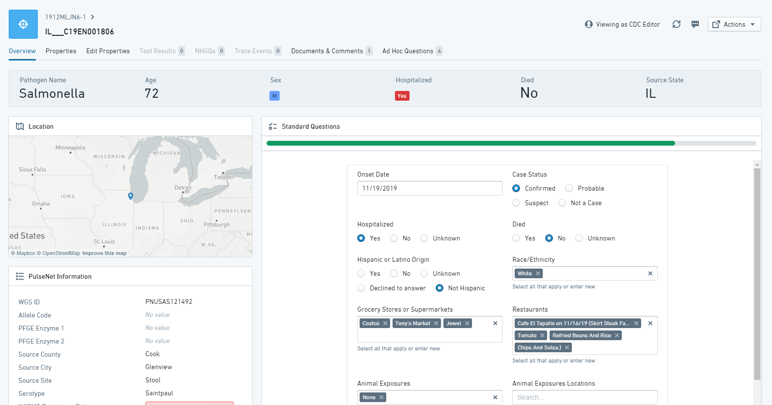
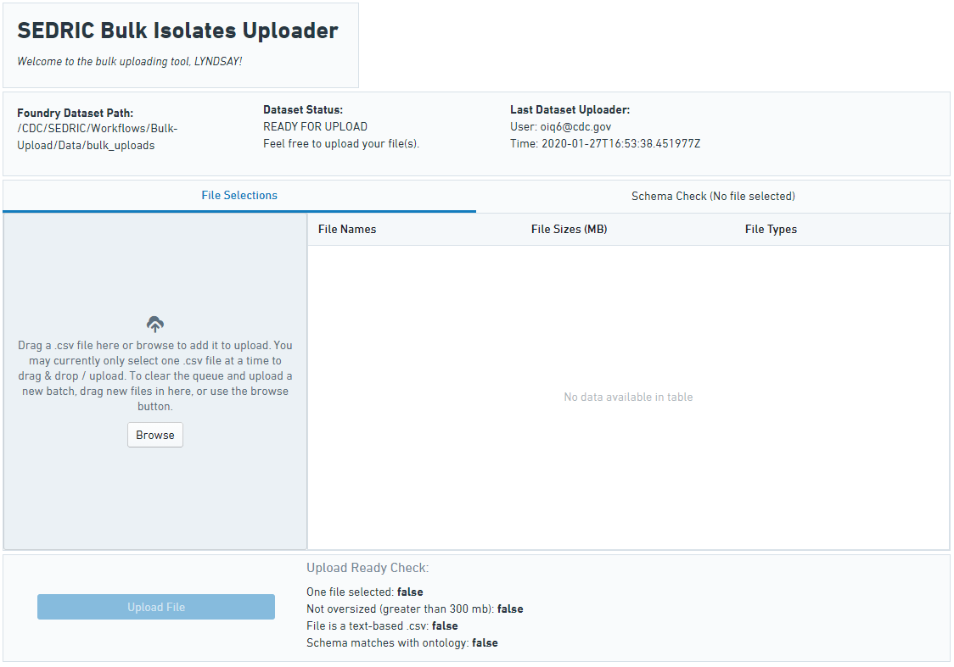
Explore and Update Isolates
Look at line list views and dashboards of isolate information
Answer standard and ad hoc questions
Store important documents and questionnaires in a single location
Link to NHGQ data
Bulk upload of isolates, through a specialized tool

Slide 15
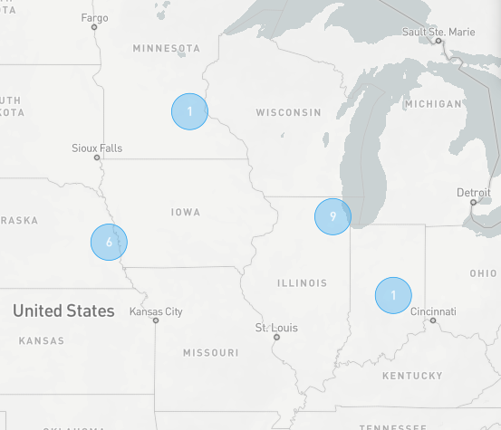
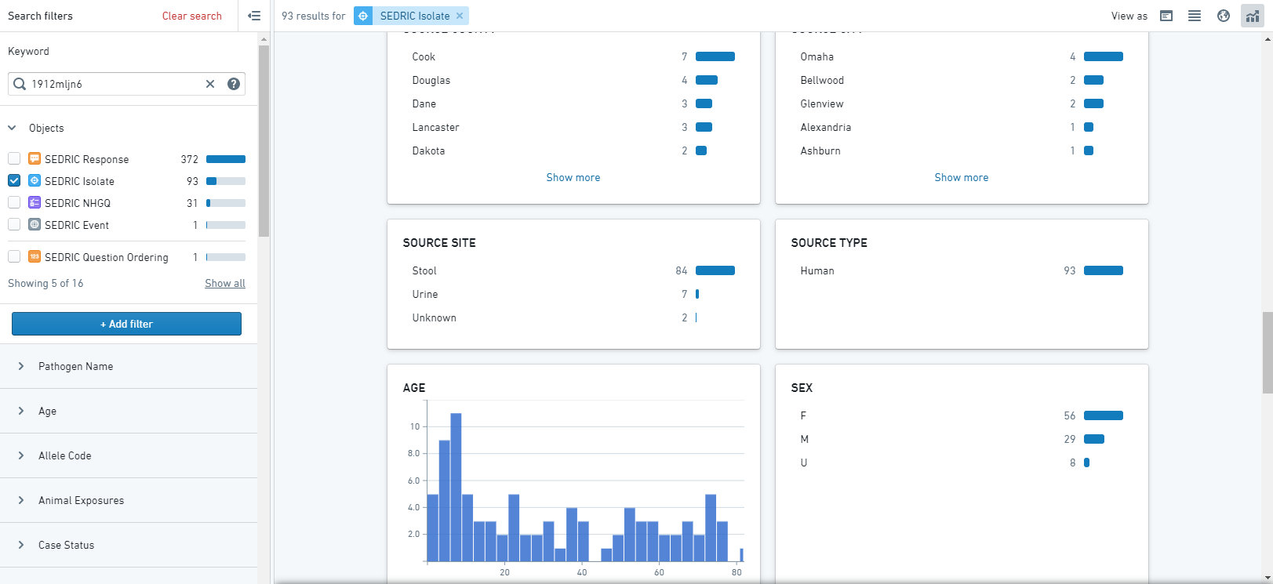
Object Explorer
Search for anything available in the system
Filter, map, sort, dashboards

Slide 16
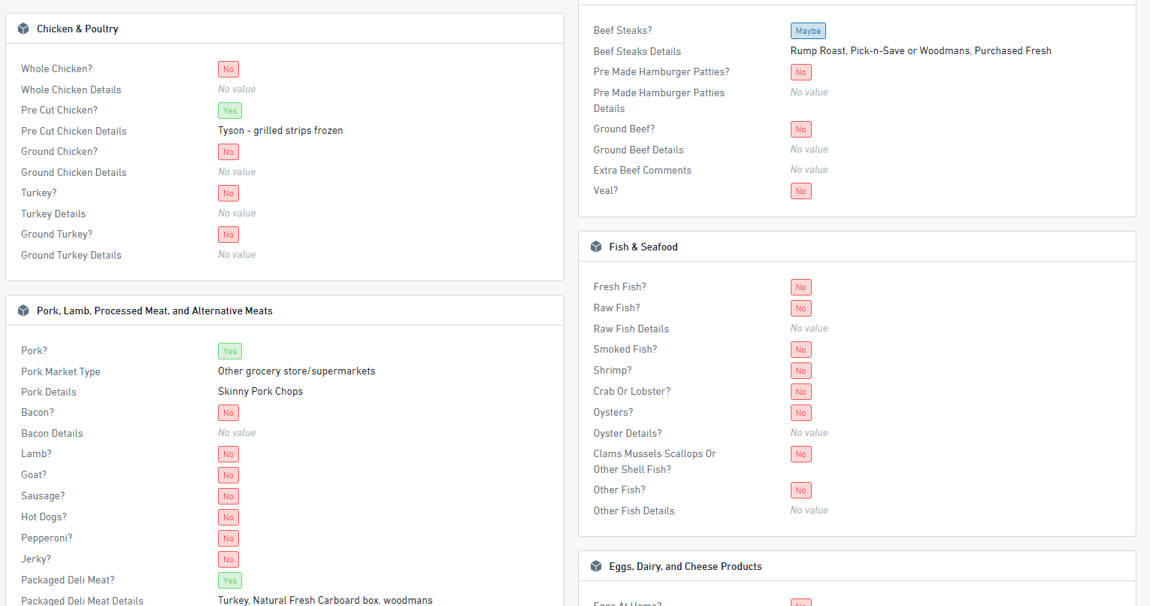
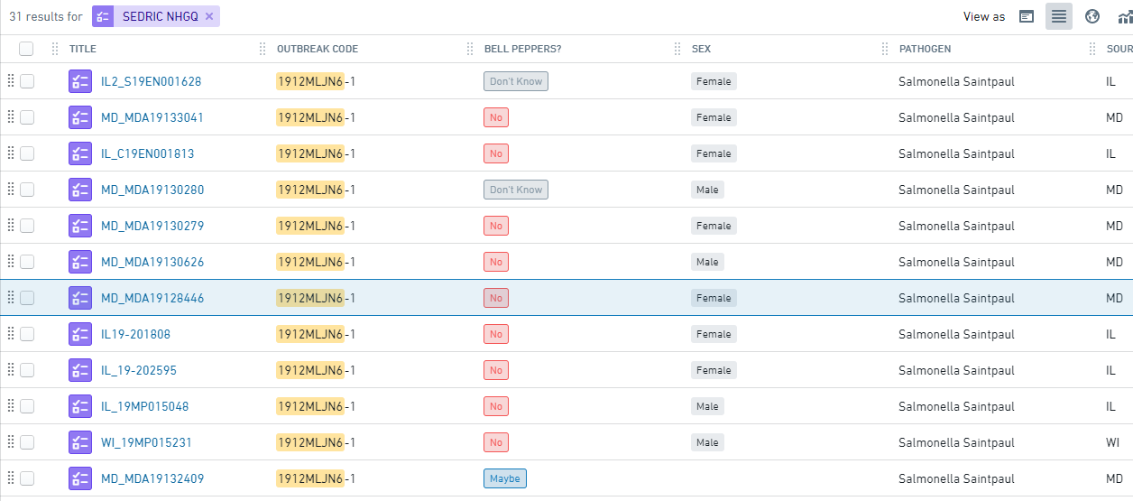
NHGQ
Direct linkage to Epi Info Web Surveys, syncs every 2 hours
Searchable forms, vehicles, grocery stores
Easy view form attached to isolates

Slide 17
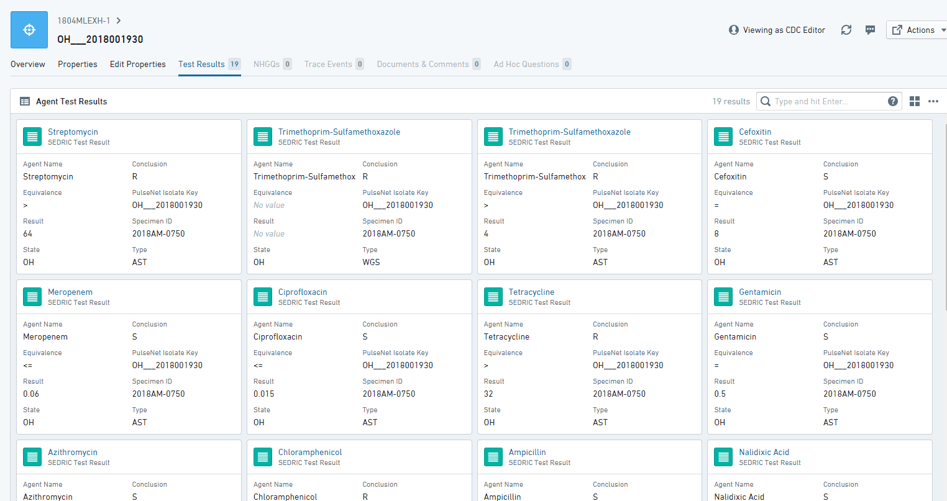
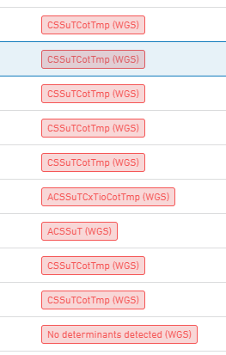
Test Results (NARMS)
Direct linkage to NARMS, syncs every 2 hours from both phenotypic and predicted genotypic testing
Searchable resistance patterns and drugs
Easy view form attached to isolates

Slide 18
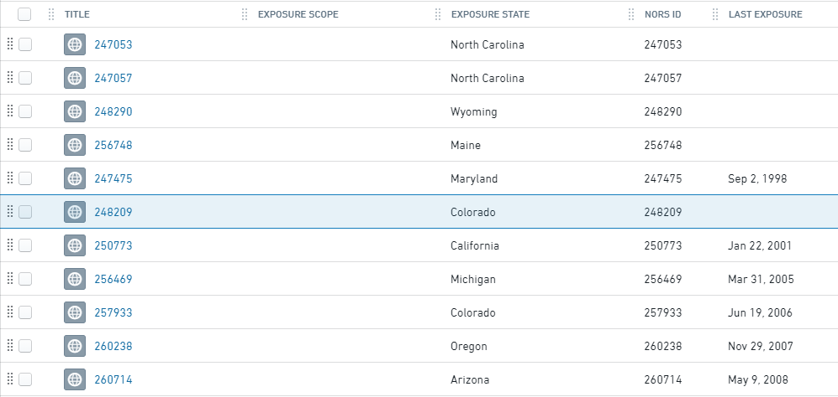
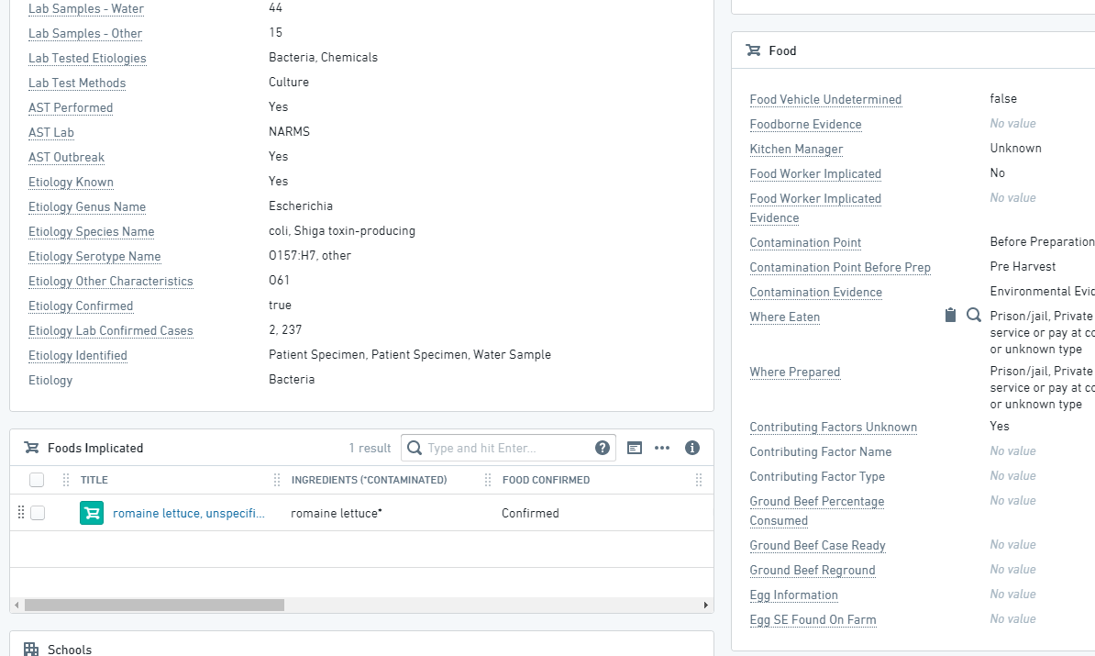
NORS Outbreak
All finalized reports now available
Searchable from object explorer
Full report attached to corresponding outbreaks

Slide 19
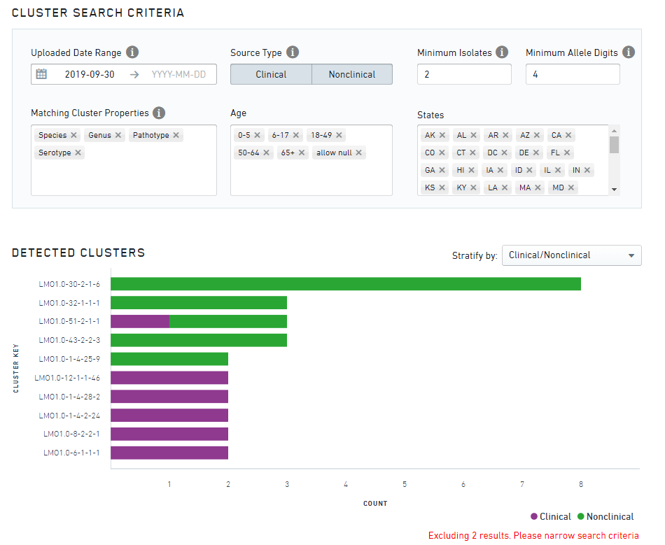
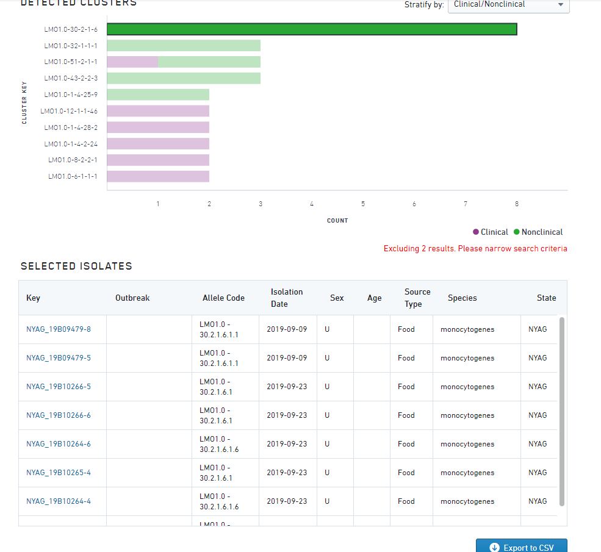
Tools – Cluster Detection
Enables users to set easy parameters to find clusters of isolates based on allele codes
Provides exportable listing of isolates for line list generation

Slide 20
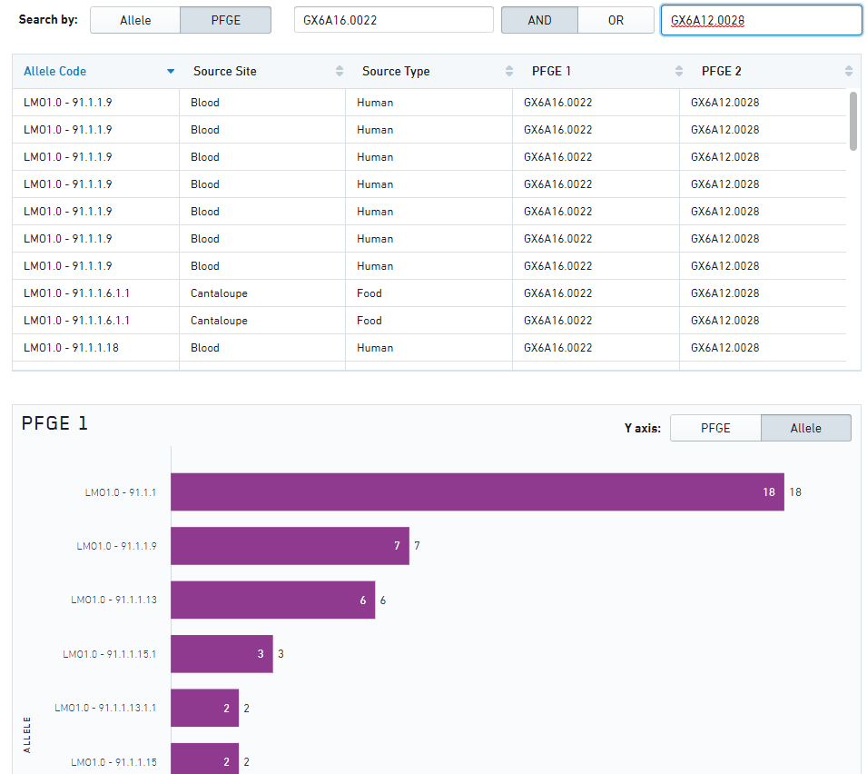
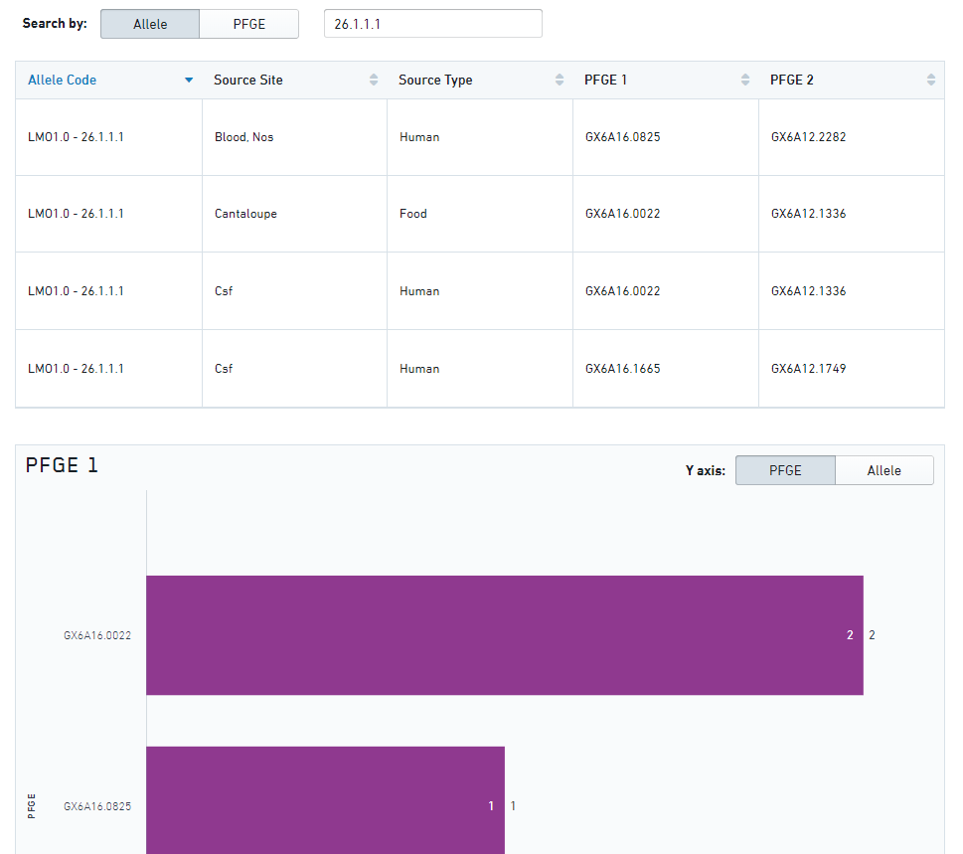
Tools – Allele Code/PFGE Pattern Crosswalk
Provides a quick comparison of PFGE patterns under an allele code
Provides a quick comparison of allele codes under a PFGE pattern (or pattern combination)

Slide 21
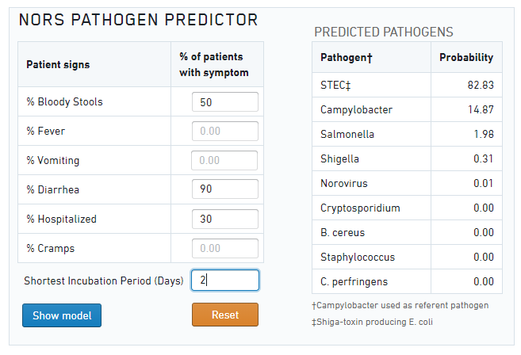
Tools – Pathogen Predictor
Enter percentage of patients with certain symptoms, get back predicted pathogens to help figure out what testing may need completed

Slide 22
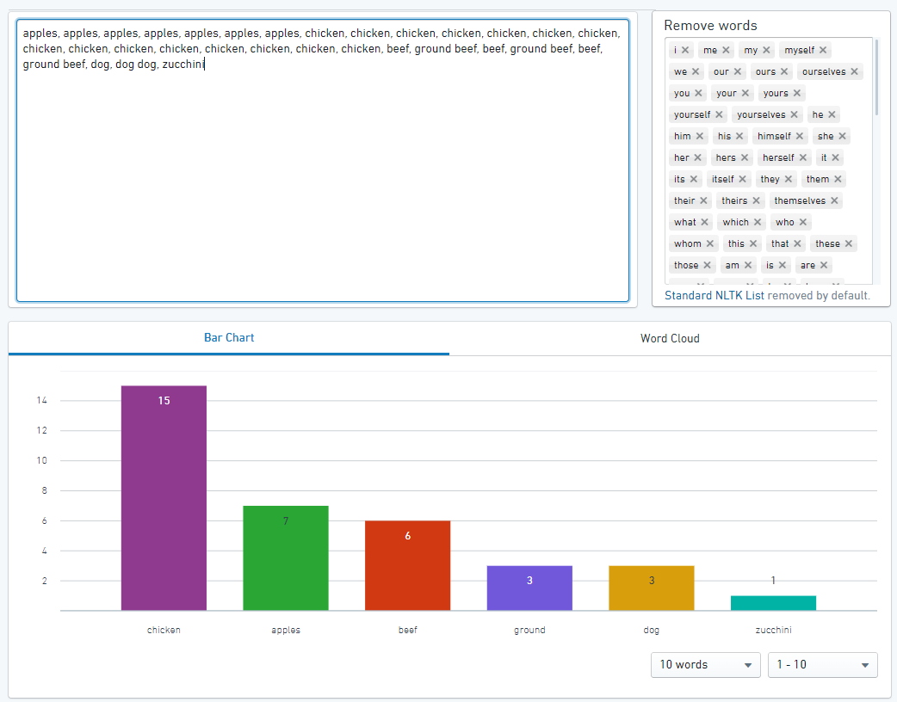
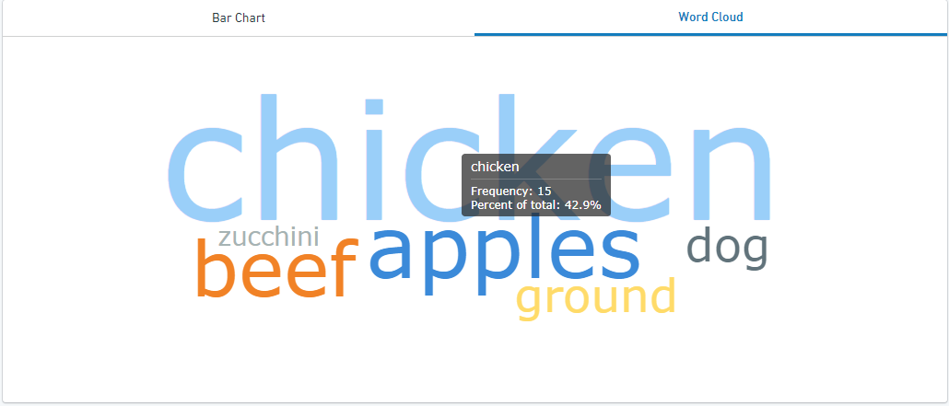
Tools – Text Analysis
Copy and paste, or type, text to get bar charts of word counts
Word clouds also available
Can remove common words from the analysis

Slide 23
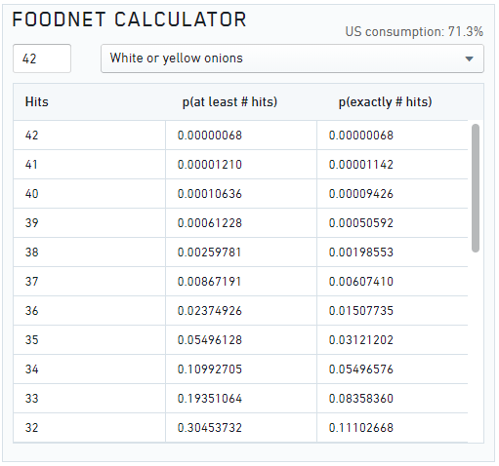
Tools – FoodNet Calculator
Use the binomial calculation against the static 2006-2007 FoodNet Population Survey dataset to determine statistical significance of a hypothesized vehicle

Slide 24

Experience
Increased speed and efficiency in cluster management and triage
  Easy, ad-hoc queries at our fingertips
  Search across surveillance sources
  Meeting times more effectively utilized
  Increased efficiency in creating summaries and visualizations for meetings, presentations, publications
Empowering state and local epidemiologists, laboratorians, and food safety staff to easily mine and visualize their own surveillance data
Collaboration!

Slide 25
Looking Ahead for 2020
Incorporation of allele codes for all pathogens, new analysis widgets
Integrating COVIS data
Integrating Shigella NNDSS data for outbreak response
Connection with NCBI Pathogen Detection Pipeline
Additional cluster detection tools

Slide 26
For more information, contact:
sedric@cdc.gov
https://sedric.cdc.gov

