Slide 1
Dashboard

Slide 2
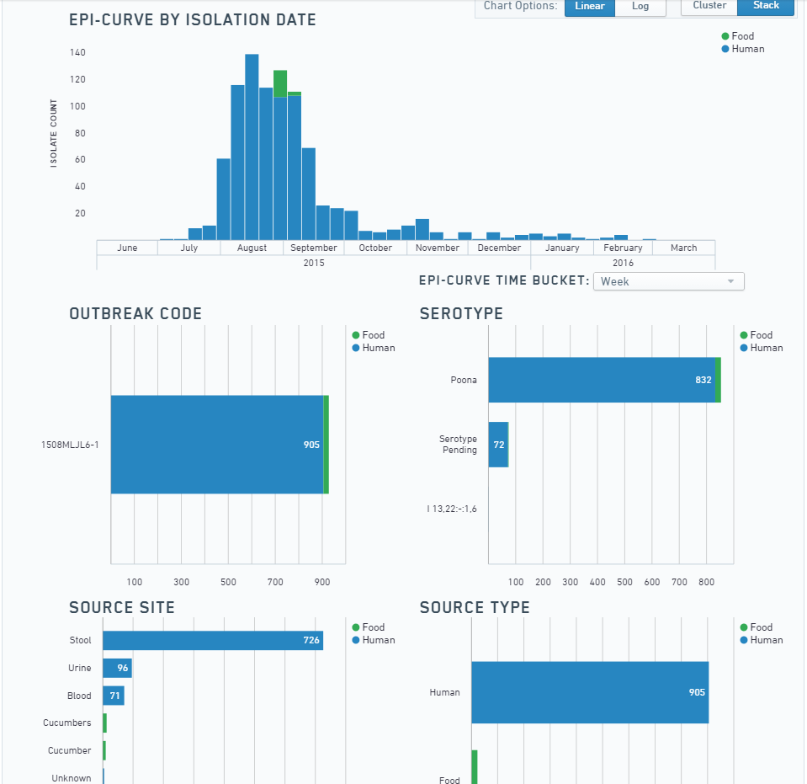
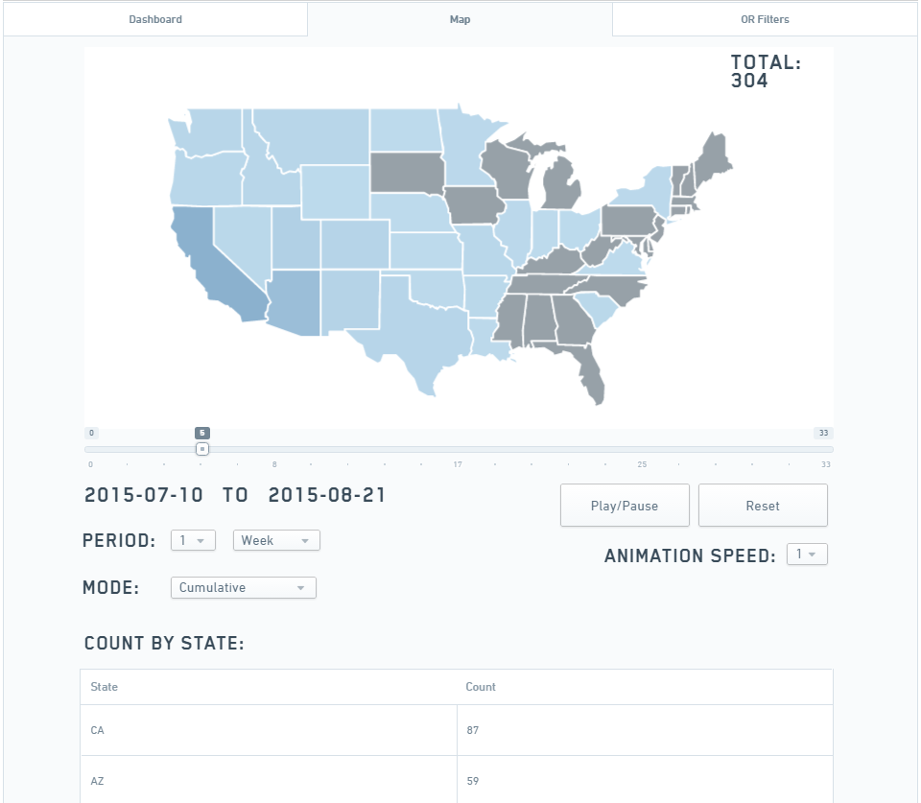
Dashboard
Quick look at outbreaks, PFGE patterns, or serotypes
Fast and broad comparisons of outbreaks, patterns, states, sex
Time trend map analysis
Important Helpers: None

Slide 3
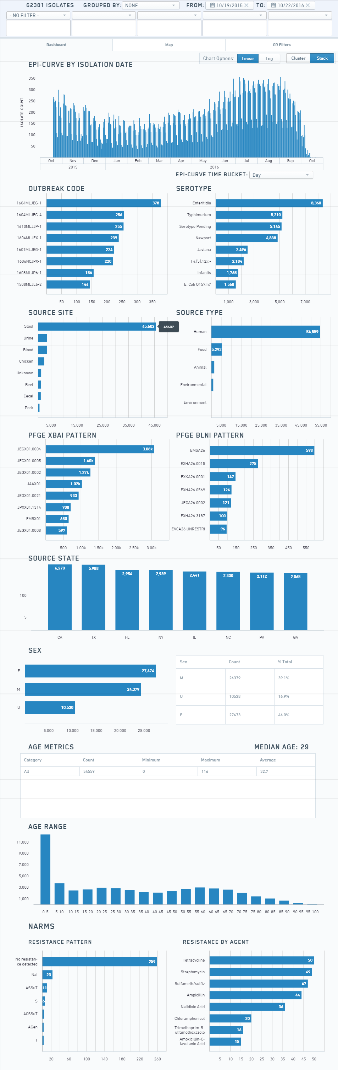
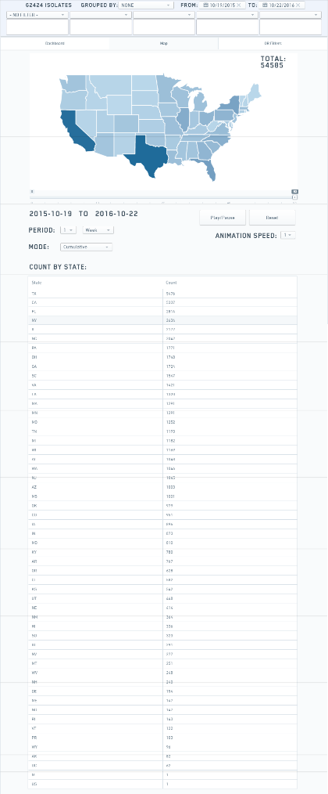
Dashboard First Look
On sign in, you currently do NOT see any data displayed
Current data streams are PulseNet and NARMS
Multiple filtering techniques can be employed to see a 30,000 foot view of sub-sets of data
A time-trend map feature is available on the second tab

Slide 4
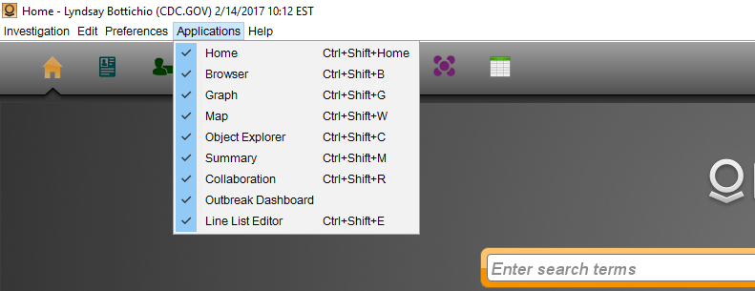
But first – let’s make sure you have Dashboard turned on!
In your top application icon list, you should see an icon that looks like purple overlapping circles. If you do, you are good to go to the next slide!
If you do not see the dashboard icon, go to Applications and select the Outbreak Dashboard. If it does not automatically open, click the icon to now open it.
Step 1
Step 2

Slide 5
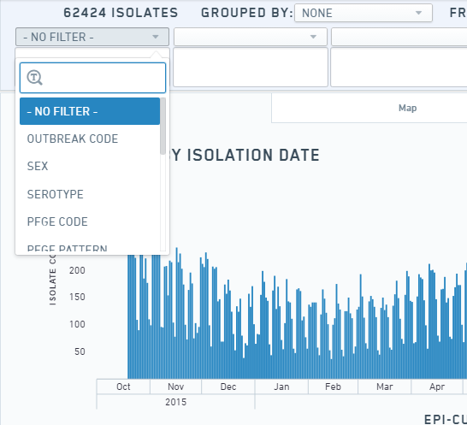

Filtering by Outbreak Code
Filtering on an outbreak code can give you a quick, 30,000 foot view of the descriptive epidemiology of that outbreak.
Click on the “No Filter” button and select “Outbreak Code”.
The dashboard will show you spinning wheels to indicate it is working

Slide 6
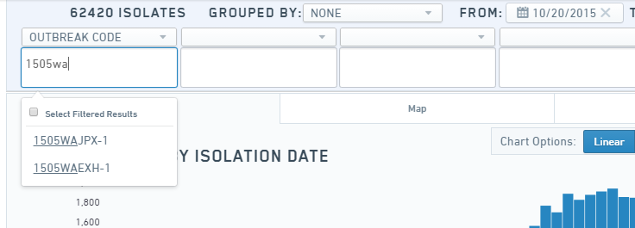
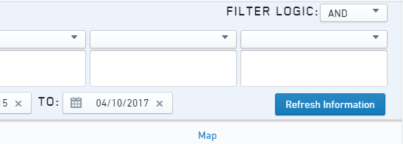
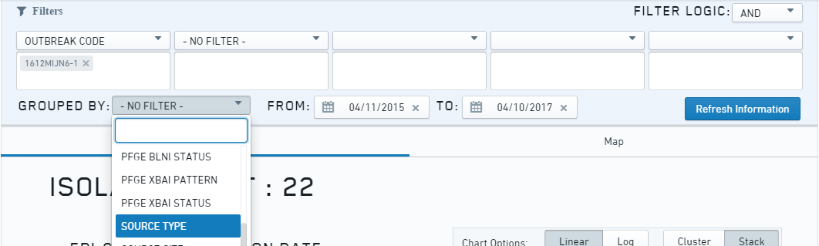
Filtering by Outbreak Code 1
In the box below where it now says Outbreak Code, begin typing 1612MLJN6-2. A list should appear and you can click that code to select it. Click “Refresh Information” and our dashboard will adjust to only show that outbreak.
If you wanted to look at which isolates in the dashboard were food, environmental, and human, select “Source Type” from the drop down list under Grouped By and again click “Refresh Information”.
Note: You will need to click “Refresh Information” when you change any filters!

Slide 7
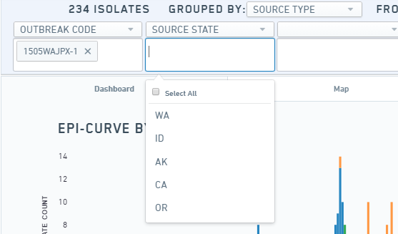
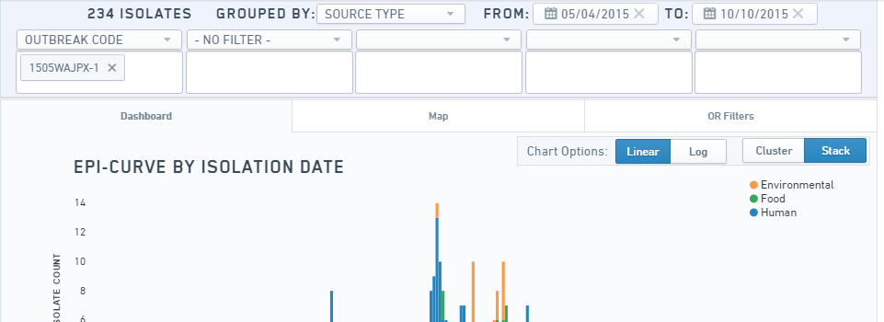
Filtering by Outbreak Code 2
The filters along the top are all conditional to the filters before it, so if I wanted to now filter on Source State, I would select that from the next “No Filter” dropdown and then I will only have the states in this outbreak available to choose from.
Note: The date ranges will automatically adjust to include the (isolate date/onset date range) for the data subset in the filter (in this case the outbreak code). The date range cannot be adjusted to include dates earlier than the earliest isolation date/onset date in the data subset. Additionally, the default is the last two years of data, so please adjust your dates to include outbreaks or other filters outside that range.

Slide 8
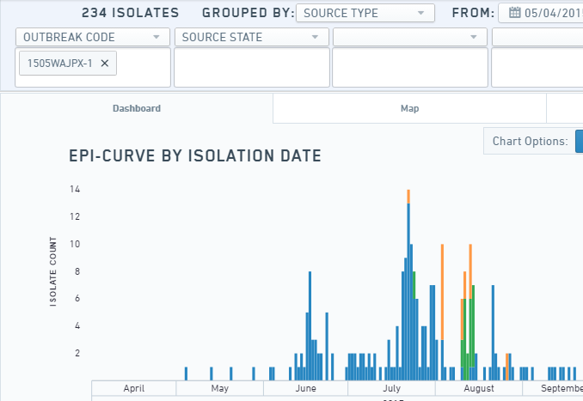
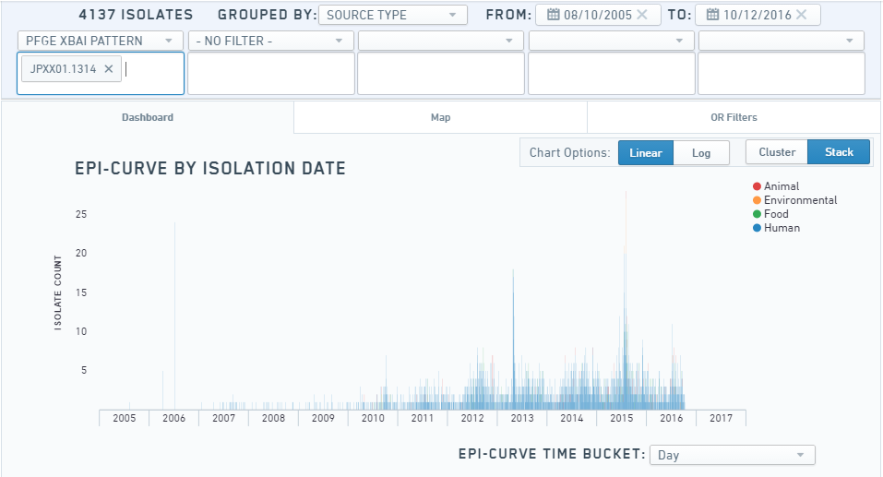
Filtering by Outbreak Code 3
If you want to clear the filters, you can just click the “X” next to the filtered item, or select “No Filter” from the dropdown where you had previously selected one.
If you wanted to search for a PFGE pattern instead of an outbreak code, you can select “PFGE XbaI pattern” from the dropdown list (I used JPXX01.1314 here.)
Don’t forget to click “refresh information” after each filter change!
Remember to adjust your dates if you need more than two years of information!

Slide 9
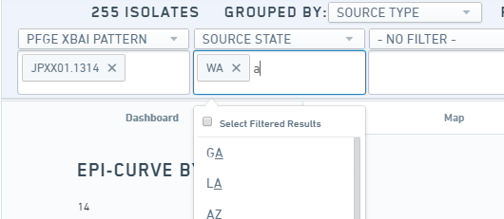
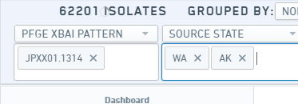
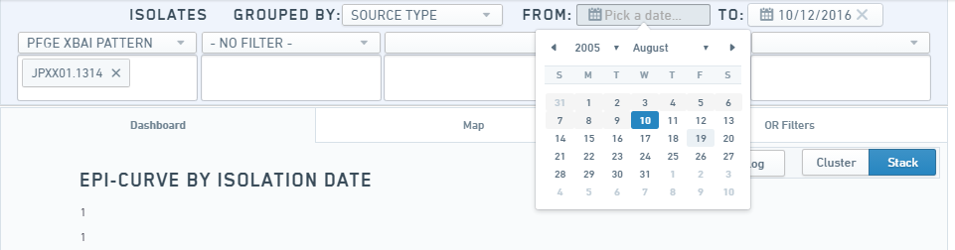
Filtering by Outbreak Code - contunued
If you want to select multiple PFGE patterns or multiple states (or multiple of any filter you selected), you can just continue clicking on the options you want from the list or keep typing and select those options.
If you only wanted to look at a PFGE pattern in a specific time period, you can select the date range that you want in the top right hand corner.

Slide 10
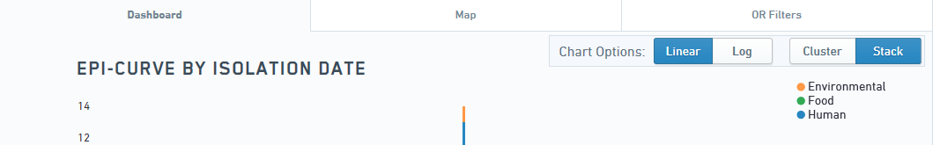
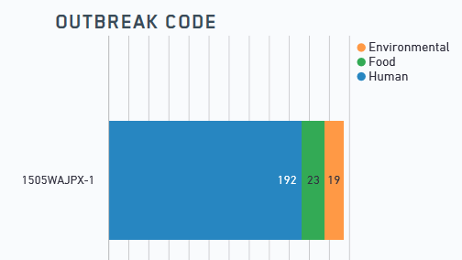
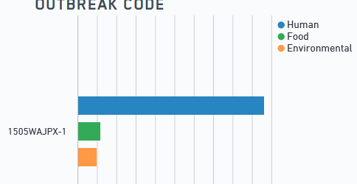
Dashboard Tips and Tricks
In addition to filtering and grouping and changing date ranges, the dashboard is set up to consider your preferences
The epi curve can be displayed either in linear or log form and you can choose your graphs to be clustered or stacked
Stack
Cluster

Slide 11
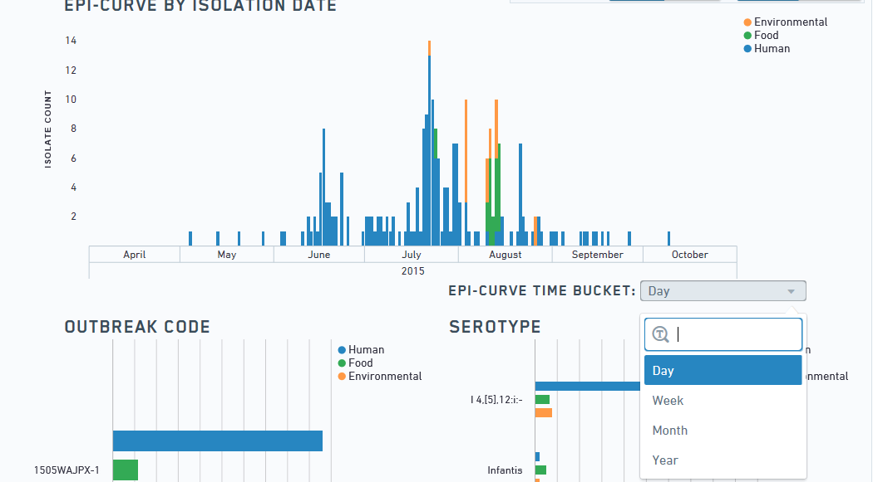
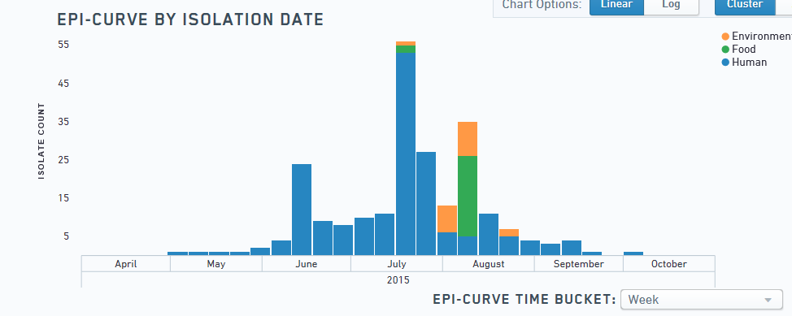
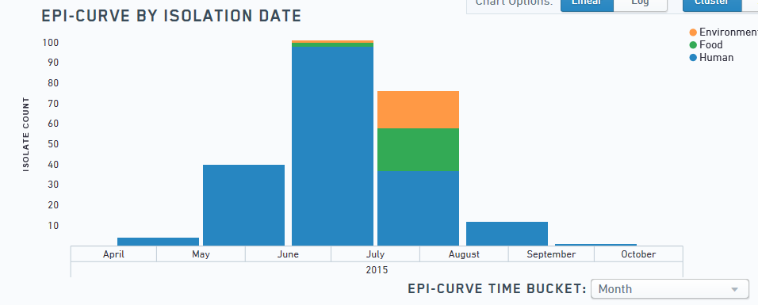

Dashboard Tips and Tricks 2
Your epi curve can be bucketed in different time allotments (day, week, month, or year)
Finally, if you hover over any bar within a graph, it will have a pop-up window to show you the number of items contained in that bar.

Slide 12
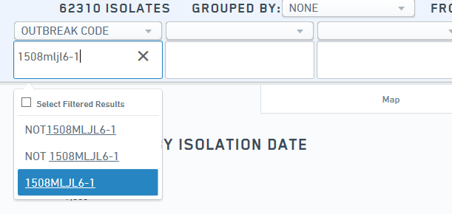
Unusual Comparisons in Dashboard
Sometimes you may want to compare an outbreak to a PFGE pattern that is not included in the outbreak. (Like comparing the 2015 Salmonella Poona outbreak to the Saintpaul pattern associated with cucumbers)
Select outbreak code from the “No Filter” dropdown and then type in 1508MLJL6-1 underneath, like you would normally search an outbreak.

Slide 13
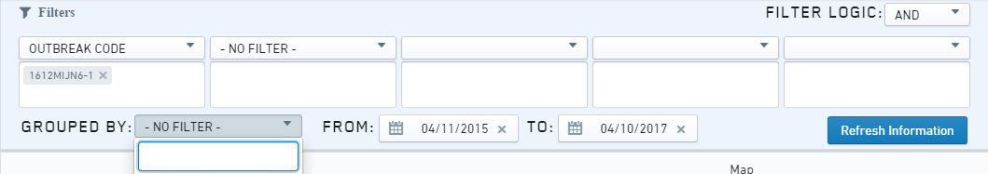
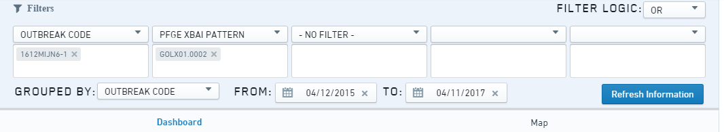
Unusual Comparison in Dashboard 2
Click on the “AND/OR” button next to the “Filter Logic” and select OR. The default is “AND”.
Now, use the second filter box like you did the first and select PFGE XBaI pattern from the “No Filter” dropdown and then type in JN6X01.0048 in the box to the right and select it.

Slide 14
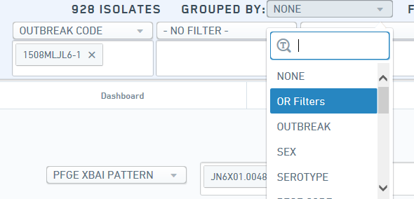
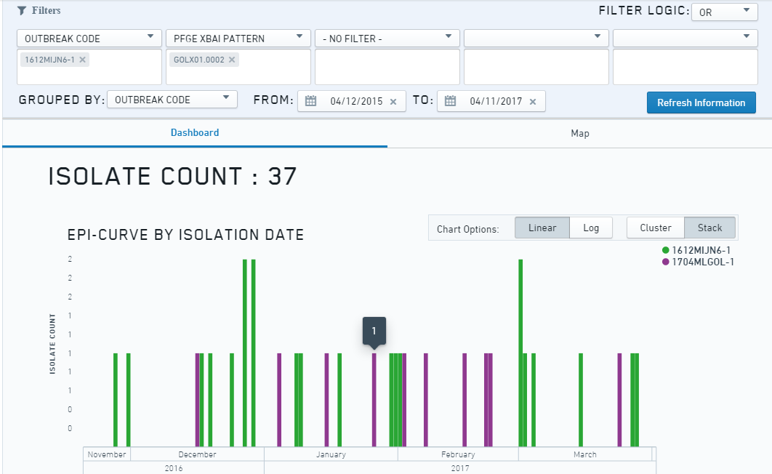
Unusual Comparisons in the Dashboard 3
Now, you will need to go the “Group By” dropdown and select any filter to parse them (like PFGE code or outbreak code).
Don’t forget to click “Refresh Information” once done selecting filters.

Slide 15
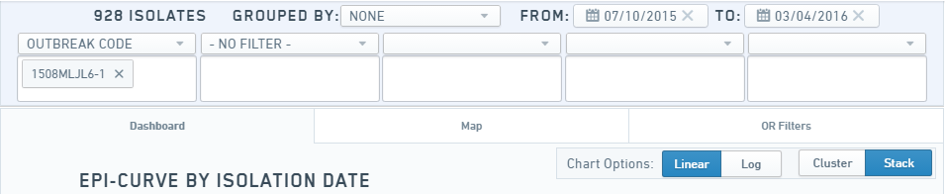
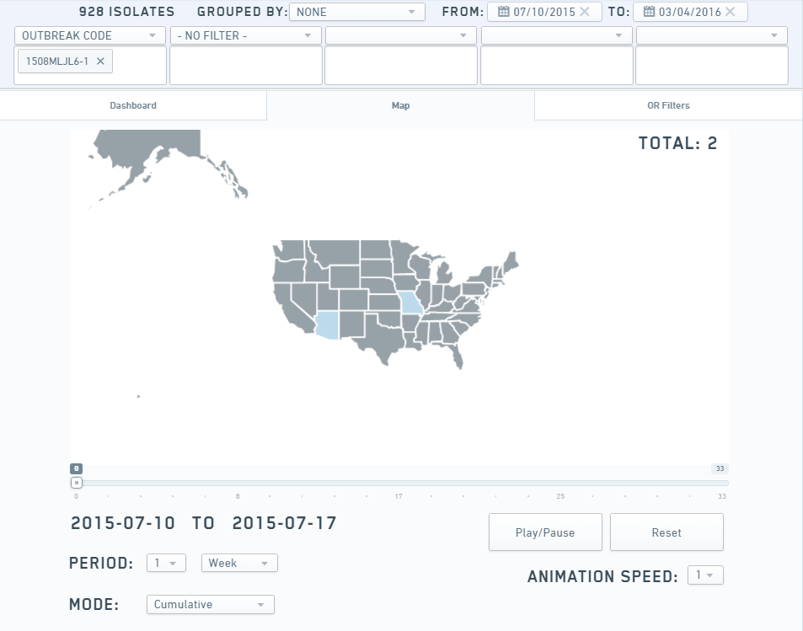
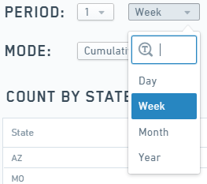
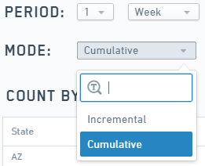
Time Trend Map
The filters for the dashboard control the map, featured on the second tab.
The map is able to show temporal progression of the outbreak or PFGE pattern. You can select the time period buckets (e.g., by week, by month, by year) and how the progression will display (e.g., incrementally or cumulatively).
Zoomed In

Slide 16
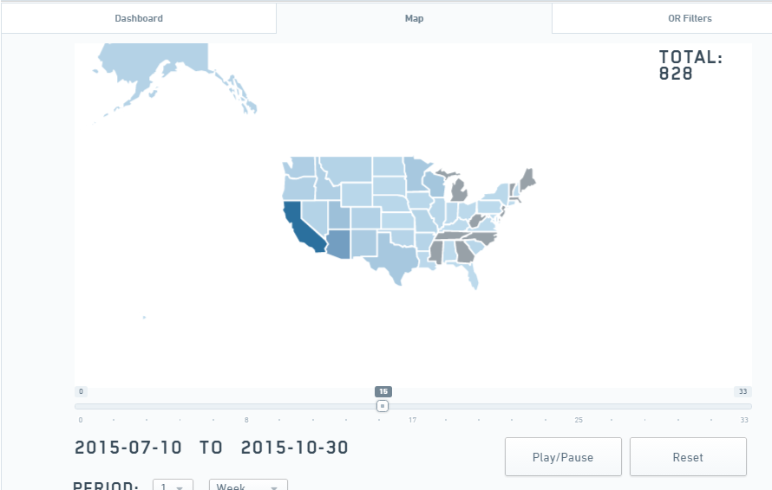
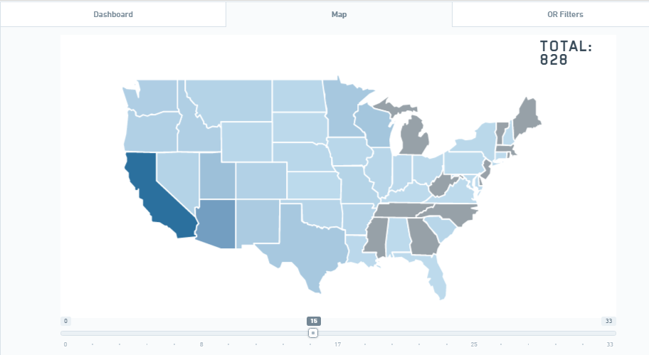
Time Trend Map 2
Once you have selected your options, press play/pause to watch the map change. You could also drag the slider bar to a point in time, indicated by the dates underneath.
You can also zoom in or zoom out of the map by using your scroll wheel on your mouse or double clicking within the map frame.

Slide 17
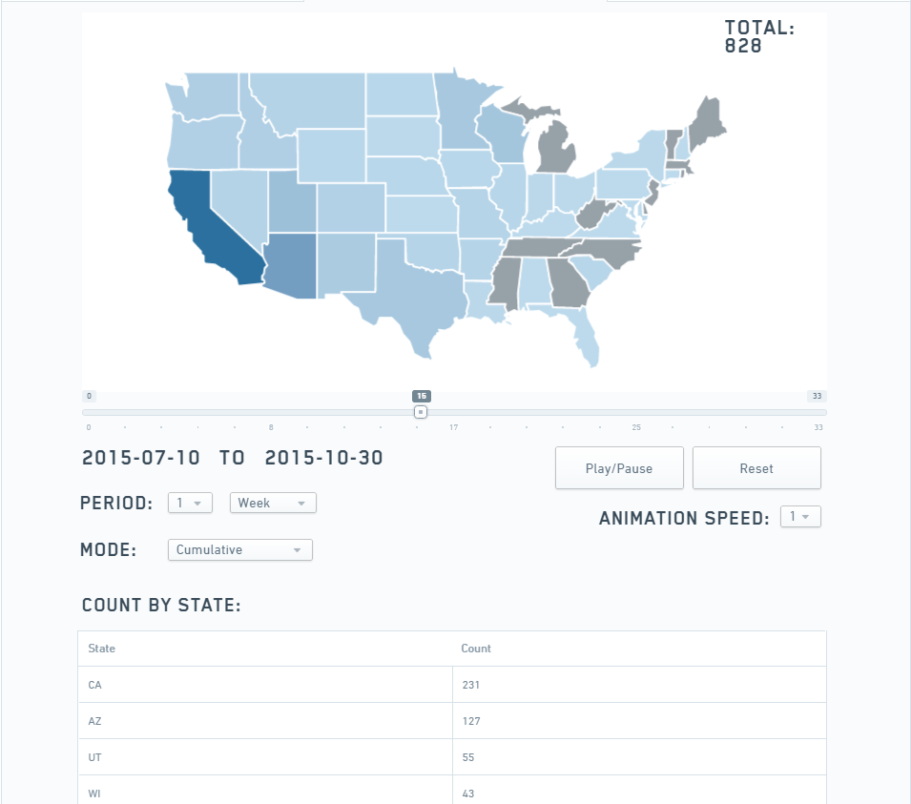
Time Trend Map 3
Finally, the table underneath the map changes as the map changes. You can see which states have cases and the count as each time period passes.

Slide 18
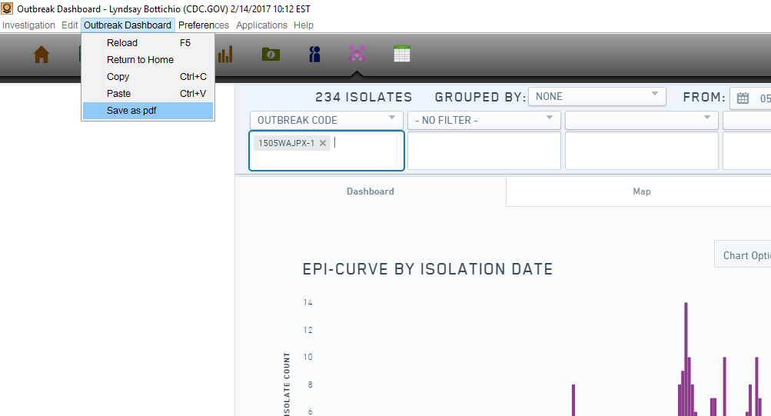
Saving a PDF of the Dashboard
The dashboard can be saved as a PDF to email or print!
  Click on the Outbreak Dashboard drop-down and select “Save as PDF”
  Select where you want to save to and then open from that location

Slide 19
Self Quiz (Answers on Next Slide)
Make the dashboard display outbreak 1404MLJPX-1. (You will need to adjust the dates to give it a more broad window.) What is the date range for this outbreak?
Filter this outbreak down to Texas only. How many females are there?
Remove the state filter from TX and filter it to NY instead. What is the age range and median age?
Remove the state filter and group by sex. How many males had “No Resistance Detected” on the NARMS panel?

Slide 20
Self Quiz Answers
06/03/2012 – 09/11/2014
Four
2-83 (25)
Three

Slide 21
Closing slide
For more information, contact:
Lyndsay Bottichio (xmm8@cdc.gov)
404-639-0570
https://sedric.cdc.gov
The findings and conclusions in this report are those of the authors and do not necessarily represent the
official position of the Centers for Disease Control and Prevention.

